Slide 1
What is humanism?
KS3/4 Assembly

Slide 2
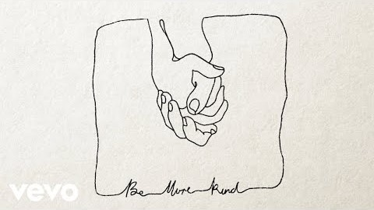
Notes:
Play ‘Be More Kind’ by Frank Turner as the students enter the assembly
Ask the students if they had heard the song before? Does anyone know the artist? What do they think the song was about?
Explain that Frank Turner is a humanist and this song reflects his humanist worldview.

Slide 3


World Humanist Day
    21 June
    A day to celebrate humanism and humanist values across the world
    Humanist groups and organisations mark the day with concerts or conferences to raise awareness of the ethical values of humanists
Notes:
Explain that today (or on the 21 June) it is World Humanist Day, a day celebrated by humanists around the world. Humanism is not a religion but a non-religious approach to life followed by many people in the UK and around the world. The day is not marked by tradition or ritual, instead, many humanist groups and organisations mark it with activities or conferences that aim to raise awareness of their values. In this assembly you are going to learn a little more about what these values are.

Slide 4
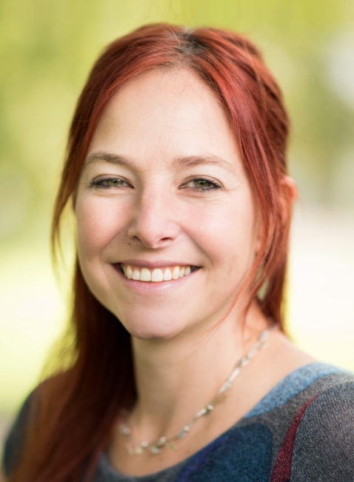
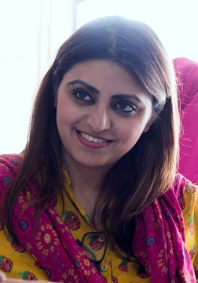
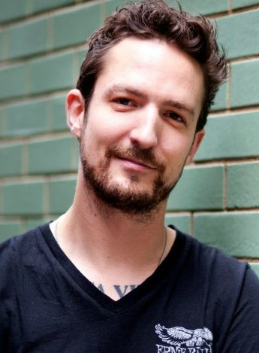
What does it mean to be a humanist?
Notes:
Explain We’ll explore three of the things that humanists value by looking at three different humanists.
Show the pictures of the humanists
Ask the students if they recognize any of these humanists. What do they know about them if they recognize them?
Explain that on this day, you are going to explore three things that humanists celebrate and value about being human:
1. Our capacity to use science to answer questions about the world
2. Our natural capacity for empathy and the development of human rights
3. Our creativity and the diversity of our talents and potential

Slide 5
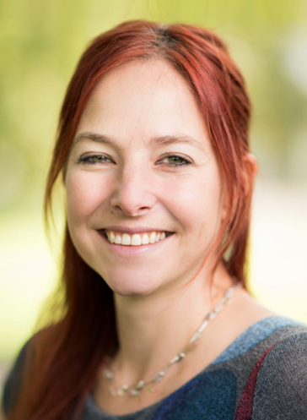
Professor Alice Roberts
Notes:
Explain First we’re going to look at Professor Alice Roberts
Explain Alice grew up in Bristol in South West England. Despite having a flair for art and illustration – and winning a Blue Peter award for her artwork when she was 15 years old – she pursued science as her subject of choice.

Slide 6
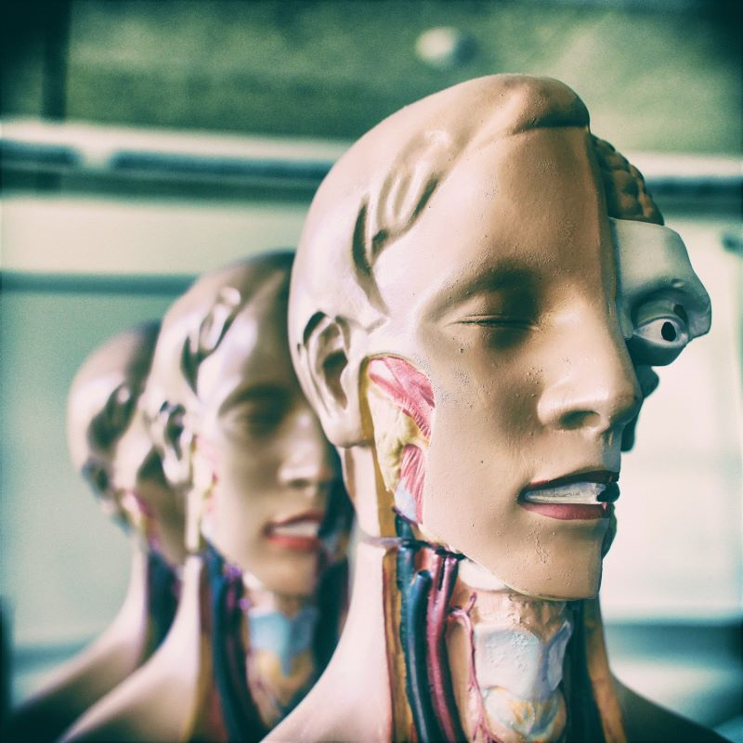
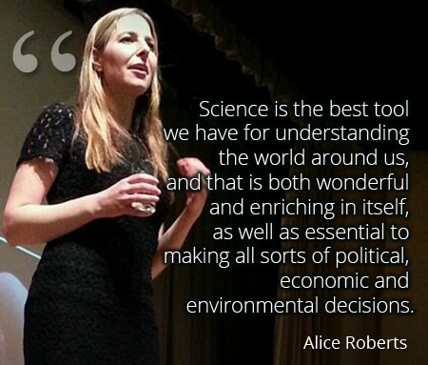
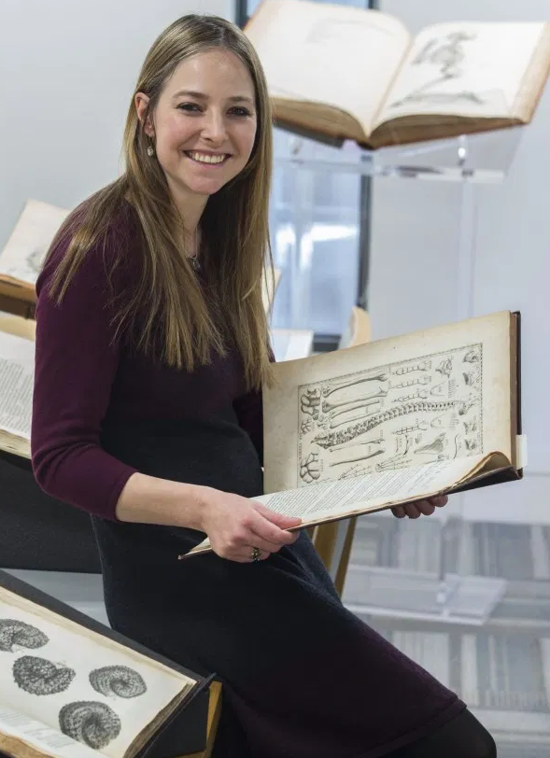
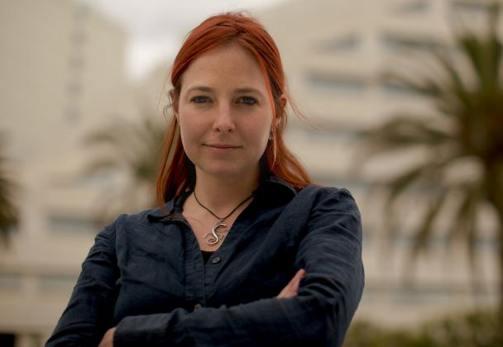
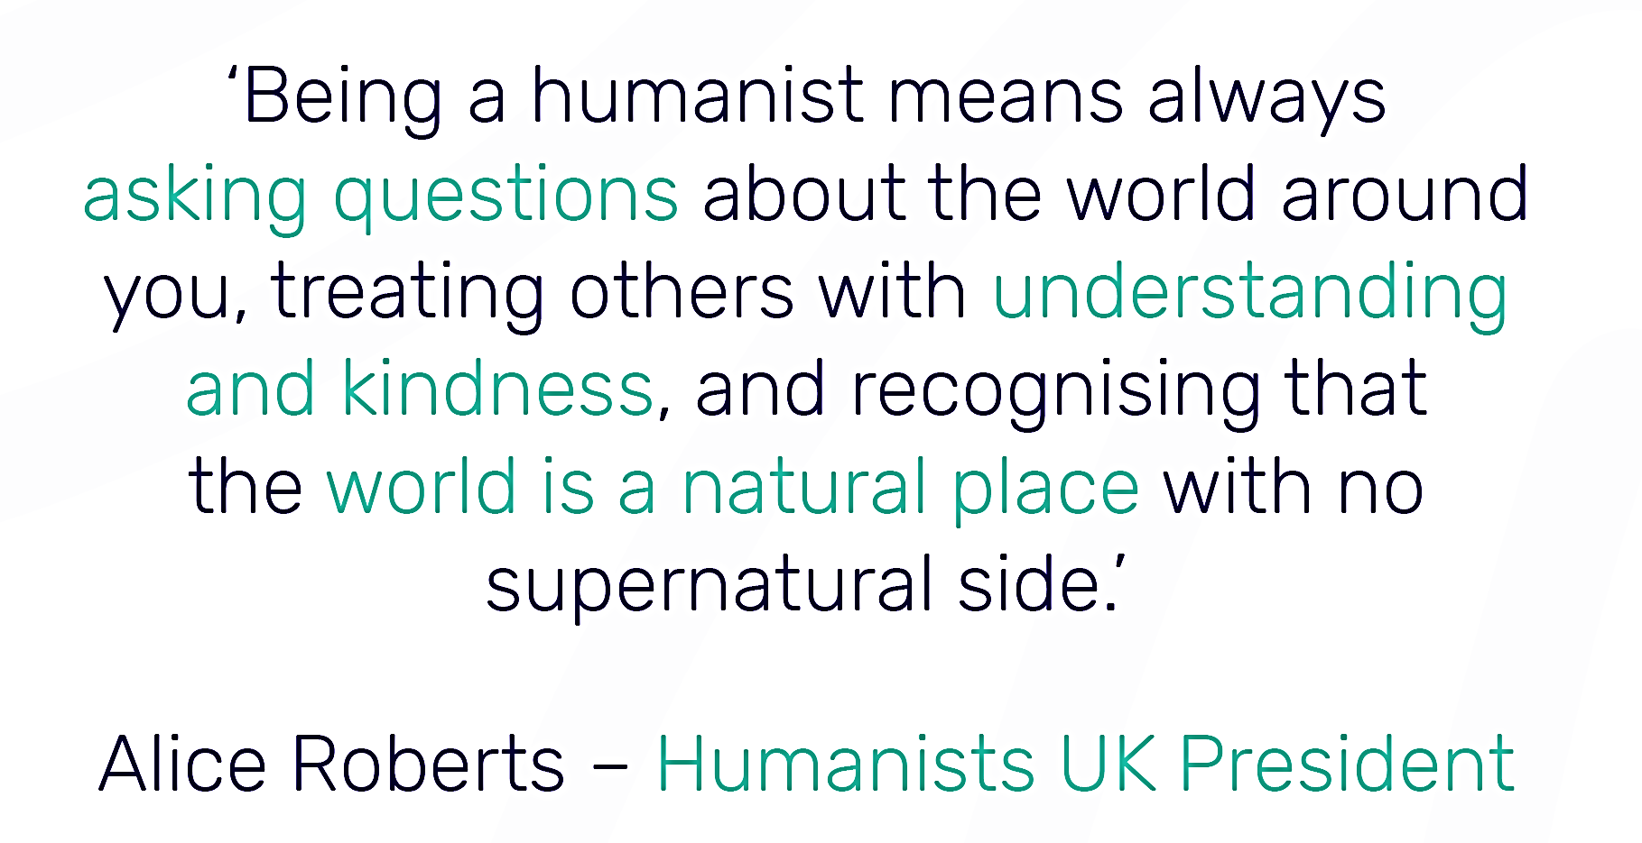
Professor Alice Roberts
Notes:
[Click to show pictures for underlined words]
Explain Alice studied medicine at university and went on to specialize in anatomy (show picture), eventually becoming an anatomy lecturer. She completed a PhD in the study of disease in ancient human remains. She is now a presenter of scientific and archeological TV programmes (show picture) and is also the President of Humanists UK, a charity that raises awareness of humanism and supports non-religious people.
Explain that by pursuing science, Alice’s life work has revolved around asking questions about the world and applying the scientific method to find evidence that can enable us to find answers.
Show the quote. As Alice describes here, ‘Science is the best tool we have for understanding the world around us, and that is both wonderful and enriching in itself, as well as essential to making all sorts of political, economic, and environmental decisions.’
Explain that humanists believe we should ask questions about the world around us, and they believe science is the best method that we have to determine what is true. Humanists believe the world is a natural place, as there is no scientific evidence for the supernatural. They don’t believe in a god or gods.
Show the quote. As Alice says here: ‘Being a humanist means always asking questions about the world around you, treating others with understanding and kindness, and recognizing that the world is a natural place with no supernatural side.’

Slide 7
Gulalai Ismail
Notes:
Show the picture of Gulalai Ismail
Explain that the next humanist whose life and work provides an example of the humanist worldview is Gulalai Ismail.
Explain that Gulalai Ismail grew up in Pakistan.

Slide 8
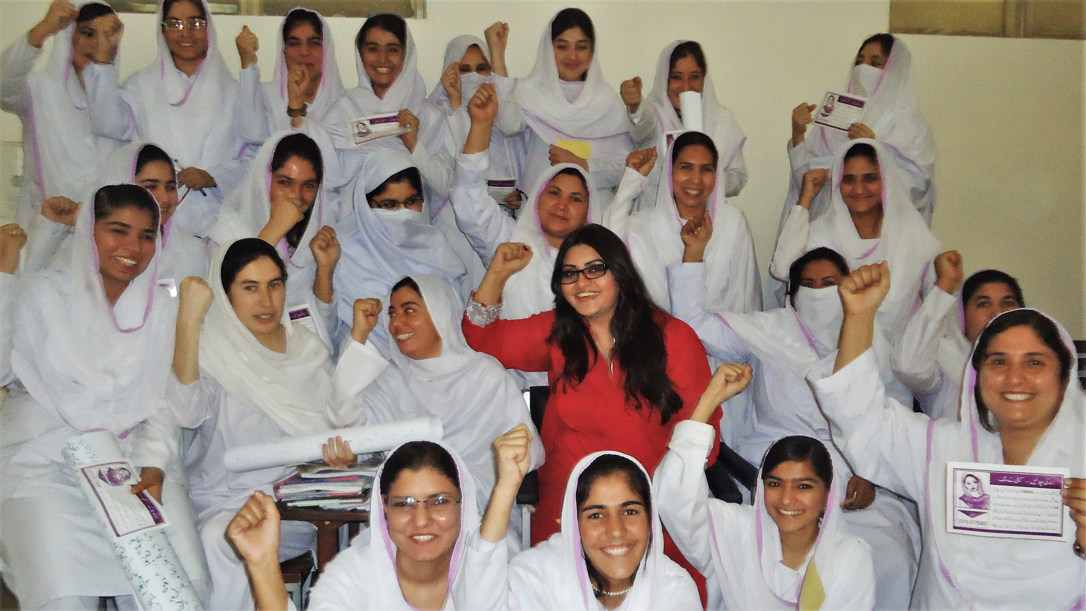
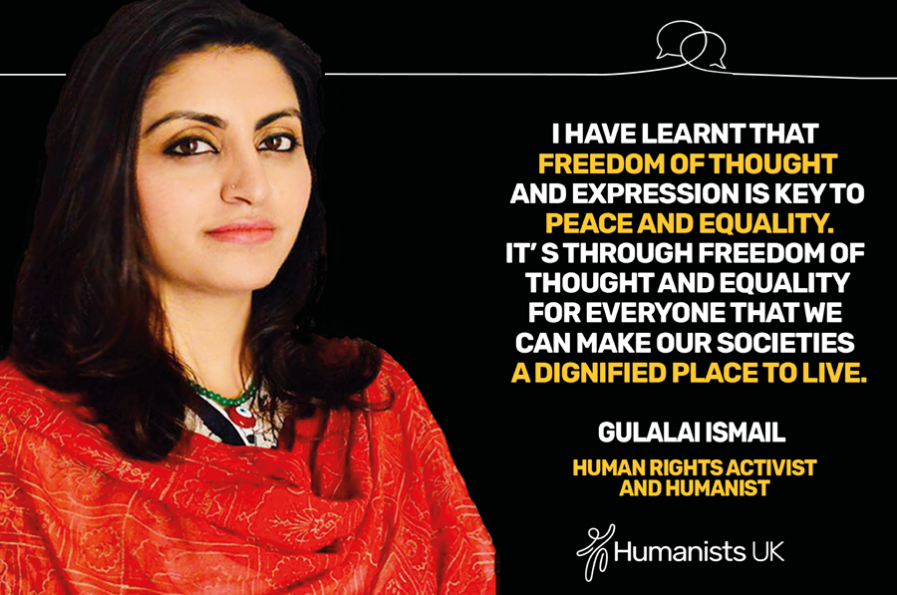
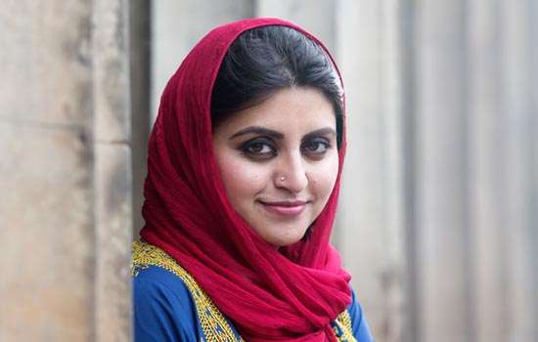
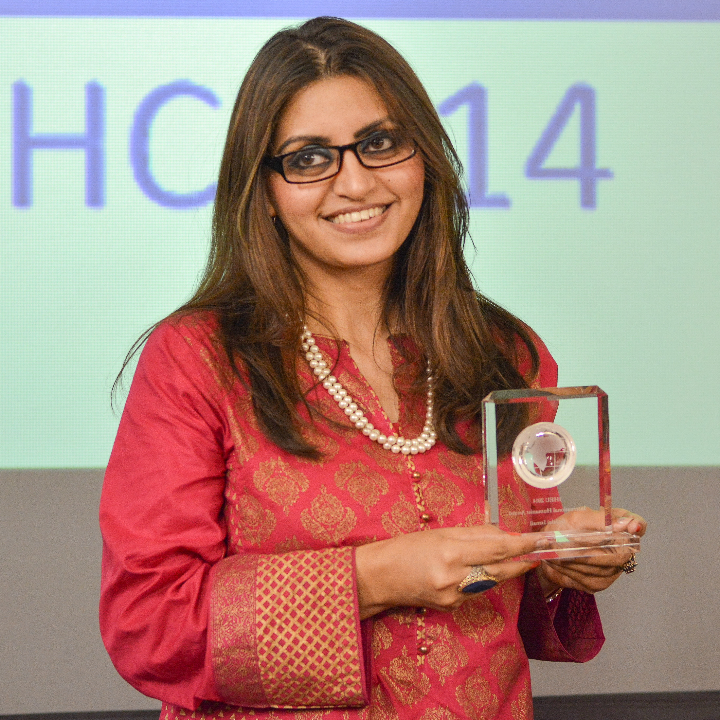
Gulalai Ismail
Notes:
Explain that her father was a human rights activist, and from an early age she learned about human rights. Despite being interested in science, and studying biotechnology at university, she couldn’t ignore the inequality that she could see in the treatment of girls and boys in her society. When her female cousin was 15, she had an arranged marriage to a man twice her age, and then couldn’t finish her education, while her male cousins were allowed to stay in school. Seeing these things happen drove Gulalai towards taking a stand for women’s rights. When she was 16 years old, she set up an organization with her sister called ‘Aware Girls’ (show picture). This provided young girls with awareness of their human rights and the tools to be able to encourage their families and communities to support their education and their rights, to empower them to choose how they lived their lives. For this, she won the International Humanist of the Year award in 2014 (show picture).
Explain that for Gulalai, the fact that she was able to pursue her own education wasn’t enough, she wanted other girls and women to have the same freedom that she did. Empathy and compassion for other people is important to humanists, and it’s the reason why humanists fight for human rights. Humanists believe we should treat others the way we would like to be treated. Humanists believe that this is the one life we all have, there’s no afterlife. That means we must work towards making this life as fair and just as possible in the here and now.
Show the quote ‘I have learnt that freedom of thought and expression is key to peace and equality. It’s through freedom of thought and equality for everyone that we can make our societies a dignified place to live.’

Slide 9
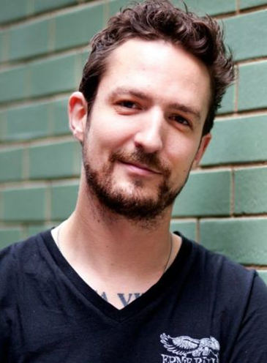
Frank Turner
Notes:
Show the picture of Frank Turner
Explain that lastly, you’ll look at Frank Turner, and how his life reflects the humanist approach to life.
Explain Frank Turner is an English musician and singer-songwriter who wrote and performed the song you heard on your way into assembly.

Slide 10
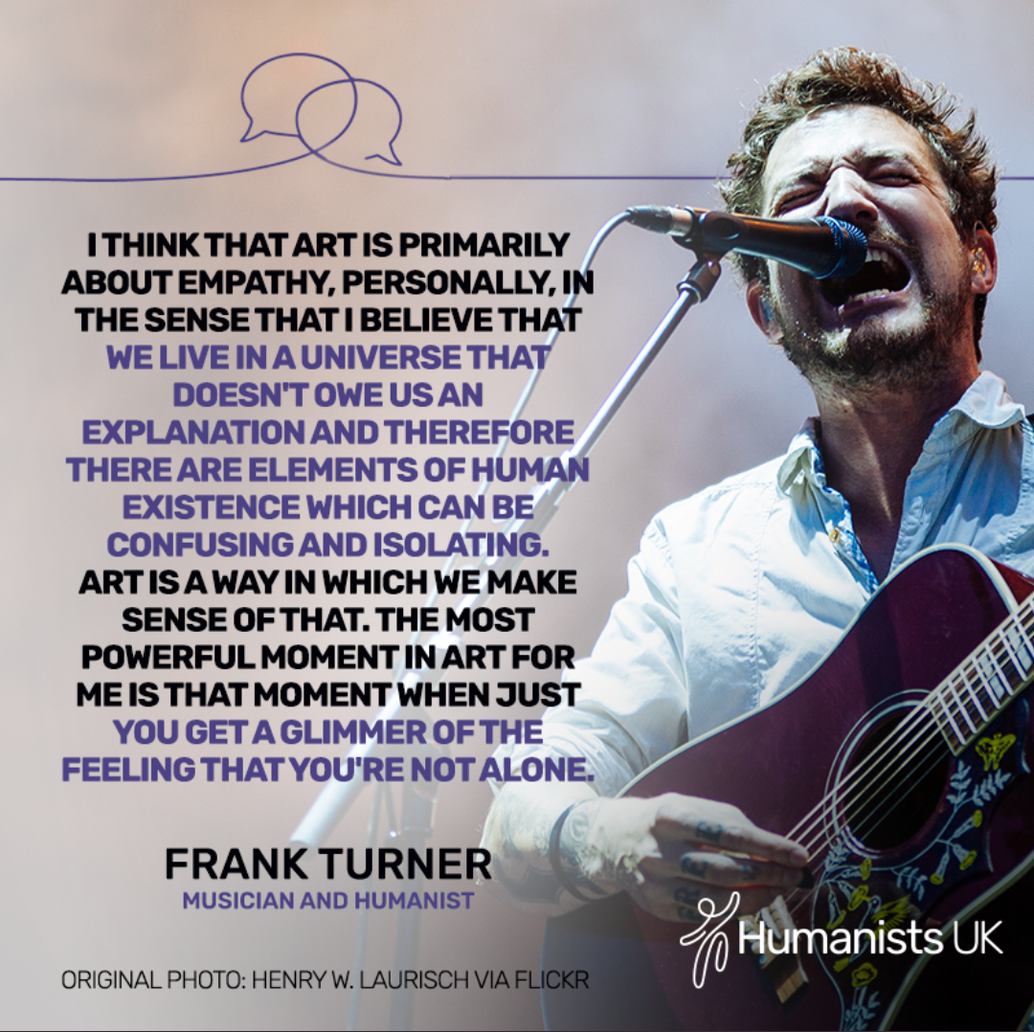

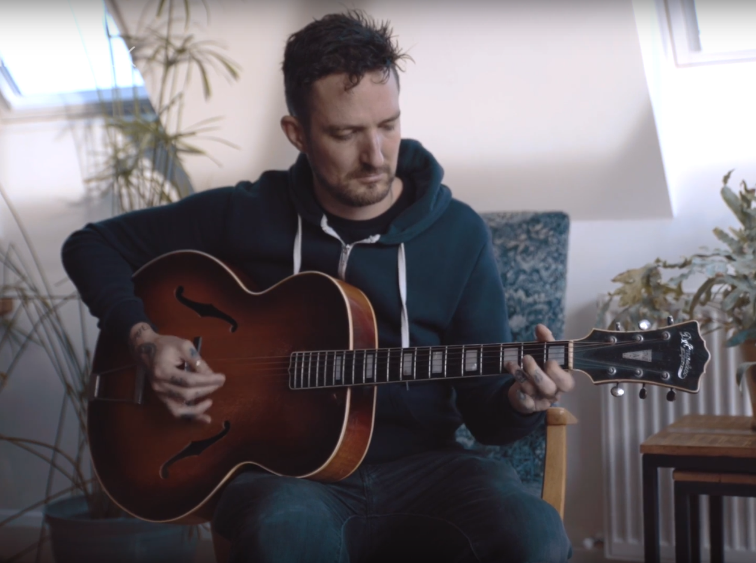
Frank Turner
Notes:
Explain that Frank is a prolific songwriter and performer, having released 8 solo studio albums and regularly performs on tour. He sees music as a way of communing and connecting with other people, and for him, rock shows (show picture) are a form of social and communal gathering. He has dedicated his life to art through music, and he views art as an expression of empathy for other people.
Show the quote
Explain For humanists, there is no ultimate or higher meaning, instead they believe that we can make our own lives meaningful. They believe that there are many different ways to find happiness and make the most of the one life that we have. For Frank, meaning can be found in creativity, music, and the connections with other people we make through music. Many different humanists will find meaning and happiness in other ways (e.g. through following their passions, achieving their goals, making connections with other people, and working to make the world a better place).
Ask the students about the different ways they find happiness and what gives their lives meaning.
Explain that for humanists there is no one single way to find happiness. We all have different tastes and talents. Humanists believe we should be free to decide how we live as long as we do not cause harm to others.

Slide 11
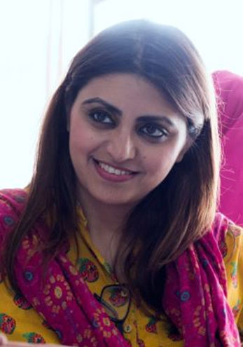
What does it mean to be a humanist?
    Having empathy for others and fighting for human rights
    Asking questions and using science to understand the world
    Finding meaning for ourselves in the one life we have
Notes:
Show the pictures of the three humanists with the ‘What it means to be a humanist?’
Asking questions and using science to understand the world
Having empathy for other and fighting for human rights
Finding meaning for ourselves in the one life we have

Slide 12
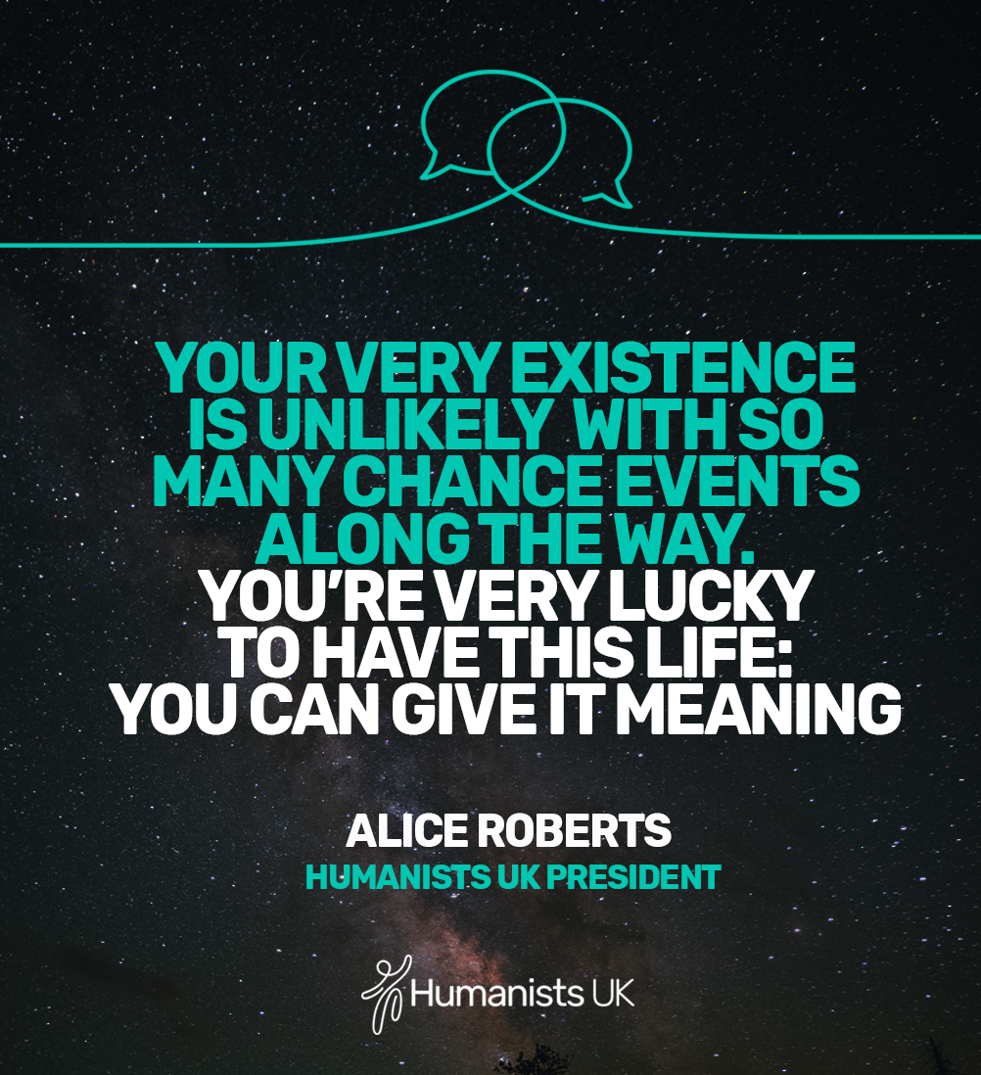
Notes:
Show Leave the students with this final thought on humanism from President of Humanists UK, Professor Alice Roberts.

Slide 13
Notes:
Explain Let’s listen to Frank Turner’s song again and consider how its message expresses his humanist worldview.
Play ‘Be More Kind’ by Frank Turner for students to leave the assembly

