Slide 1
WHAT IS SECULARISM?

Slide 2
Further resources
For handouts, activities, articles, interviews, and links to external resources, see
understandinghumanism.org.uk/secularism

Slide 3

What is secularism?
Animation: understandinghumanism.org.uk/secularism

Slide 4

A pluralistic society
People have different worldviews
In the 2021 census of England and Wales
46% of people described themselves as Christian
37% as having no religion
6.5% as Muslim
1.7% as Hindu
With a wide variety of other religions and beliefs making up the rest
What challenges might this create?
How might we best address those challenges?

Slide 5
What is secularism?
Secularism is not the same as…
Non-religious
Atheist
Humanist
Anti-religious
Secularism is a political position on on how society should be organised and the responsibilities of the state on matters relating to religion or belief.

Slide 6
What is secularism?
Secularists believe the following:
There should be a separation between religious institutions and state institutions (no single religious or non-religious institution should say how the country should be run or have special influence over the law, nor should the government seek to influence citizens’ religion or belief, say how they must live their private lives, or impose on them a state-sanctioned conception of the good life)
Individuals should have freedom of religion or belief, and be free to reject or change their beliefs, within the limits of public order and the rights of others
There should be equal treatment and no privilege or discrimination on the grounds of religion or belief

Slide 7
Secularism
‘One of our key aims is that the UK should be a secular state guaranteeing human rights, with no privilege or discrimination on grounds of religion or belief. This is not only because it is the fairest approach, but also because it reflects the diversity of Britain today.’
Humanists UK

Slide 8
Secularism
‘We are committed to secularism – the principle that, in a plural, open society where people follow many different religious and non-religious ways of life, the communal institutions that we share (and together pay for) should provide a neutral public space where we can all meet on equal terms. State secularism, where state institutions are separate from religious institutions or the state is otherwise neutral on matters of religion or belief, guarantees the maximum freedom for all, including religious believers. In such a state, no one should be privileged nor disadvantaged on grounds of their religious or non-religious beliefs.’
Humanists UK

Slide 9
Secularism and human rights
‘Everyone has the right to freedom of thought, conscience and religion; this right includes freedom to change his religion or belief.’
Article 18, Universal Declaration of Human Rights

Slide 10
What issues might secularists campaign on?
In the UK
Disestablishment of the Church of England
Bishops in the House of Lords
State-funded religious schools
Education about religion and worldviews in schools
Daily acts of worship in schools
State funding for religious groups in providing public services
Humanist marriage
Non-religious pastoral support in hospitals, prisons, and the armed forces
Inclusive national ceremonies such as remembrance ceremonies
Public broadcasting about religious and non-religious worldviews
In other countries, secularists may be campaigning simply for the rights of non-religious people or those from minority religions to be open about their beliefs. There are 12 countries in which being non-religious is punishable by death.

Slide 11
The case for secularism
‘What are the virtues of citizens required in a secular state? We have to accept that other people have views different from our own. We have to adopt a measure of tolerance in our dealings with others, be willing to extend freedom of speech, freedom of worship even to those we might disagree with. That can be very hard, but it’s the most effective way to guarantee a stable, peaceful society.’
Andrew Copson, Chief Executive, Humanists UK

Slide 12

The case for secularism
Three main arguments
The argument for freedom
The argument for fairness
The argument for peace
Each argument on its own may not convince everyone but, together, secularists believe they provide a strong case.

Slide 13
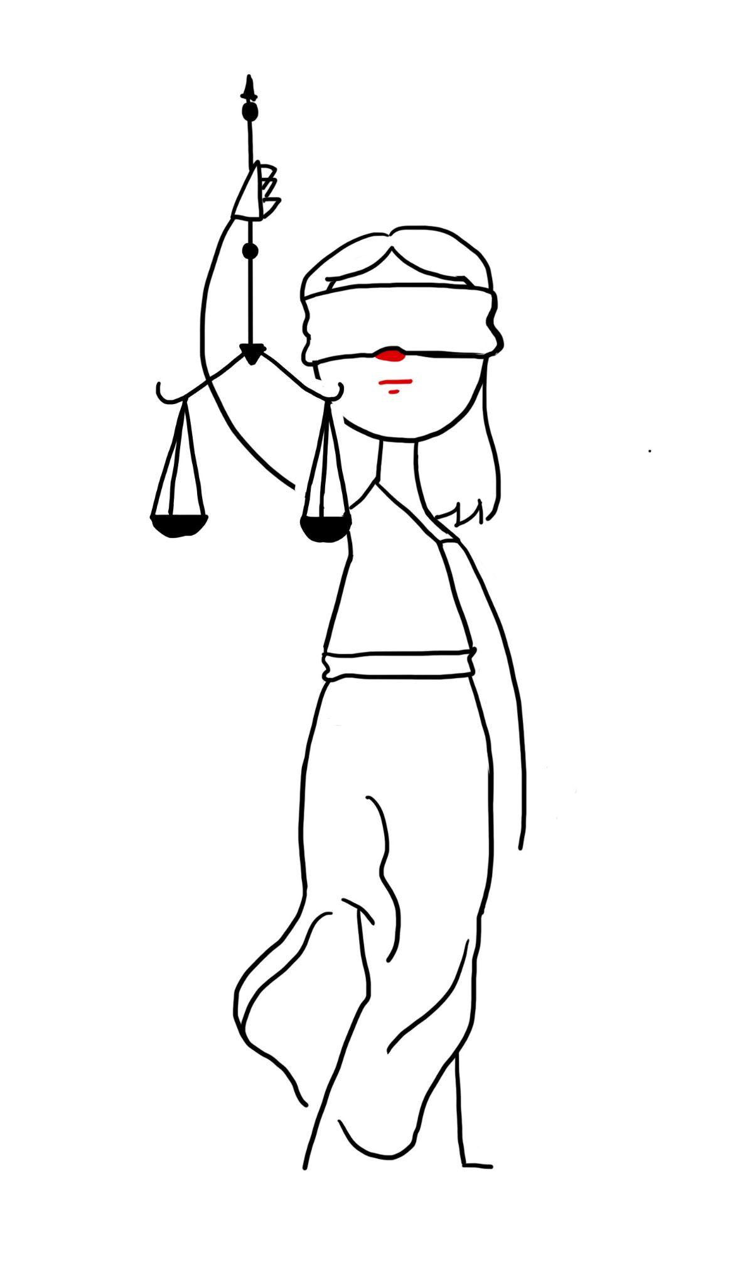
The veil of ignorance
‘A just society is a society that if you knew everything about it, you'd be willing to enter it in a random place.’
John Rawls (1921-2002), political philosopher
Rawls argued for individual freedom and equality of opportunity.
What if you did not know whether you was going to be born into a religious or non-religious family, or if you was unaware of what one’s initial inclinations towards religious or non-religious beliefs would be (or how these might change throughout your life)?
Would you want to be born into a society in which there existed freedom of religion or belief and fair treatment of all, in which one could live according to one’s beliefs without fear of persecution or punishment – a secular society?

Slide 14
The case for secularism
‘In a world where people will inevitably continue to disagree on matters of religious belief, and where religious believers will continue to feel strongly about their competing religious allegiances, a secular state in this sense – a neutral state – is the only kind of state which can plausibly be seen to be in the common interest and which all can accept without feeling themselves to be the victims of discrimination or exclusion.’
Richard Norman, The Case for Secularism

Slide 15
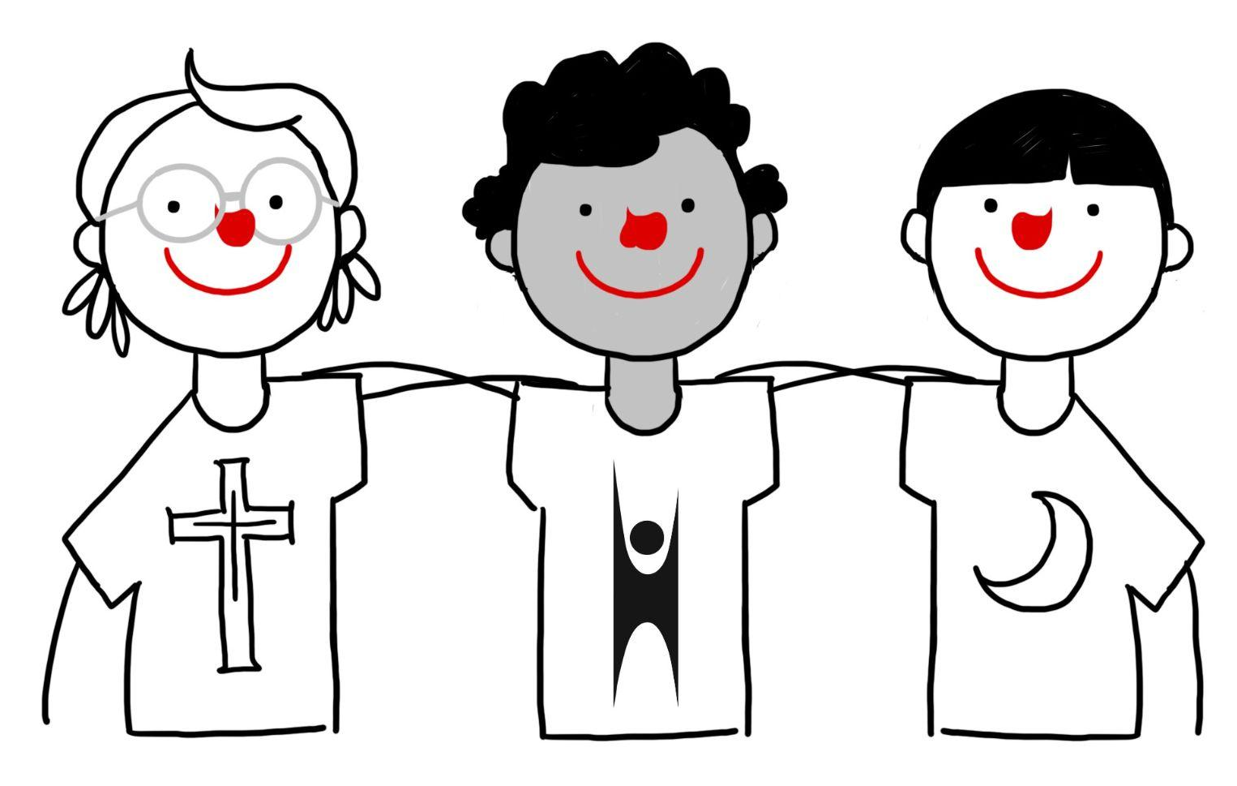
Who supports secularism?
Secularism is supported by both religious and non-religious people (including humanists).
50% of Britons want the Church of England to be separate from the State, compared to only 21% who want them to continue to be linked.
Among Anglicans, 46% want to keep the connection between church and state, while 30% say it should be disestablished.
61% of the population (including 51% of Anglicans) believe bishops should no longer automatically be given seats in the House of Lords.
71% of British adults agree that ‘religion and law should be kept strictly separate’, with just 12% disagreeing.

Slide 16
Who supports secularism?
‘I swear by my religion. I will die for it. But is my personal affair. The state has nothing to do with it. The state will look after your secular wealth, health, communications...’
Mahatma Gandhi

Slide 17
Are there any secular states?
The UK is not a secular state. It has an established state church. – the Church of Engaland.
Many other states are not secular:
Denmark has a Protestant state church
The constitution of Myanmar grants special preferences towards Buddhism
Islam is the state religion of Saudi Arabia
In Greece the Greek Orthodox Church is constitutionally recognized as the ‘prevailing religion’ of the country
Israel is defined in several of its laws as a ‘Jewish state’ (however, there is debate about whether ‘Jewish’ refers to an ethnic or religious group)
China has a policy of official state Marxist-atheism – citizens are only allowed to practice particular state sanctioned religions, and members of the ruling party strongly discouraged from holding religious faith
Catholicism is the state religion in Costa Rica
Iran’s constitution defines the country as an Islamic republic and specifies Shia Islam as the official state religion

Slide 18
Are there any secular states?
Many states are constitutionally secular, such as…
The USA,
France
India
Turkey
However, countries can be secular in name and not in practice if freedom and equal treatment are not respected, and secularism is under threat in many places around the world today.
There have been rising tensions in states that are, on paper, secular, but have governments that have rejected secular principles and turned towards religious nationalism, for example in India and the USA.

Slide 19
Threats to secularism
Secularism is under threat in many parts of the world today, including in countries that are secular states.
Many countries are far from being secular, e.g Iran, Saudi Arabia, China
Religious nationalism is in the rise in many countries, e.g. The USA, India, Turkey
Secularists can be found all over the world trying to defend secularism. This is a core area of work for many humanist organisations from Nigeria to Nepal, and Poland to Puerto Rico.
Many secularists worry that, without constant campaigning, and speaking up for what they see as the benefits of secularism, past achievements may be washed away and that this will be a threat to freedom, equality, and peace.

Slide 20
Opposition to secularism
Arguments
‘We don’t want neutrality’
‘Secularism means no morality’
‘Secularism is just enforced atheism’
‘Secularism doesn’t work in practice - the state can’t be impartial’
‘Secularism can be undemocratic’
‘Secularism harms people without their knowing it’
How might a secularist respond?

Slide 21
Activity: Is this secularism?
Sort the statements into those that a secularist would support and those that they wouldn’t.
Everybody should be treated equally regardless of their religion or belief.
Religion should have a special place in society.
People should be free to believe what they want – free to be religious or non-religious.
The religion of the majority should be favoured by the state.
The state should ban religion.
We should not discriminate against anyone because of their religion or belief.
Religious people’s opinions should not be listened to.
The state should aim to be neutral on matters of religion and belief.
The church should not have any influence over the government’s decisions.
Life would be better if everyone was a humanist.

Slide 22
Activity: Is this secularism?
Answers
Support
Don’t support
Support
Don’t support
Don’t support
Support
Don’t support
Support
A secularist would believe that the church should not have any more influence over the government’s decisions than any other interest group
Some secularists might believe this but they would not support a state that enforced it

Slide 23
Activity: What might a secularist think about…?
Do you think secularists would be in favour of the following or not?
How might the arguments for freedom, fairness, and peace influence their views?
State funded faith schools that can teach a form of religious education that presents one particular worldview as the truth, and that are allowed to select their pupils based on the religion of their parents
Collective worship in schools that should be wholly or mainly of a broadly Christian character
Humanist weddings being legally recognised in the same way that religious weddings are
Bishops sitting by right in parliament in the House of Lords
Funding for non-religious chaplains/pastoral carers in prisons and hospitals alongside religious chaplains
Free public transport for children to religious schools
The inclusion of non-religious perspectives on BBC Radio 4’s Thought for the Day and more general inclusion of programmes about non-religious worldviews on state funded media
Prayer rooms being made available in public spaces such as hospitals
Wearing religious clothing in public places such as schools
Bank holidays being scheduled on and around religious festivals
Holiday entitlements for staff with religious beliefs on holy days
Freedom to criticise religious or non-religious beliefs in public
NB. Secularists may differ on their feelings about the above.

Slide 24
Activity: Religious beliefs and political beliefs
In asking whether any one religion or worldview should hold a privileged position in society, the humanist philosopher Stephen Law asks us to consider how we would feel if we replaced the word ‘religion’ with the words ‘political position’.
How would you feel about the following?
The state is to be under the control of one particular political party.
The state is to fund schools run by political parties and those schools are allowed to discriminate in the teachers they employ and the students they admit based on their political beliefs or the beliefs of their parents.
Employers are denied the right to prevent their employees from wearing political symbols.
People are no longer allowed to say things that offend people holding particular political beliefs.
Is it possible to argue that there are good reason why discrimination is OK on the grounds of religion or belief but not on political positions?

Slide 25
Questions
Where do we find diversity in society?
What are the core features of secularism?
What might a secularist campaign for?
What arguments are put forward for secularism?
Are all secularists non-religious?
Are there any secular states? Are they all the same?
What threats does secularism face?
What opposition is there to secularism?
How can education and dialogue support the goals of secularism?
What do you think? Is secularism the best system for everyone?
  Should a religion have any power over how a country is run?
  Is it OK to discriminate on the grounds of religion or belief?
  Should you be allowed to believe whatever you want?
11) Given none of us can choose the religion or belief of the family into which we are born, what
laws on religion and belief should the state impose and what freedoms should it guarantee?

