Slide 1
What is humanism?

Slide 2
A humanist approach to life: a summary
Humanists believe the world is a natural place and science gives us the best way to understand it (humanists don’t believe in a god)
Humanists believe we should be free to make the most of the one life we have, seeking happiness and supporting others to do the same
Humanists believe we should use empathy and consider the impact of our actions on other people and animals

Slide 3

Humanism
Humanism is a non-religious worldview or a non-religious approach to life.
Humanists believe it is possible to lead a good, happy, and meaningful life without the need for religion.

Slide 4
Humanism
Humanism is not a religion
Humanists do not believe in a god
They do not have a holy book
They do not have places of worship like churches or mosques

Slide 5
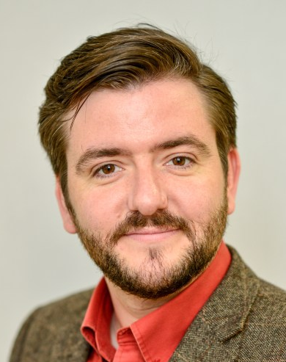
Humanism
'For as long as there have been human beings, there have been non-religious people whose view of the world can be described as 'humanist': informed by evidence, inspired by empathy, and infused with hope and wonder for the world around us.'
Andrew Copson, Chief Executive, Humanists UK

Slide 6
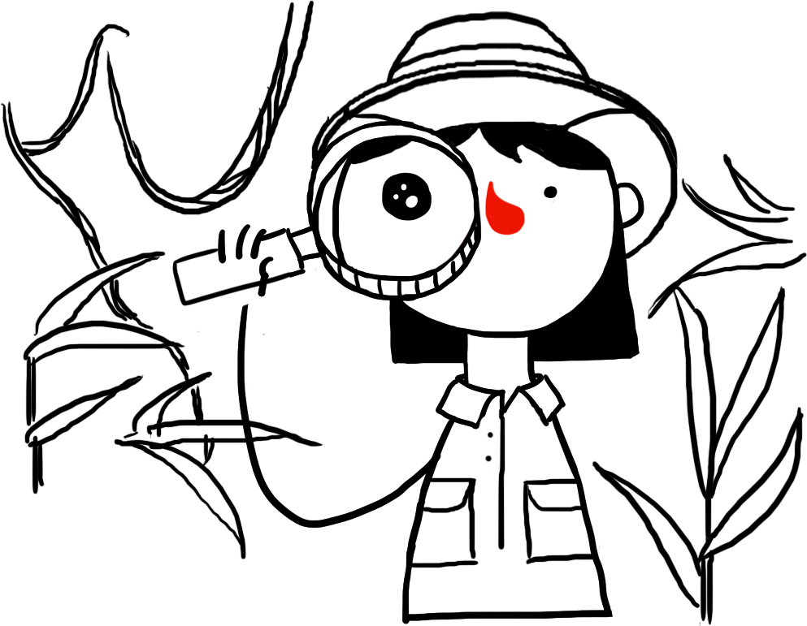


Humanism
Three things that humanists believe
The world is a natural place – we should ask questions and look for evidence to help us to understand it
We should all be free to find what makes us happy.
We should be kind to other people, animals, and the planet.

Slide 7





Five features of a
humanist approach to life
Human nature and potential
Using science to understand the natural world (no belief in god)
One life and the freedom to find happiness
Using empathy and considering the impact of our actions
Human responsibility

Slide 8
Five features of a humanist approach to life
1
Humanists believe human beings evolved naturally, like all living things. We have evolved many abilities and, if we put them to good use, we have the potential to lead good and happy lives.

Slide 9
Five features of a humanist approach to life
2
Humanists believe the world is a natural place with no supernatural side (they don’t believe in a god). They believe that science and looking for evidence gives us the best way of answering our questions about the world.

Slide 10
Five features of a humanist approach to life
3
Humanists believe this is the one life we have and so we need to make the most of it. They believe we should be free to decide how we live (as long as we do not cause harm to others), seeking happiness and supporting others to do the same.

Slide 11
Five features of a humanist approach to life
4
Humanists believe we should treat other people kindly and fairly. When deciding how to treat others we should use reason and empathy. We should consider the consequences of our actions and the likely impact on other people and animals.

Slide 12
Five features of a humanist approach to life
5
Humanists believe that human beings alone are responsible for making the world a better place. Many campaign for equality and human rights. They celebrate the progress we have made, but recognise the work that is still to be done.

Slide 13
Five features of a
humanist approach to life
Humanists believe human beings evolved naturally, like all living things. We have evolved many abilities and, if we put them to good use, we have the potential to lead good and happy lives.
Humanists believe the world is a natural place with no supernatural side (they don’t believe in a god). They believe that science and looking for evidence gives us the best way of answering our questions about the world.
Humanists believe this is the one life we have and so we need to make the most of it. They believe we should be free to decide how we live (as long as we do not cause harm to others), seeking happiness and supporting others to do the same.
Humanists believe we should treat other people kindly and fairly. When deciding how to treat others we should use reason and empathy. We should consider the consequences of our actions and the likely impact on other people and animals.
Humanists believe that human beings alone are responsible for making the world a better place. Many campaign for equality and human rights. They celebrate the progress we have made, but recognise the work that is still to be done.

Slide 14
Atheism and agnosticism
‘Atheist’ = somebody who does not believe in a god
‘Agnostic’ = somebody who accepts we can’t know whether a god exists or not

Slide 15
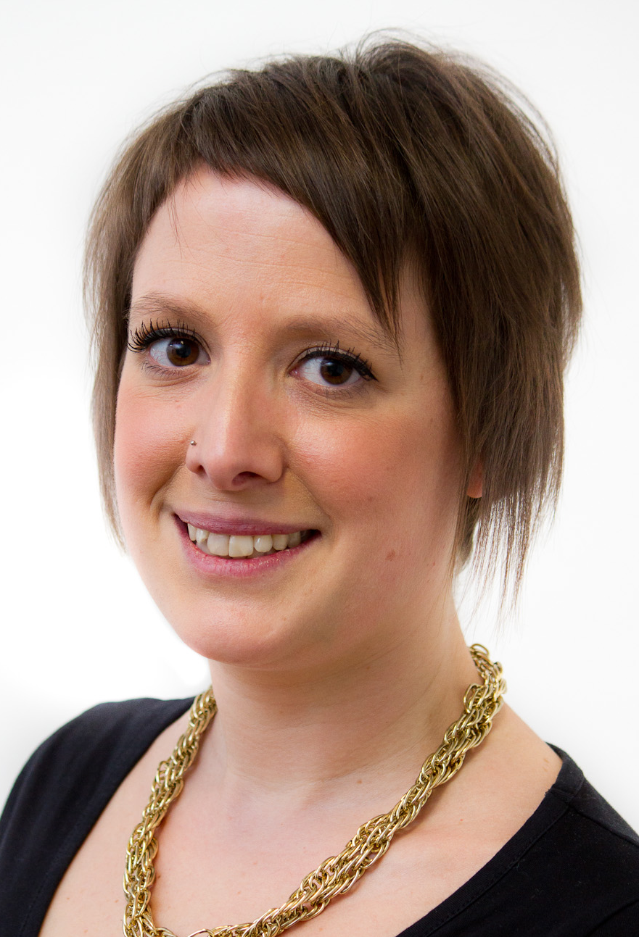
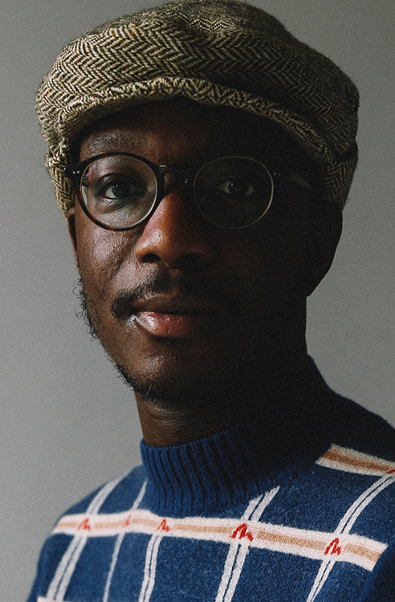
More than atheism
‘For me, humanism is sort of atheism plus.’
Naomi Phillips, humanist
‘Humanism for me has always been positive. We don’t define ourselves by what we don’t believe, which is what I had always done prior to discovering humanism.’
Ste Richardsson, humanist

Slide 16

The Happy Human
Celebrating being human
Celebrating what human beings can do
Celebrating that we can be happy

Slide 17
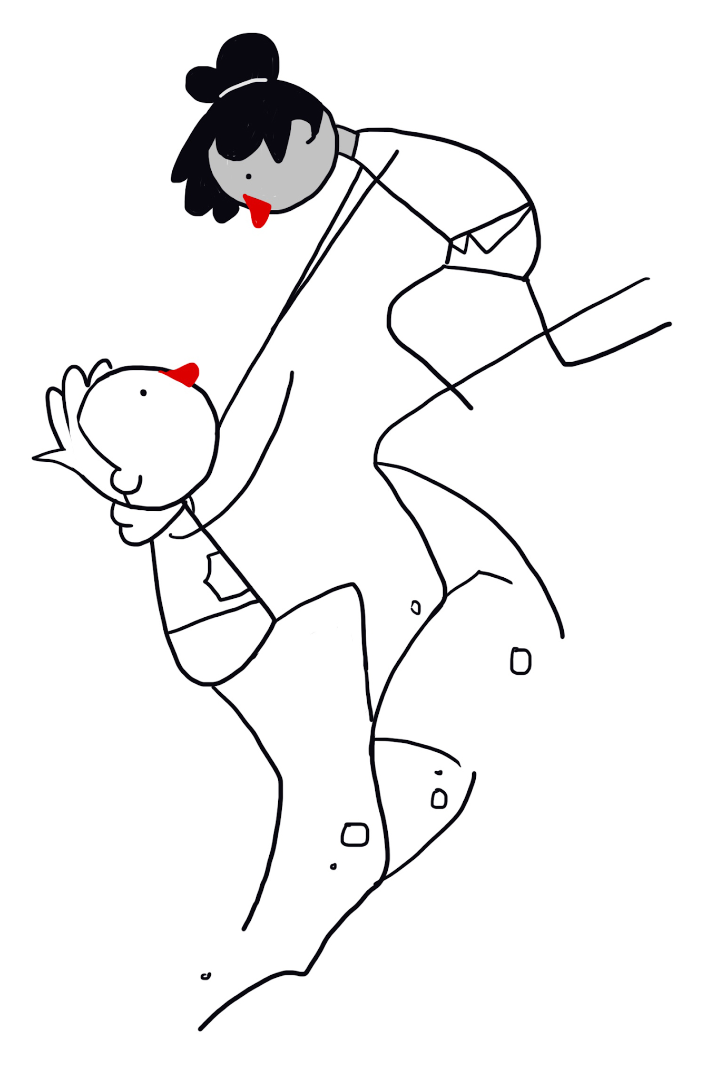
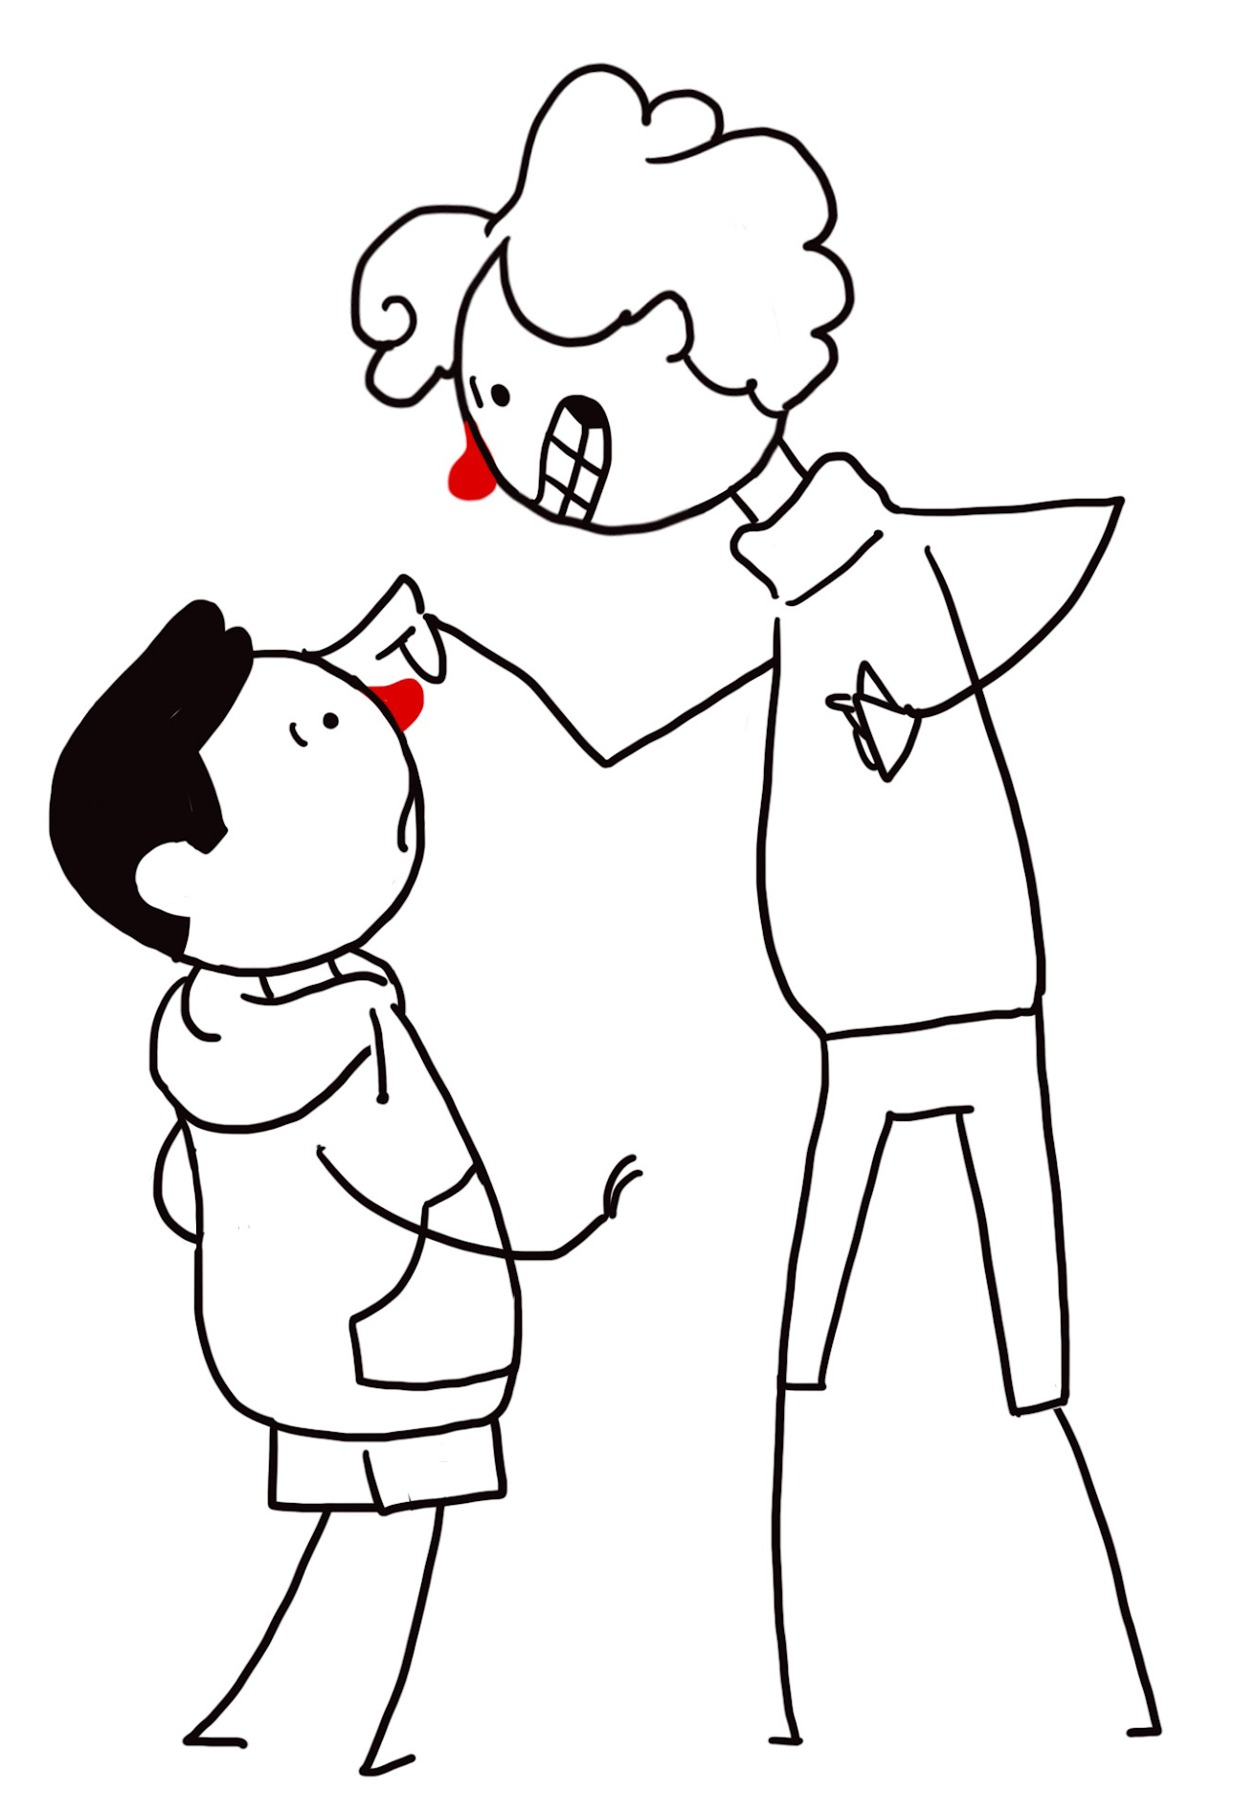
The Golden Rule
‘Treat other people as you'd want to be treated in their situation.’
‘Do not treat others in a way you would not like to be treated yourself.’

Slide 18

A humanist motto

Slide 19
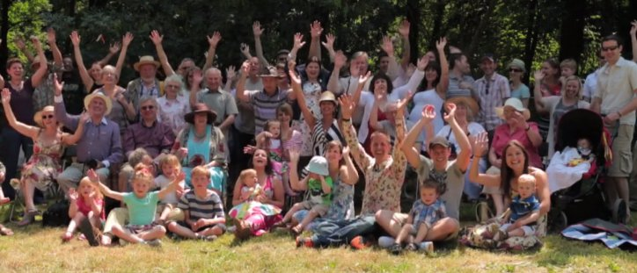
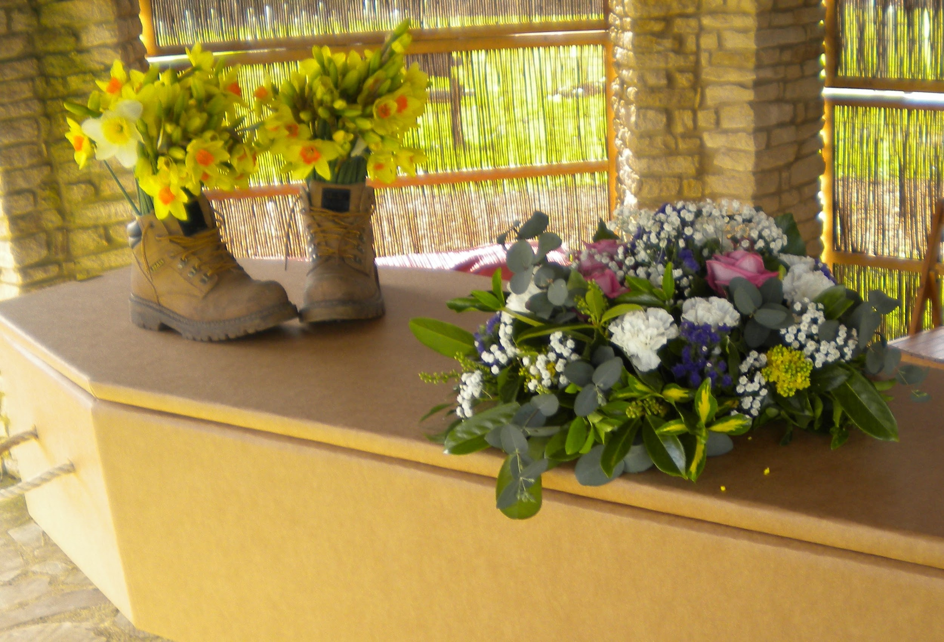
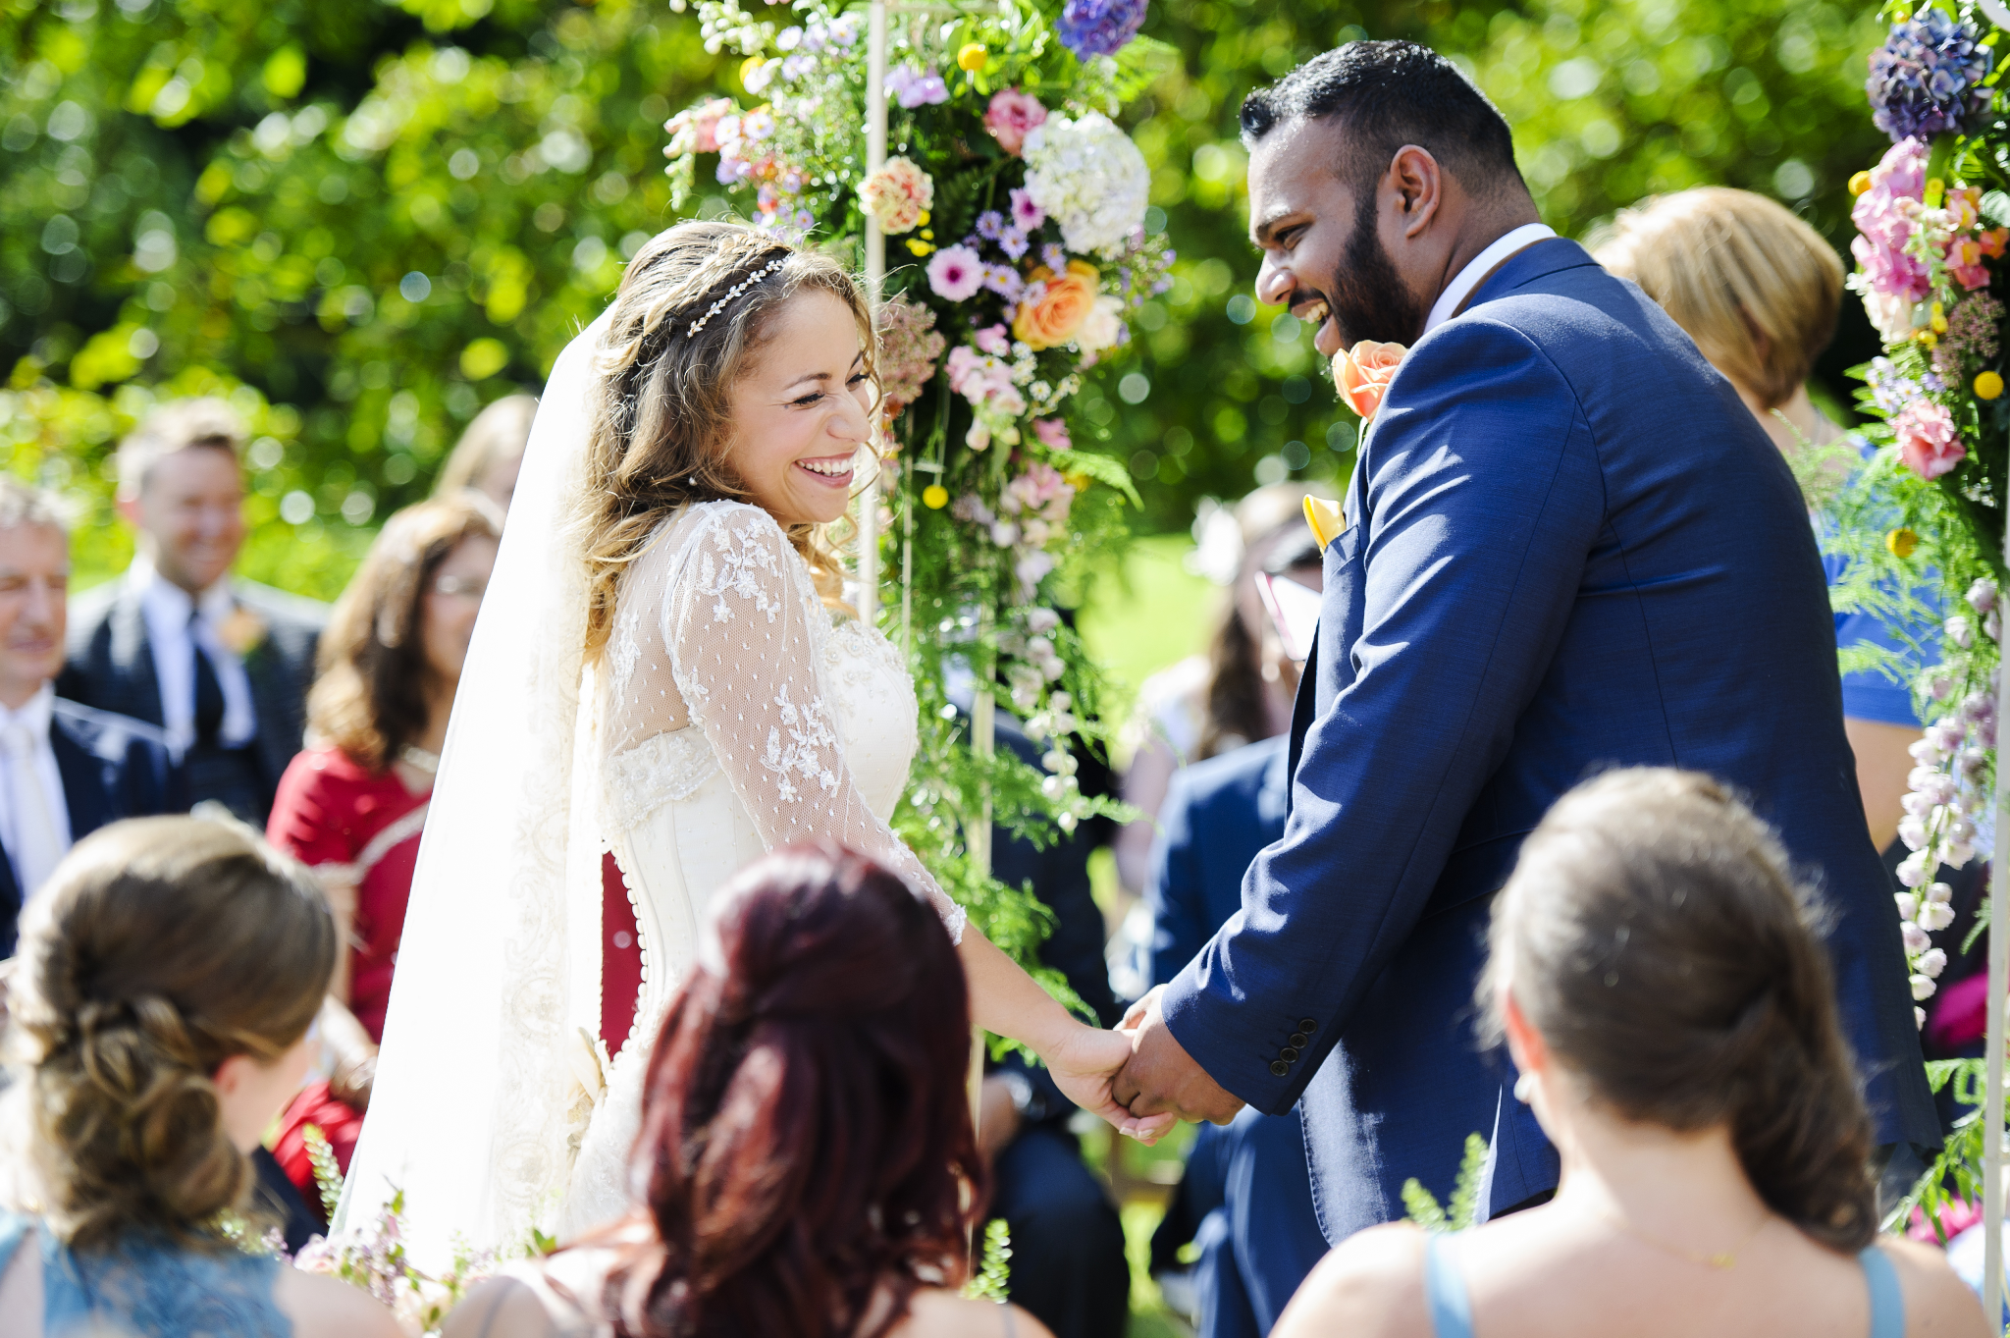
Humanist ceremonies

Slide 20
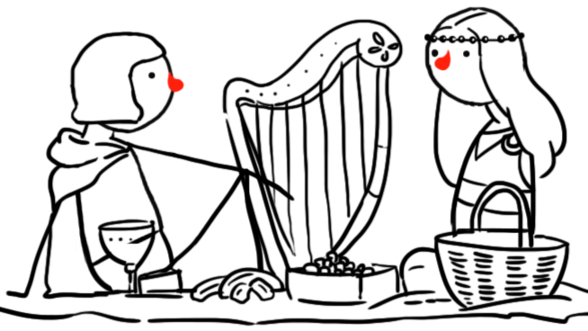
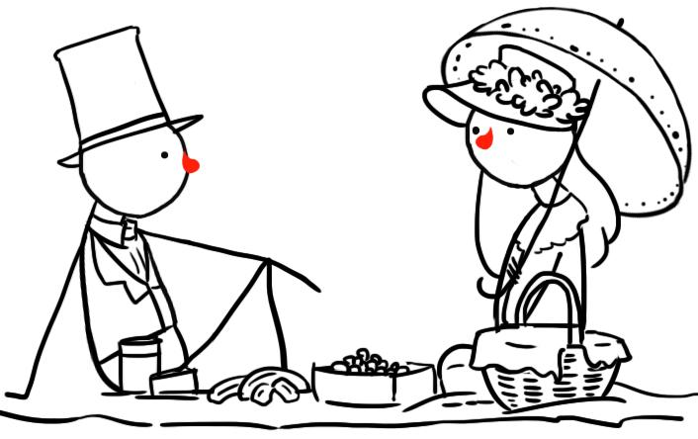
Humanist history
Humanist ideas can be found over 2000 years ago in ancient India, China, and Greece.
Humanist ideas became increasingly popular during a period called the Enlightenment in the 18th century.
Today there are millions of humanists all over the world.

Slide 21
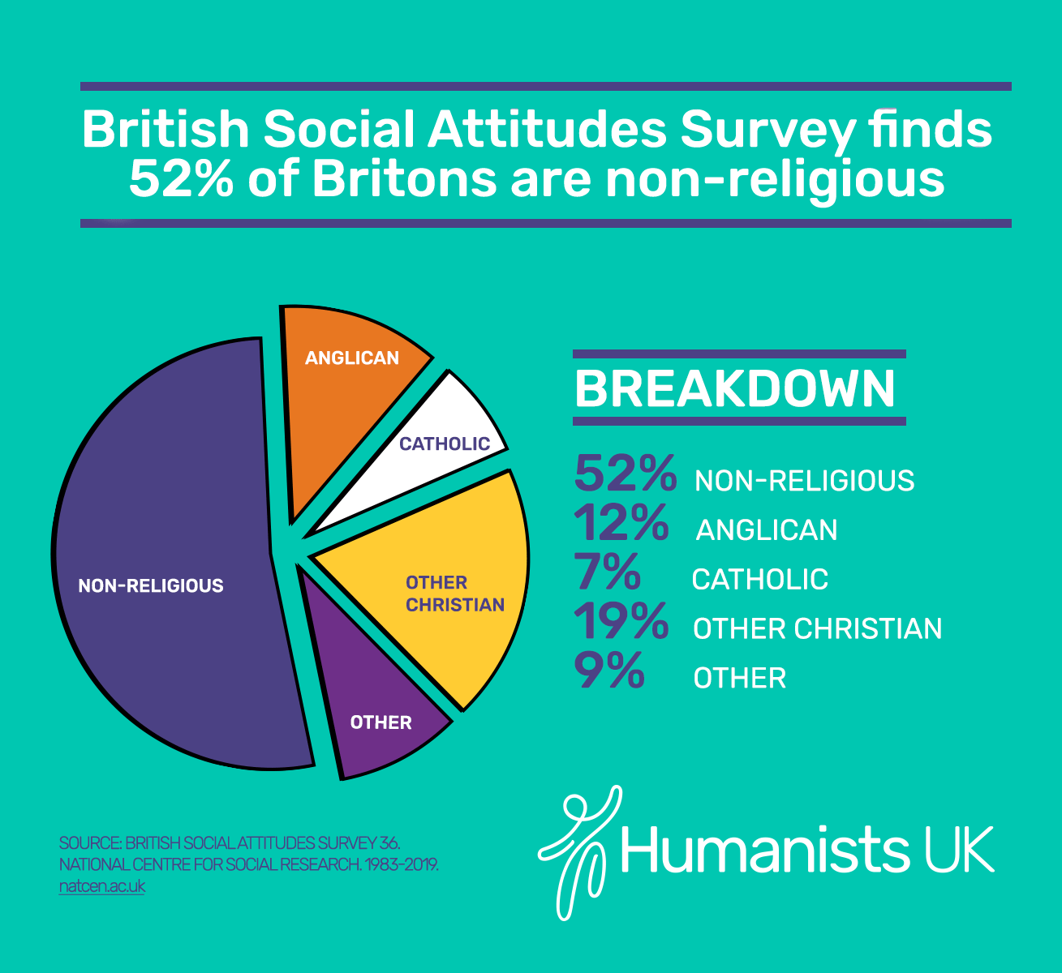
How many non-religious people are there?

Slide 22
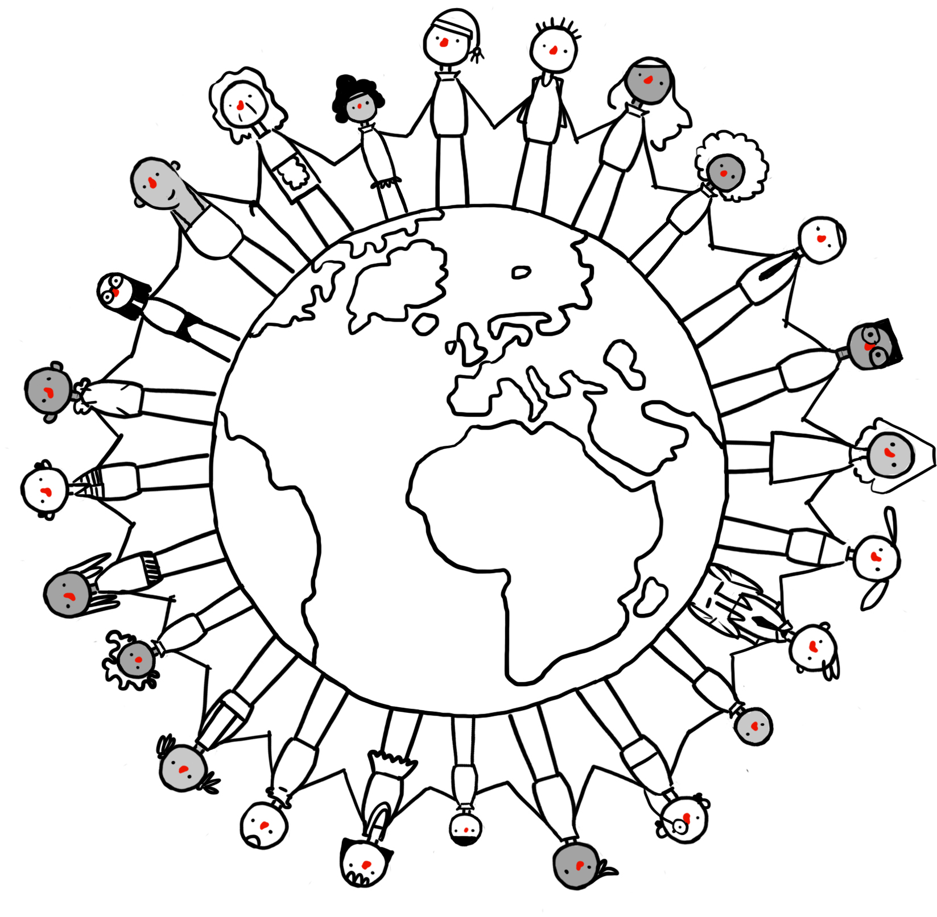
How many humanists are there?
Millions of people in the UK and around the world share humanist beliefs.
Around 5% of people in the UK (one in 20) use the label ‘humanist’ to describe themselves
Many more share humanist beliefs and values
Humanists and humanist organisations can be found all around the world – in Europe, Africa, Asia, and the Americas.

Slide 23
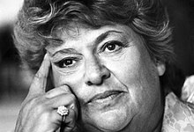
Discovering humanism
‘I was a humanist without knowing it for many years before I found the British Humanist Association – when I did, it was like finding a sort of home. Here were people with a range of views that matched my own.’
Claire Rayner, former Humanists UK Vice-President

Slide 24
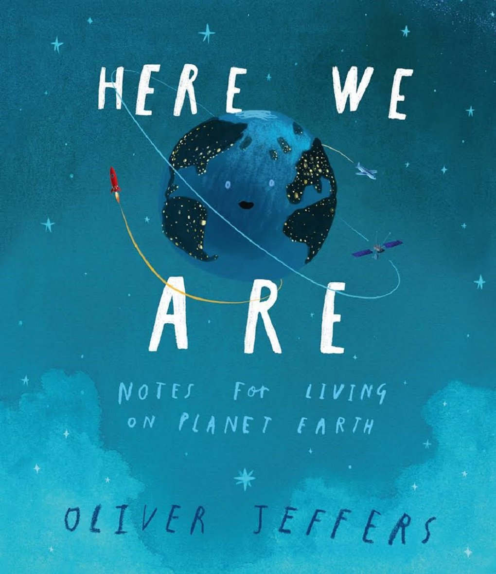
Here We Are
Notes for living on planet Earth
by Oliver Jeffers

Slide 25





How might each object link to humanism

Slide 26

Decorate a Happy Human

Slide 27
A humanist approach to life: a summary
Humanists believe the world is a natural place and science gives us the best way to understand it (humanists don’t believe in a god)
Humanists believe we should be free to make the most of the one life we have, seeking happiness and supporting others to do the same
Humanists believe we should use empathy and consider the impact of our actions on other people and animals

