Slide 1
What is humanism?

Slide 2


Slide 3
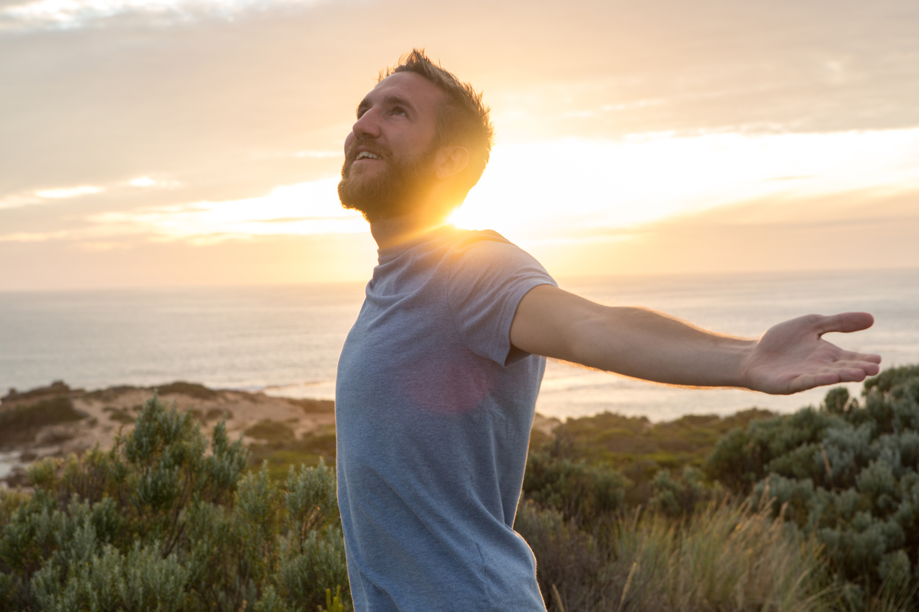

Slide 4
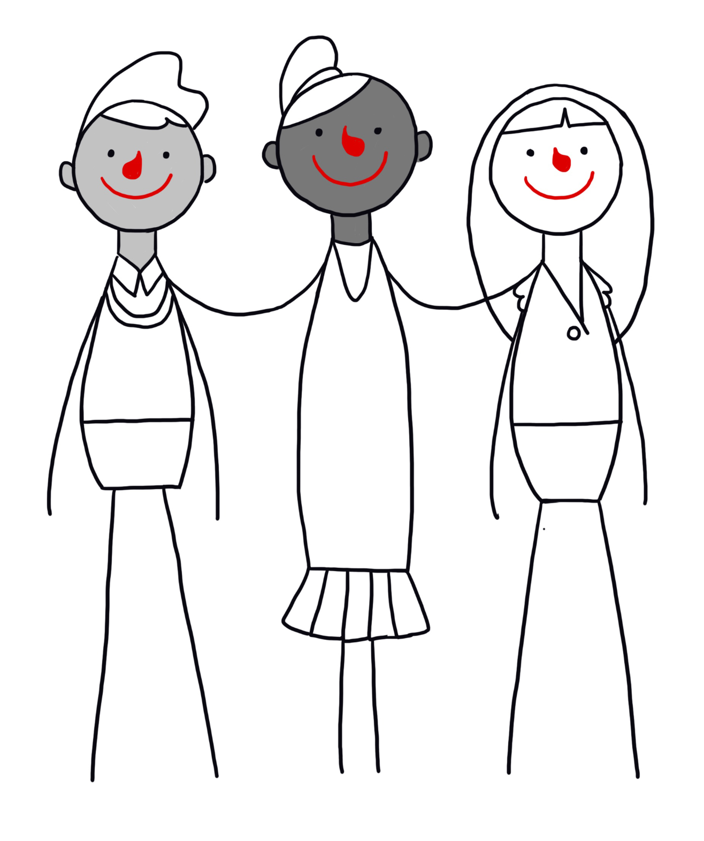
Humanism
Humanism is a non-religious worldview or a non-religious approach to life.
Humanists believe it is possible to lead a good, happy, and meaningful life without the need for religion.

Slide 5
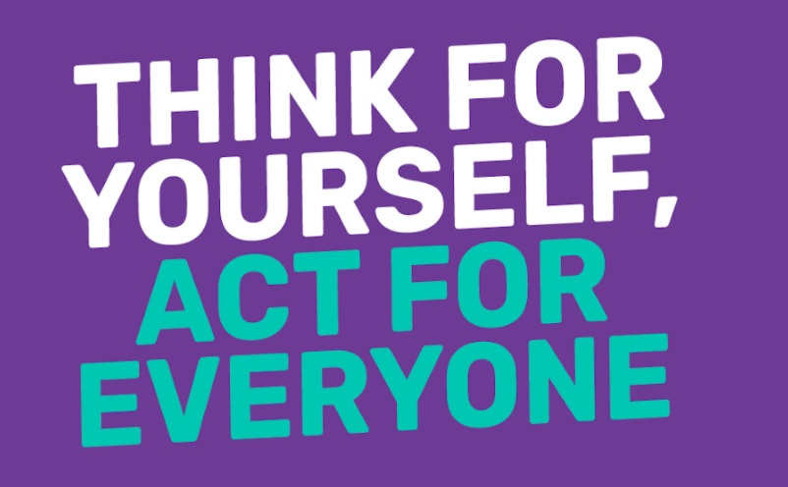
A humanist motto

Slide 6
A humanist approach to life: a summary
Humanists believe science provides the best way to understand the world and we should look for natural explanations for events (humanists don’t believe in a god)
Humanist believe we should be free to shape the one life we have and that we can make our own lives meaningful by seeking happiness in the here and now, and supporting others to do the same
Humanists believe we should use empathy and have a responsibility to consider the impact of our actions on the welfare of other people and animals

Slide 7
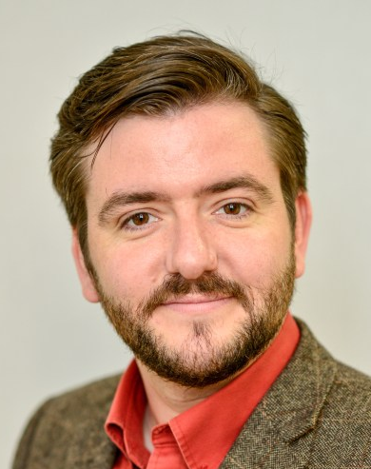
Humanism
'For as long as there have been human beings, there have been non-religious people whose view of the world can be described as 'humanist': informed by evidence, inspired by empathy, and infused with hope and wonder for the world around us.'
Andrew Copson, Chief Executive, Humanists UK

Slide 8





Five features of a
humanist approach to life
Human nature and potential
Using science to understand the natural world (no belief in god)
One life and the freedom to find happiness
Using empathy and considering the impact of our actions
Human responsibility

Slide 9
Five features of a humanist approach to life
1
Humanists believe that human beings have natural origins. We evolved naturally like all other living things. We have evolved many capacities and, if we put them to good use, we have the potential to lead good and happy lives.

Slide 10
Five features of a humanist approach to life
2
Humanists believe the world is a natural place with no supernatural side (they will be atheists or agnostics). They believe that science and the search for evidence provides the best way to answer our questions about the world.

Slide 11
Five features of a humanist approach to life
3
Humanists believe this is the one life we have and so we need to make the most of it. For humanists, there is no single ‘ultimate’ meaning of life. Instead, it is up to us to make our own lives meaningful. They believe we should be free to decide how we live (as long as we do not cause harm to others), seeking happiness and supporting others to do the same.

Slide 12
Five features of a humanist approach to life
4
Humanists believe that the origins of our moral capacities lie inside human beings and our evolution as a social animal. They believe that, when deciding how to act, we should use reason and empathy, considering the consequences of our actions and the likely impact on other people and animals.

Slide 13
Five features of a humanist approach to life
5
Humanists believe that human beings alone are responsible for making the world a better place. Many campaign for equality, human rights, and secularism. Many celebrate the progress humanity has made, but recognise the work that is still to be done.

Slide 14
Five features of a humanist approach to life
Humanists believe that human beings have natural origins. We evolved naturally like all other living things. We have evolved many capacities and, if we put them to good use, we have the potential to lead good and happy lives.
Humanists believe the world is a natural place with no supernatural side (they will be atheists or agnostics). They believe that science and the search for evidence provides the best way to answer our questions about the world.
Humanists believe this is the one life we have and so we need to make the most of it. For humanists, there is no single ‘ultimate’ meaning of life. Instead, it is up to us to make our own lives meaningful. They believe we should be free to decide how we live (as long as we do not cause harm to others), seeking happiness and supporting others to do the same.
Humanists believe that the origins of our moral capacities lie inside human beings and our evolution as a social animal. They believe that, when deciding how to act, we should use reason and empathy, considering the consequences of our actions and the likely impact on other people and animals.
Humanists believe that human beings alone are responsible for making the world a better place. Many campaign for equality, human rights, and secularism. Many celebrate the progress humanity has made, but recognise the work that is still to be done.

Slide 15
Atheism and agnosticism
‘Atheist’ = somebody who does not believe in a god
‘Agnostic’ = somebody who accepts we can’t know whether a god exists or not

Slide 16
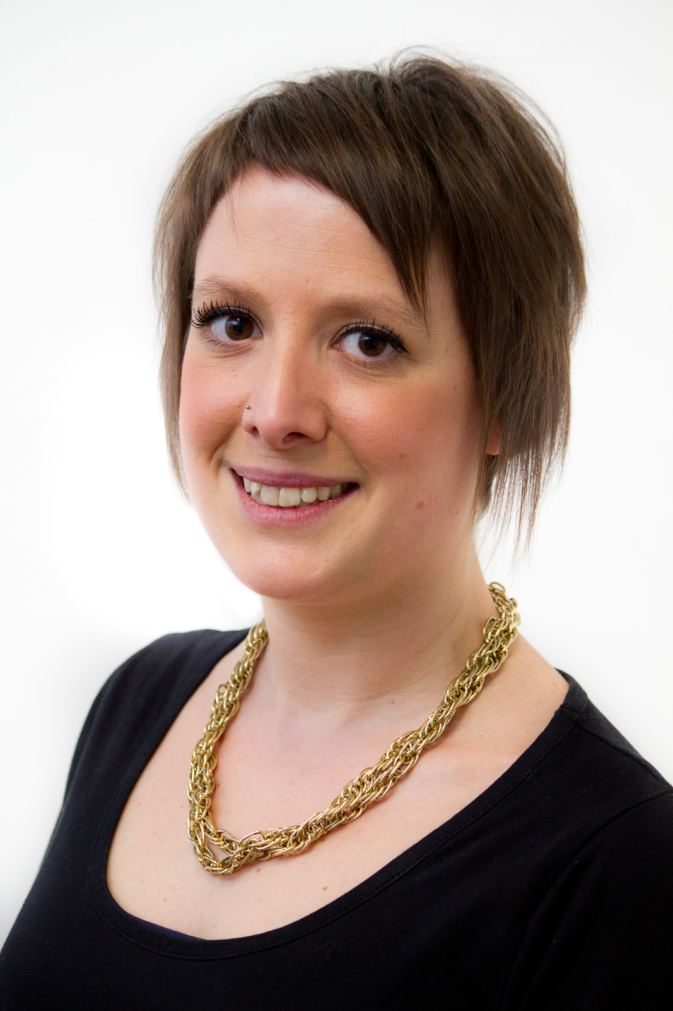
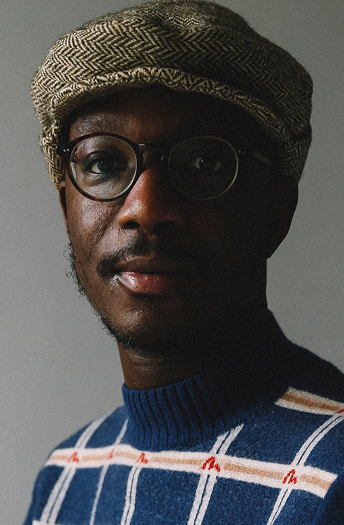
More than atheism
‘For me, humanism is sort of atheism plus.’
Naomi Phillips, humanist
‘Humanism for me has always been positive. We don’t define ourselves by what we don’t believe, which is what I had always done prior to discovering humanism.’
Ste Richardsson, humanist

Slide 17

The Happy Human
Celebrating being human
Celebrating what human beings can do
Celebrating that we can be happy

Slide 18
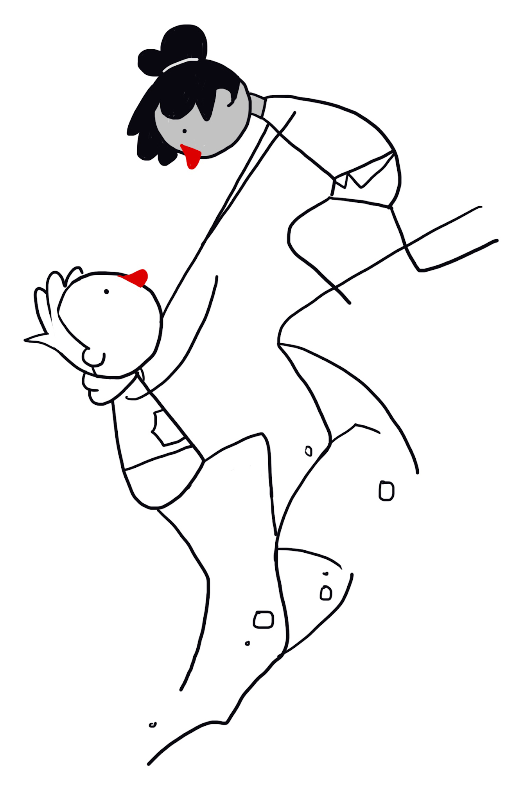
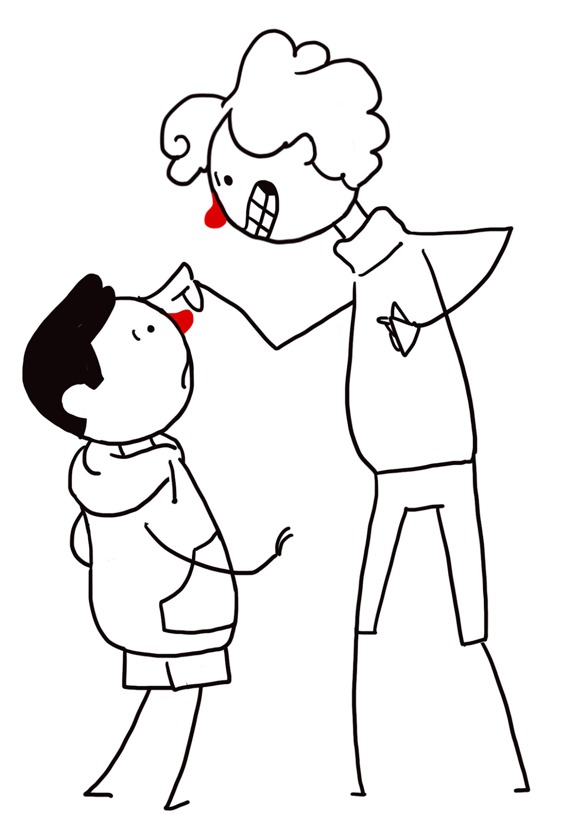
The Golden Rule
‘Treat other people as you'd want to be treated in their situation.’
‘Do not treat others in a way you would not like to be treated yourself.’

Slide 19
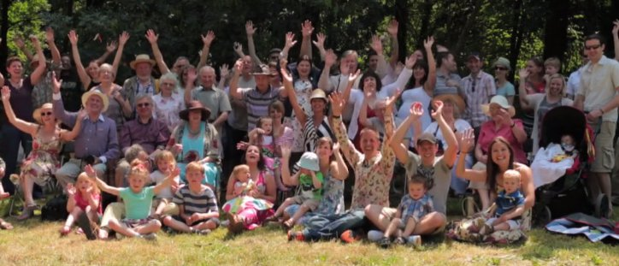
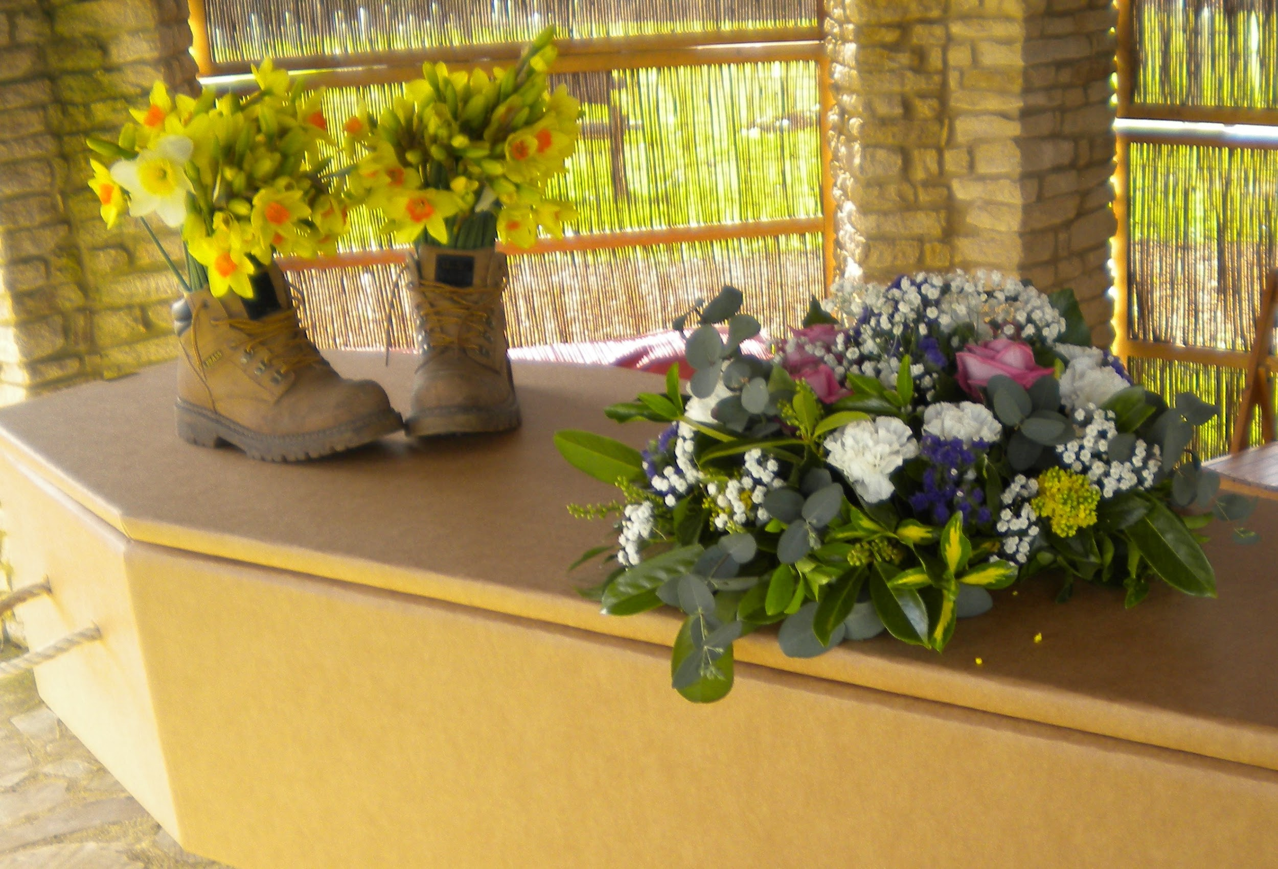
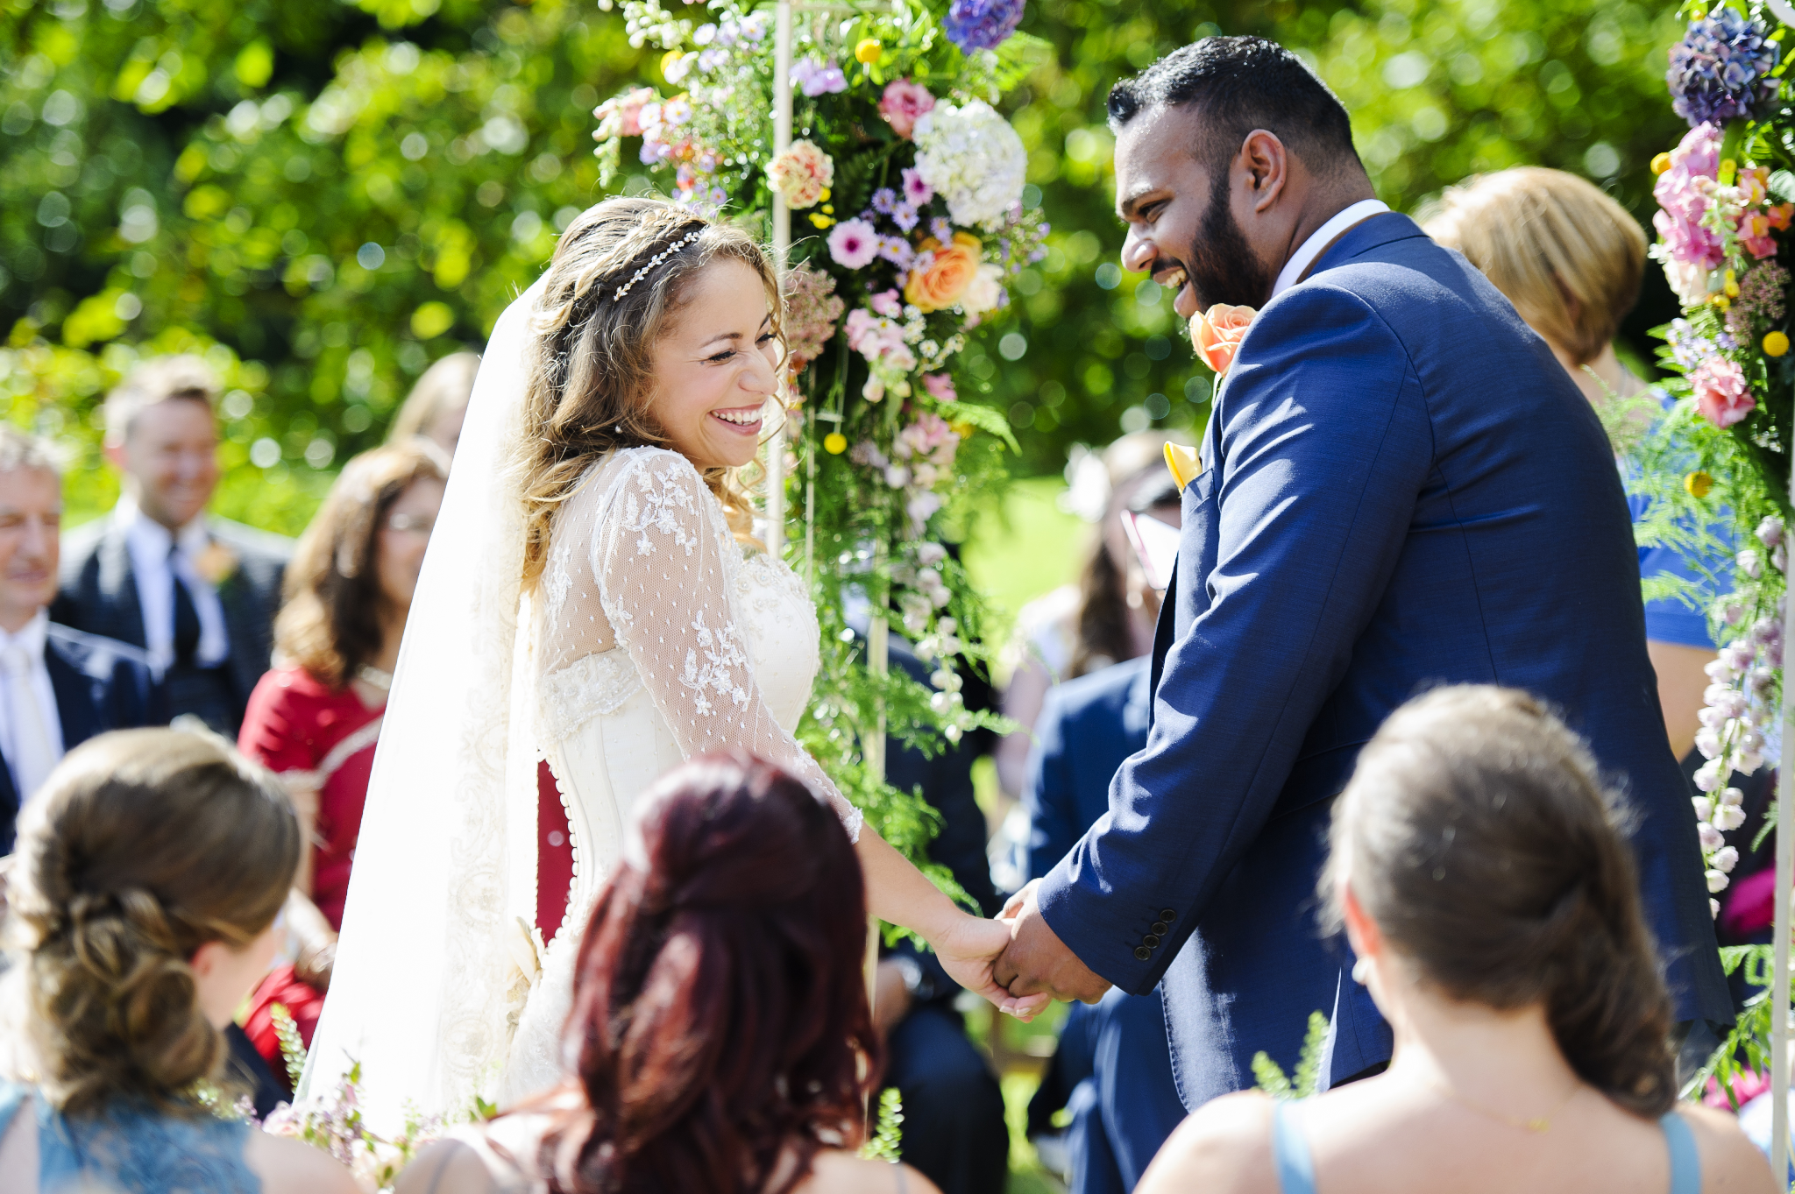
Humanist ceremonies

Slide 20

Freedom of belief
‘Most people I've worked with to put together [humanist] naming ceremonies have chosen that way to welcome their child because they want their child to be free to decide for themselves when they're old enough what they do or don't believe.’
Hannah, humanist celebrant

Slide 21
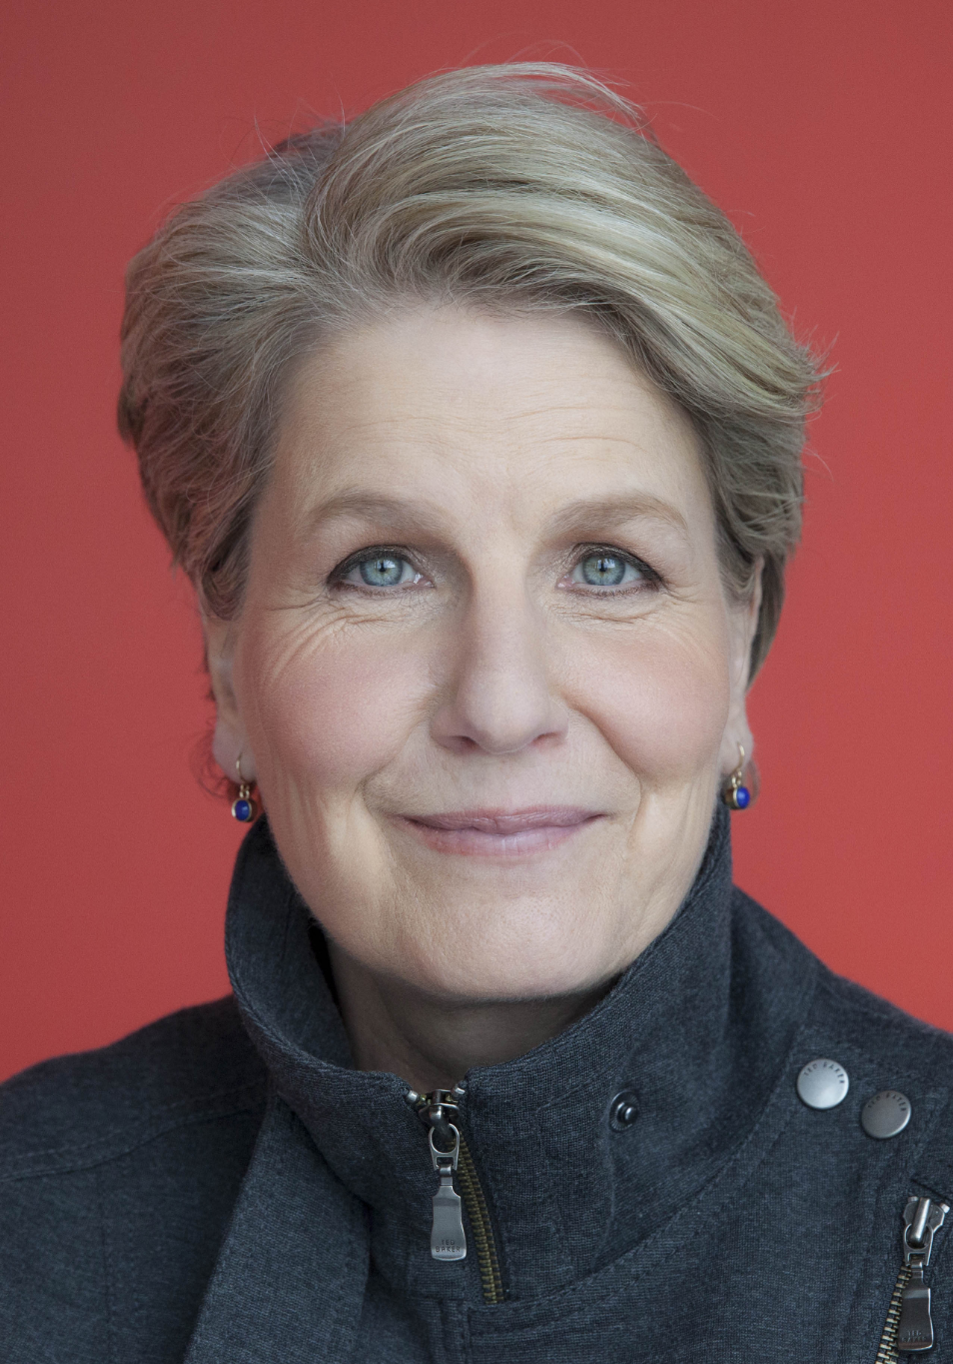
Being humanist
‘Being a humanist can be demanding. It means, when deciding what to believe or how to act, you have to do the thinking for yourself. You have to take responsibility for your own life. You have to take on what, for some, can appear like uncomfortable facts about reality. But it can also be enormously rewarding. It can be liberating and life-enhancing.’
Sandi Toksvig, broadcaster and Patron of Humanists UK

Slide 22

Being humanist
‘What being a humanist means to me is taking a stand with humanity, taking a stand inspired by human rights and human values… Humanism is a way of thinking and living that emphasises the agency of human beings. Humanism stresses the fact that we, human beings, are capable of changing the world.’
Leo Igwe, Nigerian Humanist Association

Slide 23
A humanist motto

Slide 24
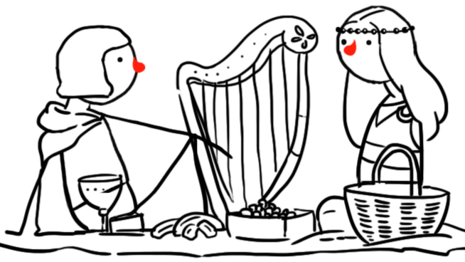
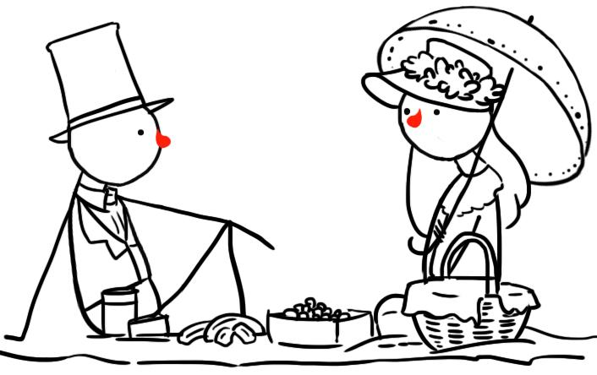
Humanist history
Humanist ideas can be found over 2000 years ago in ancient India, China, and Greece.
Humanist ideas became increasingly popular during a period called the Enlightenment in the 18th century.
Today there are millions of humanists all over the world.

Slide 25
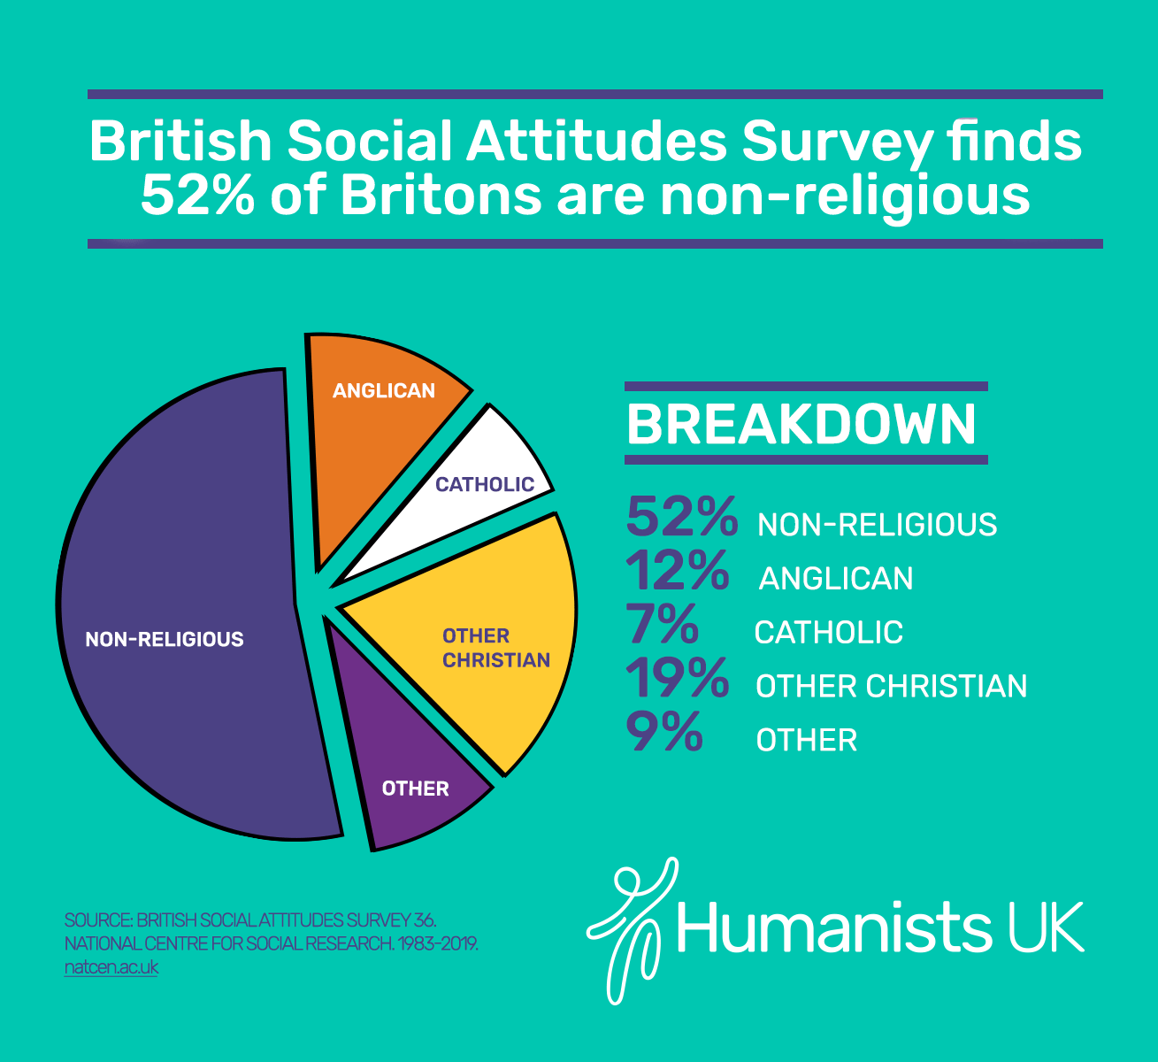
How many non-religious people are there?

Slide 26
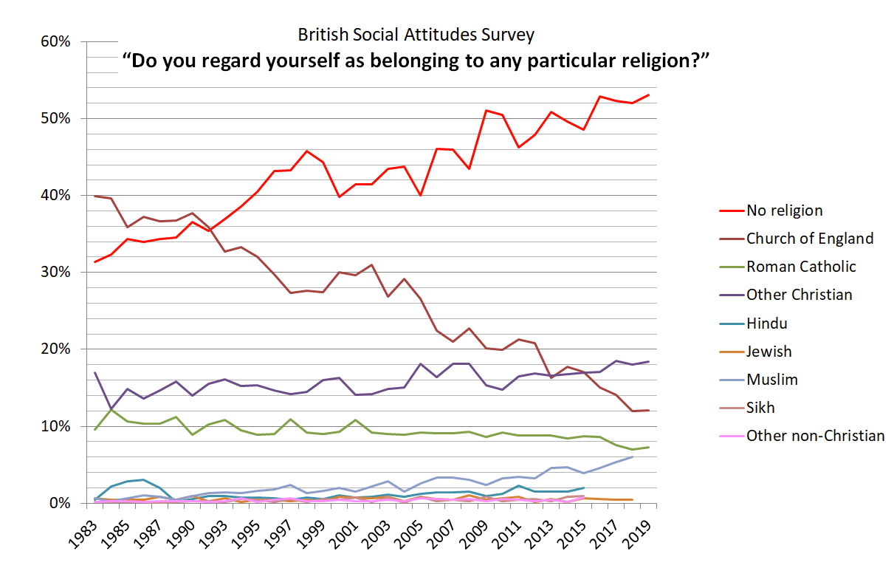
How many non-religious people are there?
Note: no data available for some religions in most recent years
Source: British Social Attitudes Survey, NatCen

Slide 27
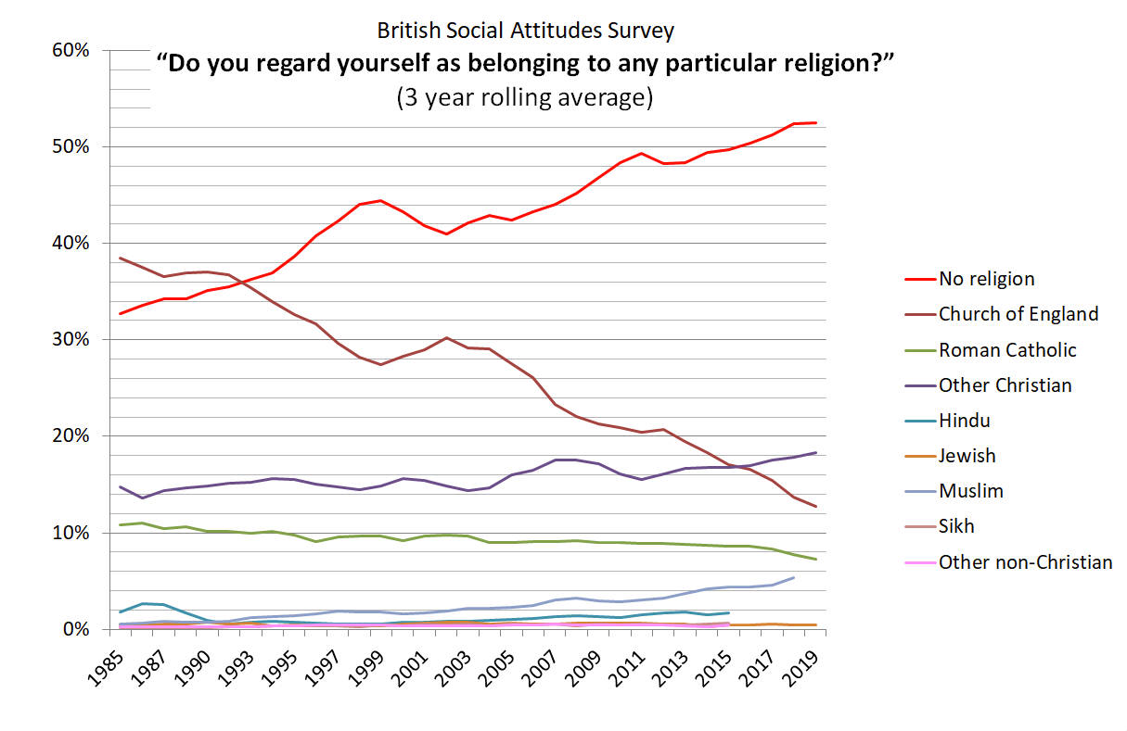
How many non-religious people are there?
Note: no data available for some religions in most recent years
Source: British Social Attitudes Survey, NatCen

Slide 28
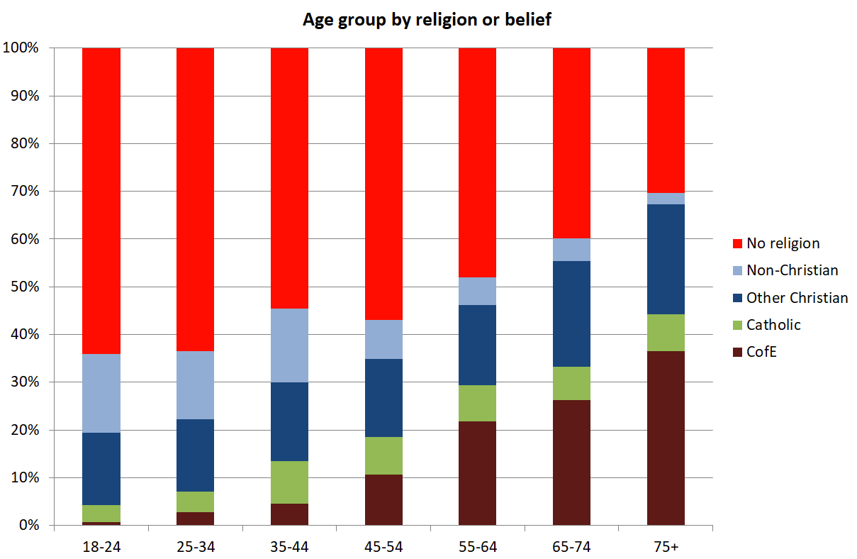
How many non-religious people are there?
Source: British Social Attitudes Survey (2018), NatCen

Slide 29
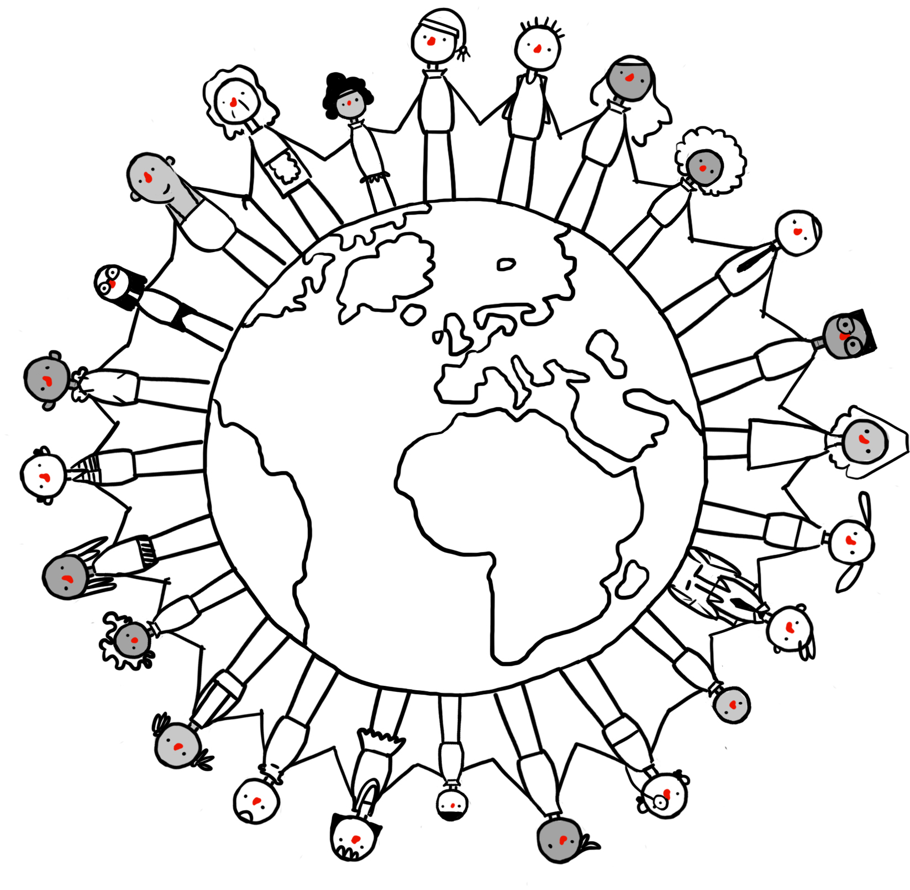
How many humanists are there?
Millions of people in the UK and around the world share humanist beliefs.
Around 5% of people in the UK use the label ‘humanist’ to describe themselves
Many more (around 20%) share humanist beliefs and values
Humanists and humanist organisations can be found all around the world – in Europe, Africa, Asia, and the Americas.

Slide 30
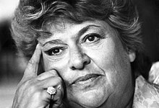
Discovering humanism
‘I was a humanist without knowing it for many years before I found the British Humanist Association – when I did, it was like finding a sort of home. Here were people with a range of views that matched my own.’
Claire Rayner, former Humanists UK Vice-President

Slide 31
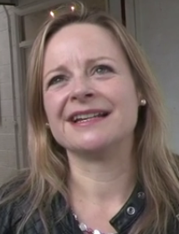
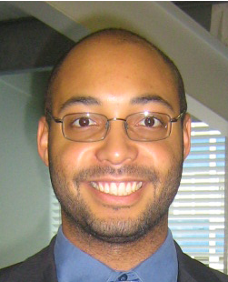
Discovering humanism
‘ I didn’t actually realise that I was a humanist until I went to a humanist funeral and I started to read about humanism and I thought this philosophy fits me exactly.’
Michelle Beckett
‘I don’t think I’d even heard the word humanism until I saw a job advertised for a public affairs officer at the British Humanist Association. I started to read more about humanism and that’s when I knew that that’s exactly my beliefs.’
Naomi Phillips
‘I decided to become a humanist quite late in life. I was raised religiously and then discovered atheism as many people do. But atheism wasn’t quite enough for me. It defined me in a negative way by saying something I didn’t believe. When I found humanism it was a delightful revelation because I could finally describe myself with a word which was positive and said a lot about what I do believe in.’
Alex Williams

Slide 32
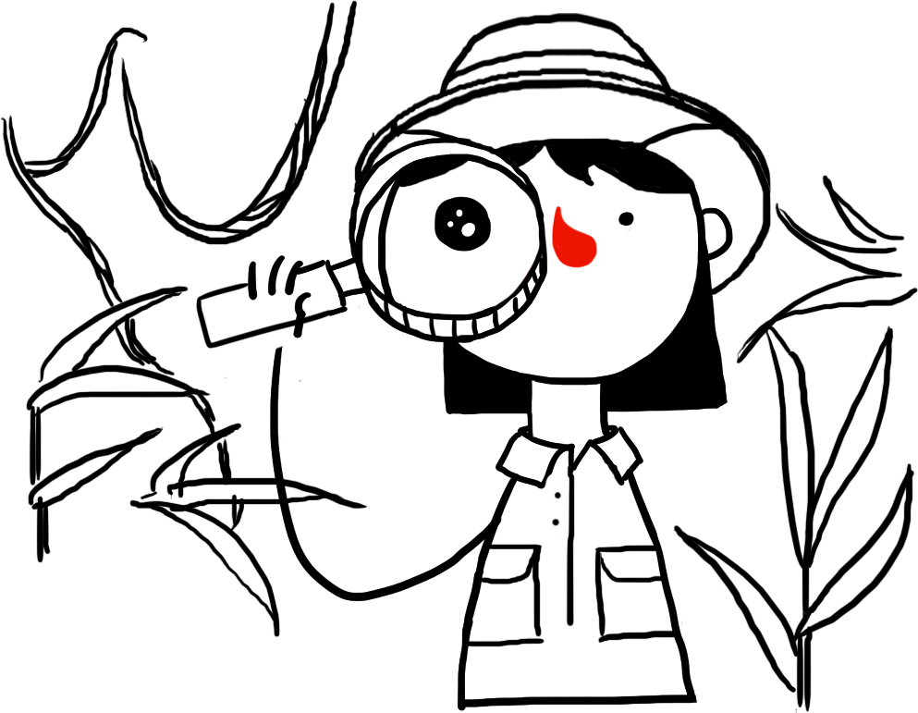

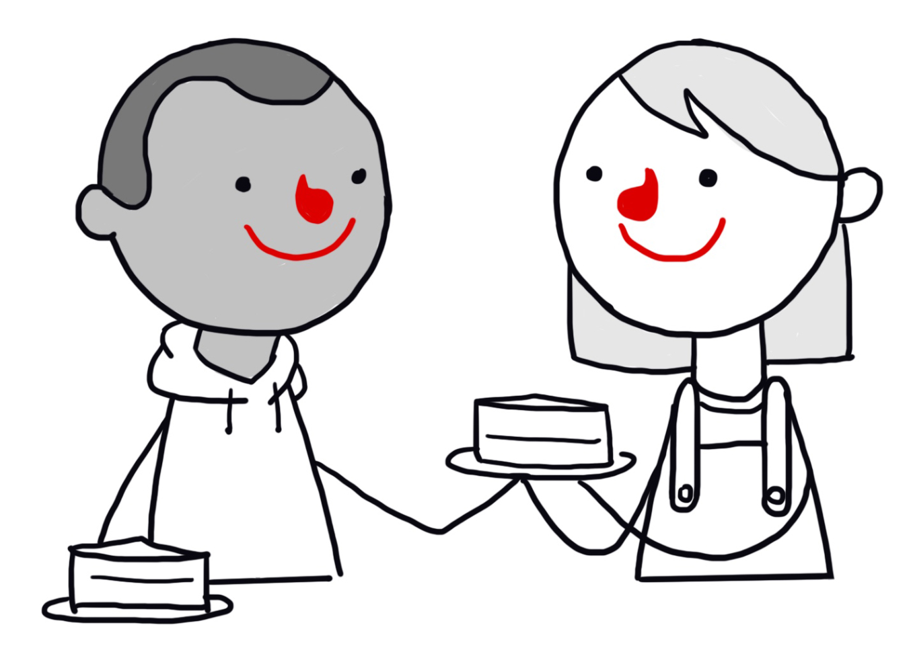
Humanism: a Venn diagram
A humanist approach to life involves three core beliefs about the world, our human potential, and how we should act.
The world is a natural place and, in seeking to understand it, we should use science to look for natural explanations (there is no scientific evidence for a god, an afterlife, or any supernatural forces).
We have the potential to lead happy, fulfilling, and meaningful lives.
We should act in ways that support the wellbeing of other human beings and sentient animals.

Slide 33
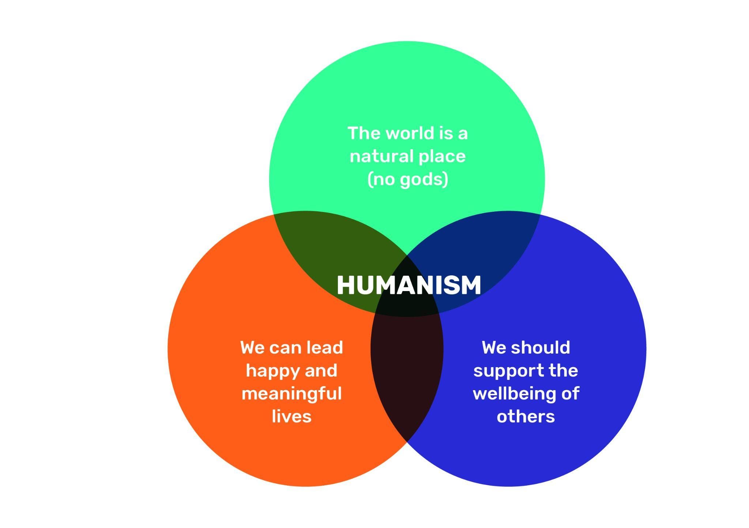
Humanism: a Venn diagram
Humanism lies at the centre of this Venn diagram of beliefs

Slide 34
Humanism: a Venn diagram
Within each of these circles there may be disagreement amongst humanists…
about how exactly to explain certain natural phenomena – although there will be general agreement that science provides the best way to answer such questions.
about the best way to make ourselves happy and our lives meaningful – although there will typically be agreement that we should be free to choose.
about how we can best support the wellbeing of others and on which causes to prioritise.

Slide 35




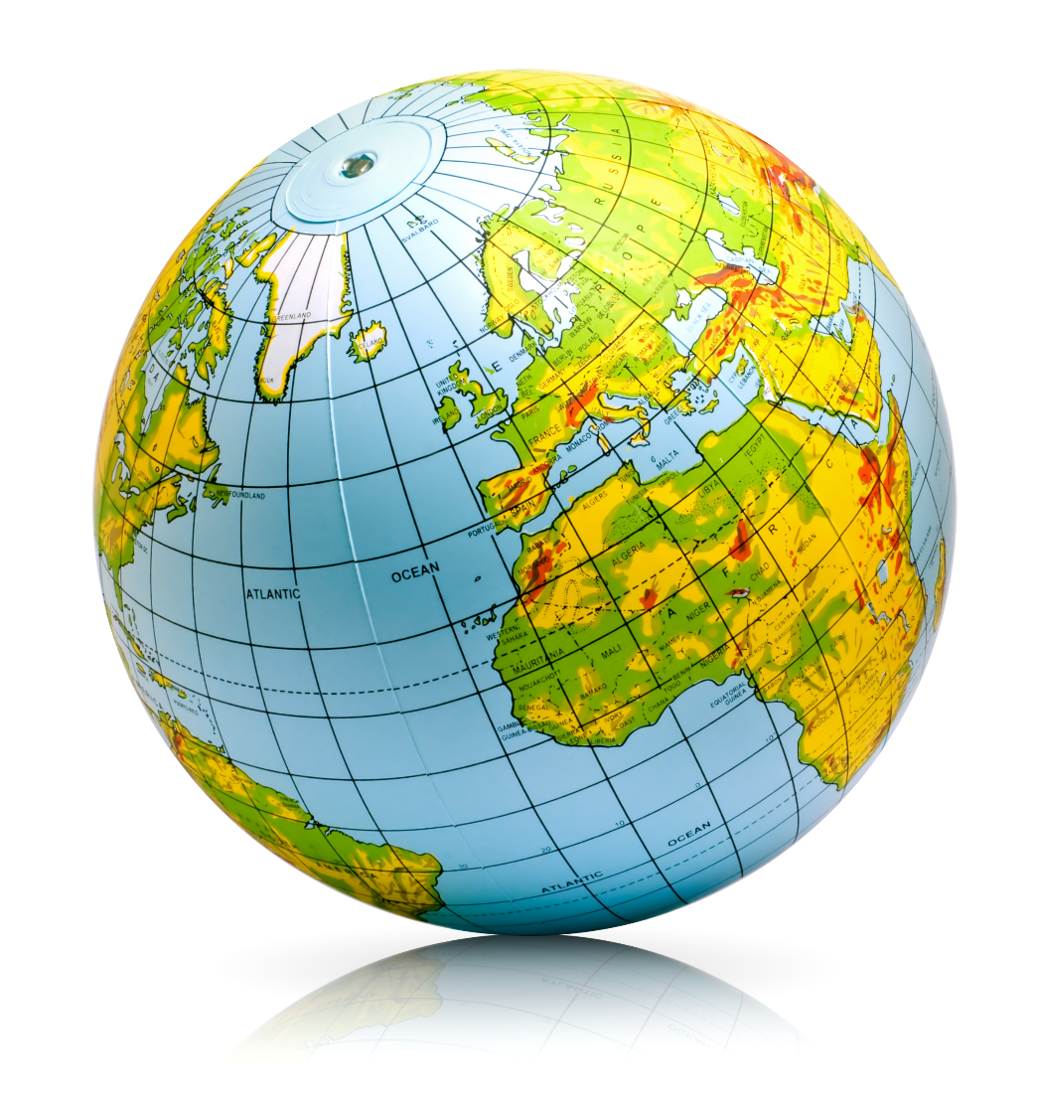
How might each object link to humanism

Slide 36

Humanists UK
‘At Humanists UK, we want a tolerant world where rational thinking and kindness prevail. We work to support lasting change for a better society, championing ideas for the one life we have.’
Humanists UK has been around since 1896
It campaigns on issues where it believes the non-religious are treated unfairly and where the common non-religious perspective on ethical questions differs from that of many religious organisations
It also provides services to support non-religious people, such as ceremonies, pastoral support, and education
In 2021 Humanists UK had 100,000 members and supporters

Slide 37

Decorate a Happy Human

Slide 38
A humanist approach to life: a summary
Humanists believe science provides the best way to understand the world and we should look for natural explanations for events (humanists don’t believe in a god)
Humanist believe we should be free to shape the one life we have and that we can make our own lives meaningful by seeking happiness in the here and now, and supporting others to do the same
Humanists believe we should use empathy and have a responsibility to consider the impact of our actions on the welfare of other people and animals

