Slide 1
Understanding the world

Slide 2
A humanist approach to life: a summary
Humanists believe the world is a natural place and science gives us the best way to understand it (humanists don’t believe in a god)
Humanists believe we should be free to make the most of the one life we have, seeking happiness and supporting others to do the same
Humanists believe we should use empathy and consider the impact of our actions on other people and animals

Slide 3

A humanist understanding of the world
Our beliefs can be mistaken and we should be prepared to question them
Science provides the best way of answering questions about the world
The world is a natural place and we should look for natural explanations

Slide 4
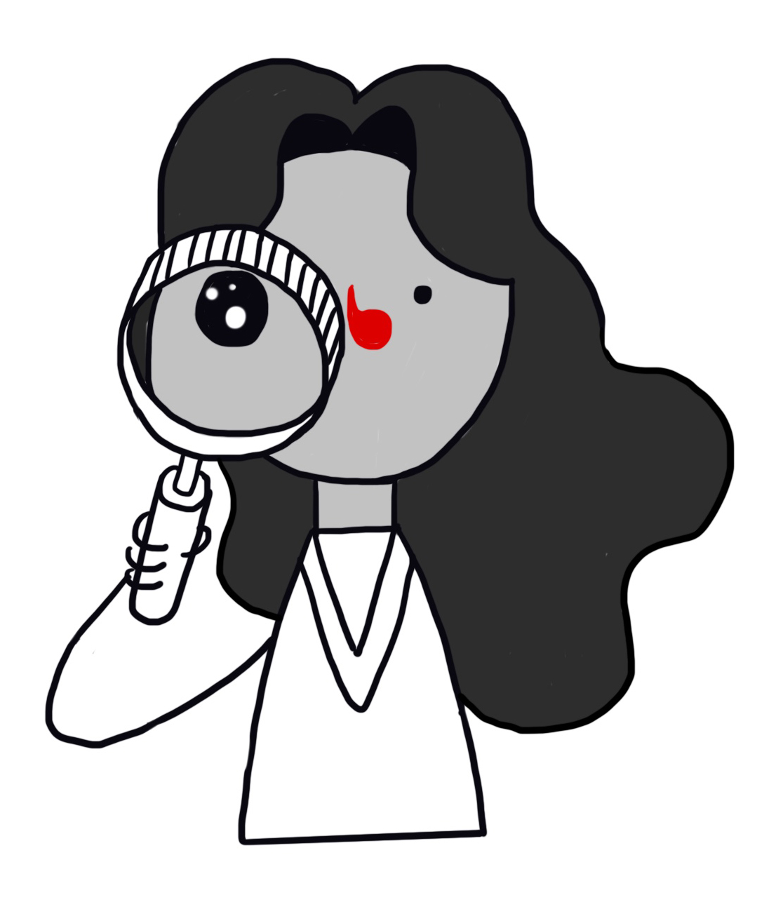
THE TRIAL
An expensive painting has been stolen and a man has been accused of stealing it. The case has come to court and you are on the jury. You will hear evidence from eight witnesses who believe the accused man is the thief.
Which witnesses provide good evidence?
Witness 1: ‘I had a dream that he did it.’
Witness 2: ‘My friend’s mother’s hairdresser said he did it.’
Witness 3: ‘I read that he did it in the newspaper.’
Witness 4: ‘Everyone thinks he did it.’
Witness 5: ‘I just feel deep down inside that he did it.’
Witness 6: ‘His fingerprints match those on the door of the room the painting was in.’
Witness 7: ‘I know that he had a motive to do it.’
Witness 8: ‘I saw him do it.’

Slide 5
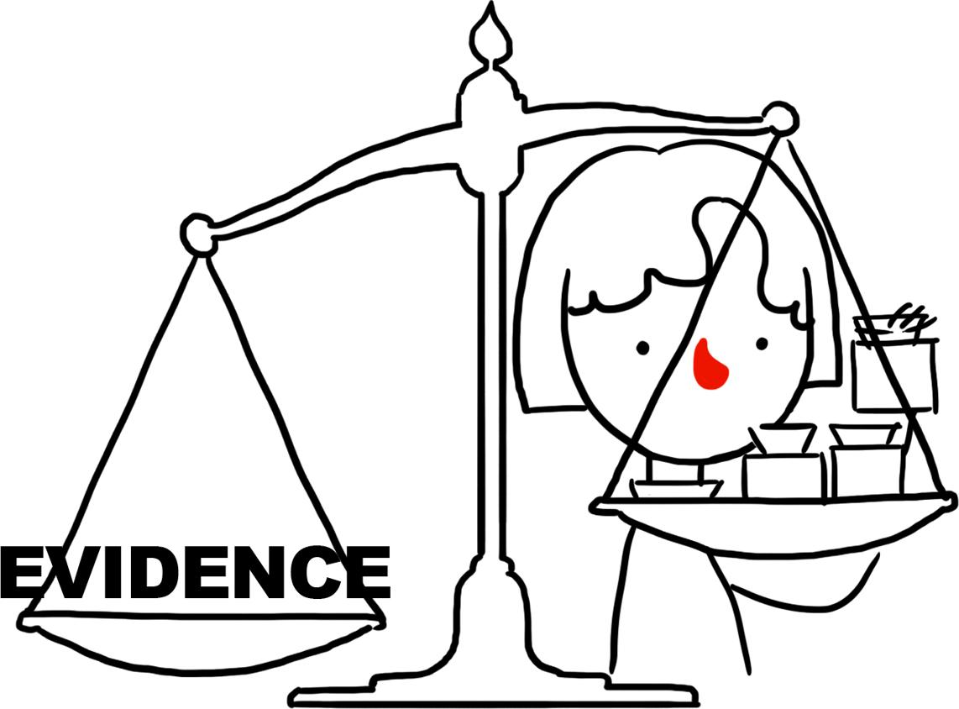
THE TRIAL
Do you think the evidence is good evidence or not? Explain why.
Can you order the evidence from best to worst?
Could anything be wrong with the evidence?
How would you question each witness’ statement?
Would any of the evidence be enough to convince you the man is guilty?

Slide 6
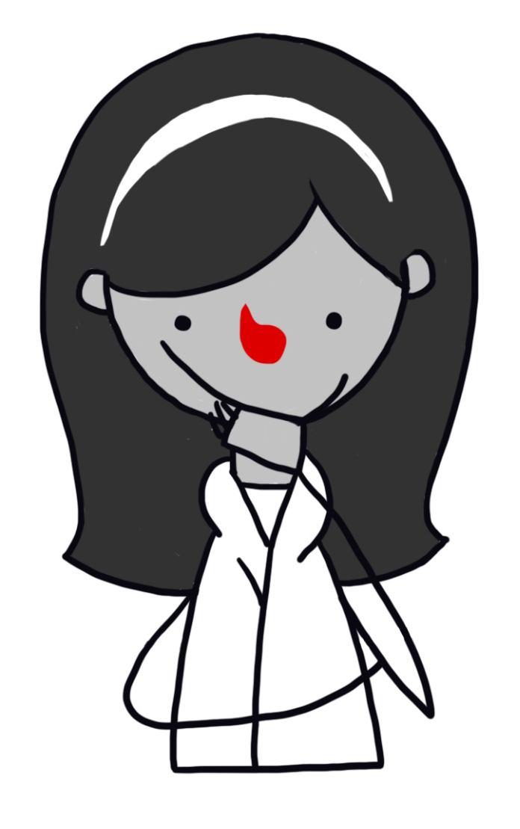
Understanding the world
There may be many different reasons we believe things
Sometimes we make mistakes
Our beliefs can be true or false

Slide 7
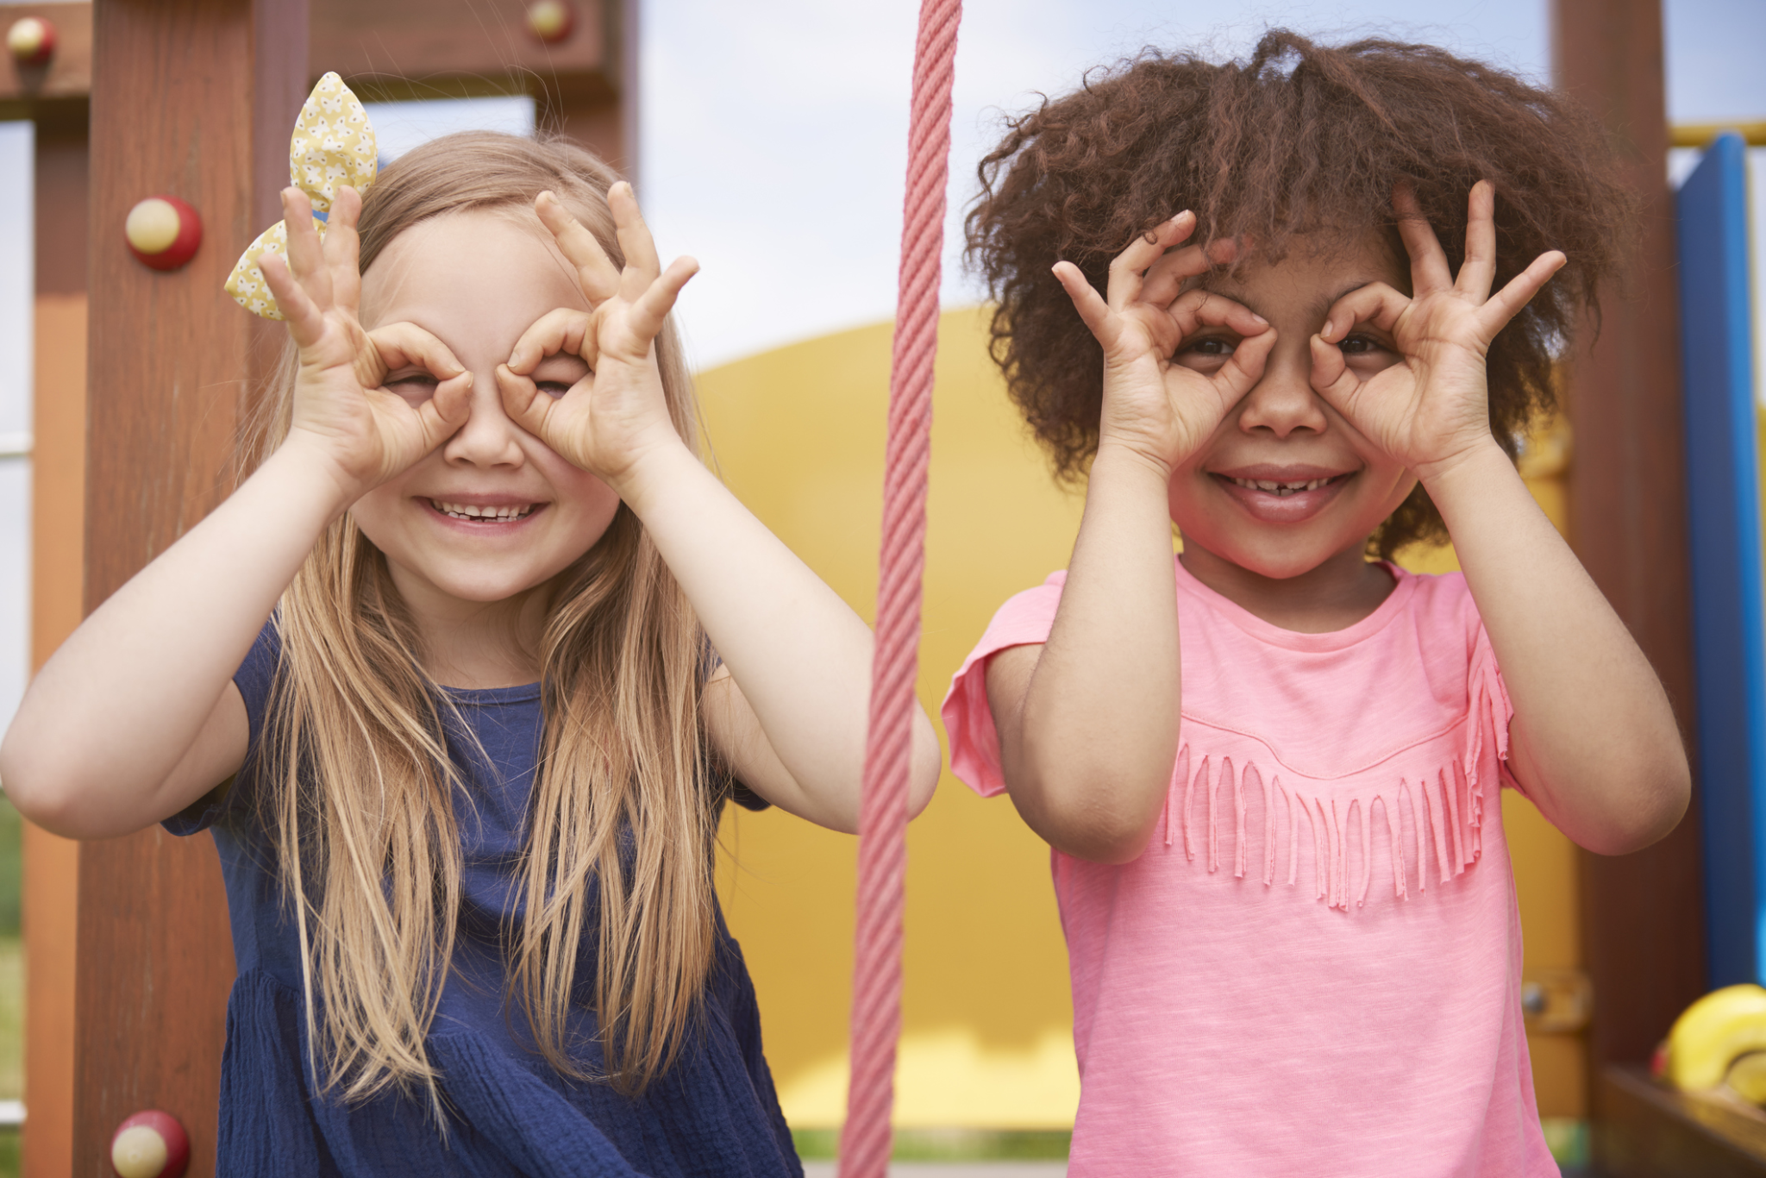

Slide 8


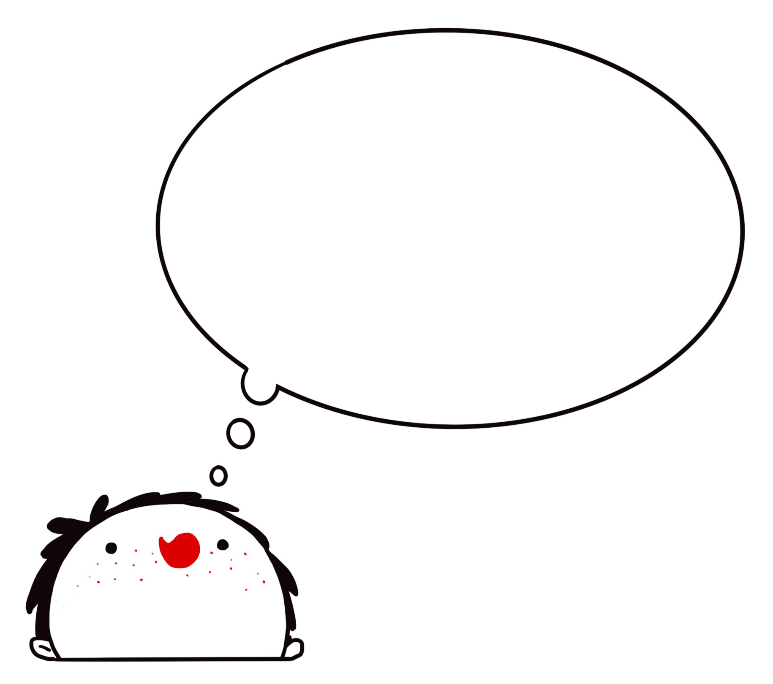
The humanist approach

Slide 9
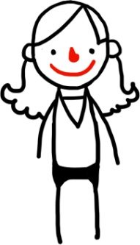
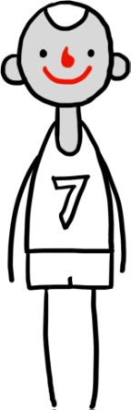
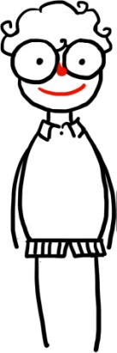
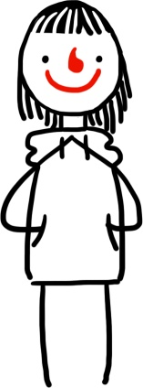
Understanding the world
I believe astrology can predict the future because my mum told me so.
I believe plants need water to survive because I did an experiment to test it.
I believe Henry VIII had six wives because I read it in a book.
I believe UFOs have visited Earth because lots of people believe in them.

Slide 10
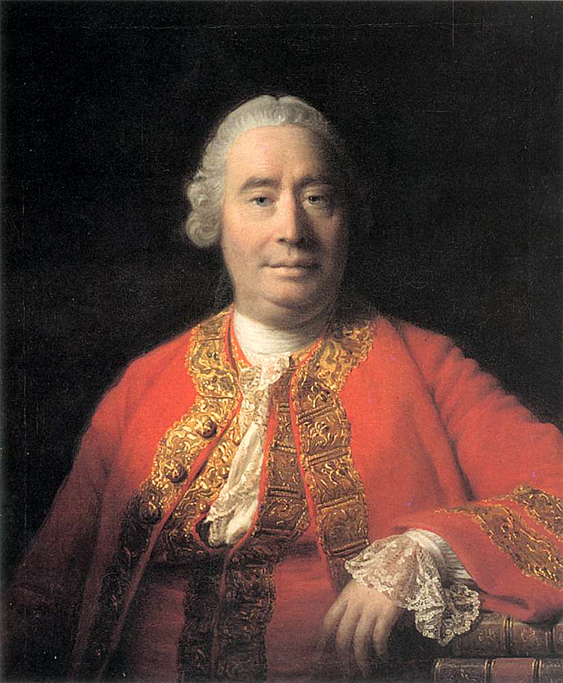
Evidence
‘A wise man proportions his belief to the evidence.’
David Hume, philosopher
(1711–1776)

Slide 11
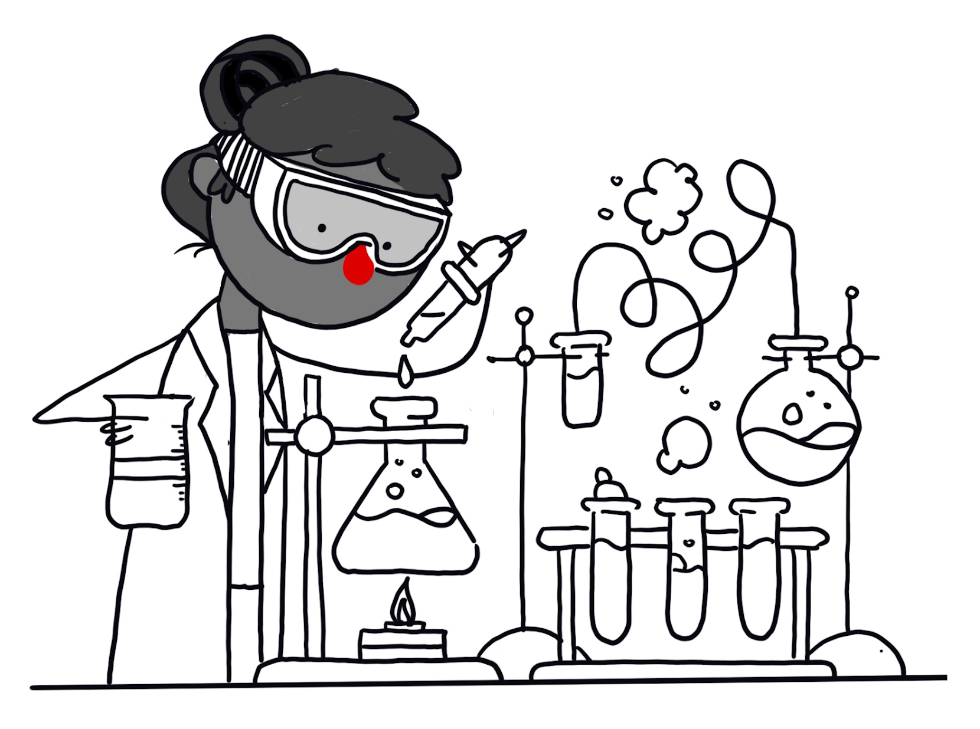
Science
How science works
Observation
Hypothesis
Prediction
Test (experiment)
Results (evidence)
Conclusion

Slide 12
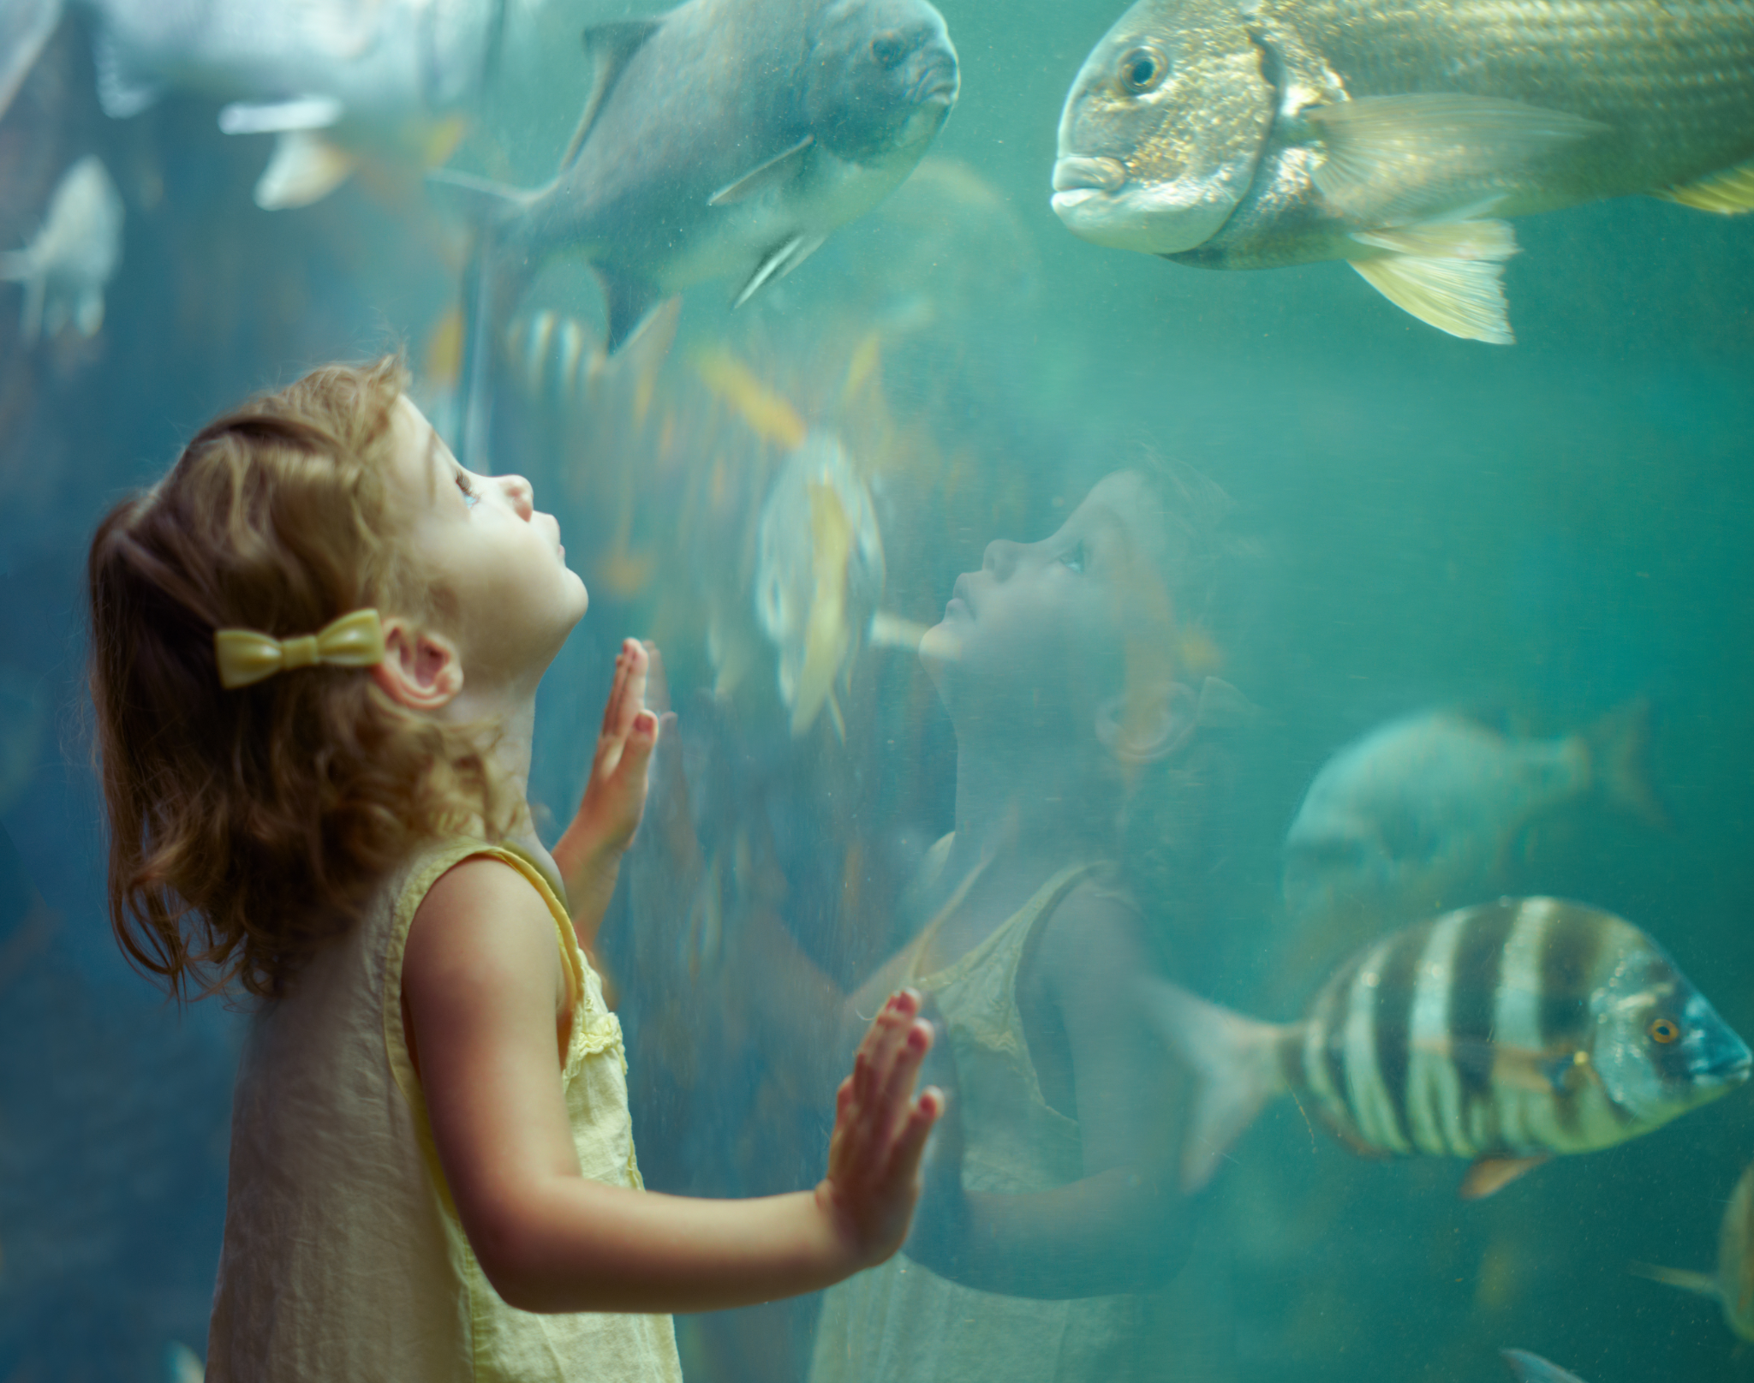

Slide 13
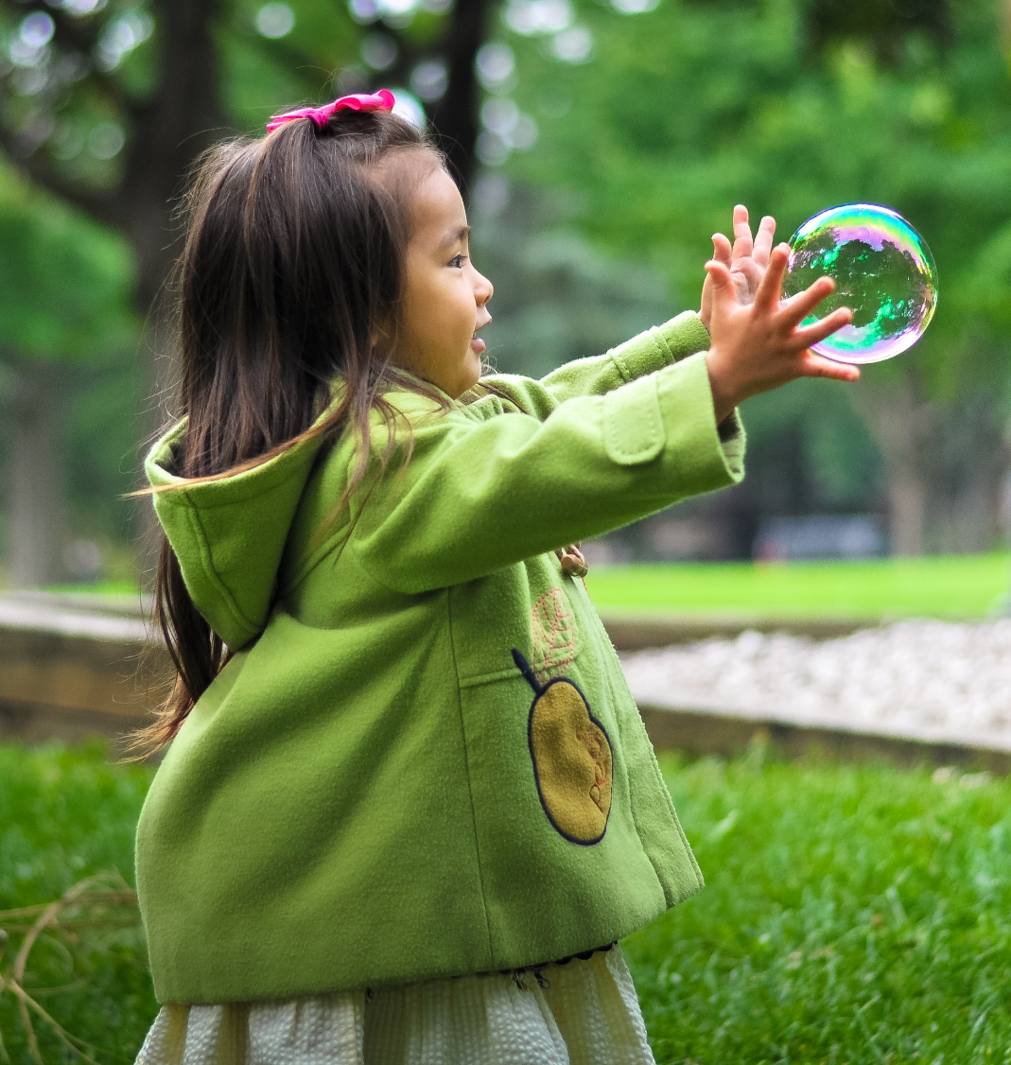
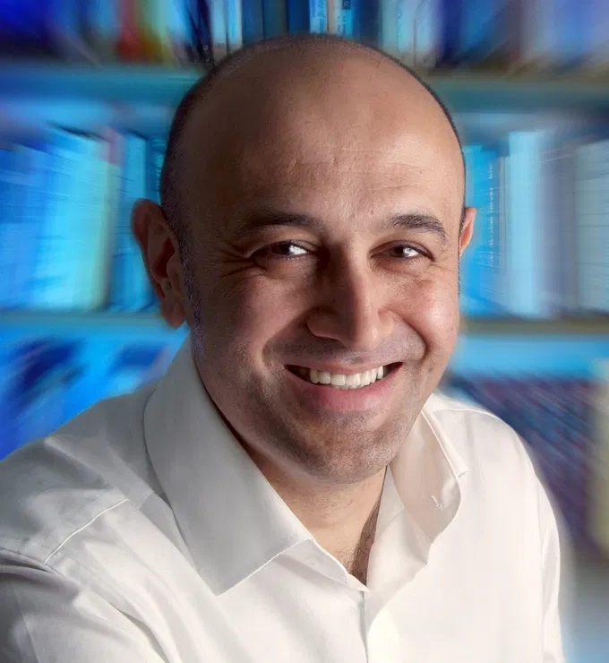
Curiosity and wonder
Curiosity can be one of life’s great pleasures
Science can be a source of wonder
‘Learning about the nature of space and time or the structure of atoms fills me with awe and wonder. It makes me want to learn more.’
Jim al-Khalili, scientist

Slide 14

Humanists believe the world is a natural place
We should always look for natural explanations

Slide 15
Supernatural
Humanists don’t believe in supernatural beings or forces
Supernatural =
Something above, outside, or beyond the natural world
Something beyond scientific understanding or the laws of nature

Slide 16
Atheist
= someone who does not believe in god

Slide 17
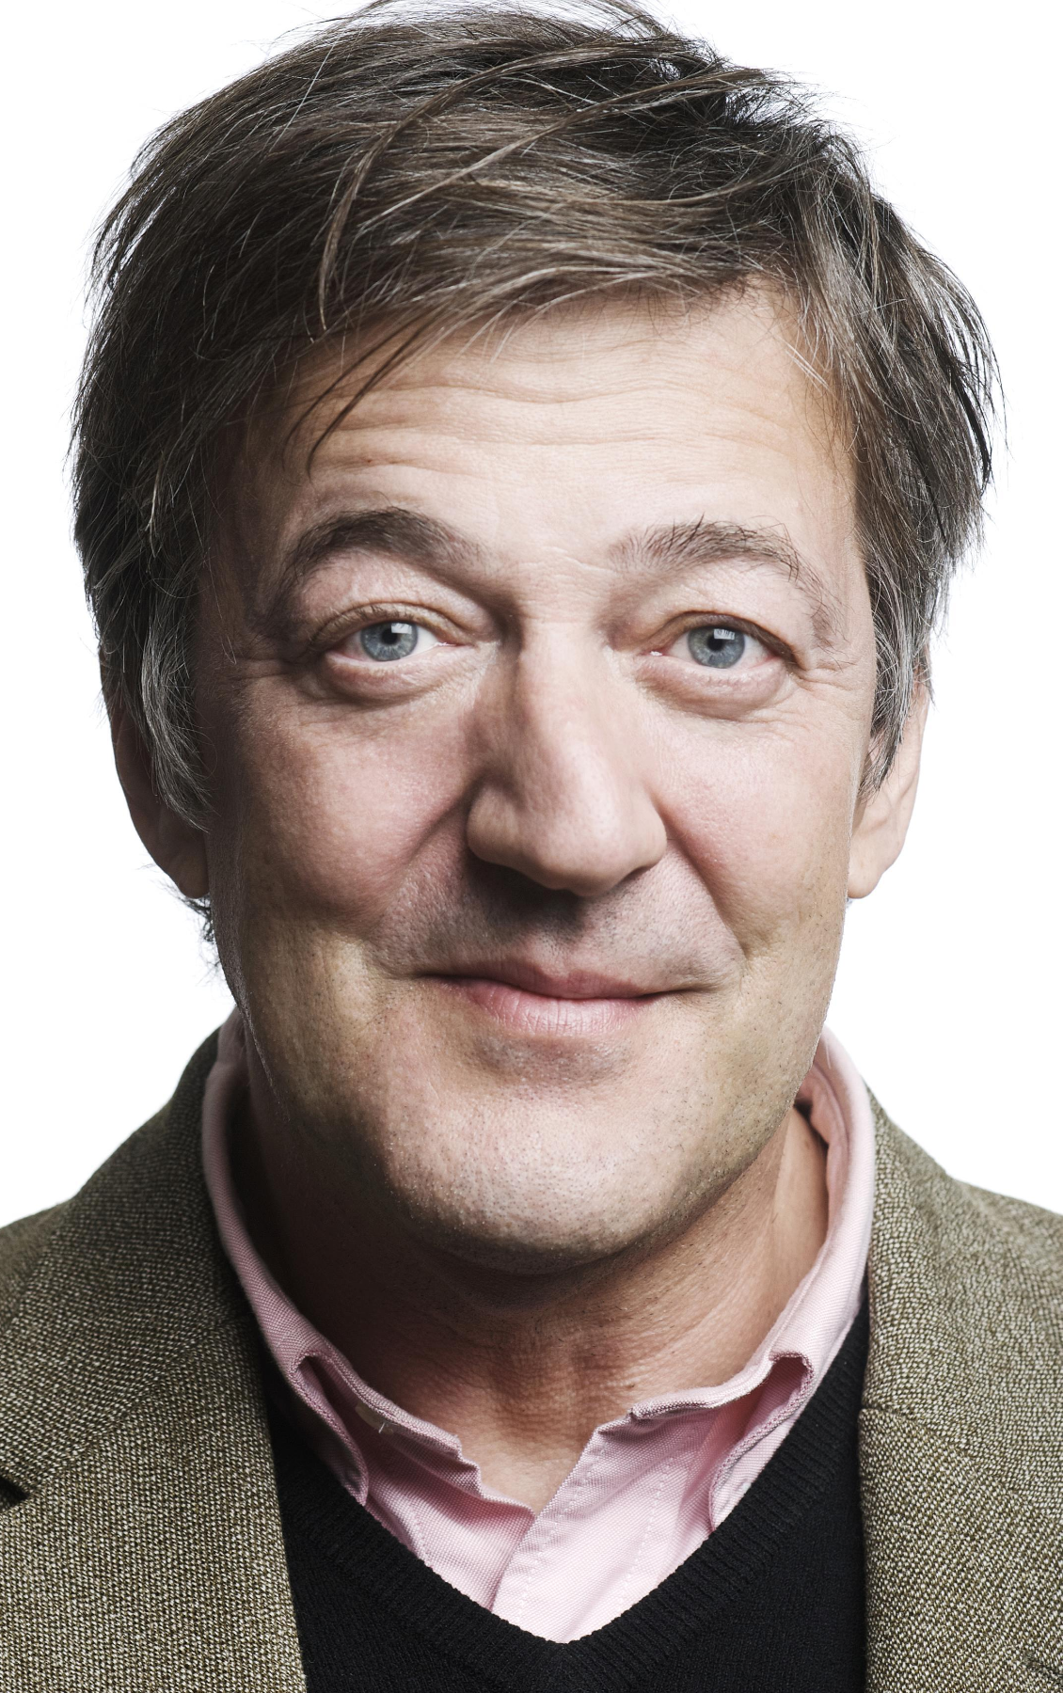
Freedom of belief
‘A humanist is someone who will never tell you what to believe. We will never tell you what is absolutely true. We will never make claims that cannot be proven and that you cannot find out for yourself.’
Stephen Fry, writer and broadcaster

Slide 18
A humanist understanding of the world
Our beliefs can be mistaken and we should be prepared to question them
Science provides the best way of answering questions about the world
The world is a natural place and we should look for natural explanations

