Slide 1
Understanding the world

Slide 2
A humanist approach to life: a summary
Humanists believe the world is a natural place – we should ask questions and look for evidence to help us to understand it (humanists don’t believe in a god)
Humanists believe we should be free to find what makes us happy
Humanists believe we should be kind to other people, animals, and the planet

Slide 3

A humanist understanding of the world
We should ask questions
We should look for evidence
The world is a natural place

Slide 4

Asking questions
How can I cure this disease?
How can I grow more food?
How can I make the world a fairer place?

Slide 5
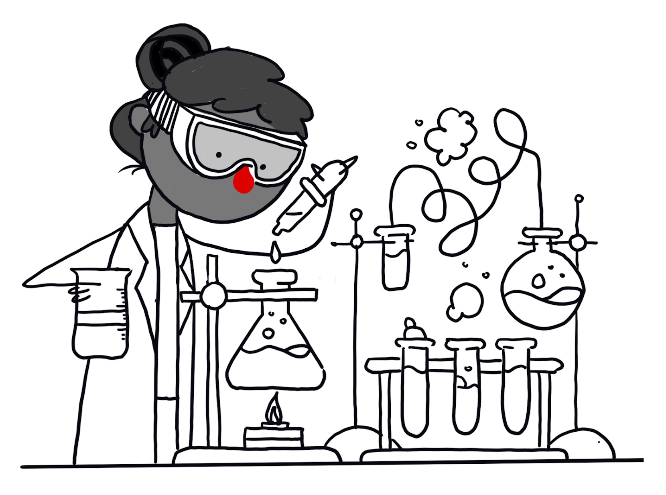
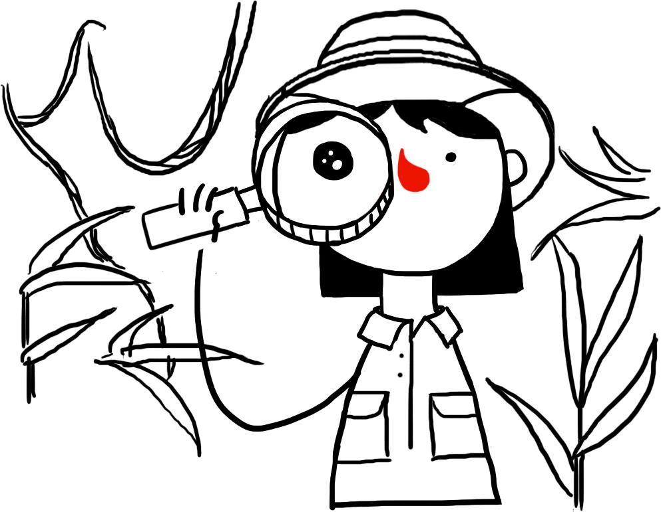
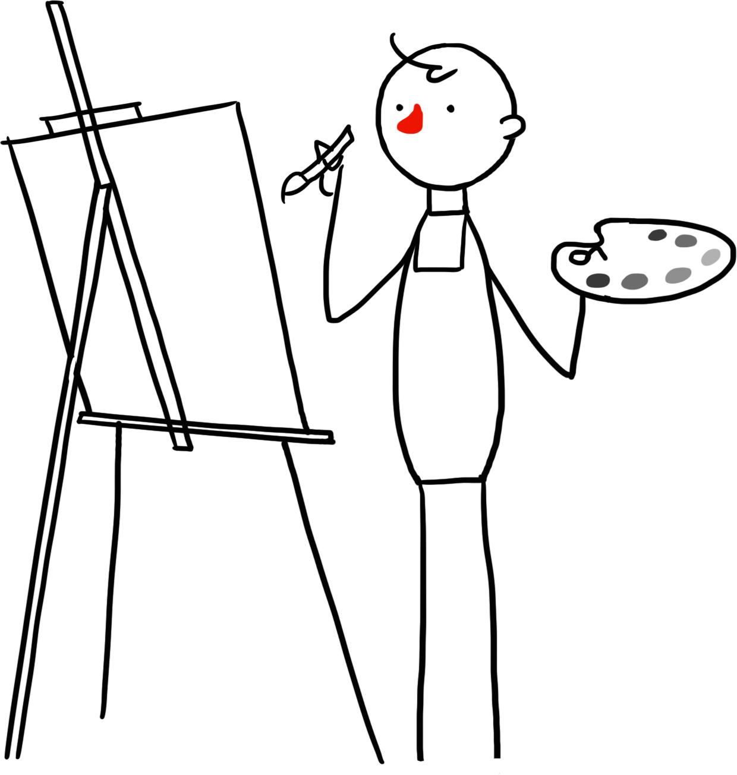

Asking questions

Slide 6
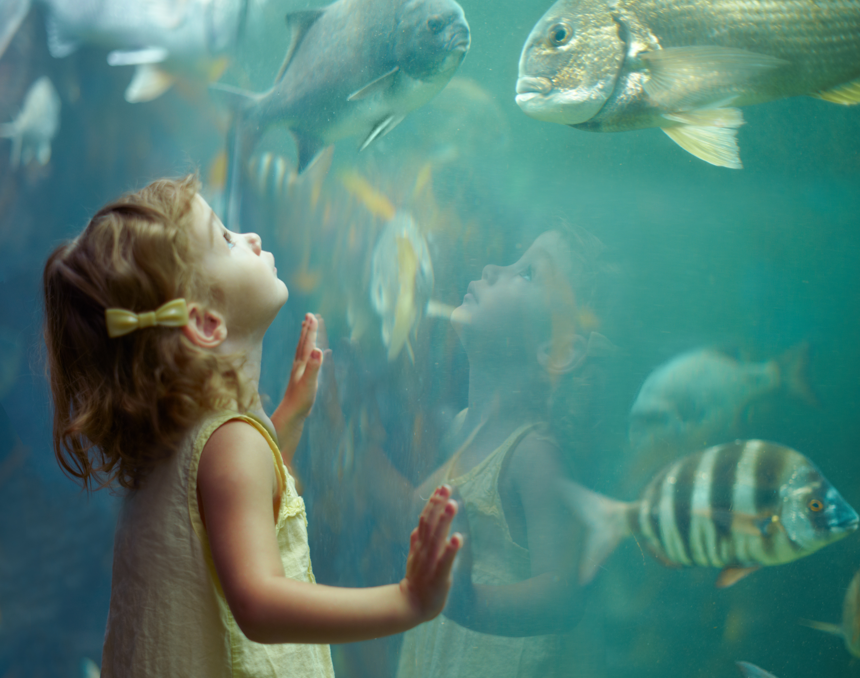

Slide 7
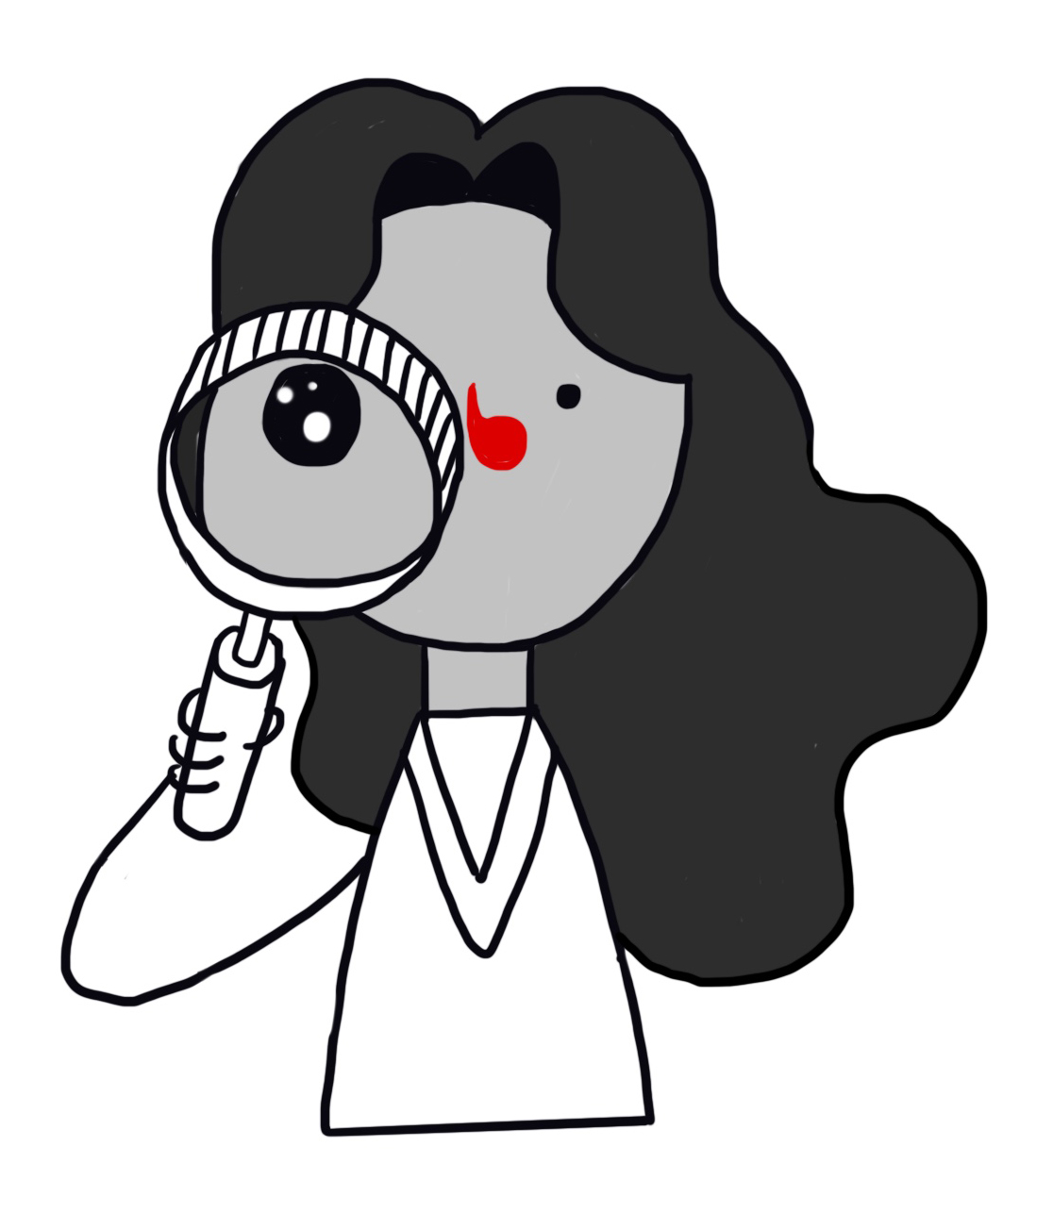
Curiosity and wonder
‘Human beings have this wonderful curiosity, that makes them rather special and rather different from other living creatures.’
Philip Pullman, author
'I think, at a child's birth, if a mother could ask a fairy godmother to endow it with the most useful gift, that gift would be curiosity.'
Eleanor Roosevelt, political activist
‘Learning about the nature of space and time fills me with awe and wonder. It makes me want to learn more.’
Jim al-Khalili, physicist

Slide 8
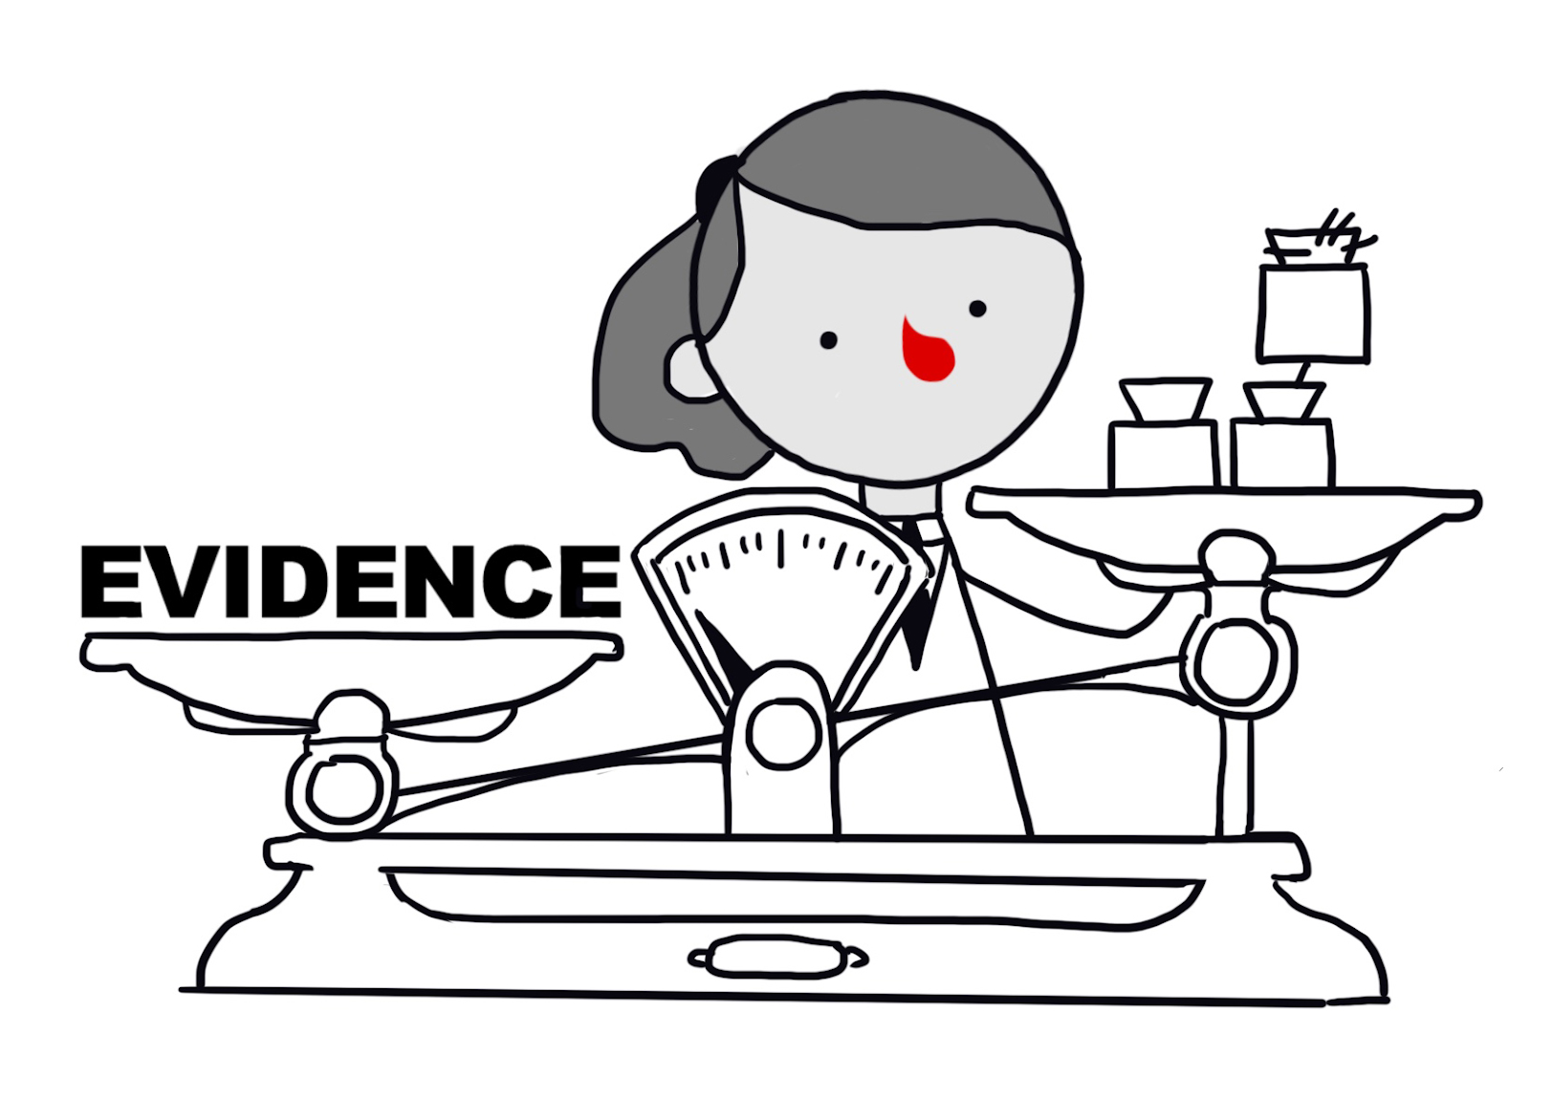

Looking for evidence

Slide 9


Slide 10
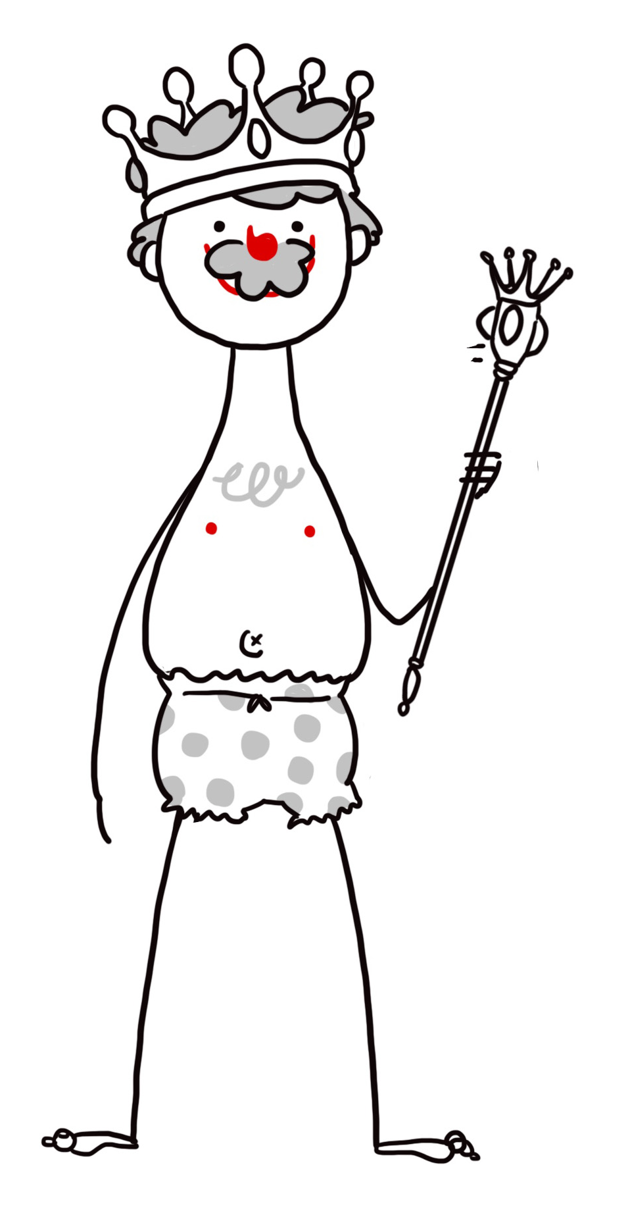
The Emperor’s New Clothes

Slide 11
Understanding the world
How might you look for evidence for these beliefs?
Plants need water to grow
Sugar is bad for your teeth
Elephants are scared of mice

Slide 12



The humanist approach

Slide 13

Humanists believe the world is a natural place

Slide 14
Atheist
= someone who does not believe in god

Slide 15
A humanist understanding of the world
We should ask questions
We should look for evidence
The world is a natural place

