Slide 1
Understanding the world

Slide 2
A humanist approach to life: a summary
Humanists believe science provides the best way to understand the world and we should look for natural explanations for events (humanists don’t believe in a god)
Humanist believe we should be free to shape the one life we have and that we can make our own lives meaningful by seeking happiness in the here and now, and supporting others to do the same
Humanists believe we should use empathy and have a responsibility to consider the impact of our actions on the welfare of other people and animals

Slide 3

A humanist understanding of the world
We should adopt a sceptical approach to the search for knowledge
Science provides the best way of answering questions about the world
The world is a natural place and we should look for natural explanations

Slide 4
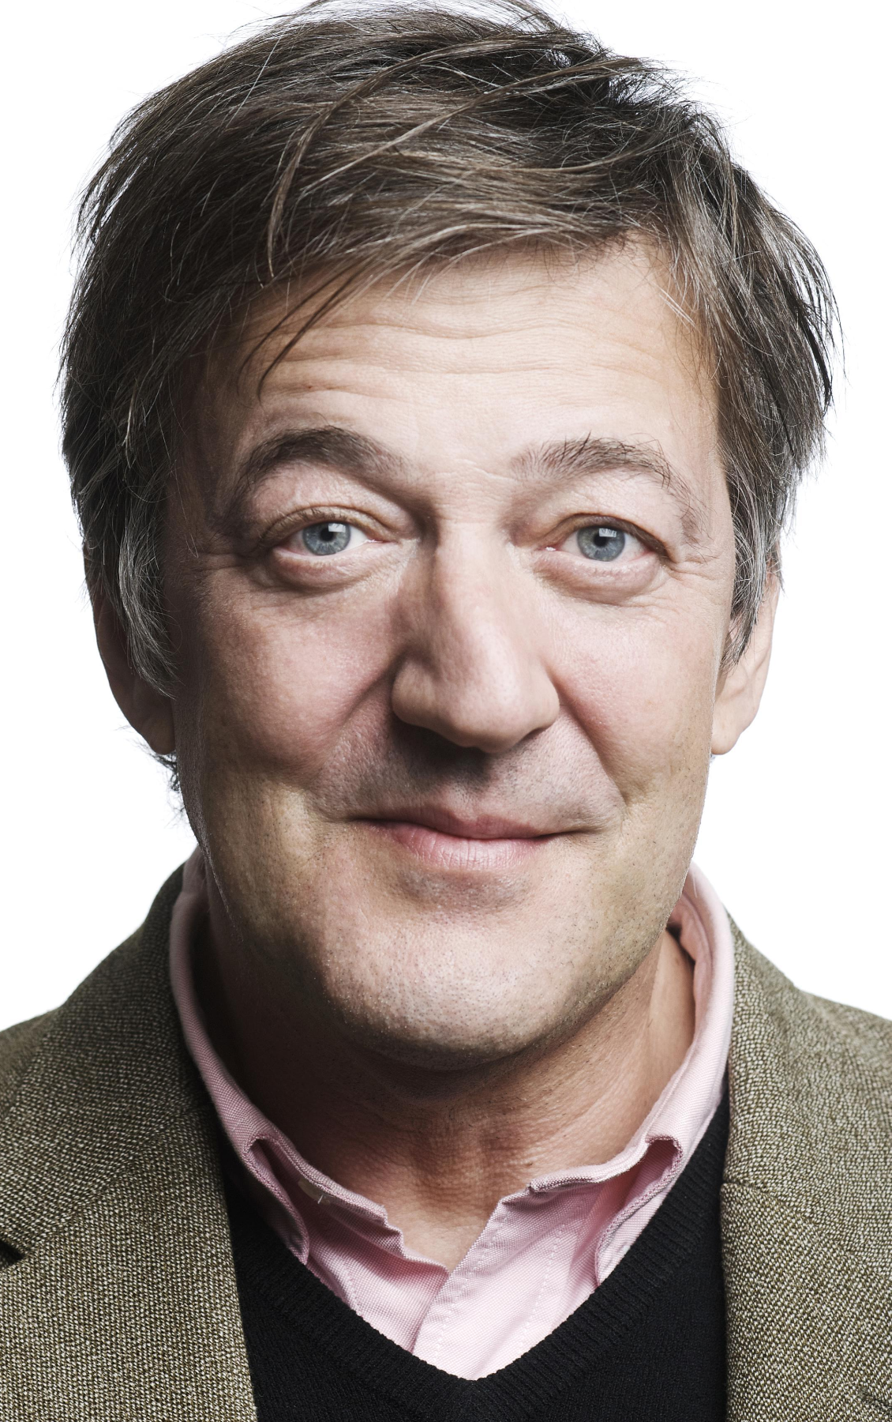
A sceptical approach
‘Scepticism’
= questioning and investigating claims to assess whether they are true or false
‘Humanists do not claim to know, we just ask you to be very wary of those who do claim to know. Who told them? What does their knowledge mean? Why should you trust them? Above all, don’t take my word for it either. Don’t take anybody’s word for it. Find out for yourselves.’
Stephen Fry

Slide 5
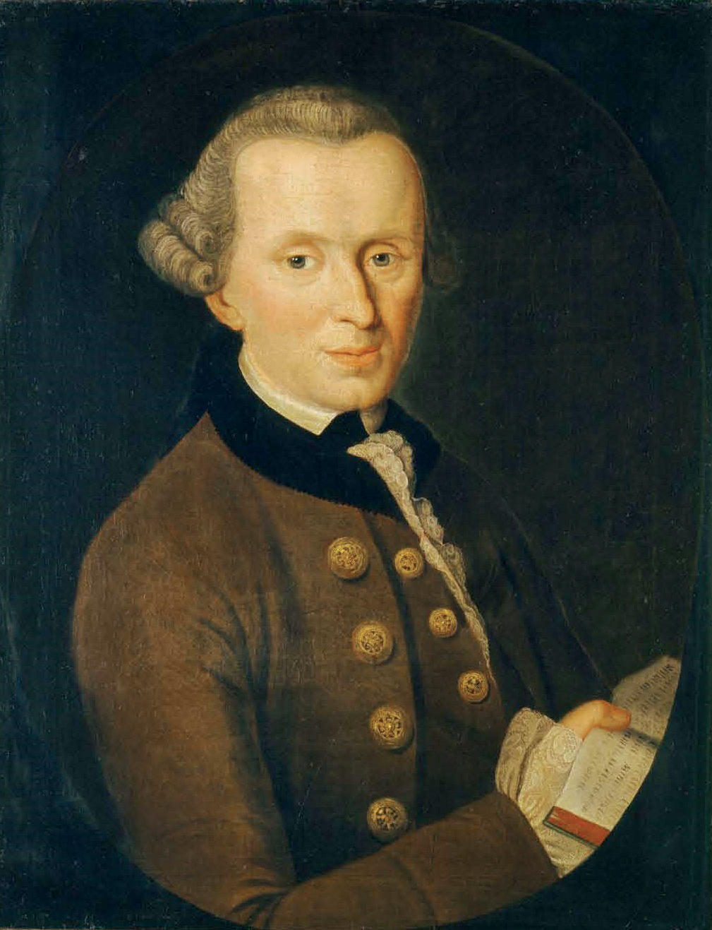
Understanding the world
‘Sapere aude’ =
‘Have the courage to think for yourself’
The philosopher Immanuel Kant’s phrase became the motto of the Enlightenment, a period in history in which many human beings promoted science and reason as the best way to truth.

Slide 6


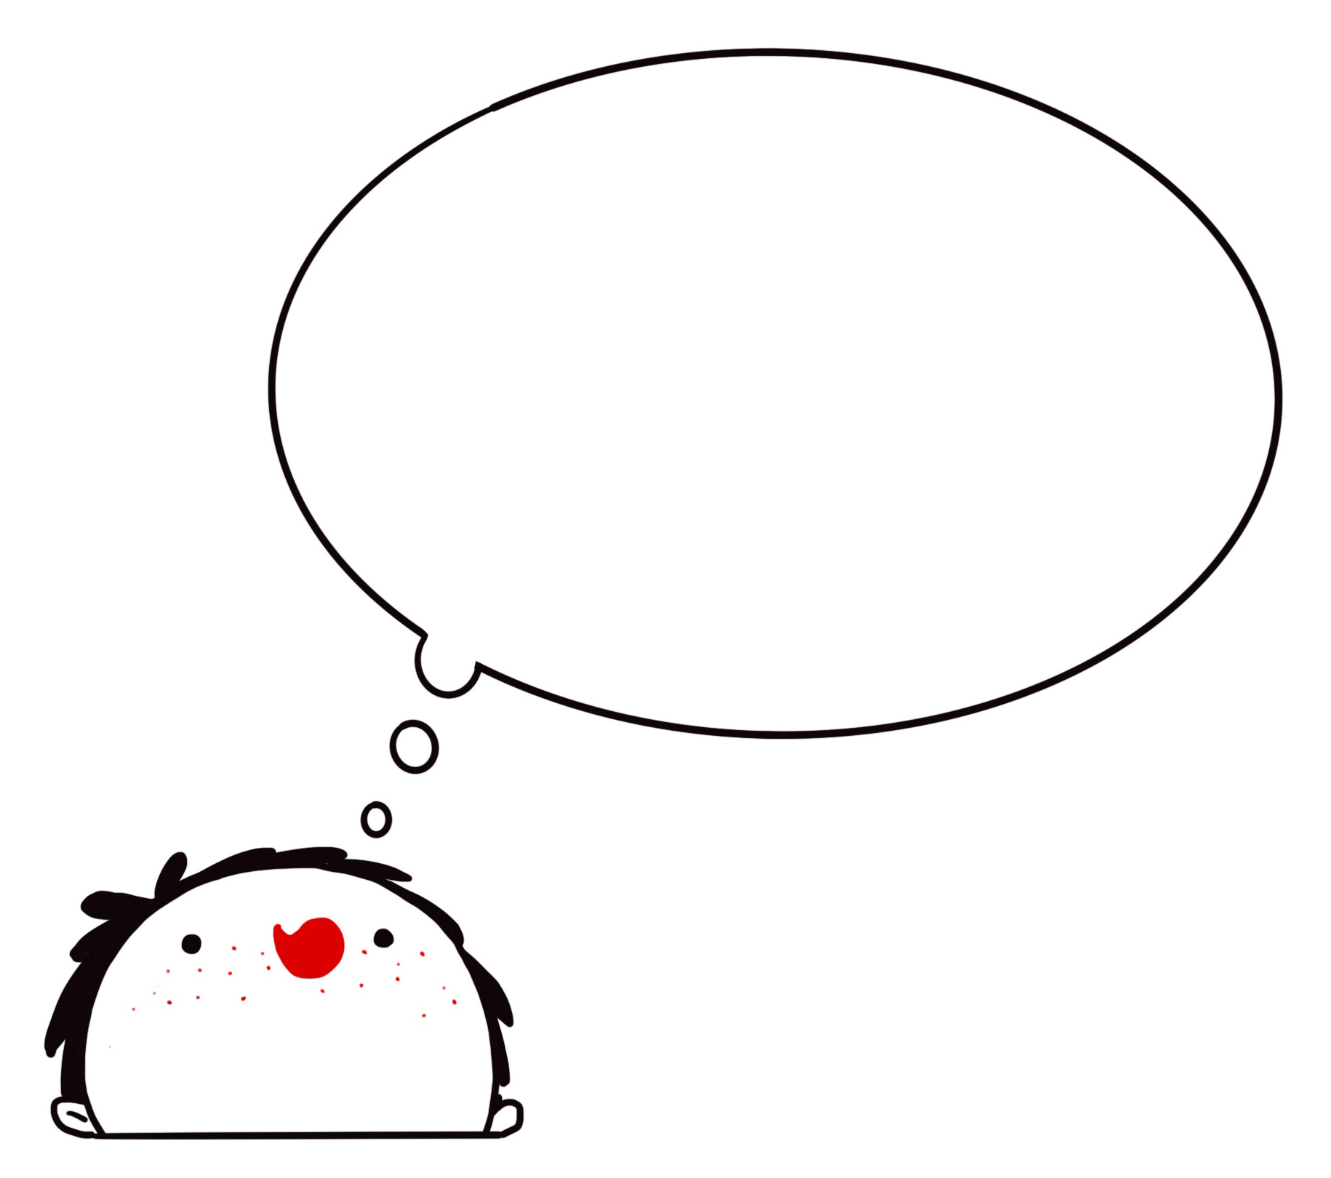
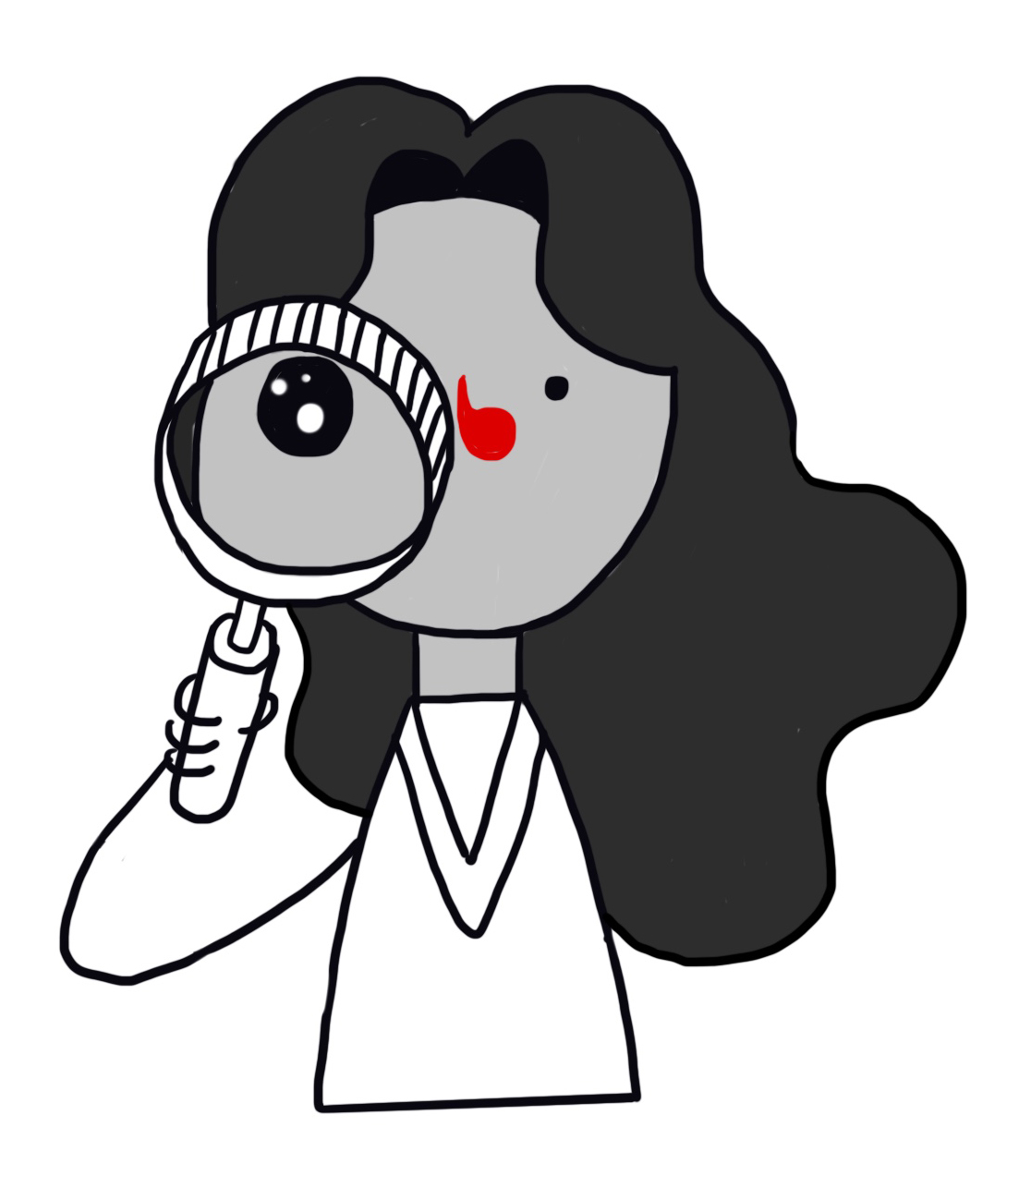
The humanist approach

Slide 7
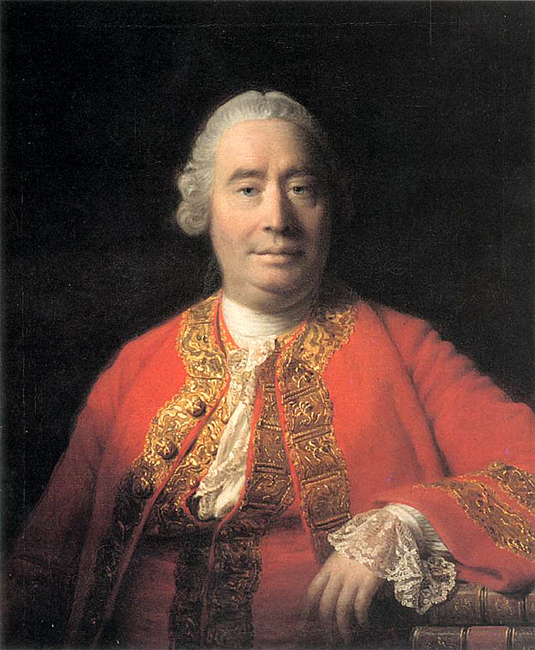
Evidence
‘A wise man proportions his belief to the evidence.’
David Hume, philosopher
(1711–1776)

Slide 8
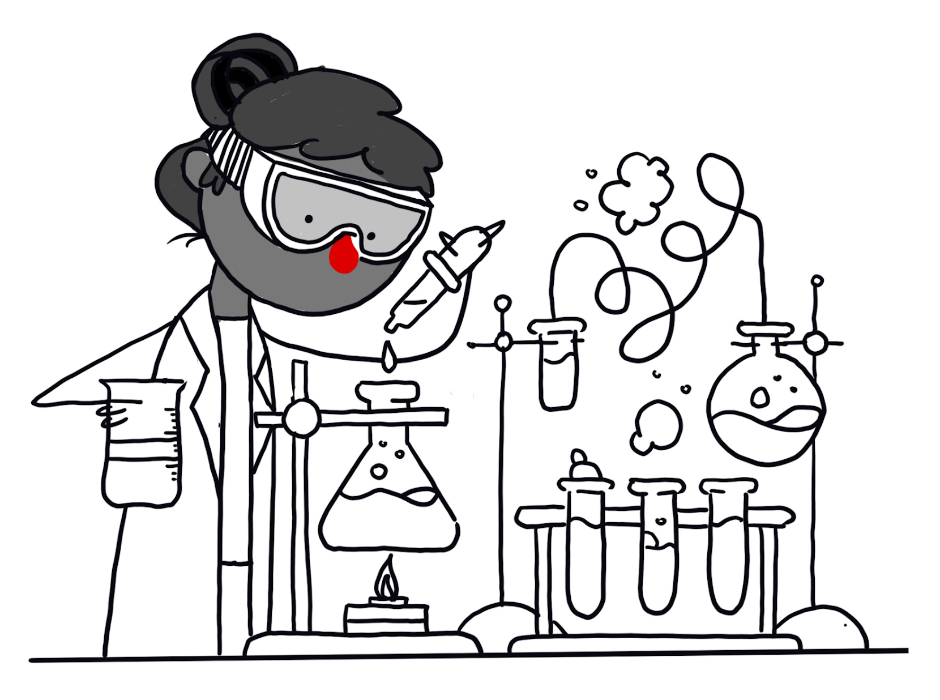
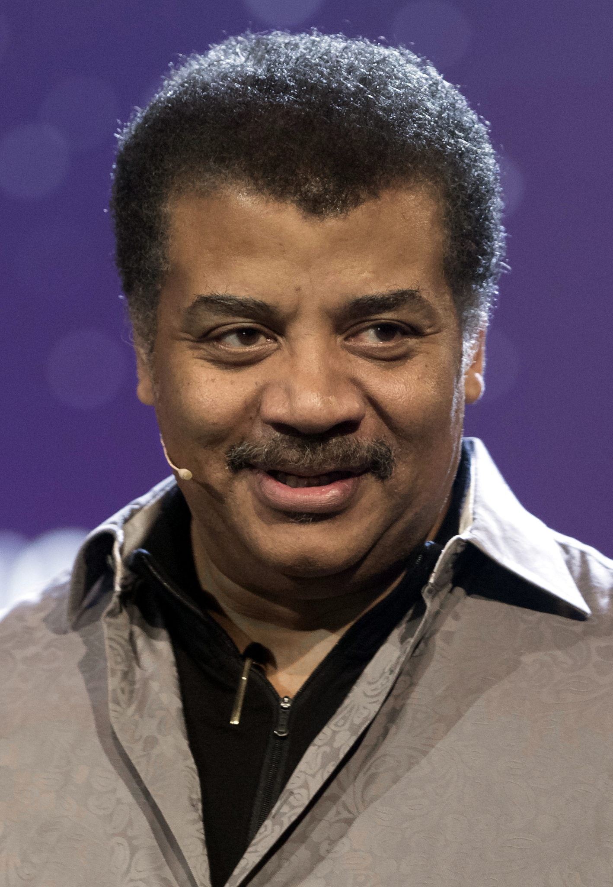
Science
‘The scientific method... can be summarized in one sentence: Do whatever it takes to avoid fooling yourself into thinking something is true that is not.’
Neil deGrasse Tyson, astrophysicist
How science works
(organised scepticism)
Observation
Hypothesis
Prediction
Test (experiment)
Results (evidence)
Conclusion

Slide 9
Understanding the world
Humanists believe we make progress in our understanding by continually asking questions, testing our theories, and checking our results.
They believe wisdom is something that develops over time.
We sometimes need to be comfortable with uncertainty.
‘Science is one of the very few human activities – perhaps the only one – in which errors are systematically criticised and fairly often, in time, corrected. That is why we can say that, in science, we often learn from our mistakes, and why we can speak clearly and sensibly about making progress there.’
Karl Popper, philosopher

Slide 10
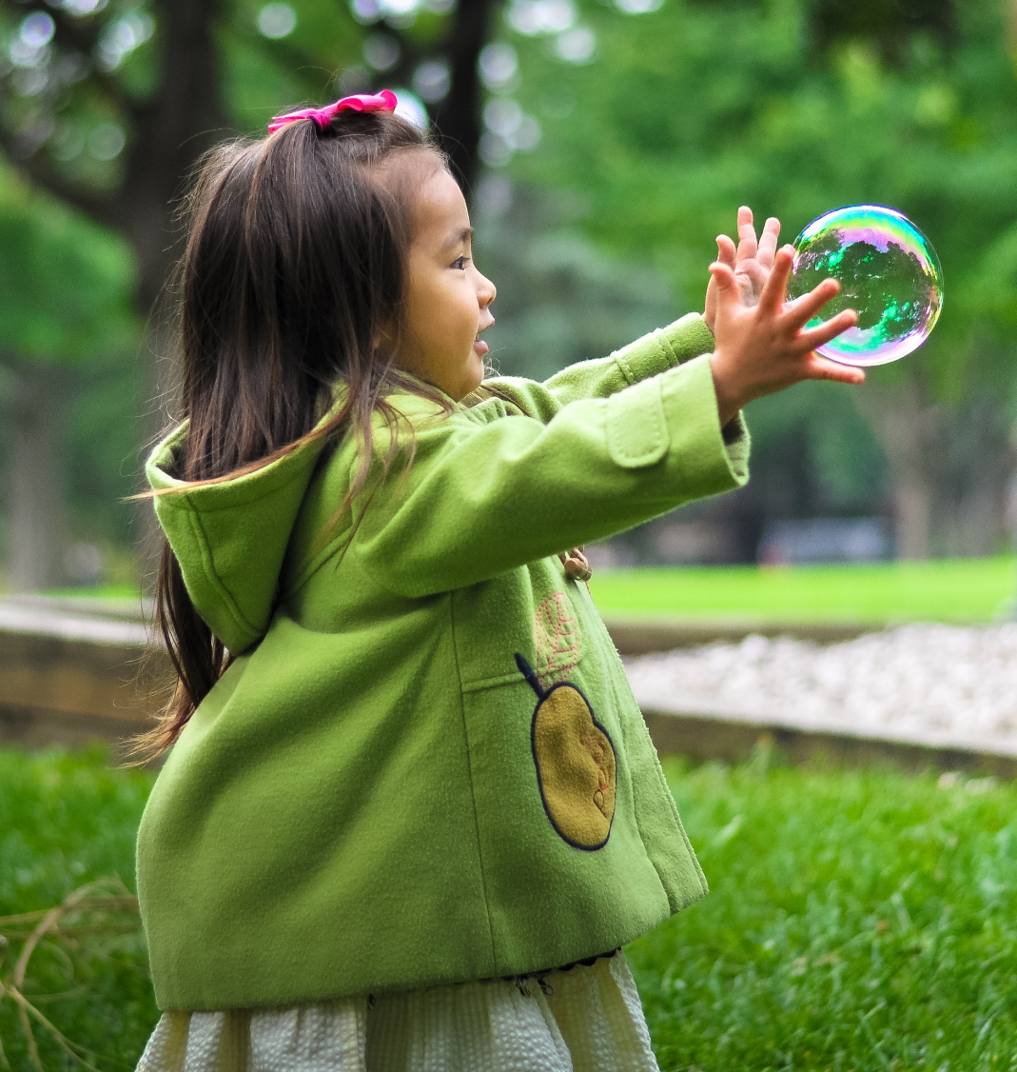
Curiosity and wonder
Curiosity can be one of life’s great pleasures
Science is a source of wonder
‘Learning about the nature of space and time or the structure of atoms fills me with awe and wonder; it makes me want to learn more. I see a beauty in the laws of nature that can be explained by science.’
Jim al-Khalili, physicist
‘I am among those who think that science has great beauty. A scientist in his laboratory is not only a technician: he is also a child placed before natural phenomena which impress him like a fairy tale…’
Marie Curie, chemist

Slide 11

Humanists believe the world is a natural place
We should always look for natural explanations

Slide 12
Supernatural
Humanists avoid explanations that rely on supernatural beings or forces
Supernatural =
Something above, outside, or beyond the natural world
Something beyond scientific understanding or the laws of nature

Slide 13
‘Atheist’ = somebody who does not believe in a god
‘Agnostic’ = somebody who accepts we can’t know whether a god exists or not

Slide 14
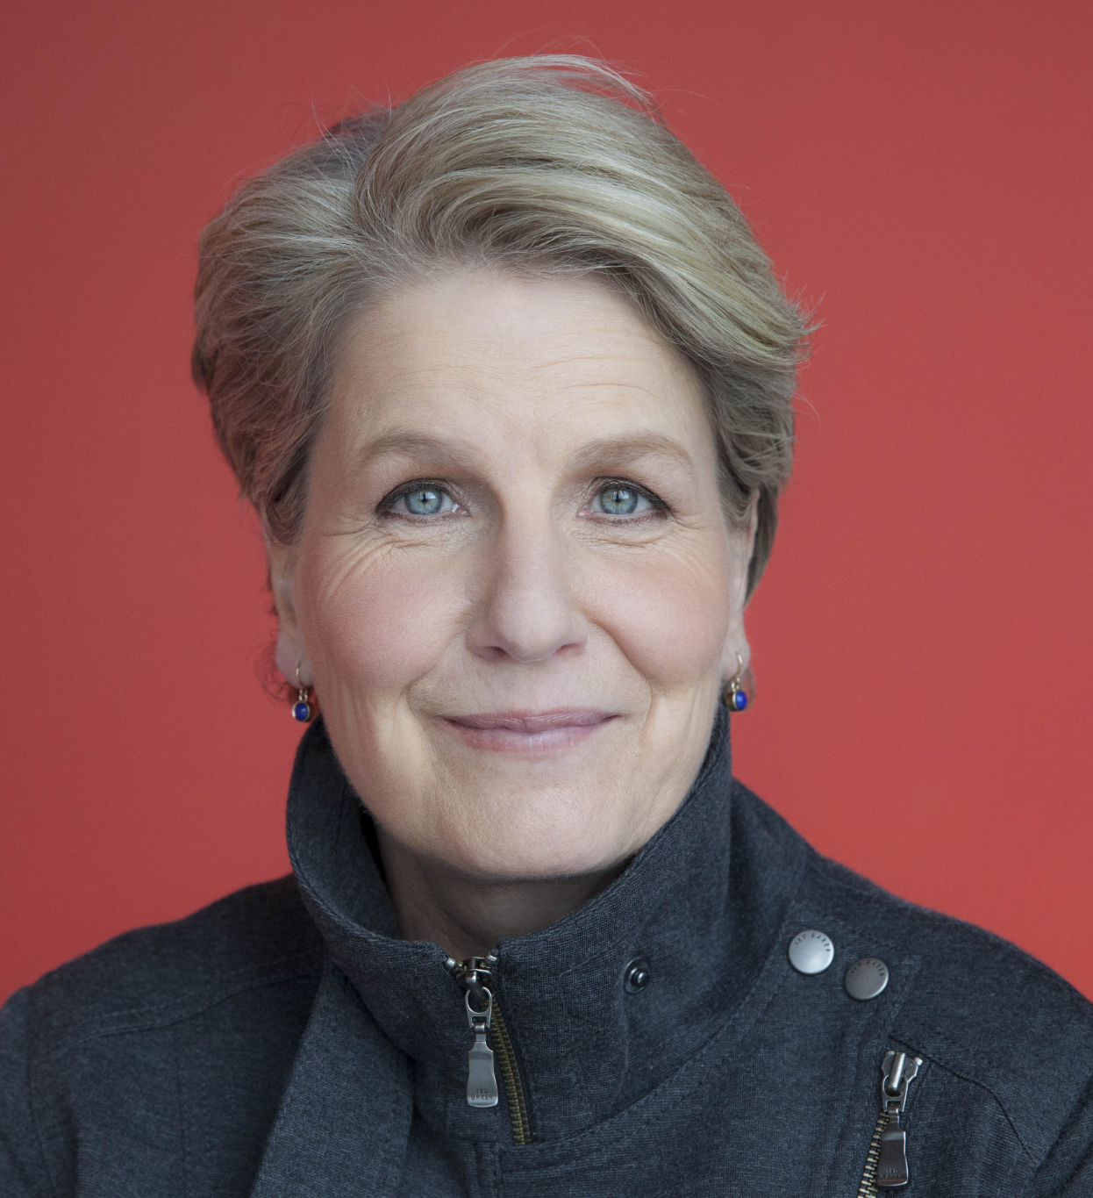
Understanding the world
‘Could the humanist understanding of reality be wrong? Of course. But, the more important question for humanists is not ‘Is this definitely true?’ but ‘Is this probably true?’
Sandi Toksvig

Slide 15


Slide 16
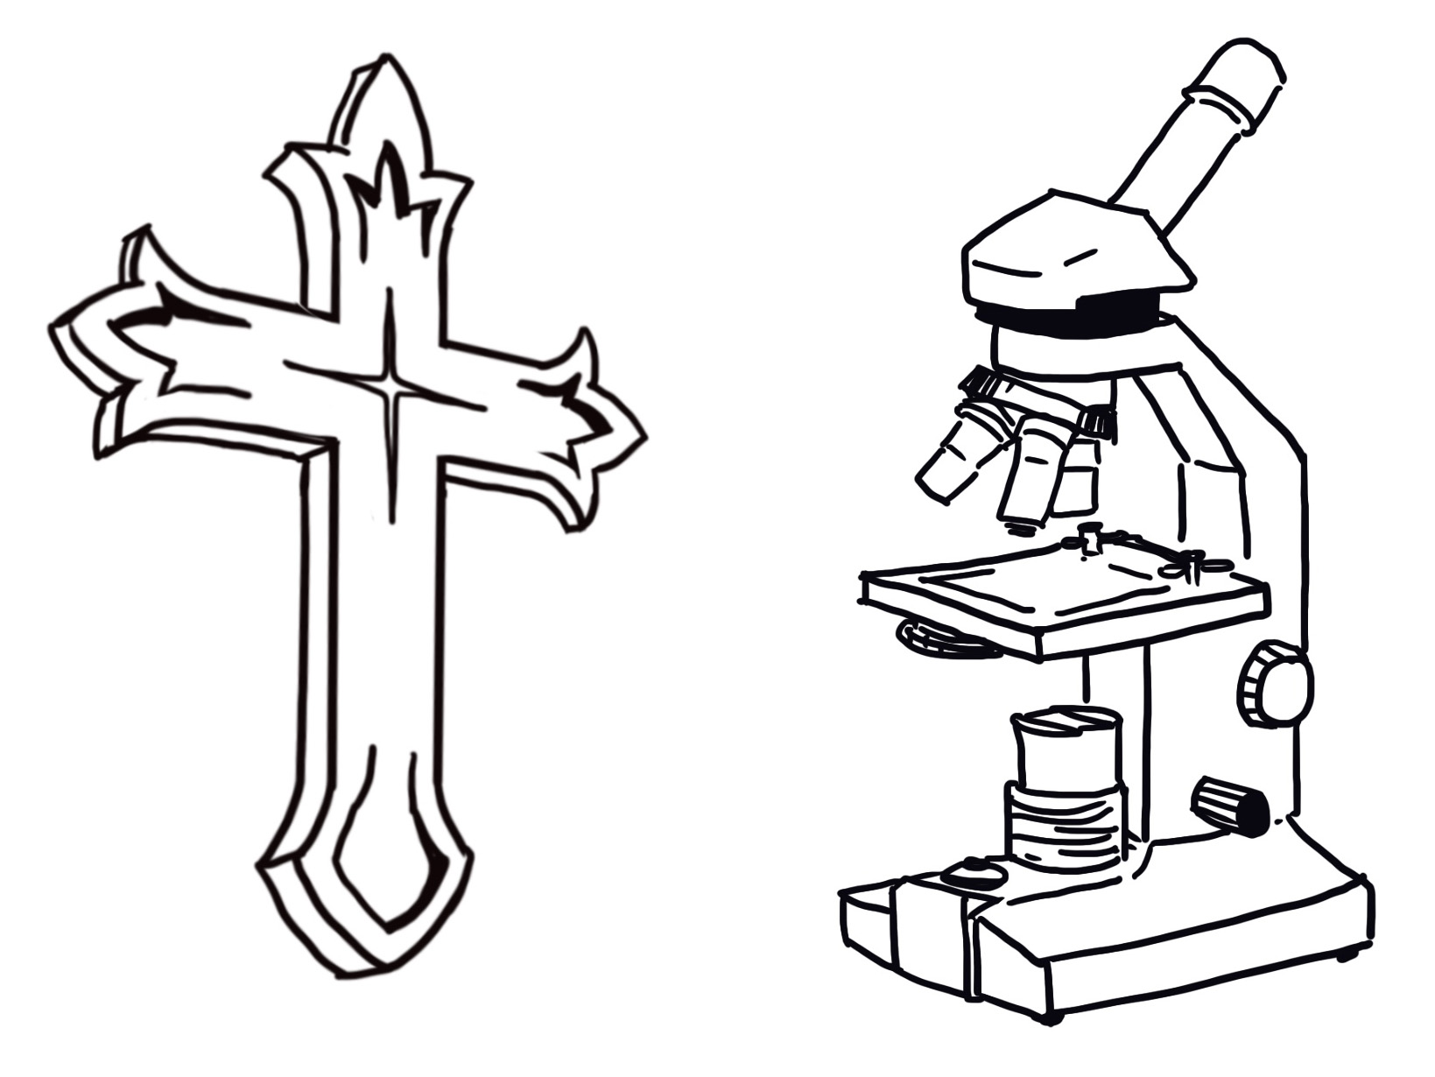
Religion and science / religion and humanism
Types of questions:
Questions science has answered
Questions science might possibly answer in the future
Questions which science cannot answer
Do we need religion to answer the questions science cannot answer or can we rely on other resources?

Slide 17
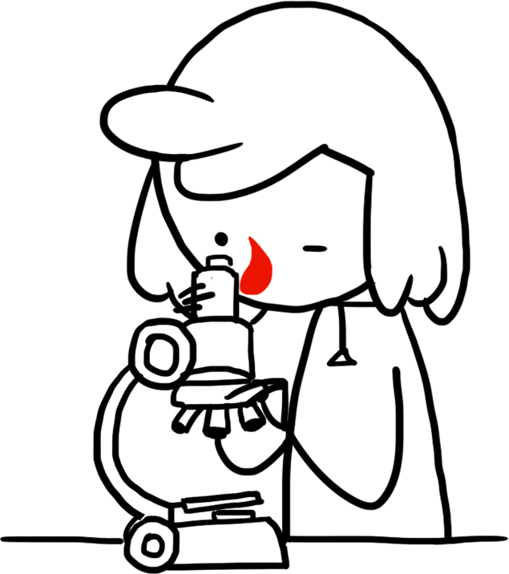

Religion and science / religion and humanism
The humanist approach = science and philosophy, literature, the arts, and history
(Relying on human thought and experience without the need for religion)

Slide 18
Understanding the world: humanist responses
How might a humanist respond to these statements?
Science does not give us certainty so there’s no point even trying to answer questions about the world.
There are still many things we can’t explain so there must be a mysterious, supernatural side to reality
We need religion to answer the questions that science can’t answer

Slide 19
A humanist understanding of the world
We should adopt a sceptical approach to the search for knowledge
Science provides the best way of answering questions about the world
The world is a natural place and we should look for natural explanations

