Slide 1
The one life

Slide 2
A humanist approach to life: a summary
Humanists believe the world is a natural place and science gives us the best way to understand it (humanists don’t believe in a god)
Humanists believe we should be free to make the most of the one life we have, seeking happiness and supporting others to do the same
Humanists believe we should use empathy and consider the impact of our actions on other people and animals

Slide 3

The humanist approach to living a happy life
We have one life and we should make the most of it
Everyone should have the freedom to pursue what makes them happy, as long as they cause no harm
We should be tolerant of those whose choices are different from our own

Slide 4

A HUMANIST SYMBOL
What does this symbol look like to you?
What does it make you think of?
When might you stand like that?
Why do you think humanists organisations choose to use this symbol?

Slide 5






THE HAPPY HUMAN

Slide 6
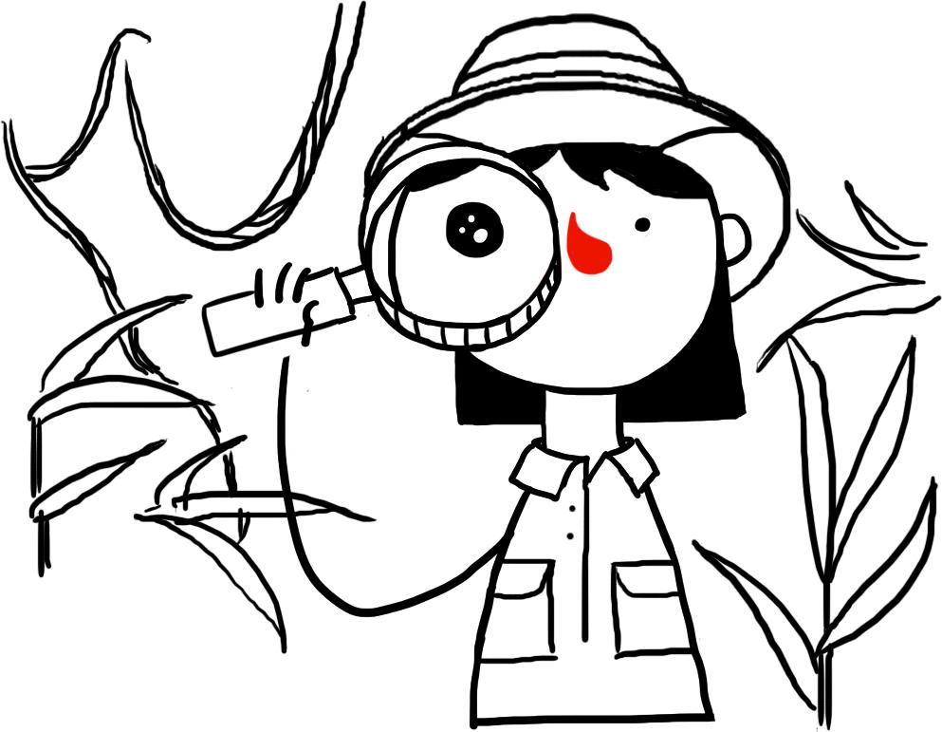
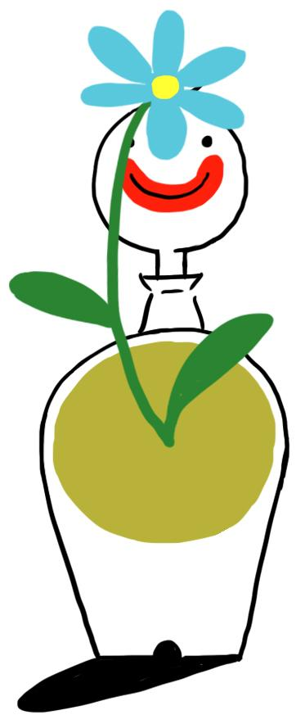
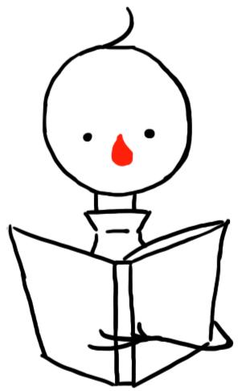
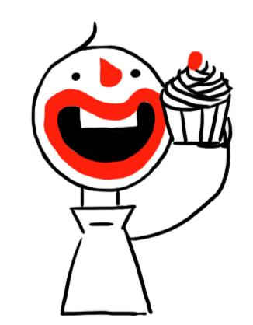

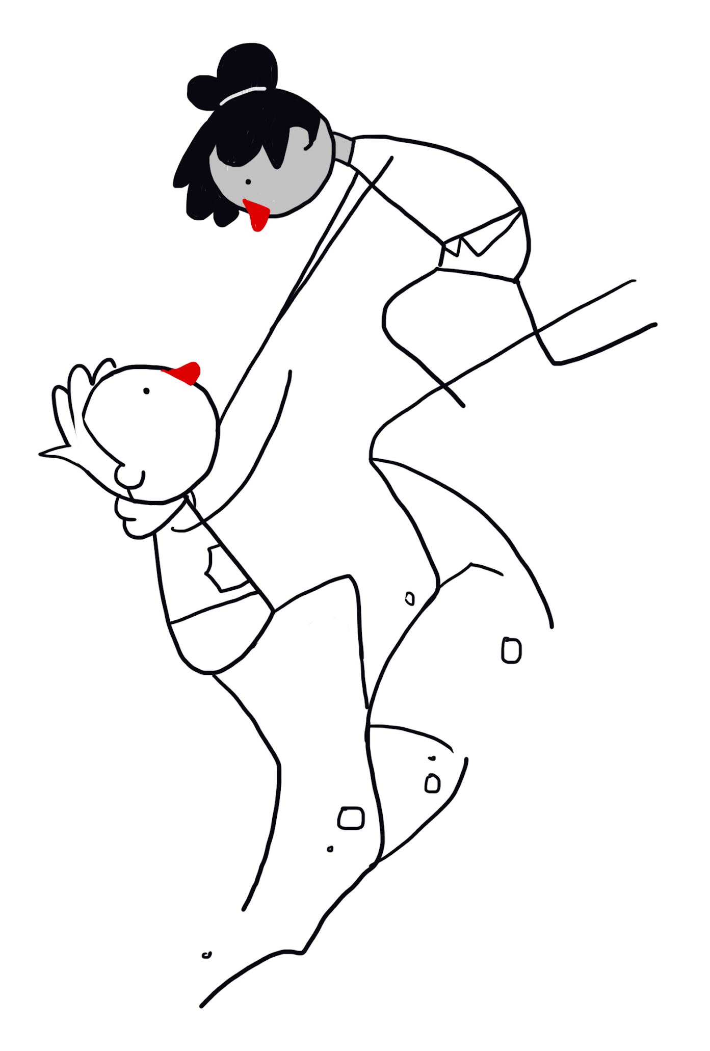

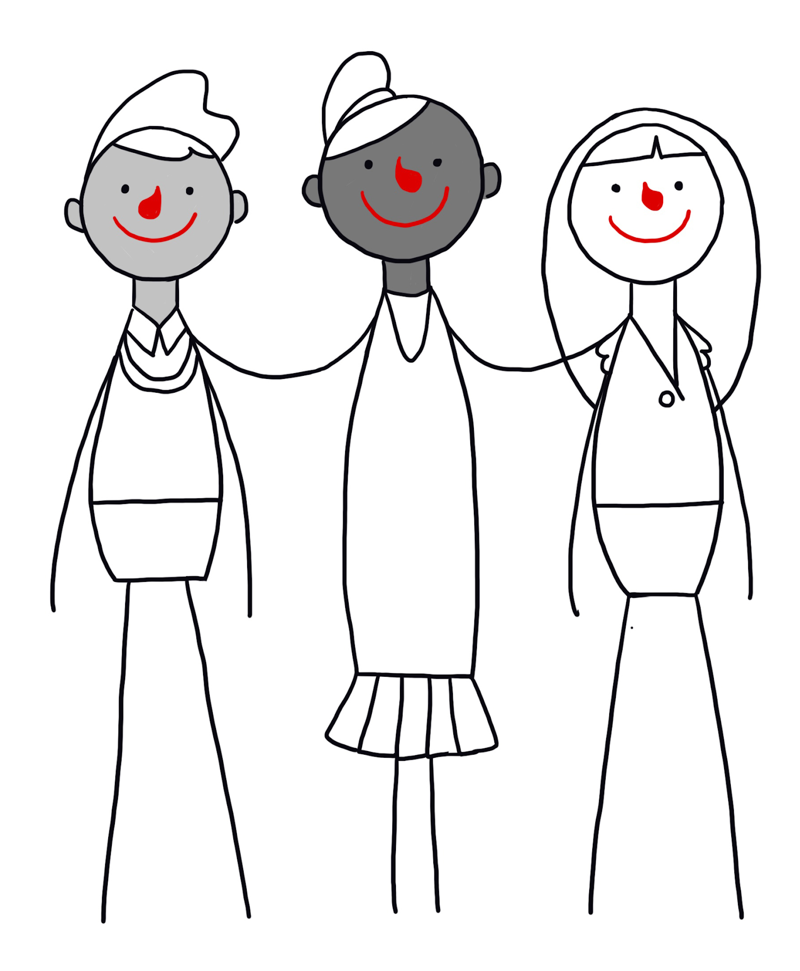
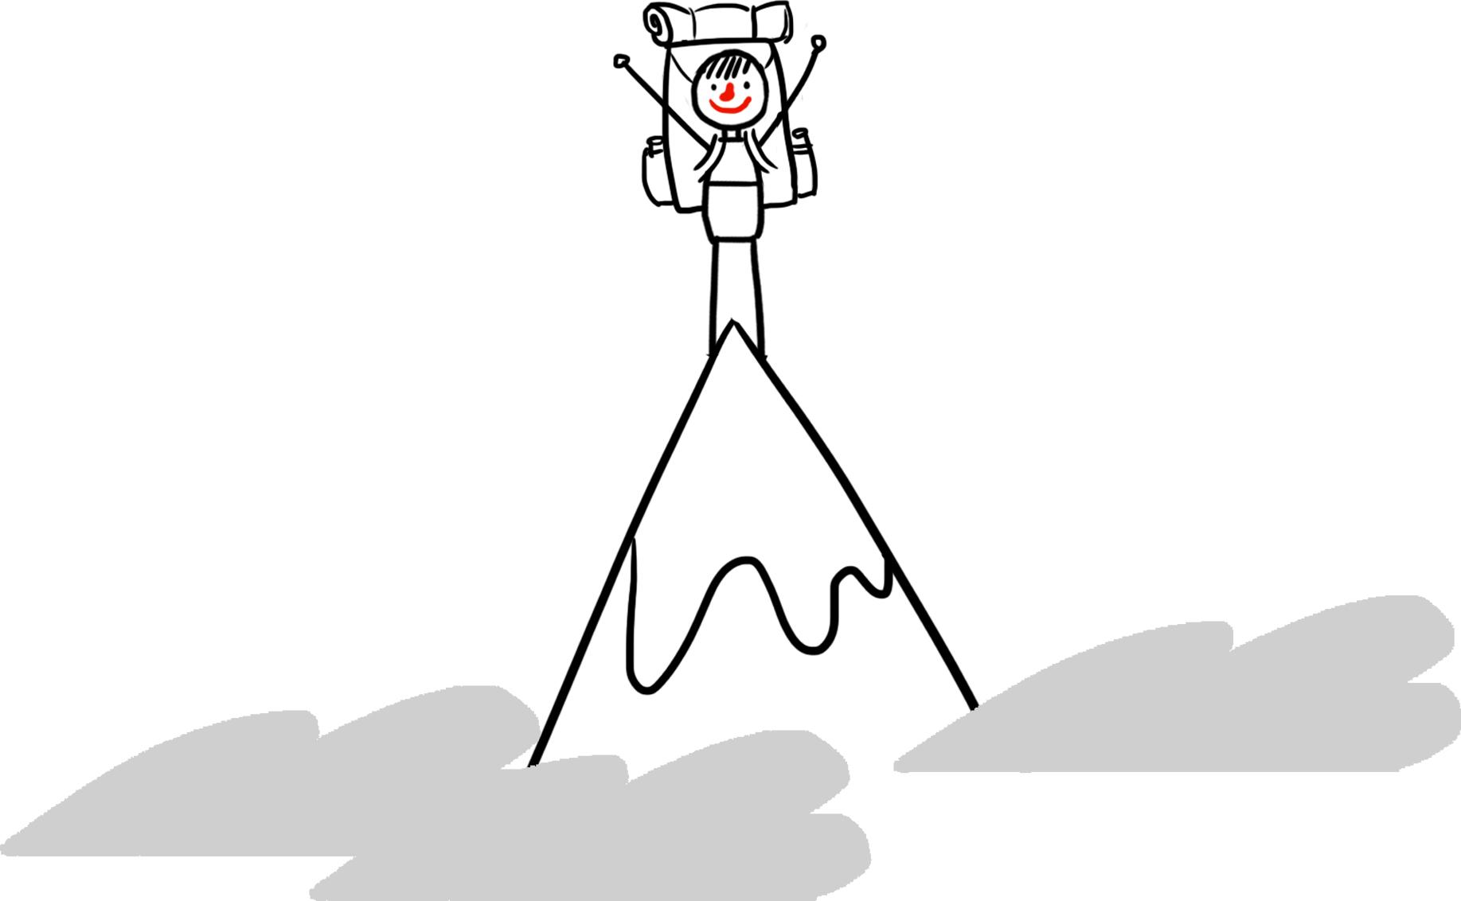

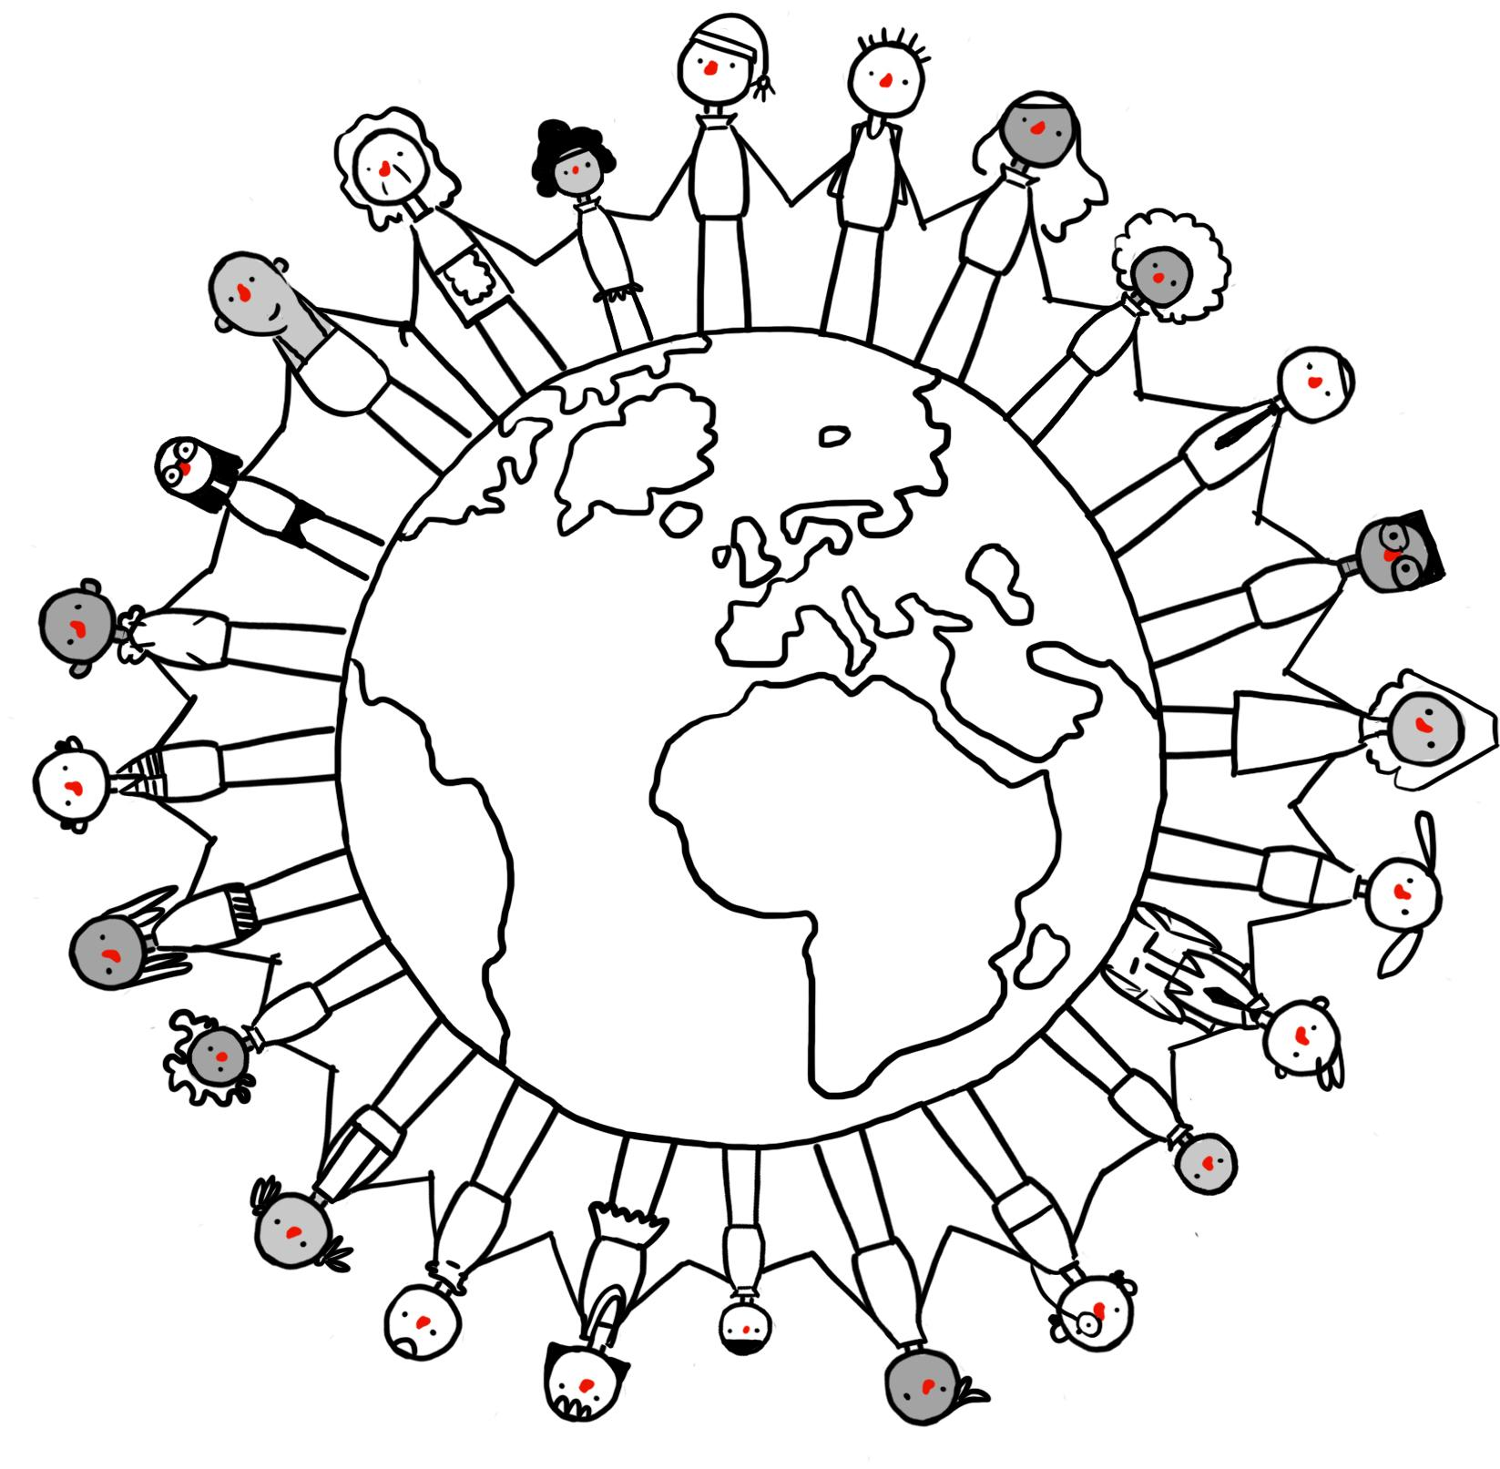
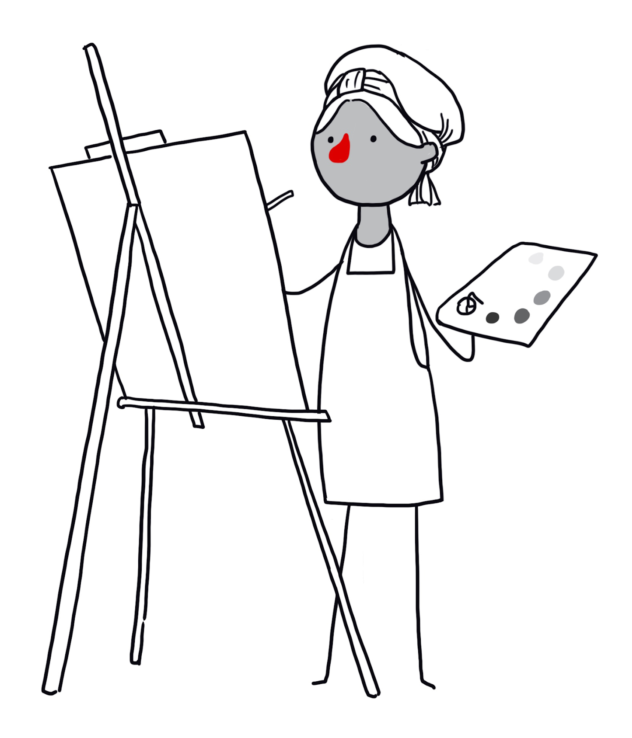
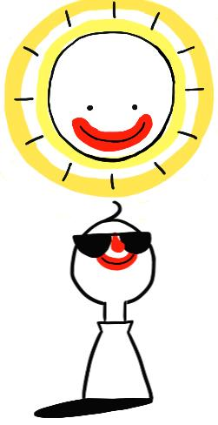
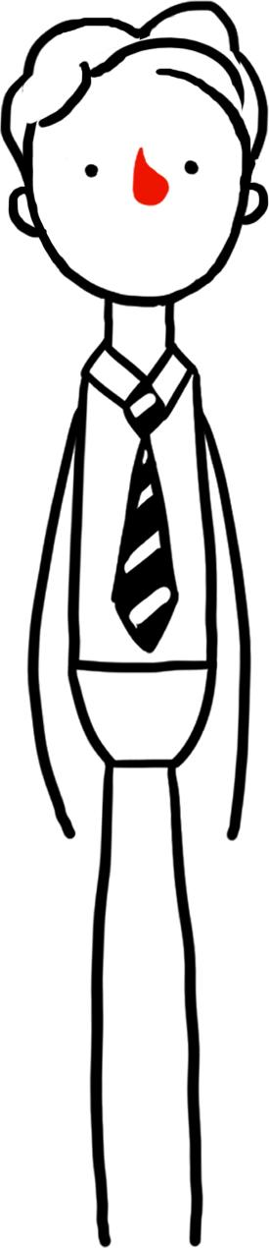
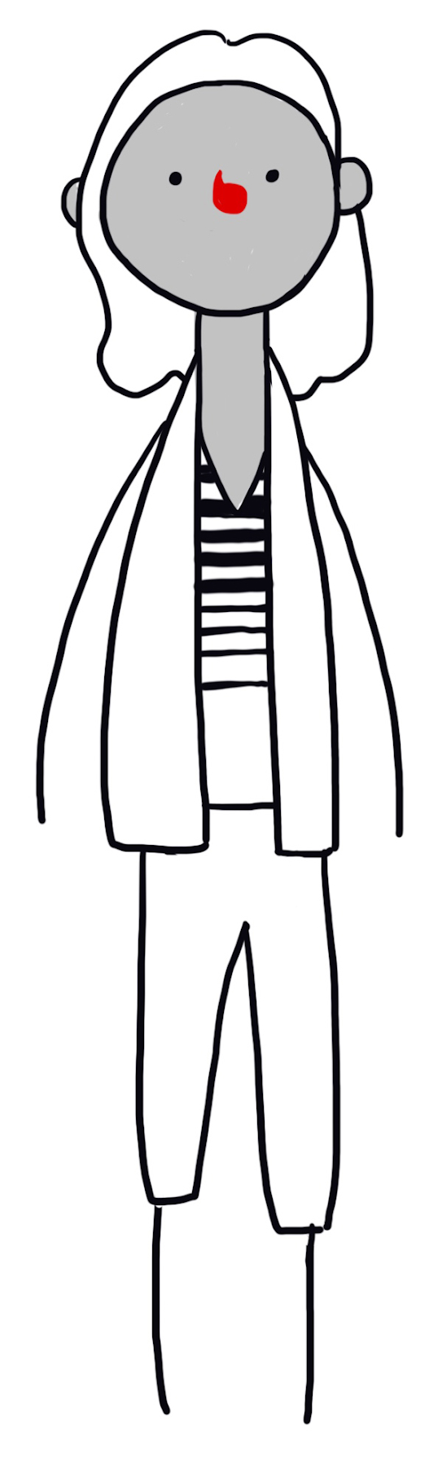
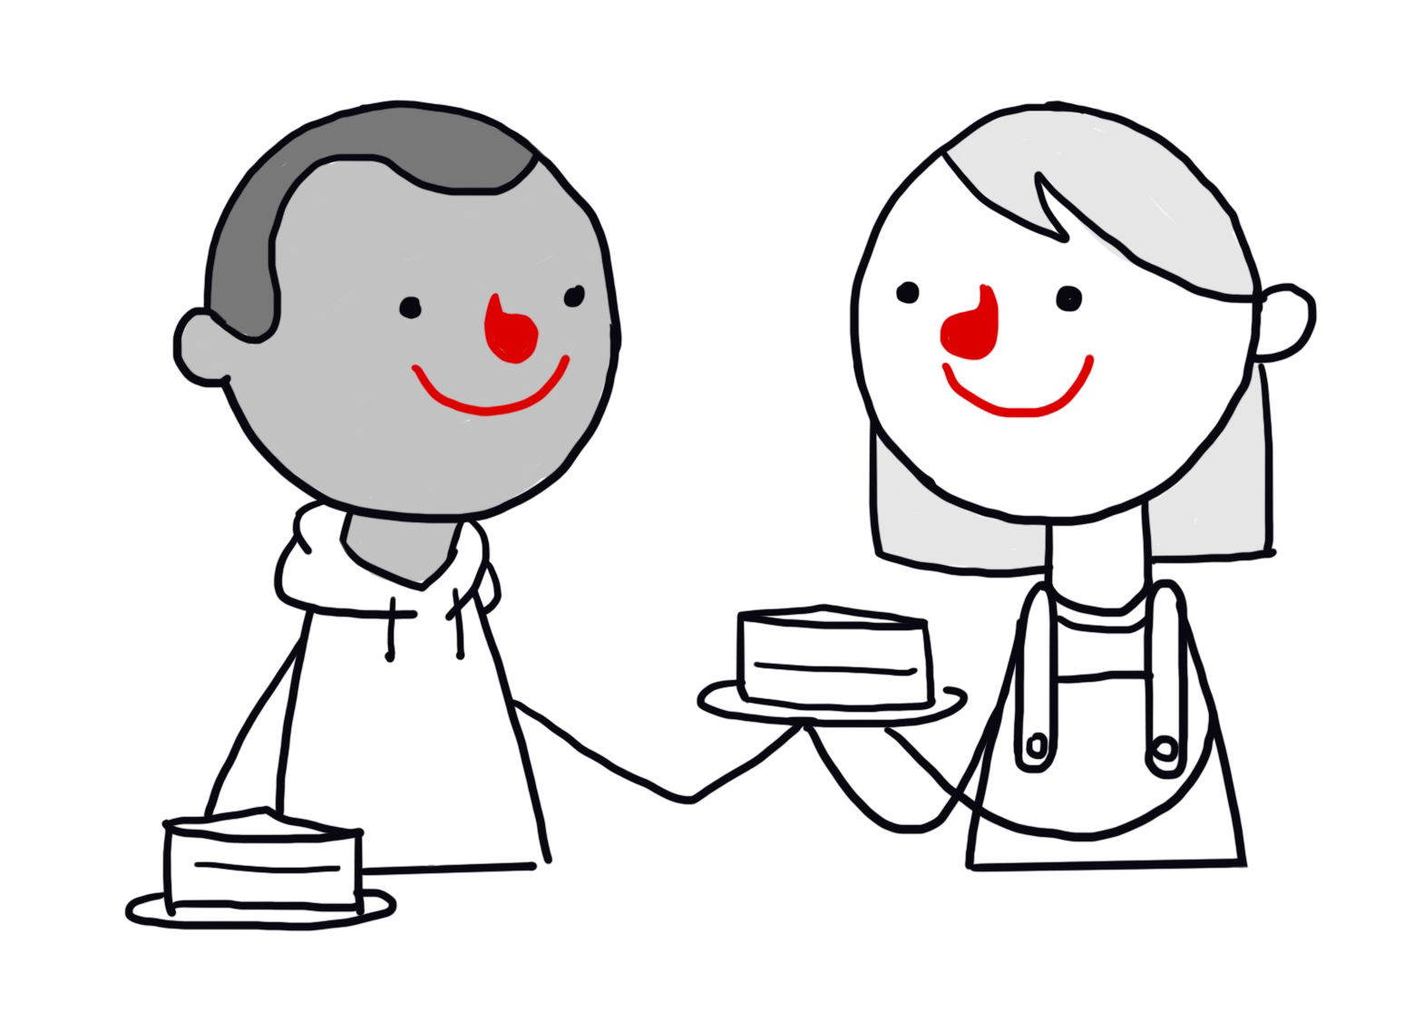
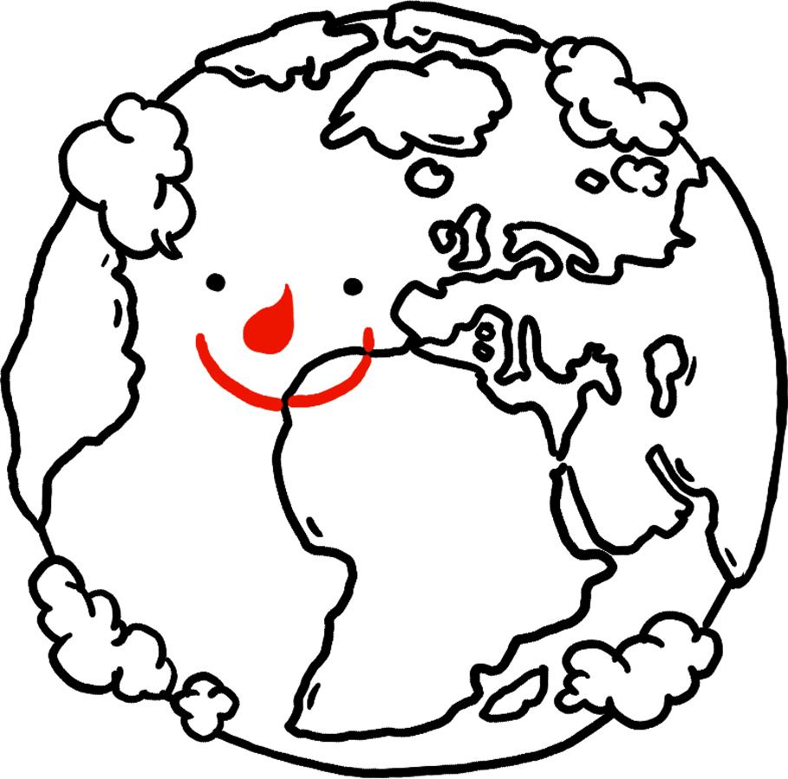

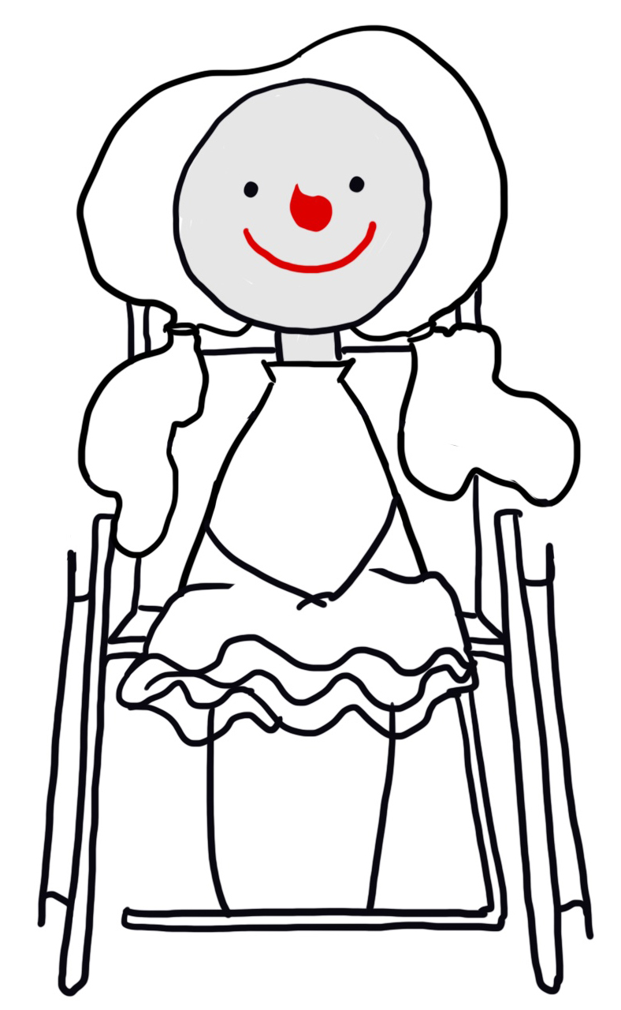
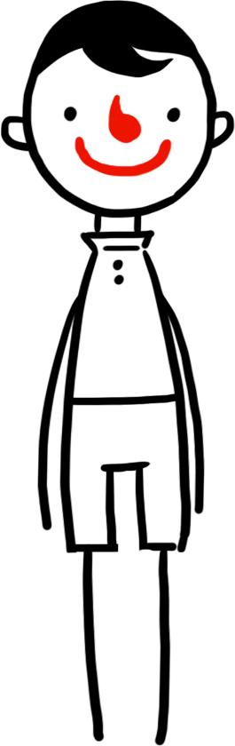
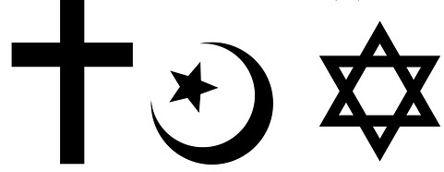
POSSIBLE INGREDIENTS OF HAPPINESS
£

Slide 7
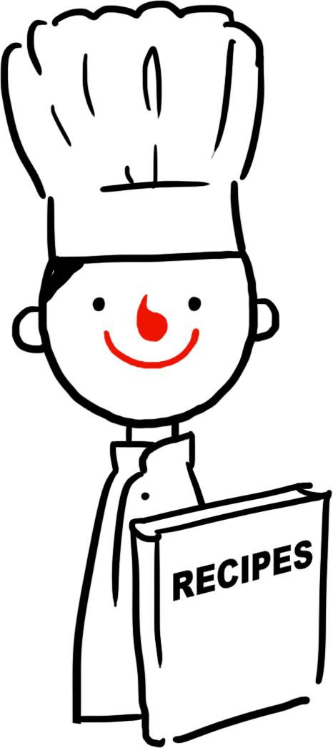
RECIPE FOR A HAPPY LIFE
Ingredients:
Good health
Friends
Being good to other people
Curiosity
Method:
First, add a heaped tablespoon of good health to a bowl (stir it gently in order to avoid damaging it). Add a healthy mix of good friends (as many as you can manage but don’t spread them too thinly). Most importantly, stir in a large cup of kindness towards others. Before you bake, sprinkle a dusting of curiosity on top to add a little surprise to the finished flavour.
Warning:
Money can help sweeten the mixture, but be sure to avoid letting it overpower the other ingredients or your happiness might turn sour.
Can your write your own recipe?

Slide 8
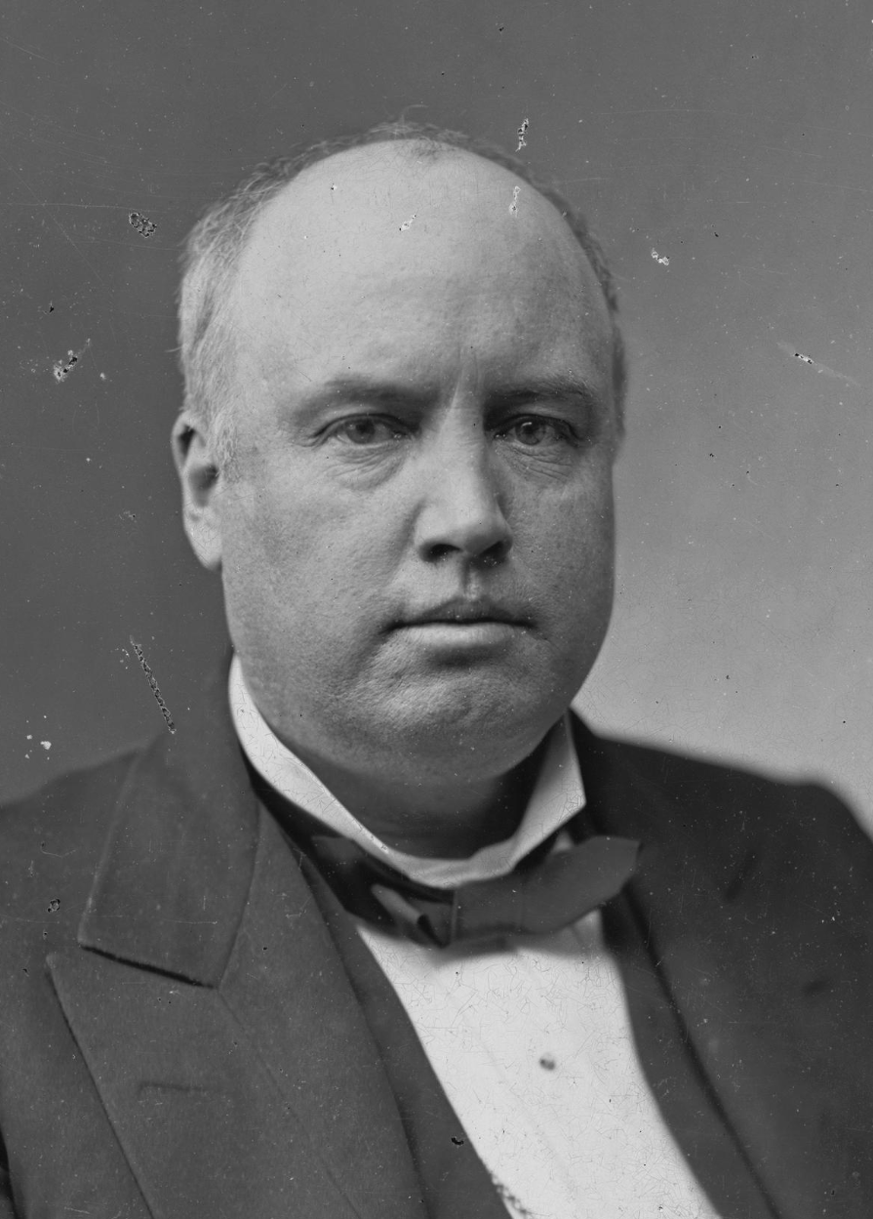
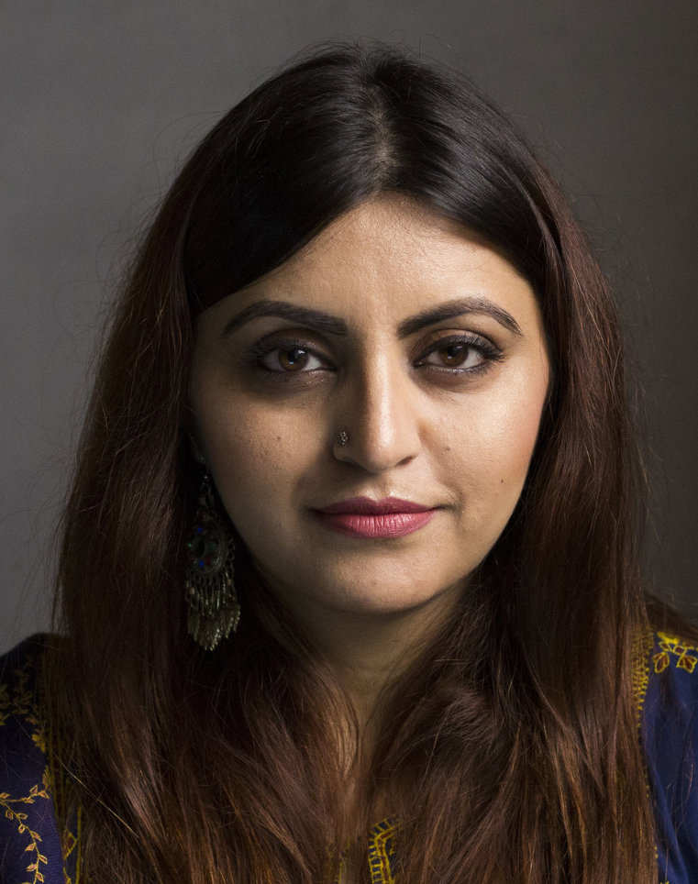
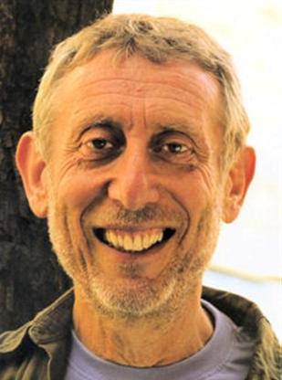
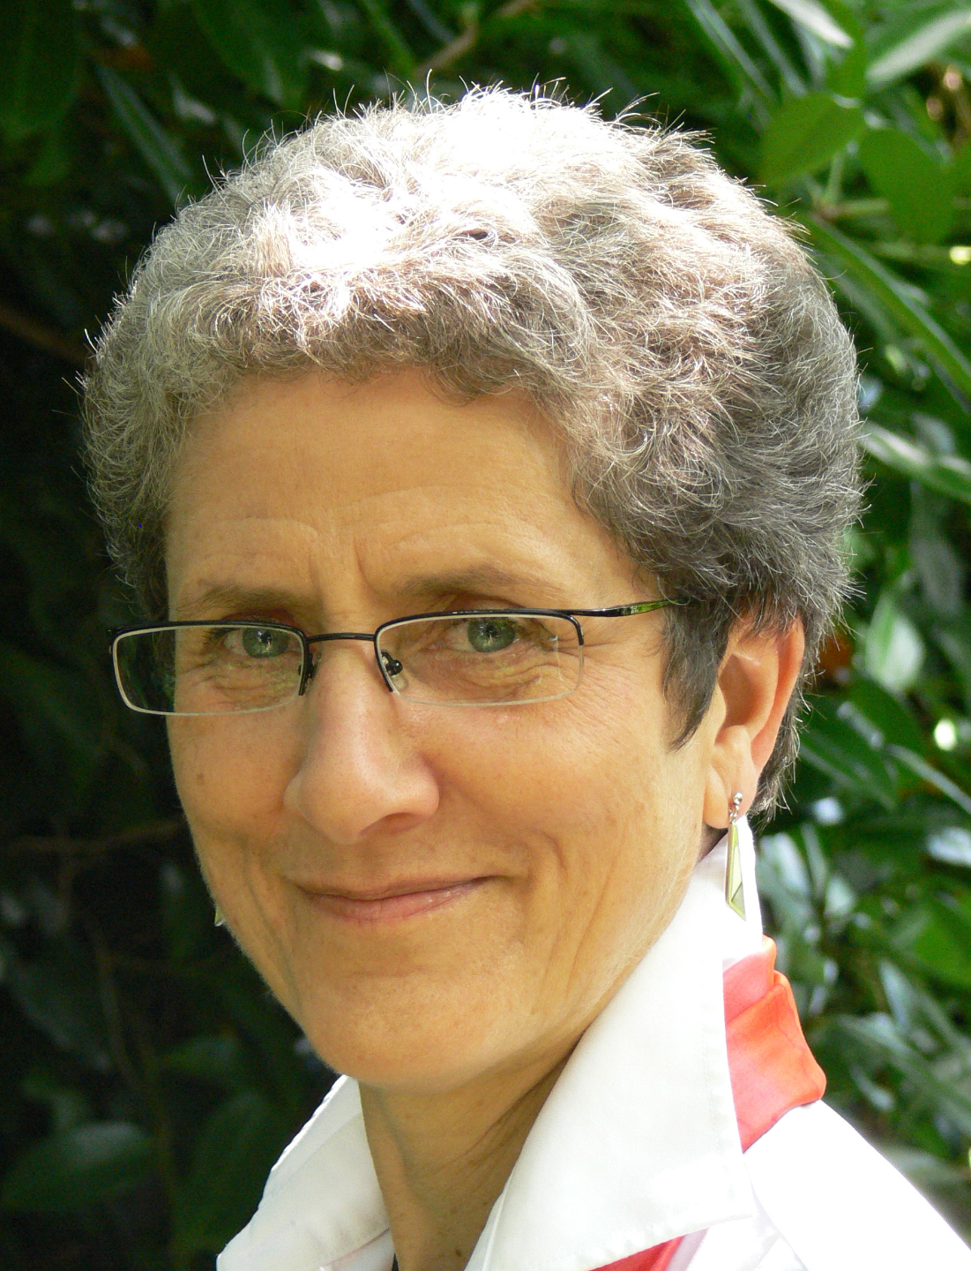
Happiness
‘The place to be happy is here.
The time to be happy is now.
The way to be happy is to make others so.’
Robert Ingersoll (1833 – 1899)
‘I believe in celebrating life. I believe in happiness. I want to explore the beauty that exists in this world, and I believe every person has this right… This is our life and we should enjoy it!’
Gulalai Ismail, Humanists International
‘It's not enough to be a happy individual; we should also try to think of ways in which others – perhaps everyone – can be happy.’
Michael Rosen and Annemarie Young, authors of What is humanism?

Slide 9
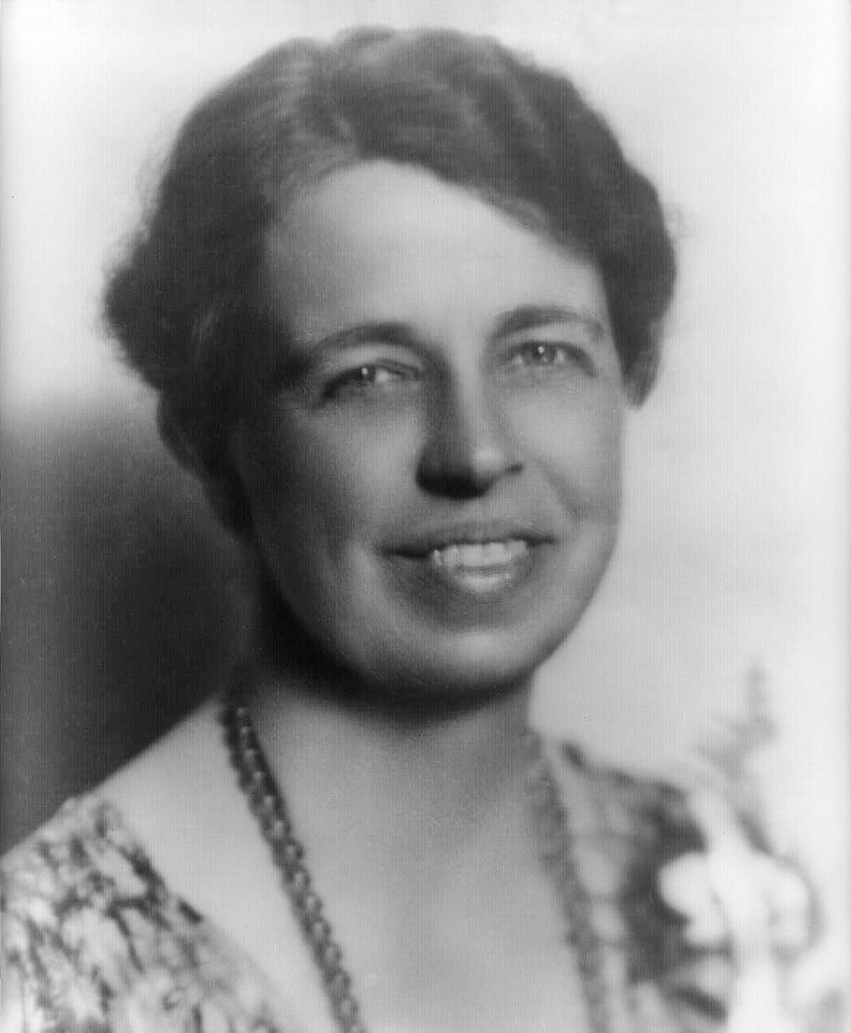
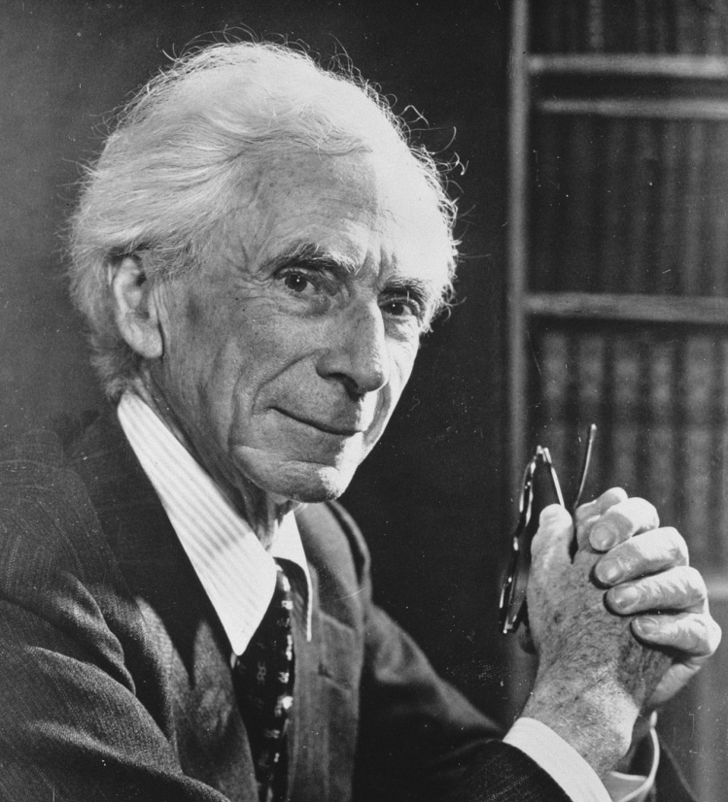
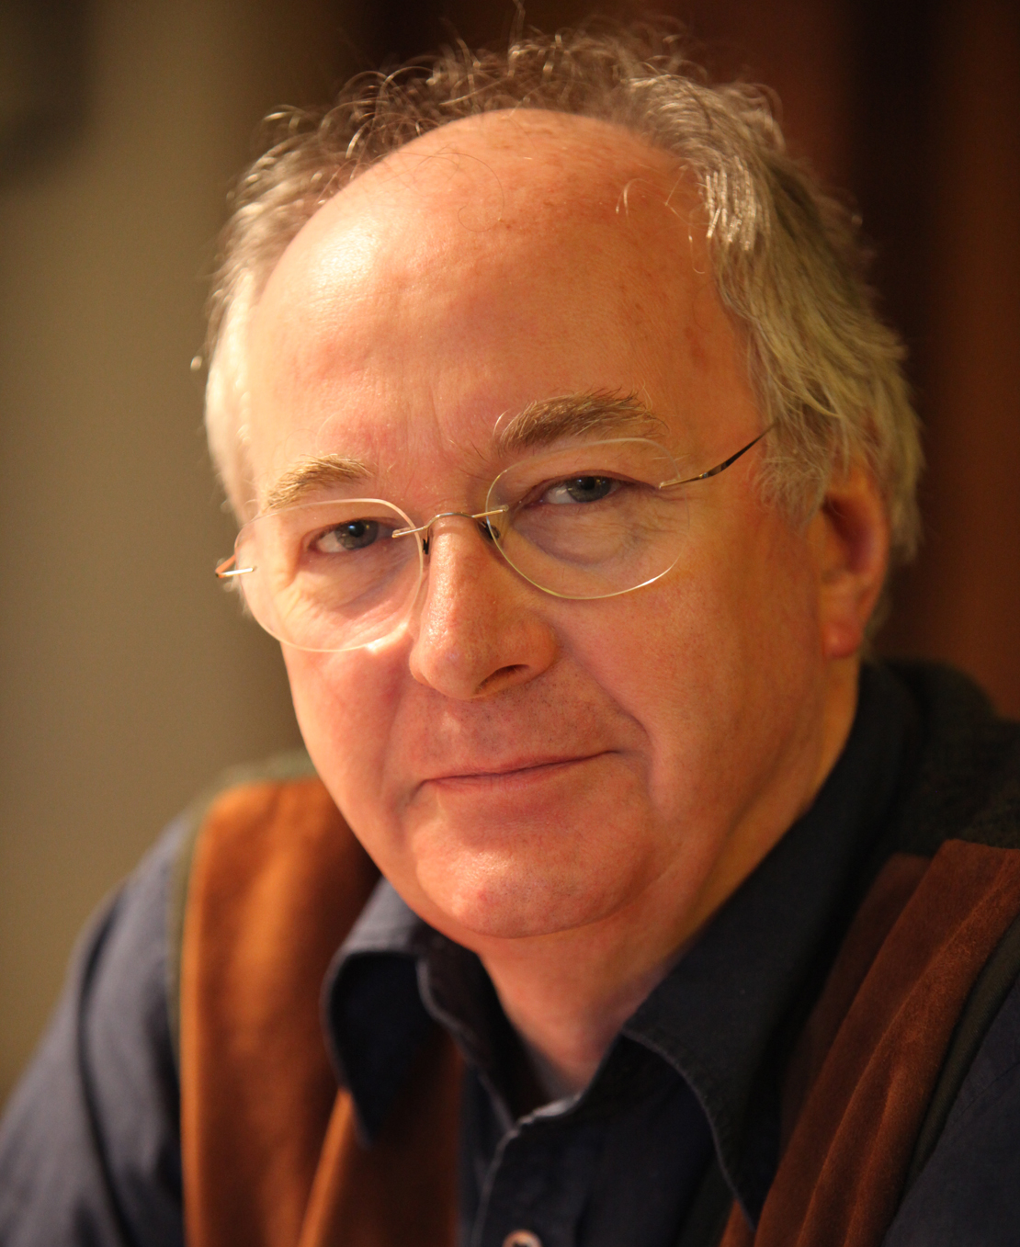
Happiness
‘We shape our lives, and we shape ourselves. The process never ends until we die. And the choices we make are ultimately our own responsibility.’
Eleanor Roosevelt, political activist (1884-1962)
‘The happy life is to an extraordinary extent the same as the good life.’
Bertrand Russell, humanist philosopher (1872-1970)
‘I would like to live to the full, right now, and I hope that I live in such a way that the world is a little bit better after I leave it than it was when I arrived.’
Philip Pullman, author

Slide 10
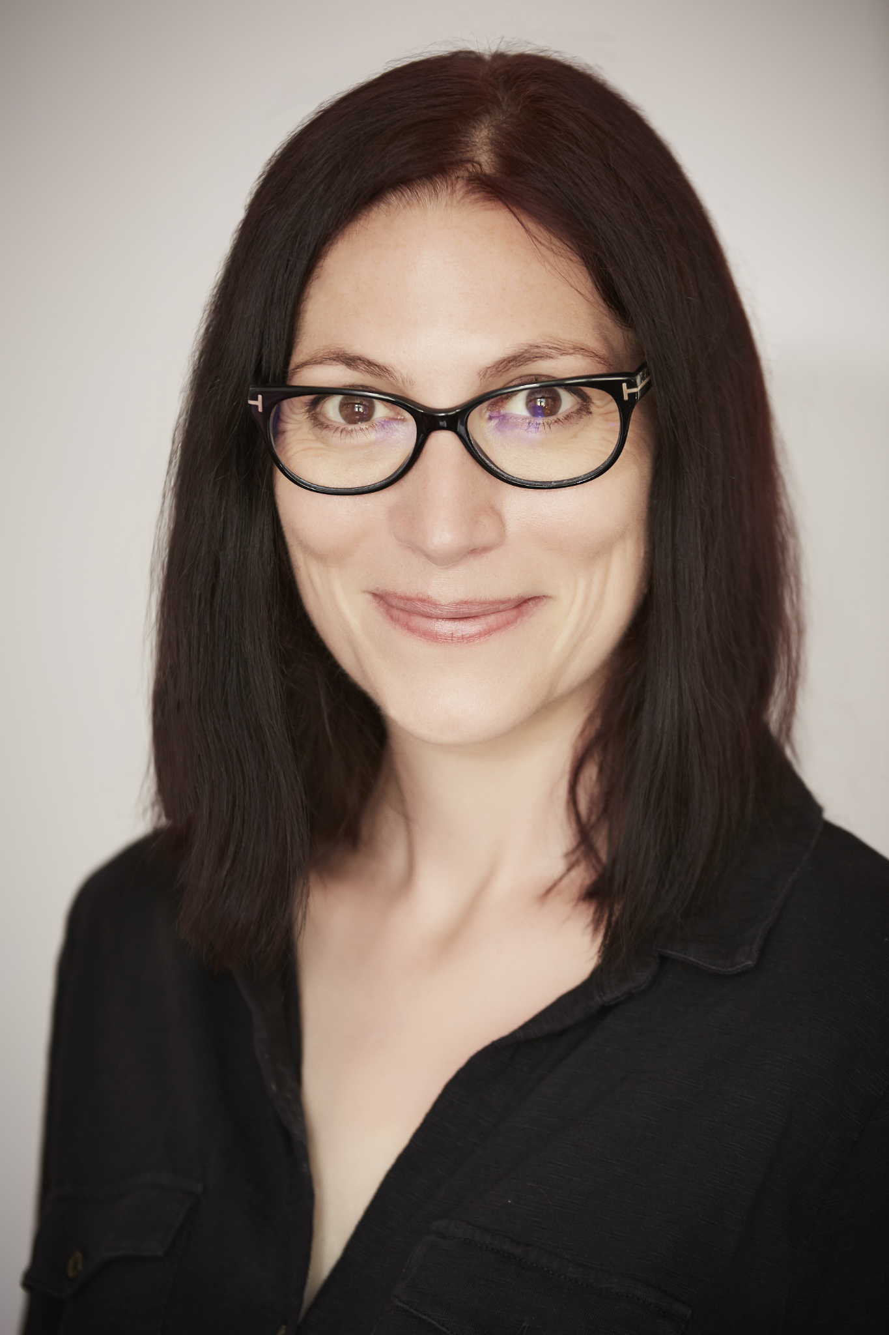
The one life
‘Imagine a room filled with your friends and family and even people you know but aren't friends with – the bus driver, the newsagent, for example. You're in the room, but you have to leave early. Would they be sad that you'd gone? Would someone tell a story about how funny it was when you said or did something? Would someone else remember a time when you'd helped them out? Would people think of you as kind or unkind? I try to live as though this room exists, and I'd like my friends and family to be proud of how I behave.’
Natalie Haynes, author

Slide 11
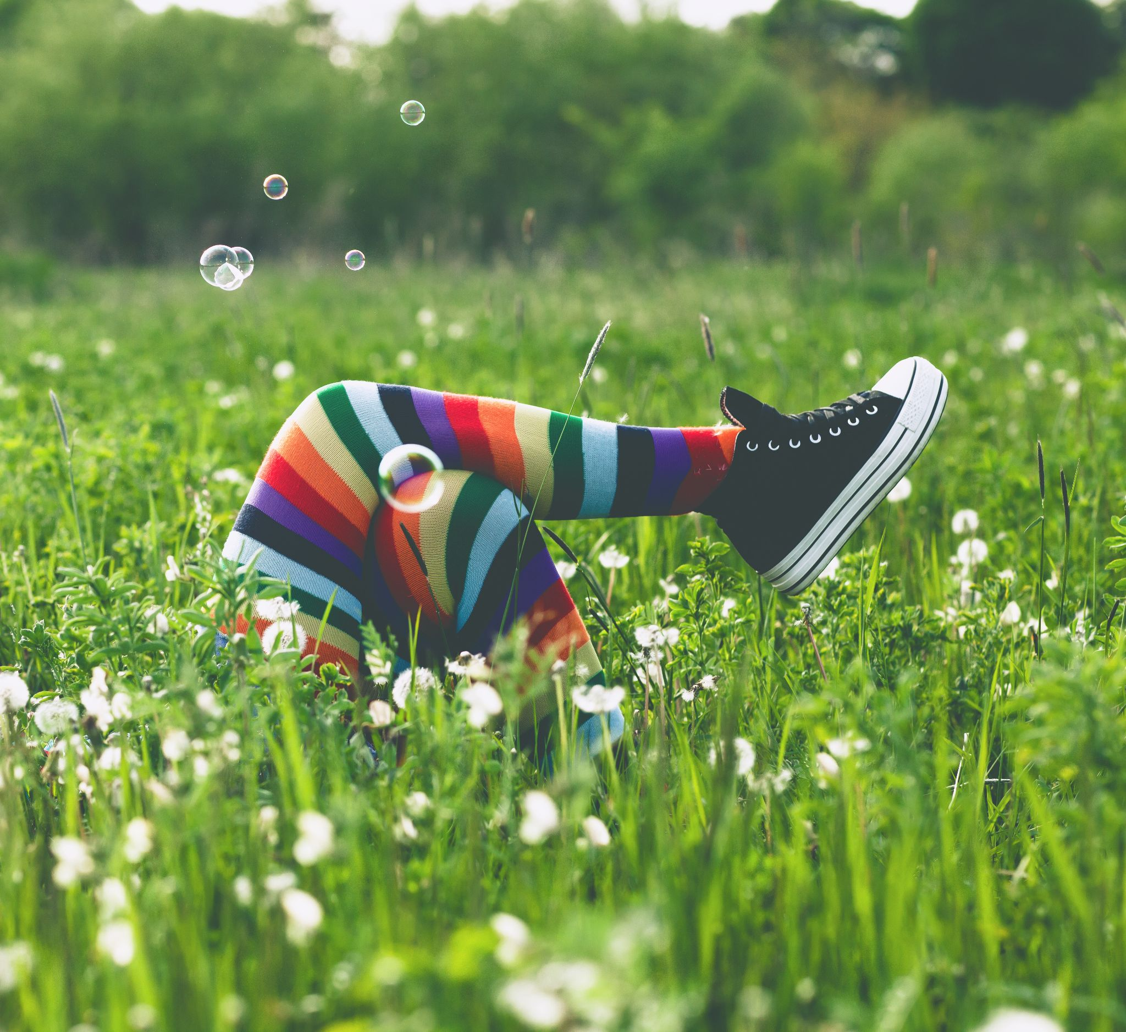

Slide 12
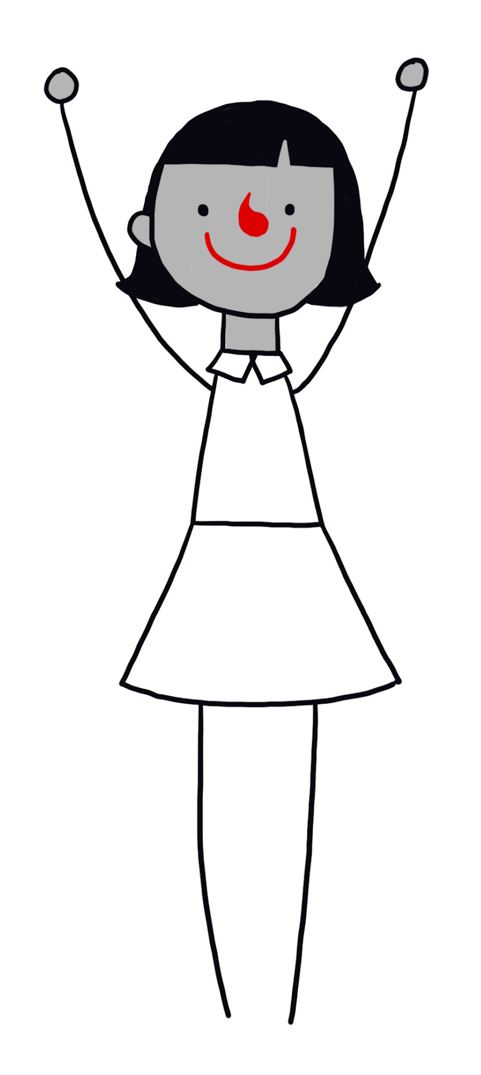
Happiness
No one single way to be happy
Some possible ingredients of a happy life
Relationships with family and friends
Being creative
Curiosity and exploration
Experiencing nature or the arts
Achieving our goals
Making other people happy
Helping make the world a better place

Slide 13
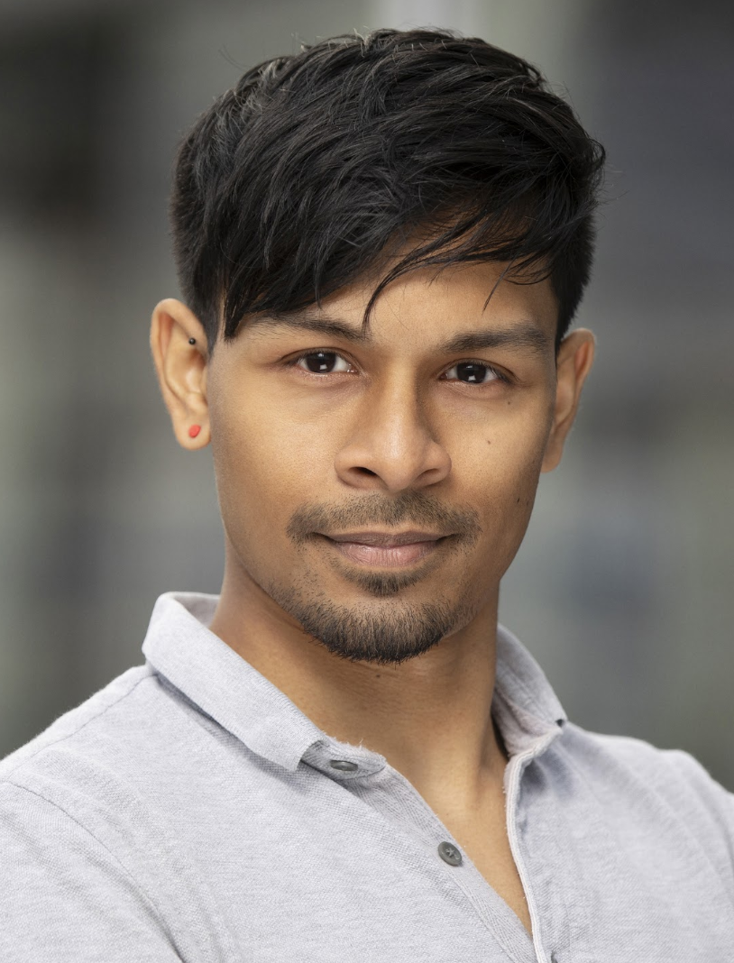
Freedom
‘For me, freedom is one of the most important things in life: the freedom to believe what I choose and to live my life however I wish, as long as I don’t cause harm to others.’
Imtiaz Shams, Trustee of Humanists UK

Slide 14

The one life

Slide 15
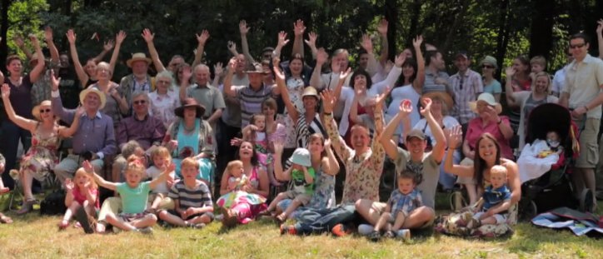
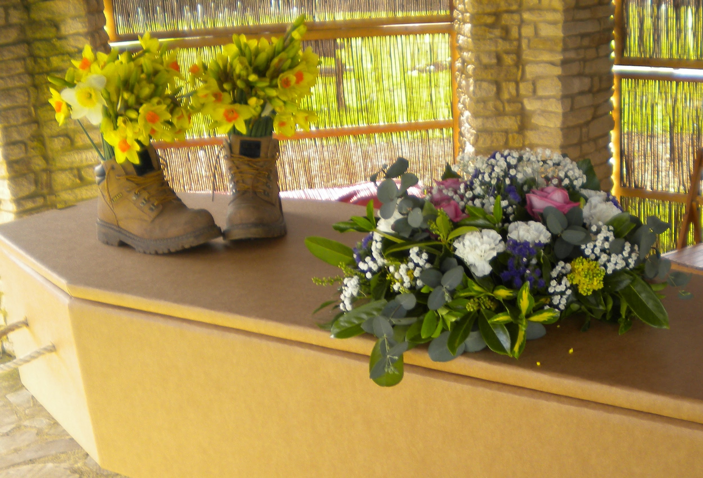
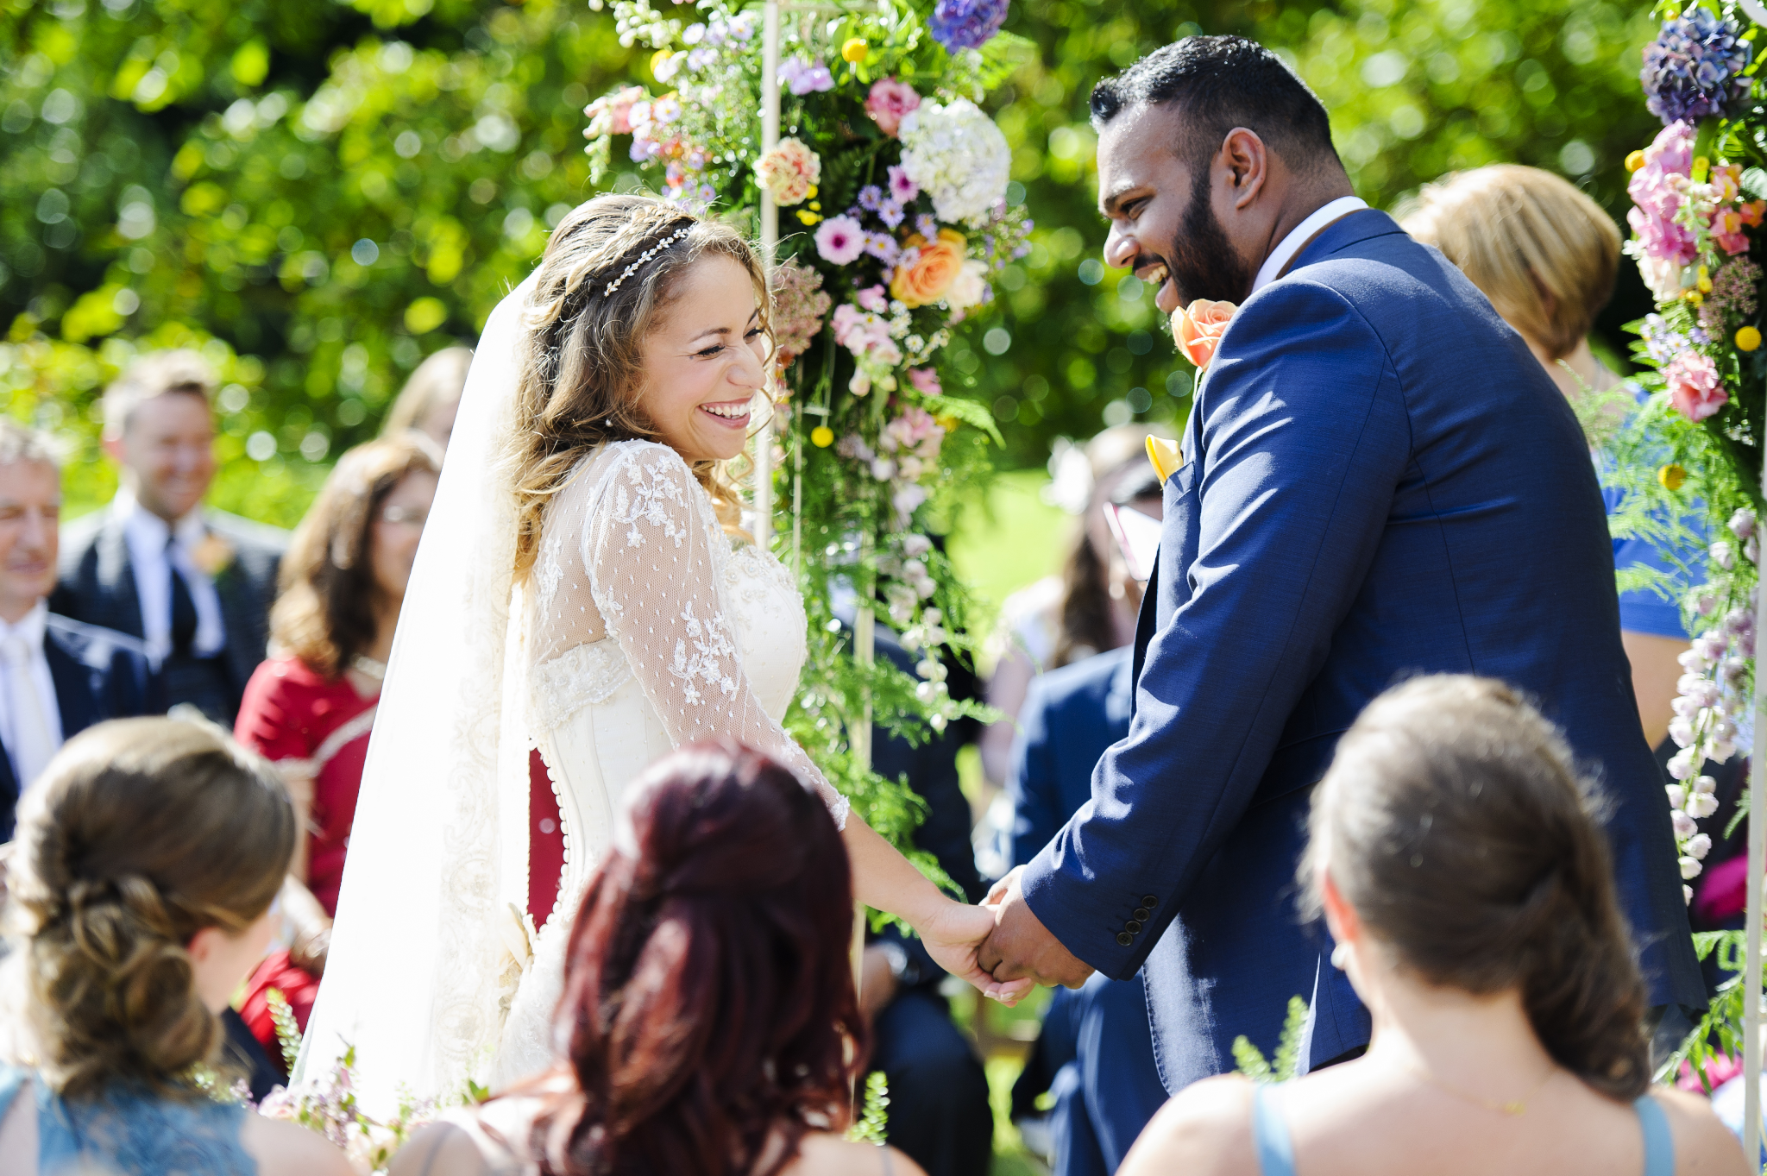
Humanist ceremonies
Support
Freedom
Connections
Love
Responsibility
Equality

Slide 16
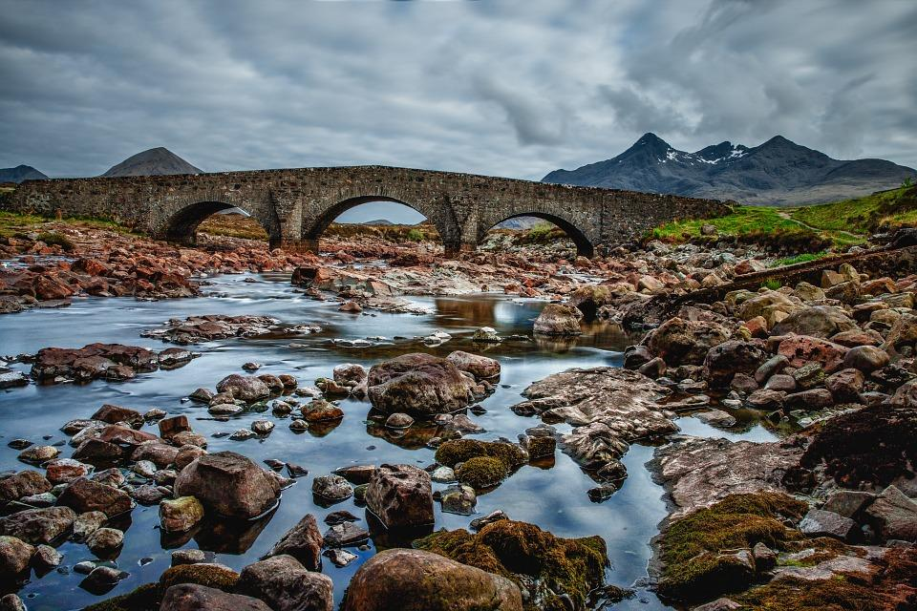
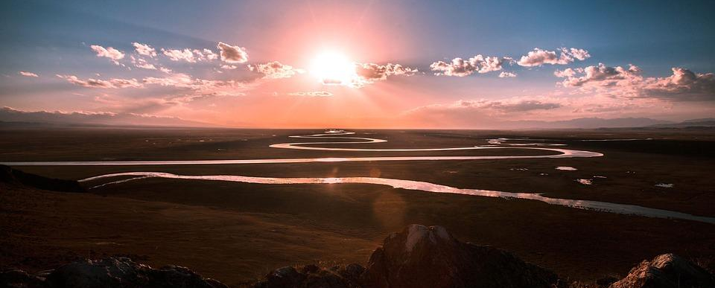
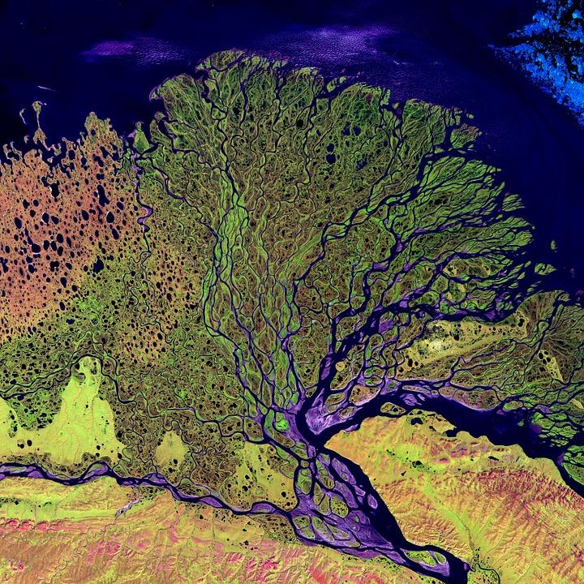
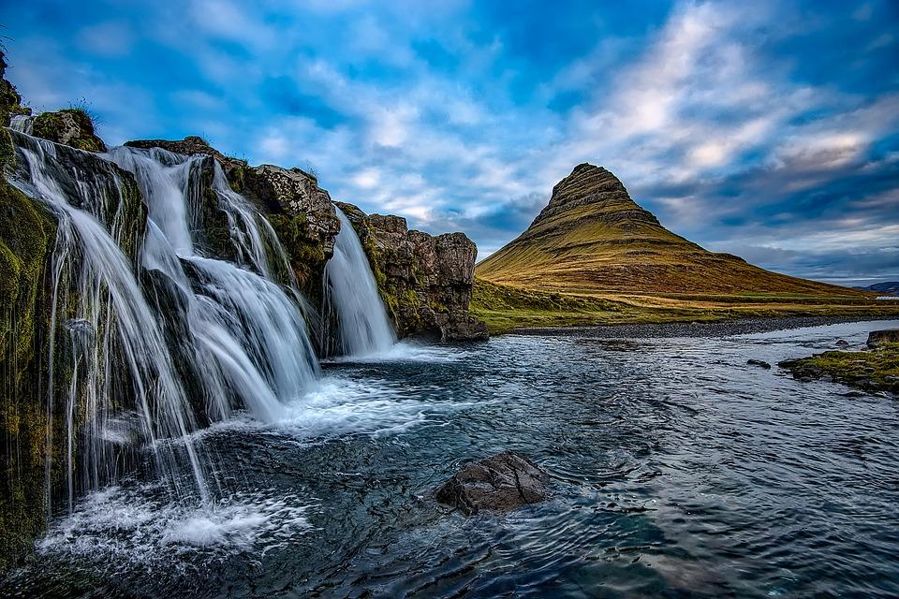

THE RIVER OF LIFE
‘An individual human existence should be like a river – small at first, narrowly contained within its banks, and rushing passionately past boulders and over waterfalls. Gradually the river grows wider, the banks recede, the waters flow more quietly, and – in the end – without any visible break, they become merged in the sea, and painlessly lose their individual being. The man or woman who in old age, can see his or her life in this way, will not suffer from the fear of death, since the things they care for will continue.’
Bertrand Russell

Slide 17

The one life
The Happy Human
Decorate a Happy Human
with the ingredients of happiness
Can you design your own symbol for humanism?

Slide 18
The humanist approach to living a happy life
We have one life and we should make the most of it
Everyone should have the freedom to pursue what makes them happy, as long as they cause no harm
We should be tolerant of those whose choices are different from our own

