Slide 1
The one life

Slide 2
A humanist approach to life: a summary
Humanists believe science provides the best way to understand the world and we should look for natural explanations for events (humanists don’t believe in a god)
Humanist believe we should be free to shape the one life we have and that we can make our own lives meaningful by seeking happiness in the here and now, and supporting others to do the same
Humanists believe we should use empathy and have a responsibility to consider the impact of our actions on the welfare of other people and animals

Slide 3

The humanist approach to living a happy life
We have one life and we should make the most of it
There is no ‘ultimate’ external meaning to life, but we have the capacity to make our own lives meaningful
Everyone should have the freedom to pursue what makes them happy, as long as they cause no harm

Slide 4


Slide 5
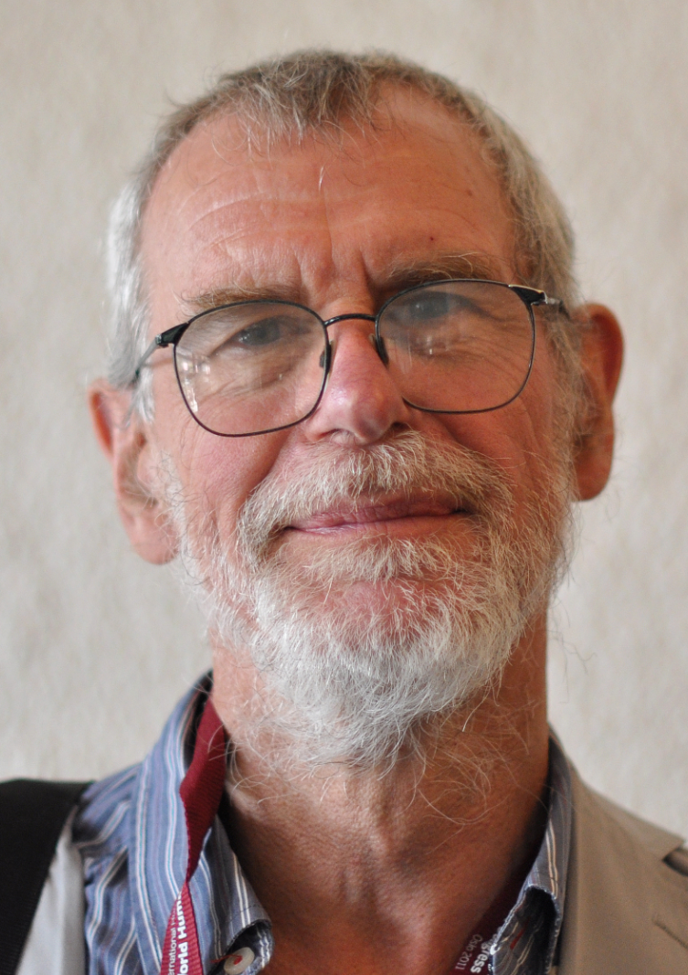
A meaningful life?
‘The search for that elusive set of beliefs which will somehow unlock the mystery of the meaning of life will no doubt go on... [but] none of them will be credible, and none will do the job if they involve a denial of the brute facts of the human condition - that we are all mortal, our lives are finite, our hopes are inescapably fragile, our projects may fail, and our purposes are not endorsed by the universe in which we find ourselves.’
Richard Norman, Handbook of Humanism

Slide 6
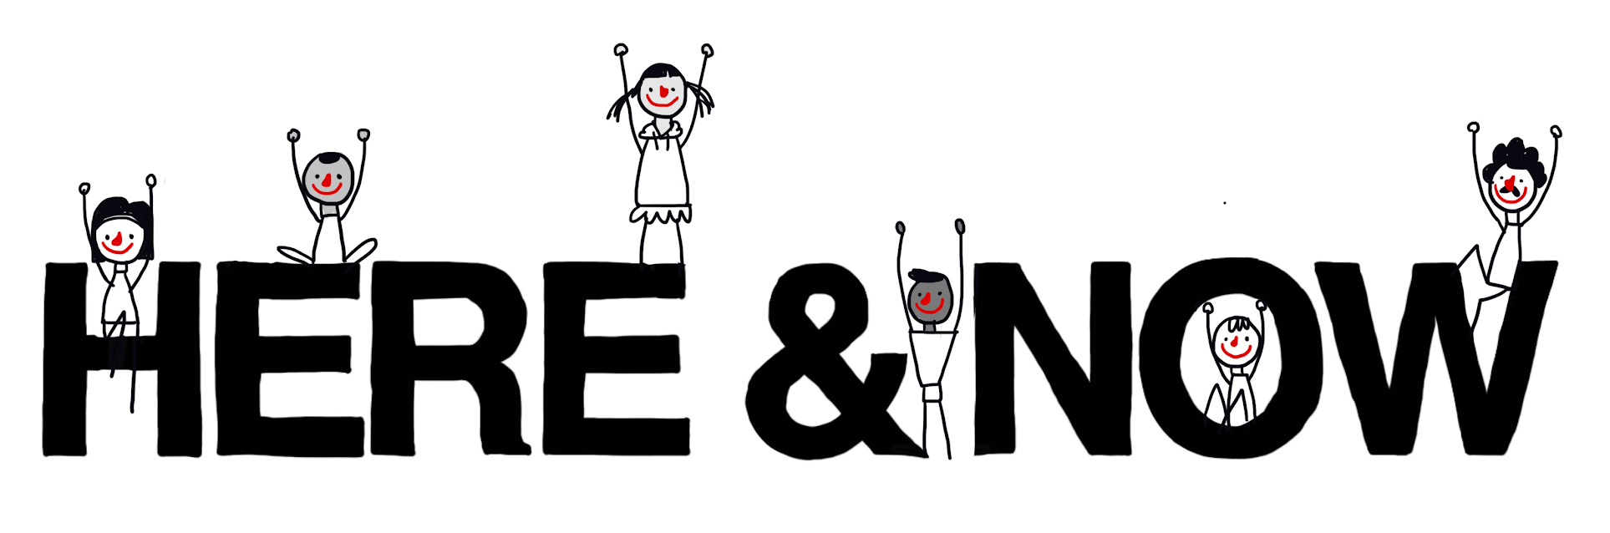
Making the most of life
‘Death destroys a man, but the idea of death saves him.’
E M Forster, author

Slide 7
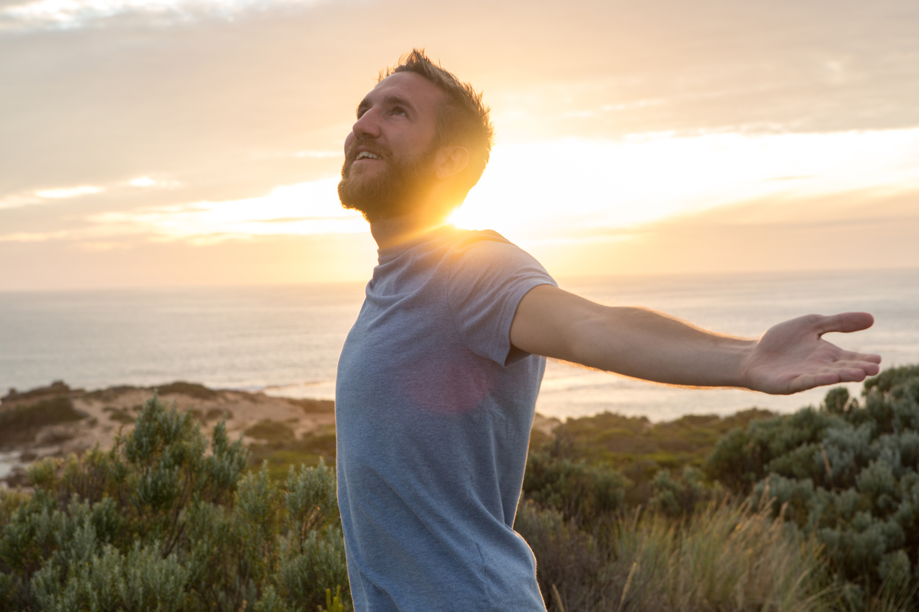

Slide 8
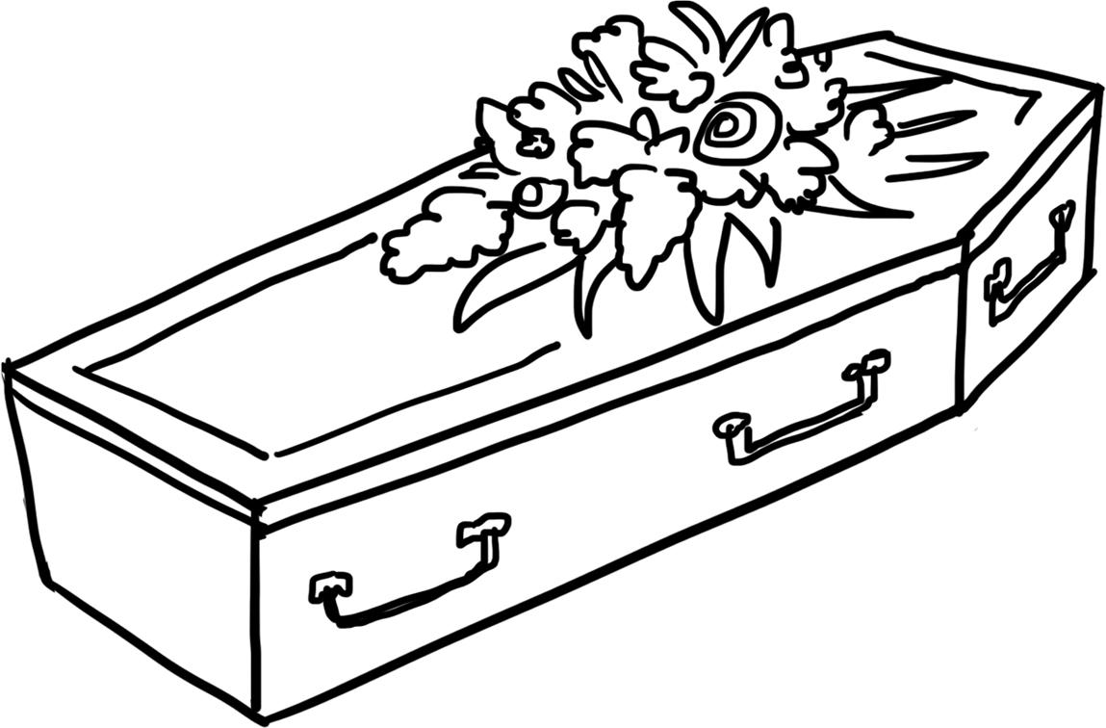
Fear and sadness
Should we be scared of death?

Slide 9
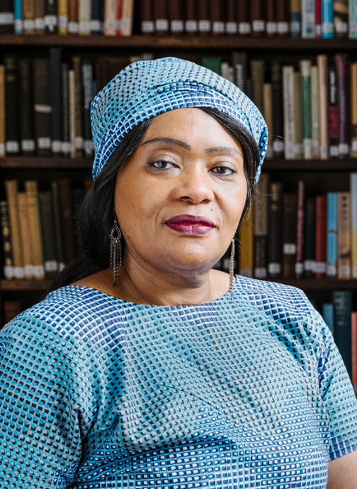
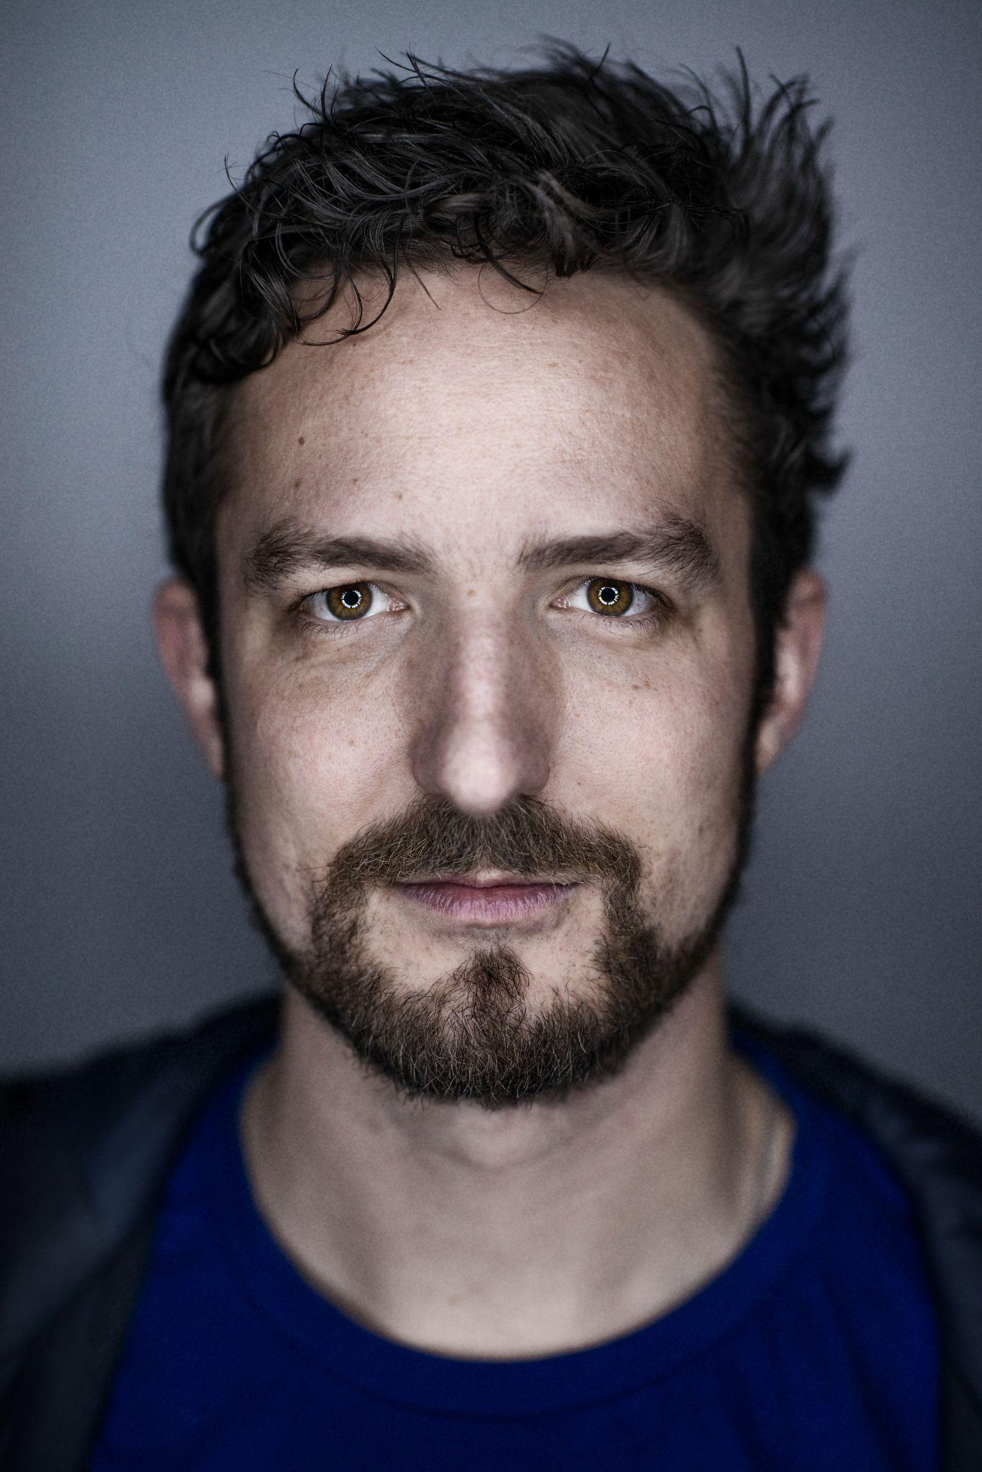
Making life meaningful
'If there’s no ultimate meaning of life, that doesn’t mean our existence needs to be meaningless; we can determine for ourselves what is meaningful.’
Lola Tinubu, Association of Black Humanists
‘As a humanist, I think there’s no inherent meaning to the universe… But that’s not the end of that statement or that conversation. We can create meaning and order and structure and beauty and art… It’s a declaration of autonomy. If we want to have beauty and structure and meaning in our lives then we have to provide it.’
Frank Turner, musician

Slide 10


Slide 11
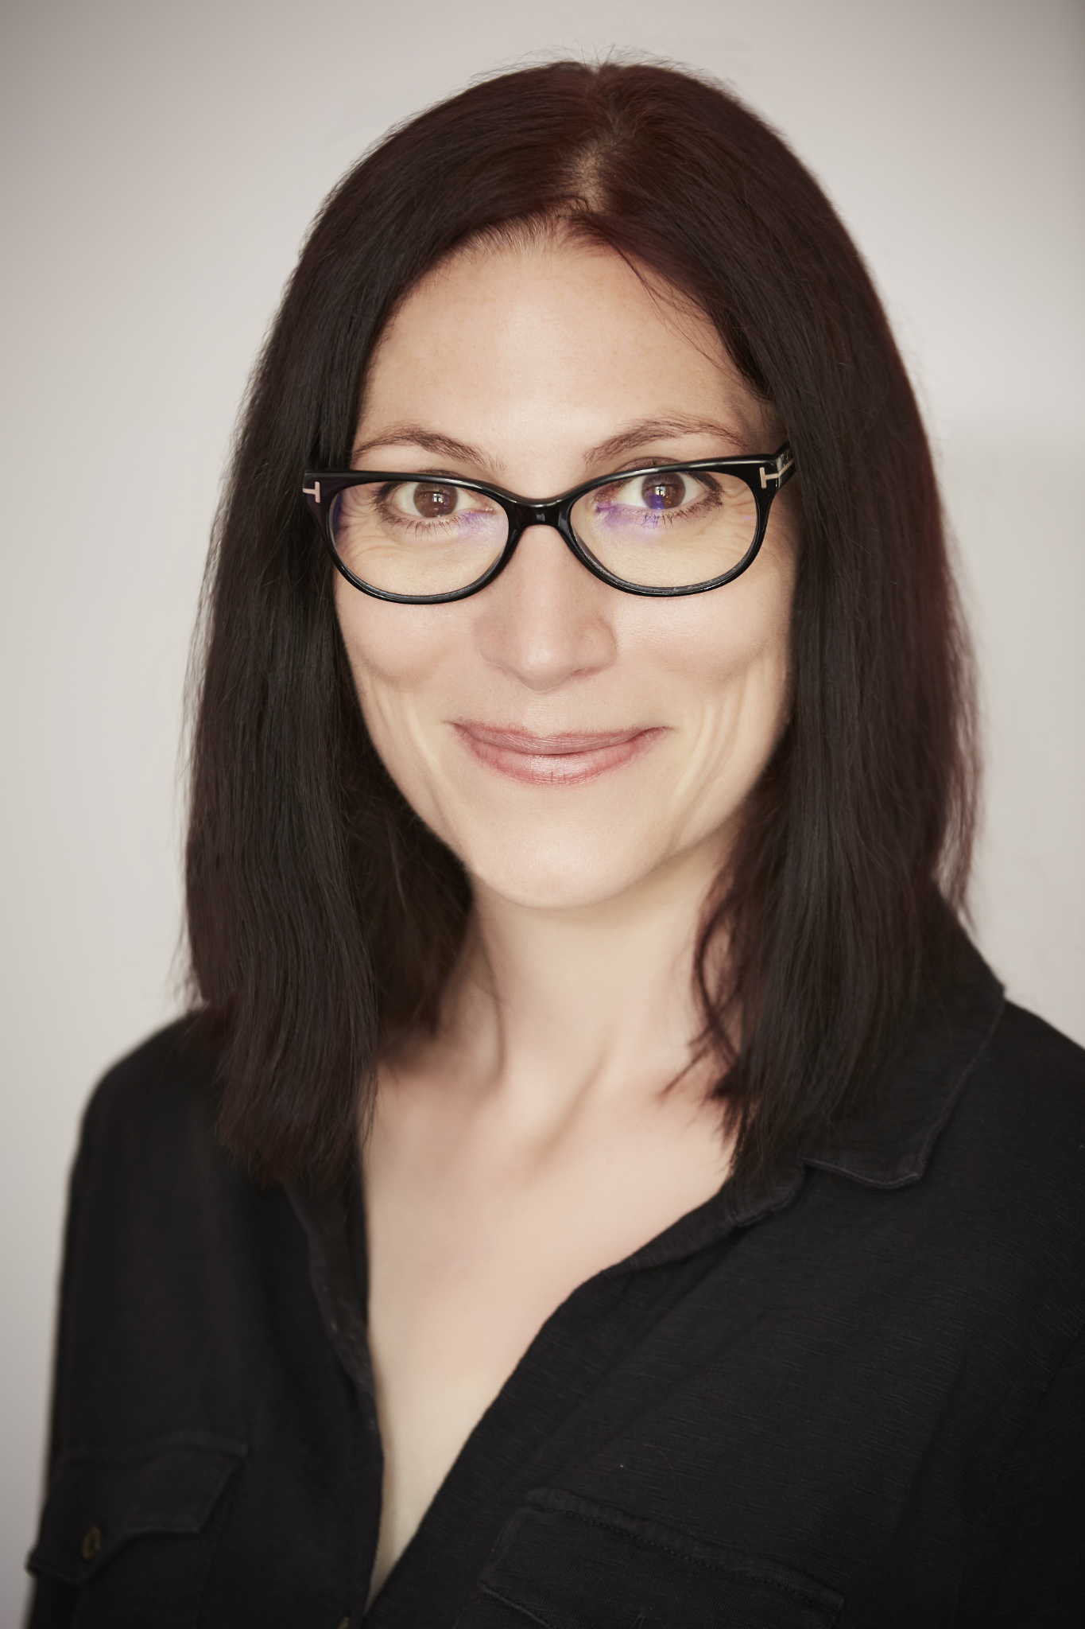
The one life
‘Imagine a room filled with your friends and family and even people you know but aren't friends with – the bus driver, the newsagent, for example. You're in the room, but you have to leave early. Would they be sad that you'd gone? Would someone tell a story about how funny it was when you said or did something? Would someone else remember a time when you'd helped them out? Would people think of you as kind or unkind? I try to live as though this room exists, and I'd like my friends and family to be proud of how I behave.’
Natalie Haynes, author

Slide 12

Happiness
No one single way to be happy
Some possible ingredients of a happy and meaningful life
Making connections and building relationships with other people
Being creative
Curiosity and exploration
Experiencing nature or the arts
Achieving our goals
Making other people happy
Helping make the world a better place (e.g. challenging injustice, relieving suffering)

Slide 13
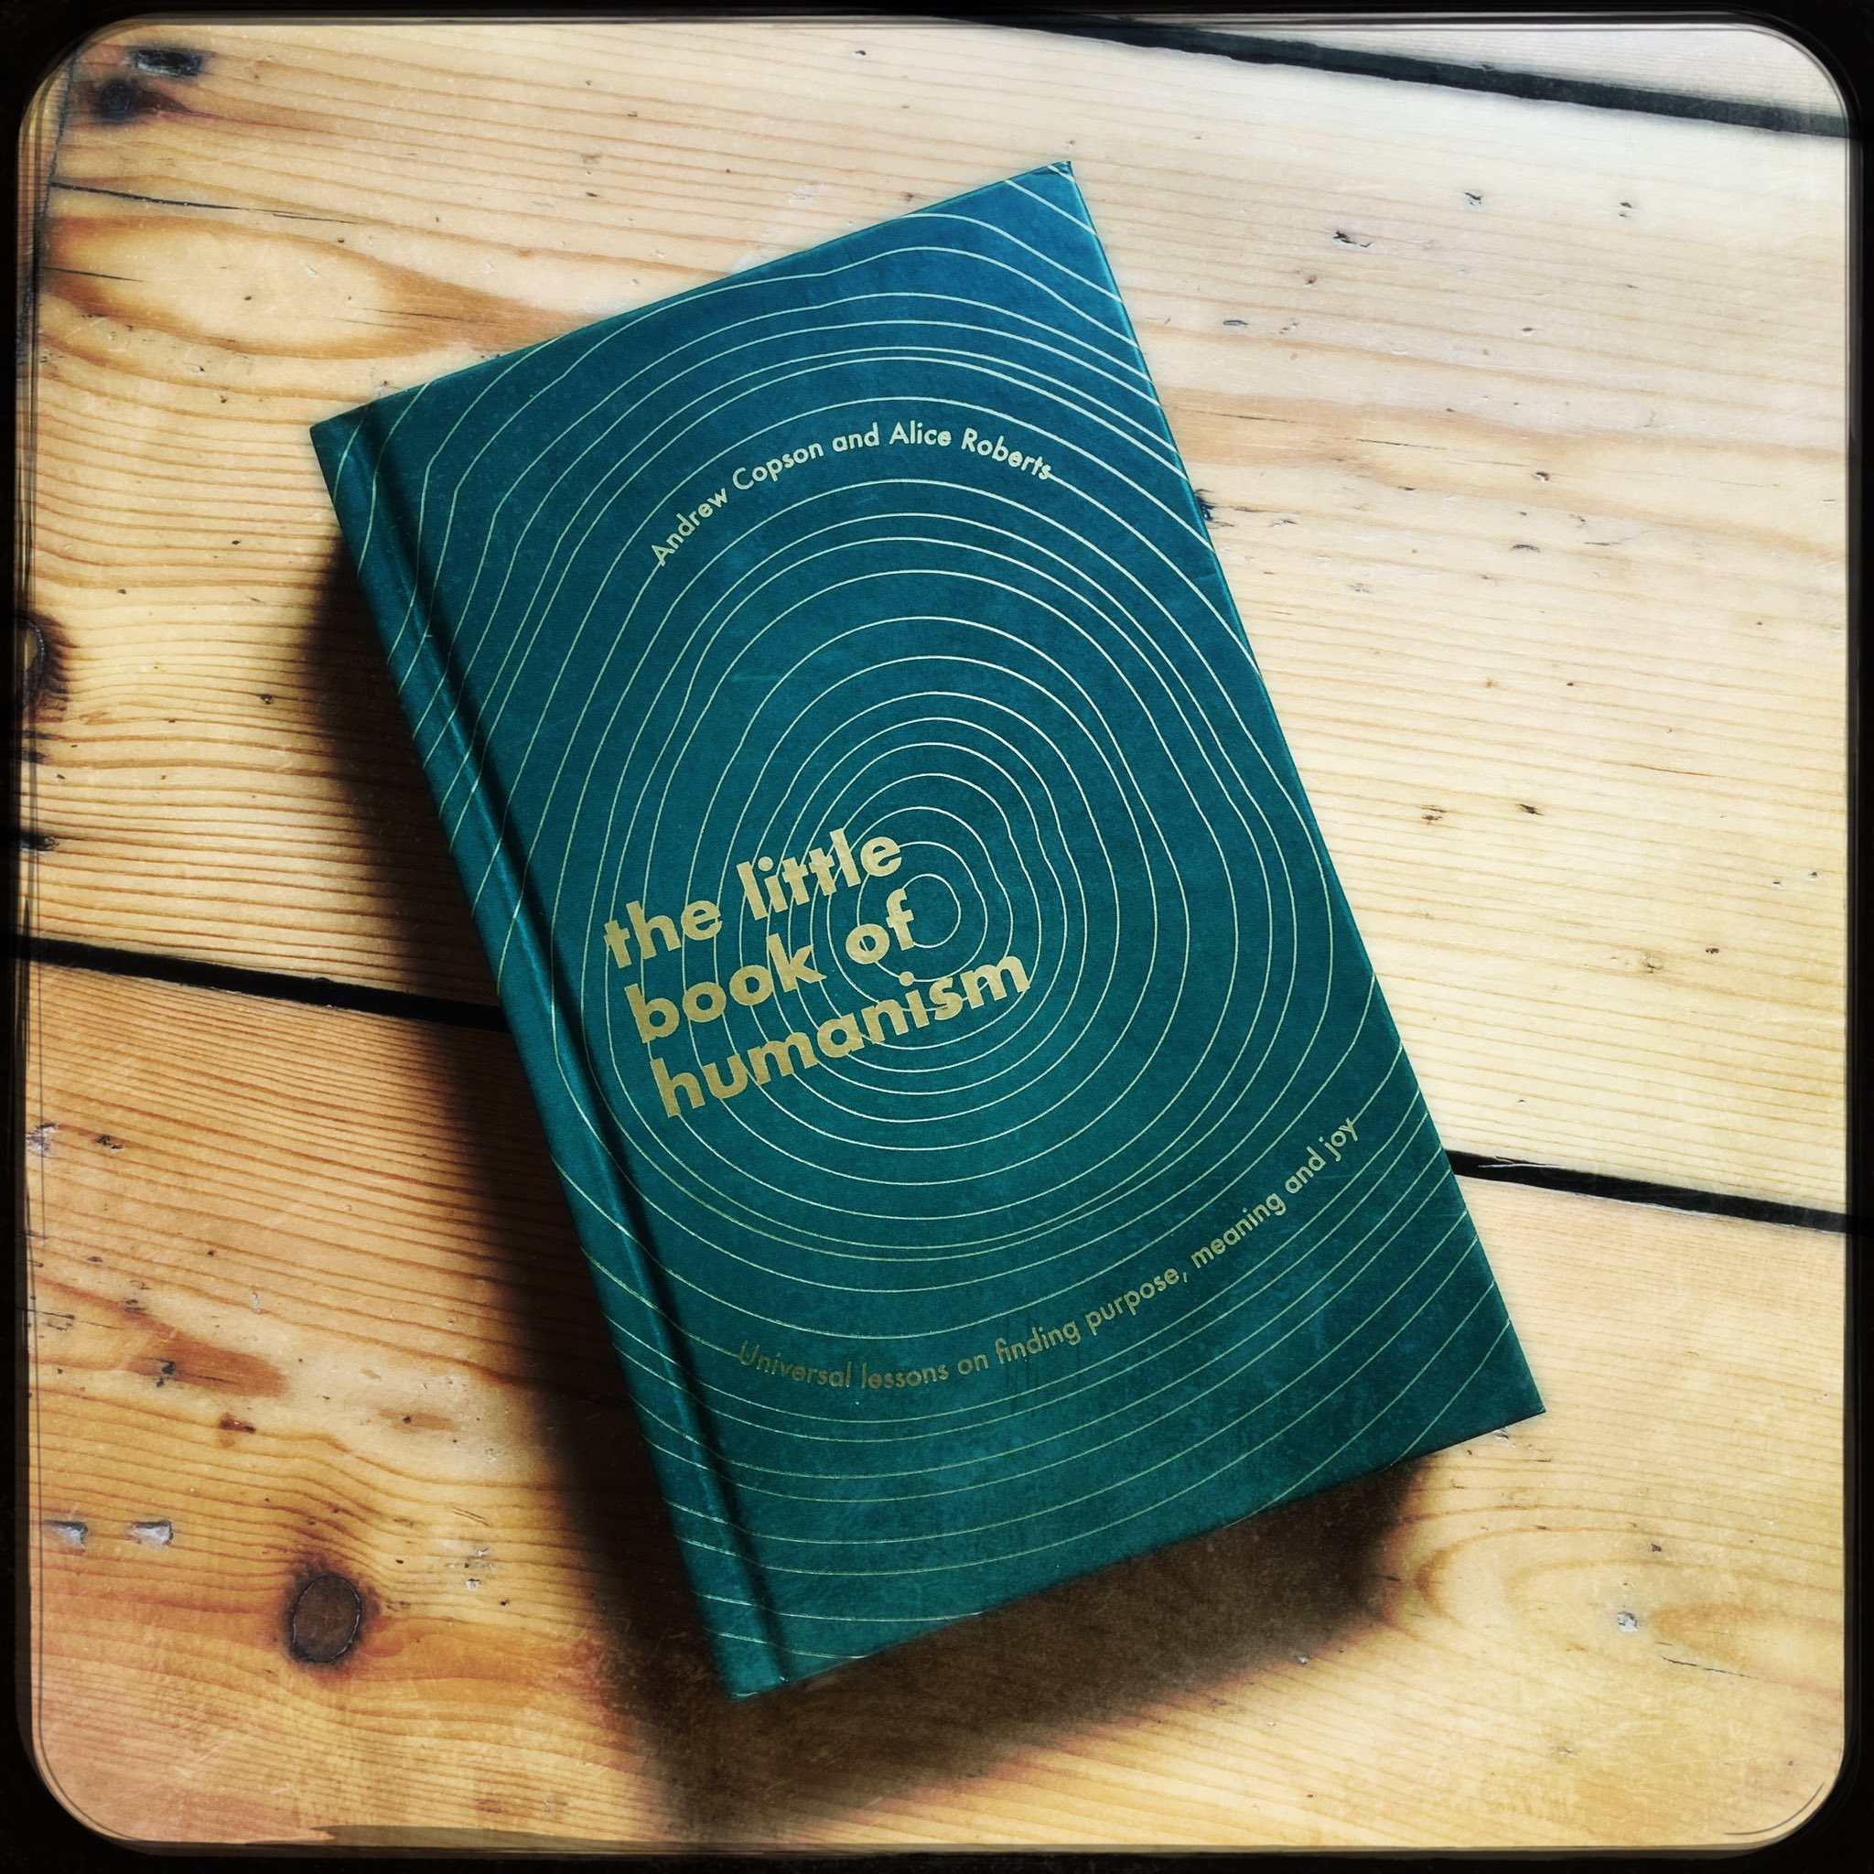
Choose your own adventure
If you were reading the book of your life, what would you want to happen next? Are there things you wish you could do, things you would like to say, places you wish you could go?
Do those things, say those things, go to those places! You are not reading your story, you’re writing it. You’re writing it even this minute.
Of course you can’t control every twist of the plot. And there will be sad and painful moments along the way – they’re part of every story. But you know where you’ve come from. You know where you’re going to. There will be love and laughter and joy whatever else there will be. Put down this book and step back into your own. The choices there are yours to make, they’re waiting for you, and you have all you need to make them.
from the Little Book of Humanism

Slide 14

The one life

Slide 15
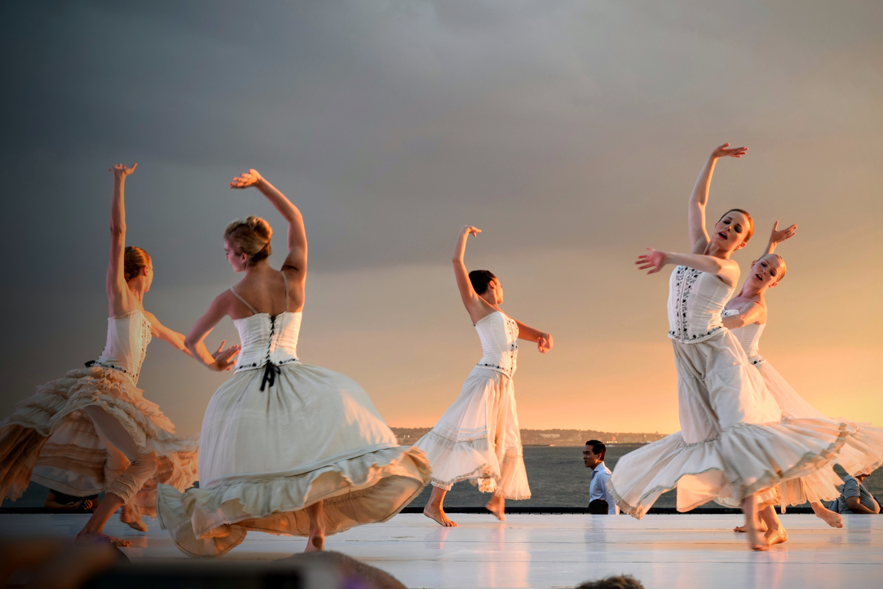

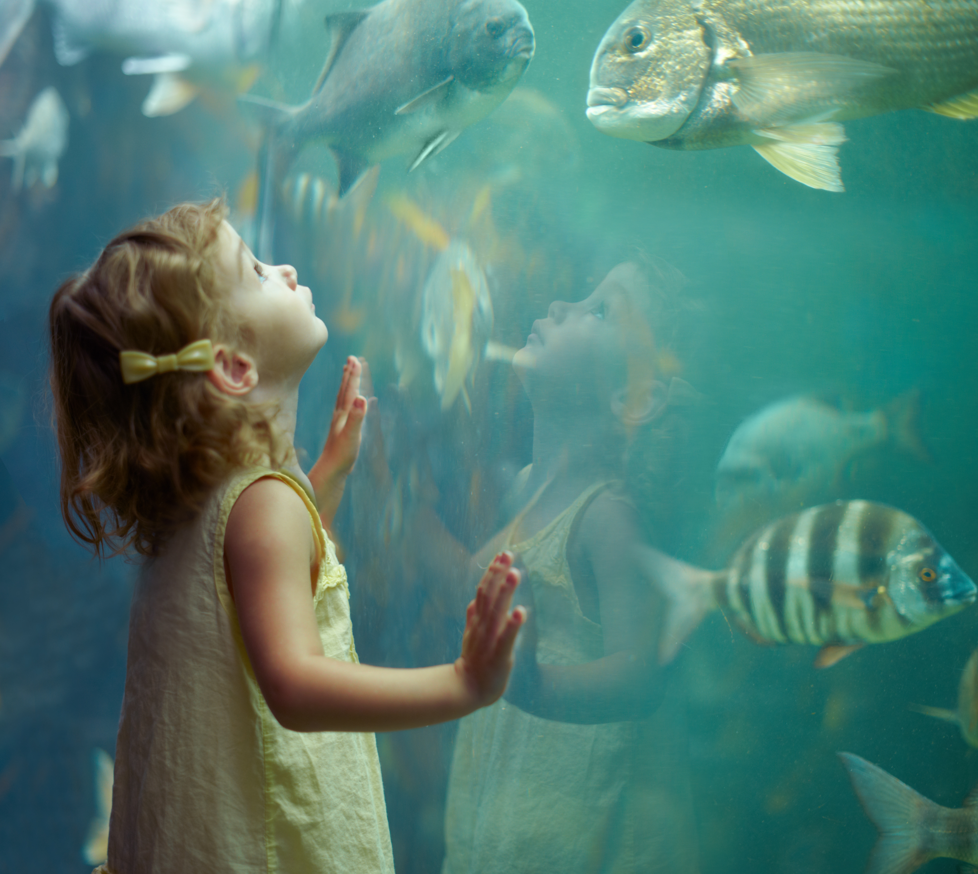
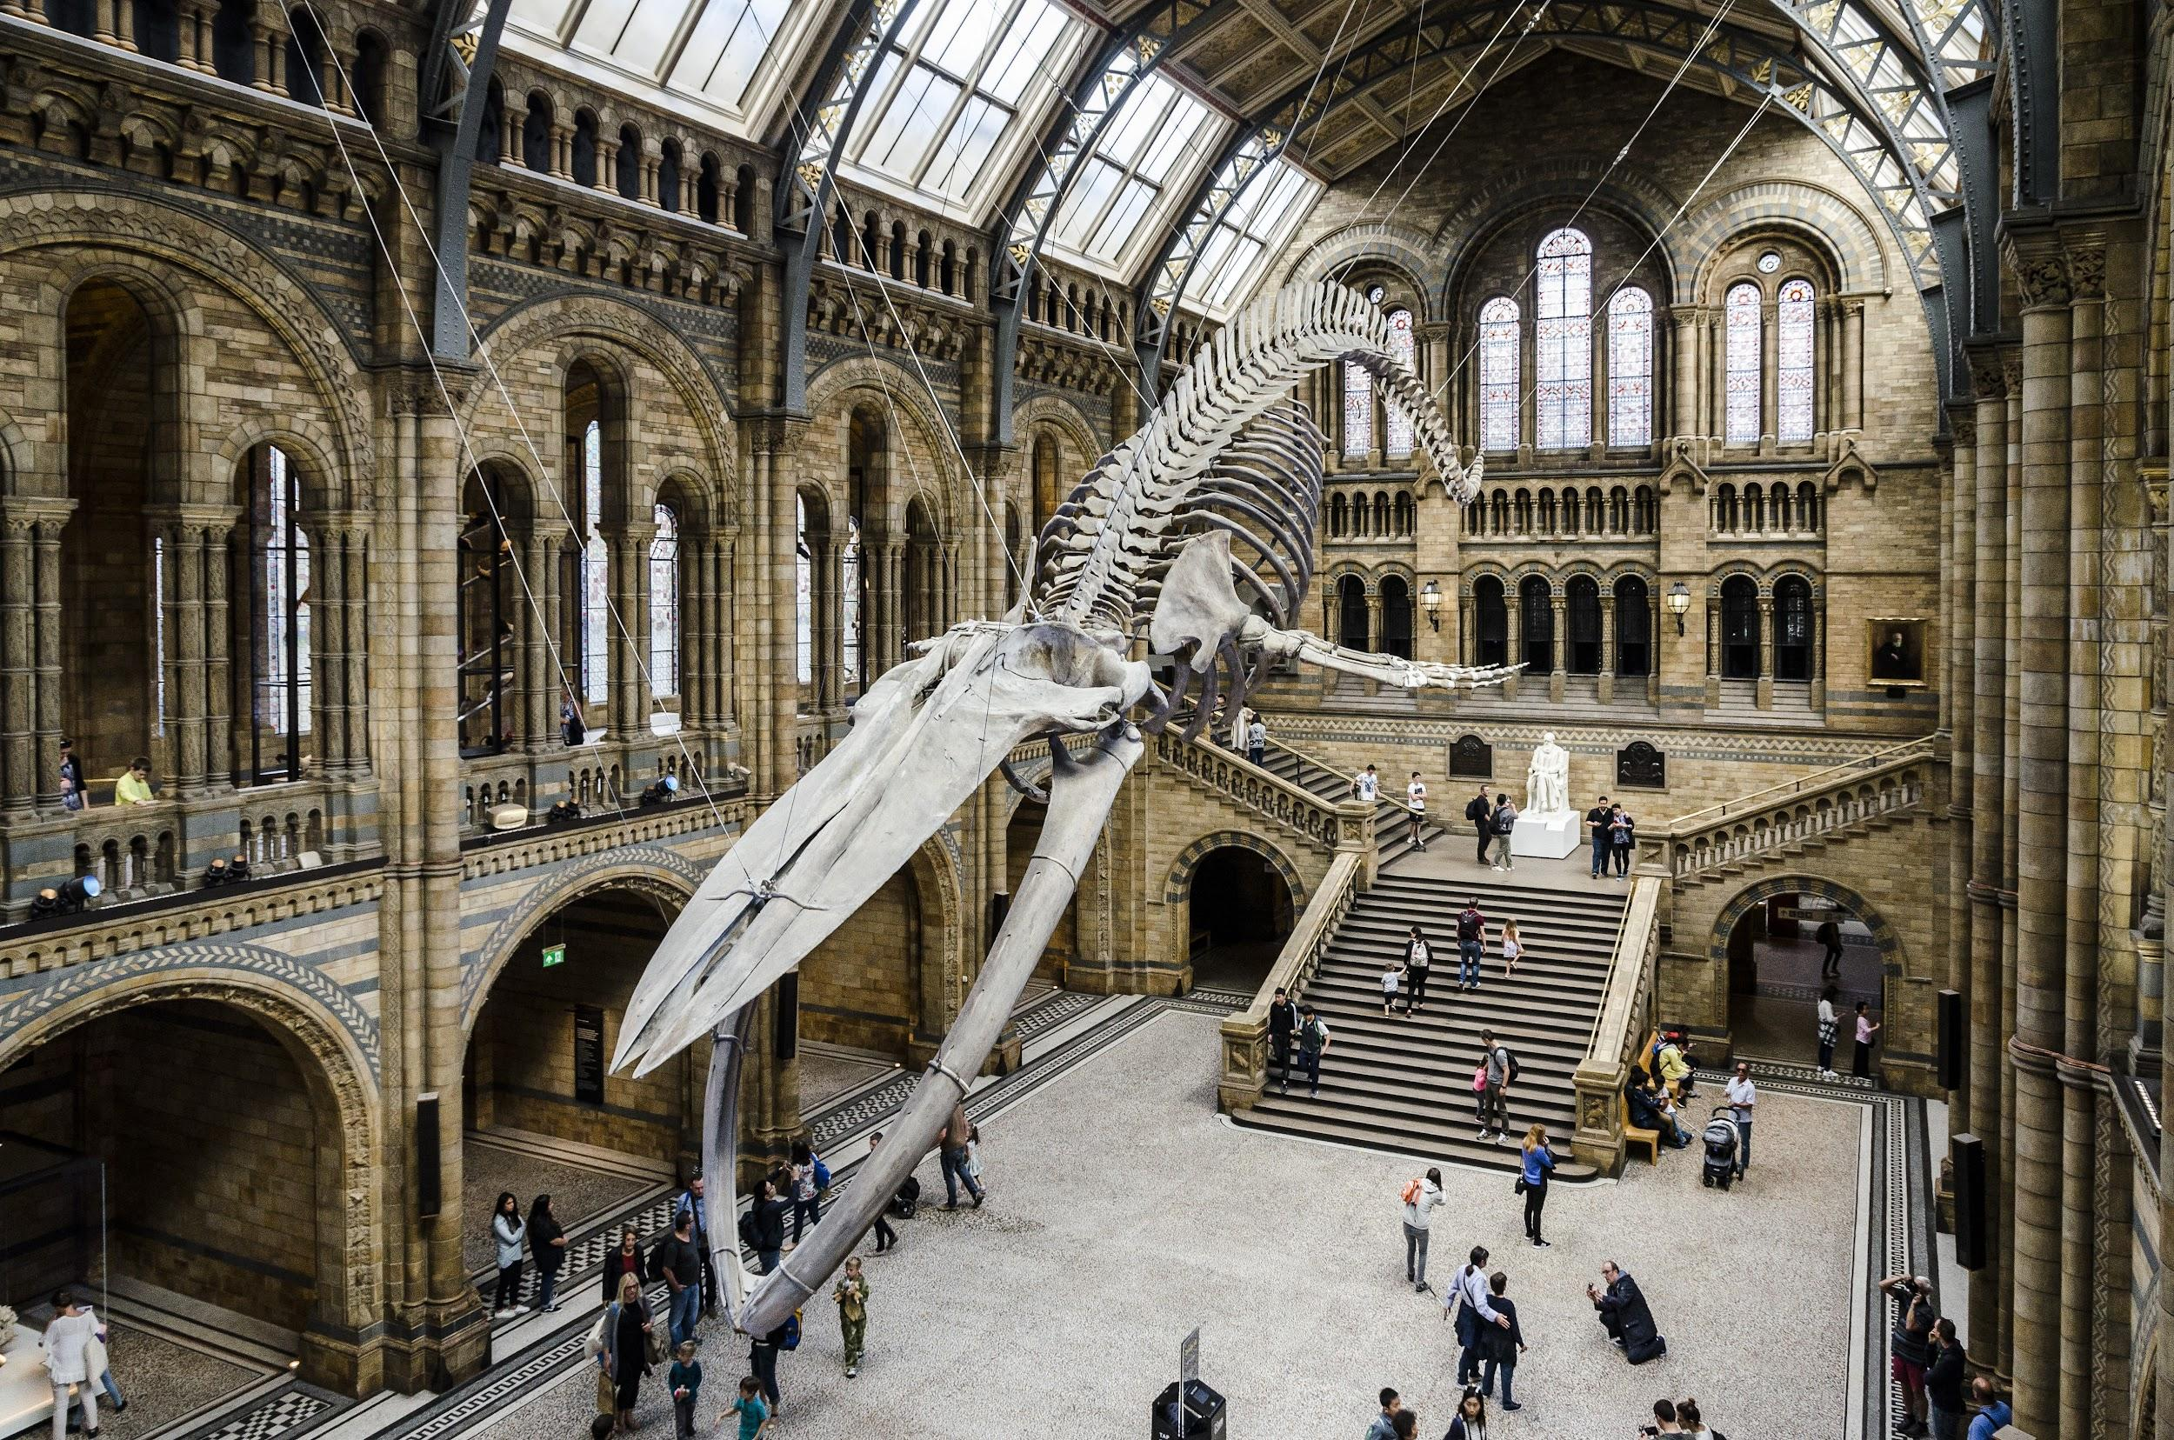
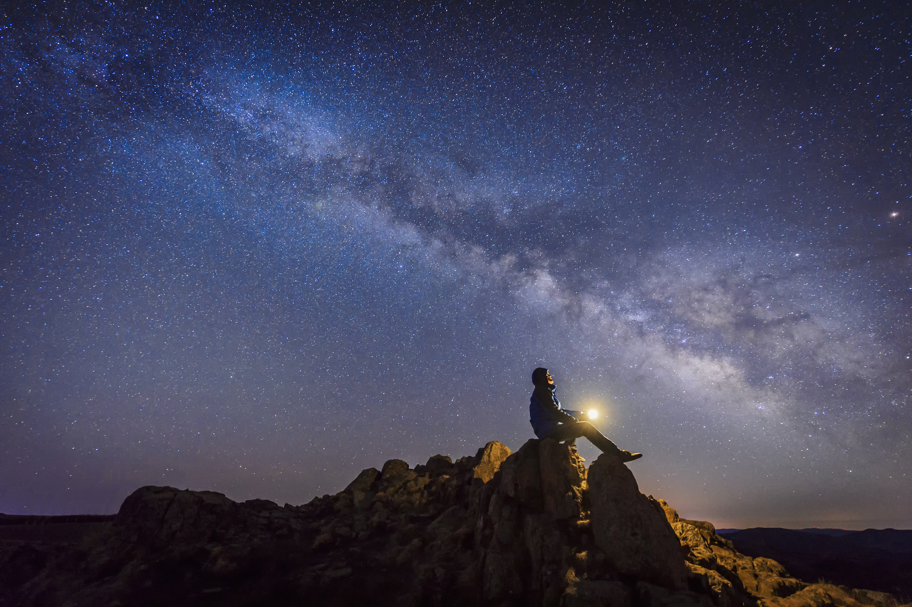
Wonder

Slide 16
Spirituality for humanists
‘If anything is to count as ‘spiritual’ for humanists, it has to be a feature of our worldly experience in the here and now. Of course there are any number of experiences which are ‘spiritual’ in that sense, things which ‘lift the spirits’ – the inspiration to be derived from relationships with other people, from the experience of great art, or from the beauty of the natural world.’
Richard Norman, humanist philosopher

Slide 17
Criticisms of a humanist approach
Humanists just want an excuse to eat, drink, and have a good time.
Humanists believe we should be free to live as we choose. So anything is acceptable. There is no right or wrong way to live so we can’t oppose those who choose to be violent or cruel.
Humanists may believe their lives are meaningful, but they are meaningless and insignificant from the viewpoint of the universe. If one day we will all be dead and gone, then it all means nothing in the long run.
If there is no bigger ‘ultimate’ meaning or purpose, then there is no consolation for those whose lives are full of suffering and pain.

Slide 18
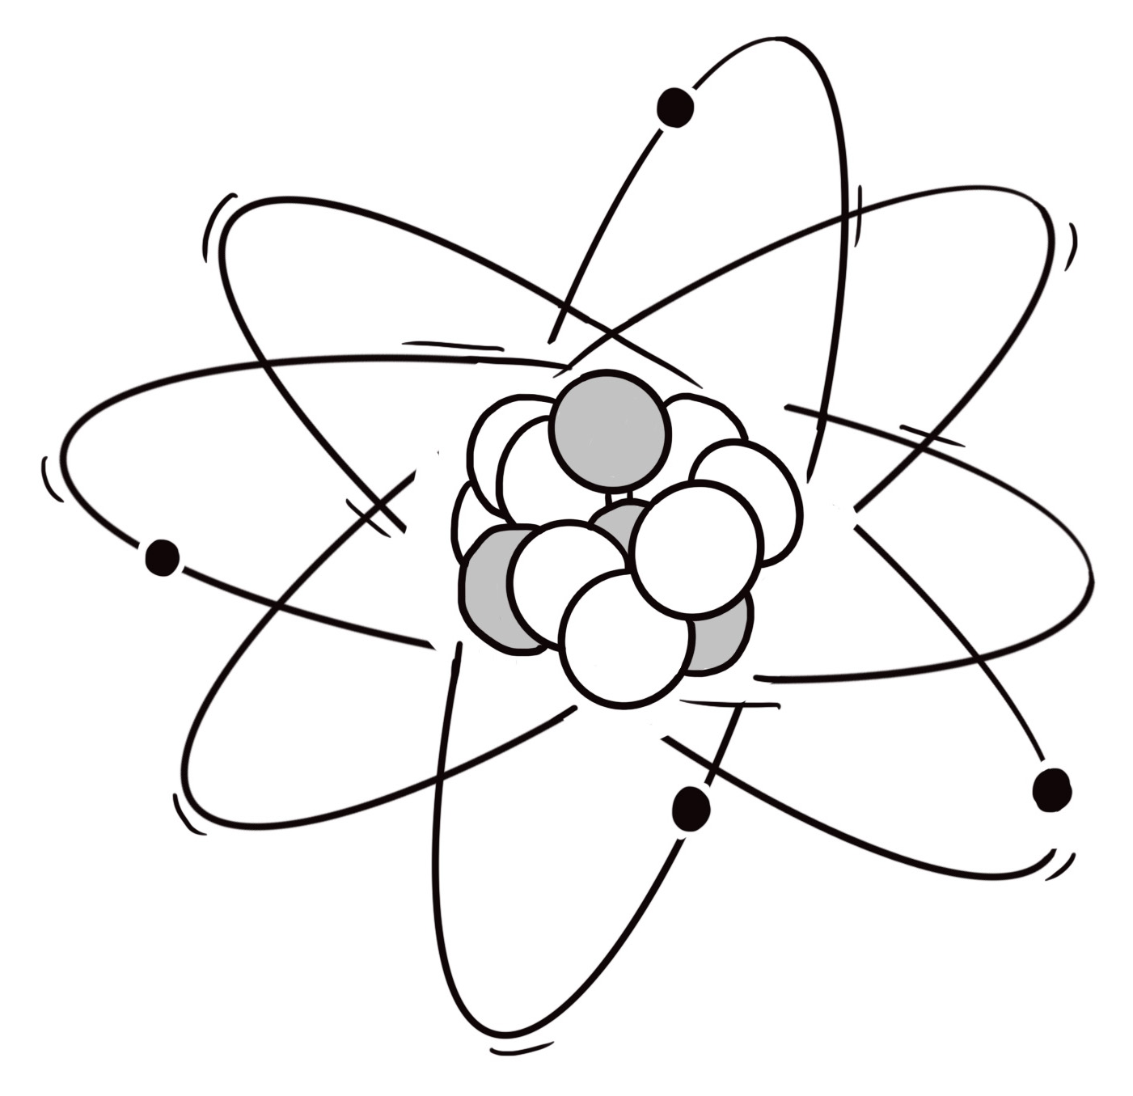
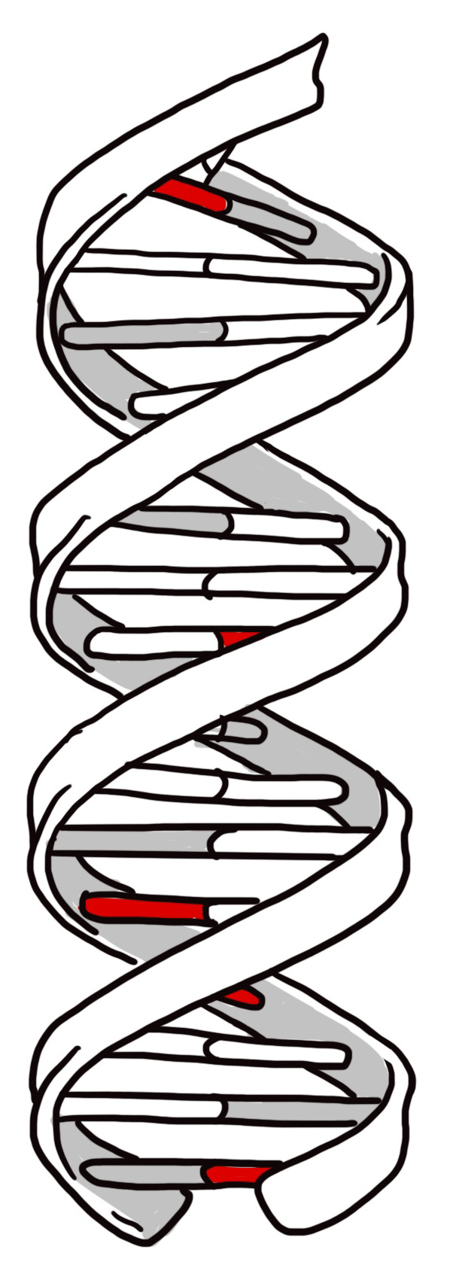
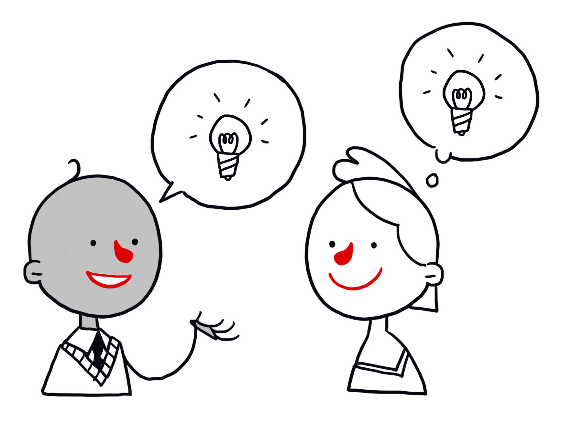
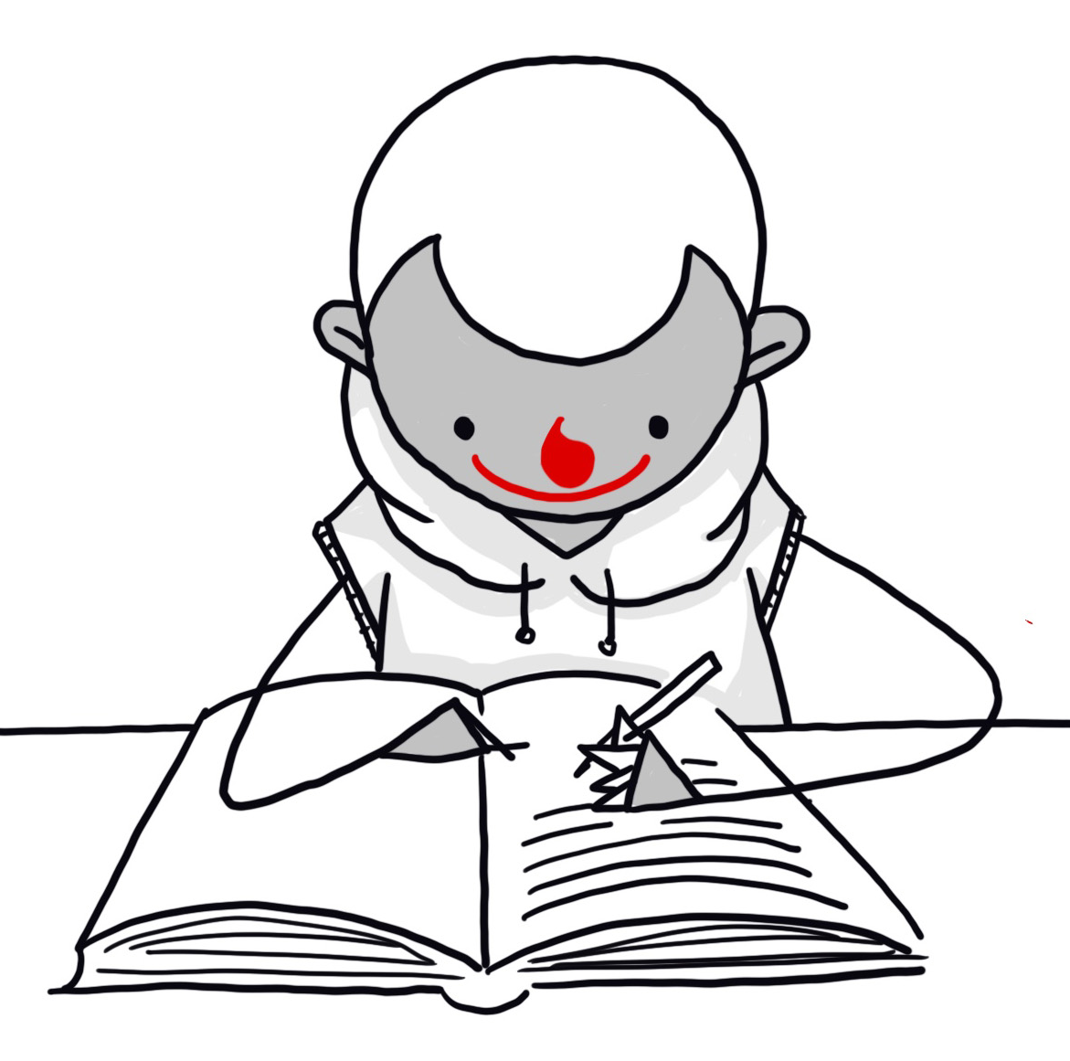
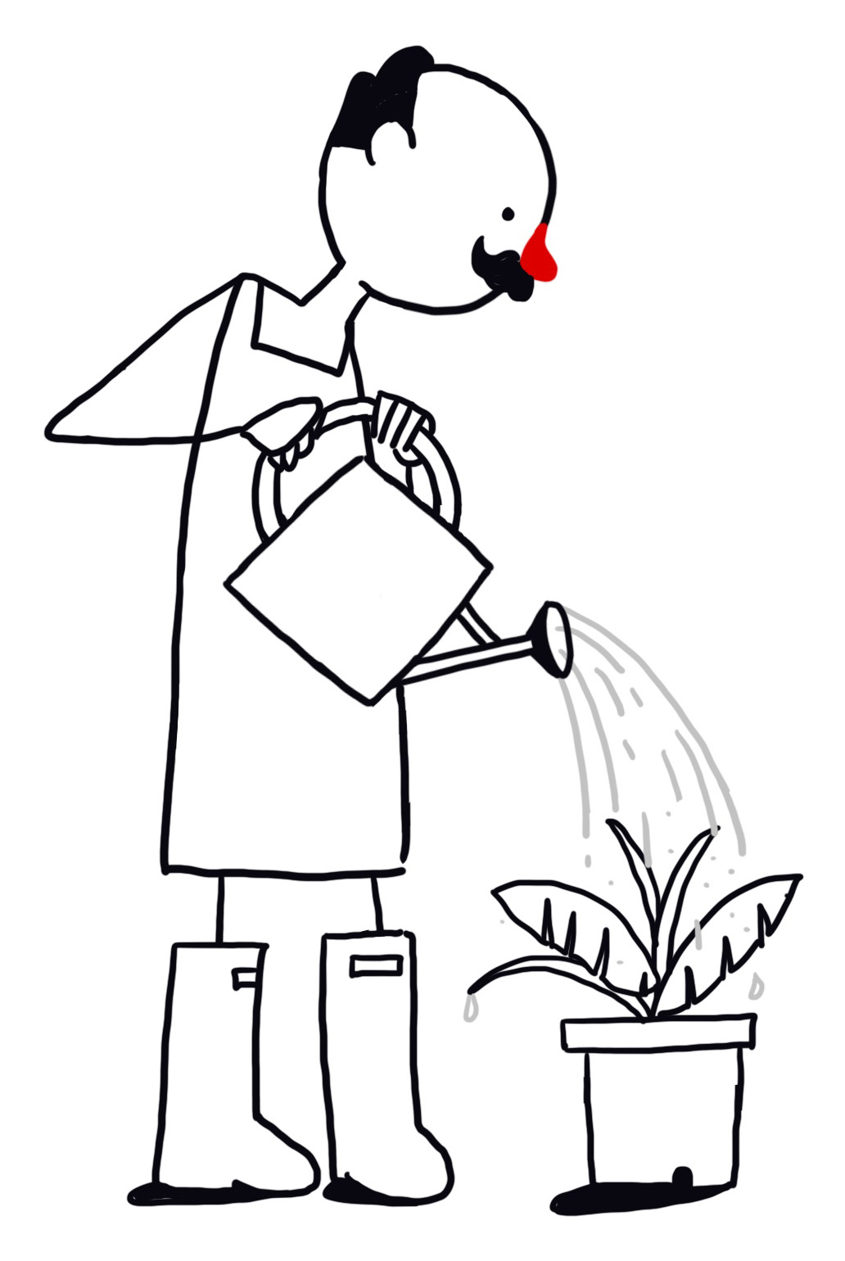
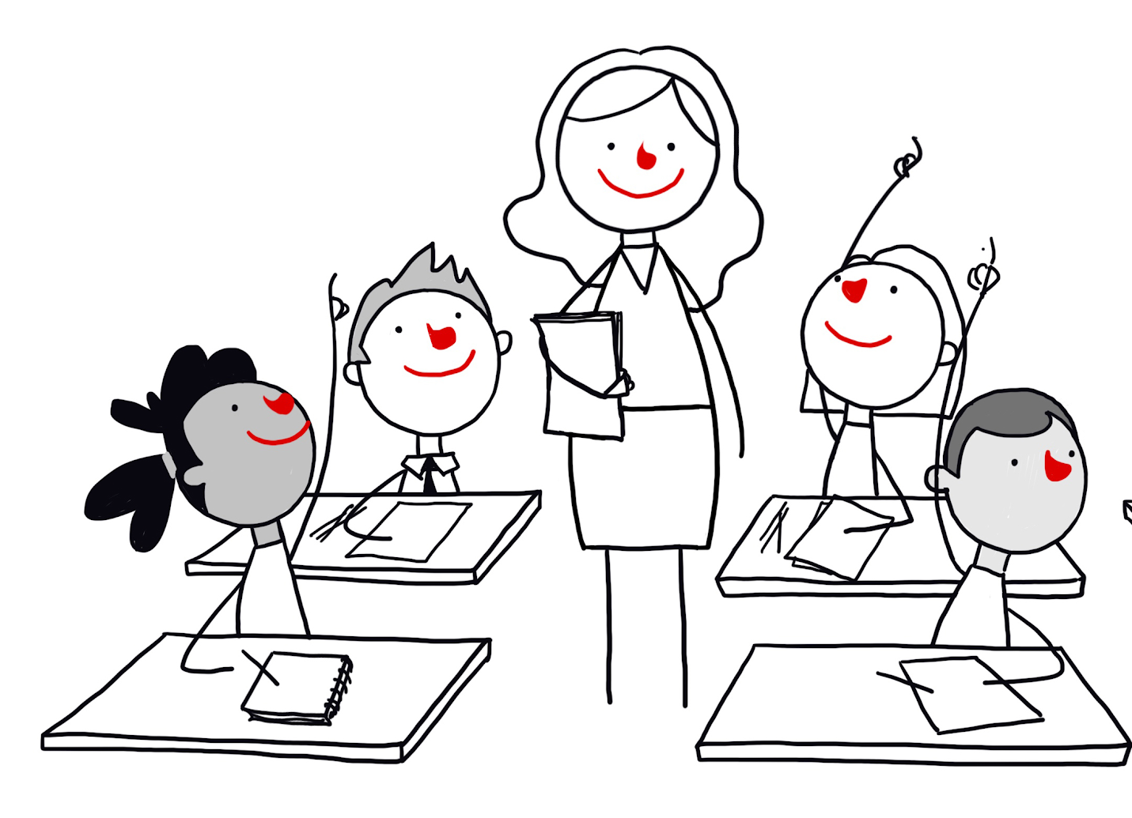
What survives?
Atoms
Genes
Ideas
Works
Contributions

Slide 19

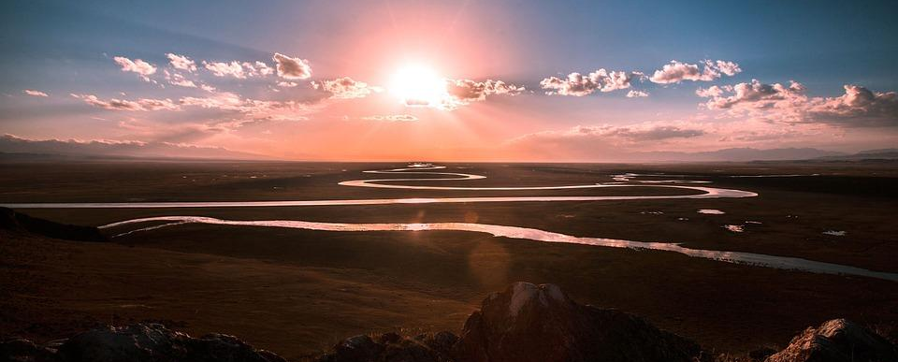
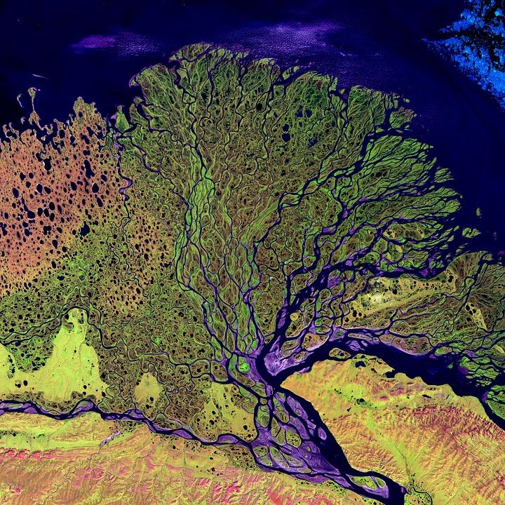
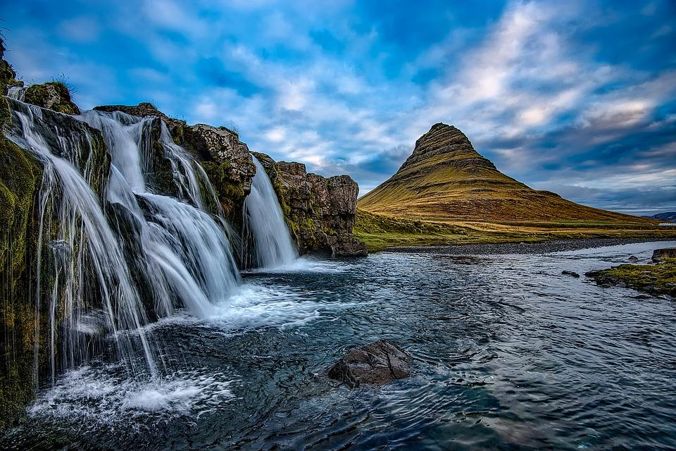

THE RIVER OF LIFE
‘An individual human existence should be like a river – small at first, narrowly contained within its banks, and rushing passionately past boulders and over waterfalls. Gradually the river grows wider, the banks recede, the waters flow more quietly, and – in the end – without any visible break, they become merged in the sea, and painlessly lose their individual being. The man or woman who in old age, can see his or her life in this way, will not suffer from the fear of death, since the things they care for will continue.’
Bertrand Russell

Slide 20
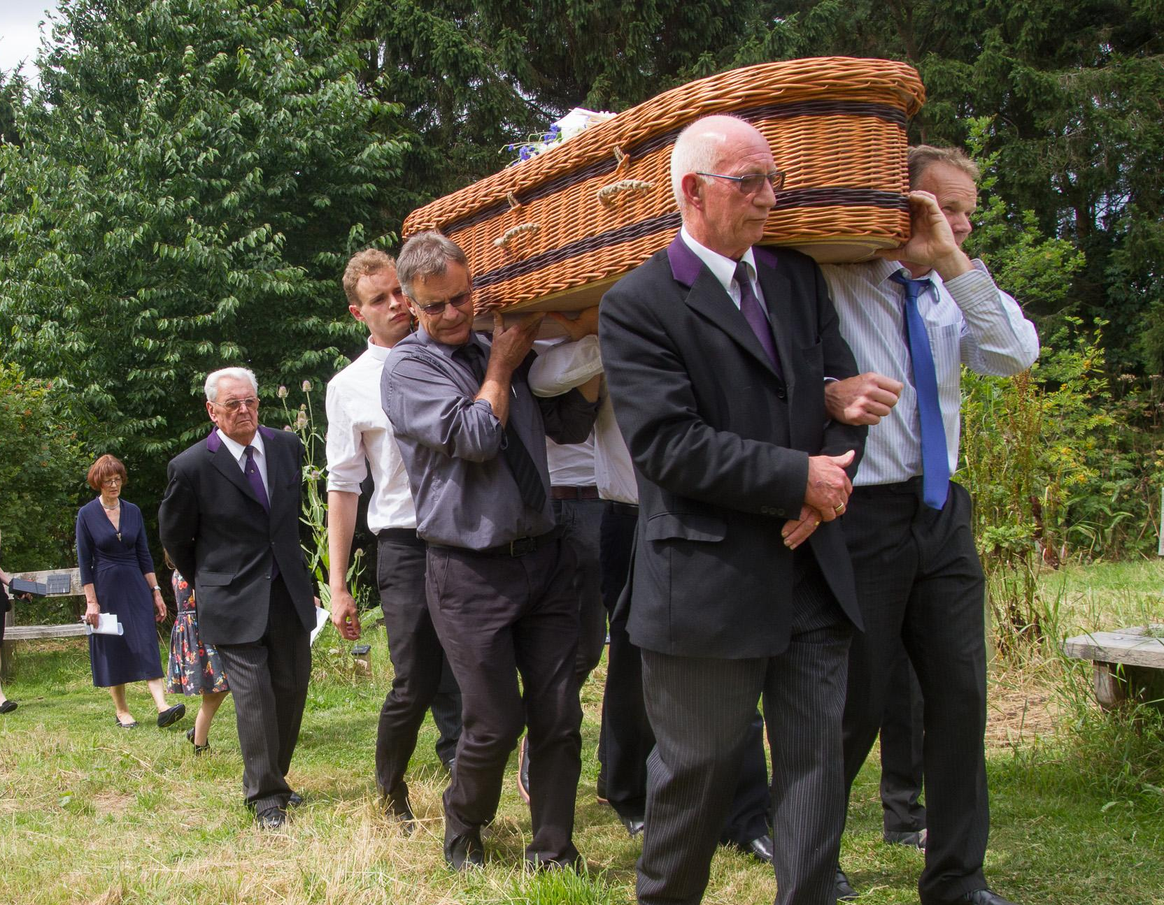
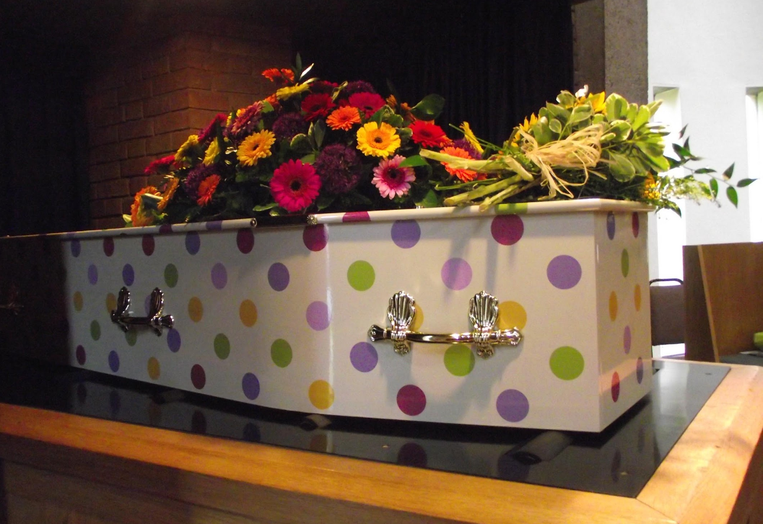
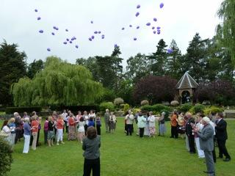
Humanist funerals

Slide 21
HUMANIST BELIEFS ABOUT DEATH
Death is the end of our individual existence.
We should try to make the most of the one life we have.
Funerals can celebrate a life that has been lived as well as acknowledging sadness at saying goodbye.
Something of us can live on after we die: our atoms, genes, works, and shared ideas and experiences.
Look for examples of these in the words spoken at humanist funerals.

Slide 22
The one life: humanist responses
How might a humanist respond to these statements?
Seeking freedom and happiness is a selfish way of life.
It must be terrifying and depressing to believe this is the only life we have.
Without a god or an afterlife, life has no meaning.

Slide 23
The humanist approach to living a happy life
We have one life and we should make the most of it
There is no ‘ultimate’ external meaning to life, but we have the capacity to make our own lives meaningful
Everyone should have the freedom to pursue what makes them happy, as long as they cause no harm

