Slide 1
Humanism and society

Slide 2
A humanist approach to life: a summary
Humanists believe the world is a natural place and science gives us the best way to understand it (humanists don’t believe in a god)
Humanists believe we should be free to make the most of the one life we have, seeking happiness and supporting others to do the same
Humanists believe we should use empathy and consider the impact of our actions on other people and animals

Slide 3

A humanist approach to building a healthy society
Human being have many shared needs and feelings
We have responsibility for making the world a better place
We should promote freedom, fairness, and kindness

Slide 4

One life, one world

Slide 5
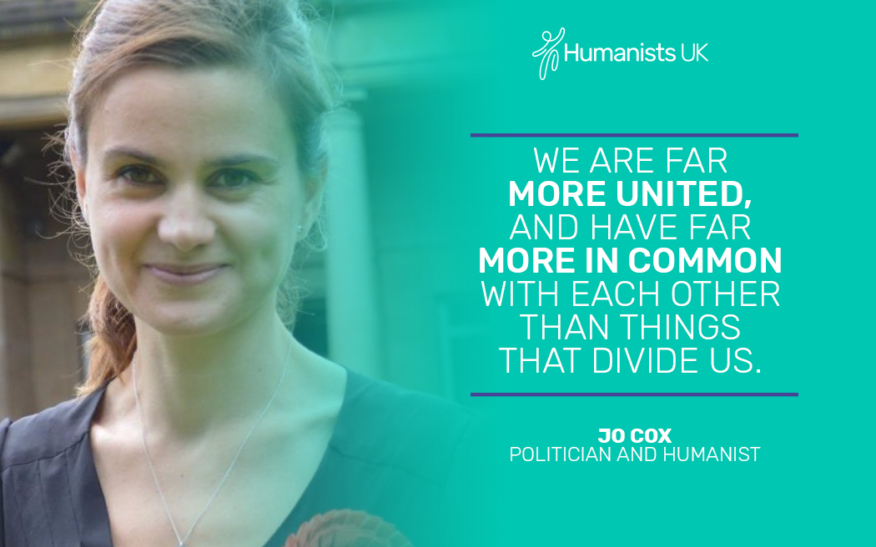
Human solidarity
How are human beings different from each other?
How are we all similar to each other?

Slide 6
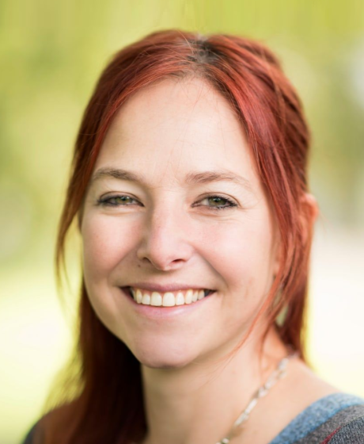
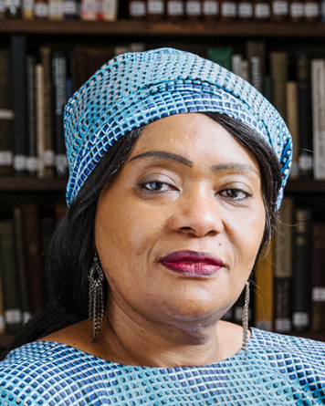
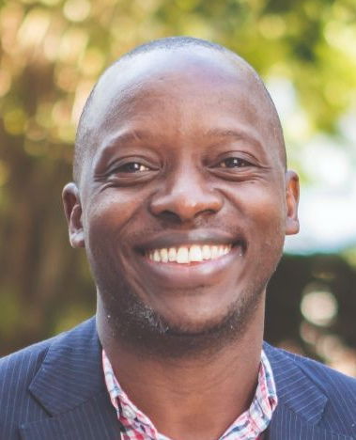
Human solidarity
‘The truth of humanity is that we are one, whilst we are different. We must oppose any who seek to divide and dehumanise us.’
Alice Roberts, President of Humanists UK
'Science has shown that all human beings belong to the same species, so we should respect each other.'
Lola Tinubu, Association of Black Humanists
‘Being a humanist means being a person that puts human beings first, being a person that doesn’t look at humans in terms of their religions, in terms of their tribes, in terms of their races. A person that looks at people because they are human beings like you.’
Kato Mukasa, Uganda Humanists Association

Slide 7
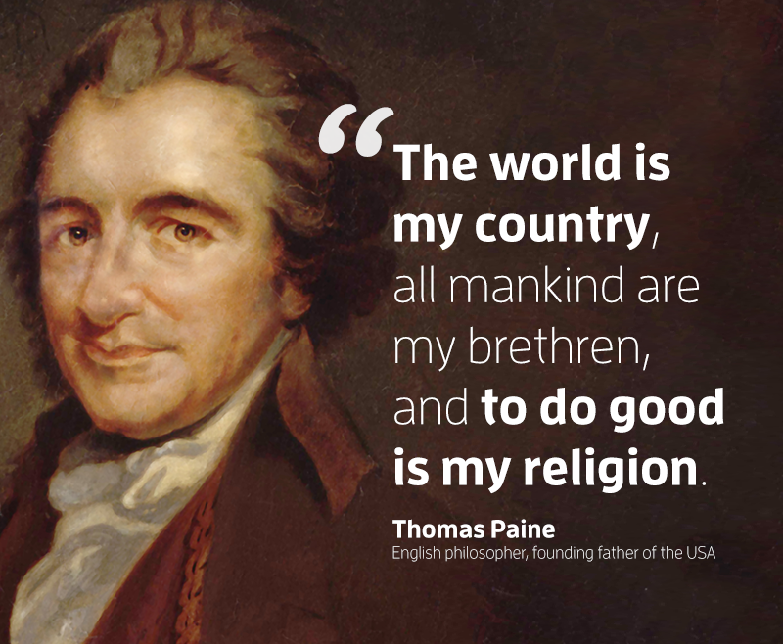
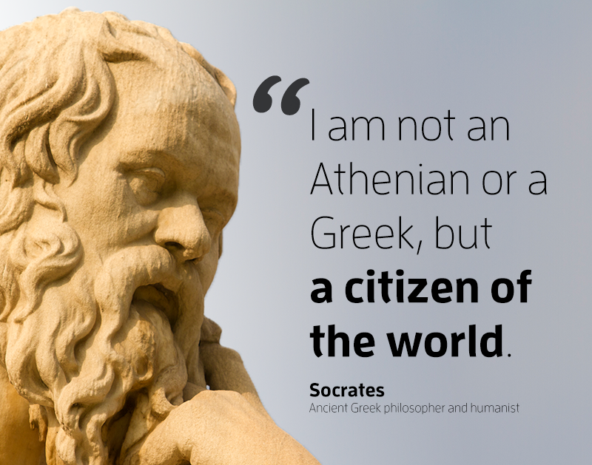
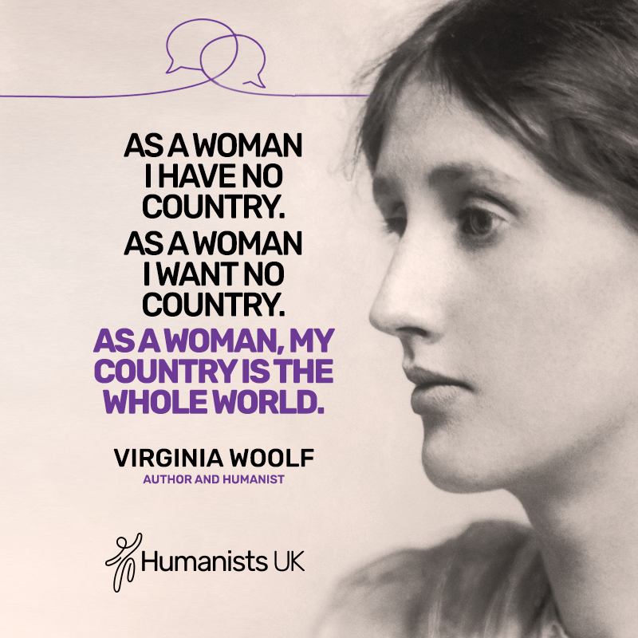
Human solidarity

Slide 8
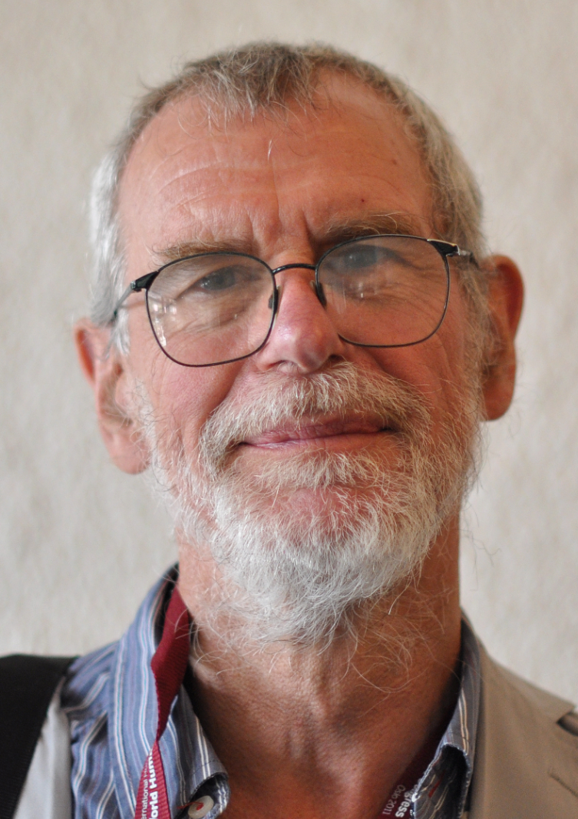
Human solidarity
‘If ‘humanism’ means anything at all, it must surely embrace respect and concern for all human beings, whether they are members of our own family or group or society or are people on the other side of the world whom we do not know and will never meet. It means a responsiveness to the needs of all with whom we share a common humanity.’
Richard Norman, humanist philosopher

Slide 9
Humanist motivations and goals
How might the following motivate humanists?
Humanists don’t believe that there is any force outside humanity that can help us.
Humanists believe this is the one life we all have (there is no afterlife after this one).

Slide 10
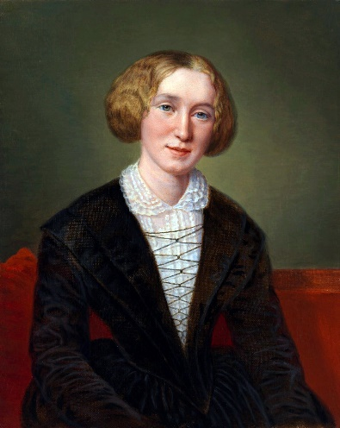
Human responsibility
‘It will never rain roses: when we want to have more roses we must plant more trees.’
George Eliot (Mary Anne Evans), humanist and author

Slide 11
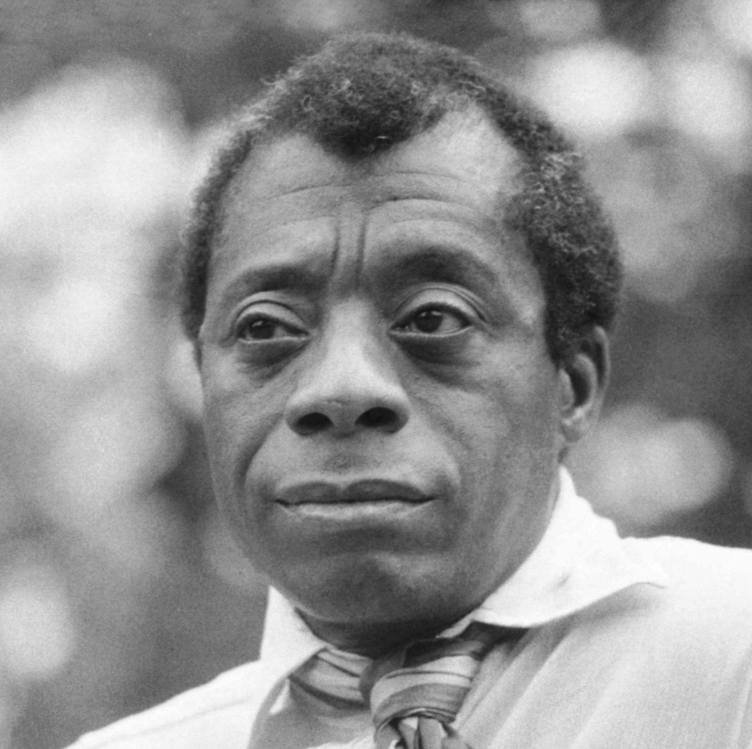
Human responsibility
'The world is before you and you need not take it or leave it as it was before you came in.'
James Baldwin, author

Slide 12
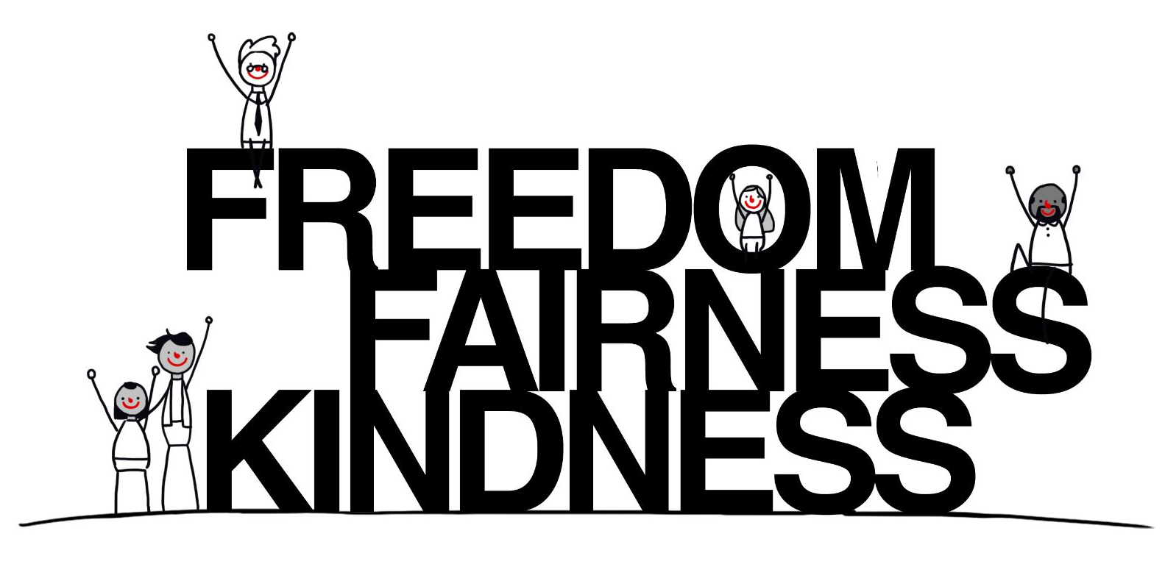
Humanist goals

Slide 13
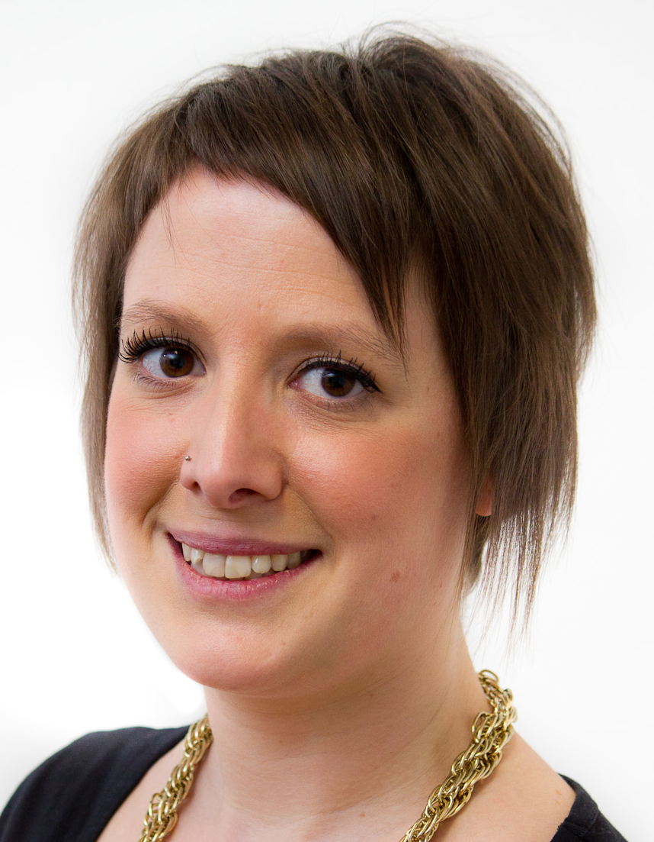
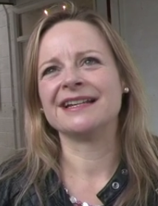
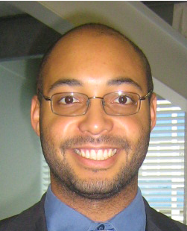
Humanist goals
‘Humanists want a world where people are free and people live good, happy, and fulfilling lives as far as possible.’
Naomi Phillips
‘I believe the world that humanists would want is a world where everybody is treated equally and with fairness and with respect.’
Michelle Beckett
‘A humanist’s ideal world would be one in which everybody feels that they can be their genuine selves.’
Alex Williams

Slide 14
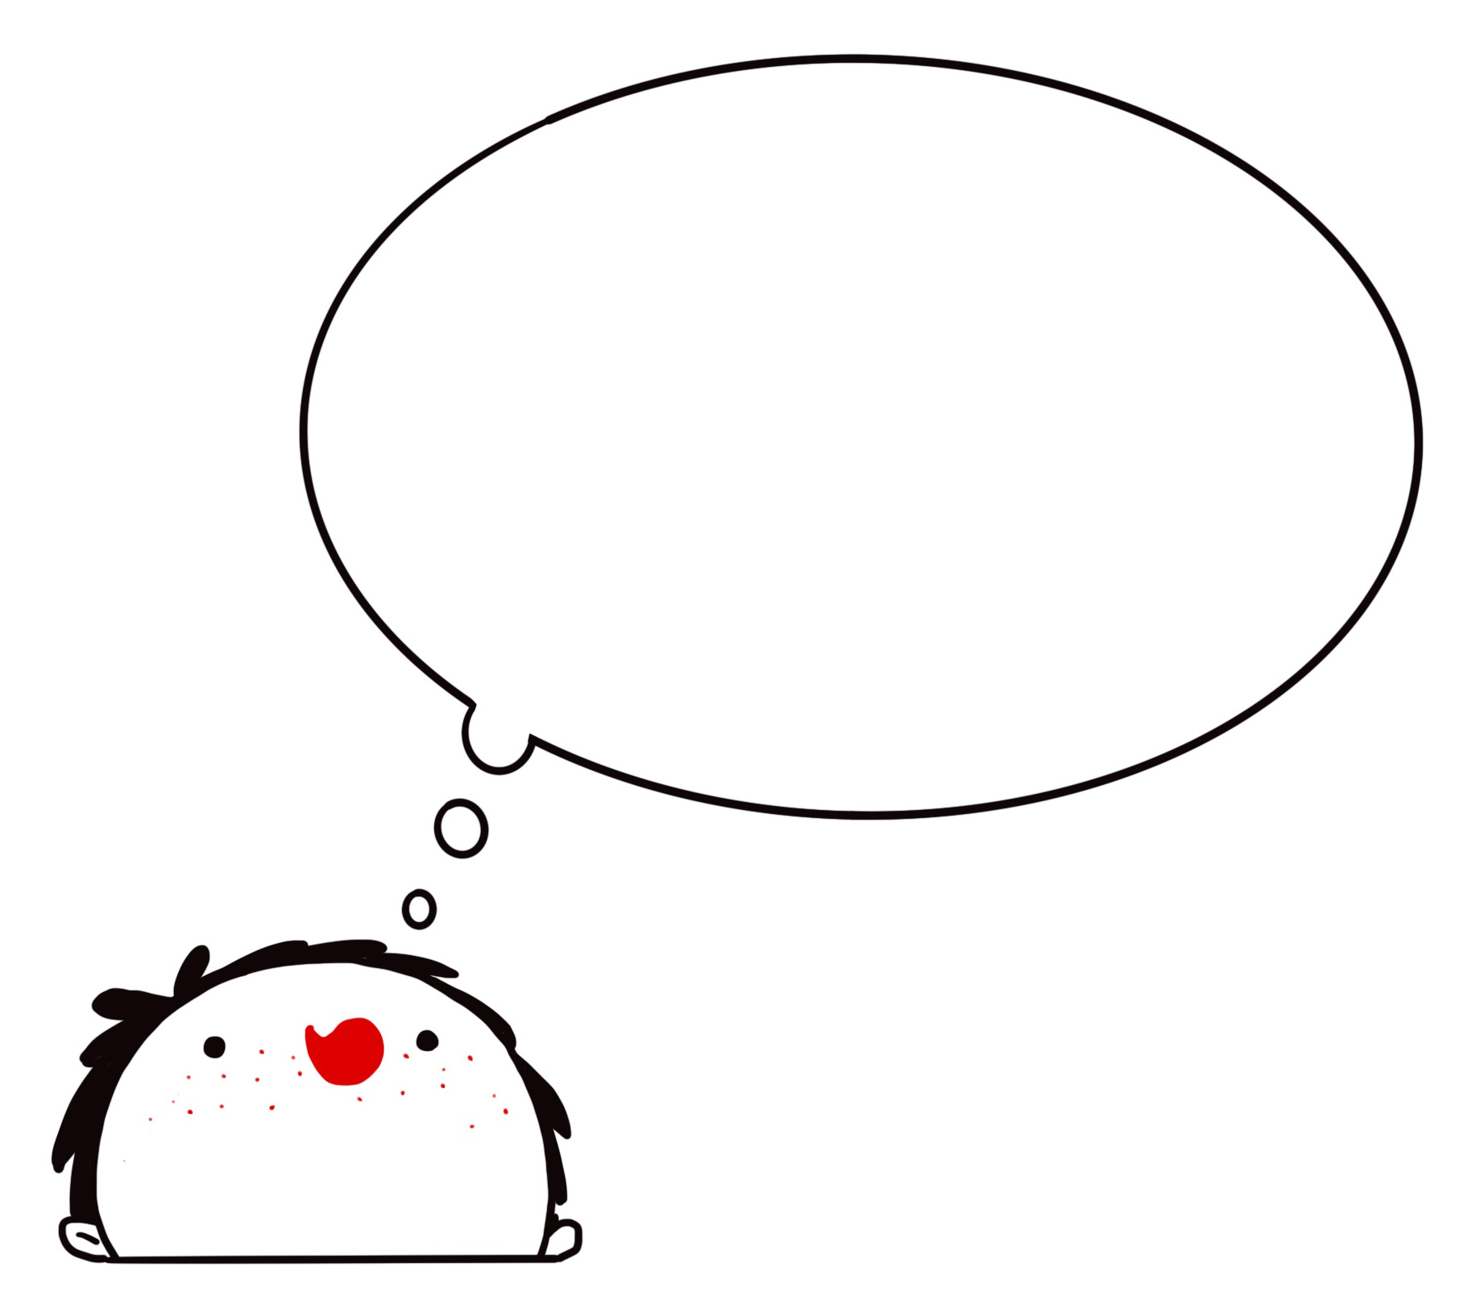
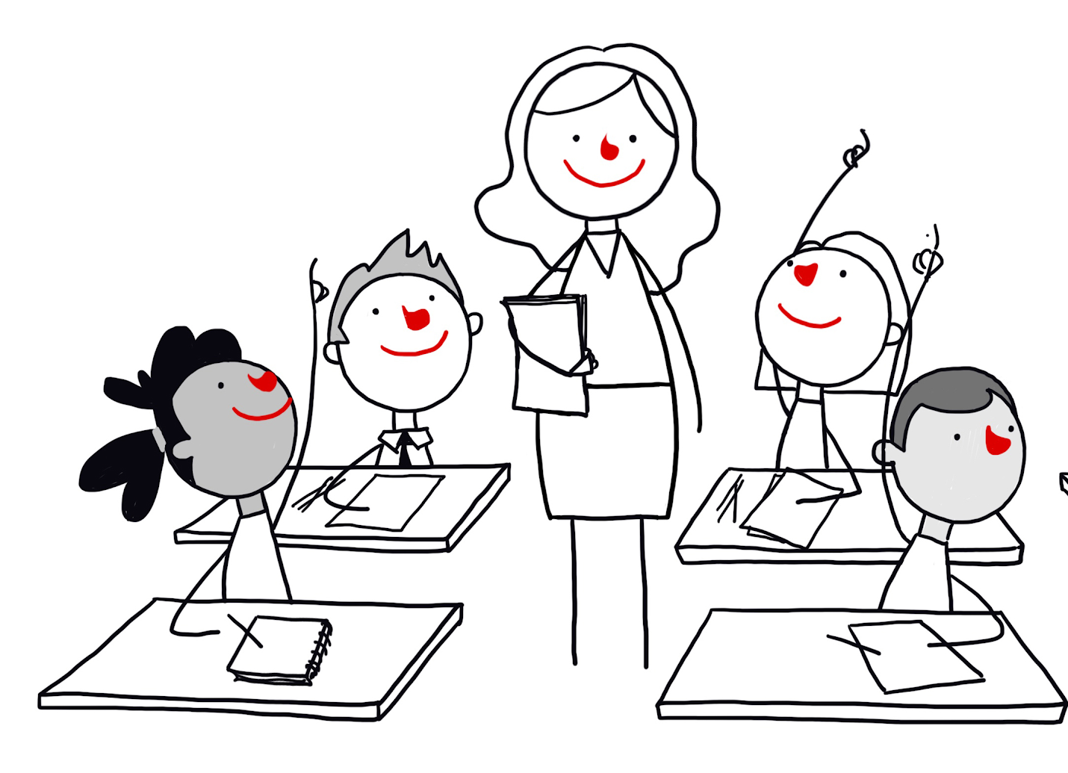
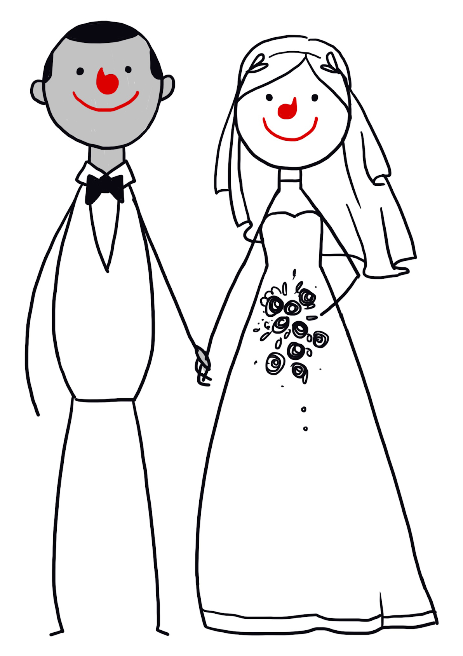

Human rights
Human rights say that everyone should have…
The freedom to believe what they want
The freedom to say what they believe
The right to an education
The right to marry and start a family
The right to privacy
The right to take part in elections

Slide 15
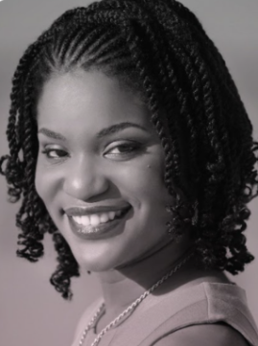
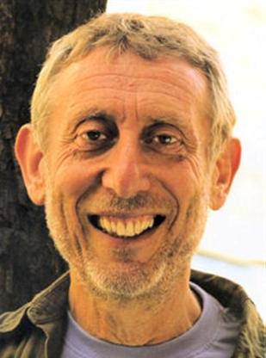
Work to be done
‘Being a humanist empowers me to live a meaningful life, to take a stand against inequality and injustices, and to create a better world for future generations.’
Maachelle Farley, Humanists Barbados
‘Most of us try to do things that are good for ourselves and our loved ones. I do this, but then I see that millions of people who try to do things that are good for themselves and their loved ones also struggle to earn enough, to stay well enough, to look after their children and grandparents. So, this leads me to think, what can we do to make it fair? It's pointless to think I can do this on my own… I think we have to work with people in ways that are fair for all – never thinking that person is worse or better than me because of what they look like or where they were born.’
Michael Rosen, co-author of What is humanism?

Slide 16
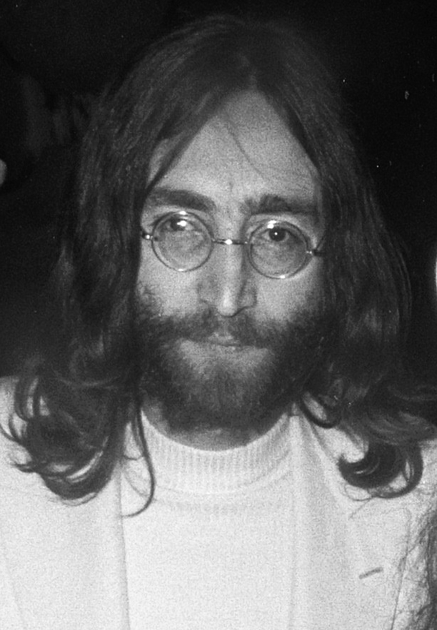
Imagine, by John Lennon
Imagine there's no heaven
It's easy if you try
No hell below us
Above us only sky
Imagine all the people
Living for today
Imagine there's no countries
It isn't hard to do
Nothing to kill or die for
And no religion, too
Imagine all the people
Living life in peace
You may say I'm a dreamer
But I'm not the only one
I hope someday you'll join us
And the world will be as one
Imagine no possessions
I wonder if you can
No need for greed or hunger
A brotherhood of man
Imagine all the people
Sharing all the world
You may say I'm a dreamer
But I'm not the only one
I hope someday you'll join us
And the world will live as one
What do you think is the message of the song?

Slide 17
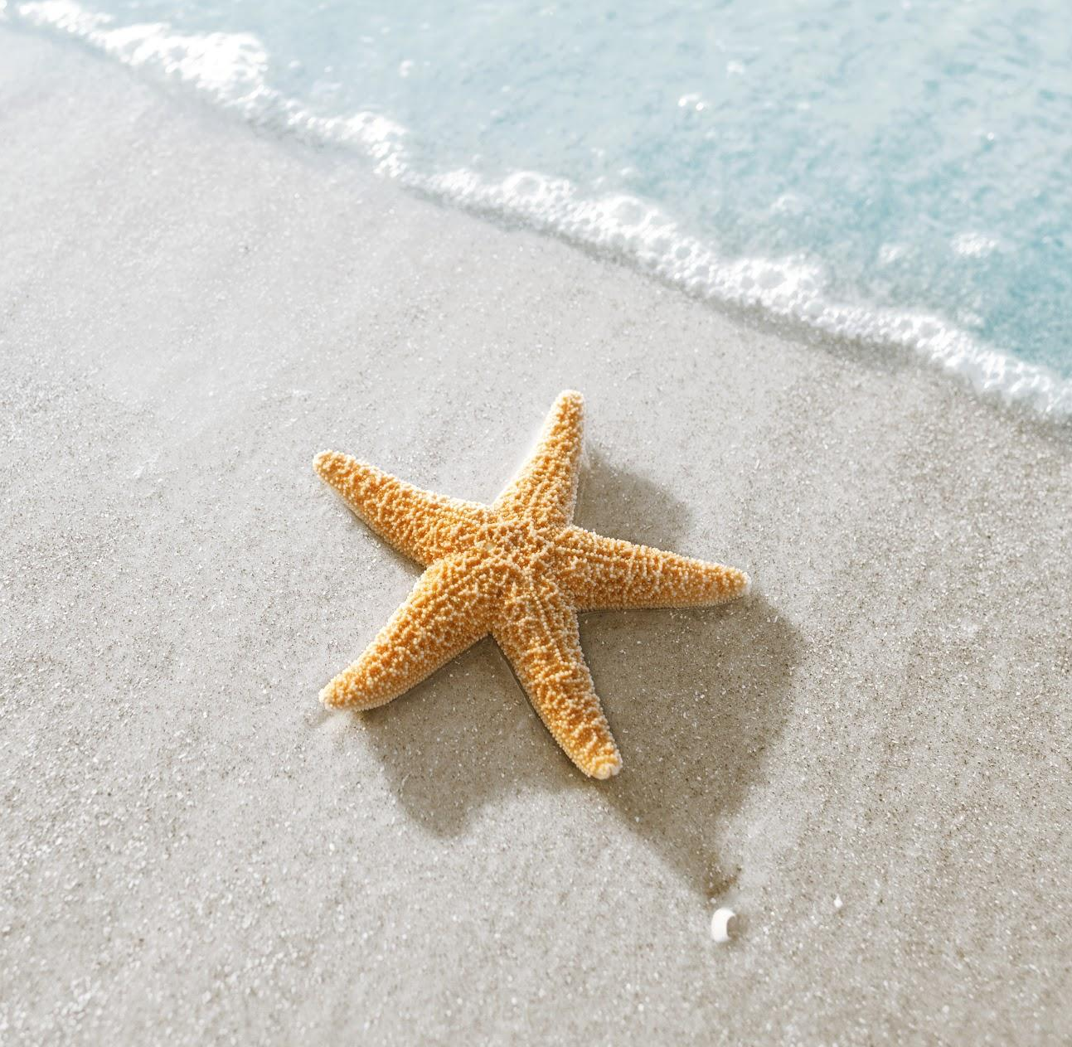
The starfish thrower
One day a man was walking along the beach when he saw a girl. He watched as the girl reached down, picked up a starfish from the sand, and threw it into the ocean.
‘What are you doing?’ asked the man.
‘I am throwing starfishes into the ocean,’ said the girl. ‘The sea has washed them up onto the beach. If I don’t throw them back before the sun comes up, they will dry up and die.’
‘But the beach goes on for miles and there are thousands of starfishes,’ said the man. ‘You’ll never throw them all back. There are too many. You can’t possibly make a difference.’
The girl listened politely, then picked up another starfish, threw it back into the sea, and said, ‘I made a difference to that one.’

Slide 18
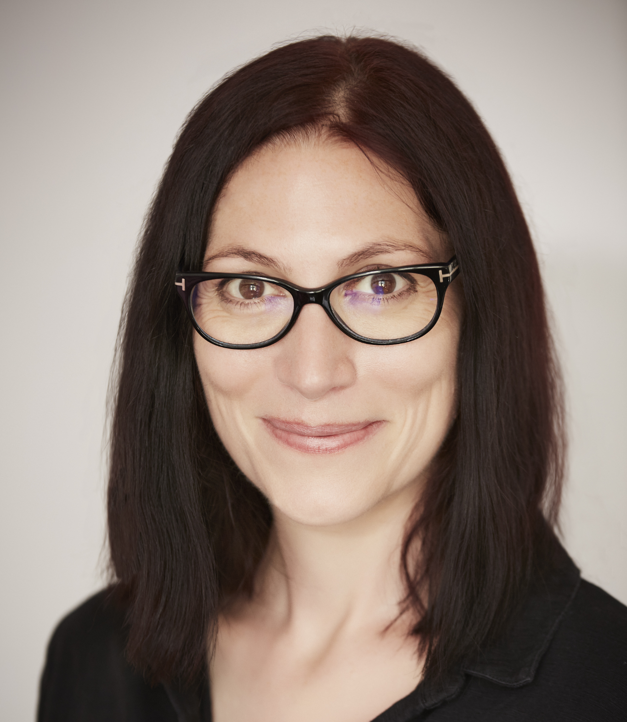
Human responsibility
Making a difference
‘It doesn’t matter if you can’t make a difference on a global level. Most of us won’t find the cure to a disease or discover clean energy. But even on the smallest scale, you can make the people around you feel happier because you’re there.’
Natalie Haynes, author

Slide 19
A humanist approach to building a healthy society
Human being have many shared needs and feelings
We have responsibility for making the world a better place
We should promote freedom, fairness, and kindness

