Slide 1
Humanism and society

Slide 2
A humanist approach to life: a summary
Humanists believe the world is a natural place – we should ask questions and look for evidence to help us to understand it (humanists don’t believe in a god)
Humanists believe we should be free to find what makes us happy
Humanists believe we should be kind to other people, animals, and the planet

Slide 3

A humanist approach to building a healthy society
We can value our human achievements
We should promote freedom, fairness, and kindness
We have responsibility for making the world a better place

Slide 4

One world

Slide 5
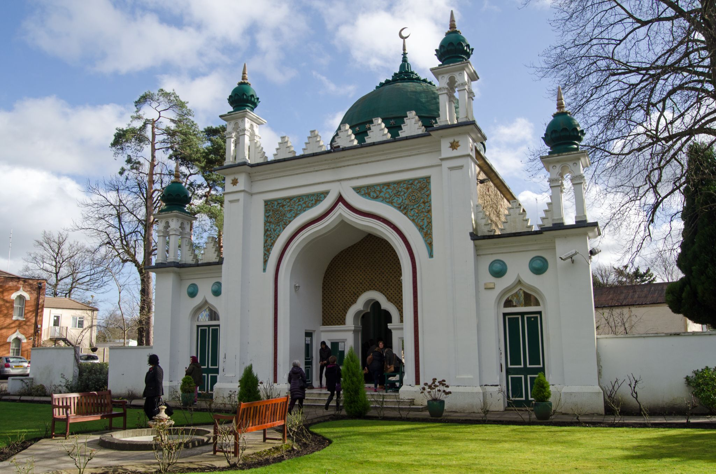
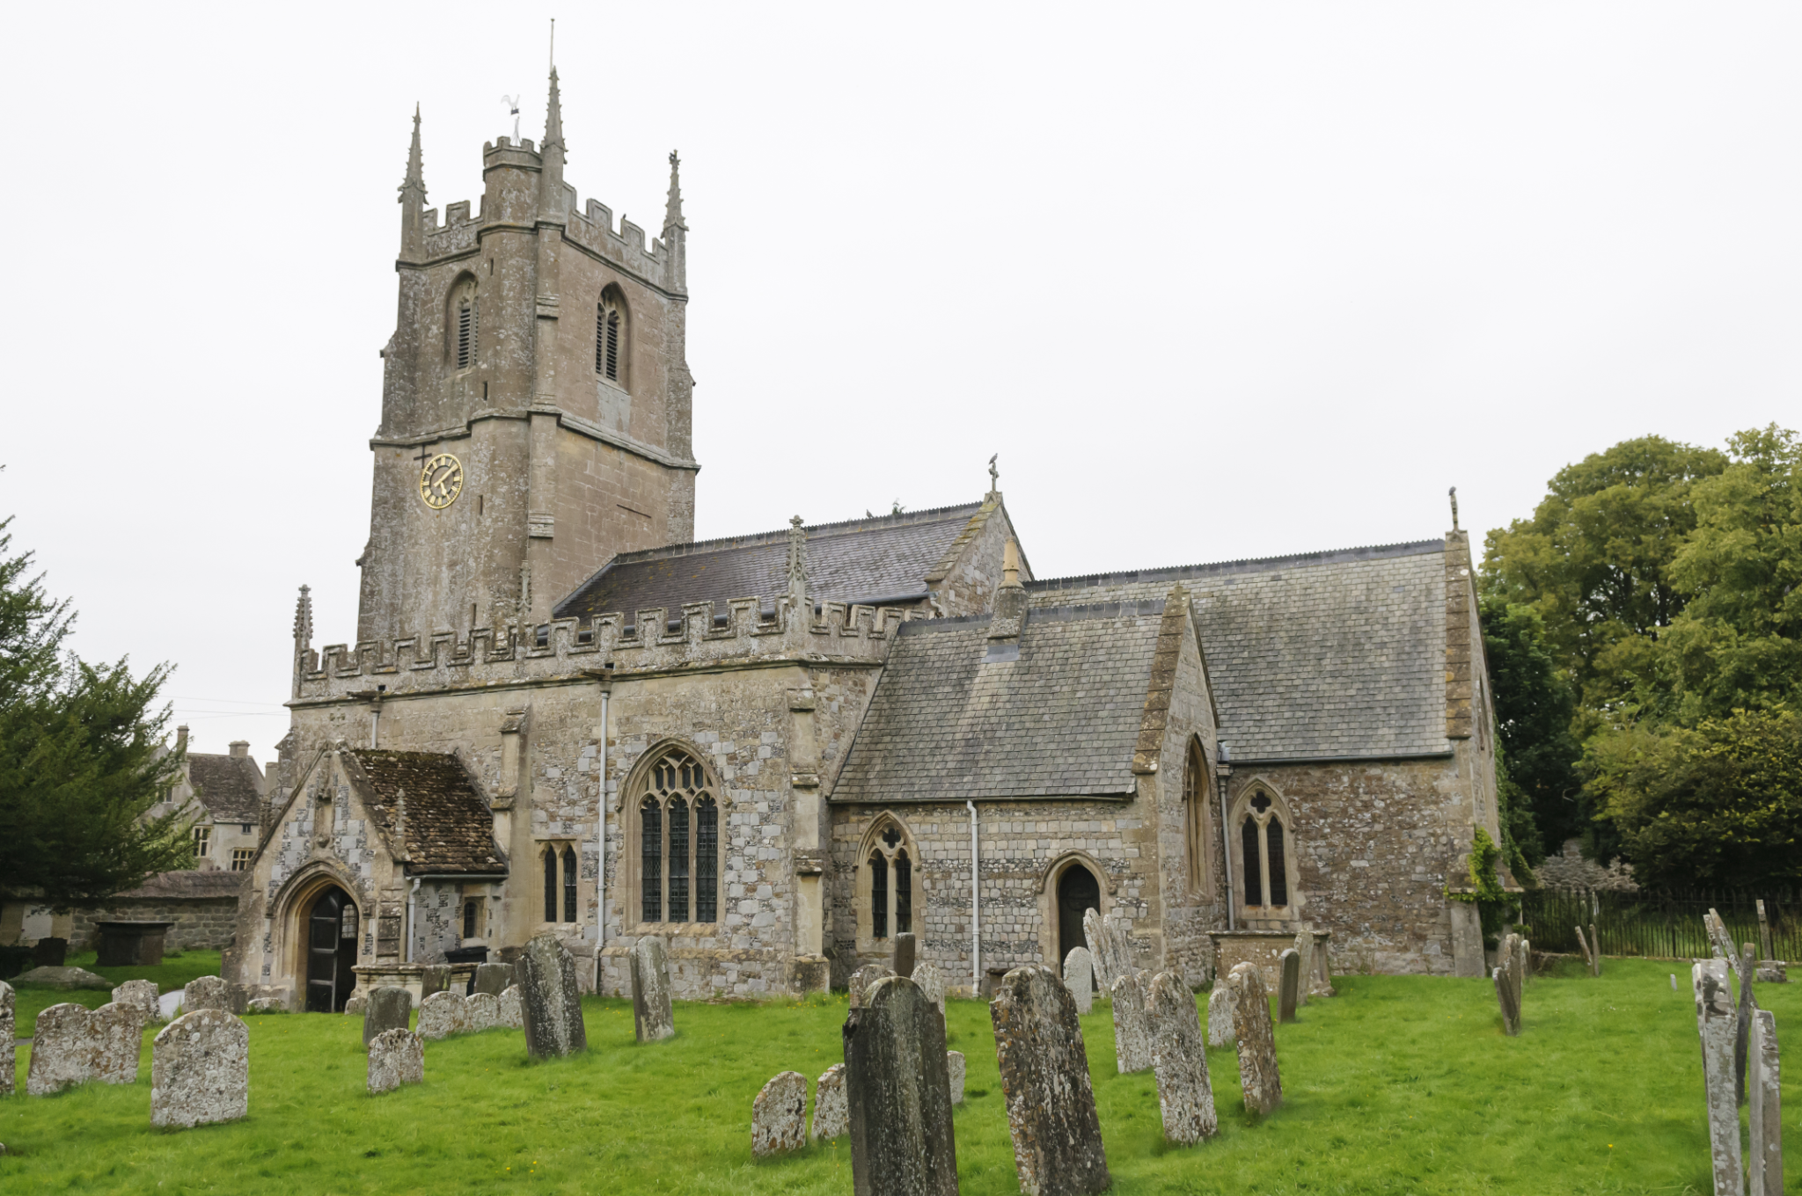
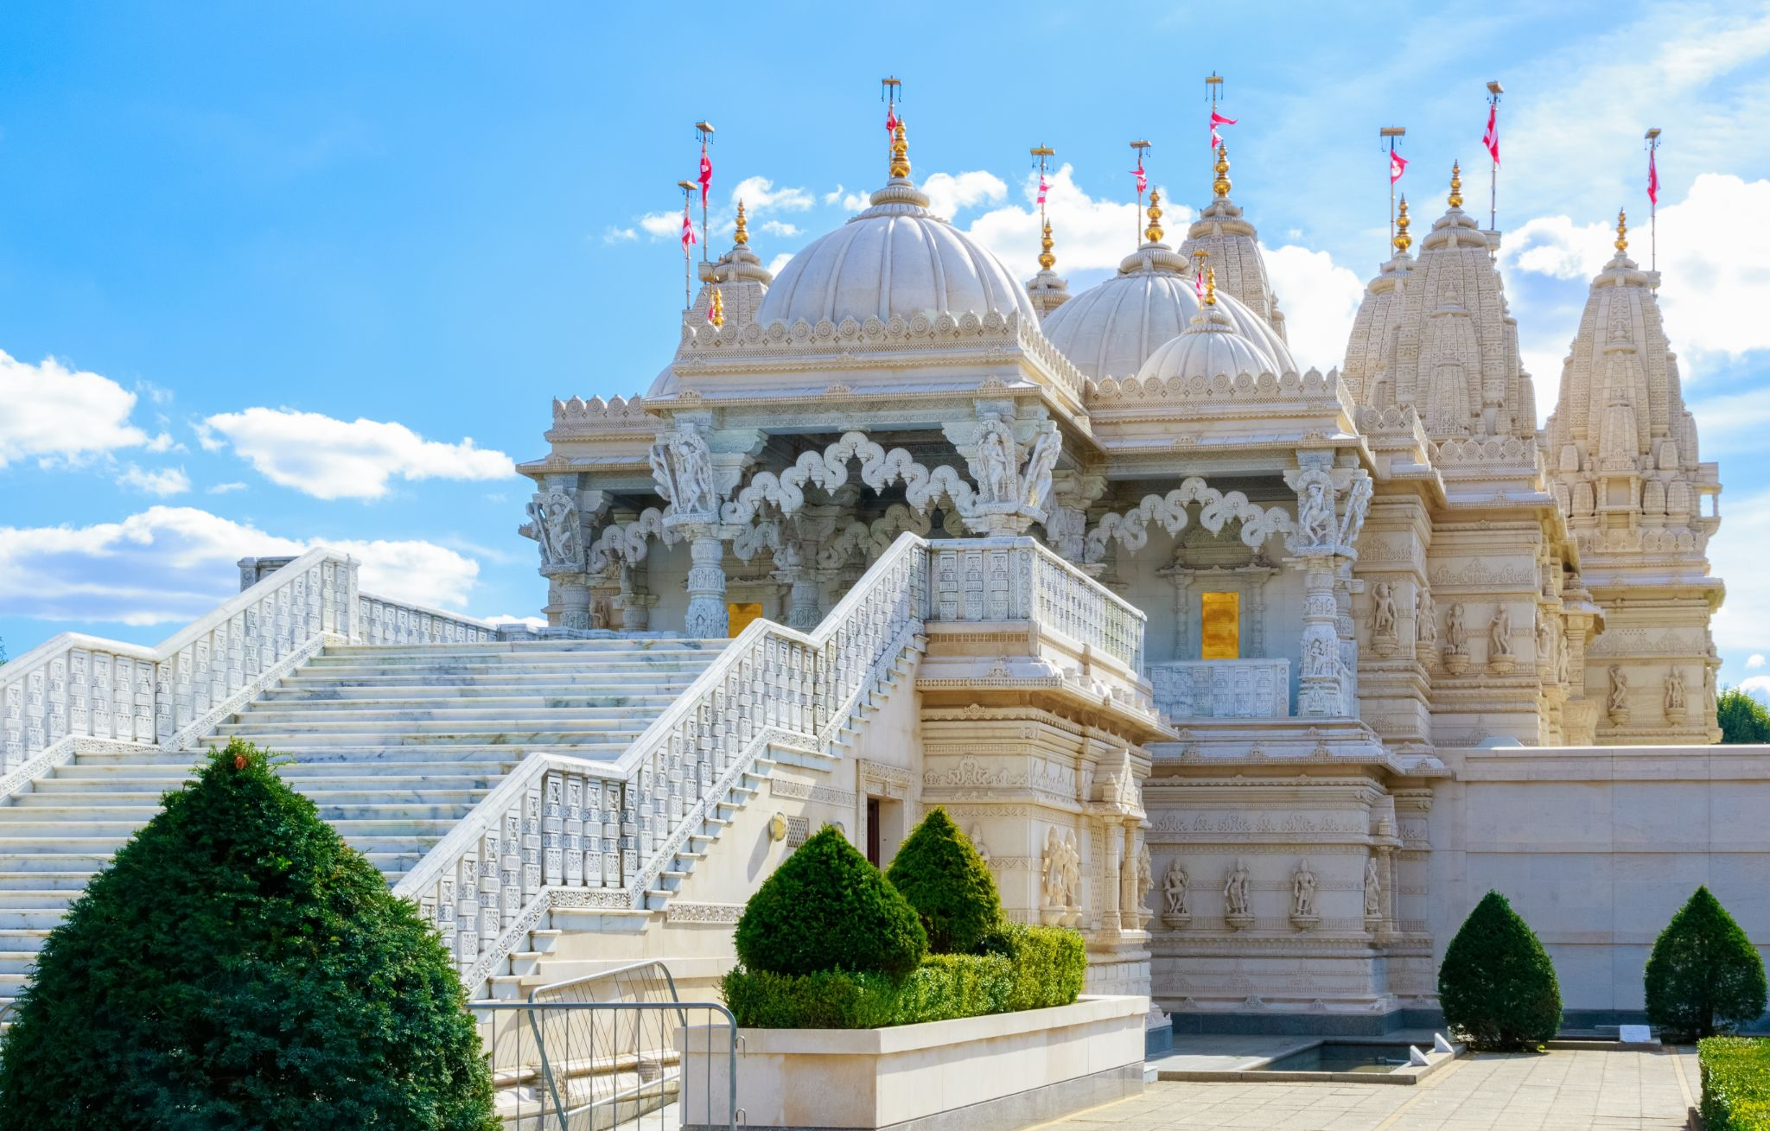
Places of worship

Slide 6
Special places
Things that humanists value:
Happiness
Good health
Education
Community
Democracy (everybody sharing in decisions about what happens in society)
What places might humanists think of as special places?

Slide 7

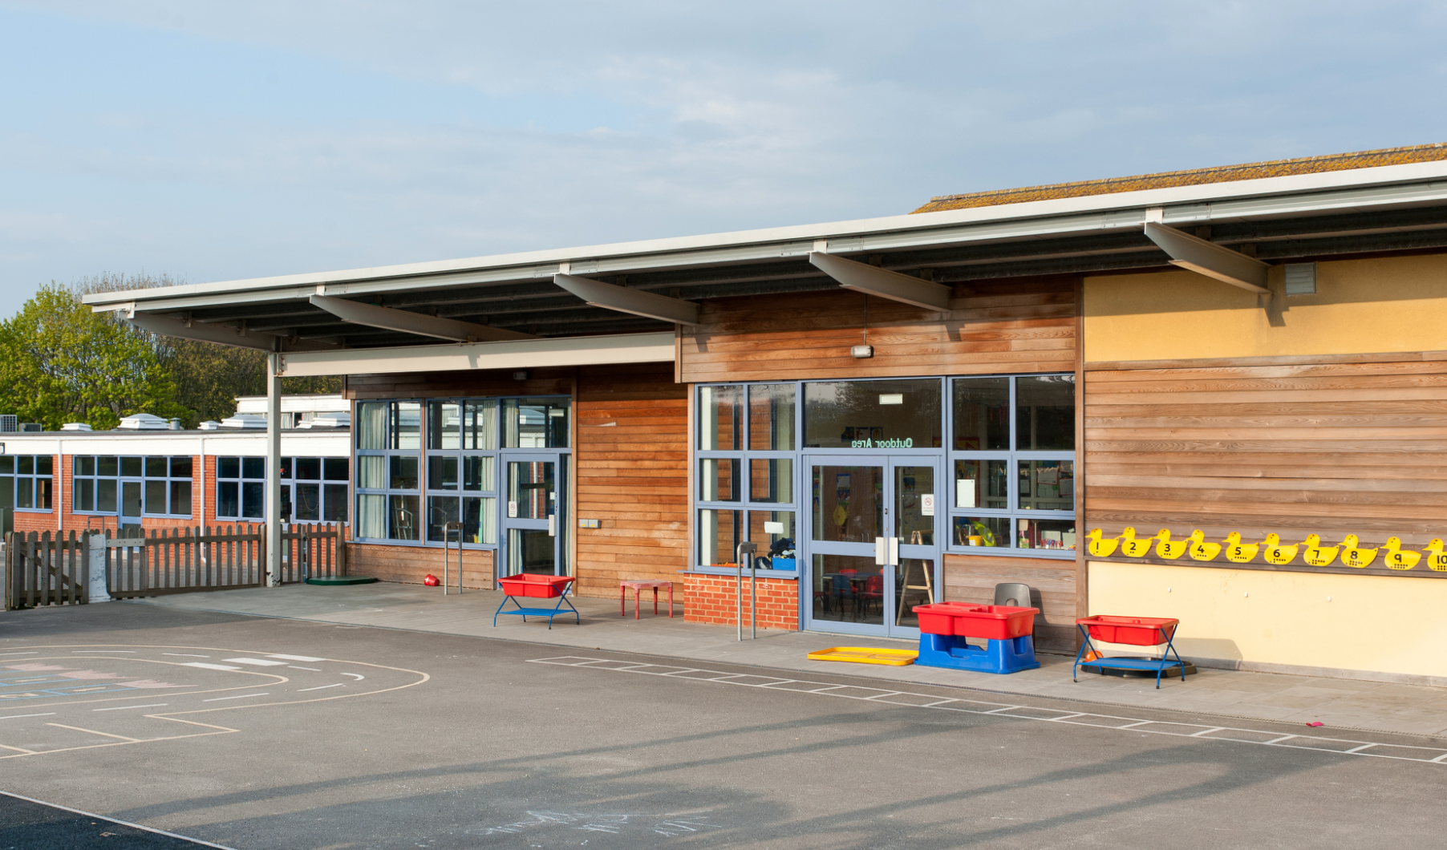
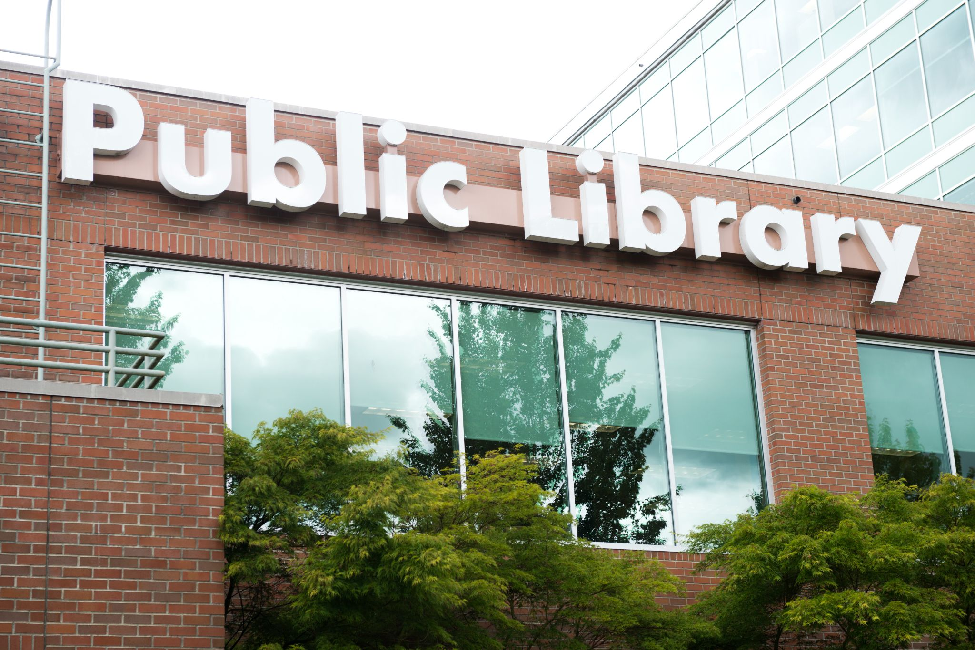
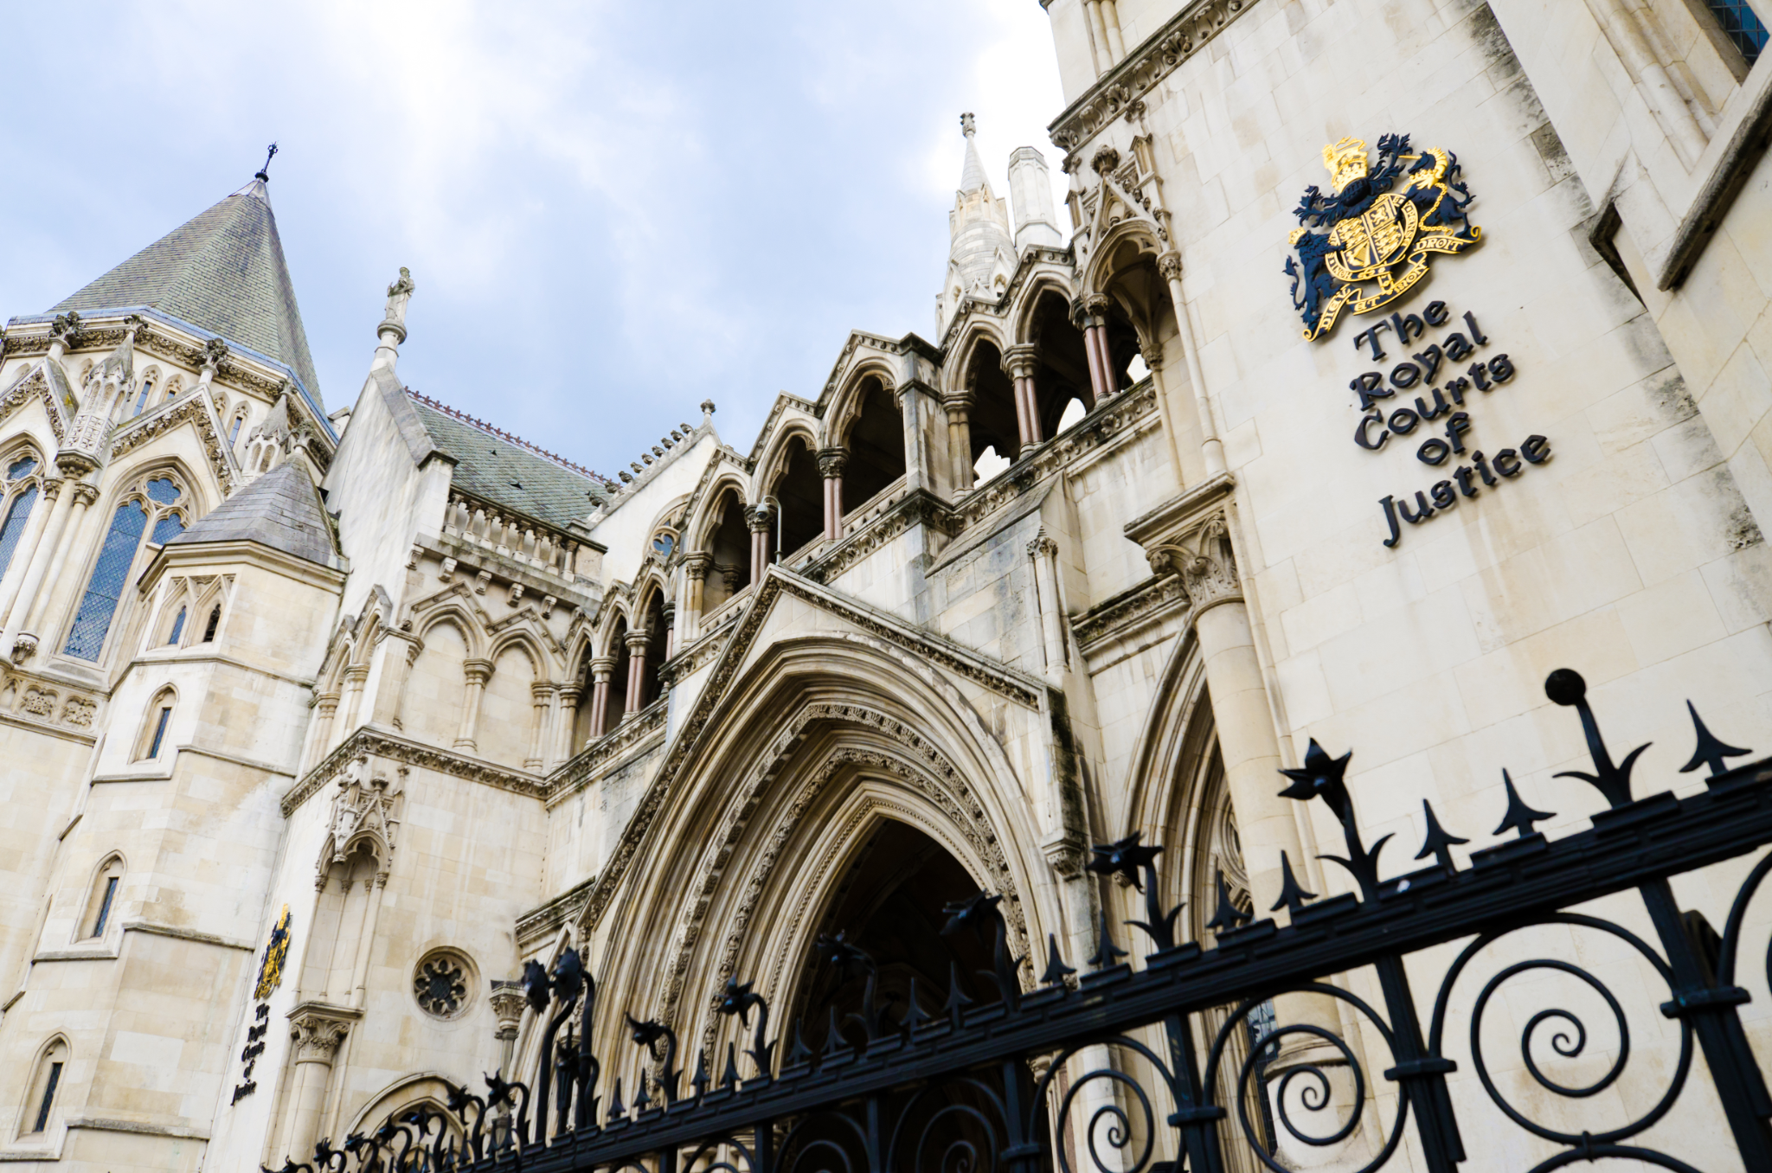
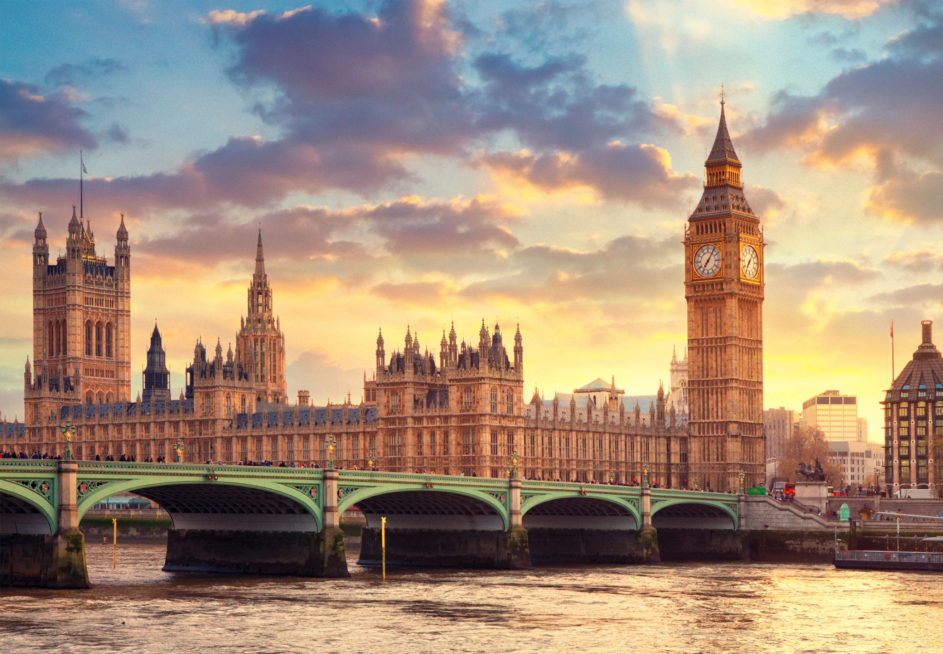
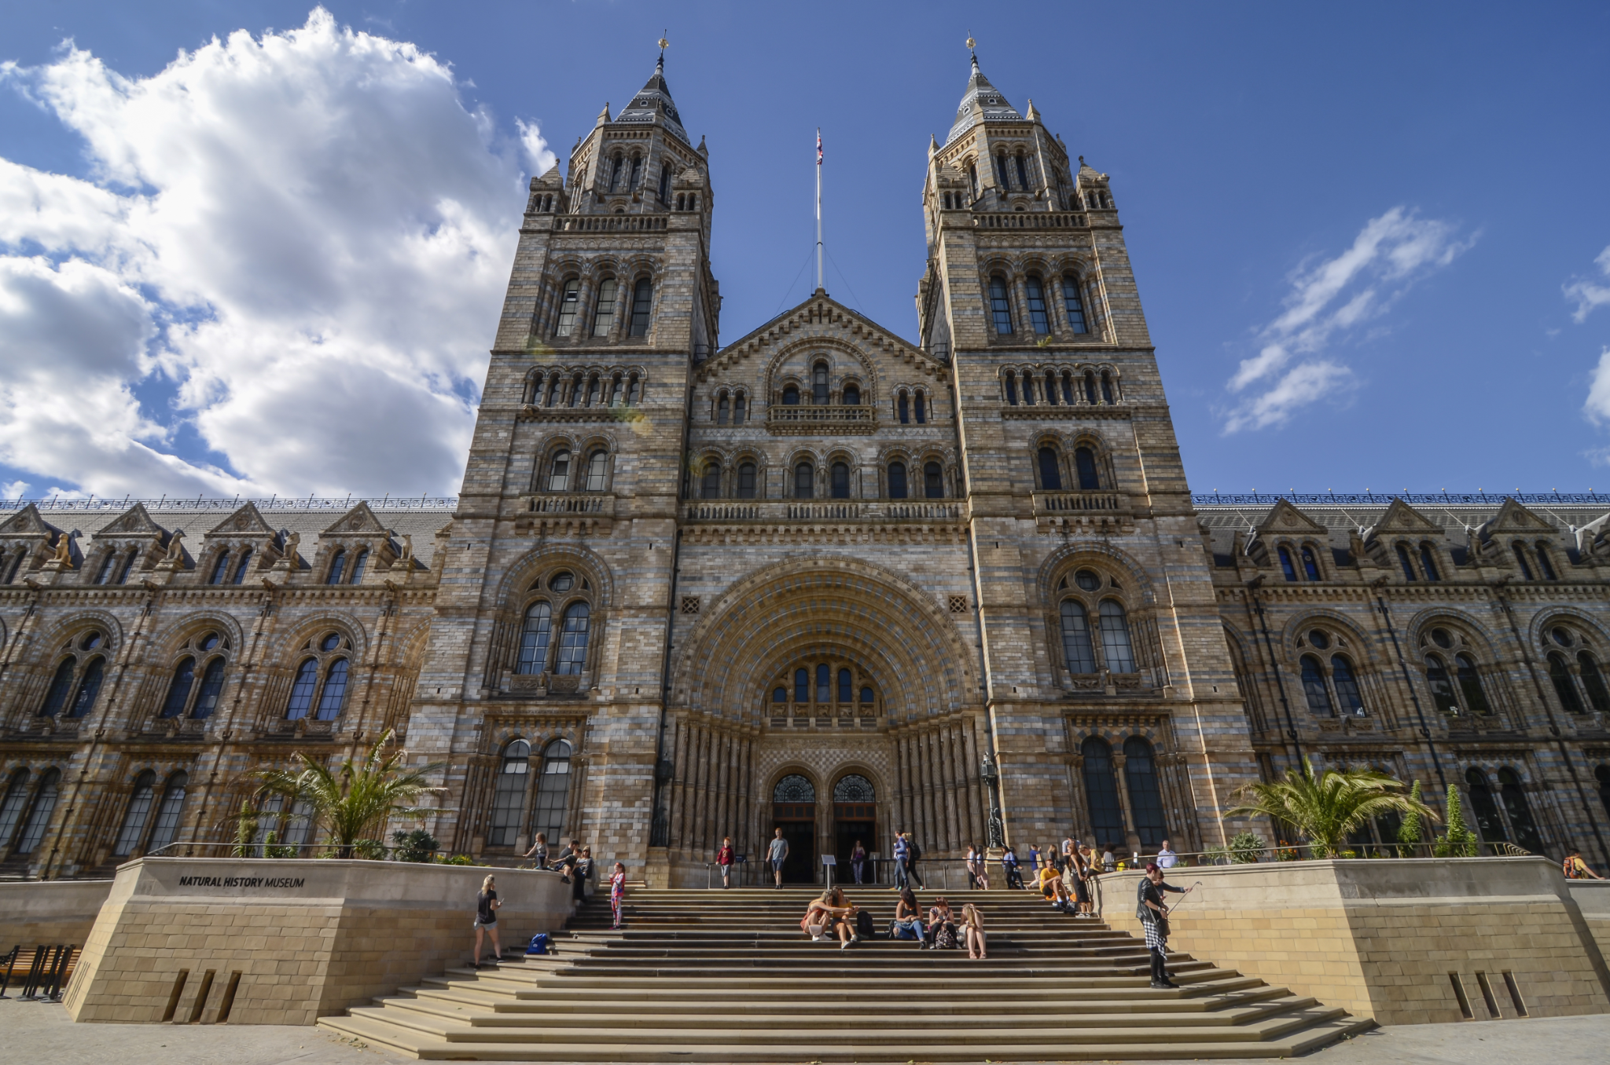
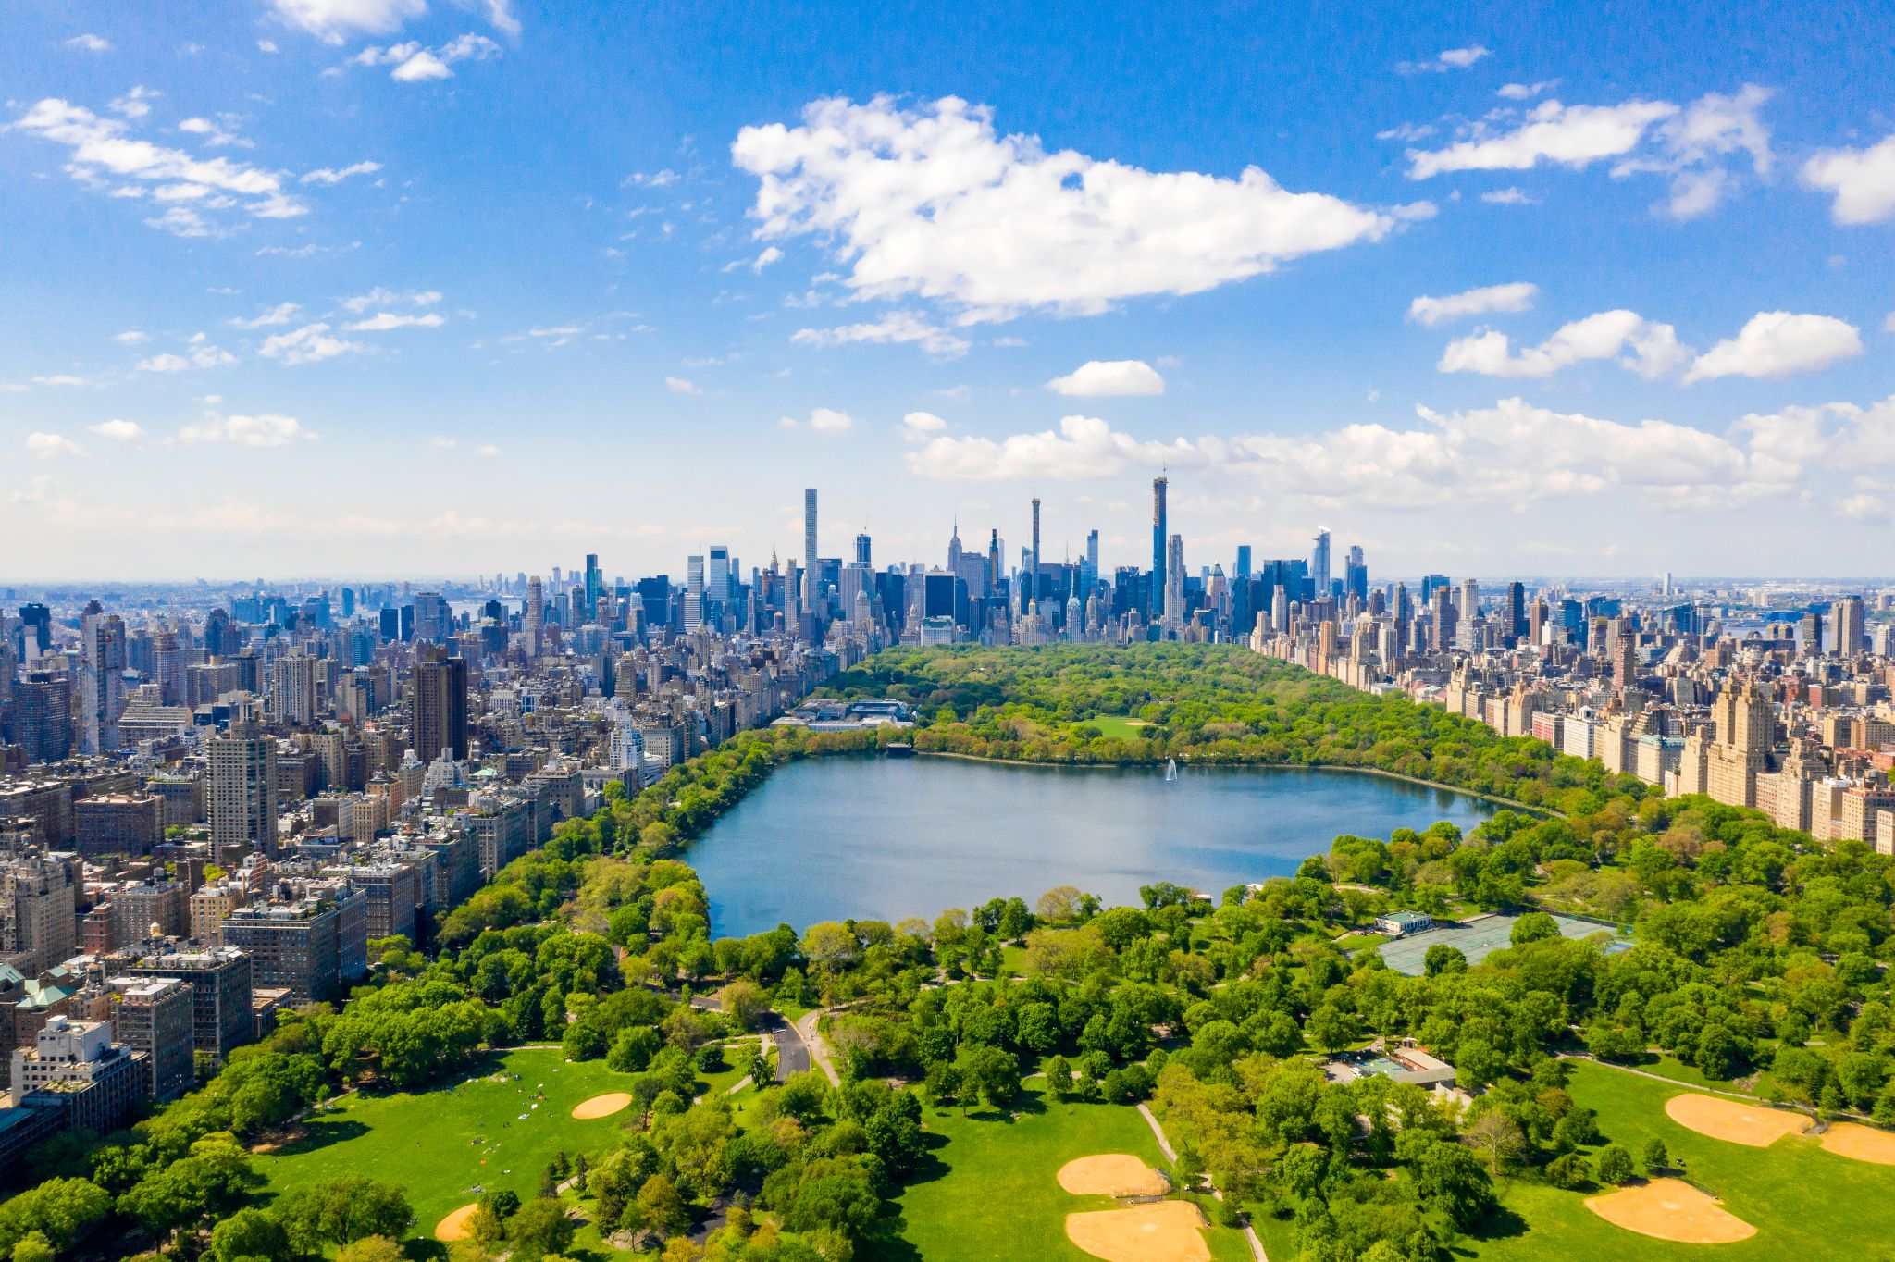
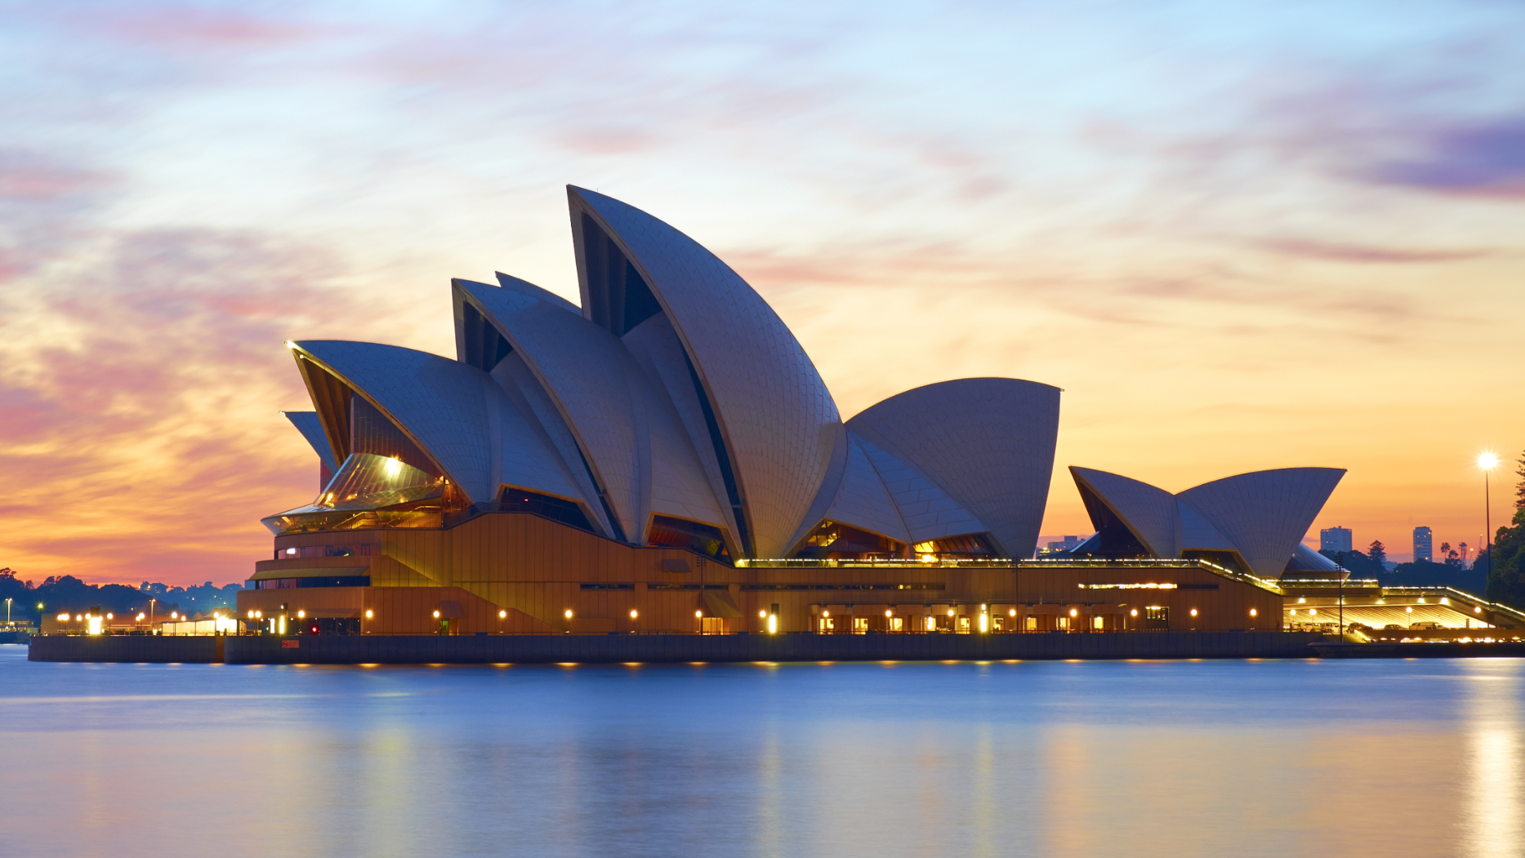
Special places

Slide 8
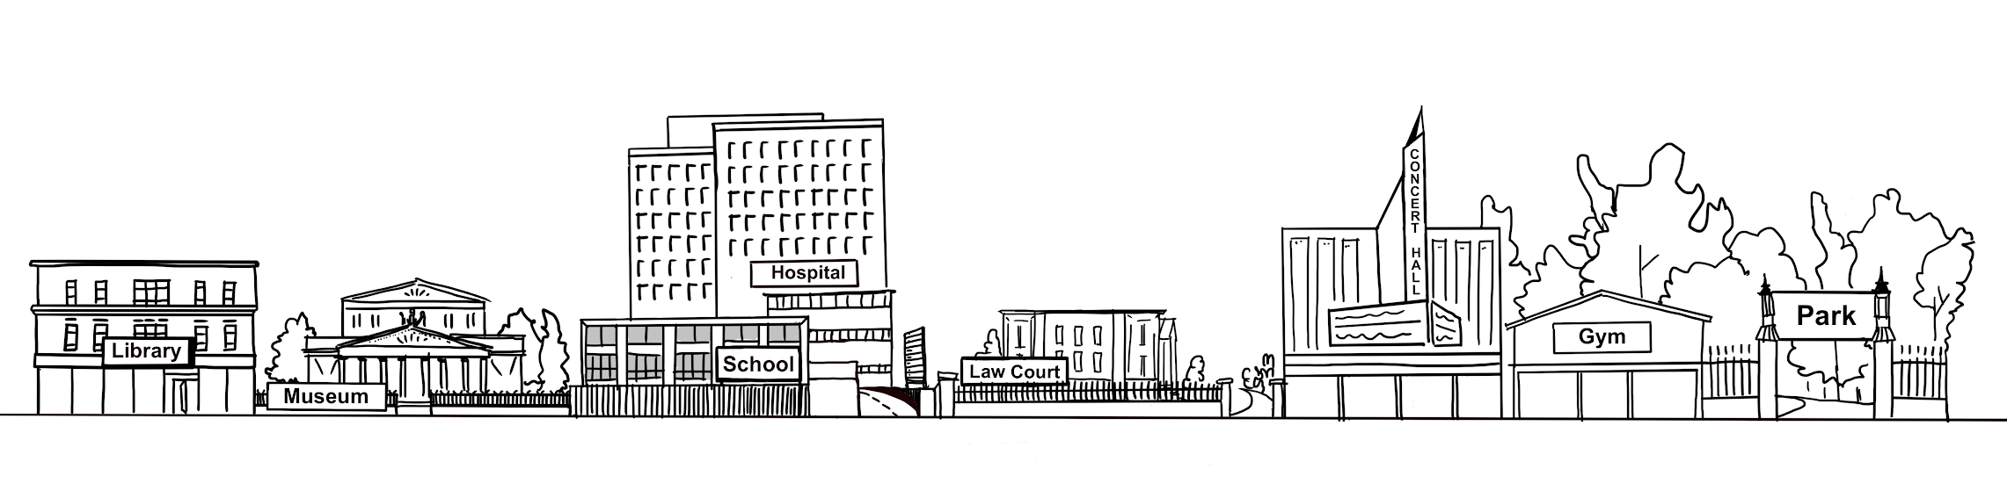
Special places

Slide 9

Humanist goals

Slide 10
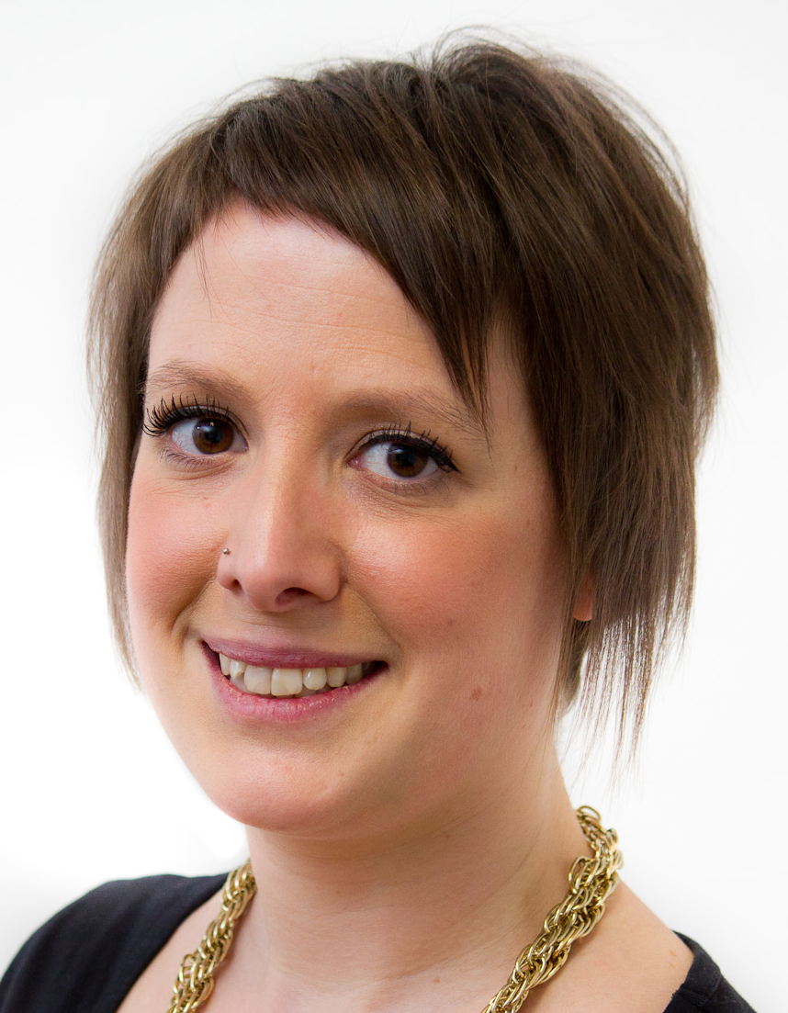
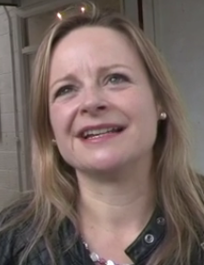
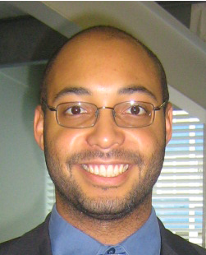
Humanist goals
‘Humanists want a world where people are free and people live good, happy, and fulfilling lives as far as possible.’
Naomi Phillips
‘I believe the world that humanists would want is a world where everybody is treated equally and with fairness and with respect.’
Michelle Beckett
‘A humanist’s ideal world would be one in which everybody feels that they can be their genuine selves.’
Alex Williams

Slide 11
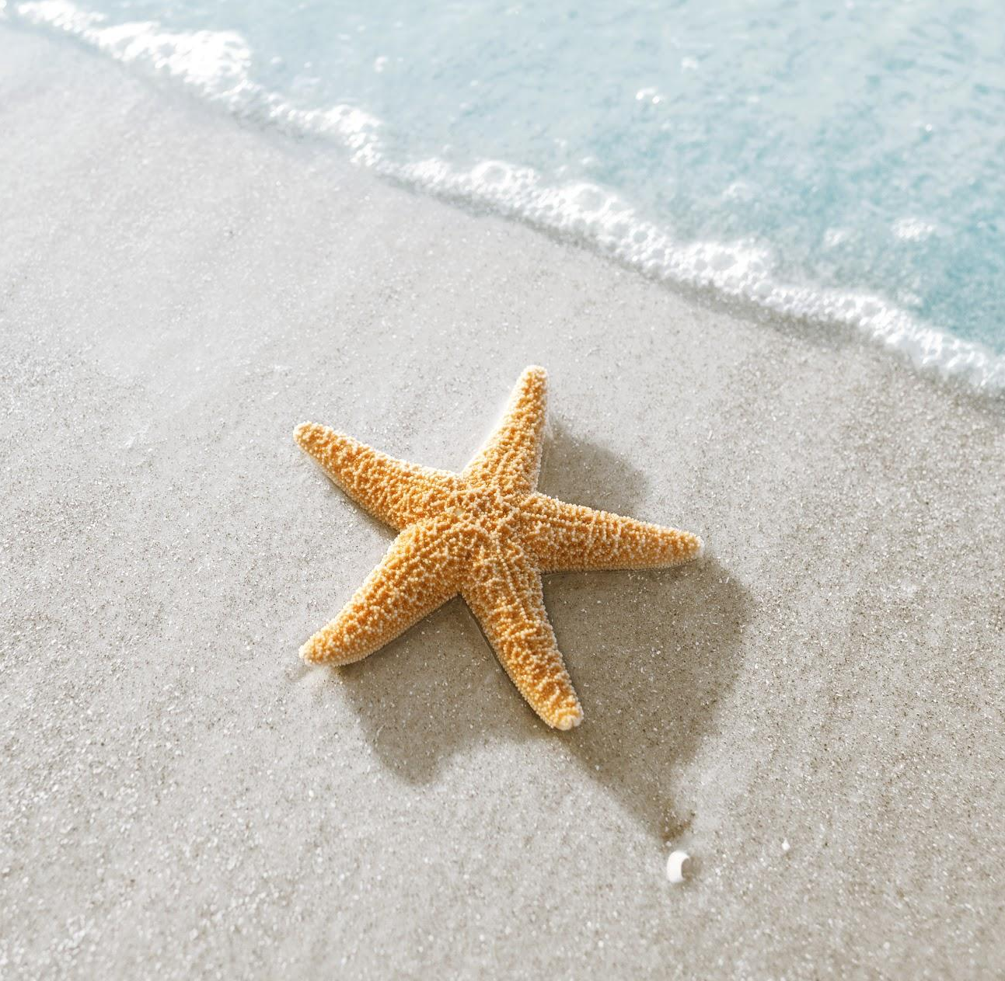
The starfish thrower
One day a man was walking along the beach when he saw a girl. He watched as the girl reached down, picked up a starfish from the sand, and threw it into the ocean.
‘What are you doing?’ asked the man.
‘I am throwing starfishes into the ocean,’ said the girl. ‘The sea has washed them up onto the beach. If I don’t throw them back before the sun comes up, they will dry up and die.’
‘But the beach goes on for miles and there are thousands of starfishes,’ said the man. ‘You’ll never throw them all back. There are too many. You can’t possibly make a difference.’
The girl listened politely, then picked up another starfish, threw it back into the sea, and said, ‘I made a difference to that one.’

Slide 12
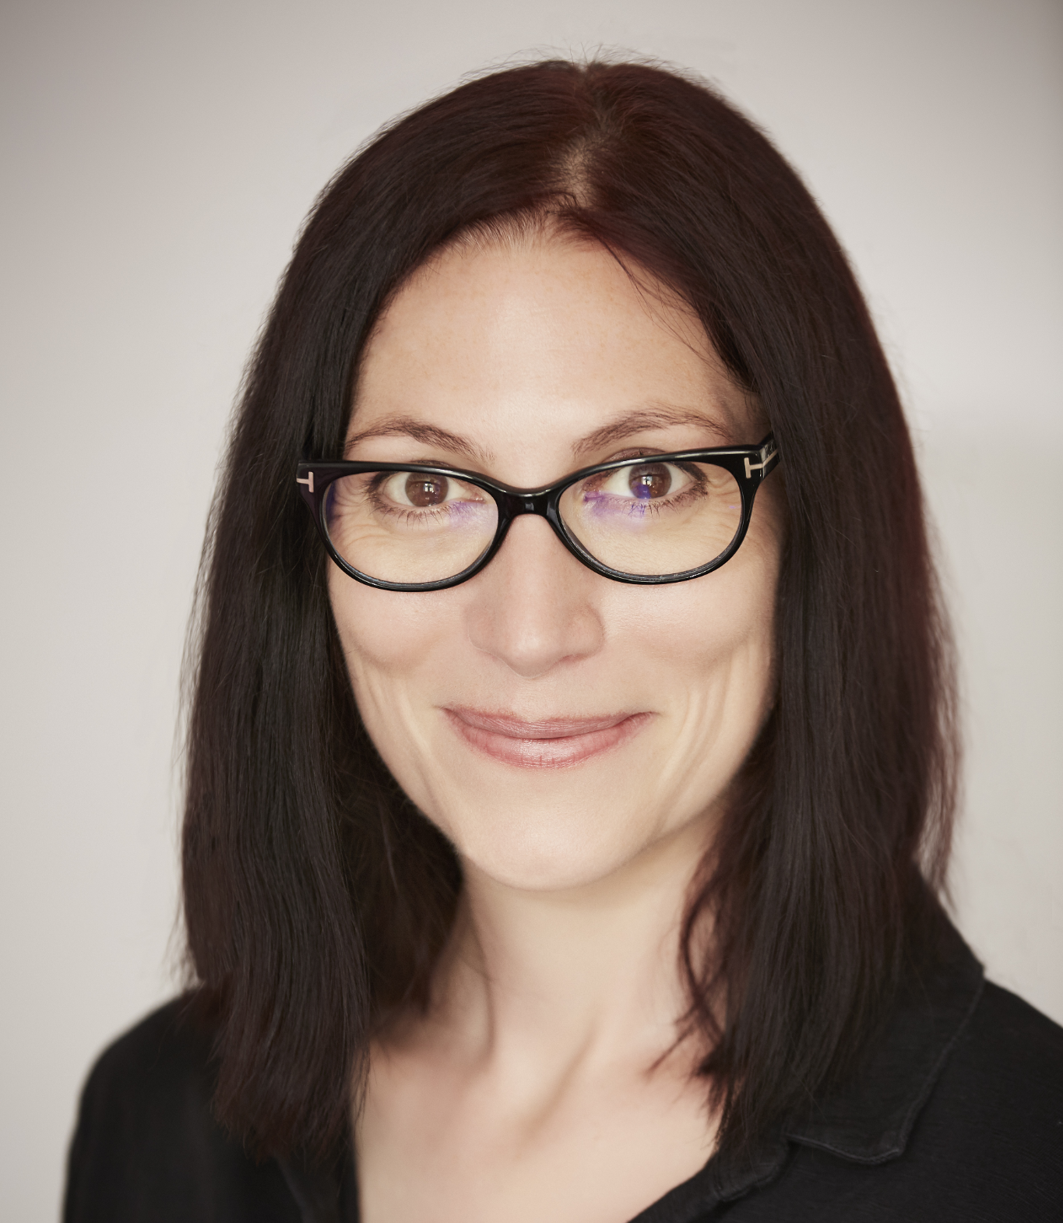
Human responsibility
Making a difference
‘It doesn’t matter if you can’t make a difference on a global level. Most of us won’t find the cure to a disease or discover clean energy. But even on the smallest scale, you can make the people around you feel happier because you’re there.’
Natalie Haynes, author

Slide 13
A humanist approach to building a healthy society
We can value our human achievements
We should promote freedom, fairness, and kindness
We have responsibility for making the world a better place

