Slide 1
Humanist ethics

Slide 2
A humanist approach to life: a summary
Humanists believe the world is a natural place and science gives us the best way to understand it (humanists don’t believe in a god)
Humanists believe we should be free to make the most of the one life we have, seeking happiness and supporting others to do the same
Humanists believe we should use empathy and consider the impact of our actions on other people and animals

Slide 3

A humanist approach to being good
The reason to be good is because our actions can have an impact on others
We should think for ourselves about what to do and consider the consequences of our actions
Empathy and the Golden Rule can help us to decide how we should act

Slide 4
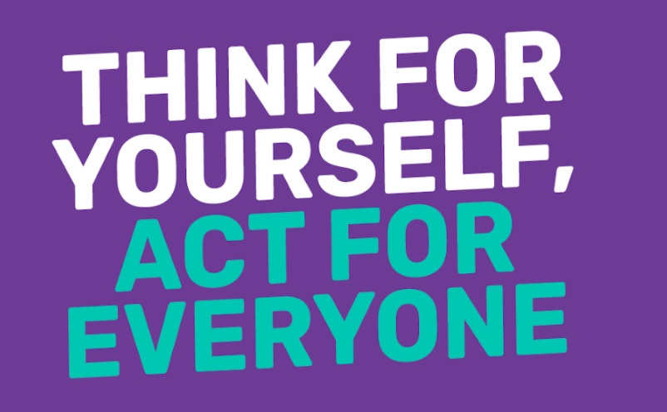
Being good

Slide 5
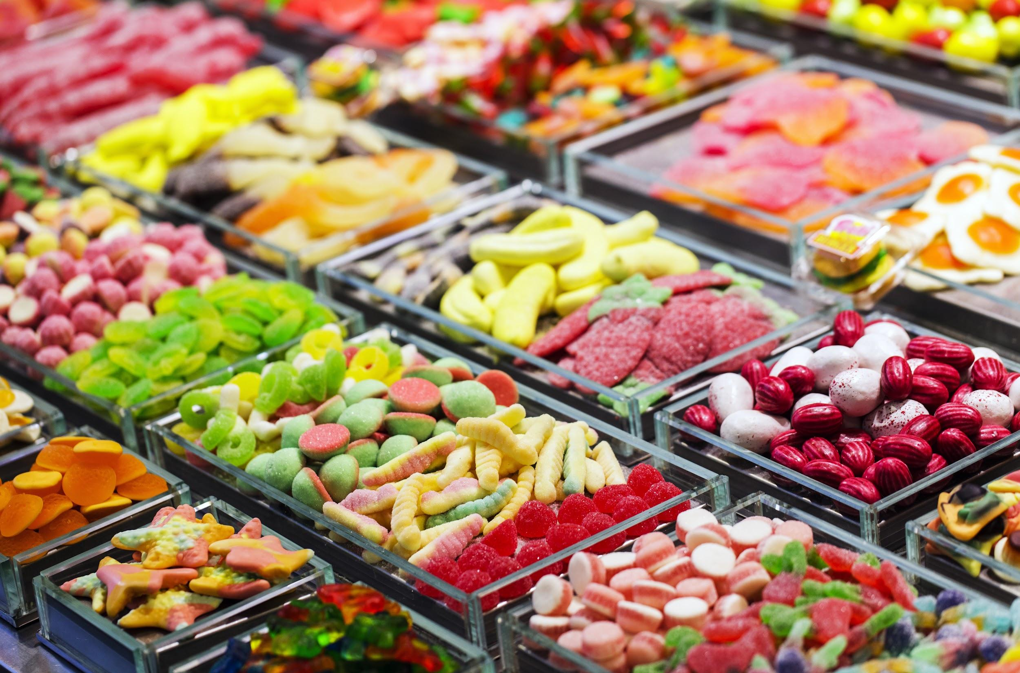
The sweet shop
You are in a sweet shop with some friends. The owner of the shop is not looking. One of your friends says he is going to steal some sweets.
What should you do? Why?
If you think he shouldn’t steal the sweets, how would you persuade him not to?

Slide 6
The sweet shop (part 2)
Imagine your friend had a cloak of invisibility (like Harry Potter), he would be able to do whatever he wanted without anyone being able to see him. If he wanted, he could steal the sweets without anyone knowing it was him.
Should he steal the sweets?
If not, why not?

Slide 7


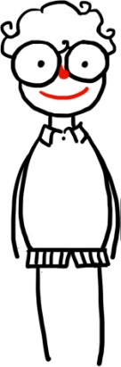

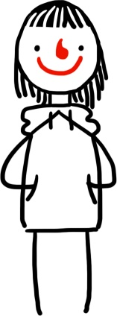
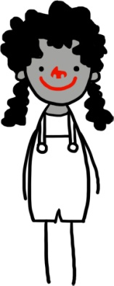
Why not steel the sweets?
I might get caught and get in trouble.
The shop keeper would be unhappy.
It’s against the law.
I wouldn’t like it if someone stole from me.
If everyone did it, then the sweet shop would close down.
I would feel like a bad person.

Slide 8
Questions
Is being good so that you will be rewarded a selfish reason to be good?
If you are following rules, are you being good or are you just doing as you are told?

Slide 9
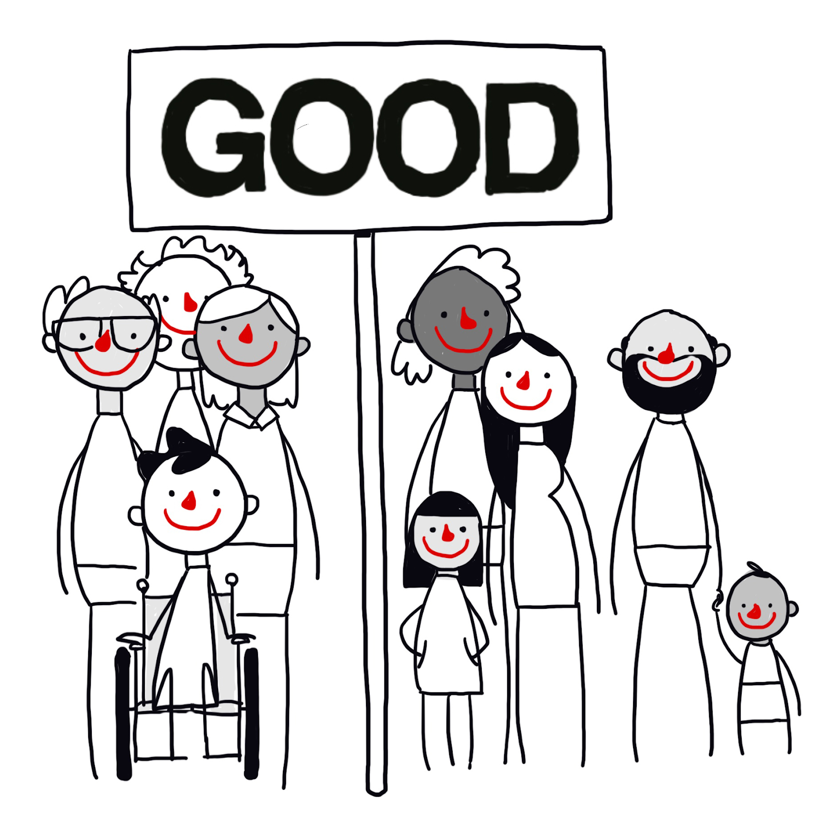

Why might a humanist believe we should we be good?
Our actions have an impact on other people’s feelings and wellbeing.
Shared feelings and needs
We all want to be happy
We all want to be treated with kindness and respect
None of us wants to suffer or be harmed
Humanists believe we need to take care of each other, other animals, and the planet. Being good to each other makes the world a better place to live.

Slide 10
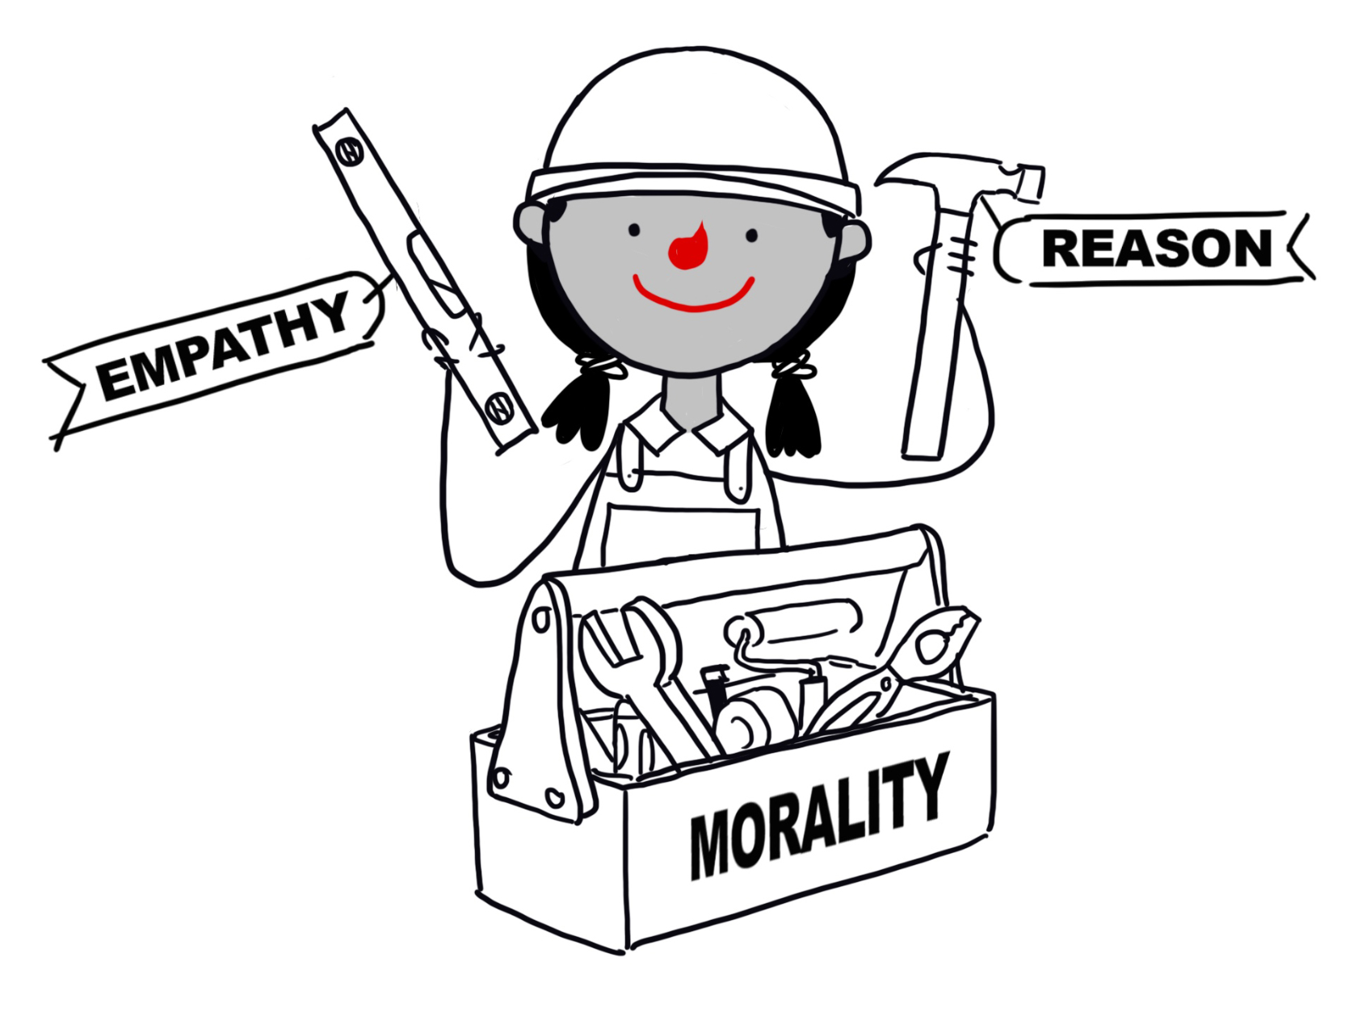
How might a humanist decide what to do?
Responsibility
Think for yourself
Empathy
Reason
Consequences
Golden rule

Slide 11
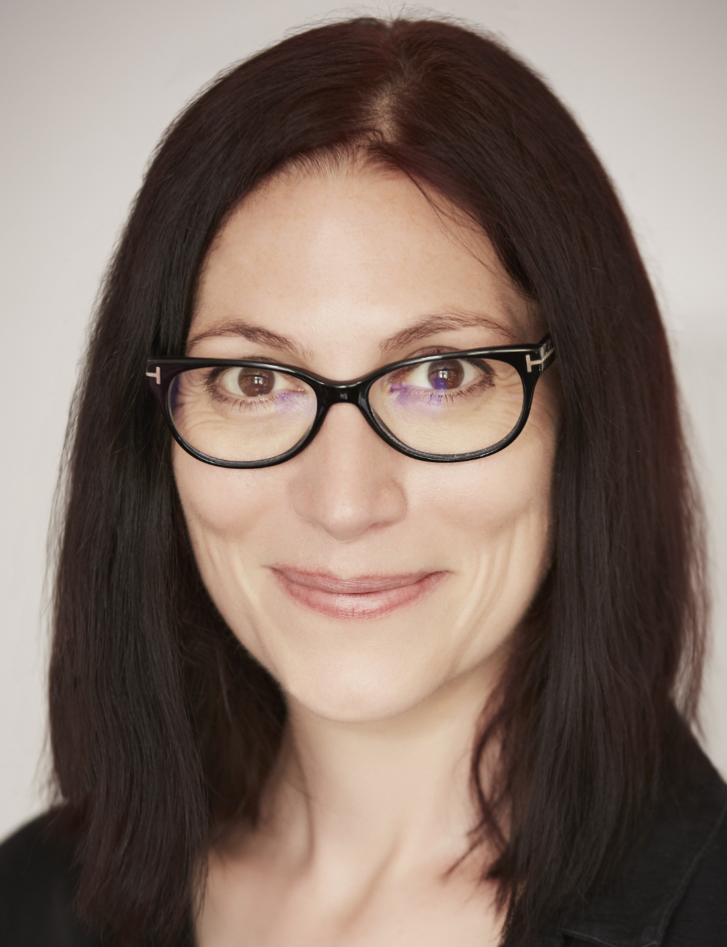
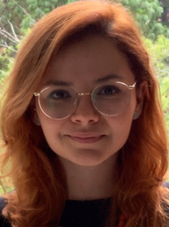
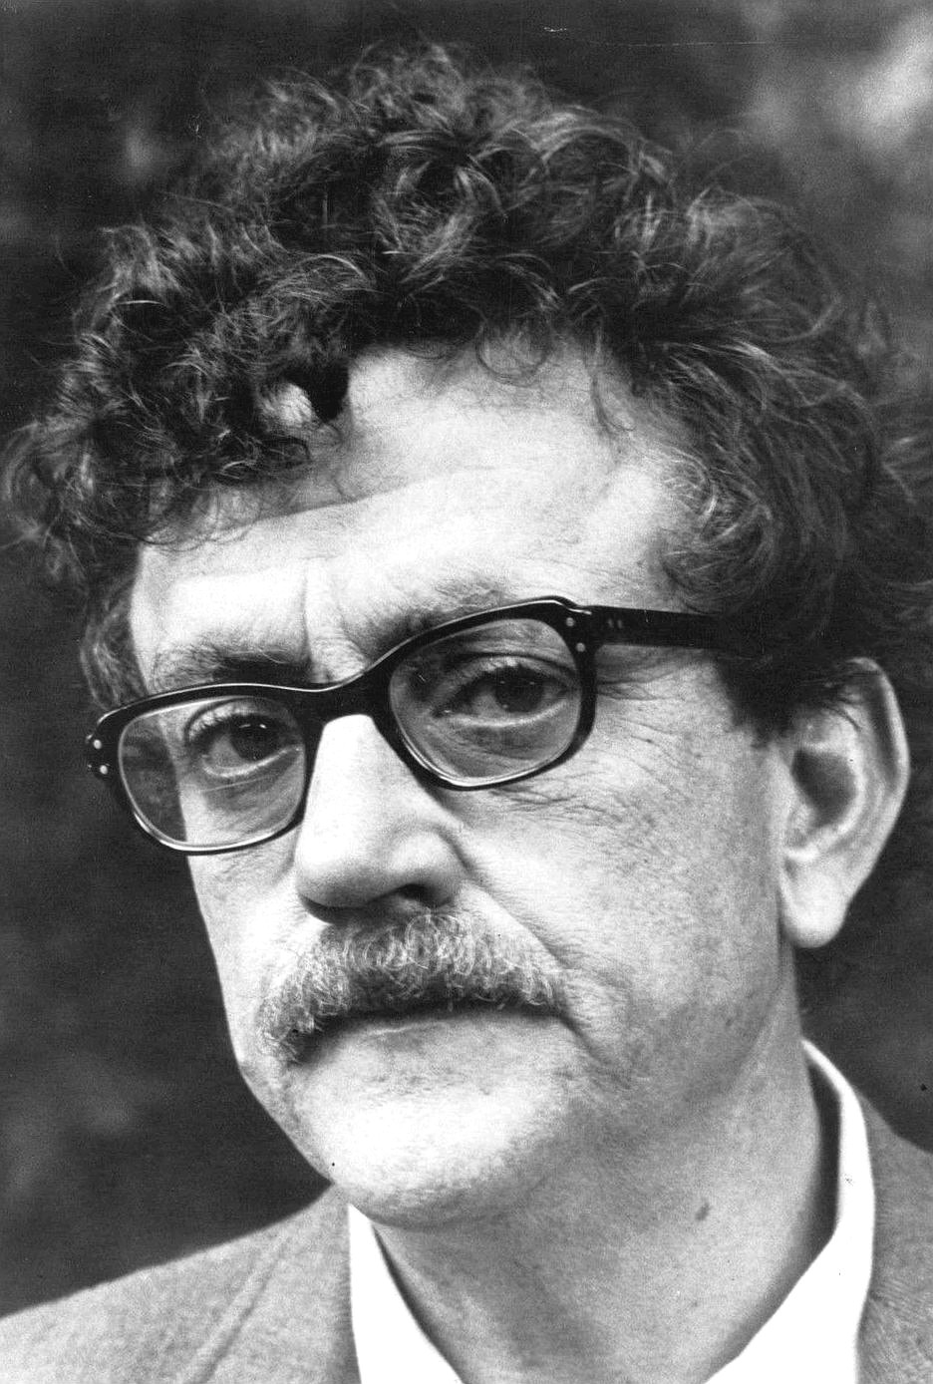
Being good
'Imagining yourself on the receiving end of your own behaviour is a good way to decide whether you're doing what you think is right or wrong.'
Natalie Haynes, author
‘If you want to be a good person, you will be because you decided to; not because someone else tells you to.’
Ana Raquel Aquino, Humanists Guatemala
‘There’s only one rule that I know of… you’ve got to be kind.’
Kurt Vonnegut, author

Slide 12
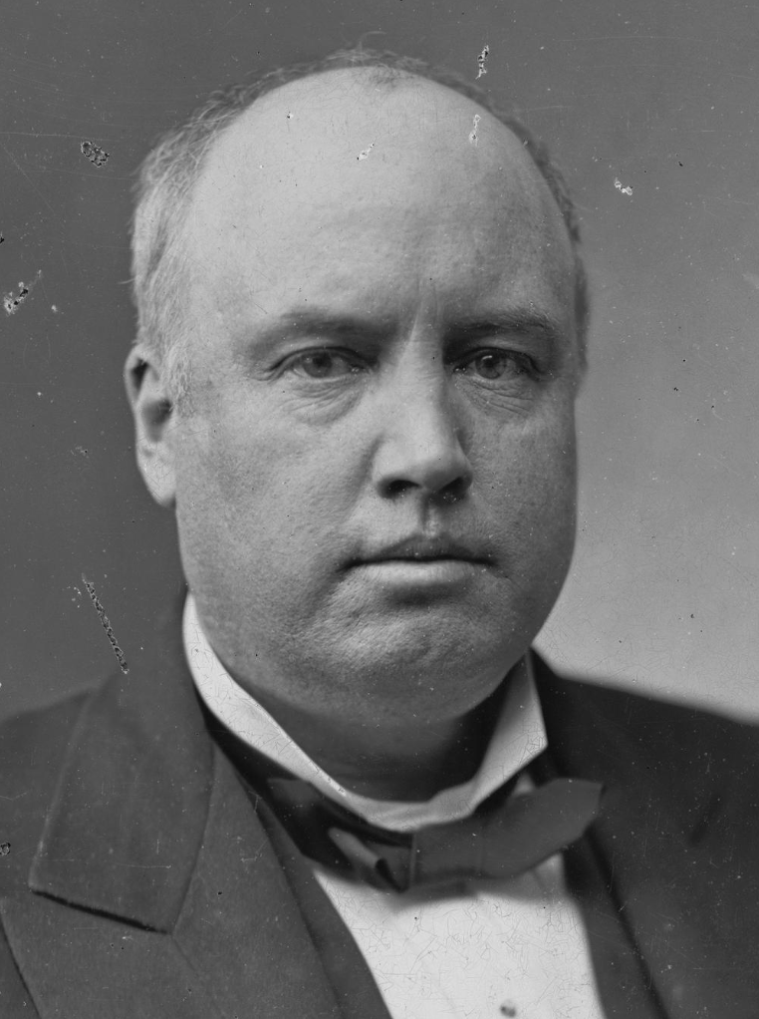
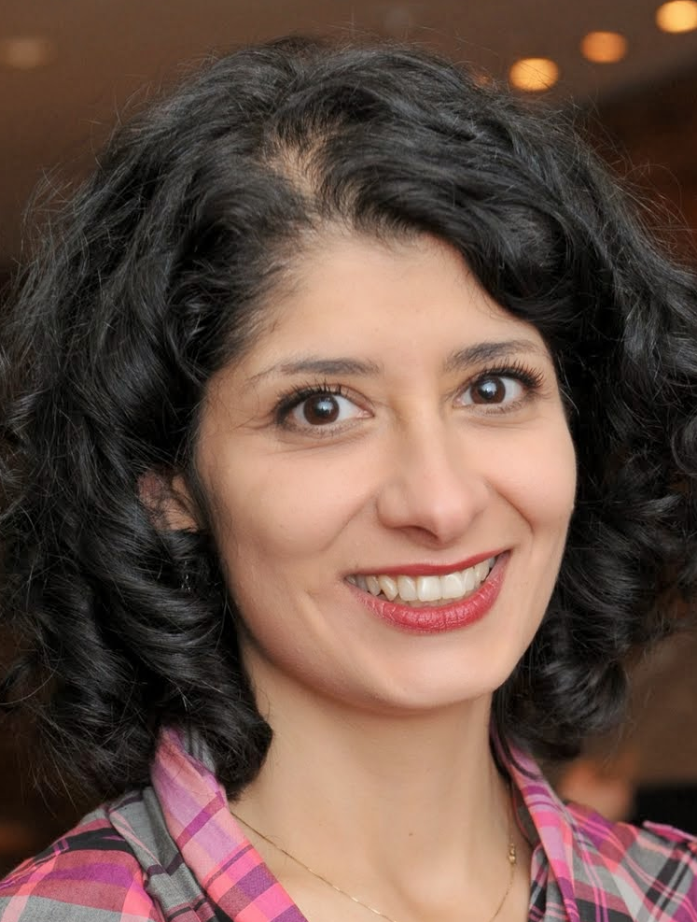

Being good
‘The time to be happy is now… The way to be happy is to make others so.’
Robert Ingersoll, American humanist
‘I have learned that there is no such thing as helping someone and not getting anything in return, because helping someone makes you feel good inside.’
Shappi Khorsandi, comedian
‘Every good deed is like a pebble in a pond, sending ripples out in all directions… Kindness is catching.’
Rutger Bregman, historian

Slide 13
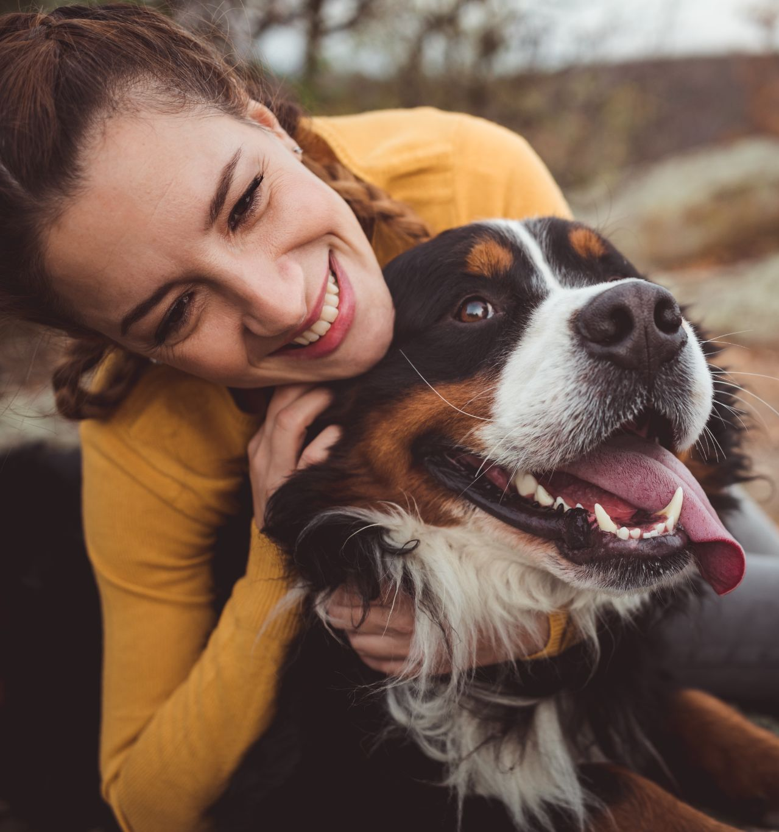
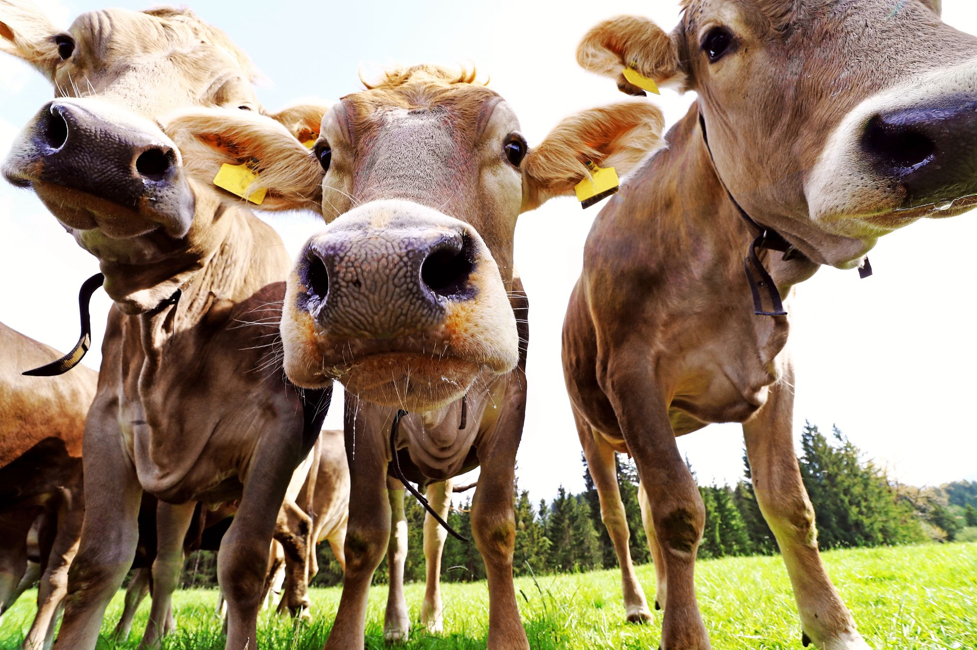
Animal welfare
‘The question is not can they reason, nor can they talk, but rather can they suffer?’
Jeremy Bentham (1748-1832), philosopher

Slide 14
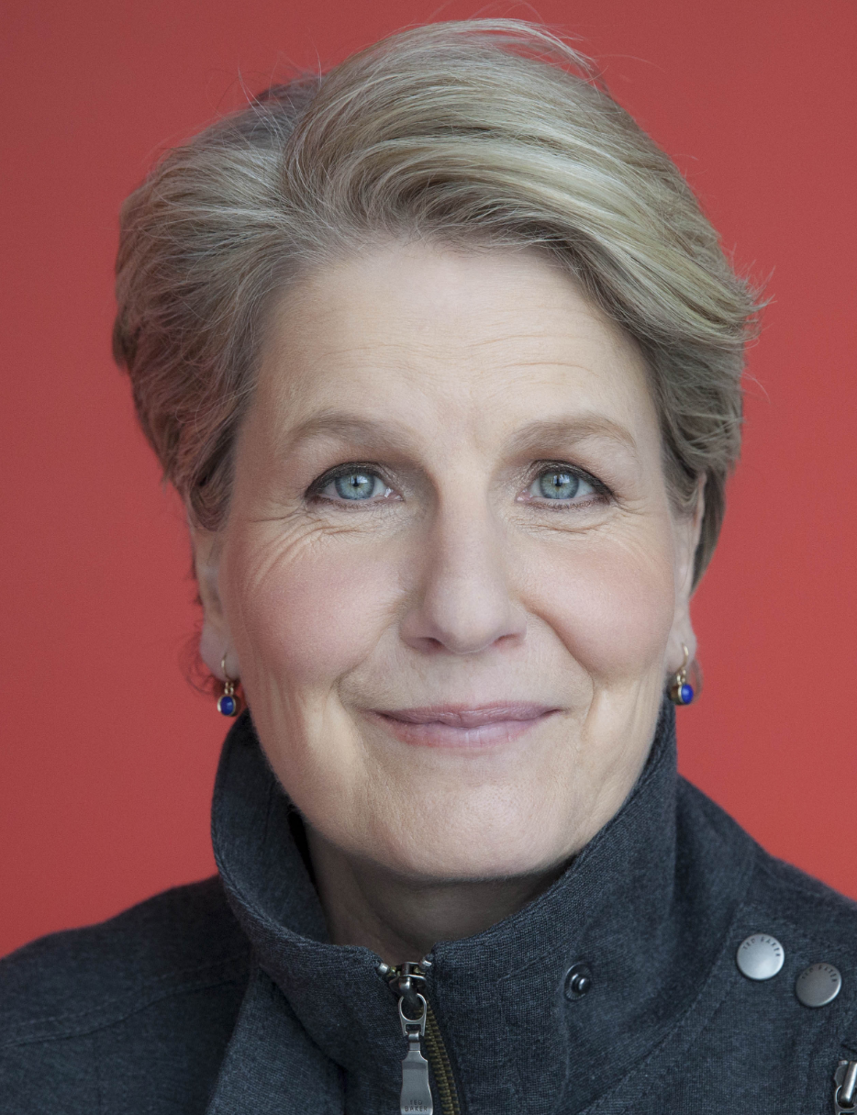
Being good
‘Often it’s easy to be good: to hold the door open for someone carrying heavy bags, to give honest directions to someone who’s lost, or to bake a cake for a friend who’s feeling down. Most of the time we have a pretty good idea of what is the right thing to do. And we just do it.’
Sandi Toksvig, broadcaster and patron of Humanists UK

Slide 15
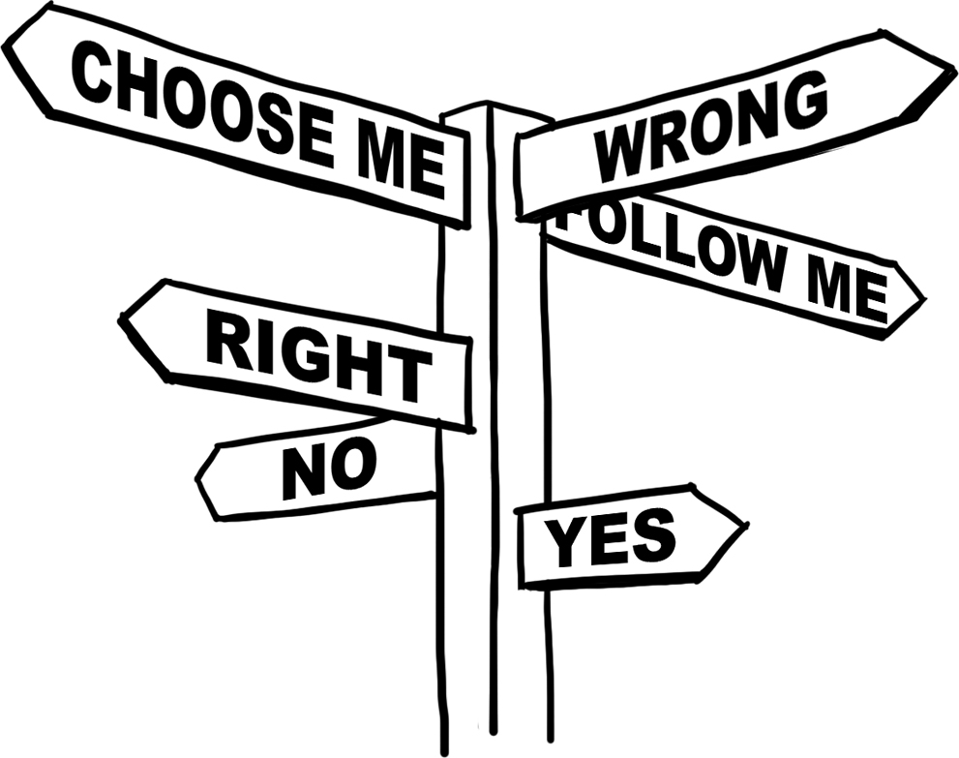
Moral dilemmas
Who might you have empathy with?
How might you use the Golden Rule?
What would be the consequences of the different options?
What would the world be like if everyone acted the same way?

Slide 16
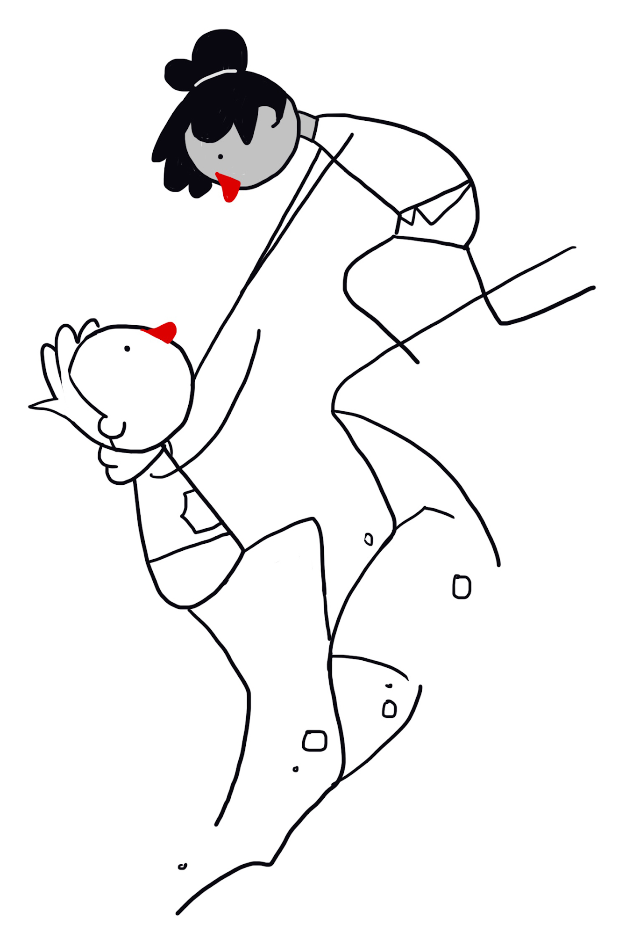
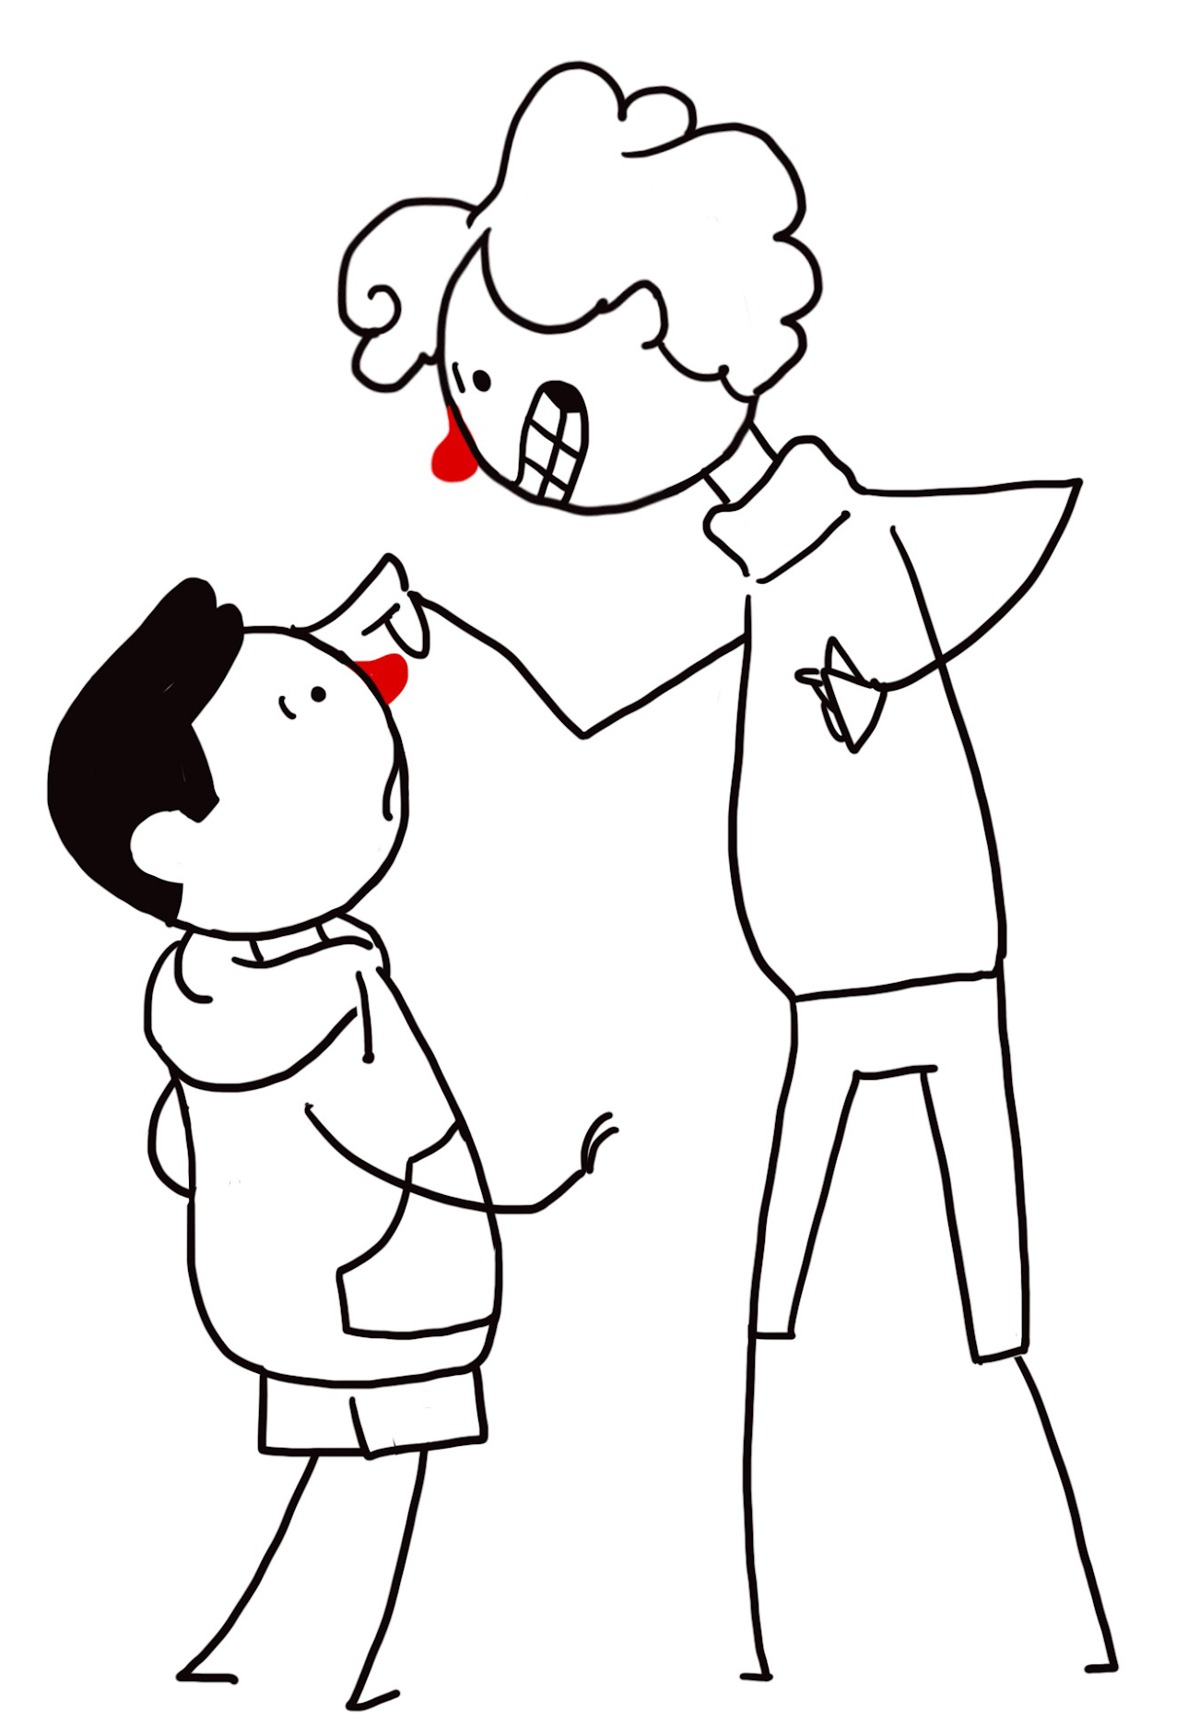
The Golden Rule
‘Treat other people as you'd want to be treated in their situation.’
‘Do not treat others in a way you would not like to be treated yourself.’

Slide 17

The Golden Rule around the world

Slide 18
Applying the Golden Rule
Last week I was on a trip with three of my friends. I was put in charge of buying lunch and went to the shop. I wanted to do the right thing so I followed the Golden Rule.
My favourite sandwich is tuna mayonnaise so I bought tuna mayonnaise for everyone. However, when I handed out the sandwiches, Caroline said she would have preferred cheese, Emma said she didn’t like tuna, and Jacob said he was allergic to mayonnaise!
Where did I go wrong?
Yours sincerely,
Sam
‘Treat other people as you'd want to be treated in their situation.’
‘Do not treat others in a way you would not like to be treated yourself.’
Take a look at the letter from a child asking for advice on how to use the Golden Rule.
Questions
Could you have done better than Sam?
What would you have done differently?
Did the Golden Rule not work, or was Sam not using it properly?
Activity: Write a reply to Sam’s letter from a humanist explaining where she went wrong and how she might have used the Golden Rule differently.

Slide 19
A humanist approach to being good
The reason to be good is because our actions can have an impact on others
We should think for ourselves about what to do and consider the consequences of our actions
Empathy and the Golden Rule can help us to decide how we should act

