Slide 1
Humanist ethics

Slide 2
A humanist approach to life: a summary
Humanists believe science provides the best way to understand the world and we should look for natural explanations for events (humanists don’t believe in a god)
Humanist believe we should be free to shape the one life we have and that we can make our own lives meaningful by seeking happiness in the here and now, and supporting others to do the same
Humanists believe we should use empathy and have a responsibility to consider the impact of our actions on the welfare of other people and animals

Slide 3

A humanist approach to ethics
The origins of morality lie inside human beings
We should aim to improve human welfare and happiness in the here and now
We should think for ourselves about how to act, using reason and empathy

Slide 4
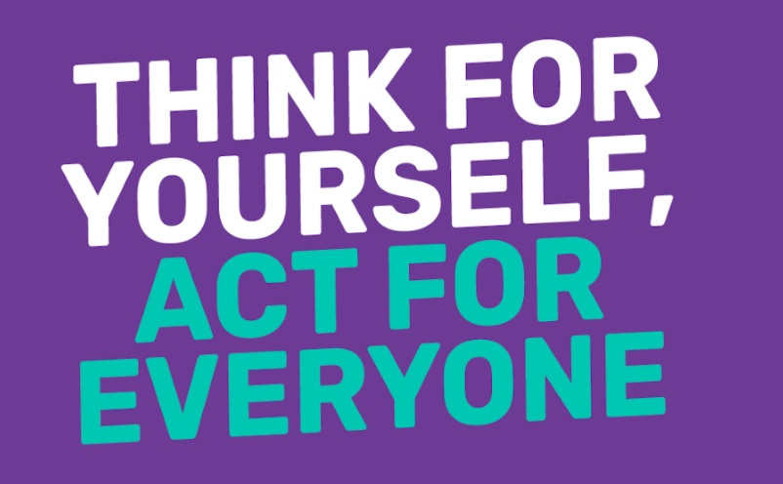
Being good

Slide 5
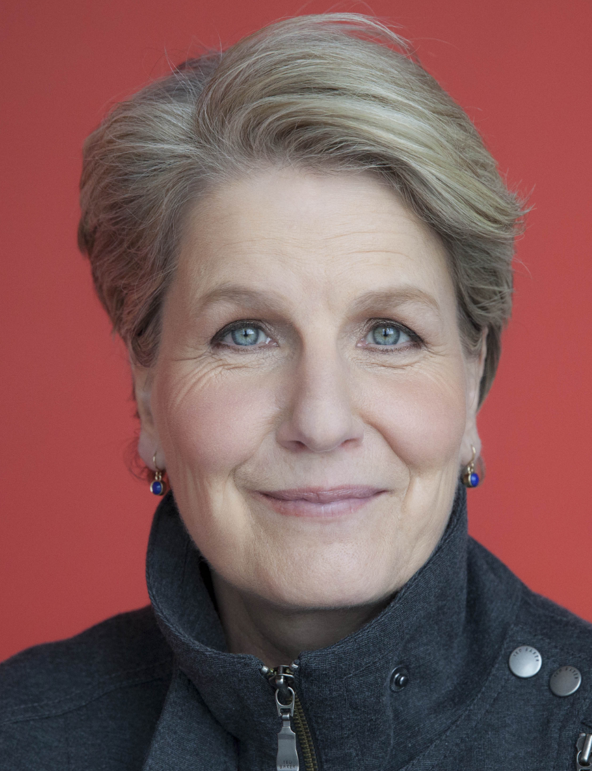
Shared needs, feelings, and values
'Morality is not a set of non-negotiable rules handed down to us from on high, nor is it just a matter of personal preference. Instead morality is rooted in our nature as human beings. Our shared values give us ground on which we can build.'
Sandi Toksvig, broadcaster and Patron of Humanists UK
What are our shared needs, feelings, and values?

Slide 6
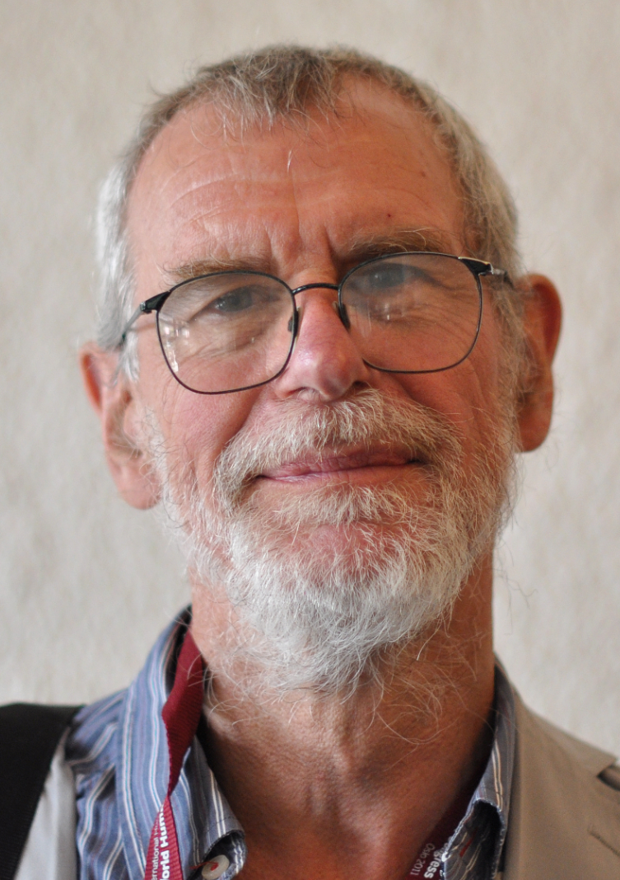
Shared values
‘We won’t all come up with the same list of values. But we seem already to have a plausible list of values which many people would accept – kindness, consideration, peace, love, cooperation, honesty, loyalty, fairness, mutual respect, and tolerance.’
Richard Norman, humanist philosopher

Slide 7
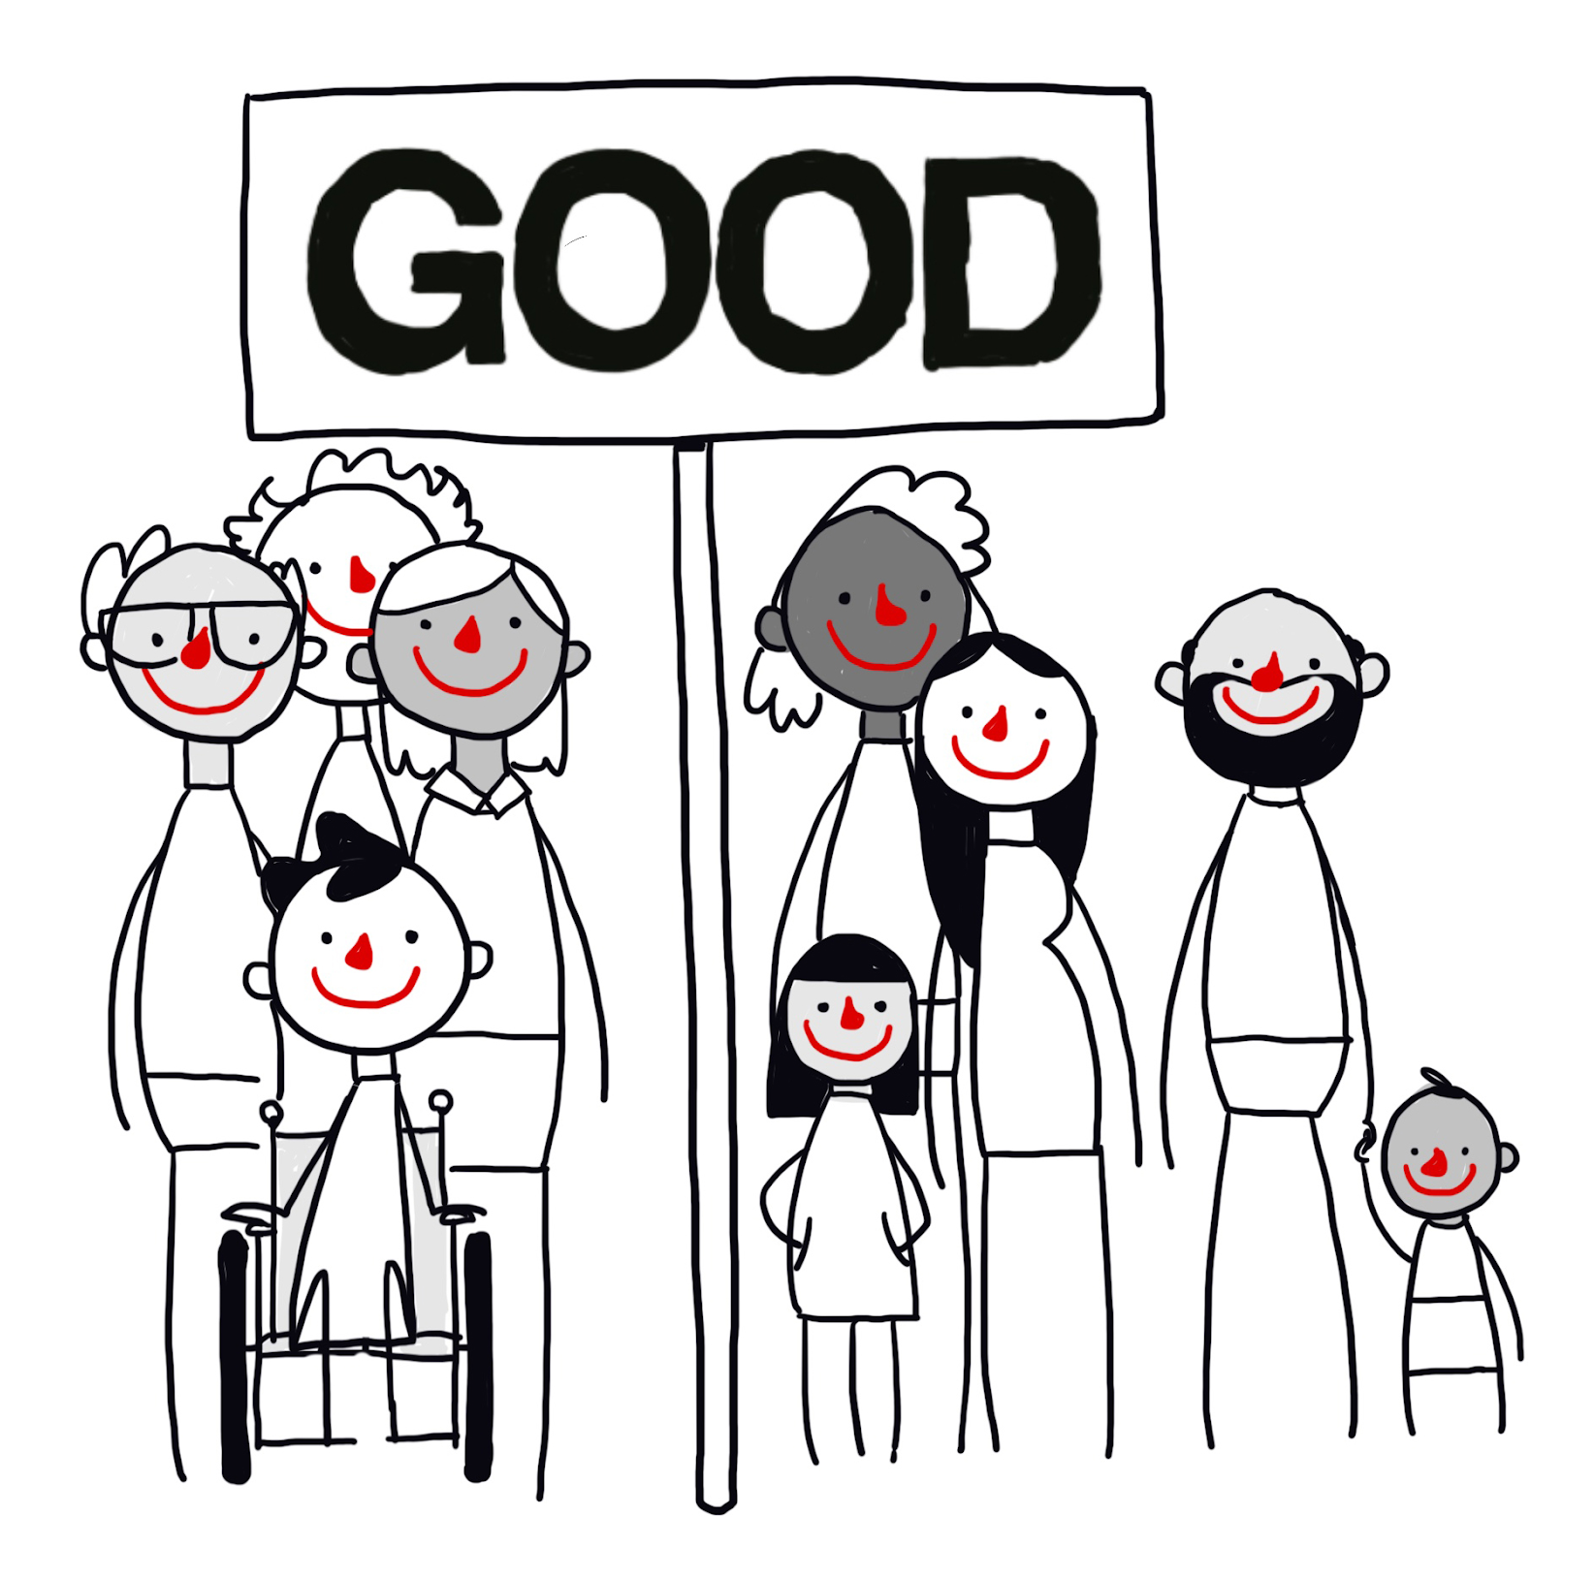

Being good
For humanists, morality is about improving human welfare and flourishing.
We need to consider the impact of our actions on other people’s feelings, and on other animals and the planet.
Humanists believe this is the one life we have and so we should aim to promote happiness and reduce suffering in the here and now.

Slide 8
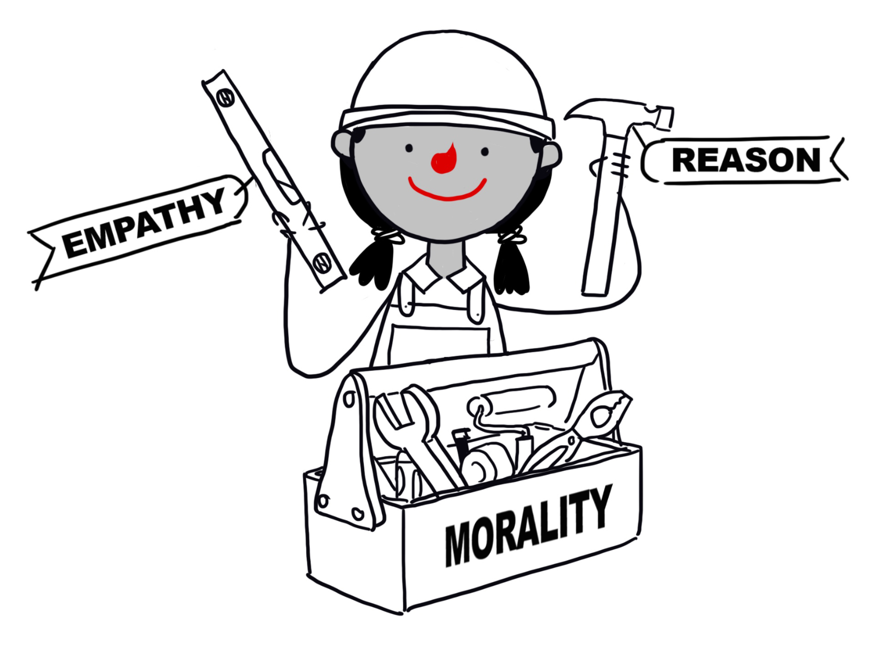
How might a humanist decide what to do?
Responsibility
Think for yourself
Empathy
Reason
Consequences
Golden rule

Slide 9
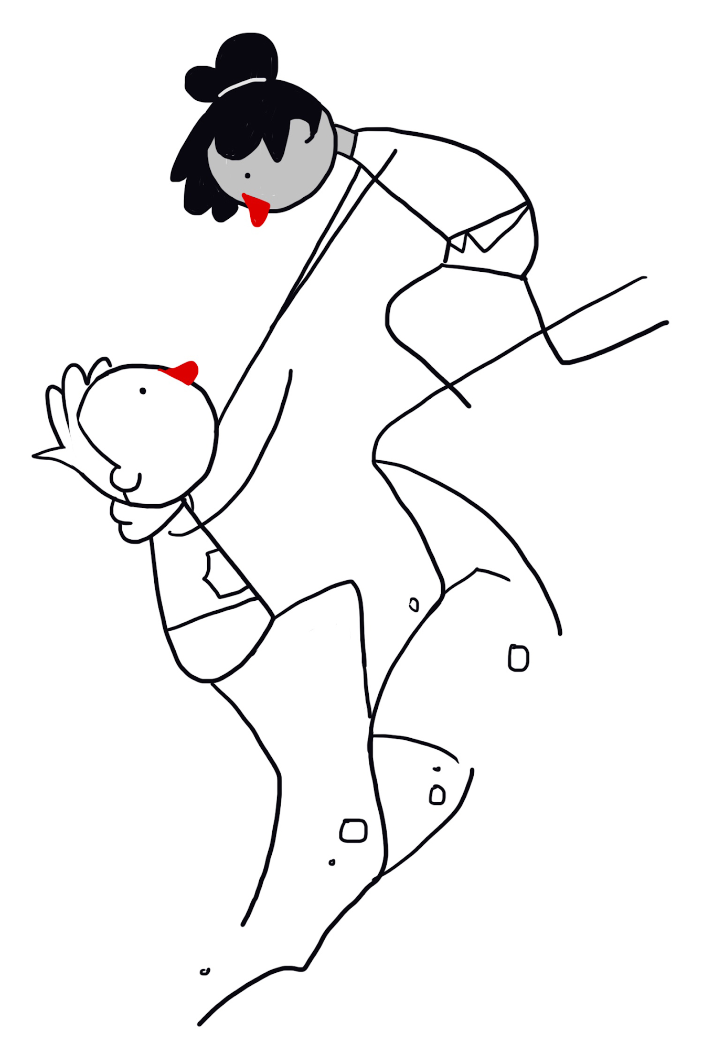
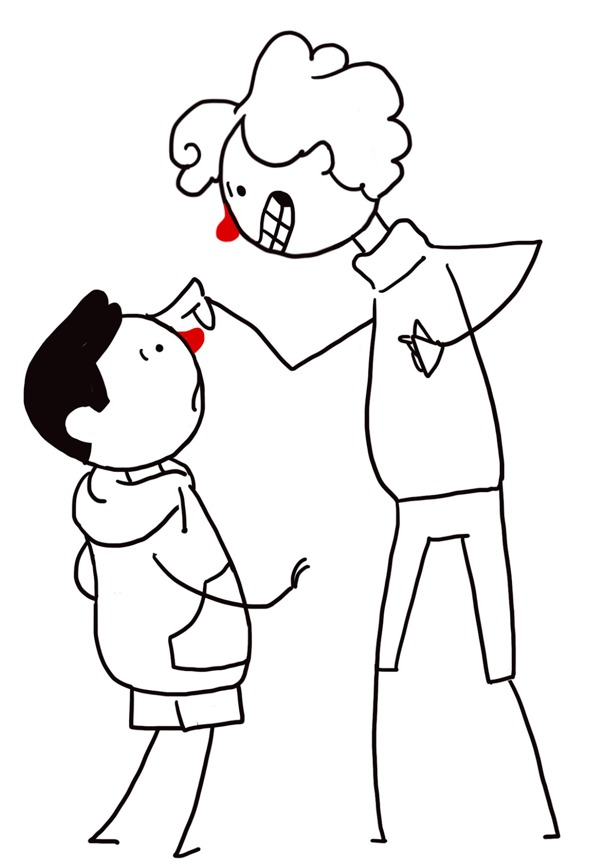
The Golden Rule
‘Treat other people as you'd want to be treated in their situation.’
‘Do not treat others in a way you would not like to be treated yourself.’

Slide 10
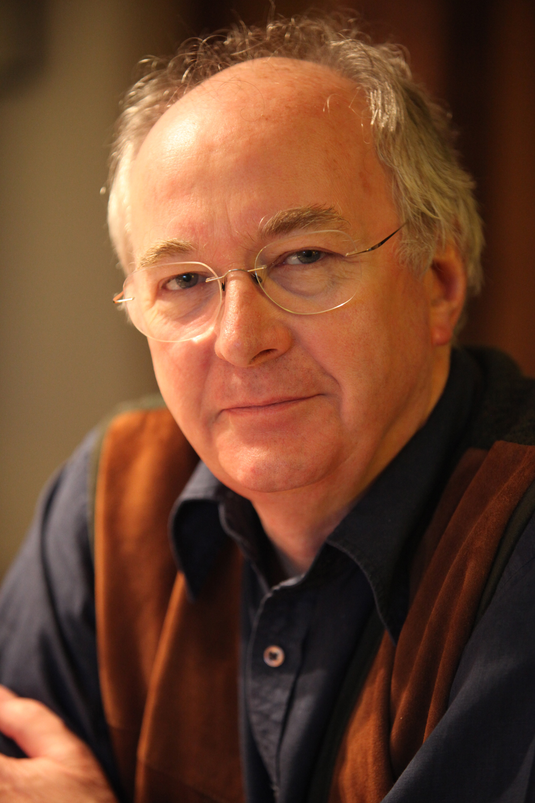
How to decide?
‘Some religions say things like, 'You must love one another.' Others seem to say things like, 'You must kill everyone who doesn't agree with what this religion says.' The trouble is that some religions say both kinds of thing. The only way we can judge what's useful and good, and what's crazy and cruel, is by stepping outside religion altogether, and just judging by human standards: which is a better way to live?’
Philip Pullman, author

Slide 11
Reasons not to cause harm
‘The genuinely moral reason... for refraining from killing would be an understanding of the wrong that would be done to the person killed, together with a recognition of the devastating grief that would be caused for the bereaved.’
Richard Norman, humanist philosopher

Slide 12
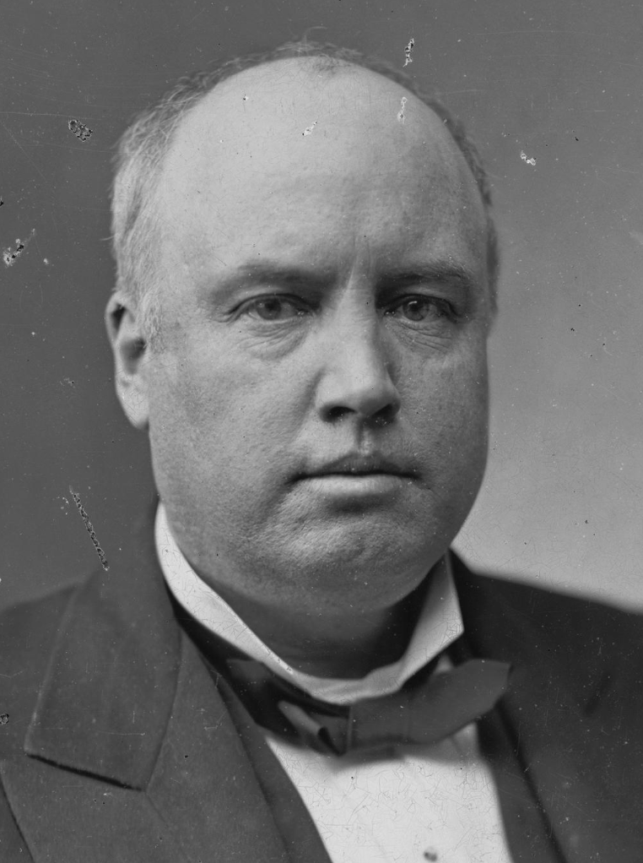
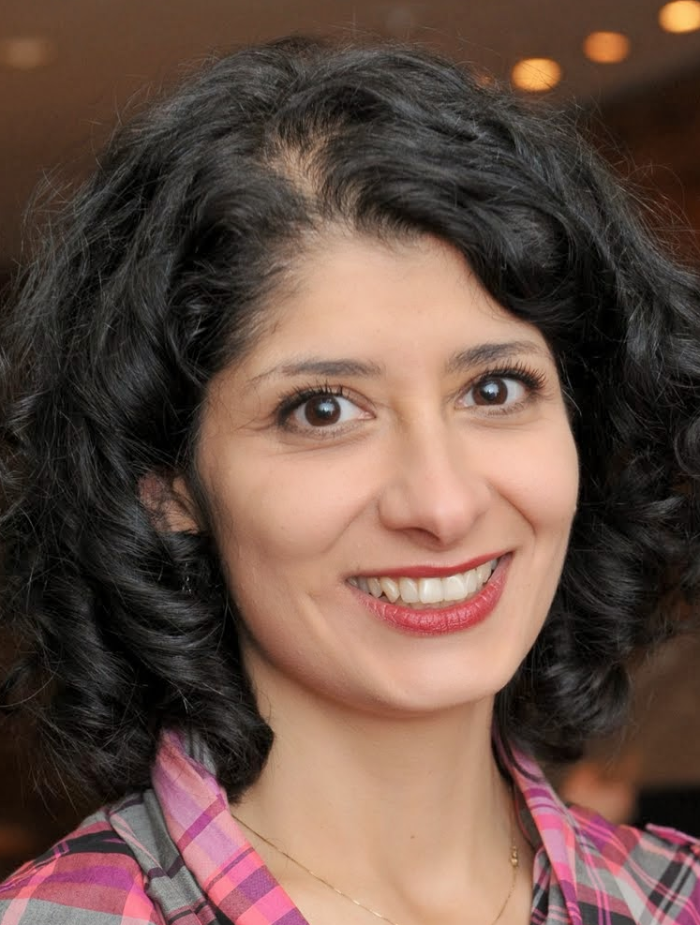

Benefits to being good
‘The time to be happy is now… The way to be happy is to make others so.’
Robert Ingersoll, American humanist
‘I have learned that there is no such thing as helping someone and not getting anything in return, because helping someone makes you feel good inside.’
Shappi Khorsandi, comedian
‘Every good deed is like a pebble in a pond, sending ripples out in all directions… Kindness is catching.’
Rutger Bregman, historian

Slide 13
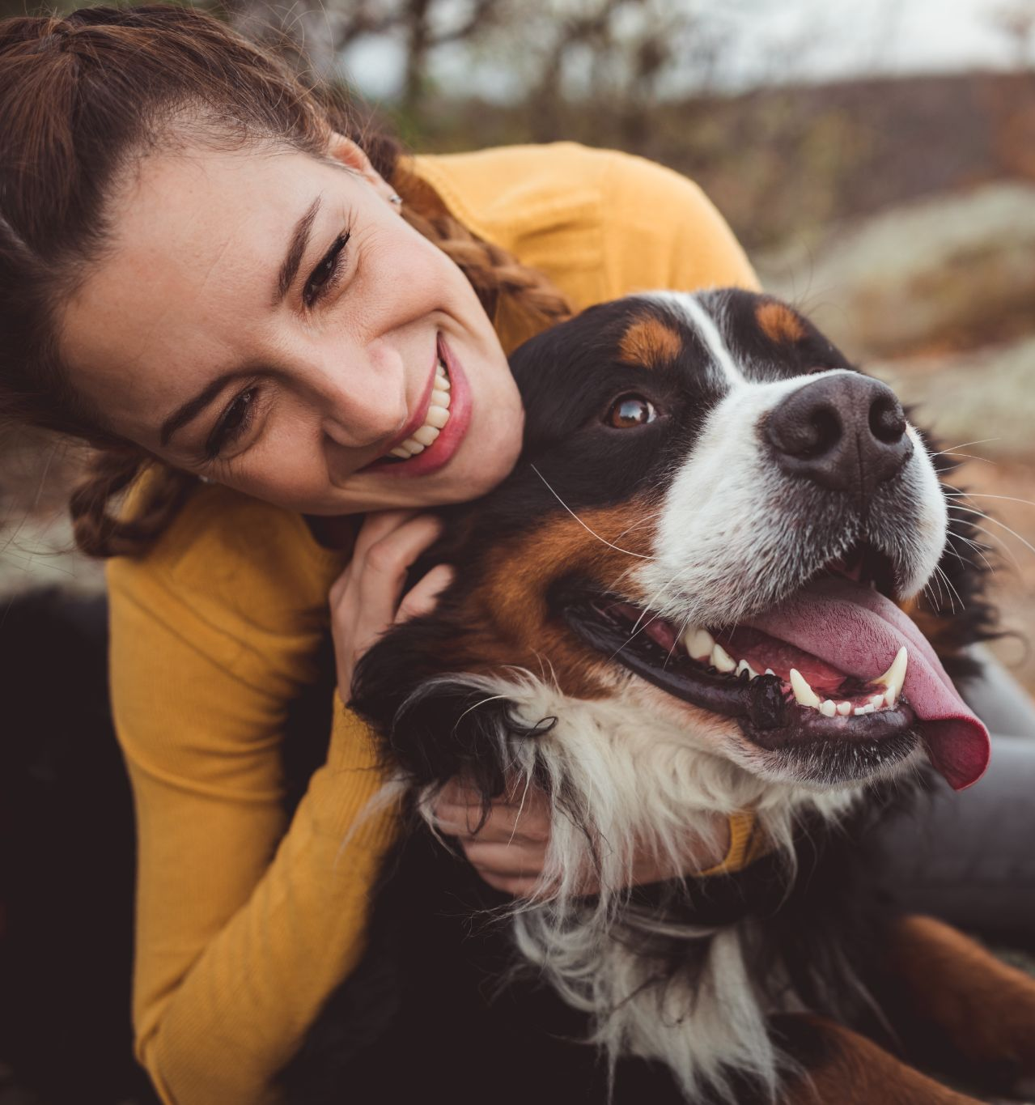
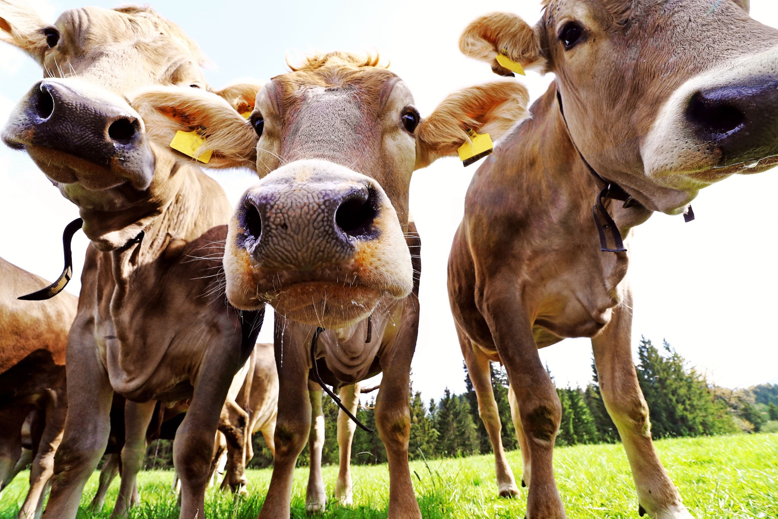
Animal welfare
‘The question is not can they reason, nor can they talk, but rather can they suffer?’
Jeremy Bentham (1748-1832), philosopher

Slide 14
Being good
‘Often it’s easy to be good: to hold the door open for someone carrying heavy bags, to give honest directions to someone who’s lost, or to bake a cake for a friend who’s feeling down. Most of the time we have a pretty good idea of what is the right thing to do. And we just do it.’
Sandi Toksvig, broadcaster and patron of Humanists UK

Slide 15
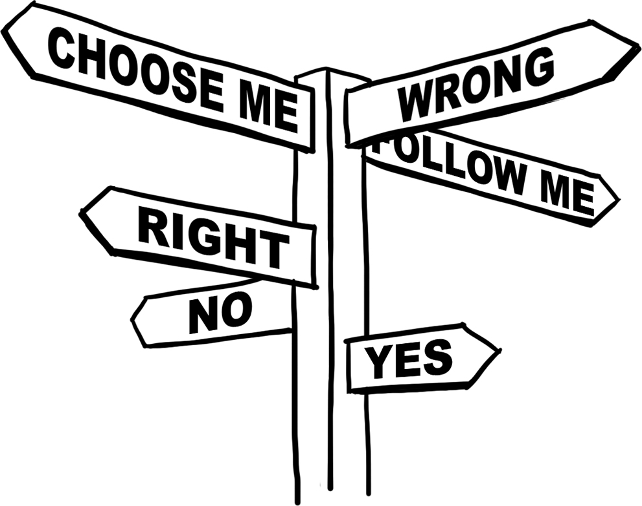
Moral dilemmas

Slide 16
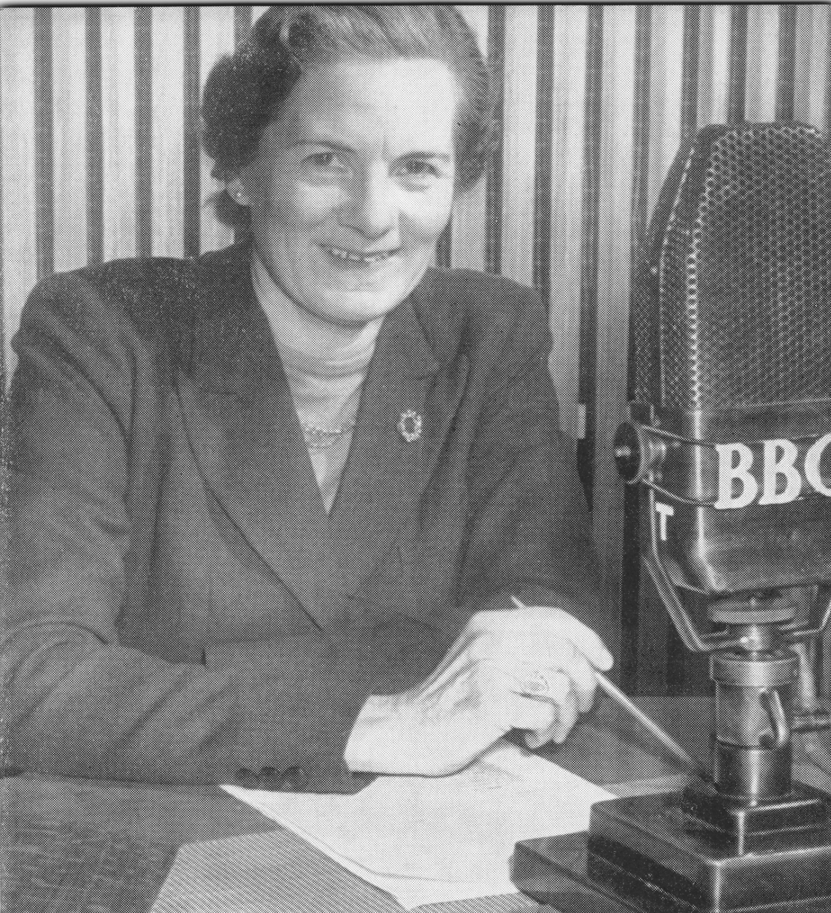
The evolution of morality
‘Why should I consider others?… I think the only possible answer to this question is the humanist one – because we are naturally social beings; we live in communities; and life in any community, from the family outwards, is much happier, and fuller, and richer if the members are friendly and cooperative than if they are hostile and resentful.’
Margaret Knight, Morals without Religion

Slide 17
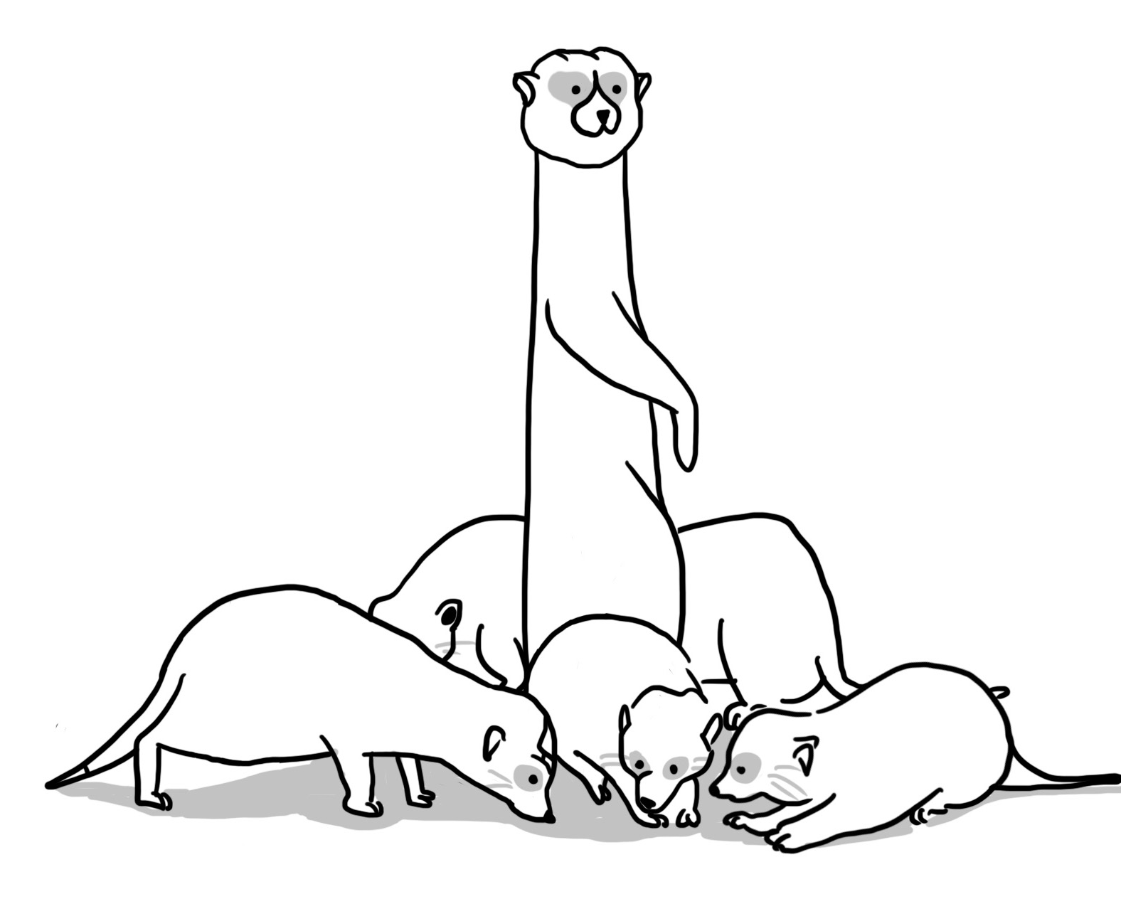
Animal altruism

Slide 18
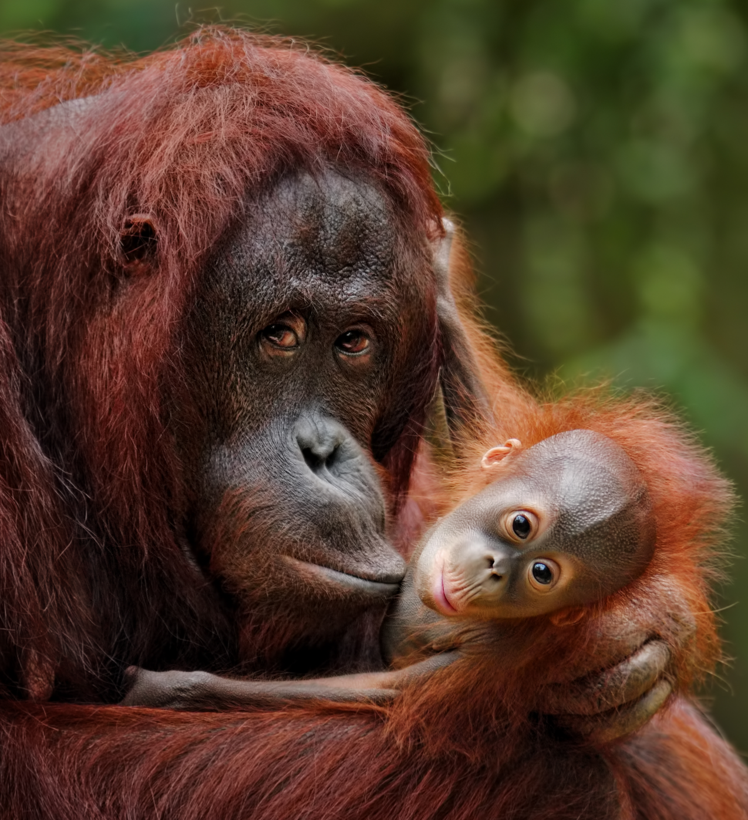
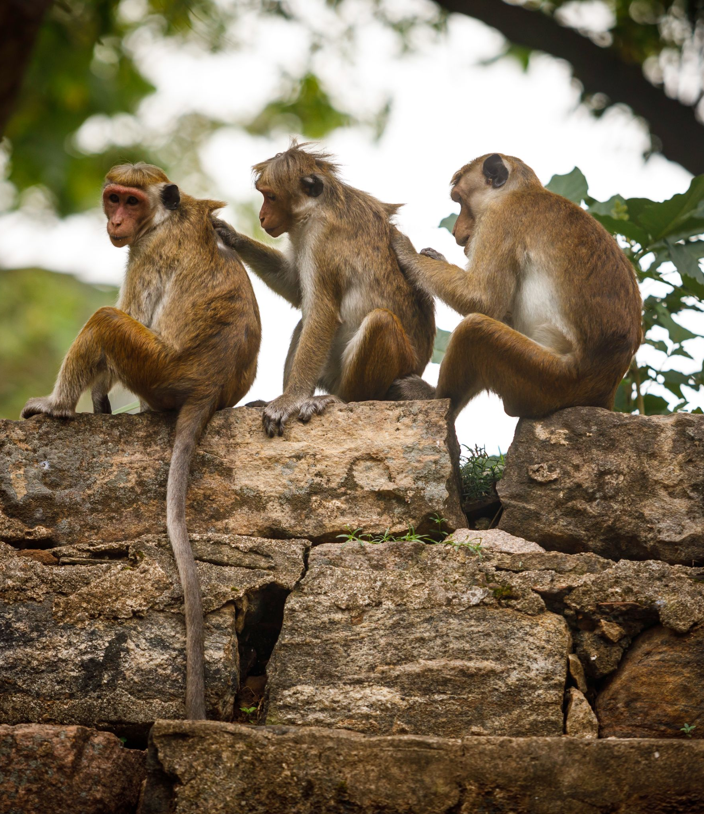

Slide 19
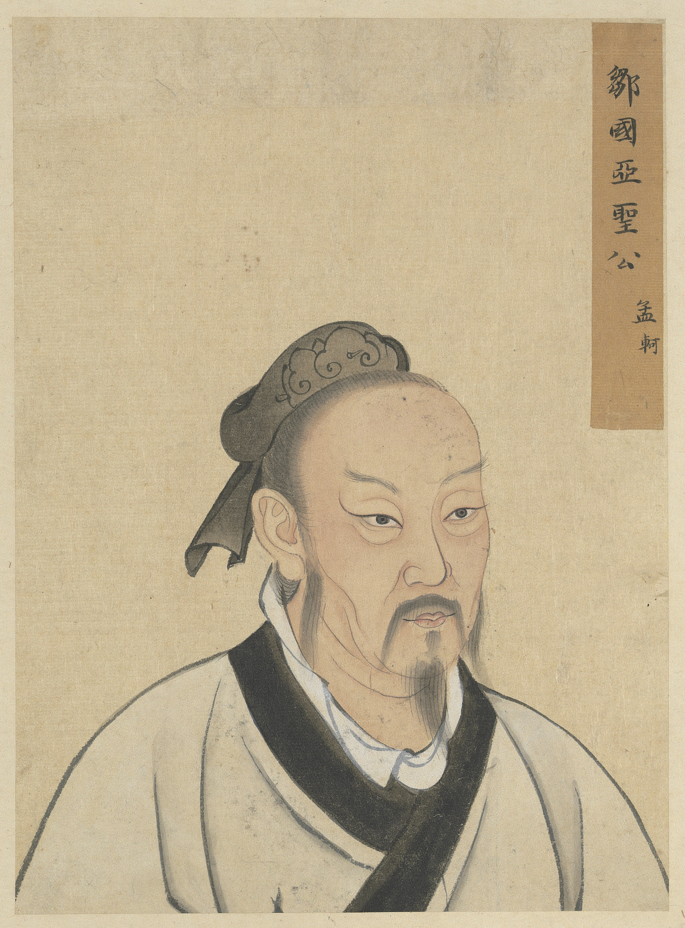
Natural instincts
'The reason why I say that humans all have hearts that are not unfeeling toward others is this. Suppose someone suddenly saw a child about to fall into a well: everyone in such a situation would have a feeling of alarm and compassion – not because one sought to get in good with the child’s parents, not because one wanted fame among their neighbours and friends, and not because one would dislike the sound of the child’s cries. From this we can see that if one is without the heart of compassion, one is not a human.’
Meng Tzu, ancient Chinese philosopher

Slide 20
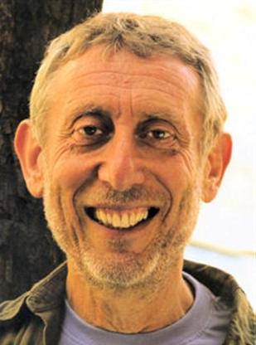
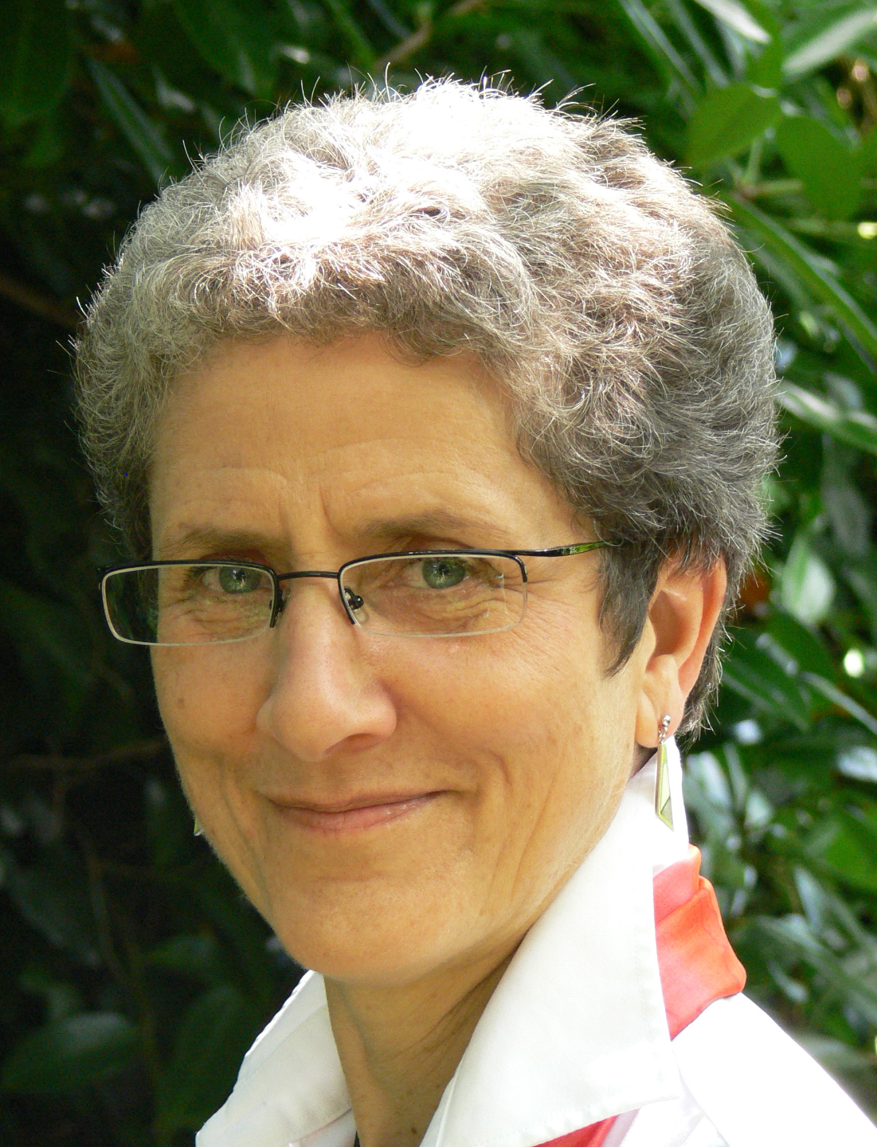
The evolution of morality
‘Humanists believe that morality – being good or at least doing no harm – is based on human nature and human experience… We humans have evolved as a social species and we need to cooperate with each other. Empathy, compassion, and reason are essential elements in the development of human society, and these form the bases of humanist morality. Selfishness, aggression, and other such characteristics are also aspects of human nature and this is why human societies develop moral values, to balance and counteract those incompatible elements.’
Michael Rosen and Annemarie Young,
What is humanism?

Slide 21


Stories and empathy

Slide 22

Stories and empathy
‘Stories can foster our capacity for imaginative identification with others. There’s no guarantee that they will do so, but they can be the beginning of empathy, compassion, and a sense of justice.’
Richard Norman, humanist philosopher
‘I think stories probably have the power to tell us everything about the human condition… we learn to understand ourselves and each other… If you spend your life jumping from inside your world to inside somebody else’s, I think you probably will be more empathetic.’
Natalie Haynes, author

Slide 23

The evolution of morality
‘Ethics loses its air of mystery. Its principles are not laws written up in heaven. Nor are they absolute truths about the universe, known by intuition. The principles of ethics come from our own nature as social, reasoning beings.’
Peter Singer, humanist philosopher

Slide 24
Humanist ethics: humanist responses
How might a humanist respond to these statements?
We can’t all agree on what is right and wrong - it’s all just a matter of personal preference.
If you don’t believe in a god, then there is no reason to be good.
Without guidance from a holy book we could never know what is the right thing to do.

Slide 25
A humanist approach to ethics
The origins of morality lie inside human beings
We should aim to improve human welfare and happiness in the here and now
We should think for ourselves about how to act, using reason and empathy

