Slide 1
Global humanism

Slide 2

Humanists International
There are many other humanist organisations around the world – in Europe, Africa, Asia, and the Americas. They share many similar ambitions and goals.
However, the rights and freedoms of non-religious people vary – in some countries it is illegal to be non-religious and one can be imprisoned or even killed.
Humanists International is the global representative body of the humanist movement, uniting a diversity of non-religious organisations and individuals. It is made up of over 170 member organisations from 75 different countries. It works to support humanists and other non-religious people all around the globe.

Slide 3
Humanists International
Humanists International has four basic areas of work:
Campaigns to promote humanist values such as reason, empathy, freedom, and secularism around the world
Advocacy, representing humanists at the United Nations and other international forums
Supporting the growth and nurture of new humanist organisations in the developing world
Supporting humanists at risk around the world
The End Blasphemy Laws campaign
The Freedom of Thought report

Slide 4
Humanists International
The largest humanist organisation in the world is the Norwegian Humanist Association (Human-Etisk Forbund)
The countries with the highest number of Humanist International member organisations are the UK, India, and the US
As of July 2021, the newest member organisations of Humanists International are from Barbados, Estonia, Malawi, Myanmar, and Zimbabwe

Slide 5
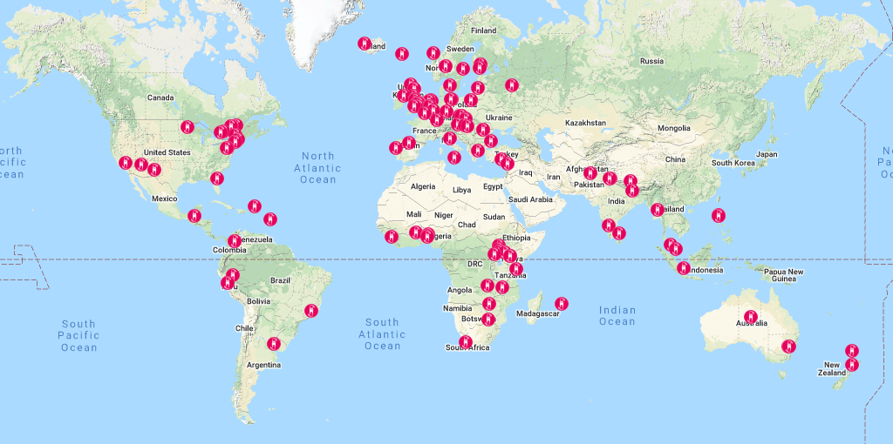
Humanists International member organisations

Slide 6
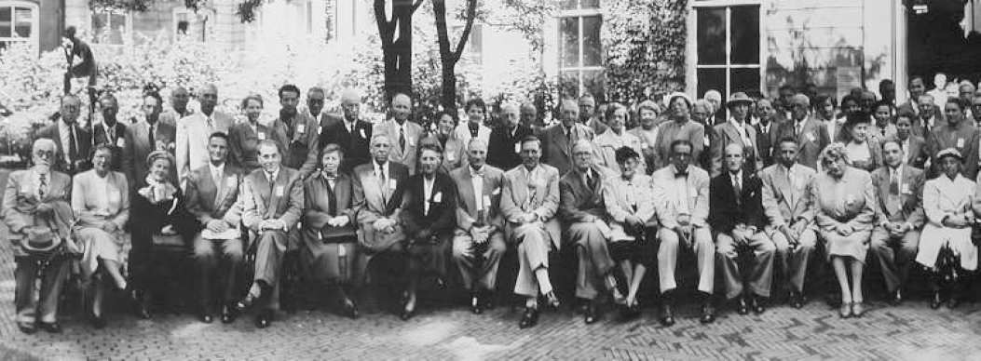
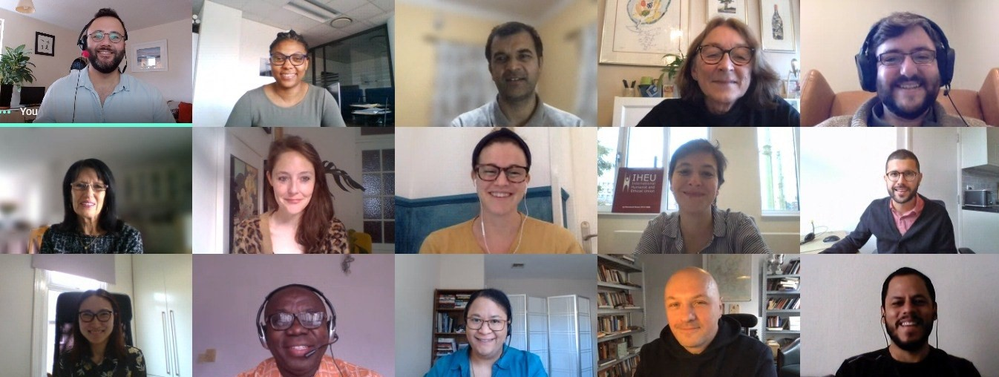
Humanists International
Some of the founding members (1952)
The board and staff members (2021)

Slide 7
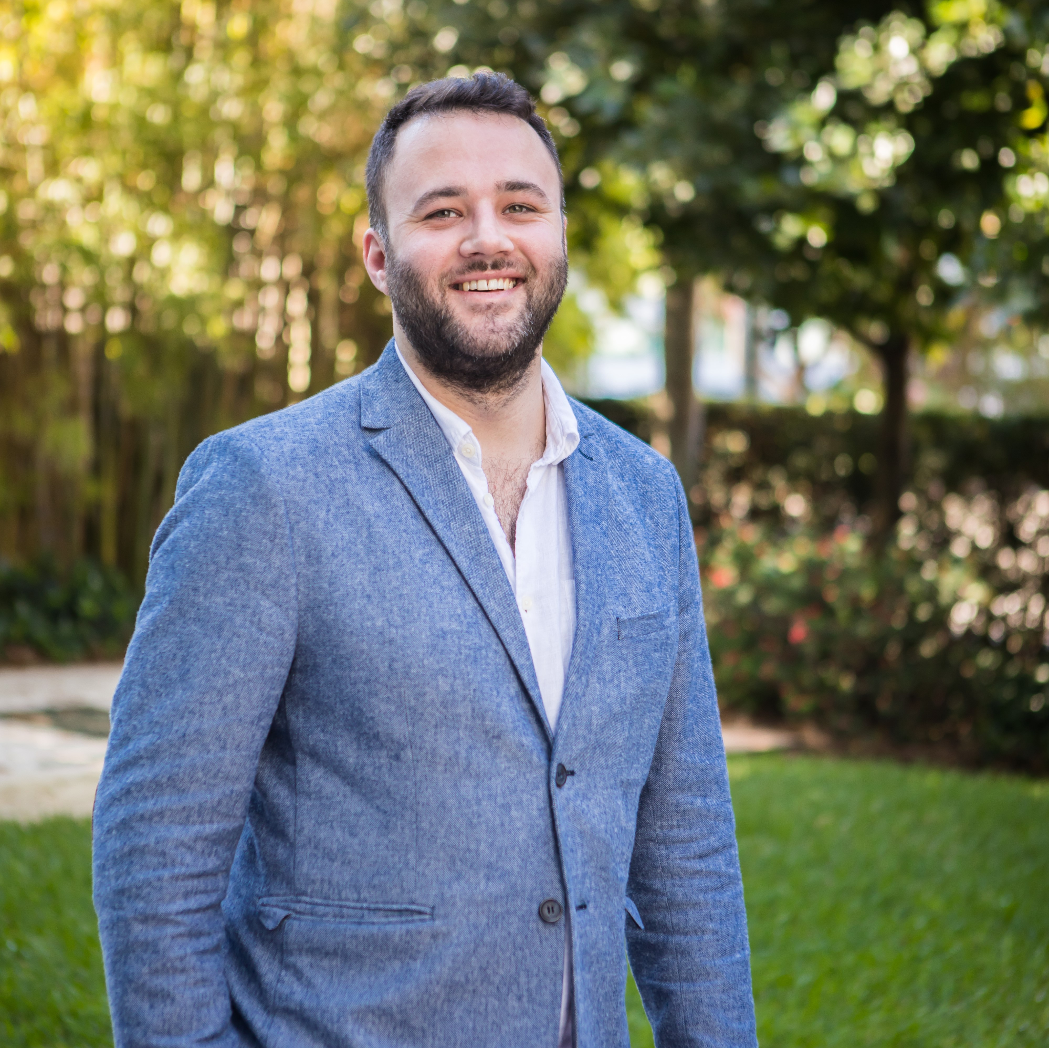
Humanists International
‘Numbers of humanists in all countries around the world continue to grow. Humanists continue to organise themselves and create new campaigns and activities at a higher rate than ever before so I think from an organisational point of view the future is very bright for humanists. But I am still very concerned that the threat to the fundamental idea of freedom of religion and belief continues to grow.’
Gary McLelland, Chief Executive,
Humanists International

Slide 8
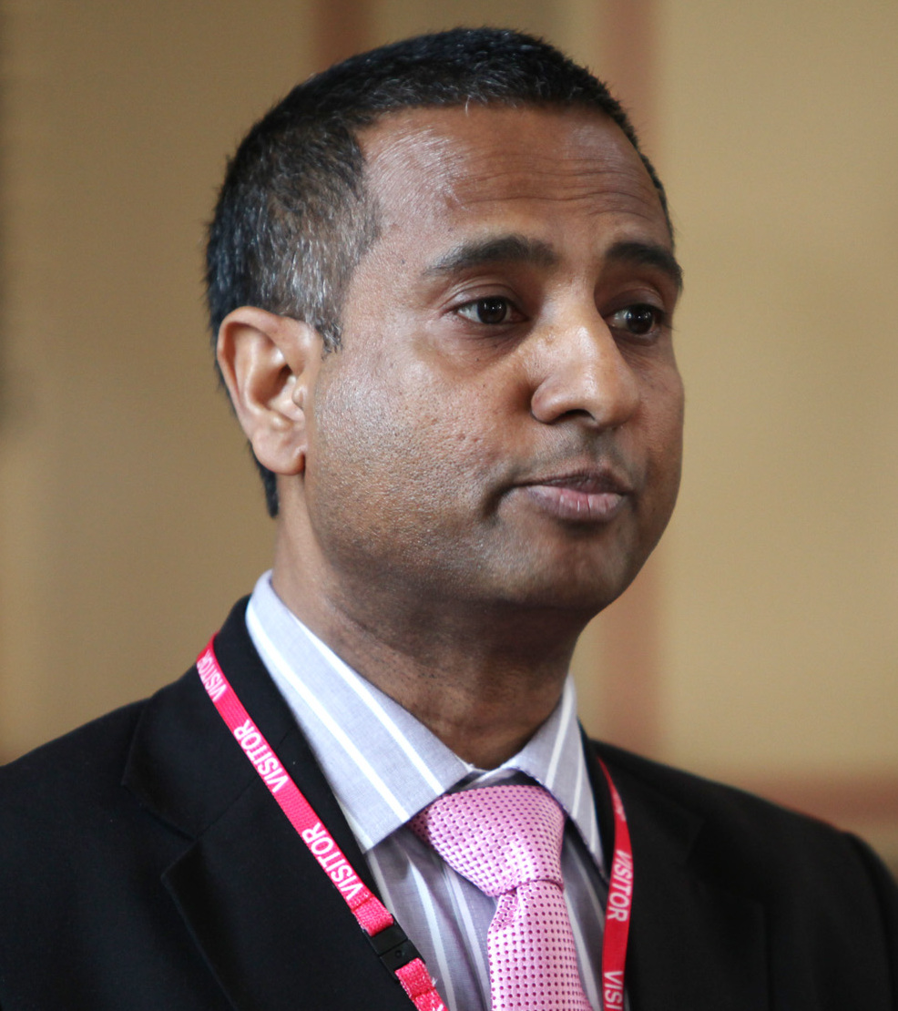
Humanists in danger
‘Humanists are the invisible people of the 21st century… While almost everybody is persecuted when they are in a minority, the attacks on humanists are particularly violent when they are exposed to harm in the community that they live, and of course, for many of them, the family is not a safe place.’
Ahmed Shaheed, United Nations Special Rapporteur on freedom of religion or belief
‘The most stark challenge that’s faced by humanists around the world is the right to even exist… Apostasy is the idea that by leaving or rejecting a religion you’ve committed an offence and this deserves to be punished… This is something that’s completely against international human rights law. It’s something Humanists International campaigns strongly against at the United Nations and around the world, but these laws do exist and we’ve seen many examples of people who have been imprisoned, tortured, and sadly killed, all for expressing a right to change or to hold new beliefs.’
Gary McLelland, Chief Executive, Humanists International

Slide 9
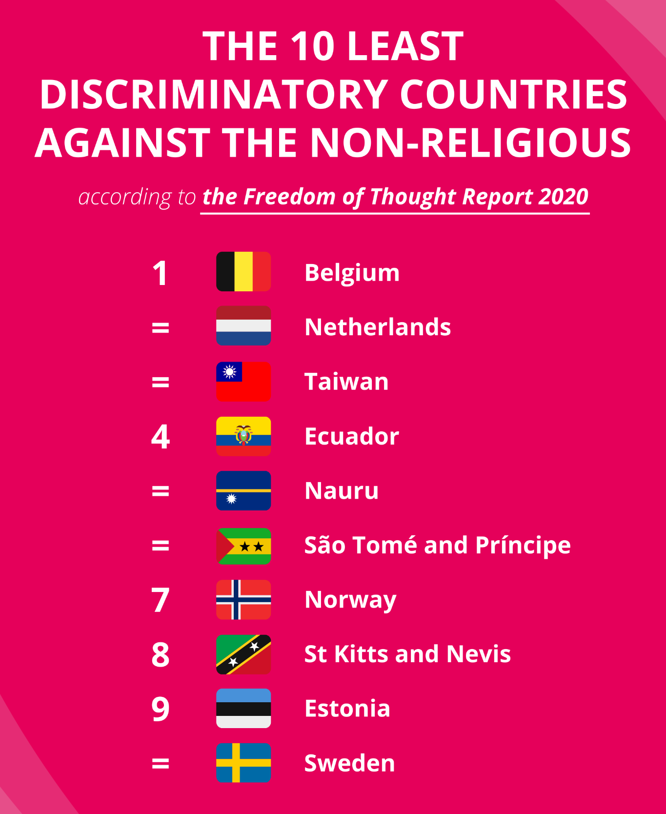
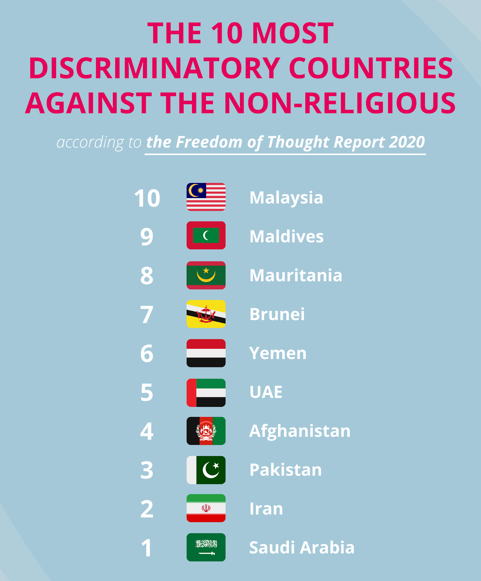
The Freedom of Thought Report

Slide 10

Humanist organisations around the world

Slide 11

The End Blasphemy Laws campaign

