Slide 1
FREEDOM, RESPONSIBILITY, CONNECTIONS
Humanism on a piece of string

Slide 2

What do you see?
Can you make your own?

Slide 3







THE HAPPY HUMAN

Slide 4
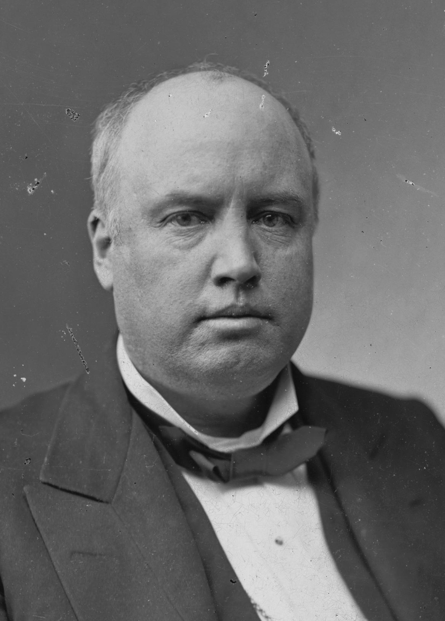
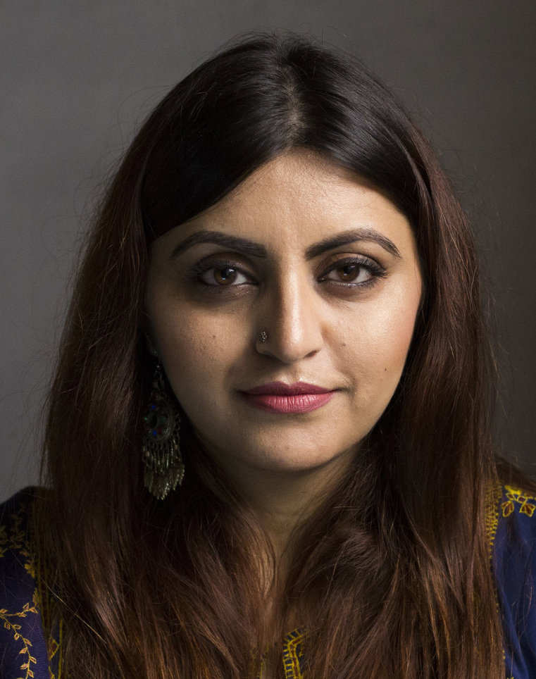
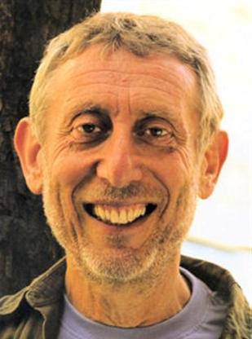
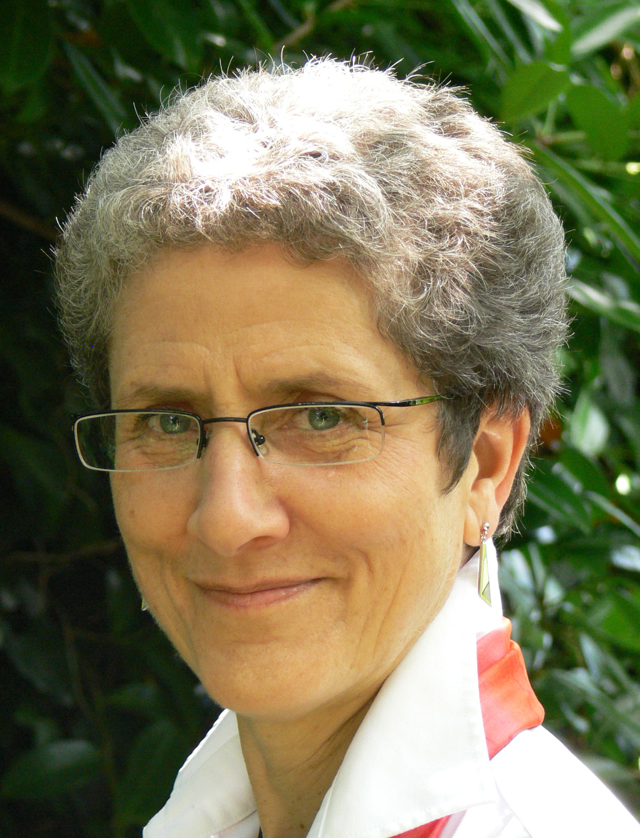
HAPPINESS
‘The place to be happy is here.
The time to be happy is now.
The way to be happy is to make others so.’
Robert Ingersoll (1833 – 1899)
‘I believe in celebrating life. I believe in happiness. I want to explore the beauty that exists in this world, and I believe every person has this right… This is our life and we should enjoy it!’
Gulalai Ismail, Humanists International
‘It's not enough to be a happy individual; we should also try to think of ways in which others – perhaps everyone – can be happy.’
Michael Rosen and Annemarie Young, authors of What is humanism?

Slide 5
HUMANISM
The following are important to humanists:
Freedom
Responsibility
What do these words mean?

Slide 6
HUMANISM
Freedoms
Freedom to think for ourselves
Freedom to live our lives the way we want
Responsibilities
Think carefully about what evidence our beliefs are founded upon
Decide for ourselves what is the best way to live
Make the most of the one life we have
Support other people to be free and happy
Consider other animals and the planet

Slide 7
RESPONSIBILITY
‘Each one of us has to decide what ends he thinks it right to pursue and what principles he is prepared to stand by … there is no escaping this responsibility.’
AJ Ayer (1910 – 1989), humanist philosopher

Slide 8
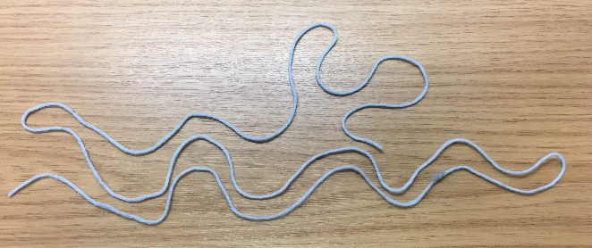
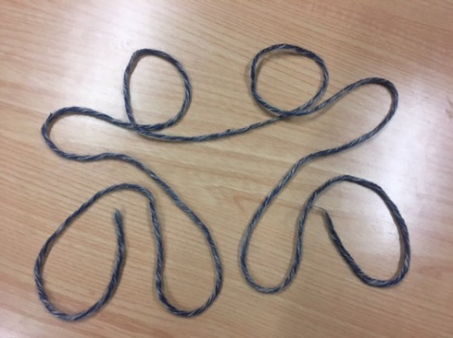
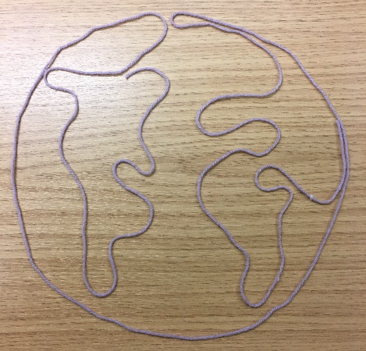
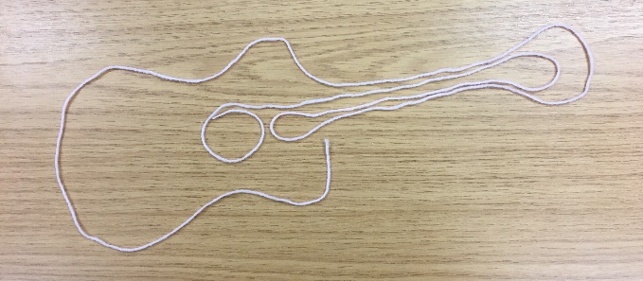
WHAT IS IMPORTANT TO YOU?

Slide 9
ACTIVITY 1: FREEDOM
Can you create an image of…?
Something important to you
Something that makes you happy
You at your best
How you see yourself in the future

Slide 10
HUMANISM
For humanists, our lives are like a piece of string
    They have a beginning and an end
    We are made from limited materials
    We can shape ourselves into who we want to be
    Our characters can be fluid and flexible
There is no single ‘right’ way to live
‘The meaning of your life is what you make it.’
AC Grayling, humanist philosopher

Slide 11
HUMAN NATURE AND CAPACITIES
‘Our entire bodies and brains are made of a few dollars’ worth of common elements: oxygen, hydrogen, nitrogen, carbon, enough calcium to whitewash a chicken coop, sufficient iron to make a two‐inch nail, phosphorous to tip a good number of matches, enough sulphur to dust a flea‐plagued dog, together with modest amounts of potassium, chlorine, magnesium and sodium. Assemble them all in the right proportion, build the whole into an intricate interacting system, and the result is our feeling, thinking, striving, imagining, creative selves. Such ordinary elements; such extraordinary results!’
James Hemming (1909 – 2007),
child psychologist and former President of Humanists UK

Slide 12
CHANGE AND PROGRESS
Humanists believe we should have the freedom to change what we believe and how we choose to live
    We can be wrong and can make mistakes so it is important that we are prepared to change
      Being open to change allows us to make progress in our understanding of the world and helps us find what makes us happy and fulfilled
        It also enables humanity to make progress in our knowledge and in our morality
Can you think of any examples of how you have changed for the better, or of how humanity has made progress?

Slide 13
CHANGE AND PROGRESS
‘Quality of character, happiness, fulfilment of potential and of human needs can be improved through changed values, through redirection of individual life, by a process of personal change, and personal evolution.’
Jeaneane Fowler, author
‘Science is one of the very few human activities – perhaps the only one – in which errors are systematically criticised and fairly often, in time, corrected. That is why we can say that, in science, we often learn from our mistakes, and why we can speak clearly about making progress there.’
Karl Popper (1902 – 1994),
former patron of Humanists UK

Slide 14
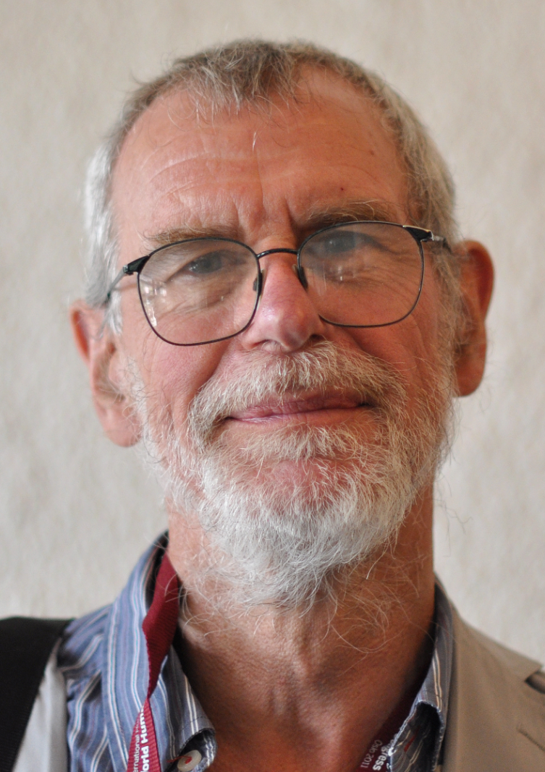
OUR STORY
‘When we think about how meaningful we find our own lives to be, one of the things we may be doing is asking whether the different bits of our lives hang together, and what they all add up to. One way in which we might put that question is to ask ourselves whether we can tell a coherent story about our lives. This idea of having a ‘life-story’ helps to explain why the language of ‘meaning’ is appropriate. We don’t merely want to have a good life in the sense of a collection of rewarding experiences and achievements. We want to be able to see the various components as woven into an ongoing narrative into which they fit and which makes that life my life.’
Richard Norman, humanist philosopher

Slide 15
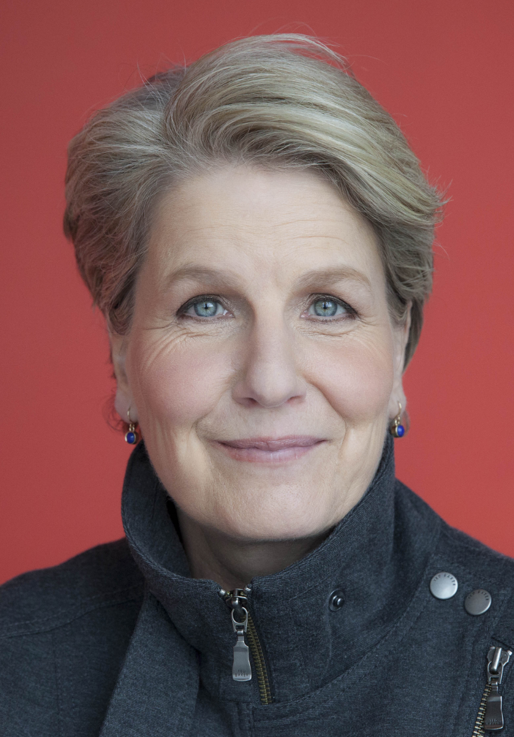
DEMANDING BUT REWARDING
‘Being a humanist can be demanding. It means, when deciding what to believe or how to act, you have to do the thinking for yourself. You have to take responsibility for your own life. You have to take on what, for some, can appear like uncomfortable facts about reality. But it can also be enormously rewarding. It can be liberating and life-enhancing.’
Sandi Toksvig, patron of Humanists UK

Slide 16
ACTIVITY 2: RESPONSIBILITY
Tie your string to somebody else’s wrist.
Now try to create a picture of something important to you.

Slide 17
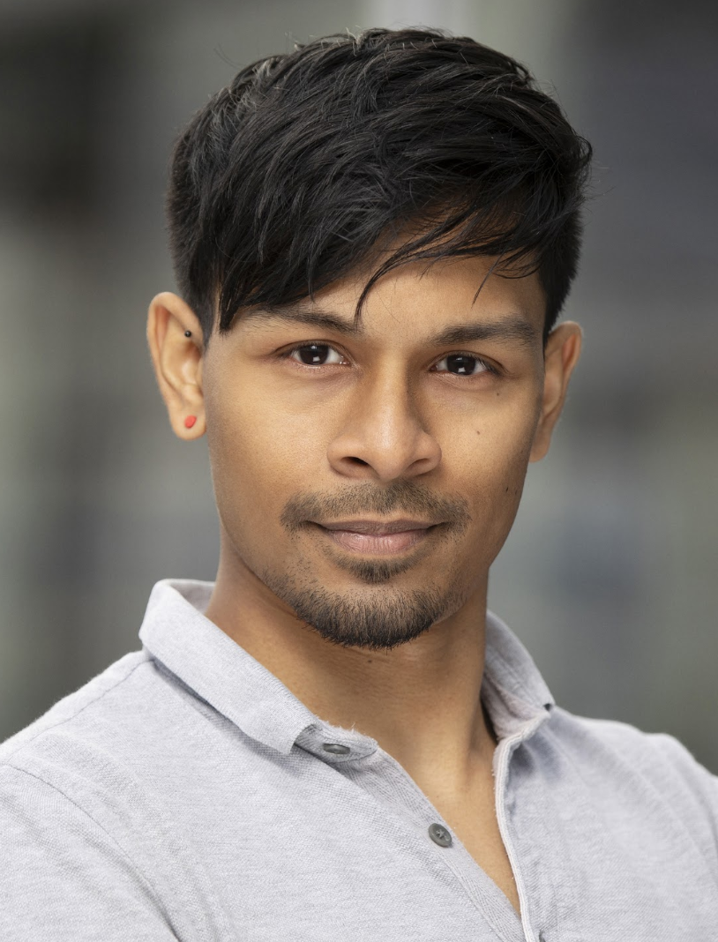
FREEDOM
‘For me, freedom is one of the most important things in life: the freedom to believe what I choose and to live my life however I wish, as long as I don’t cause harm to others.’
Imtiaz Shams, Trustee of Humanists UK

Slide 18
LIMITATIONS ON OUR FREEDOM
Should freedom come with any constraints?
‘The only purpose for which power can be rightfully exercised over any member of a civilised community, against his will, is to prevent harm to others.’
John Stuart Mill (1806 – 1873), philosopher
Sometimes this is described as:
‘The freedom to swing my fist ends at the tip of your nose.’

Slide 19
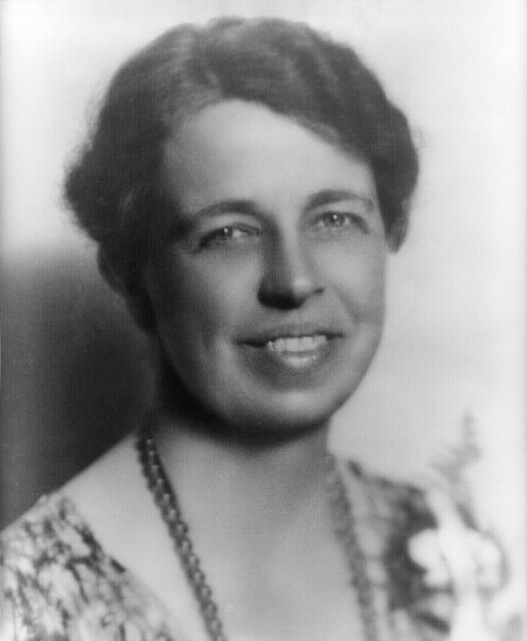
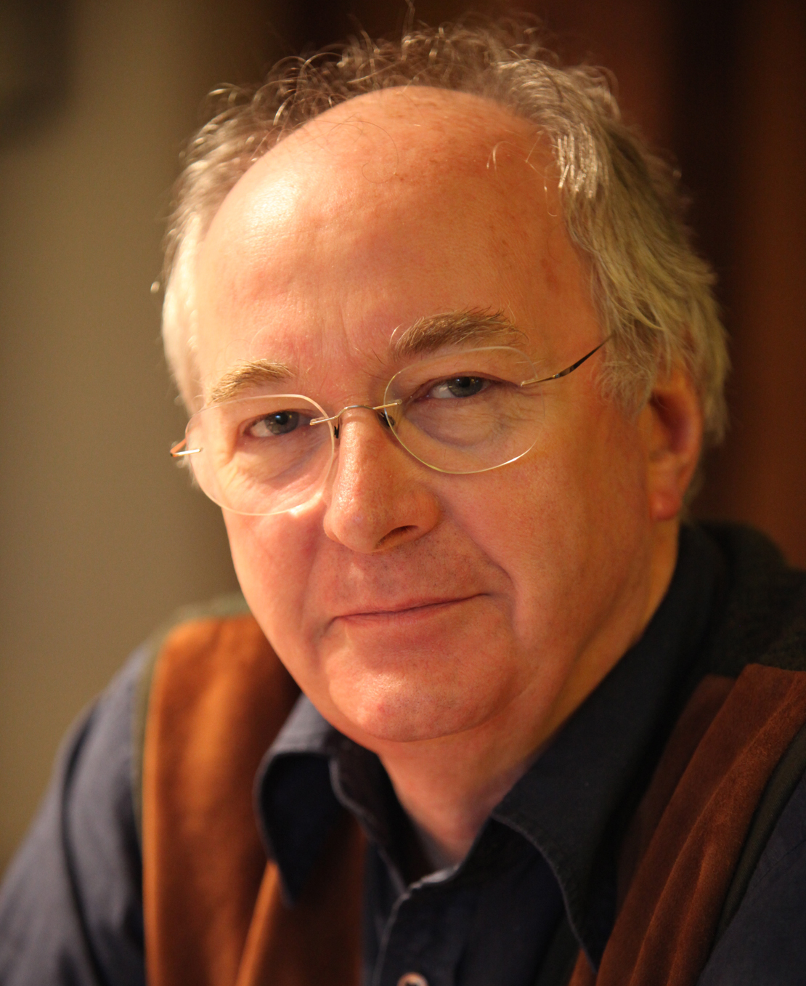
RESPONSIBILITY
‘We shape our lives, and we shape ourselves. The process never ends until we die. And the choices we make are ultimately our own responsibility.’
Eleanor Roosevelt, political activist (1884-1962)
‘I would like to live to the full, right now, and I hope that I live in such a way that the world is a little bit better after I leave it than it was when I arrived.’
Philip Pullman, author

Slide 20
RESPONSIBILITY
‘In life, the meaning comes in living, as wholly as we can, as abundantly as we can, as bravely as we can, here and now, sharing the experience with others, caring for others as we care for ourselves, and accepting our responsibility for leaving the world better than we found it.’
James Hemming (1909 – 2007),
child psychologist and
former President of Humanists UK
‘You cannot hope to build a better world without improving the individuals. To that end, each of us must work for our own improvement and, at the same time, share a general responsibility for all humanity, our particular duty being to aid those to whom we think we can be most useful.’
Marie Curie (1867 – 1934),
scientist and humanist

Slide 21
CONNECTIONS
Are our connections a good or a bad thing?
Do these ties frustrate us or can they make our lives richer?

Slide 22
CONNECTIONS
‘I fall asleep in the full and certain hope
That my slumber shall not be broken;
And that, though I be all-forgetting,
Yet shall I not be all-forgotten,
But continue that life in the thoughts and deeds of those I loved.’
Samuel Butler (1835-1902), Erewhon
‘No life is ever completely lost: we live on through the influence we have had on the lives of those who remain.’
Extract from a humanist funeral
‘Only connect!’
EM Forster (1879 – 1970),
author and humanist
‘One person alone is not a full person: we exist in relation to others.’
Margaret Atwood, author and humanist
‘Of all the things that wisdom provides for the happiness of the whole person, by far the most important is the acquisition of friendship.’
Epicurus (341 – 270 BCE), philosopher

Slide 23
ACTIVITY 3: CONNECTIONS
Work together as a group.
Using all your strings, create a picture of the richness and variety of human life.

Slide 24
CONCLUSIONS
Freedom, responsibility and connections are important to humanists
For humanists...
    We are the authors of our own story and we can make our own lives meaningful
    Being open to change enables us to make progress
    Our freedom should not restrict other people’s freedom – we have a responsibility to consider others
    Connections can enrich our lives and allow the impact of our lives to ‘live on’

