Slide 1
Data on humanists and the non-religious

Slide 2
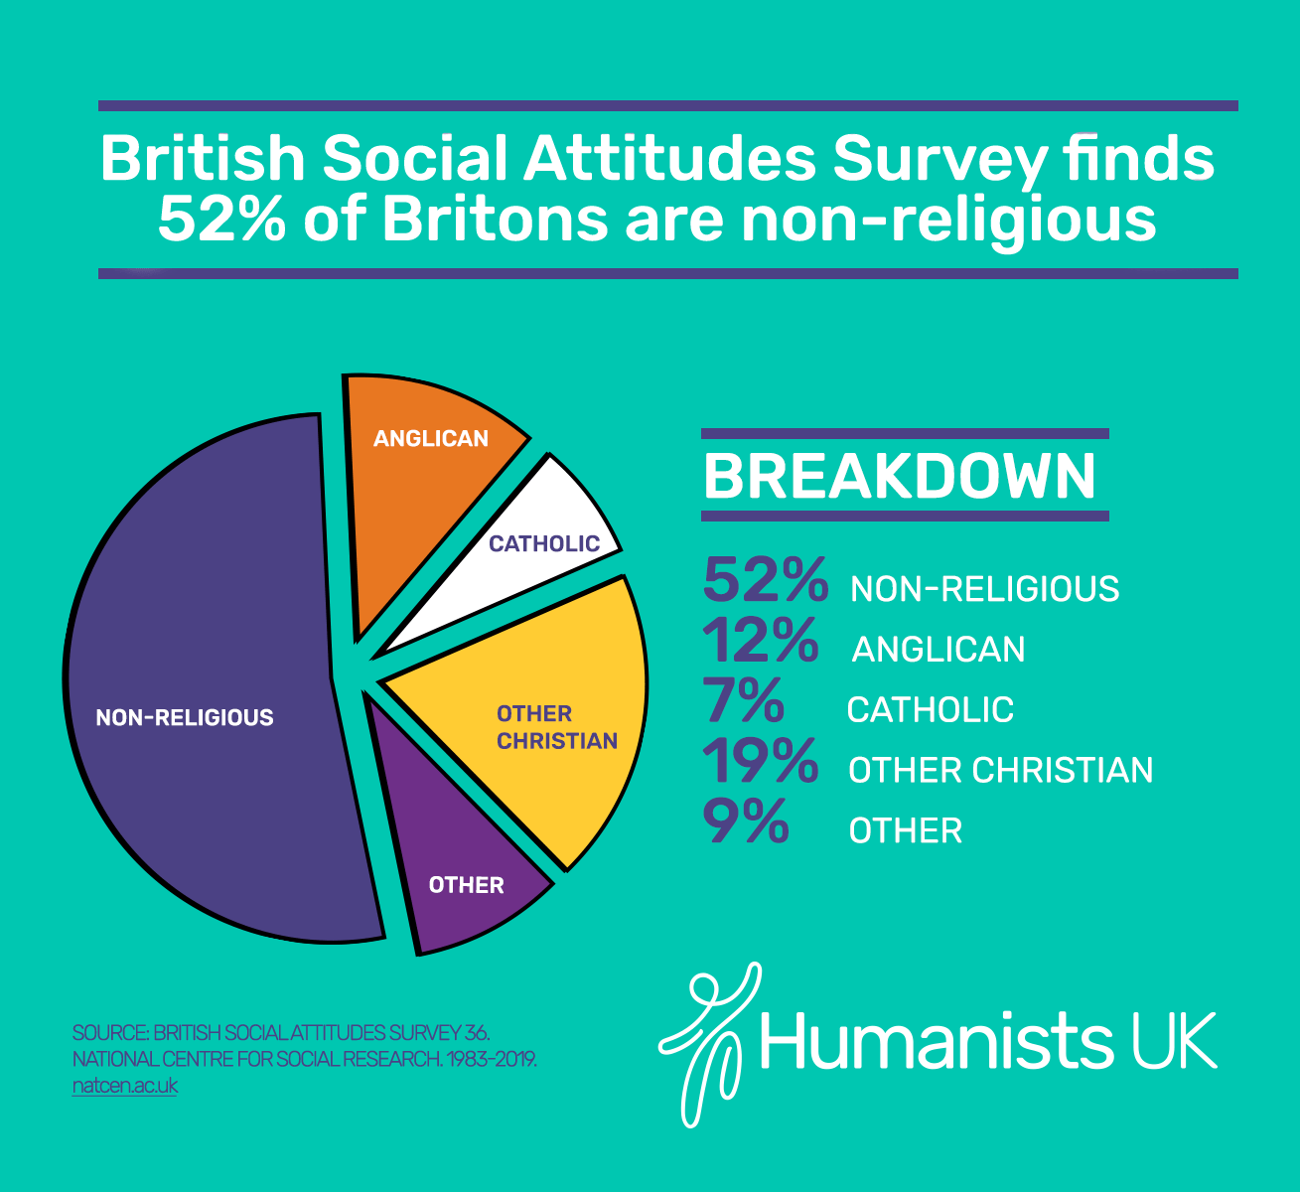
How many non-religious people are there?

Slide 3
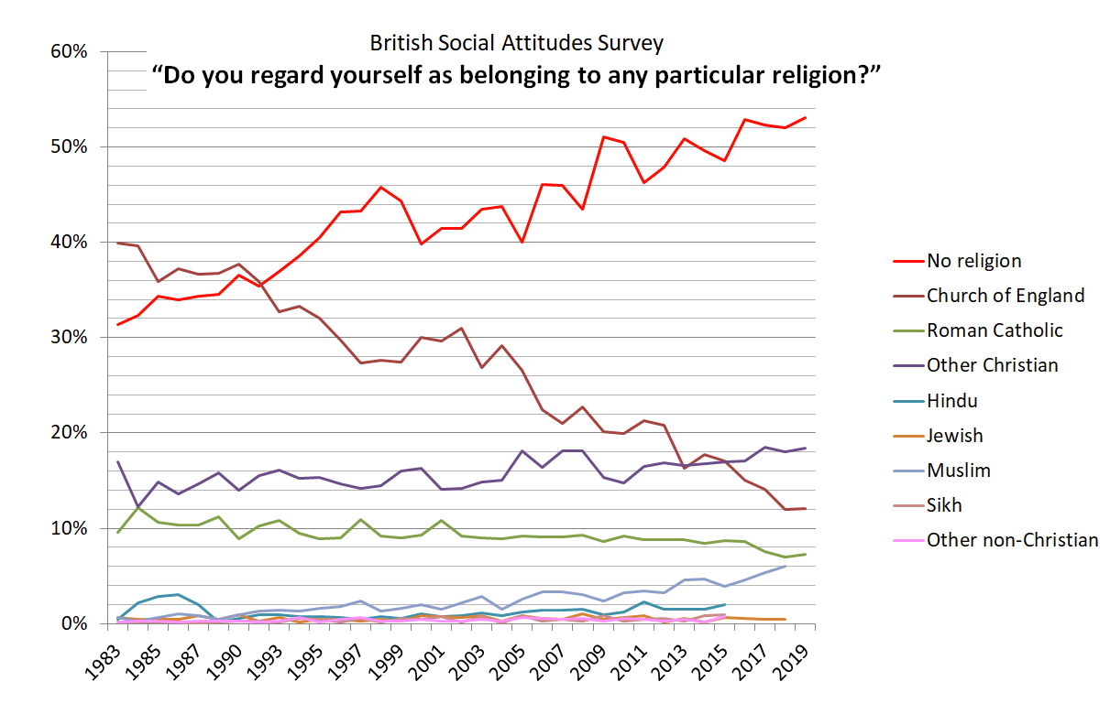
How many non-religious people are there?
Note: no data available for some religions in most recent years
Source: British Social Attitudes Survey, NatCen

Slide 4
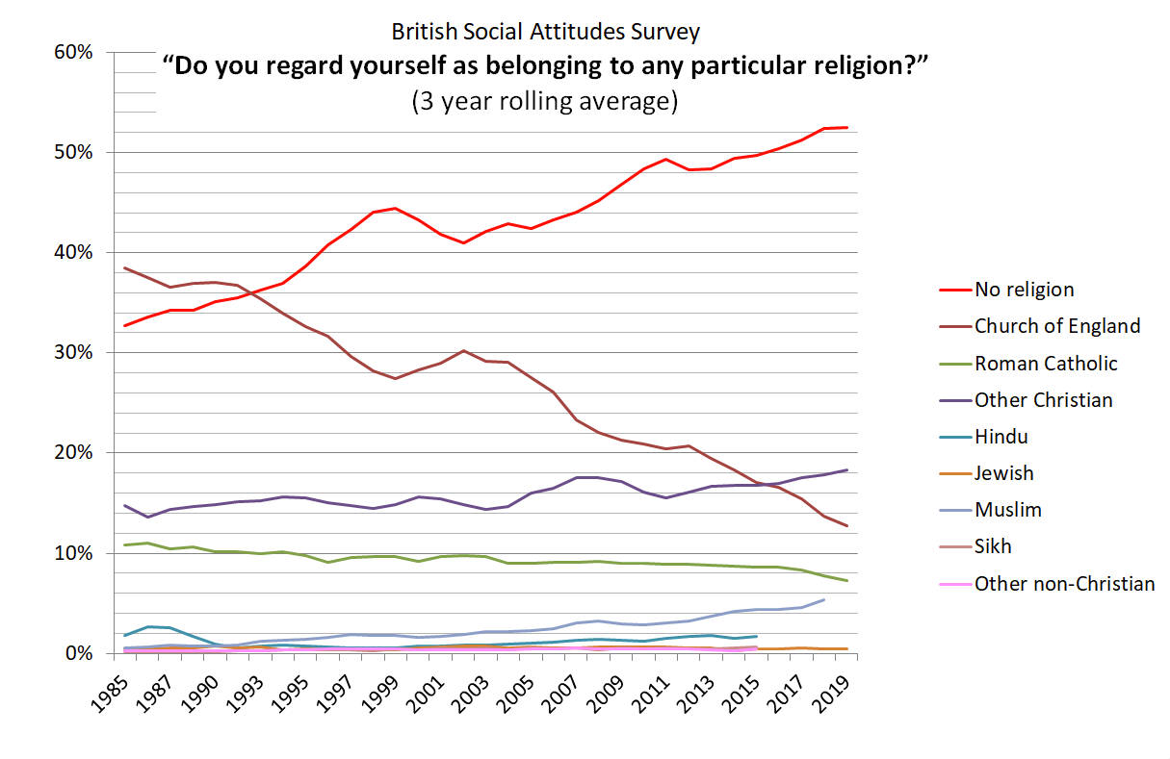
How many non-religious people are there?
Note: no data available for some religions in most recent years
Source: British Social Attitudes Survey, NatCen

Slide 5
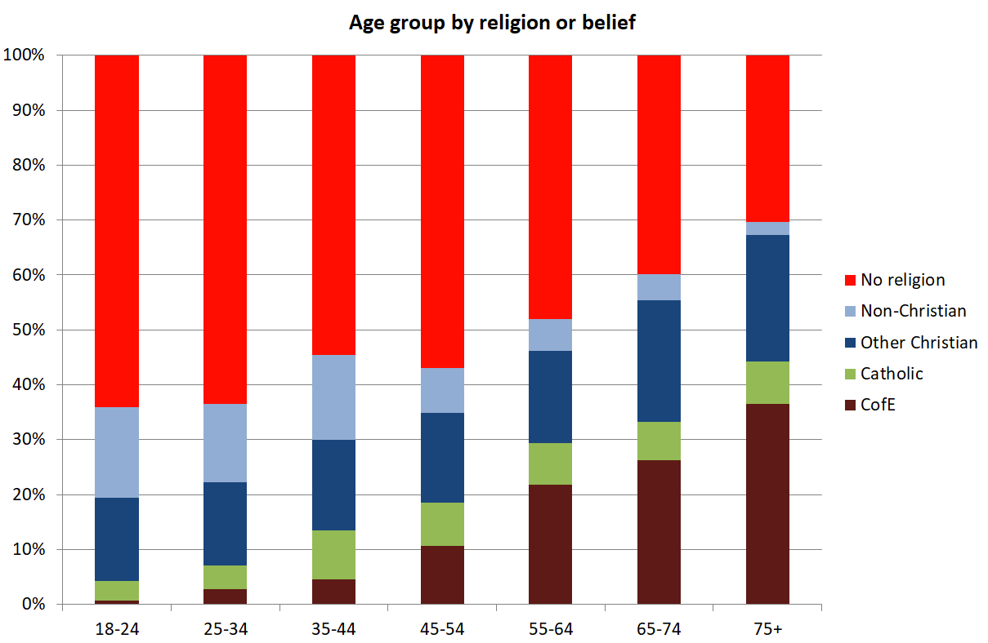
How many non-religious people are there?
Source: British Social Attitudes Survey (2018), NatCen

Slide 6
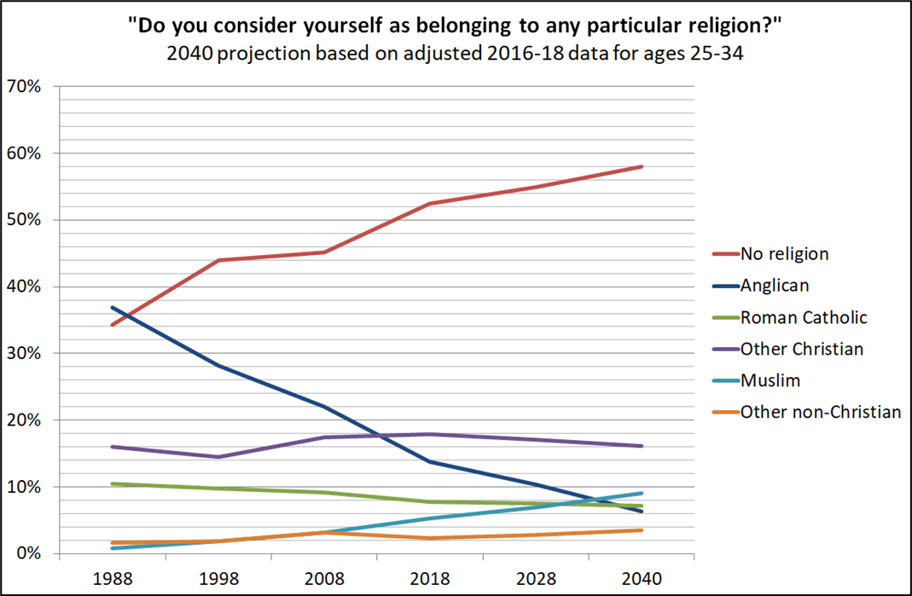
Continuing the trend into the future?

Slide 7
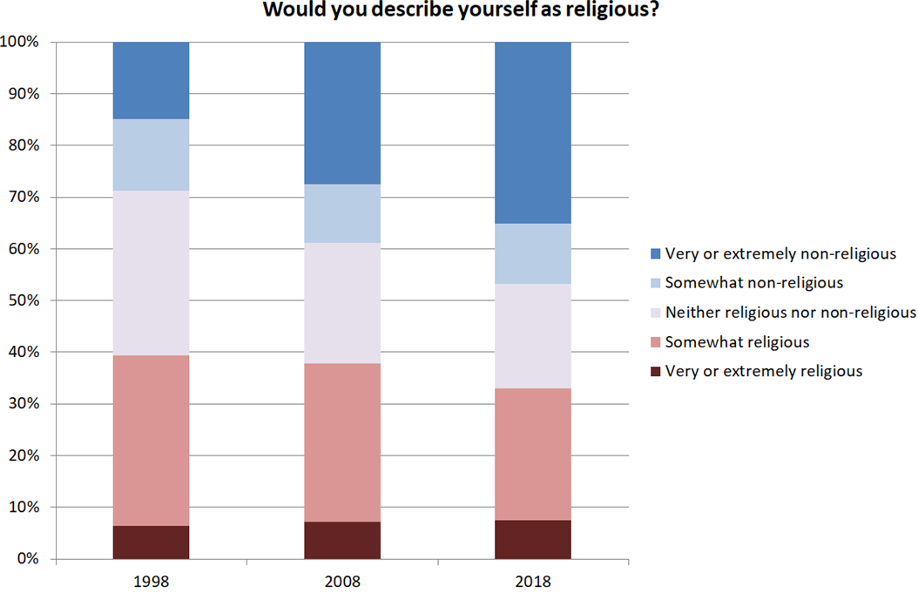
Source: British Social Attitudes Survey, NatCen

Slide 8
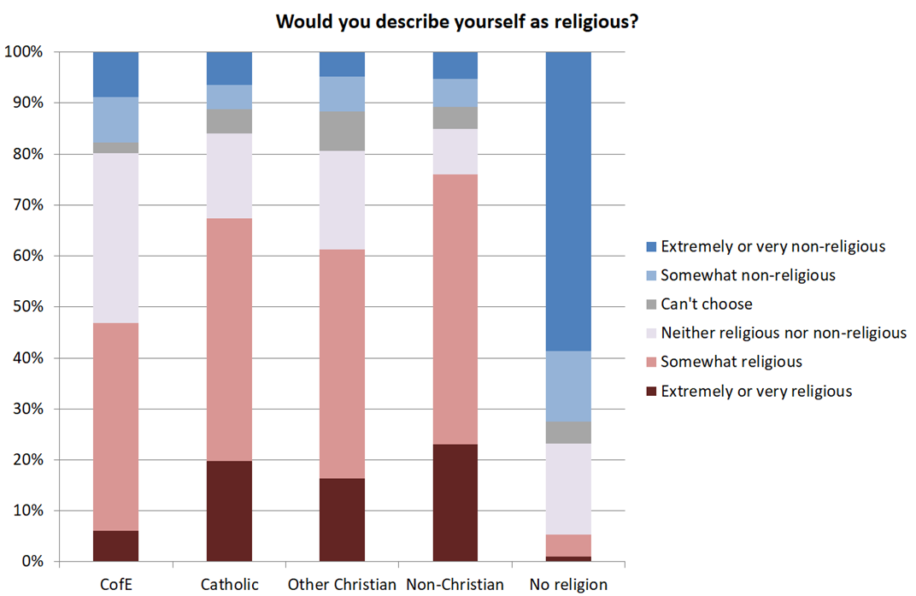
Source: British Social Attitudes Survey, NatCen (2018)

Slide 9
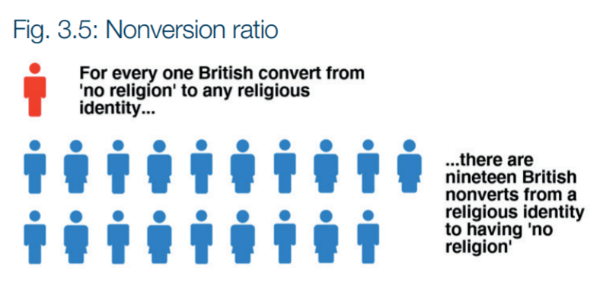
Changing your religion or belief
Two non-religious parents normally transmit their lack of religion
Two religious parents have a 50/50 chance of passing on their faith to their child
One religious parent is half as likely to pass on their faith as two
Bruce Voas
British Social Attitudes Survey 2019
Source: The no-religion population of Britain, St Mary’s University (2017)

Slide 10
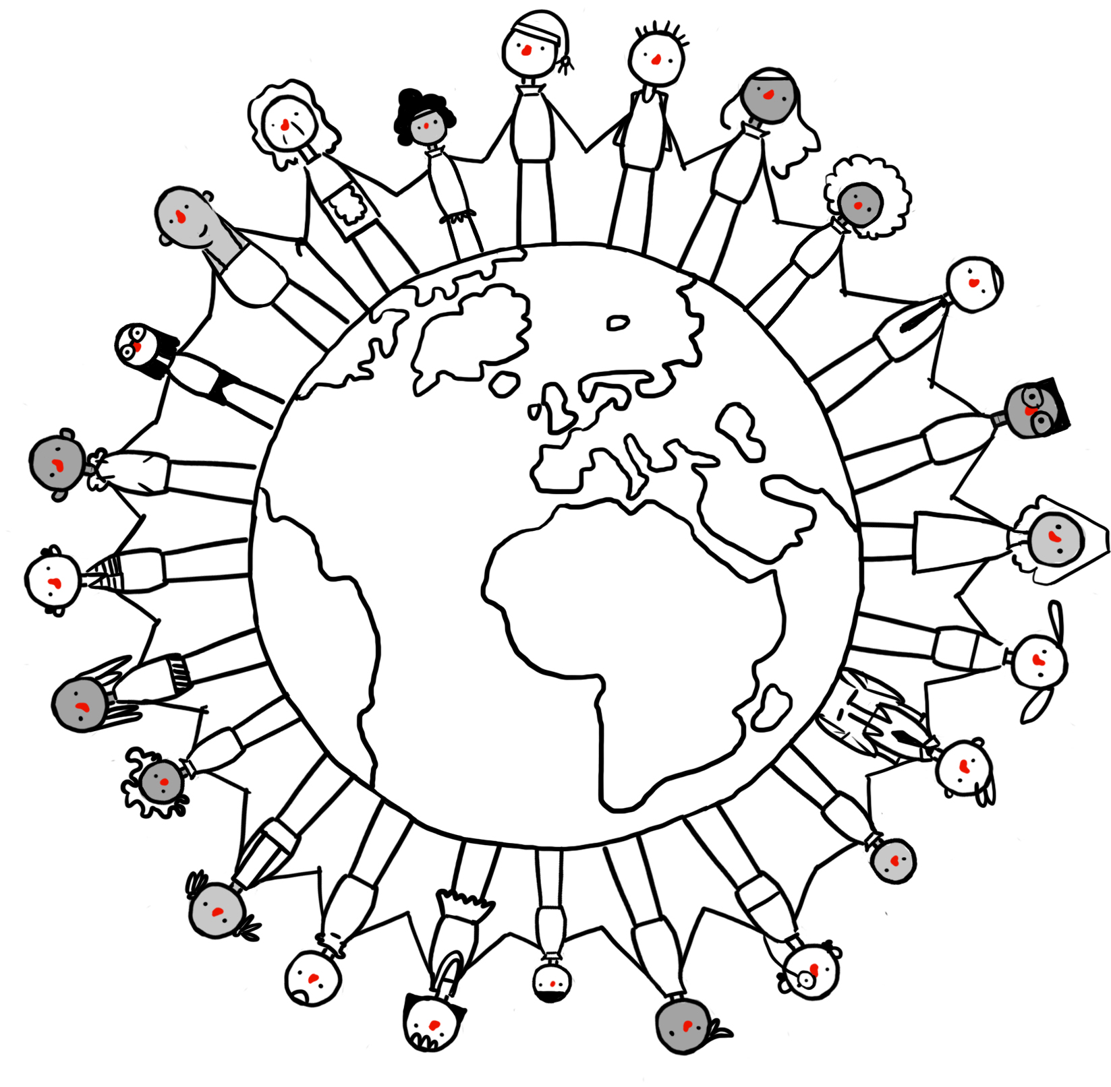
How many humanists are there?
Around 5% of people in the UK use the label ‘humanist’ to describe themselves
Many more share humanist beliefs and values
Humanists and humanist organisations can be found all around the world – in Europe, Africa, Asia, and the Americas.
‘Around a quarter of the UK population have a worldview that is mainly humanist, and… humanism likely plays a role in the beliefs and outlooks of others too.’
Dr Lois Lee, University of Kent,
Understanding Unbelief programme

Slide 11
The three ‘B’s
People can feel that they belong: they identify with a particular religion (perhaps because they were born in a particular country or because of their family history).
People can share beliefs associated with a particular religion (e.g. they believe in a god).
People can carry out certain behaviours or practices associated with a religion (e.g. they attend a mosque or follow particular rituals at Hanukkah).
It is possible to be religious in one of these ways but not in another. Labels and how people identify themselves can sometimes hide a lot about people’s beliefs.

Slide 12
Using the label
Many of those who hold humanist beliefs and values don’t use the word ‘humanist’ to describe themselves because they are unaware of the label or what it means. When the meaning of the label is described to them, many, but not all, are happy to apply the label to themselves.
Is it possible to be a humanist and not know it?

Slide 13
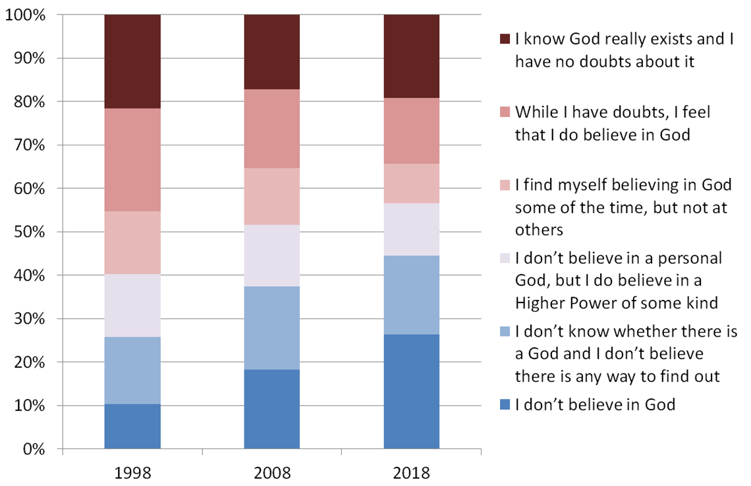
Atheism and agnosticism
Source: British Social Attitudes survey

Slide 14
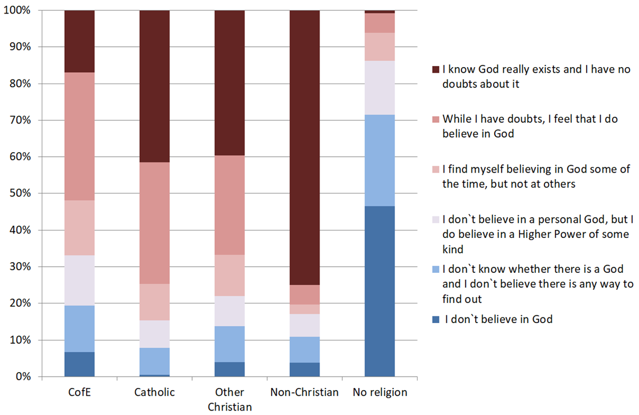
Atheism and agnosticism
Source: British Social Attitudes survey 2018

Slide 15
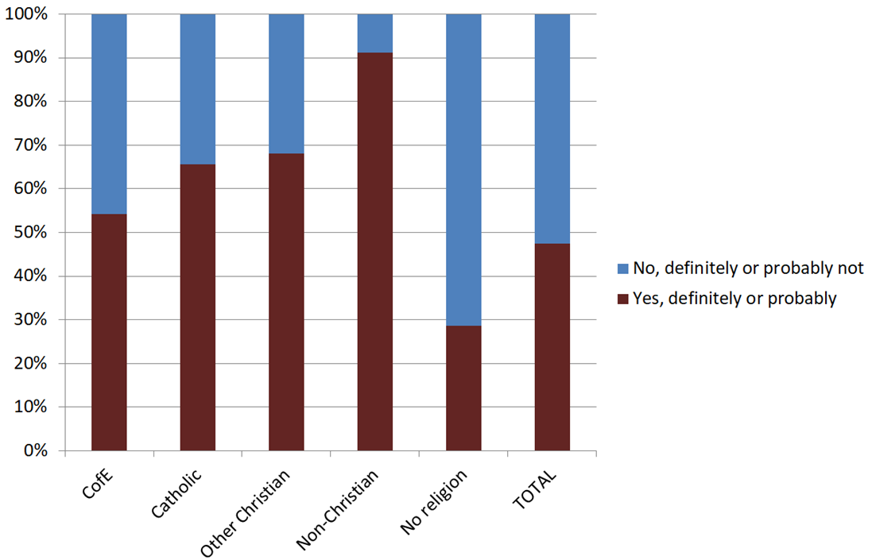
Do you believe in an afterlife?
Source: British Social Attitudes Survey, NatCen (2018)

