Slide 1
Atheism and agnosticism

Slide 2
Atheism and agnosticism
An atheist is somebody who does not believe in a god
An agnostic is somebody who says we cannot know whether a god exists or not
Humanists are atheists and agnostics who believe it is possible to lead good and happy lives

Slide 3
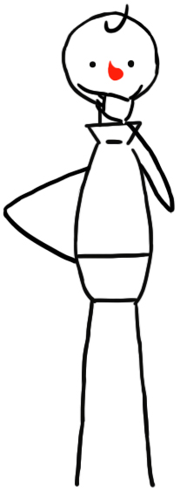
Belief
What do these words mean?
‘Certain’
‘Possible’
‘Probable’
Can you use them in a sentence?

Slide 4
Belief in god scale
I am 100% certain that a god exists.
I believe it is very unlikely that a god exists and I live my life as though there is no god.
I am uncertain but feel that it is more likely a god doesn’t exist than one does.
Atheist Theist
I am completely undecided.
I am uncertain but feel that it is more likely a god exists than one doesn’t.
I am 100% certain that there is no god.
I believe it is very likely that a god exists and I live my life as though there is a god.

Slide 5
‘Theist’ = somebody who believes in a god
‘Atheist’ = somebody who does not believe in a god
‘Agnostic’ = somebody who accepts we can’t know whether a god exists or not

Slide 6
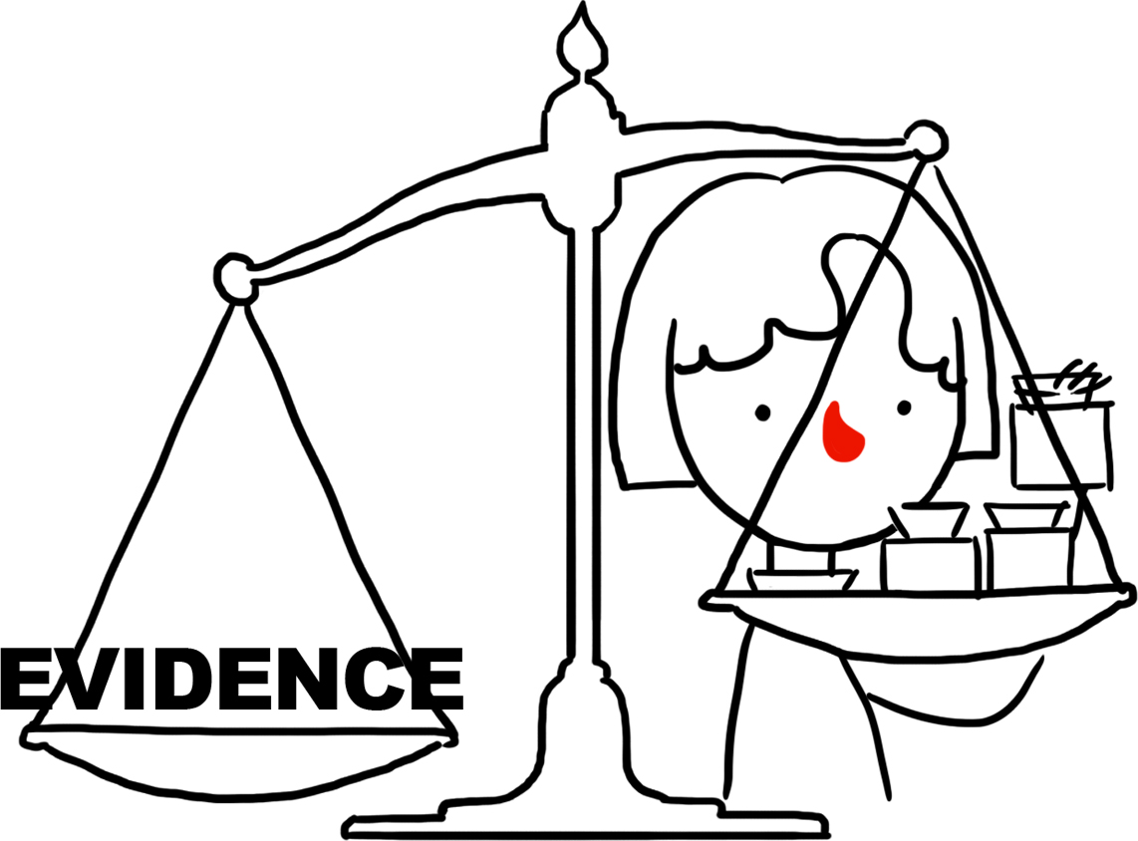
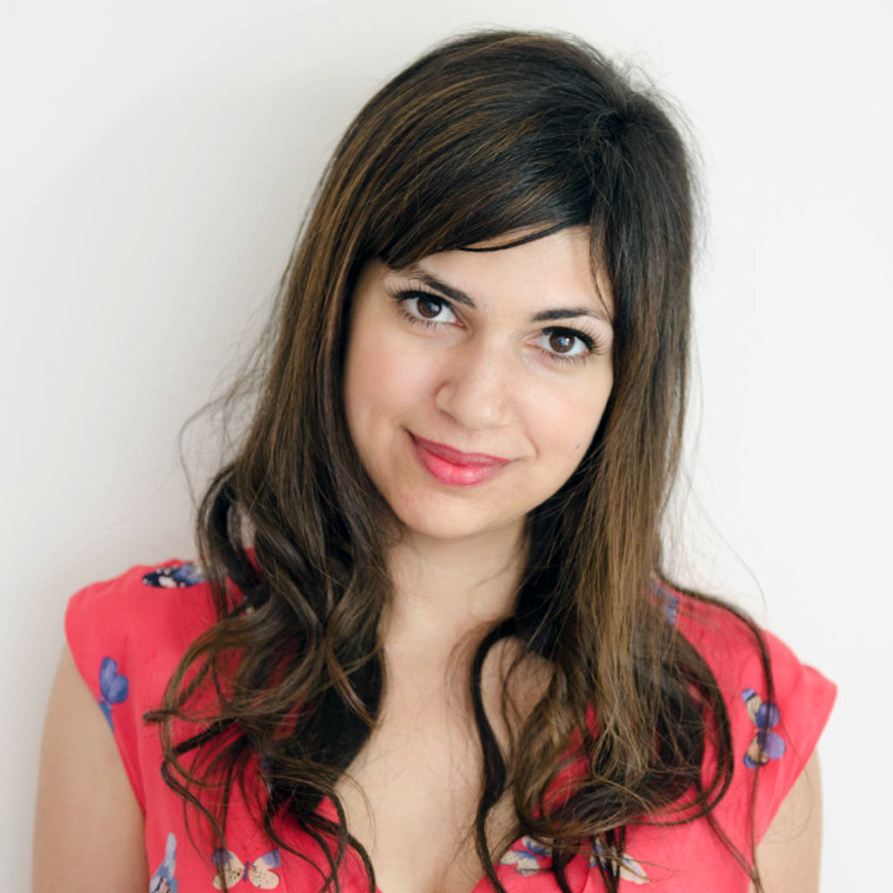
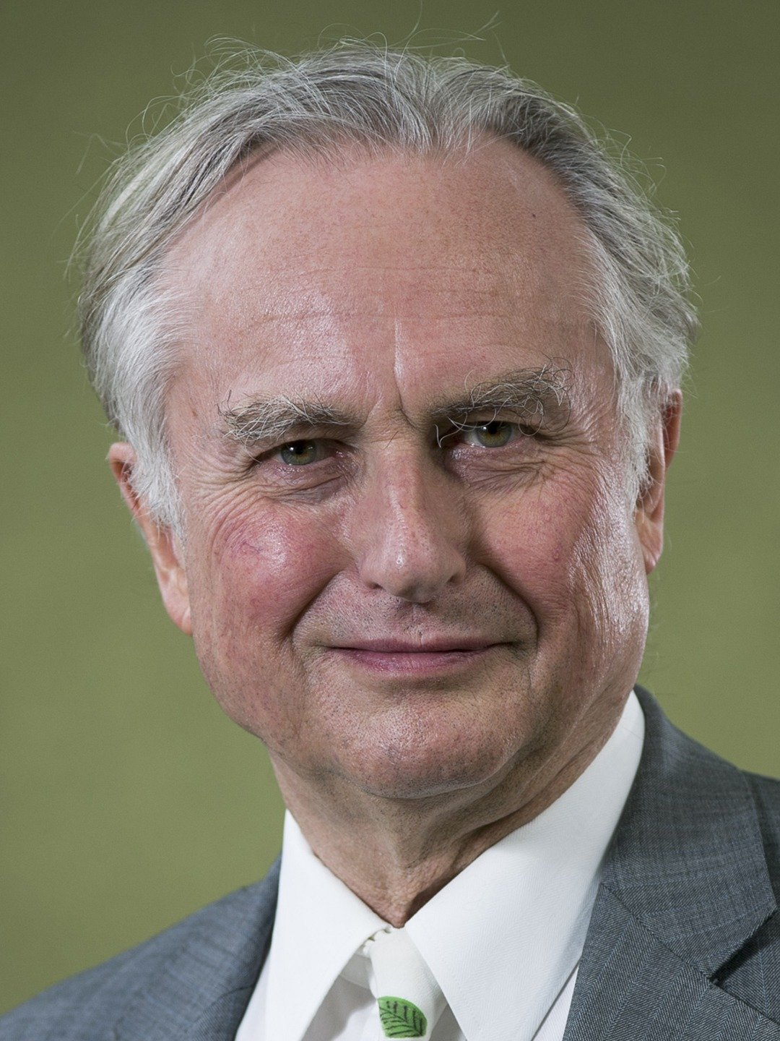
Evidence and proof
‘Even though there’s no scientific evidence at all for God’s existence, it’s also impossible to prove that God doesn’t exist (or that anything doesn’t).’
Ariane Sherine, writer
‘What matters is not whether god is disprovable (he isn’t) but whether his existence is probable.’
Richard Dawkins, scientist

Slide 7
The problem of suffering
Why would a good god allow suffering to exist?

Slide 8
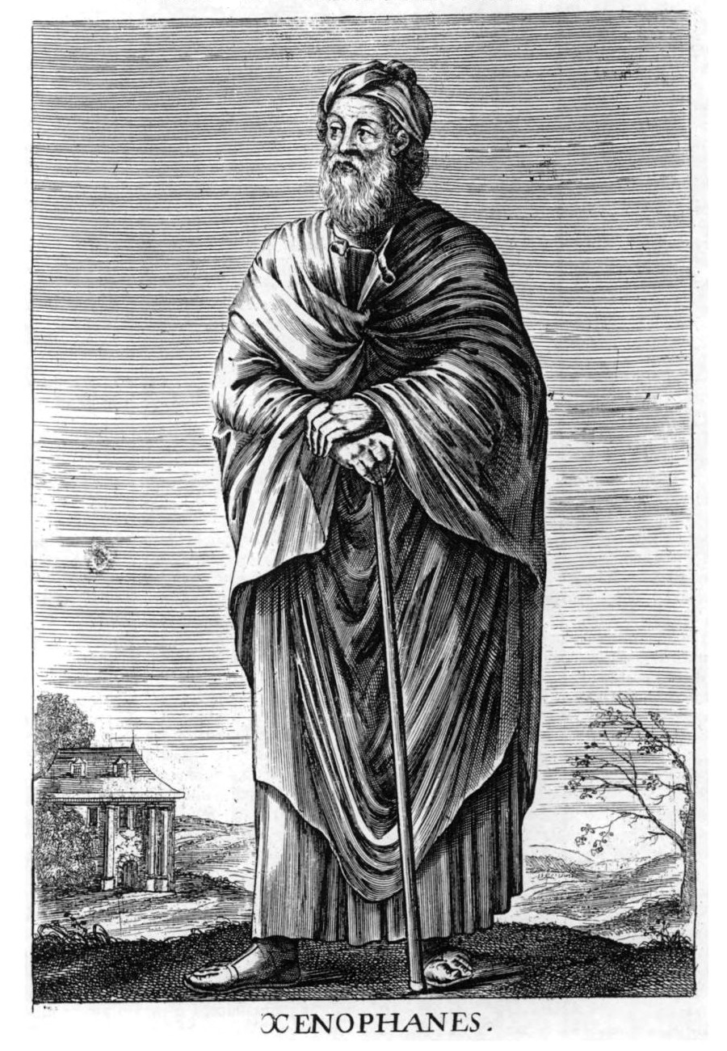
A human invention?
‘The Ethiopians say that the gods have flat noses and are black, while the Thracians say that the gods have blue eyes and red hair… And if cattle or horses or lions had hands or could draw or sculpt like men can, then the horses would draw their gods like horses, cattle draw their gods like cattle, and both would depict the bodies of the gods in their own likeness.’
Xenophanes (570 – 475 BC)

Slide 9
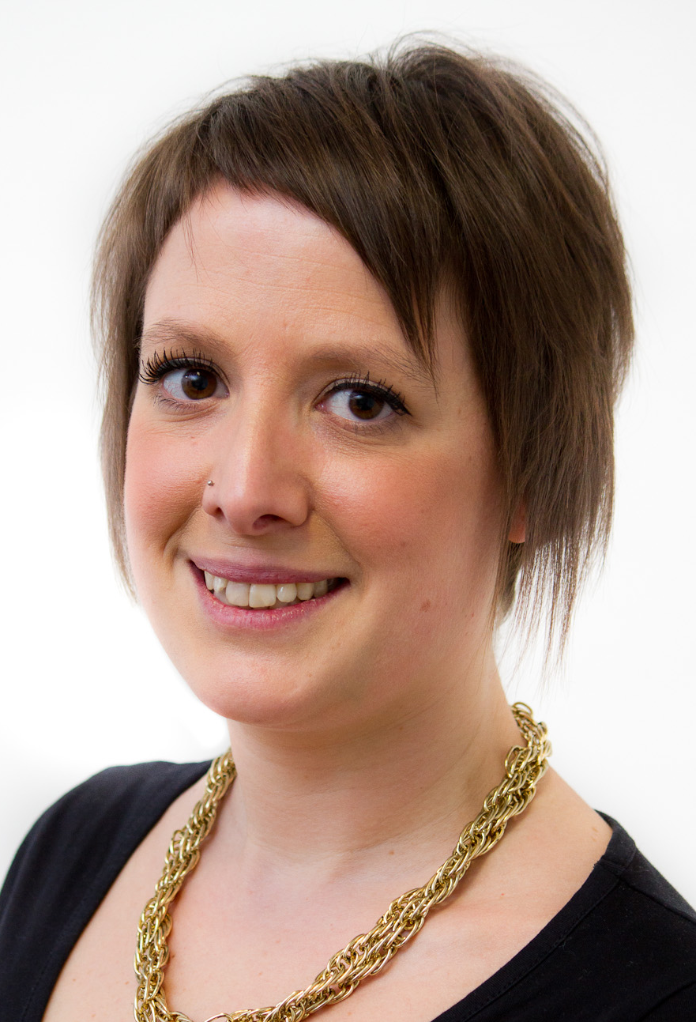
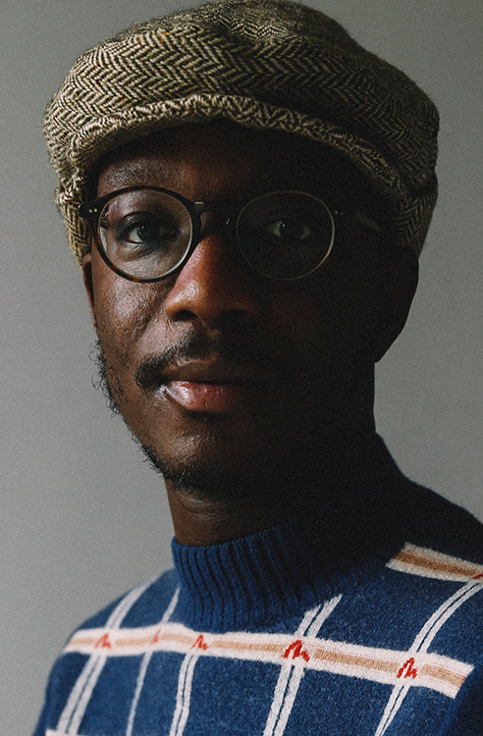
Humanism
‘For me, humanism is sort of atheism plus.’
Naomi Phillips, humanist
‘Humanism for me has always been positive. We don’t define ourselves by what we don’t believe, which is what I had always done prior to discovering humanism.’
Ste Richardsson, humanist

Slide 10
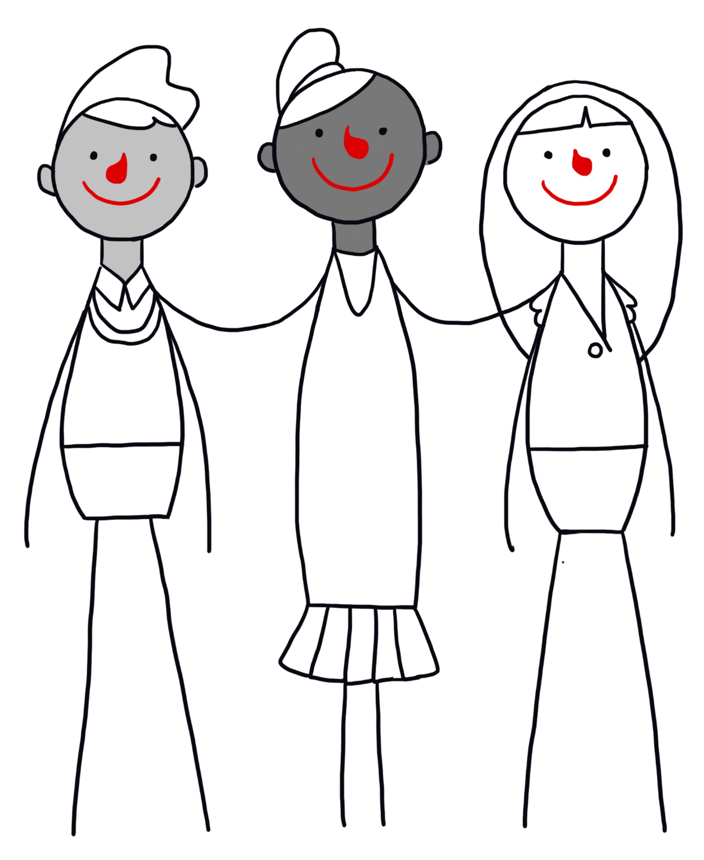
Humanists
Many atheists and agnostics are humanists.
They don’t believe in a god.
Humanists believe:
we can understand the world around us through science
we should treat each other with kindness and respect
we can lead good, happy, and meaningful lives without the need to believe in a god
Freedom of belief is important to many humanists.

Slide 11
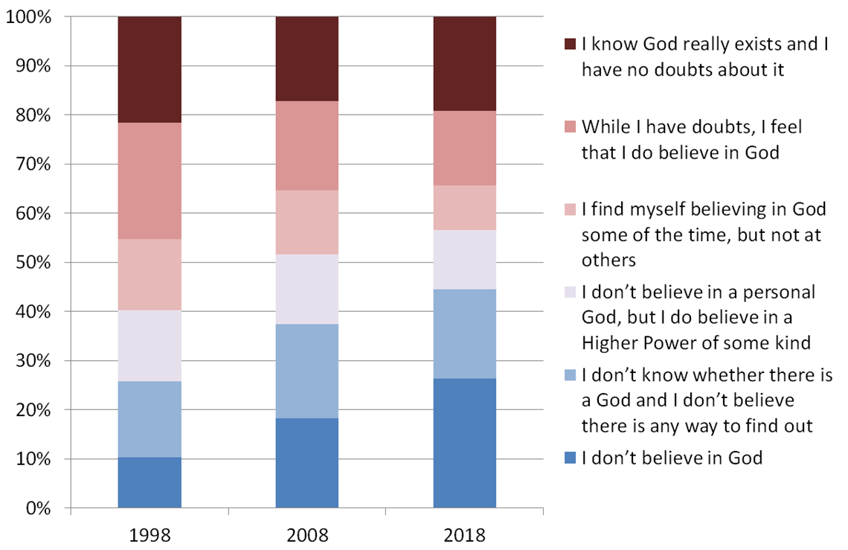
Source: British Social Attitudes survey

Slide 12
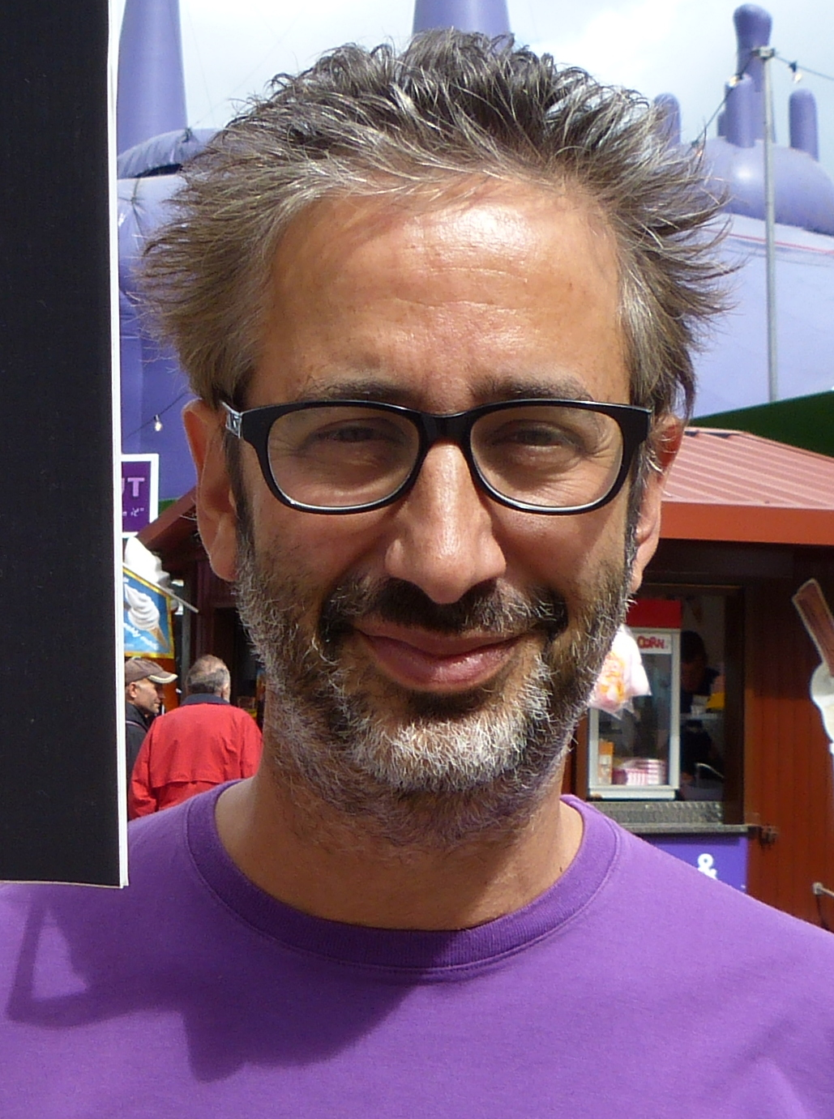
Religious and atheist/agnostic
‘I am an atheist, and this confuses some people… For me, Jewishness, and I would say for an awful lot of Jews, is nothing to do with believing in God… For me, Jew is an identity. It's an ethnic and cultural identity, which I feel very strongly.’
David Baddiel, patron of Humanists UK

Slide 13

The invisible pencil-eating monster

Slide 14
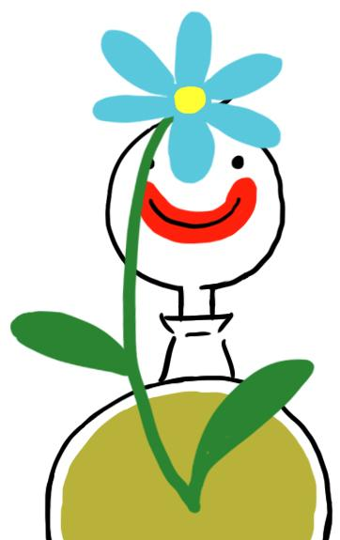
The invisible gardener

Slide 15
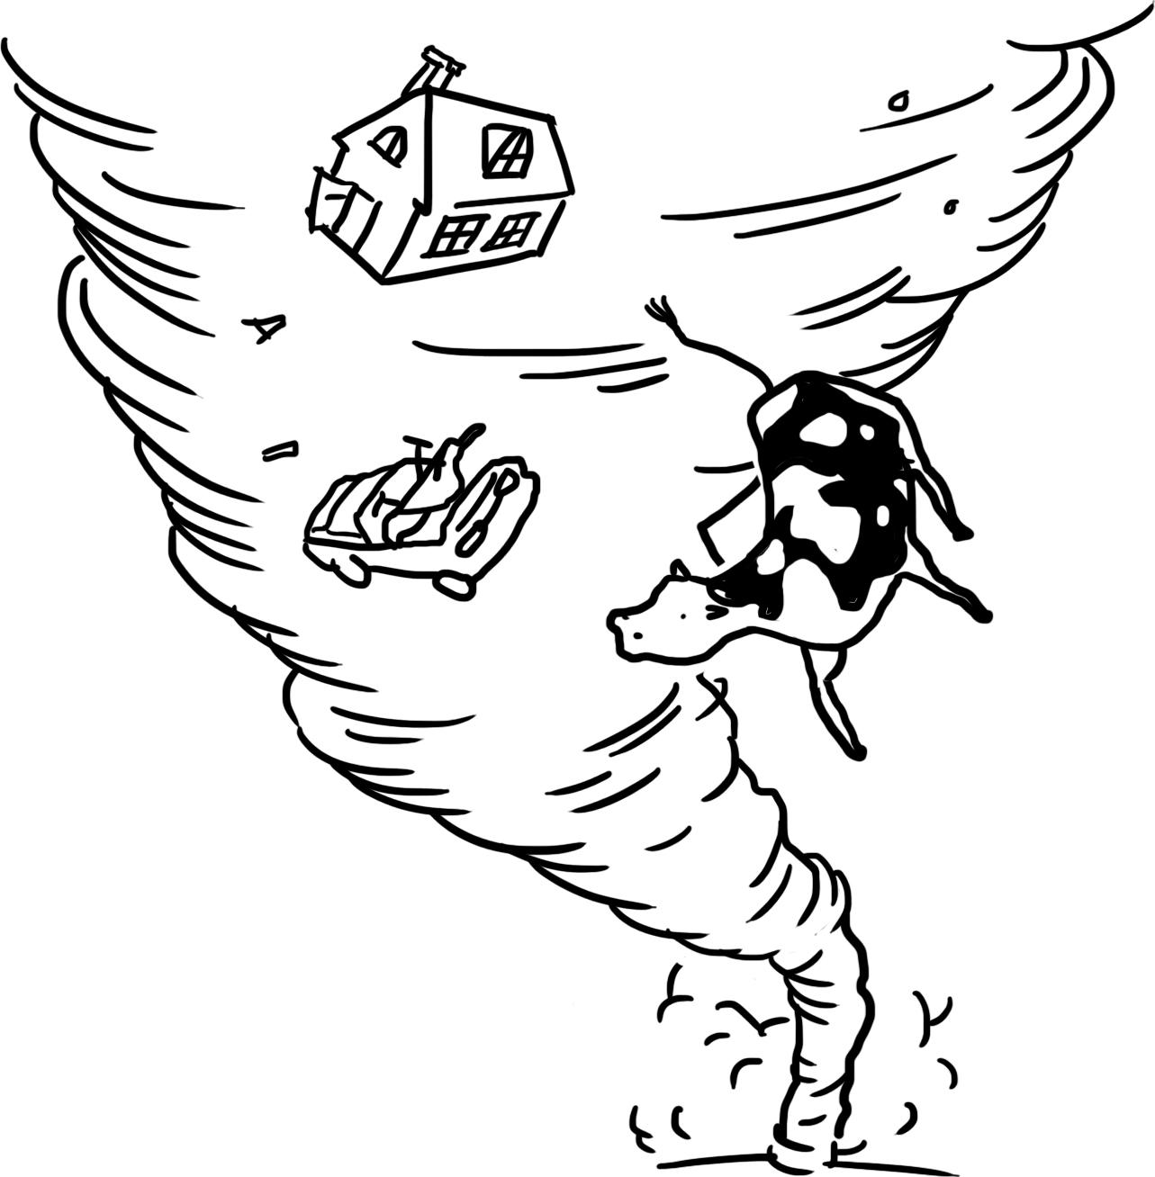
The problem of suffering
Does god want to stop evil, but can’t?
Then he is not all powerful.
Can god stop evil, but does not want to?
Then he is not good.
Does god want to stop evil and can stop it?
Then where does evil come from?
Can god not stop evil and does not want to?
Then why call him god?
Epicurus (341 – 270 BCE)

Slide 16
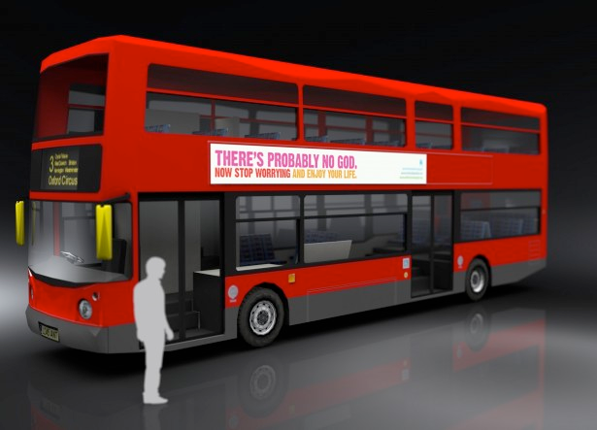
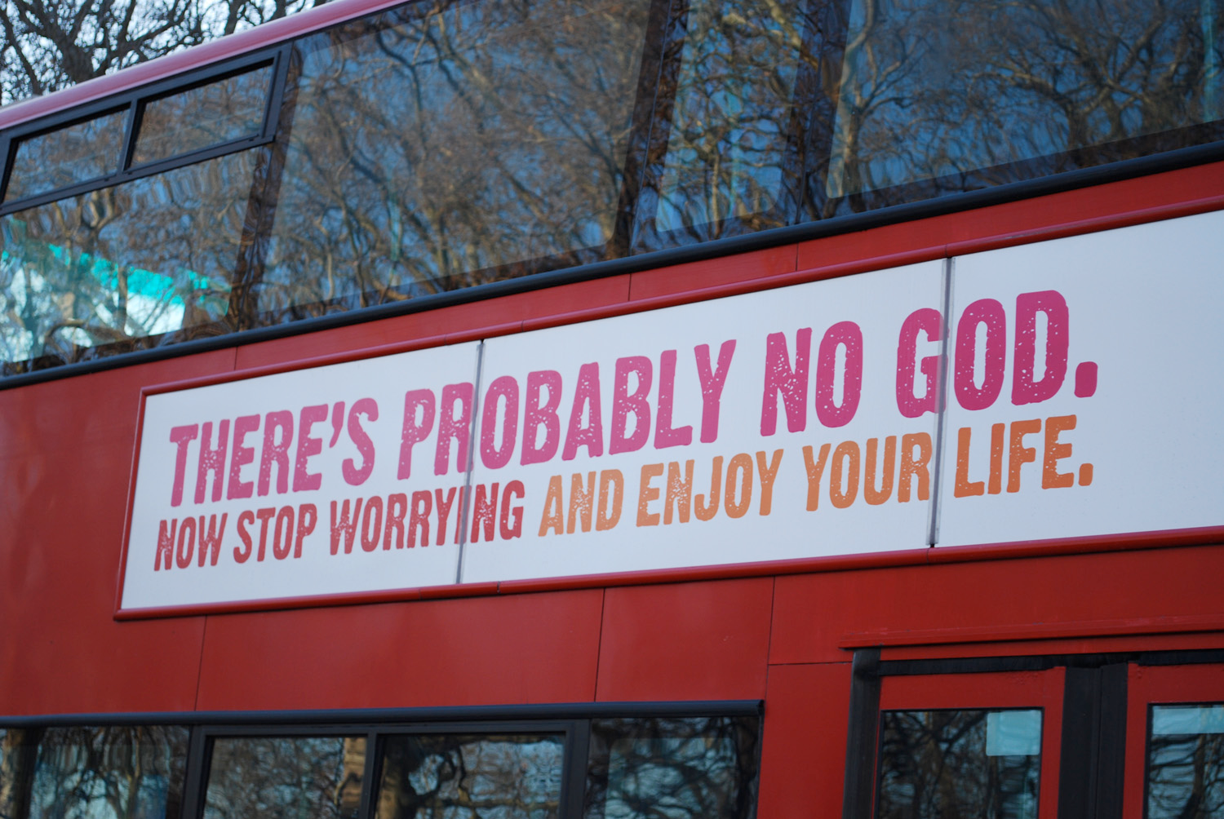
The bus campaign

Slide 17
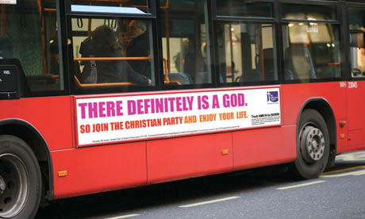
The bus campaign

Slide 18
The bus campaign
What do you think was the purpose of the campaign?
Is the message atheist or agnostic? How do you know?
Why do you think those specific words were used in the advert?
How do you think different people reacted to the campaign (religious and non-religious)?
What is the key difference in the follow-up Christian bus campaign (see the picture below)?
Do you think these sorts of adverts should be allowed? Is it OK to share our beliefs publicly? Is it OK to question the beliefs of others?

Slide 19
Atheism and agnosticism
An atheist is somebody who does not believe in a god
An agnostic is somebody who says we cannot know whether a god exists or not
Humanists are atheists and agnostics who believe it is possible to lead good and happy lives

