Slide 1
Atheism and agnosticism

Slide 2
Atheism
An atheist is somebody who does not believe in a god
Many people don’t believe in a god because they don’t see any reason or evidence to believe
Humanists are people who believe it is possible to lead good and happy lives without believing in a god

Slide 3
Atheist
= someone who does not believe in god

Slide 4
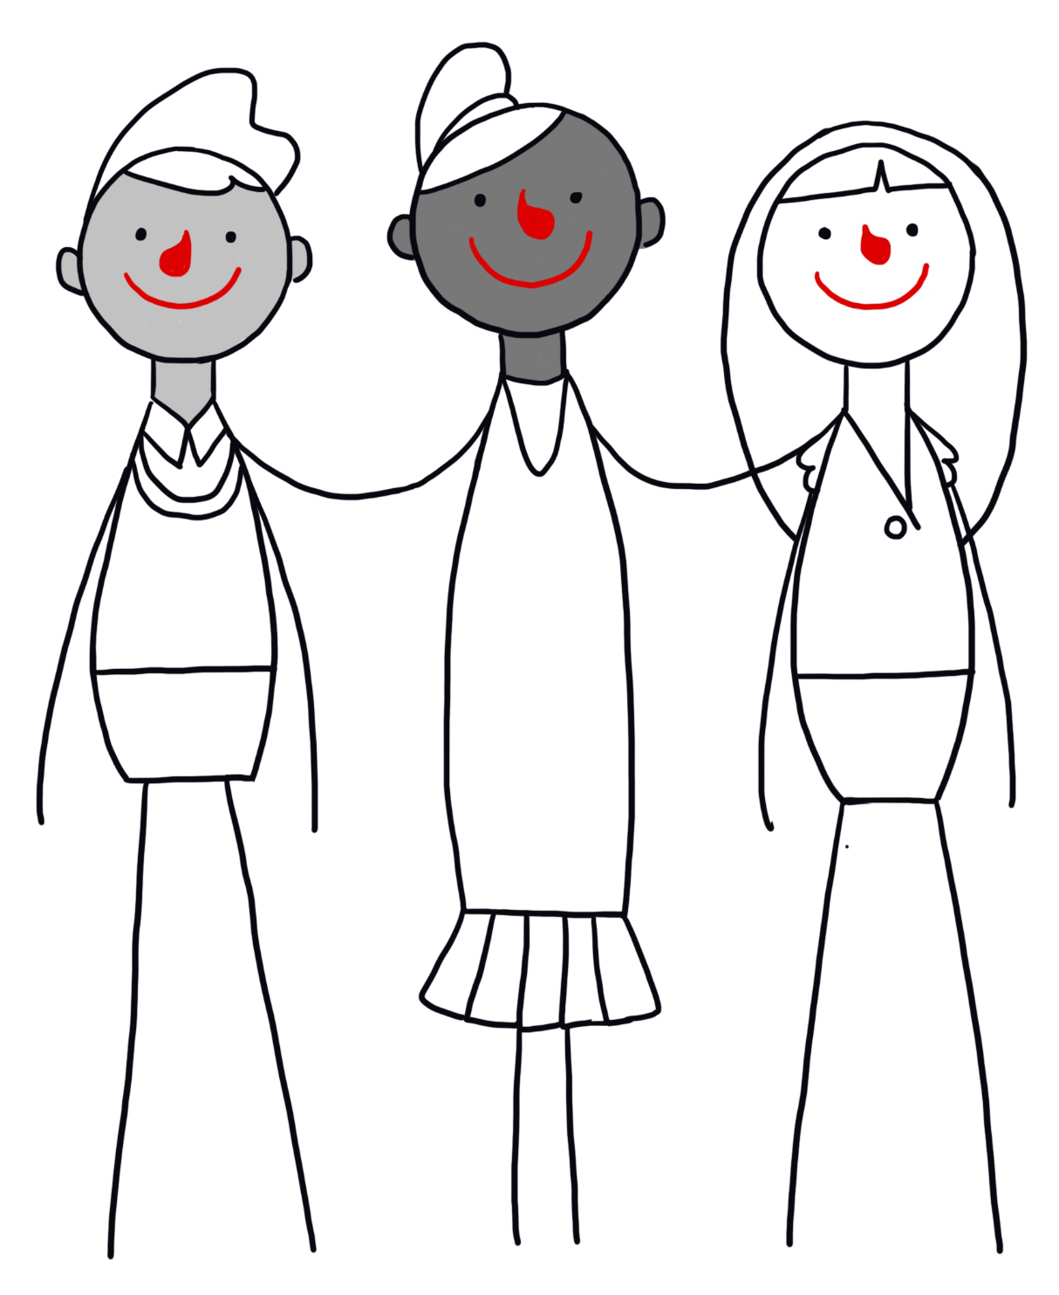
Humanists
Many atheists are humanists.
They don’t believe in a god.
Humanists believe:
we can understand the world around us through science
we can live good and happy lives without religion
Freedom of belief is important to many humanists.

Slide 5
Atheism
An atheist is somebody who does not believe in a god
Many people don’t believe in a god because they don’t see any reason or evidence to believe
Humanists are people who believe it is possible to lead good and happy lives without believing in a god

