Slide 1
Atheism and agnosticism

Slide 2
Atheism and agnosticism
An atheist is somebody who does not believe in a god
An agnostic is somebody who says we cannot know whether a god exists or not
Humanists are atheists and agnostics who believe it is possible to lead good and happy lives

Slide 3
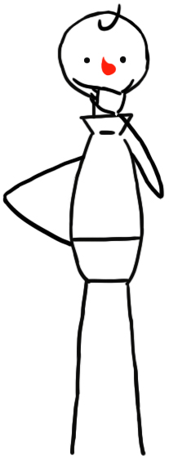
Belief
What do these words mean?
‘Certain’
‘Possible’
‘Probable’
Can you use them in a sentence?

Slide 4
Belief in god scale
I am 100% certain that a god exists.
I believe it is very unlikely that a god exists and I live my life as though there is no god.
I am uncertain but feel that it is more likely a god doesn’t exist than one does.
Atheist Theist
I am completely undecided.
I am uncertain but feel that it is more likely a god exists than one doesn’t.
I am 100% certain that there is no god.
I believe it is very likely that a god exists and I live my life as though there is a god.

Slide 5
‘Theist’ = somebody who believes in a god
‘Atheist’ = somebody who does not believe in a god
‘Agnostic’ = somebody who accepts we can’t know whether a god exists or not

Slide 6
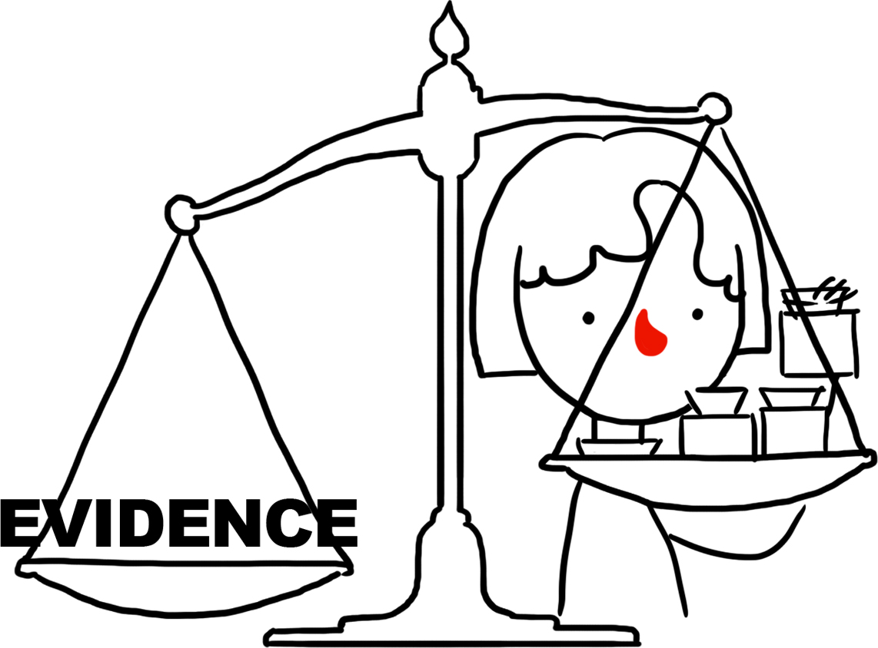
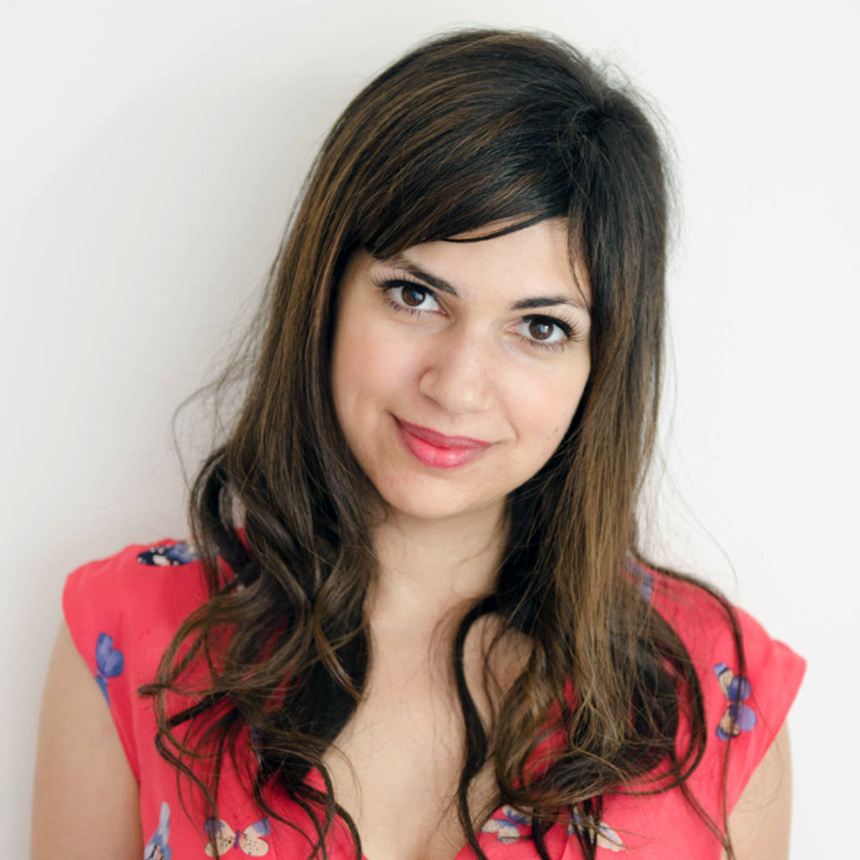
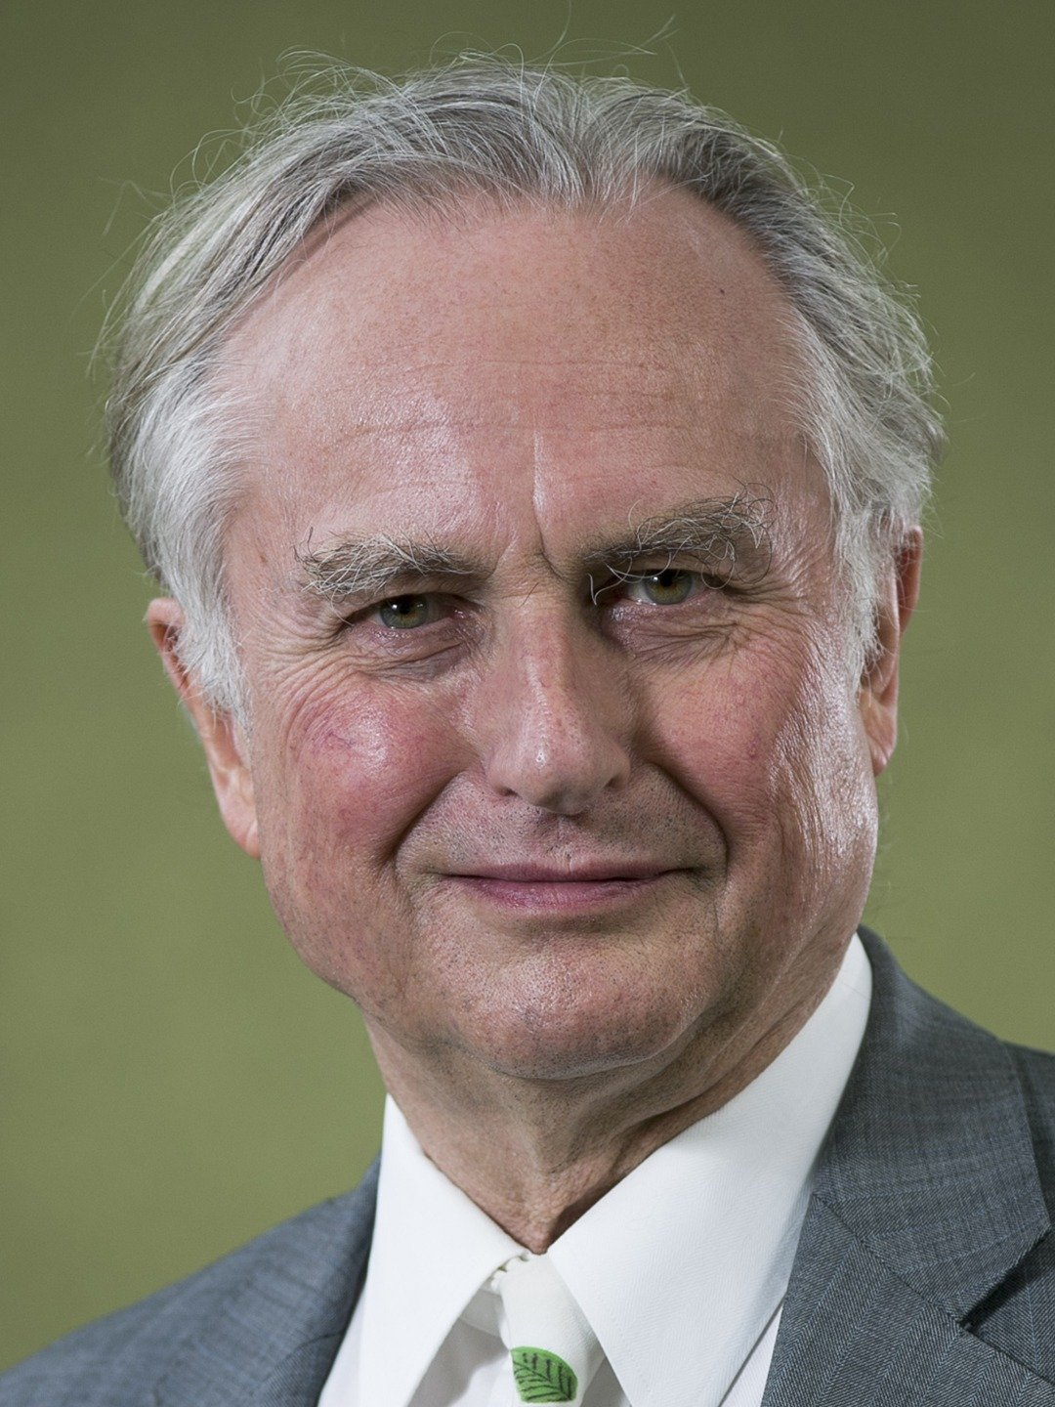
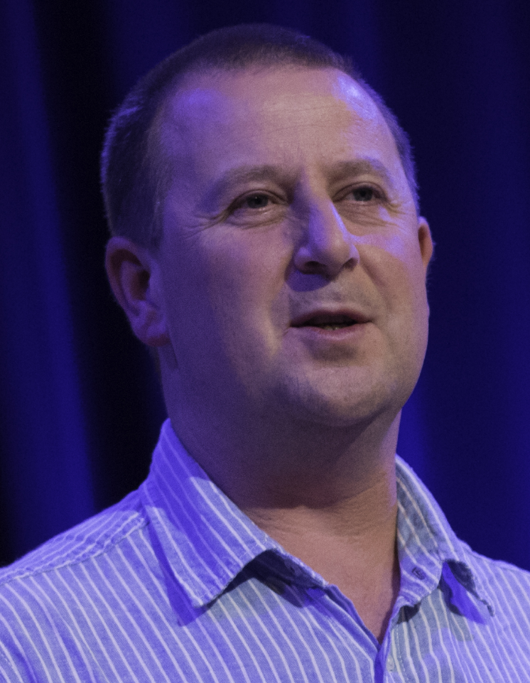
Evidence and proof
‘Even though there’s no scientific evidence at all for God’s existence, it’s also impossible to prove that God doesn’t exist (or that anything doesn’t).’
Ariane Sherine, writer
‘What matters is not whether god is disprovable (he isn’t) but whether his existence is probable.’
Richard Dawkins, scientist
‘Atheists do not believe in God because they see no good evidence that such a deity exists. This falls short of full proof but it is fundamentally an evidence-based position.’
Julian Baggini, philosopher

Slide 7
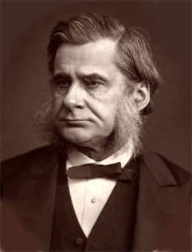
Agnosticism
‘Agnosticism as a term is not quite as vague and non-committal as generally thought – it is belief that one cannot have certain knowledge about things for which there can be no evidence.’
Thomas Henry Huxley (1825 – 1895)
‘I can’t know whether the gods exist or not, nor what they are like if they do. Two things in particular prevent any certain knowledge – the topic is obscure and life is short.’
Protagoras (5th century BCE)

Slide 8
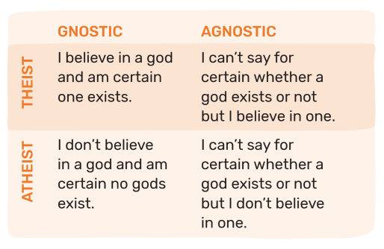
Atheism and agnosticism

Slide 9
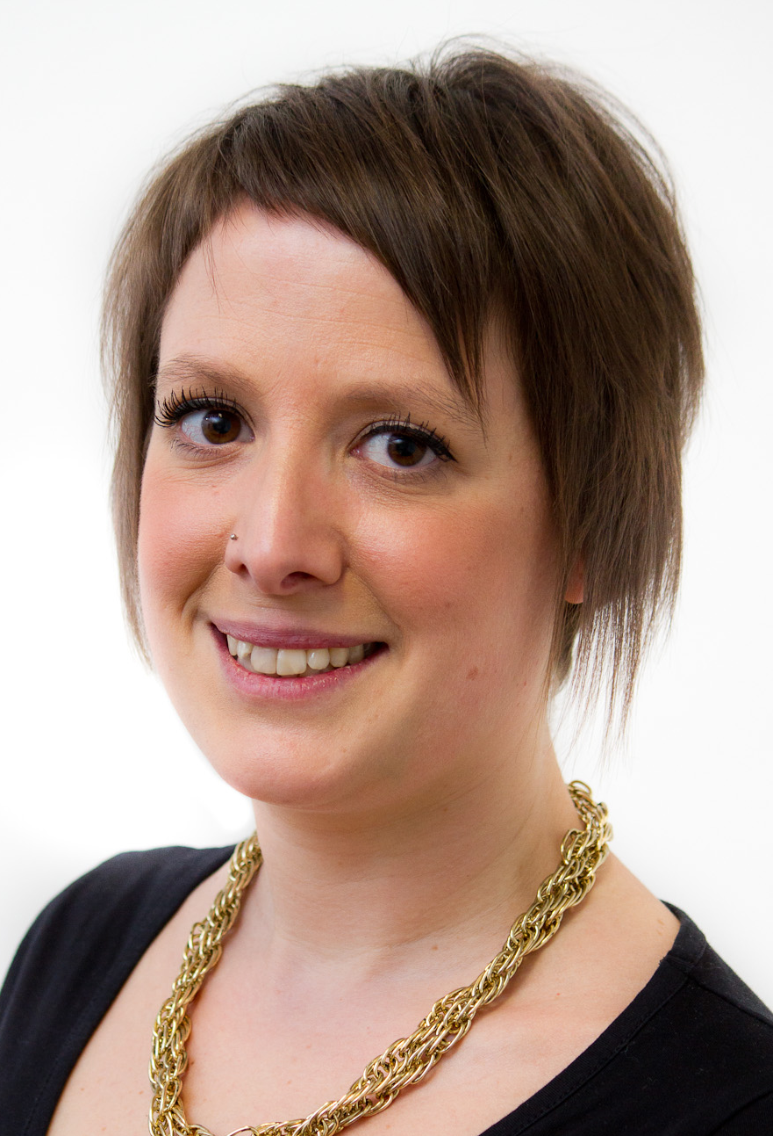
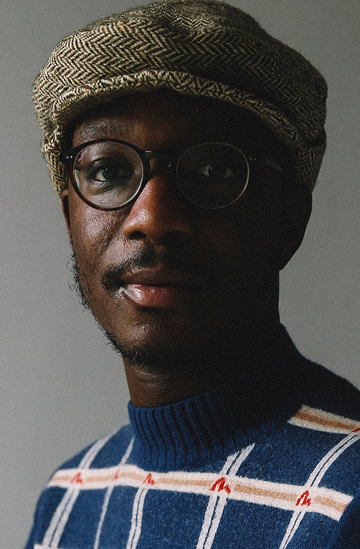
Humanism
‘For me, humanism is sort of atheism plus.’
Naomi Phillips, humanist
‘Humanism for me has always been positive. We don’t define ourselves by what we don’t believe, which is what I had always done prior to discovering humanism.’
Ste Richardsson, humanist

Slide 10
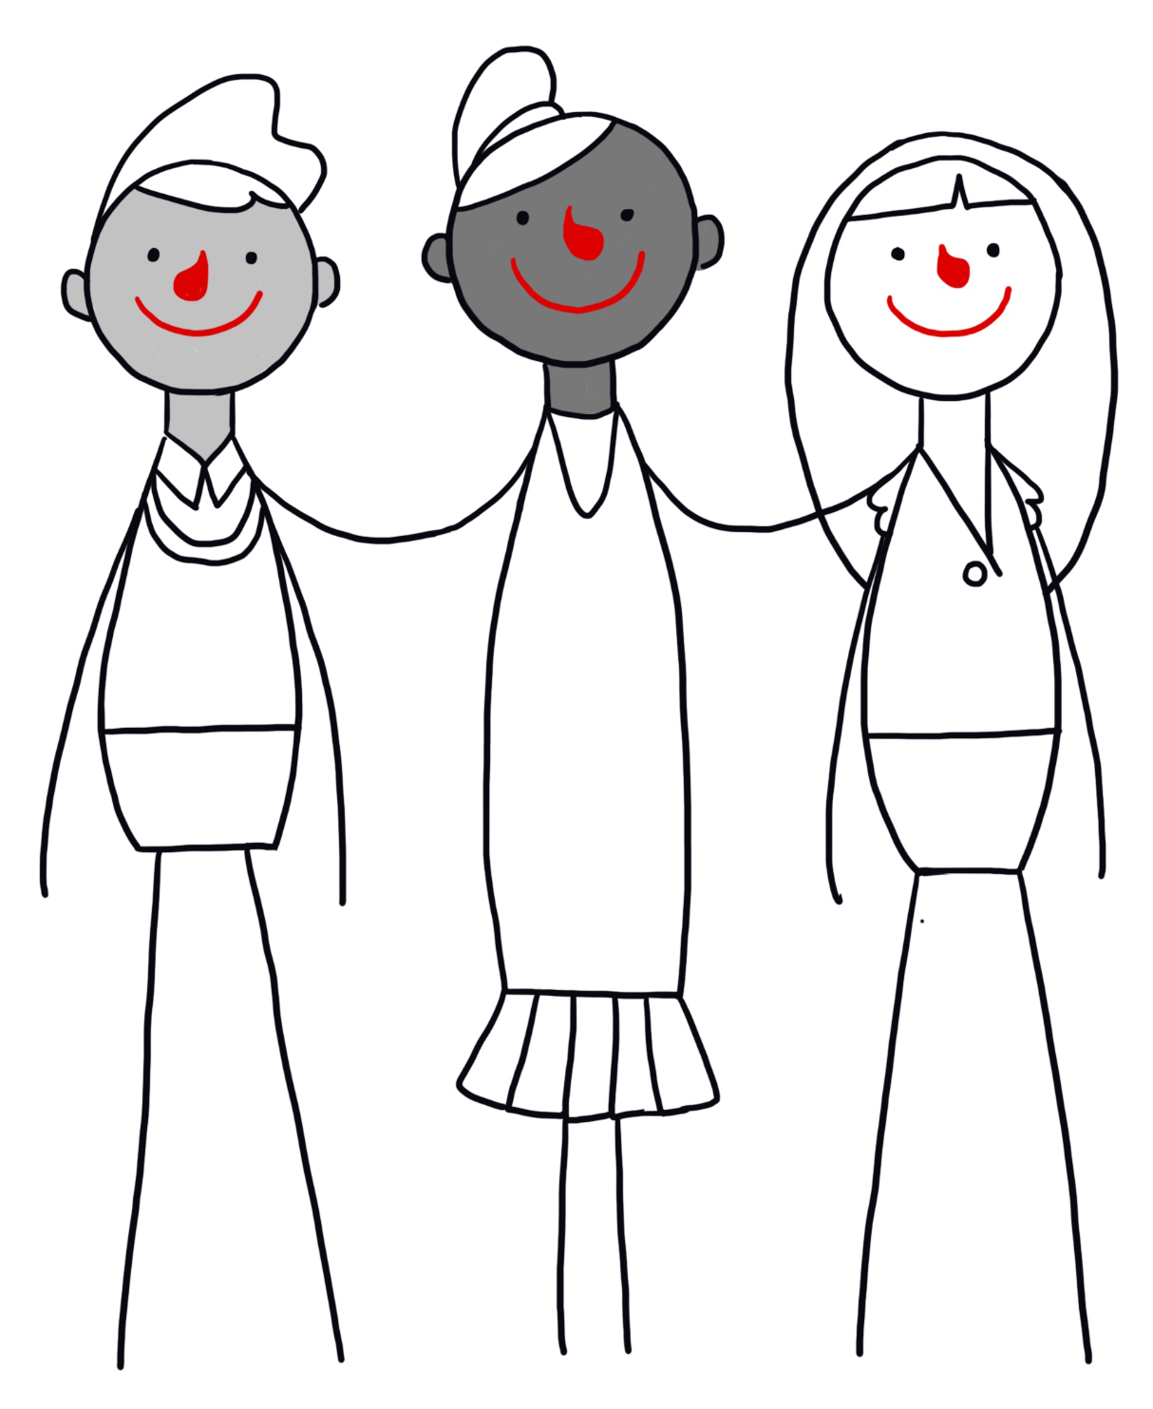
Humanists
Many atheists and agnostics are humanists.
They don’t believe in a god.
Humanists believe:
we can understand the world around us through science
we should treat each other with kindness and respect
we can lead good, happy, and meaningful lives without the need to believe in a god
Freedom of belief is important to many humanists.

Slide 11
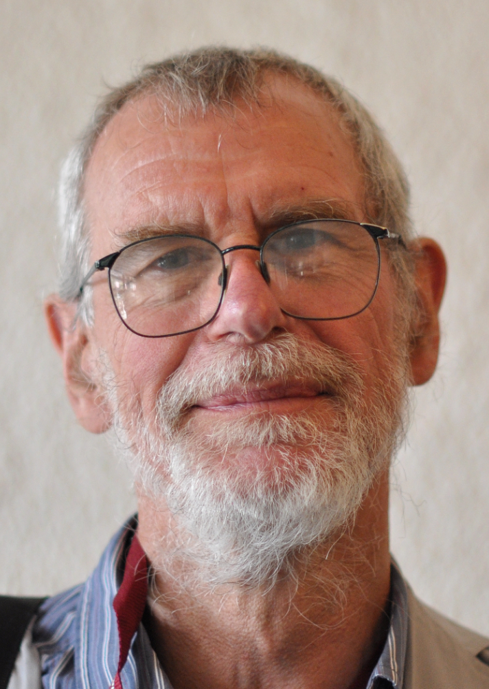
Humanism
'Humanist agnostics would say that, if we cannot know that there is a god, it makes sense to live without relying on any belief in a deity.'
Richard Norman, humanist philosopher

Slide 12
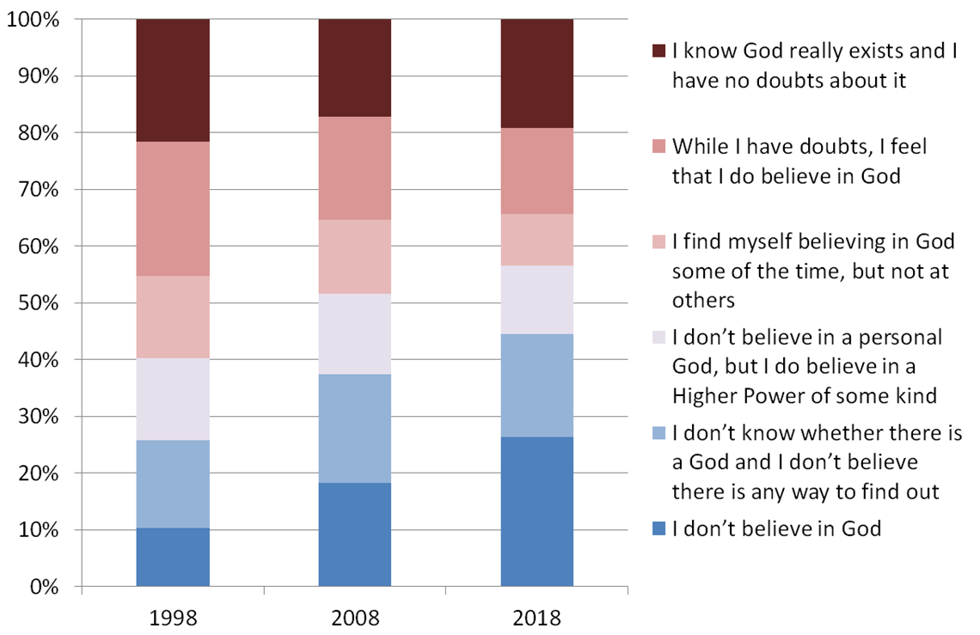
Source: British Social Attitudes survey

Slide 13
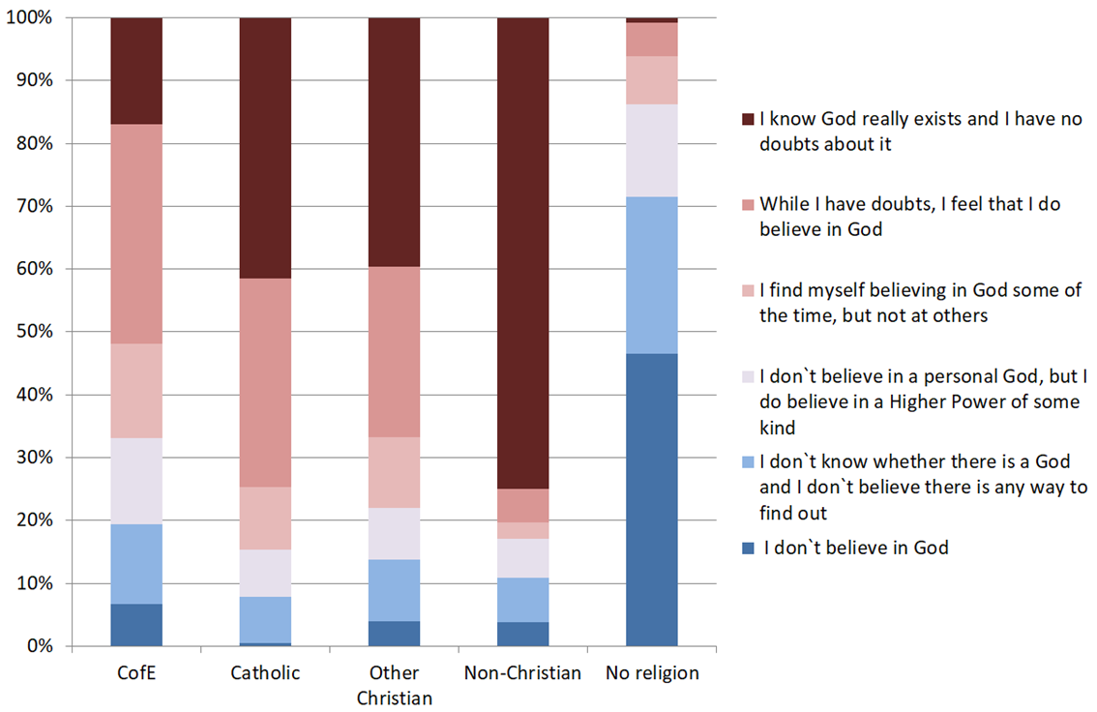
Source: British Social Attitudes survey 2018

Slide 14
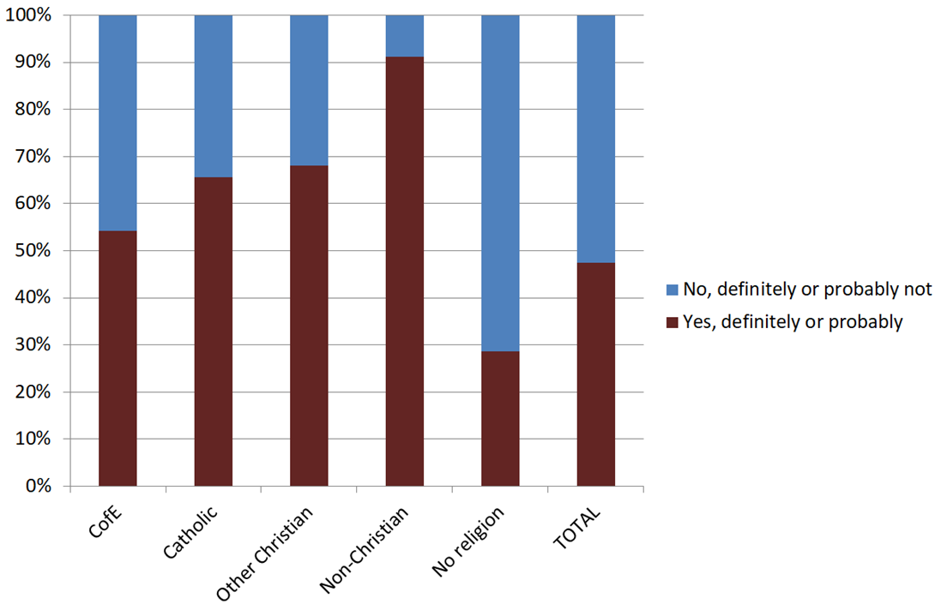
Do you believe in an afterlife?
Source: British Social Attitudes Survey, NatCen (2018)

Slide 15
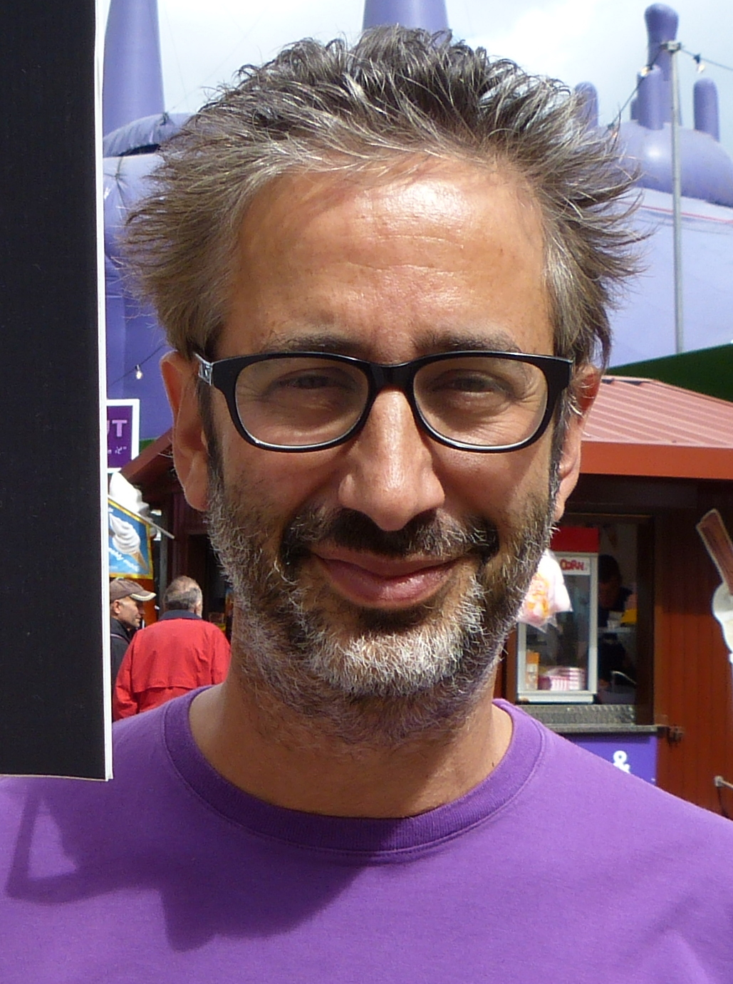
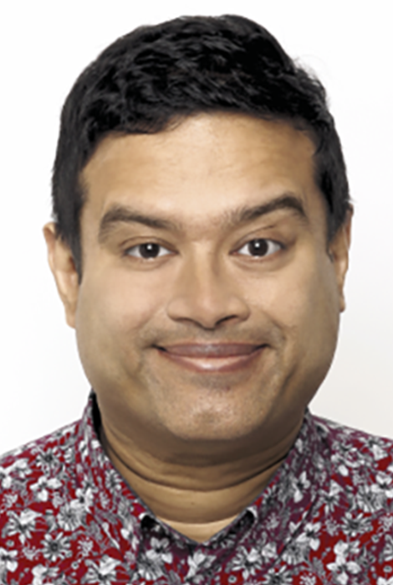
Religious and atheist/agnostic
‘I am an atheist, and this confuses some people… For me, Jewishness, and I would say for an awful lot of Jews, is nothing to do with believing in God… For me, Jew is an identity. It's an ethnic and cultural identity, which I feel very strongly.’
David Baddiel, patron of Humanists UK
‘My robust agnosticism is informed by my socially liberal Hindu parents… I consider myself a non-practicing Hindu… I consider myself a Hindu, by identity rather than belief system.’
Paul Sinha, patron of Humanists UK

Slide 16
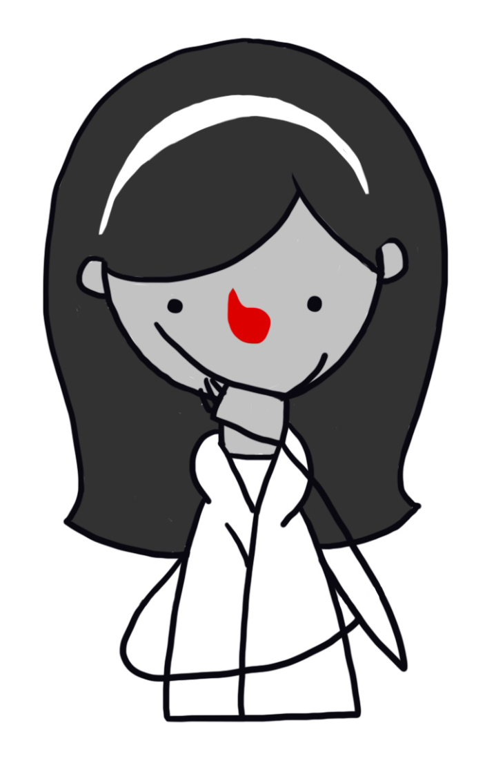
Is it still possible?
If the following events happened…
Is it still possible that a god exists?
Is it still possible that a god doesn’t exist?
Do you think it would make it more or less likely that a god exists, or neither?
Events
A celebrity says that she is thankful to god for her success.
An earthquake kills thousands of people.
Someone in your family is cured of a serious illness when you did not think she would recover.
You pray and ask for a sign that god is there, but nothing happens.
A friend tells you he can hear god talking to them inside their head.
A street preacher tells you that you will go to hell if you don’t believe in god.
We discover an alien species on another planet and they tell us they don’t believe in a god.
Archeologists discover a historic text containing evidence that contradicts what it says in the Bible.
A man claims to be the second coming of Jesus and appears to be able to cure the sick.
Everyone else in the world stops believing in a god.

Slide 17

The invisible gardener

Slide 18
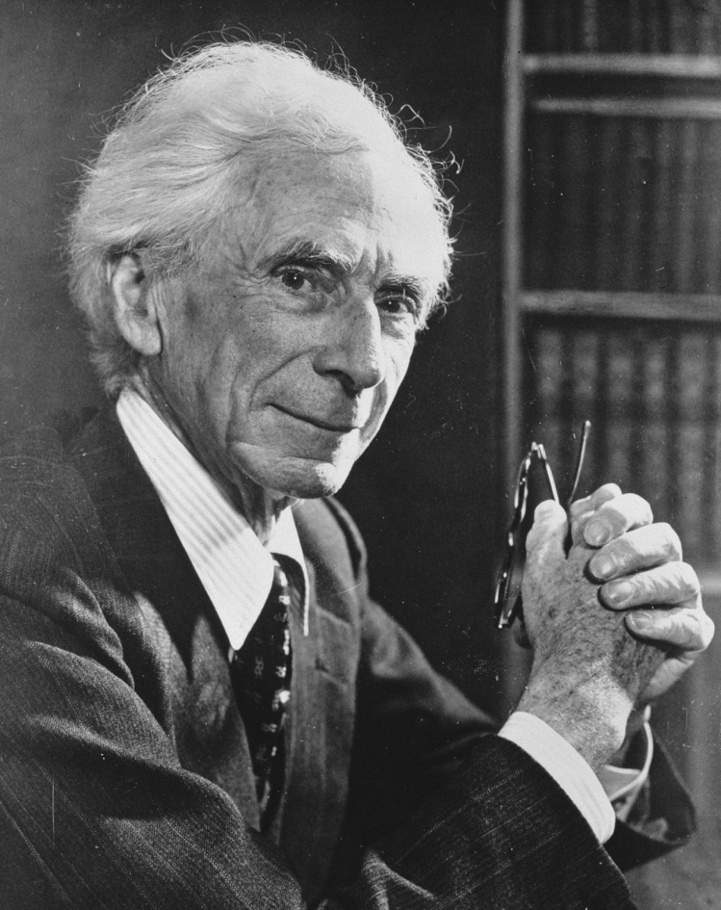

The invisible teapot
The burden of proof
Bertrand Russell

Slide 19
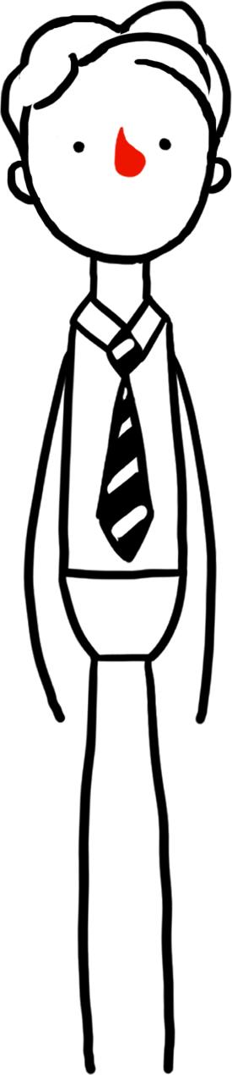
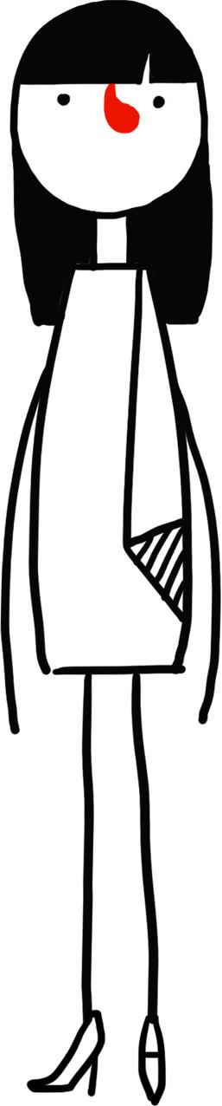
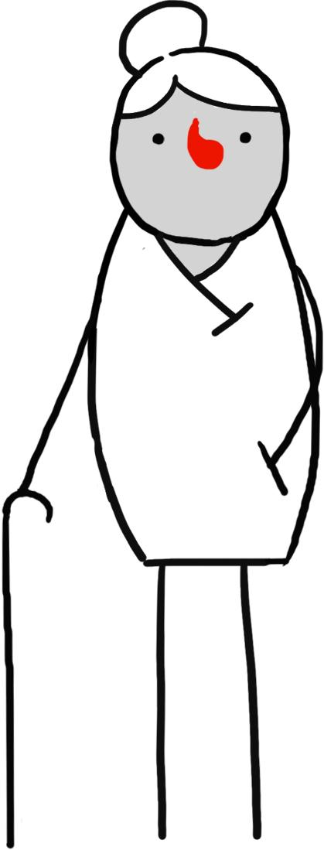
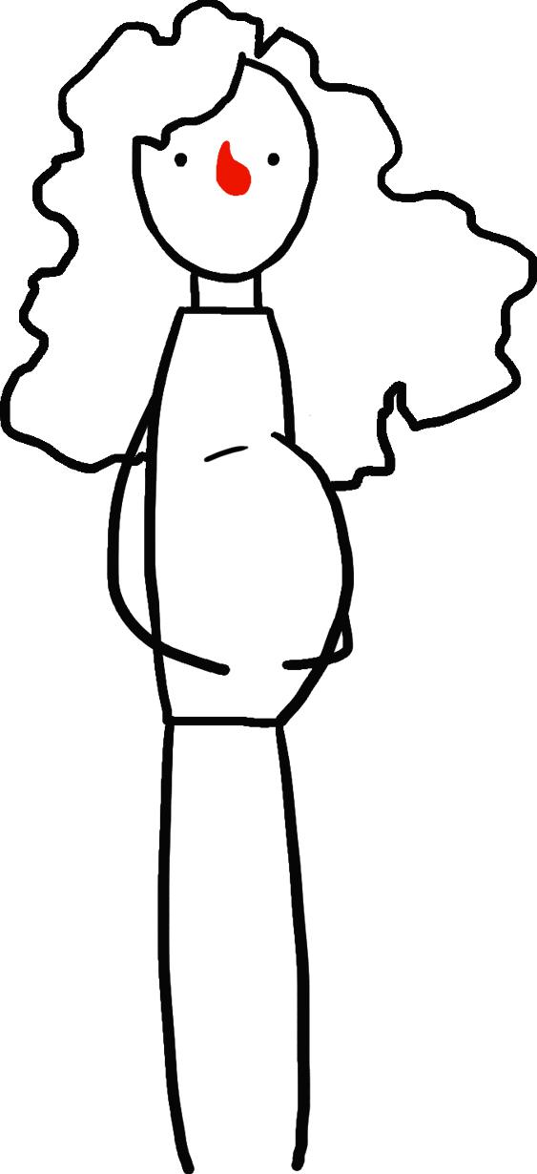
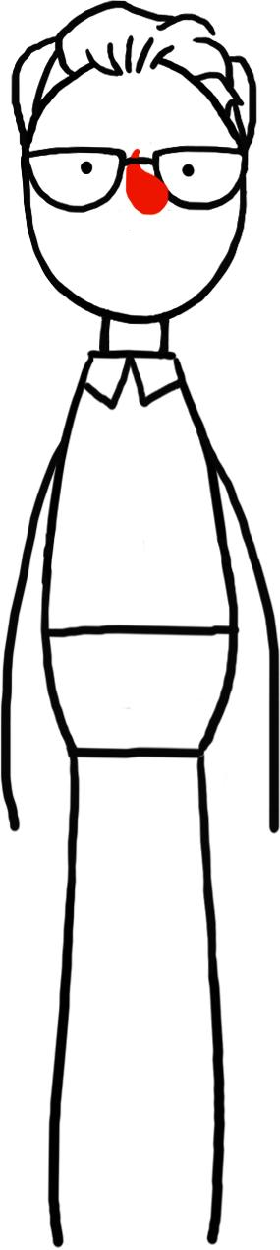
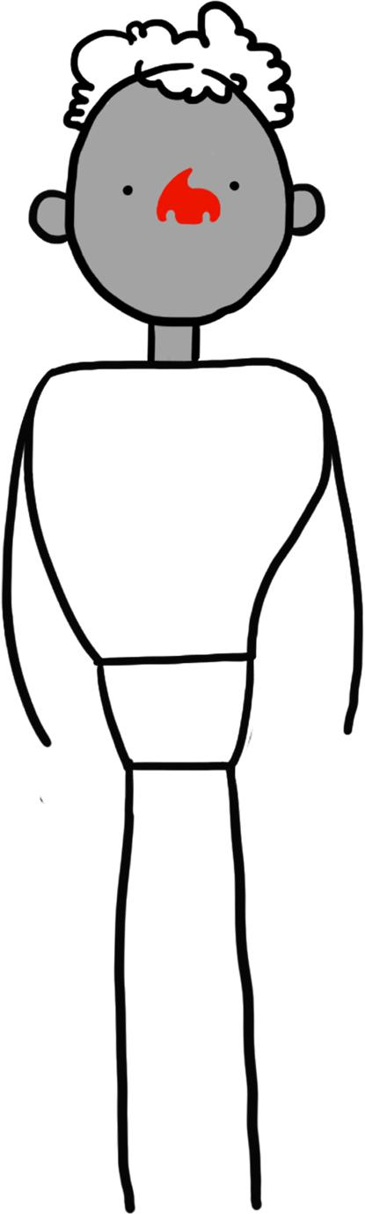
Why might someone believe in a god?
I hear god’s voice – he speaks to me.
Lots of people believe in a god so he must exist.
My holy book tells me god exists.
I have faith that god exists.
There are too many things we can’t explain without a god.
My parents told me god exists and I believe them.

Slide 20
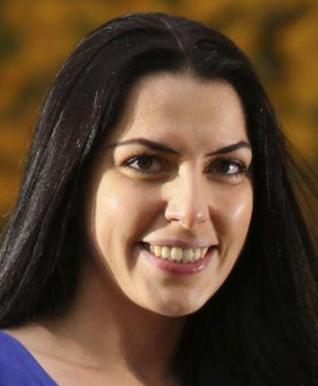
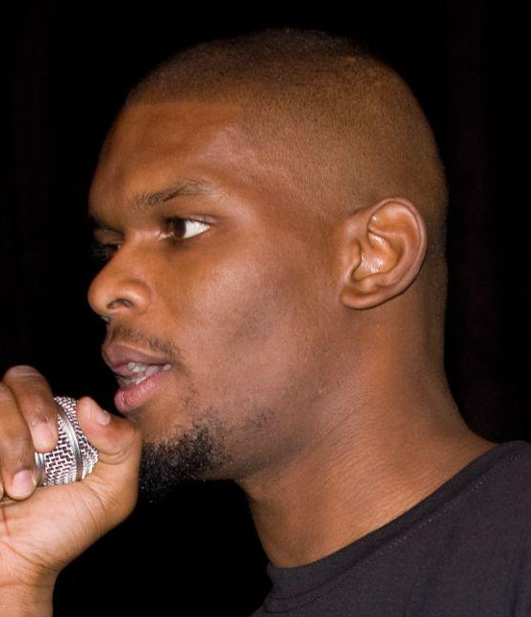
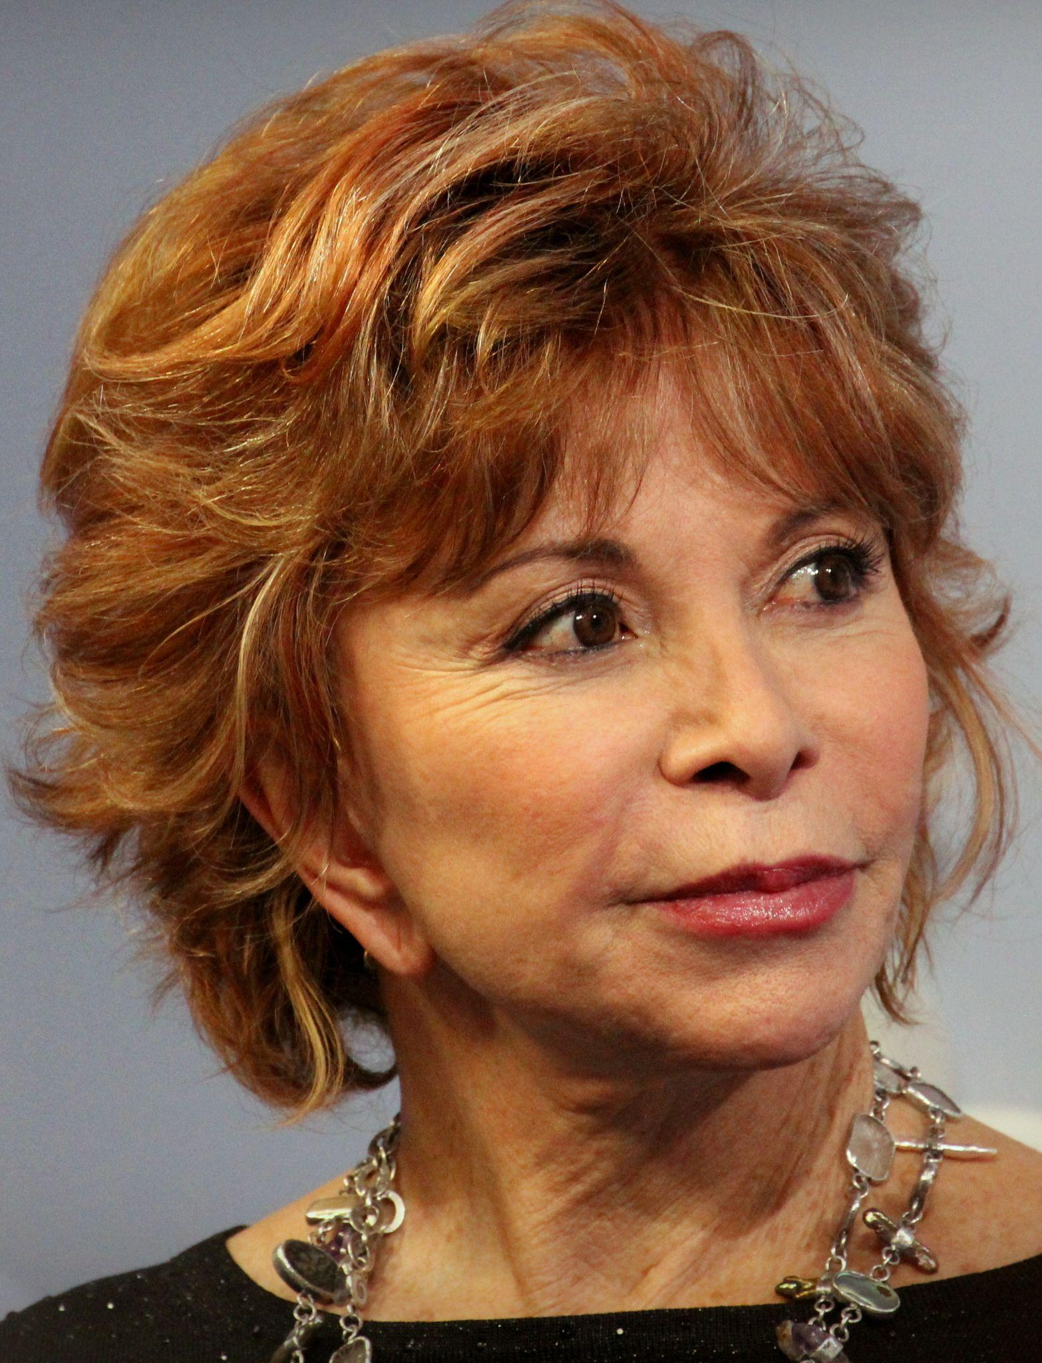
Humanist perspectives
‘The Bible is a human product. Religion is a human construct.’
Francesca Stavrakopoulou, biblical scholar
'After a lot of reading, and research, I realized, I didn't have any secret channel picking up secret messages from god or anyone else. That voice in my head was my own.'
Greydon Square, rapper
'How many times have I told you not to believe everything you hear? Seek truth for yourself.'
Isabelle Allende, author
‘Where there is evidence, no one speaks of 'faith’. We do not speak of faith that two and two are four or that the earth is round. We only speak of faith when we wish to substitute emotion for evidence.’
Bertrand Russell, philosopher

Slide 21
Atheism
‘We are all atheists about most of the gods that humanity has ever believed in. Some of us just go one god further.’
Richard Dawkins, scientist

Slide 22
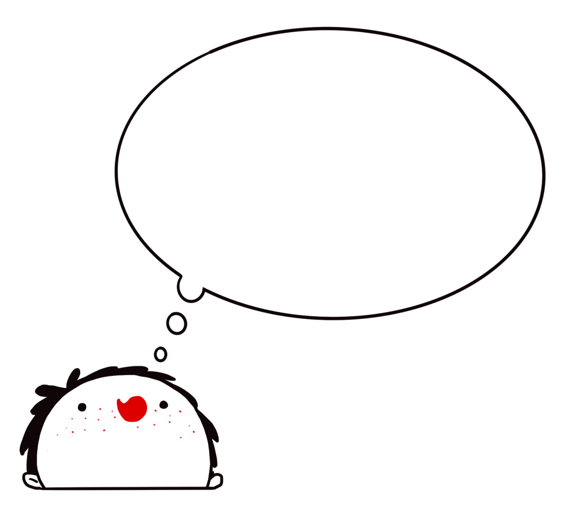
If there is no god…
why might people believe?
Possible explanations
In the past, belief in a god helped us explain the natural world and our mental experiences
We may be hardwired to believe - it perhaps evolved naturally
Belief can be a source of meaning and comfort
Society and other people can apply pressure on us to believe

Slide 23
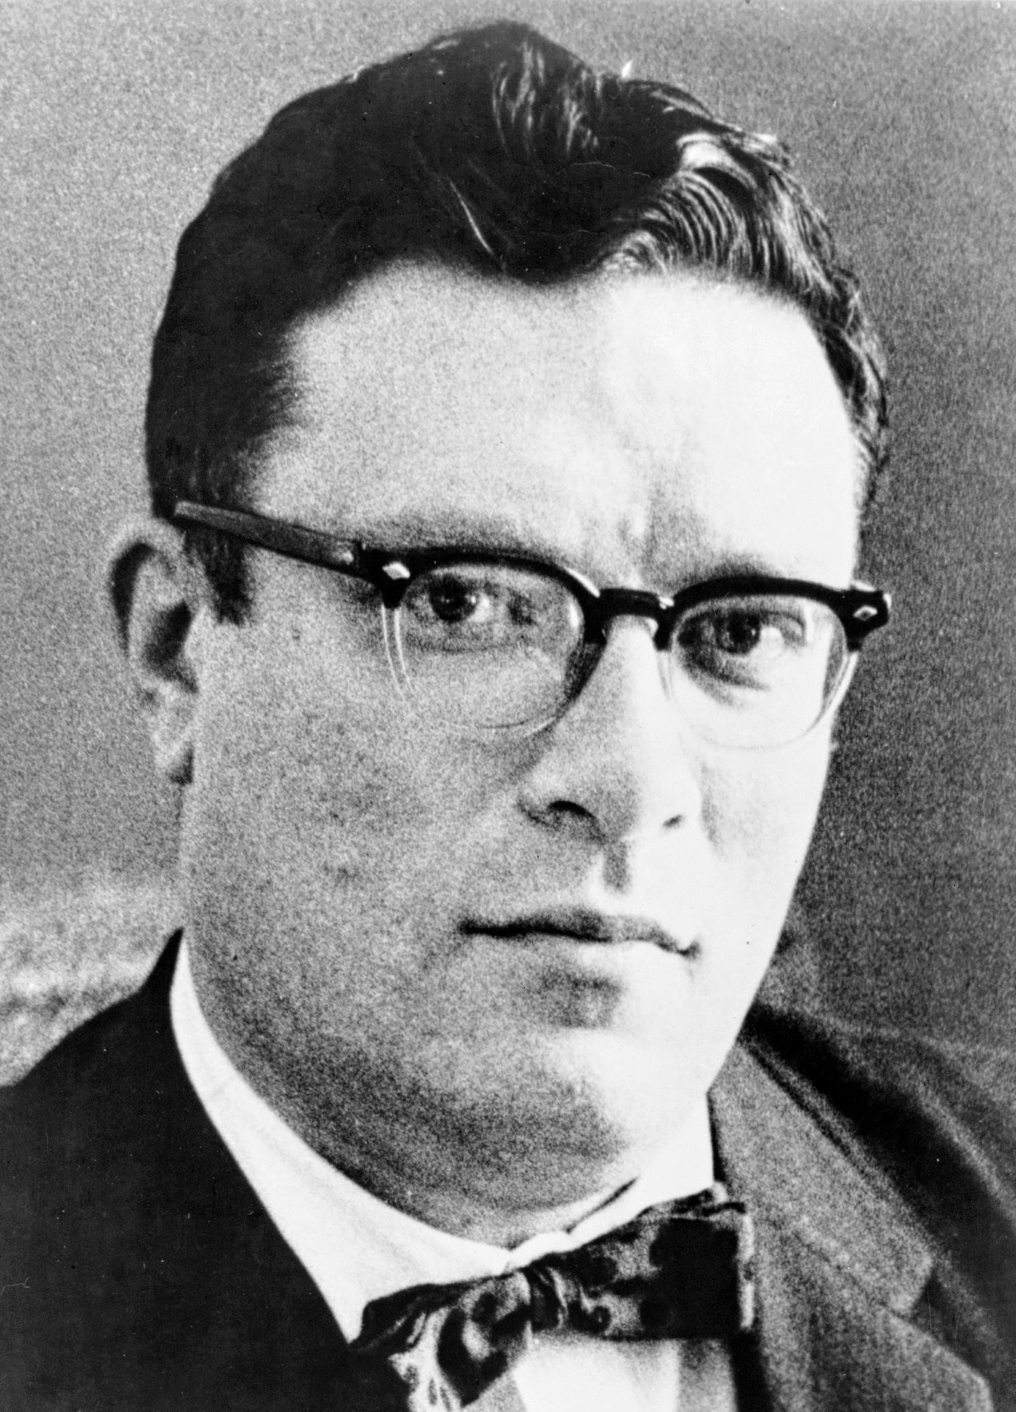
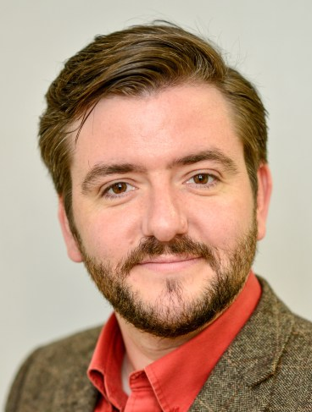
A human invention?
‘It seems to me that God is a convenient invention of the human mind.’
Isaac Asimov, author
‘It’s interesting that old gods look so much like the human beings that made them. Desert dwellers invented harsh and dry austere gods. Farmers invented gods of harvest and plenty. It’s also true of individuals today: there are no liberals who believe in a conservative god, or vice versa. Kind people believe in kind gods, and cruel people in cruel ones.’
Andrew Copson, Little Book of Humanism

Slide 24
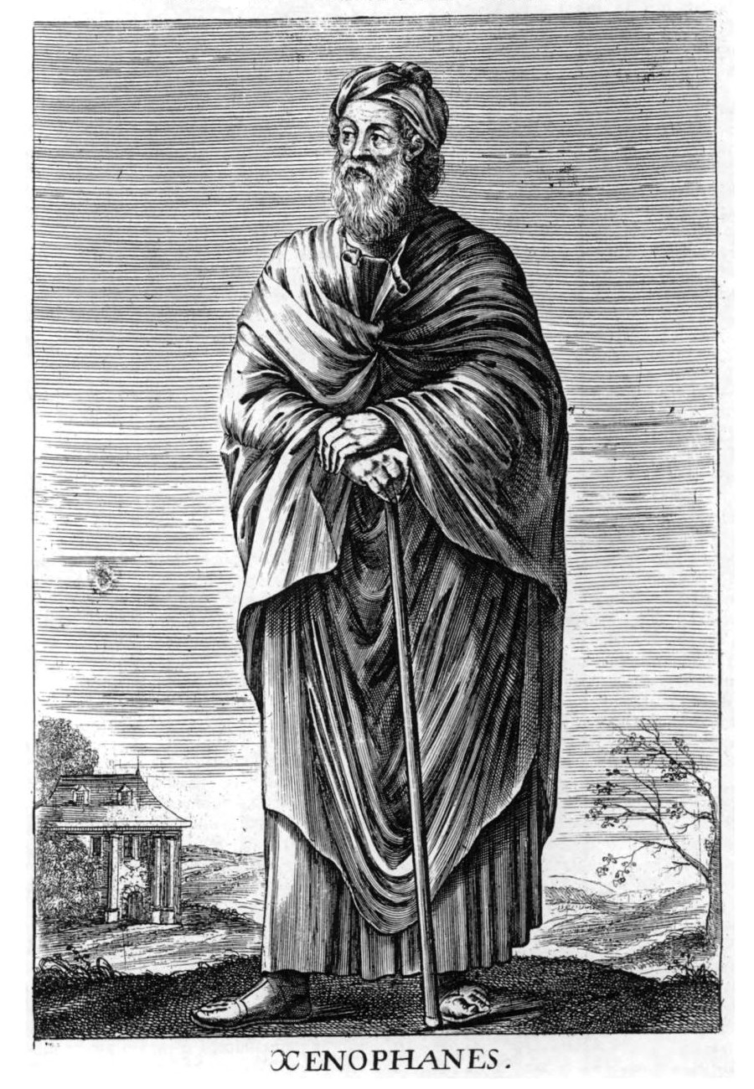
A human invention?
‘The Ethiopians say that the gods have flat noses and are black, while the Thracians say that the gods have blue eyes and red hair… And if cattle or horses or lions had hands or could draw or sculpt like men can, then the horses would draw their gods like horses, cattle draw their gods like cattle, and both would depict the bodies of the gods in their own likeness.’
Xenophanes (570 – 475 BC)

Slide 25
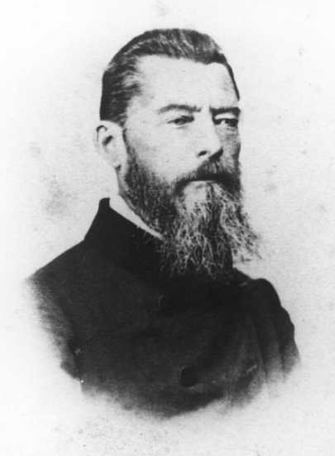
The idea of god is just ourselves
‘Religion is the dream of the human mind. But even in dreams we do not find ourselves in emptiness or in heaven, but on earth, in the realm of reality.’
‘You believe in love as a divine attribute because you yourself love, and believe that God is a wise and benevolent being because you know nothing better in yourself than wisdom and benevolence.’
Ludwig Feuerbach (1804 – 1872)

Slide 26
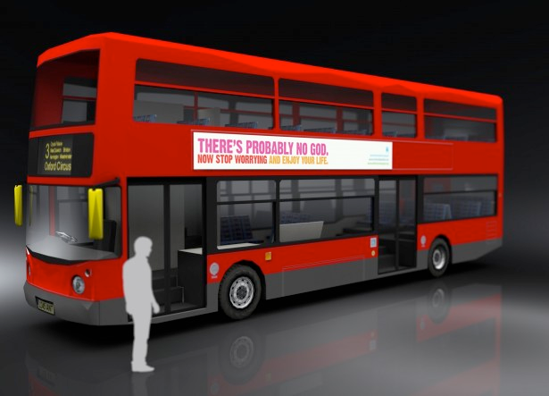
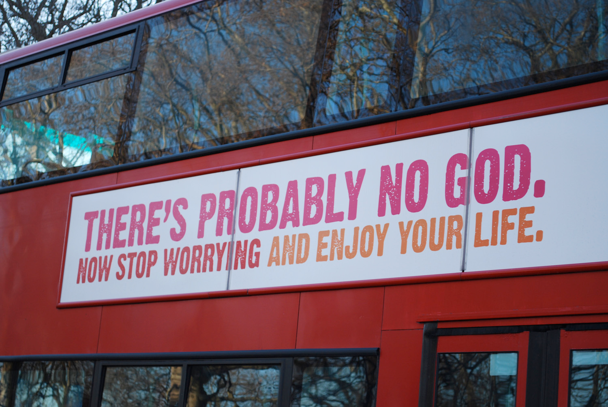
The bus campaign

Slide 27
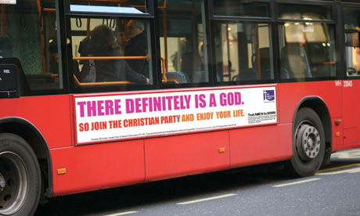
The bus campaign

Slide 28
The bus campaign
What do you think was the purpose of the campaign?
Is the message atheist or agnostic? How do you know?
Why do you think those specific words were used in the advert?
How do you think different people reacted to the campaign (religious and non-religious)?
What is the key difference in the follow-up Christian bus campaign (see the picture below)?
Do you think these sorts of adverts should be allowed? Is it OK to share our beliefs publicly? Is it OK to question the beliefs of others?

Slide 29
Pascal’s wager
Blaise Pascal said we should believe in god.
Criticisms
Different religions propose different gods. What if we believe in the wrong one?
Would a god be happy that our belief was based on a calculation or a gamble?
We can’t simply choose to believe in something if we don’t. We can’t switch our beliefs on or off. Would a god be happy if we simply faked a belief?
The argument only explores whether we should believe or not – it says nothing about whether a god actually exists.
 | God exists | God does not exist
Believe in god | Eternal happiness | A small loss
Don’t believe in god | Eternal punishment | A small gain

Slide 30
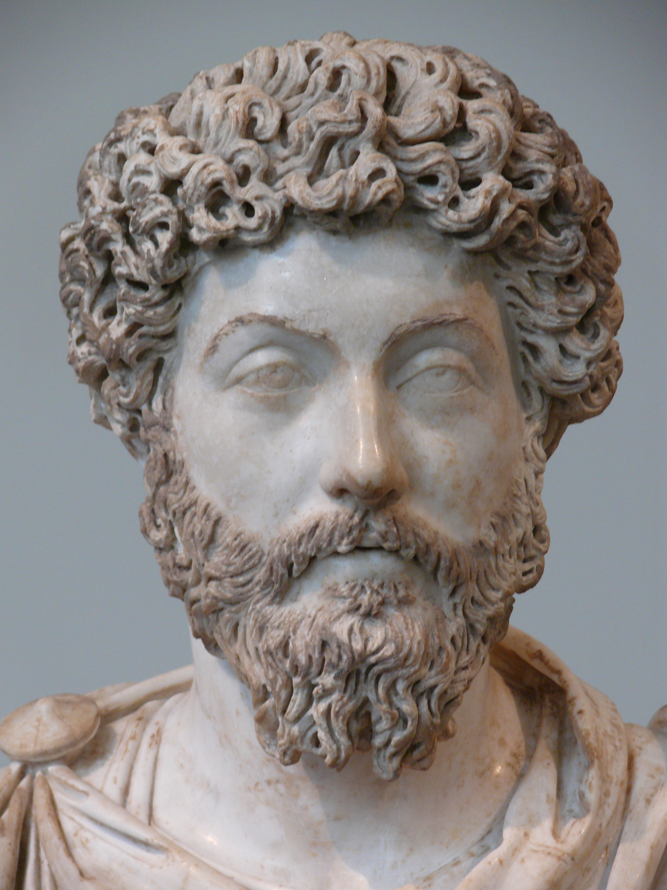
An alternative wager
‘Live a good life. If there are gods and they are good, they will not care how devout you have been, but will welcome you because of the values you have lived by. If there are gods that are not good, then you should not want to worship them. If there are no gods at all, then you will be gone, but you will have lived a noble life that will continue in the memories of your loved ones. I am not afraid.’
Marcus Aurelius, Roman Emperor and philosopher
For Marcus Aurelius, and for many humanists today, the important thing is not what you believe but how you live.

Slide 31
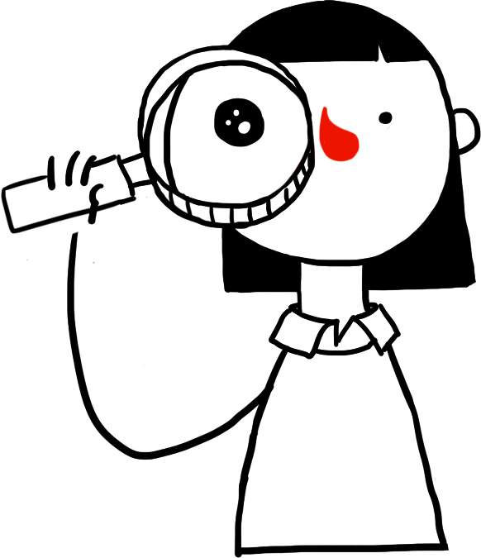
Miracles?
Look at the events below.
Do you think they are miracles?
How do you think a humanist (or someone who does not believe in miracles) might explain such an event?
Events
Most people die in a plane crash, but a few survive.
A statue of the Virgin Mary weeps.
A parachute fails but the parachutist lands in a tree and survives.
Someone walks barefoot over hot coals.
Someone says a prayer for somebody who is ill and they get better.
Someone appears to turn water into wine.
Someone claims somebody was raised from the dead.

Slide 32
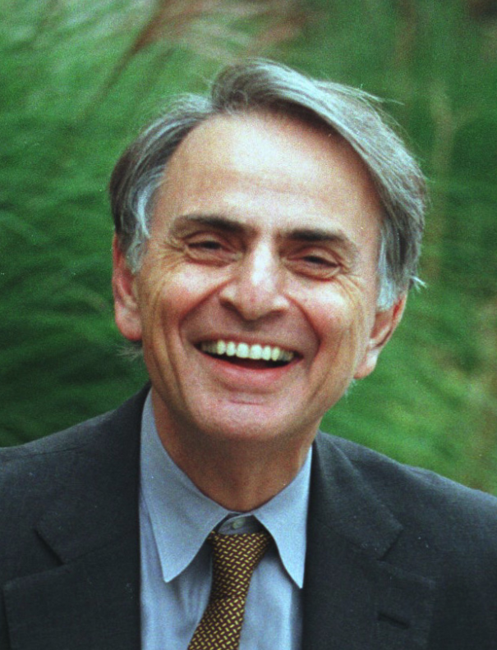
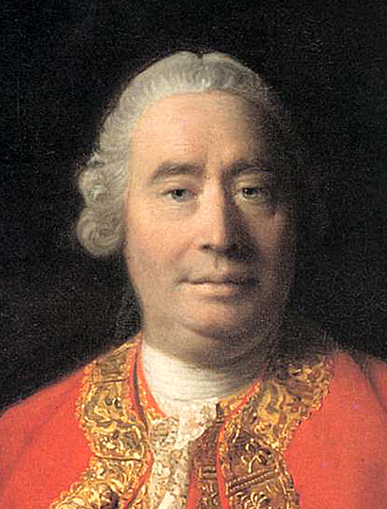
Miracles?
‘Extraordinary claims require extraordinary evidence.’
Carl Sagan, astronomer (1934 – 1996)
‘When anyone tells me, that he saw a dead man restored to life, I immediately [wonder] whether it be more probable that this person should either deceive or be deceived, or that the fact … should really have happened.’
David Hume, philosopher (1711 – 1776)

Slide 33
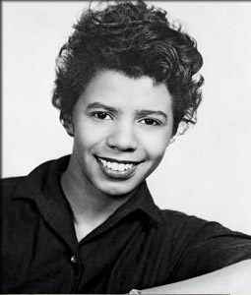
Miracles?
‘I don’t believe in God. I don’t even think about it. It’s just that I get so tired of Him getting credit for all the things the human race achieves through its own stubborn effort. There simply is no God! There is only Man, and it’s he who makes miracles!’
Lorraine Hansberry

Slide 34
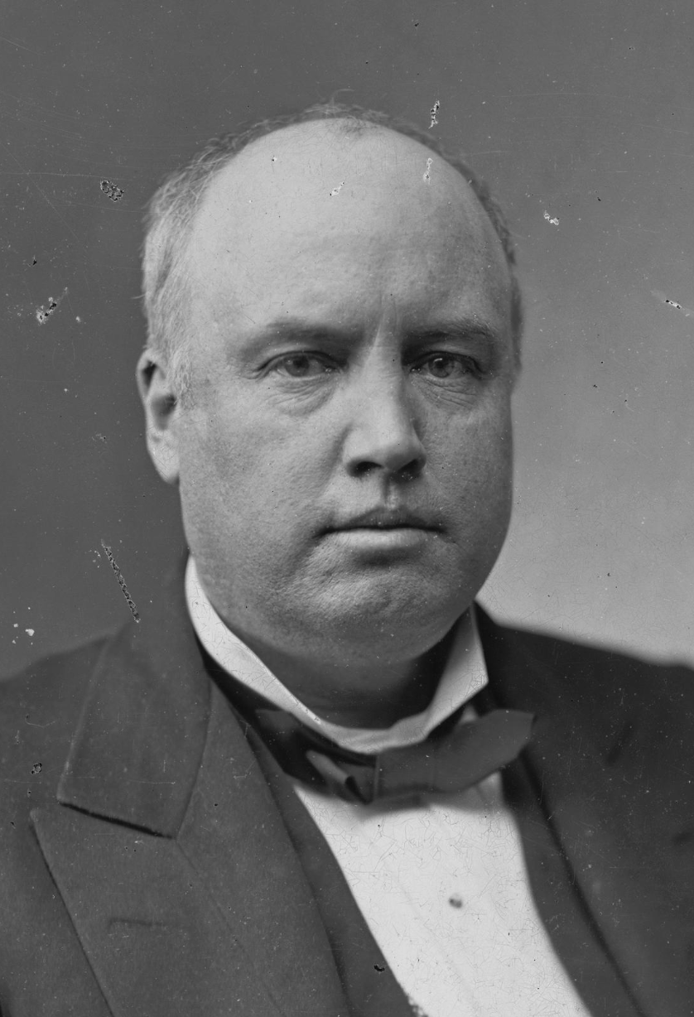

The problem of suffering
‘I have had some trouble in regarding evil as having been intended by infinite Goodness.’
Robert Ingersoll, American humanist

Slide 35
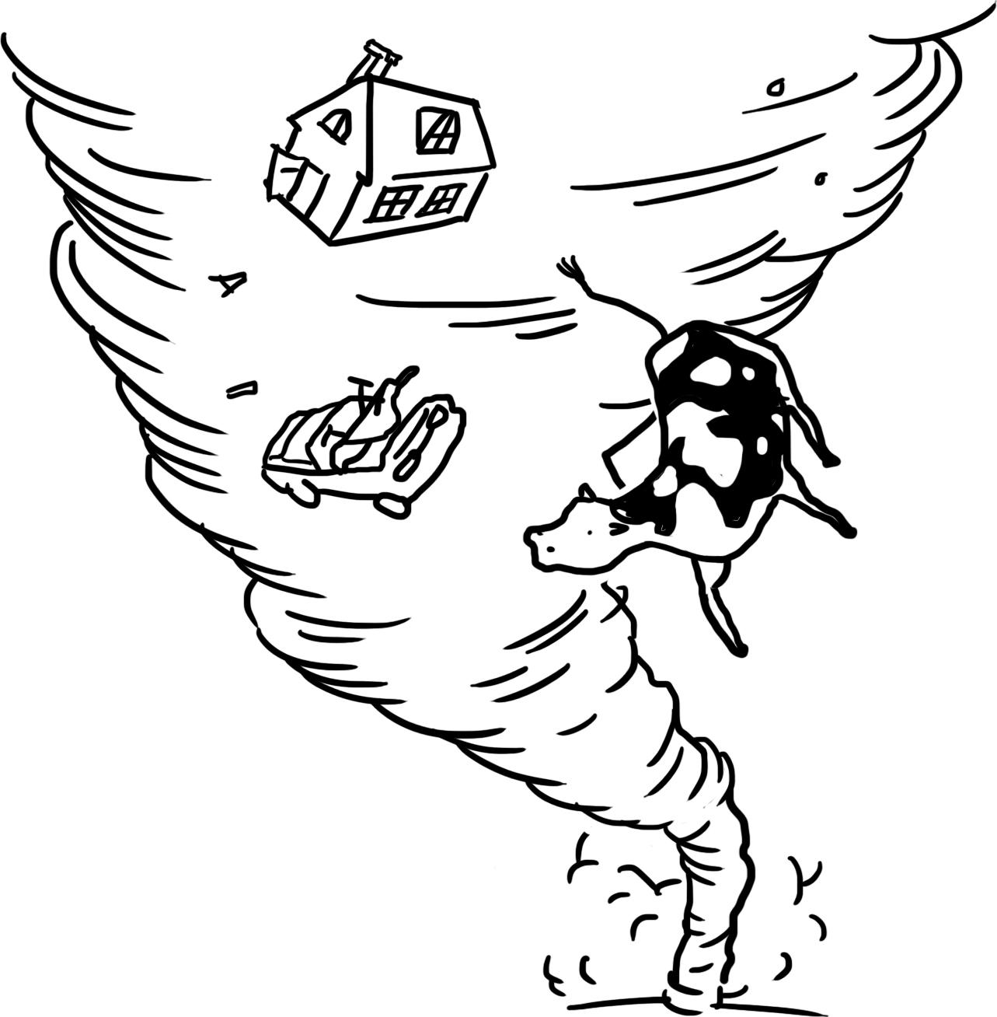
The problem of suffering
Is god willing to prevent evil, but not able?
Then he is not omnipotent.
Is he able, but not willing?
Then he is not benevolent.
Is he both able and willing?
Then where does evil come from?
Is he neither able nor willing?
Then why call him god?
Epicurus (341 – 270 BCE)

Slide 36
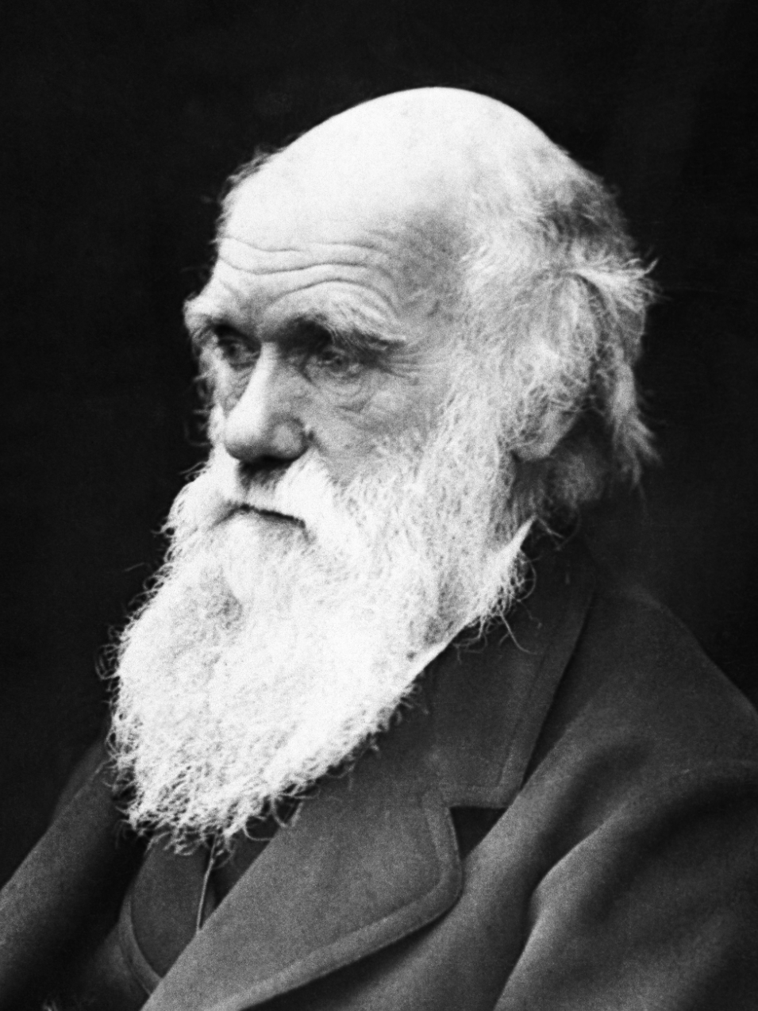
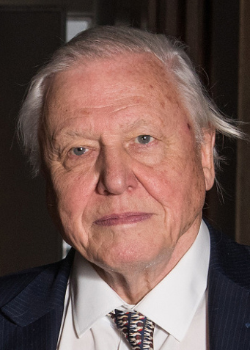
The problem of suffering
‘I cannot persuade myself that a beneficent and omnipotent god would have designed parasitic wasps with the express intention of feeding within the living bodies of caterpillars.’
Charles Darwin, scientist (1809 – 1882)
‘I think of a parasitic worm that is boring through the eye of a boy living in West Africa, a worm that’s going to make him blind. Are you telling me that the God you say is an all-merciful God, that cares for each of us individually, are you saying that God created this worm that can live in no other way than in an innocent child’s eyeball? Because that doesn’t seem to me to coincide with a God that’s full of mercy.’
David Attenborough, naturalist

Slide 37
Atheist and agnostic responses
How might an atheist or agnostic respond to these statements?
All atheists are certain there’s no god and agnostics can’t make up their minds.
You can’t be certain that there isn’t a god so you have no good reason to doubt that he exists.
If there’s no god, then why do so many people believe in one?

Slide 38
Atheism and agnosticism
An atheist is somebody who does not believe in a god
An agnostic is somebody who says we cannot know whether a god exists or not
Humanists are atheists and agnostics who believe it is possible to lead good and happy lives

