Slide 1
Human beings

Slide 2
A humanist approach to life: a summary
Humanists believe the world is a natural place and science gives us the best way to understand it (humanists don’t believe in a god)
Humanists believe we should be free to make the most of the one life we have, seeking happiness and supporting others to do the same
Humanists believe we should use empathy and consider the impact of our actions on other people and animals

Slide 3

A humanist understanding of human beings
Science can give us natural explanations for our origins
Human beings evolved positive and negative qualities
Human beings can help to make the world a better place

Slide 4
Humanism

Slide 5
Humanism

Slide 6
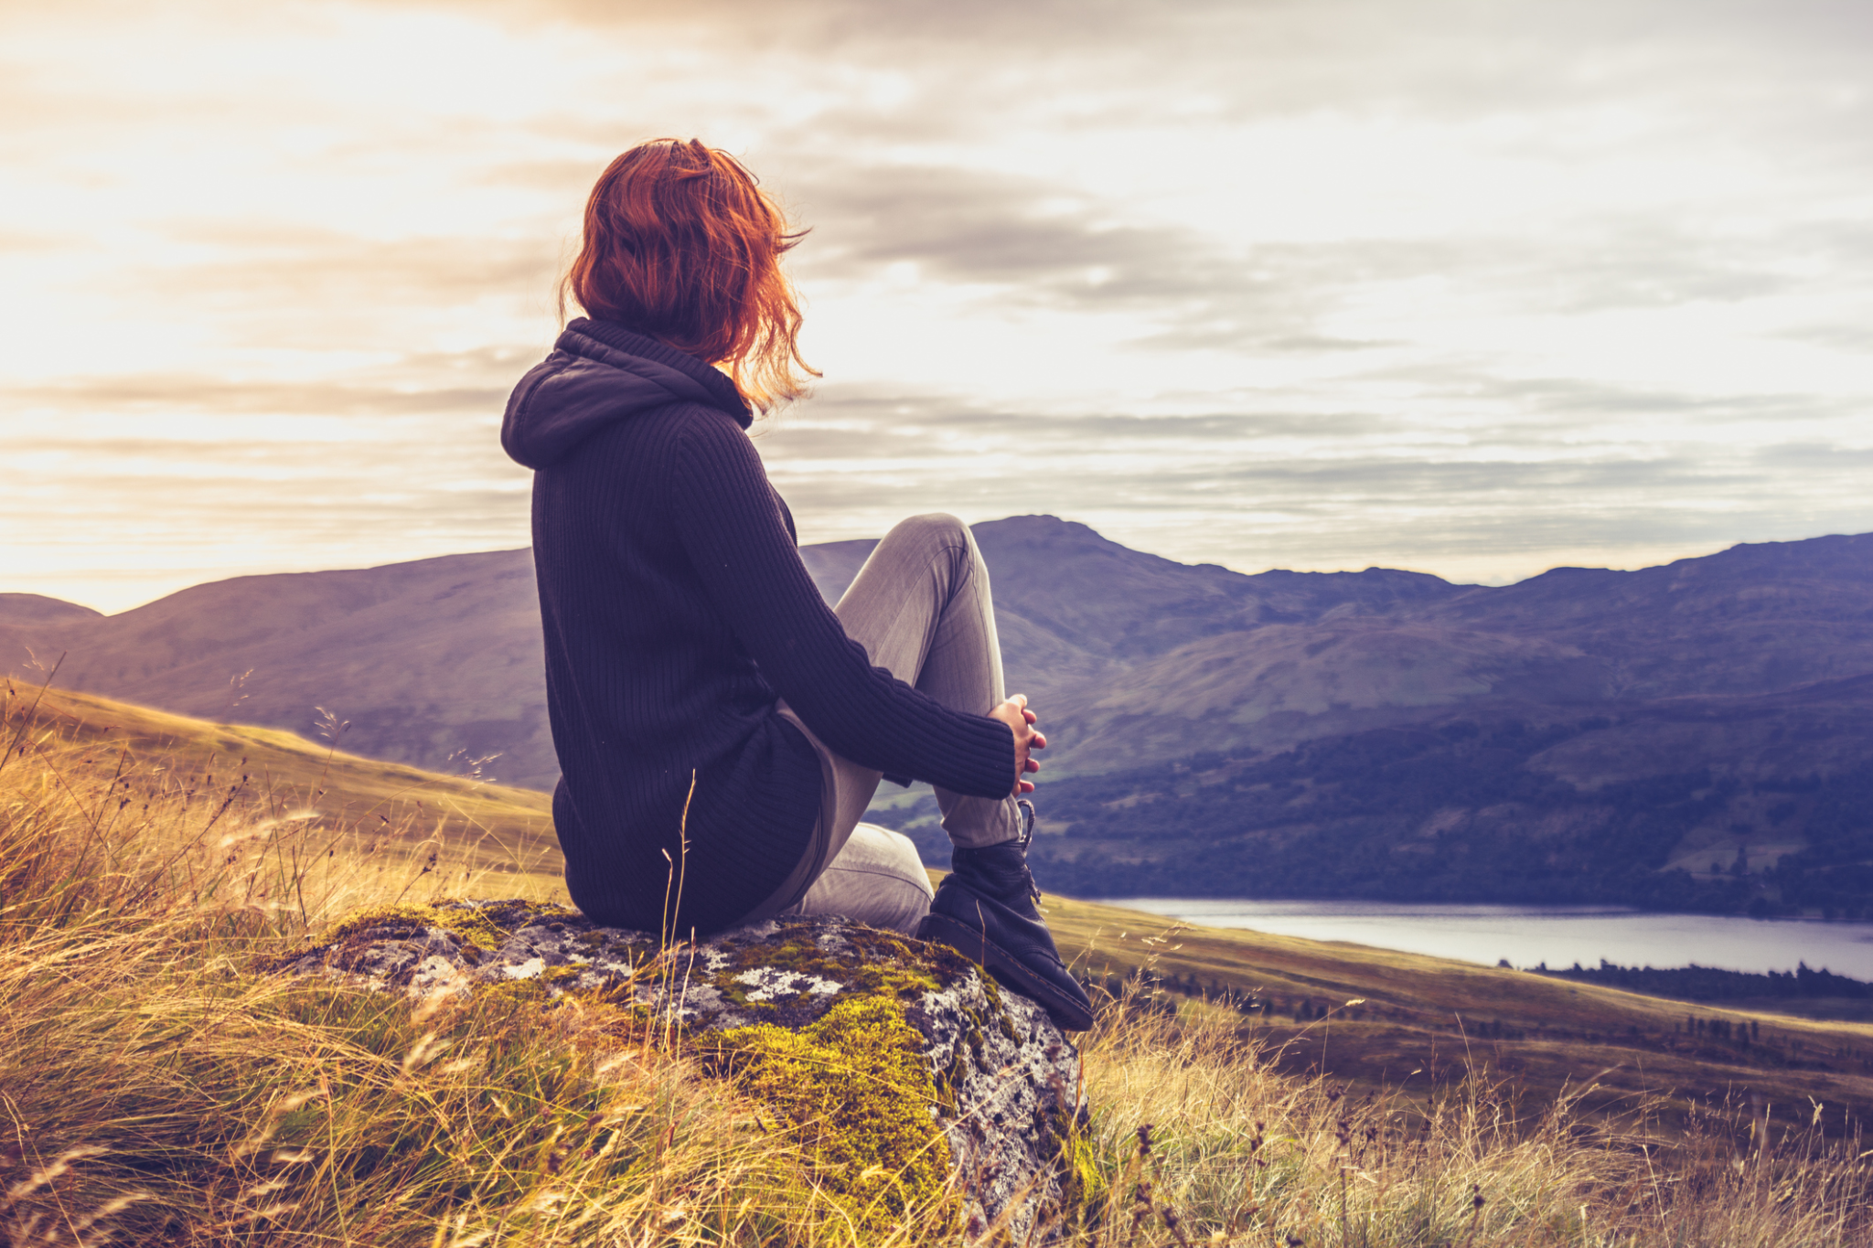
Big questions
Where do we come from?
What are we?
Where are we going?

Slide 7

Humanists believe the world is a natural place
We should look for natural explanations

Slide 8
Atheist
= someone who does not believe in god

Slide 9
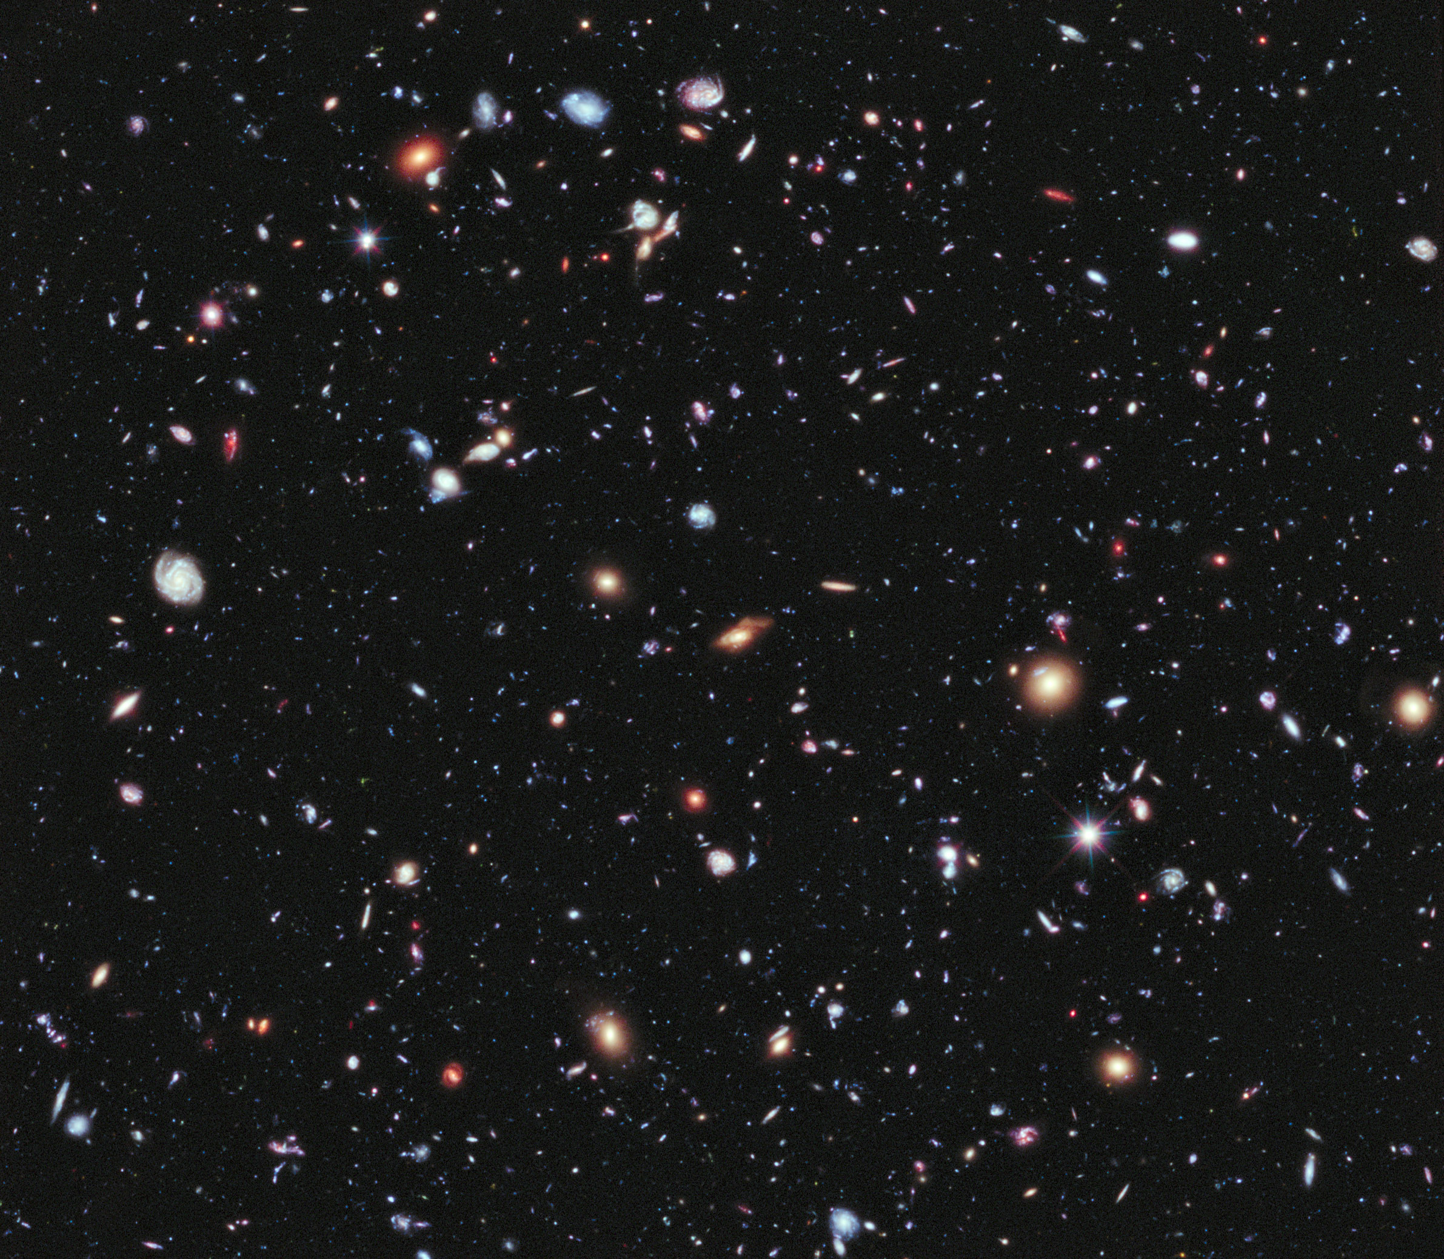
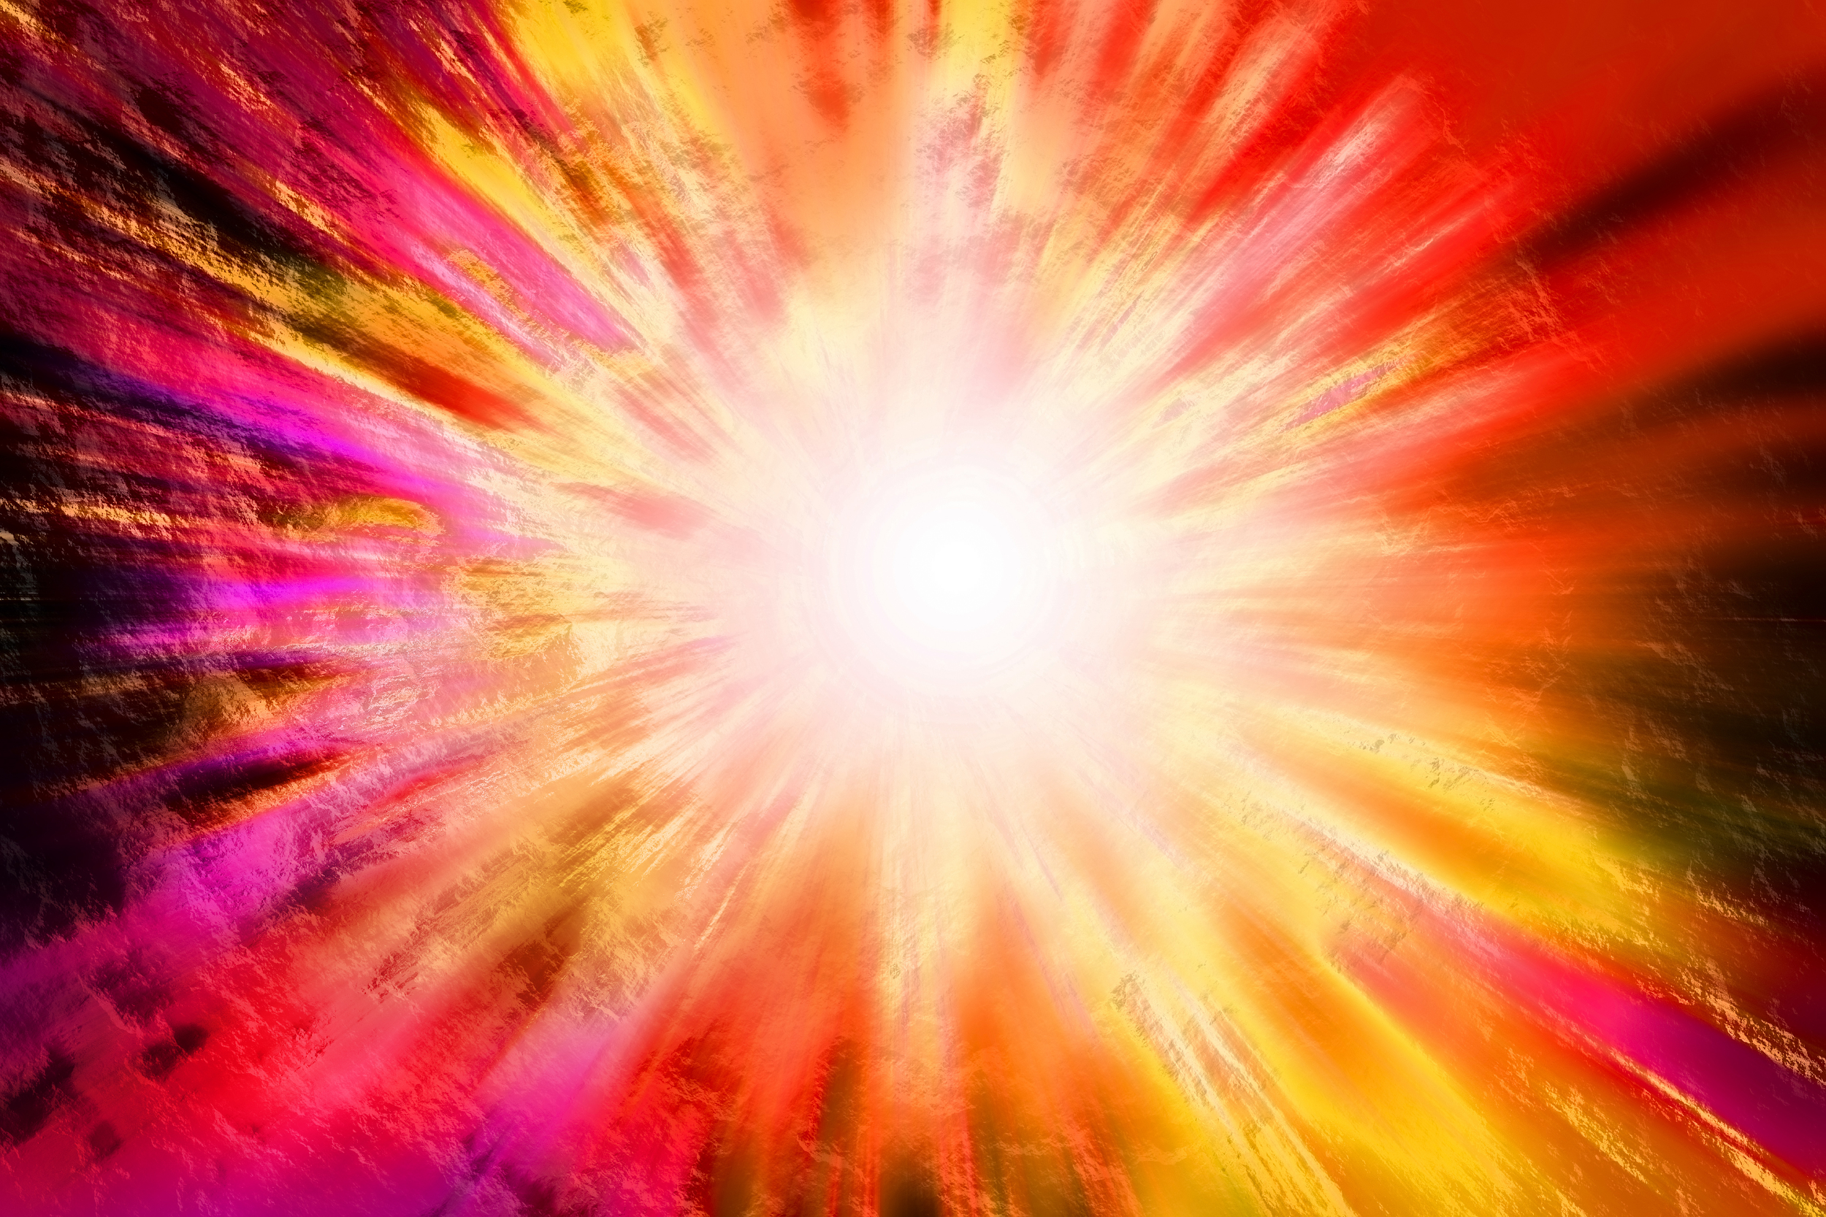
The Big Bang

Slide 10
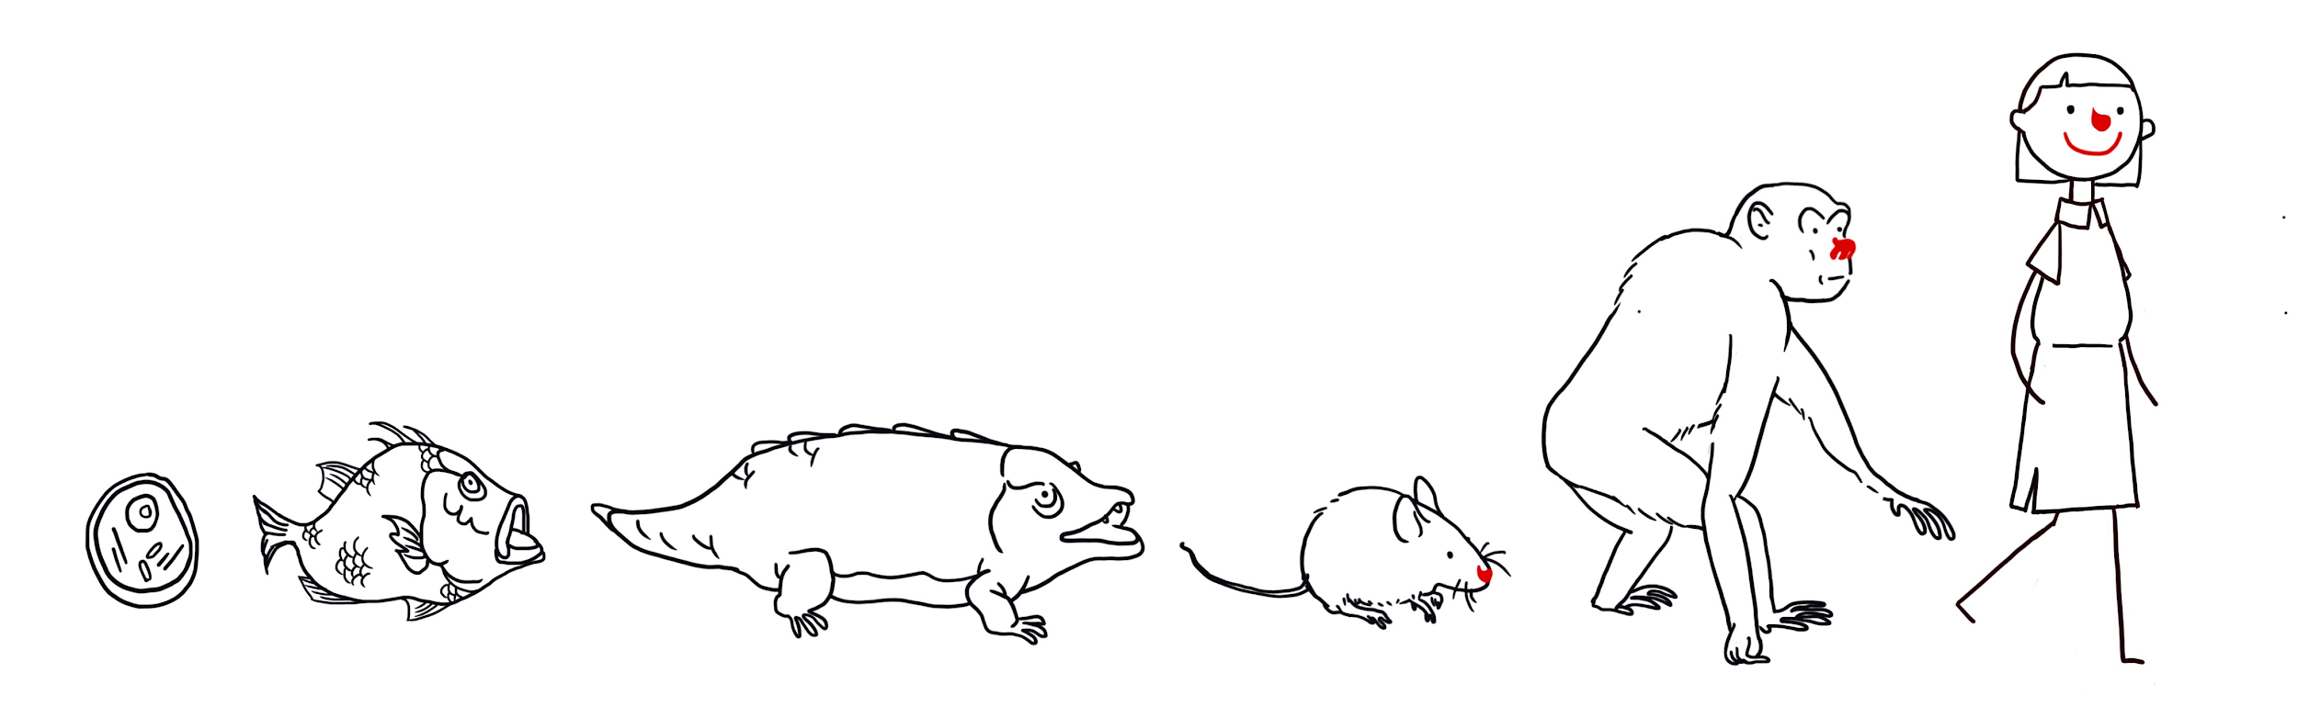
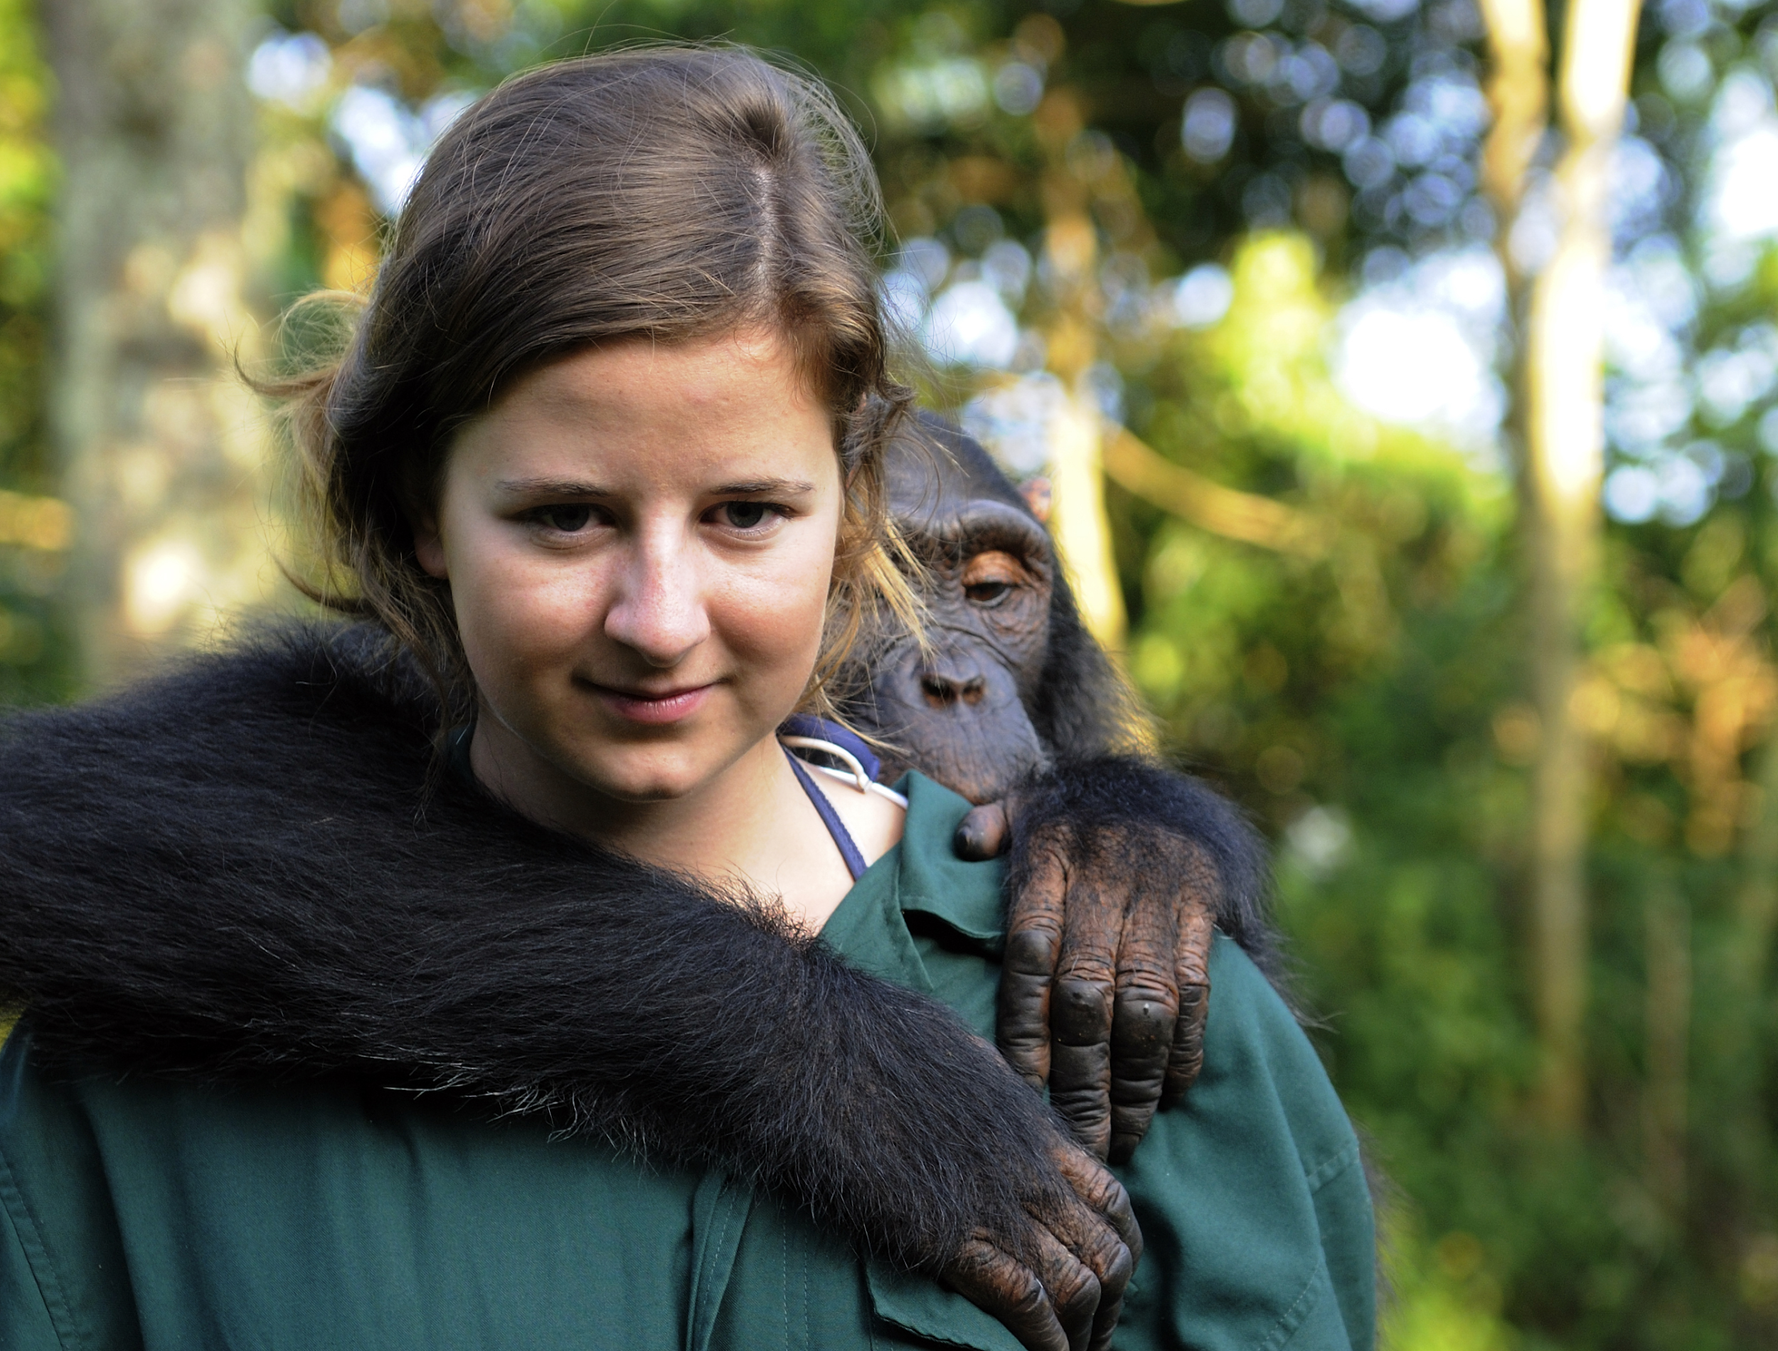
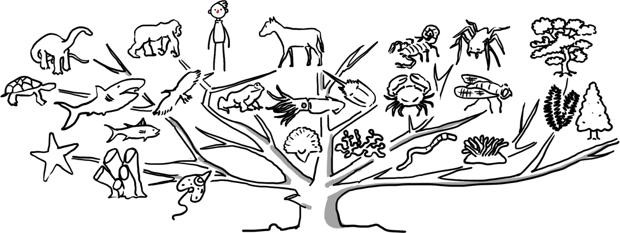
Evolution

Slide 11
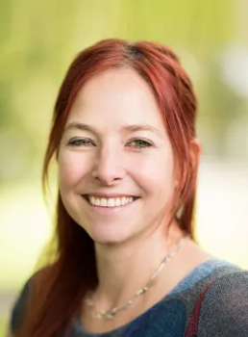
Evolution
‘We’re not the pinnacle of evolution. Instead, we are connected with all other species; part of the huge, copiously branching tree of life. As conscious beings, we must surely endeavour to look after each other – and the planet.’
Alice Roberts, President of Humanists UK

Slide 12
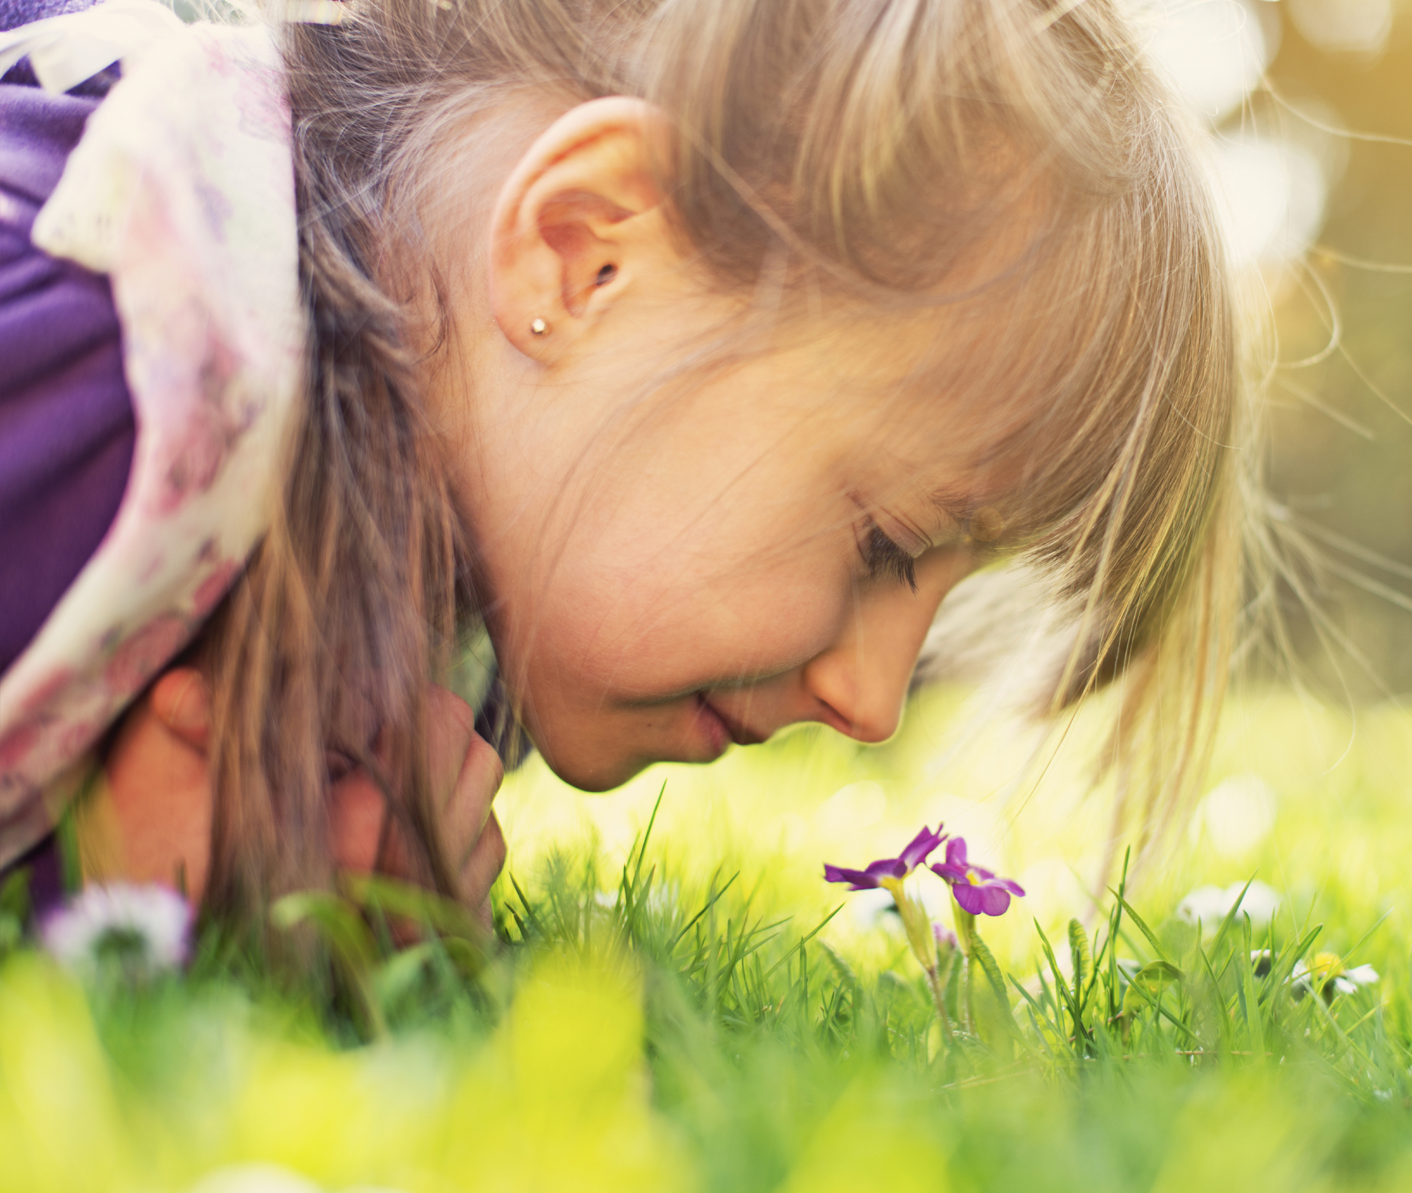
Human beings
We are made from the same materials as everything else in the universe

Slide 13
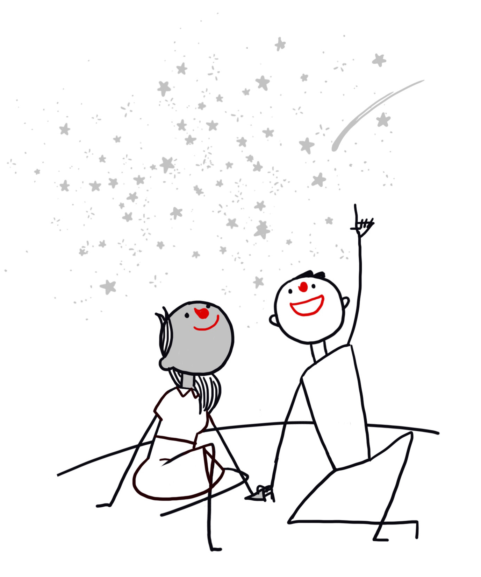
Humanists find wonder in the scientific story
‘Learning about the nature of space and time or the structure of atoms fills me with awe and wonder. It makes me want to learn more.’
Jim al-Khalili, scientist and Vice-president of Humanists UK
‘Our entire bodies and brains are made of a few dollars’ worth of common elements.... Assemble them all in the right proportion... and the result is our feeling, thinking, striving, imagining, creative selves. Such ordinary elements; such extraordinary results!’
James Hemming, President of Humanists UK (1977-1980)
‘The calcium in our teeth, the iron in our blood, the carbon in our apple pies were made in the interiors of collapsing stars. We are made of starstuff.’
Carl Sagan, astronomer

Slide 14
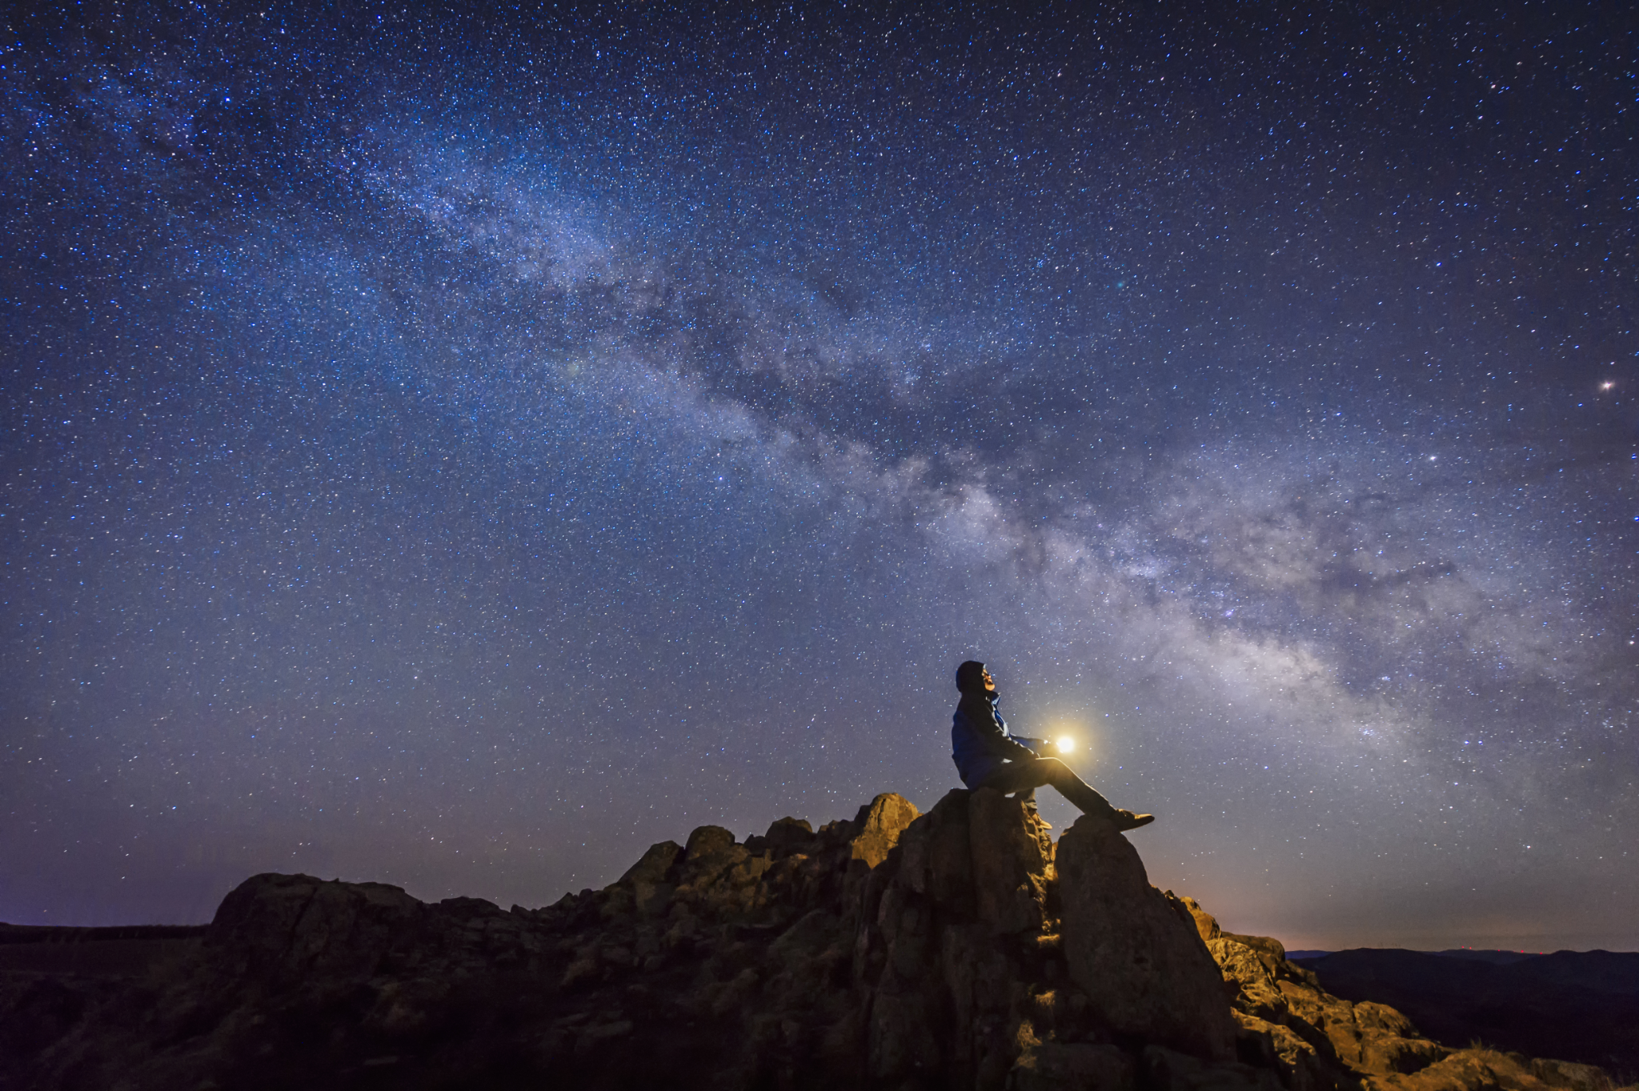

Slide 15
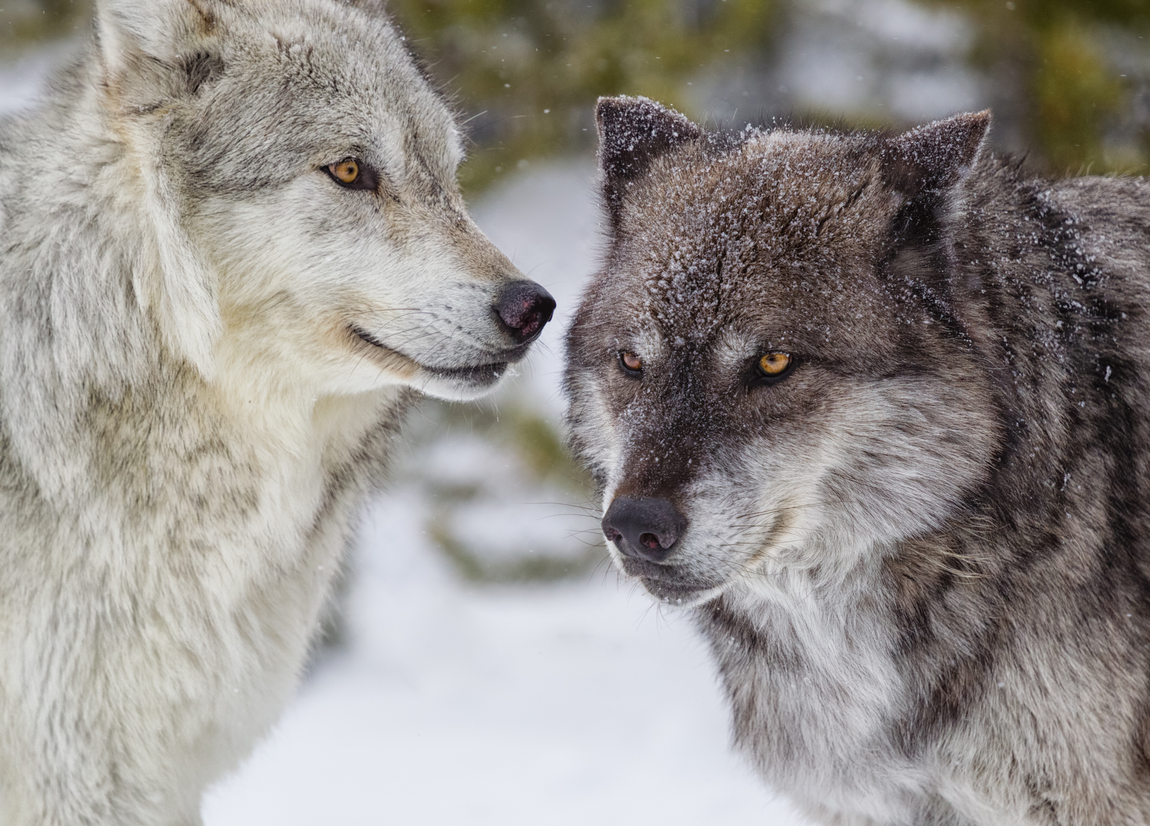
The two wolves

Slide 16
The two wolves
An old woman said to her grandson: ‘I have two wolves inside me. One wolf is bad – greedy, angry, jealous, cruel, untrustworthy, arrogant, and cowardly. The other wolf is good – loving, brave, honest, kind, peaceful, modest, and happy. These two wolves are fighting inside me every day. But these two wolves are not just inside me. They are also in you. They are fighting inside everybody.’
After a moment, the boy asked: ‘Which wolf will win?’
The old woman smiled and said: ‘The one that you feed.’

Slide 17
Human being: good and bad
What is positive and negative about human beings?
What positive and negative things have human beings achieved?

Slide 18

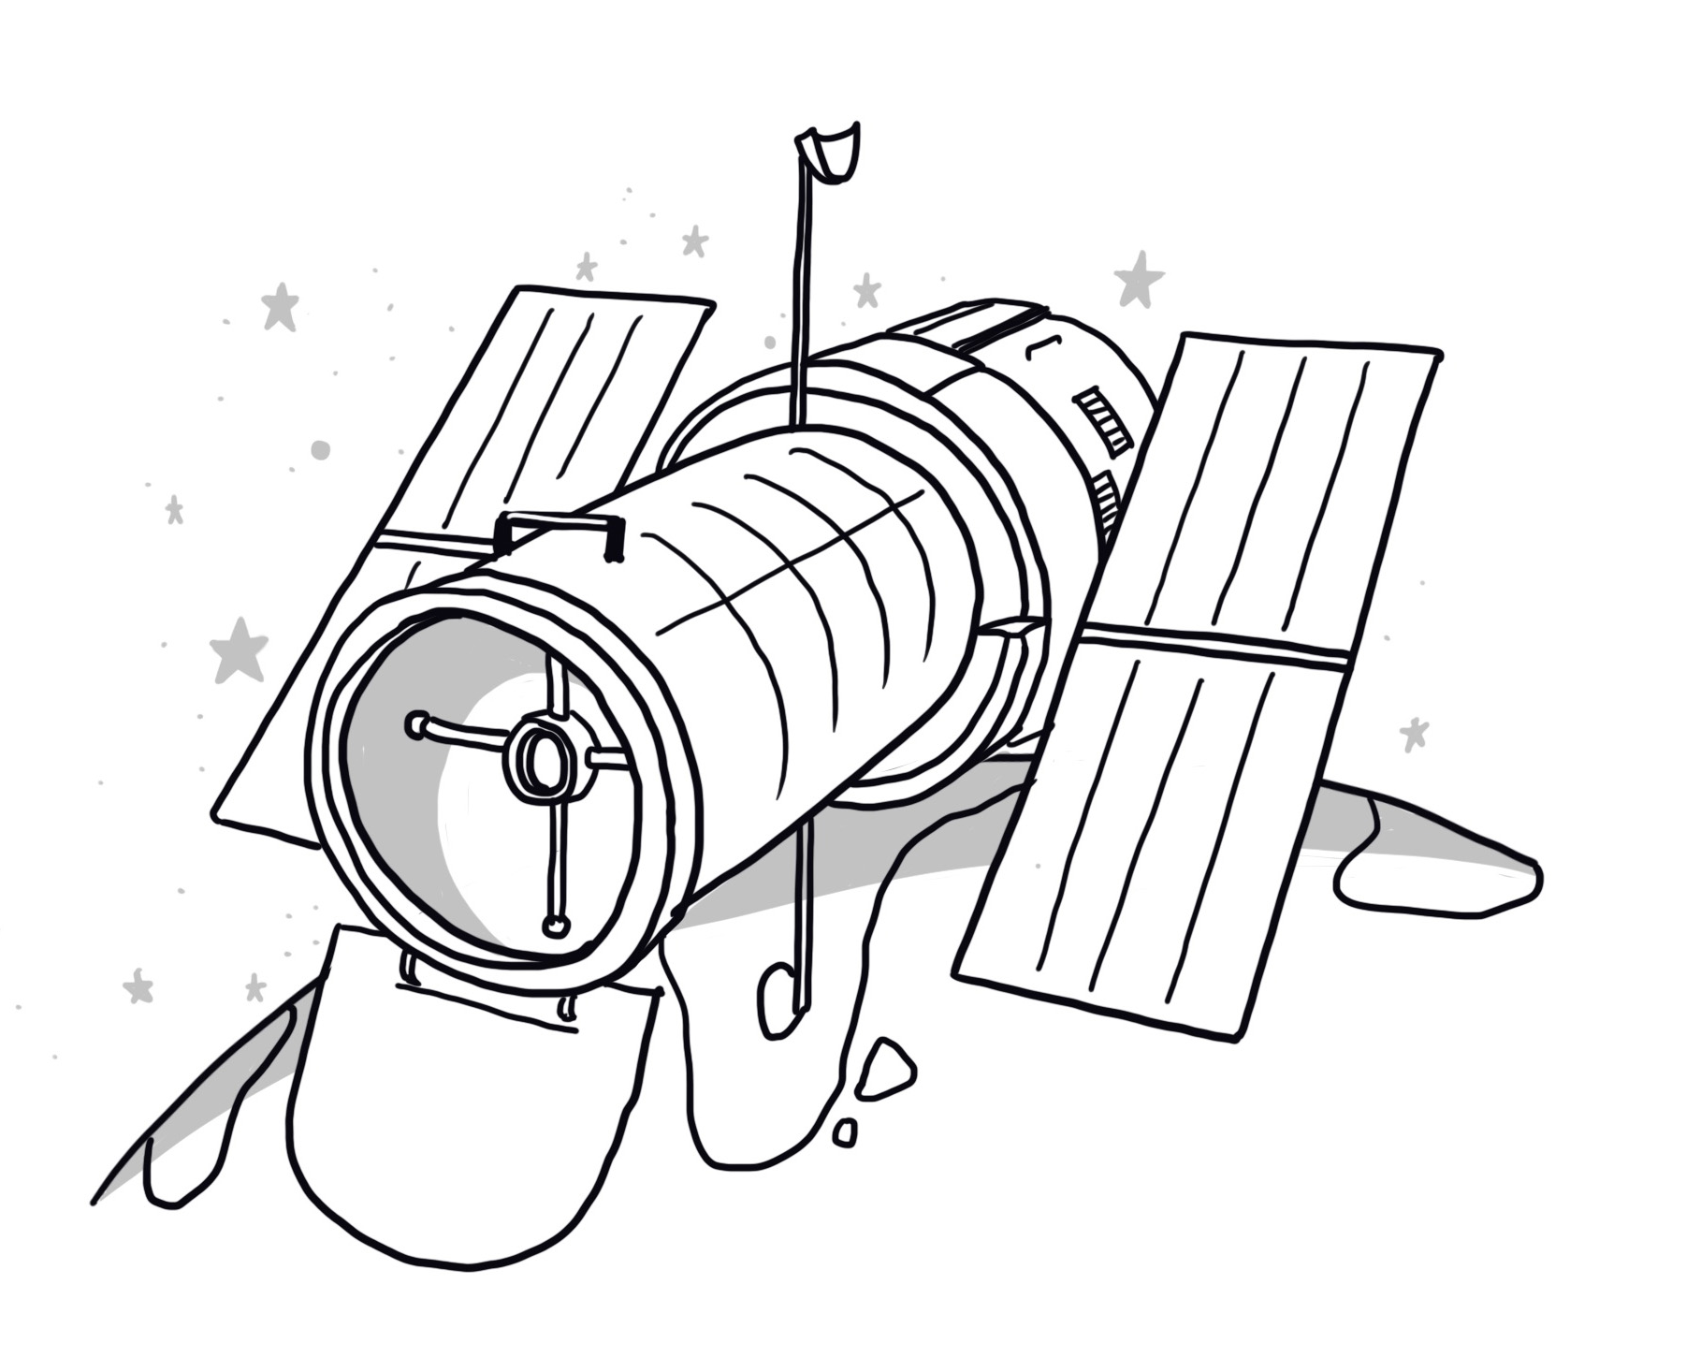
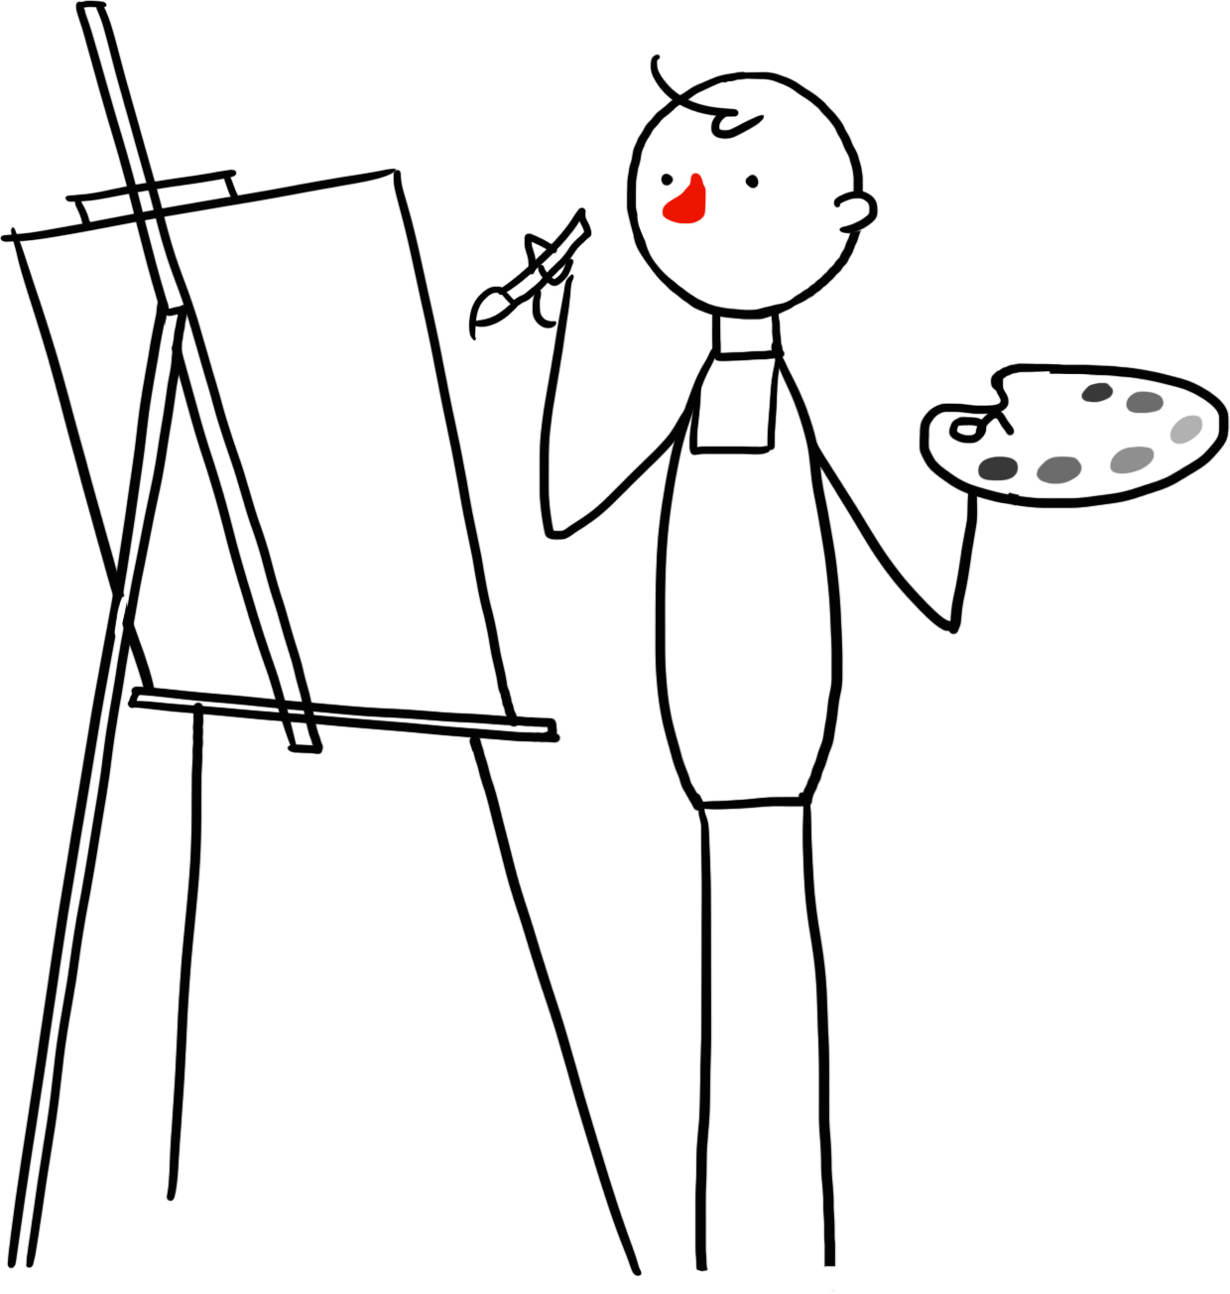

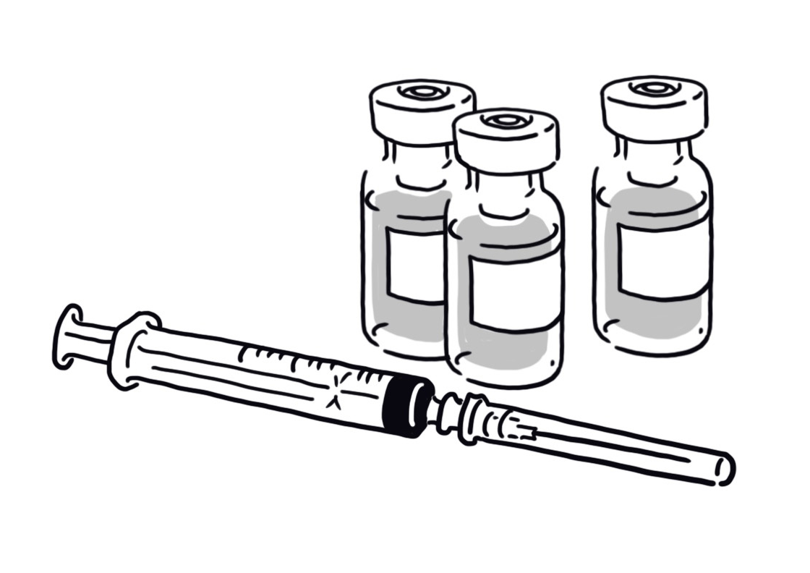
The humanist understanding of human beings
We have both positive and negative capacities
All these capacities are natural
We have a responsibility to think about how we can make the best use of our capacities
We should make the most of our potential to try to make the world a better place

Slide 19
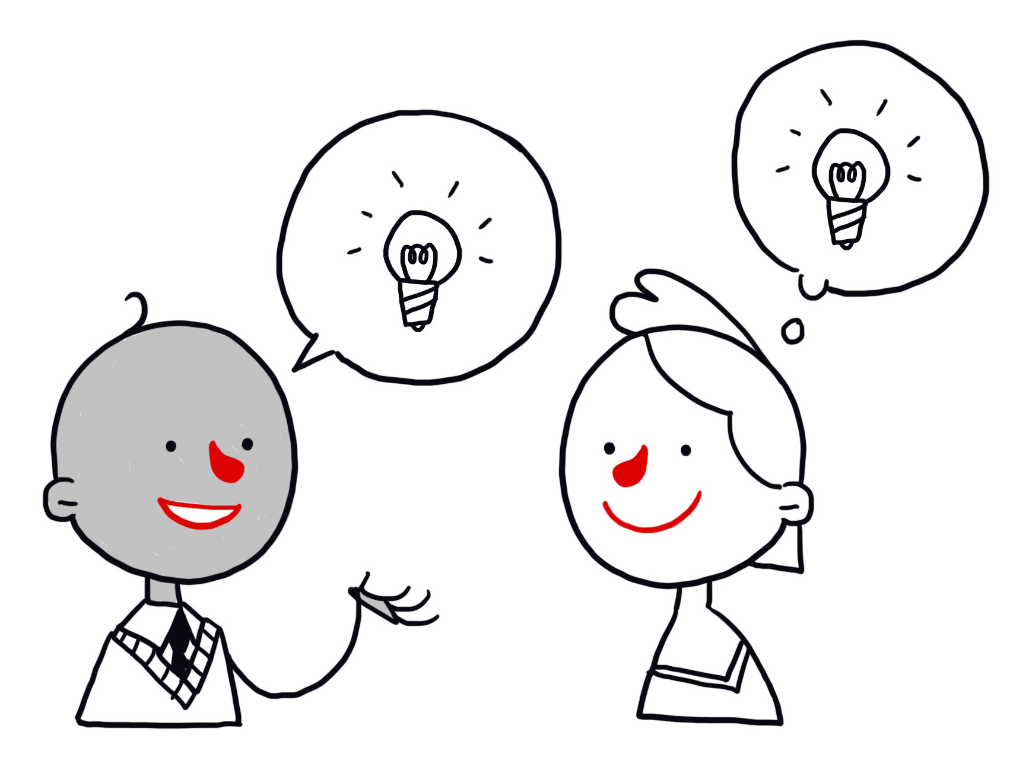
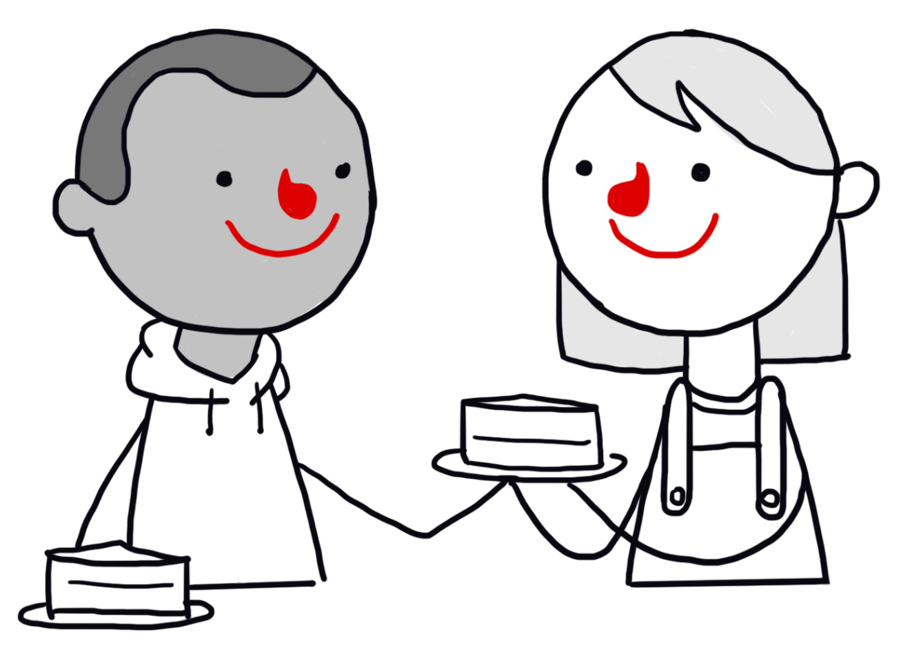
Our positive capacities
We can ask and answer questions about the world.
We can be creative and we can imagine how things could be different.
We are capable of empathy, kindness, friendship, and love.
We can communicate with each other, and can share our ideas, knowledge, and experiences.
We can plan for the future.
We can be happy.
Humanist believe all these have evolved naturally

Slide 20
Human beings
Create an image of a human being that…
Illustrates both sides of our nature (good and bad)
Highlights the features a humanist might think we should celebrate and promote

Slide 21
A humanist understanding of human beings
Science can give us natural explanations for our origins
Human beings evolved positive and negative qualities
Human beings can help to make the world a better place

