Slide 1
Human beings

Slide 2
A humanist approach to life: a summary
Humanists believe the world is a natural place – we should ask questions and look for evidence to help us to understand it (humanists don’t believe in a god)
Humanists believe we should be free to find what makes us happy
Humanists believe we should be kind to other people, animals, and the planet

Slide 3

A humanist understanding of human beings
Science can tell us the story of where we came from
Human beings are animals with good and bad features
Human beings can help to make the world a better place

Slide 4
Humanism

Slide 5
Humanism

Slide 6
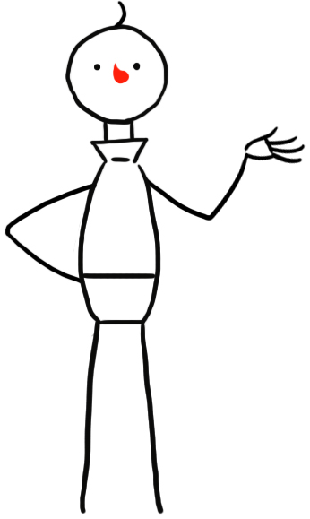
Big questions
Where do we come from?
What are we?
Where are we going?

Slide 7

Humanists believe the world is a natural place

Slide 8
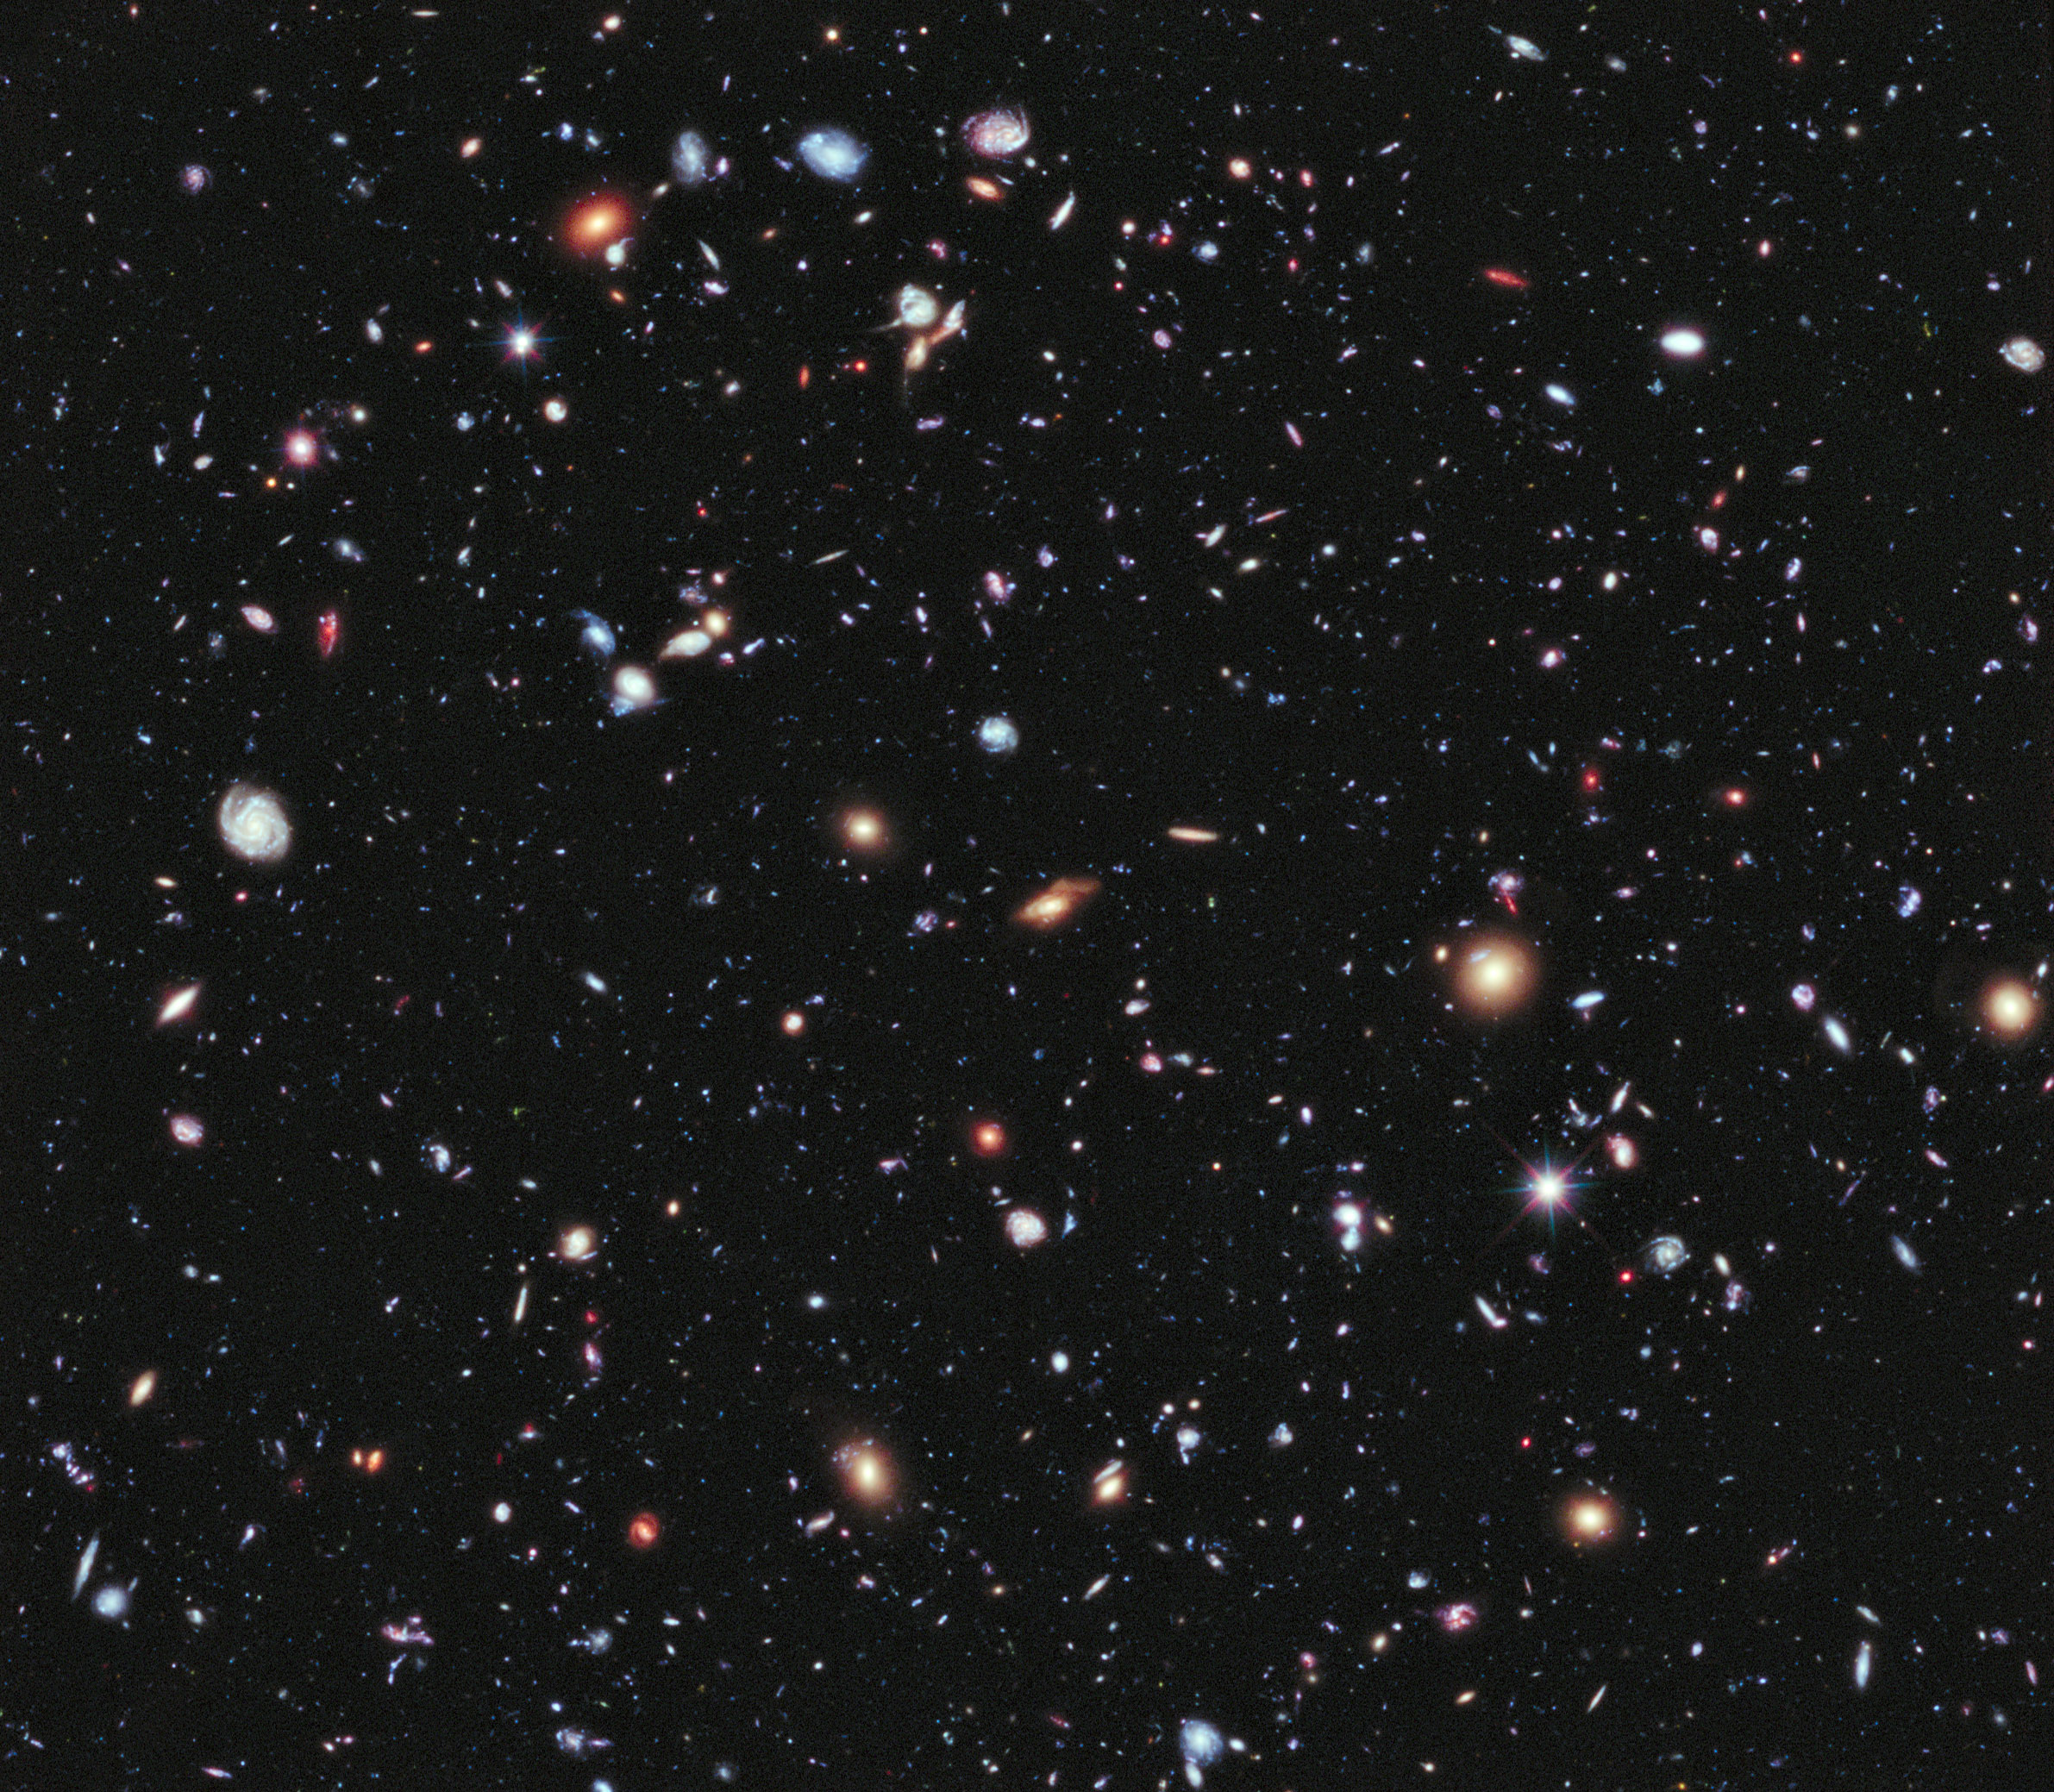
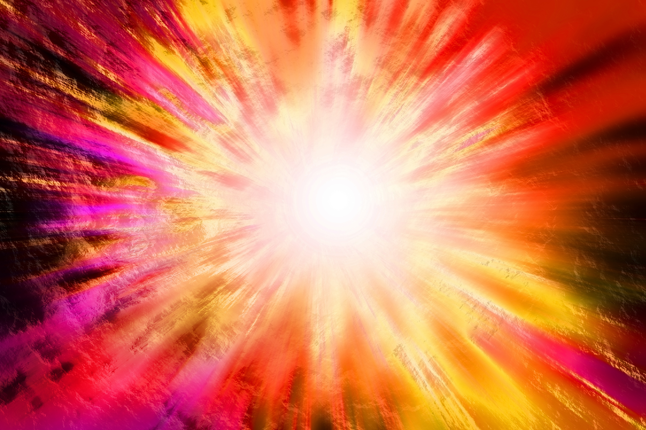
The Big Bang

Slide 9
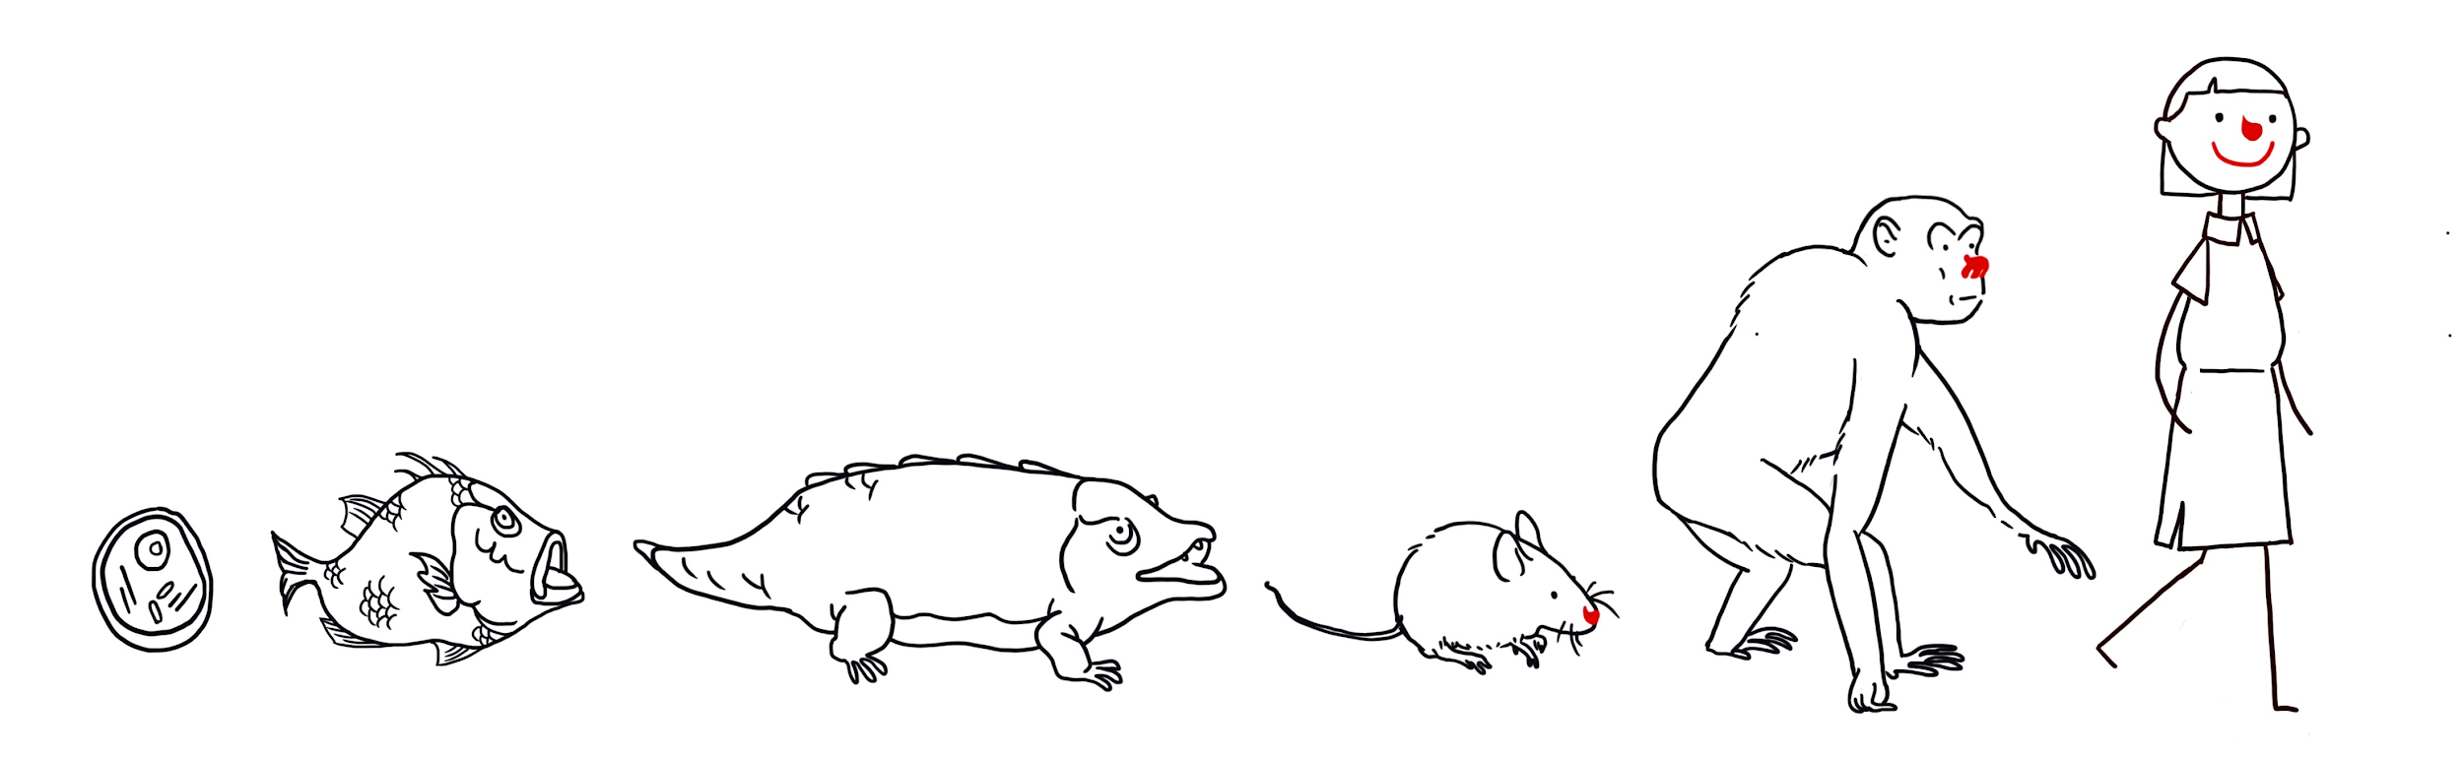
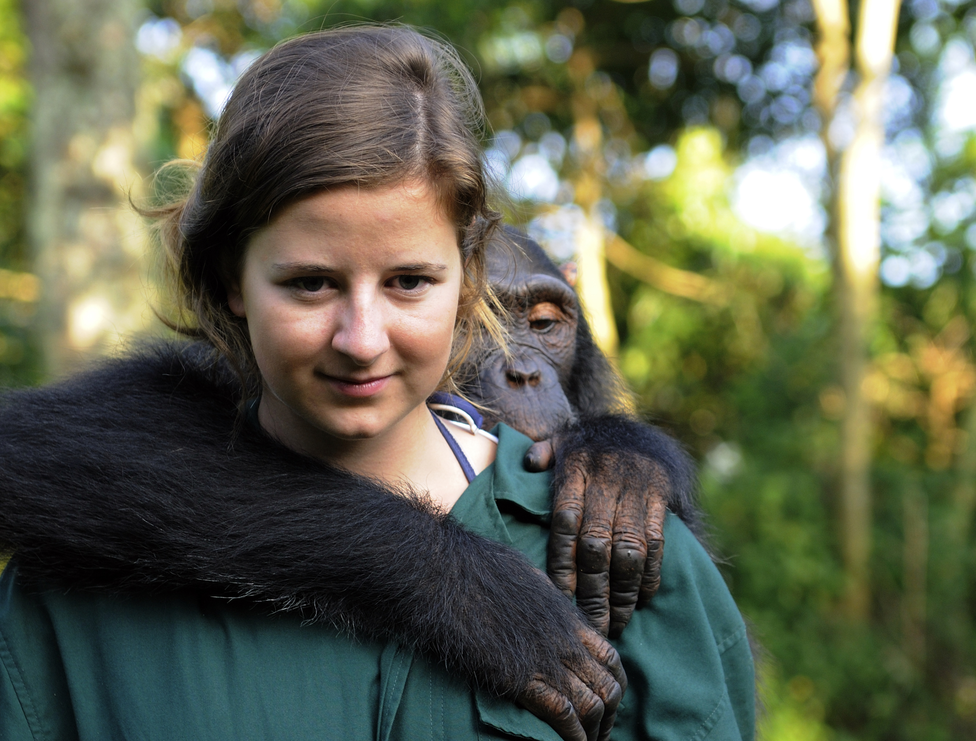
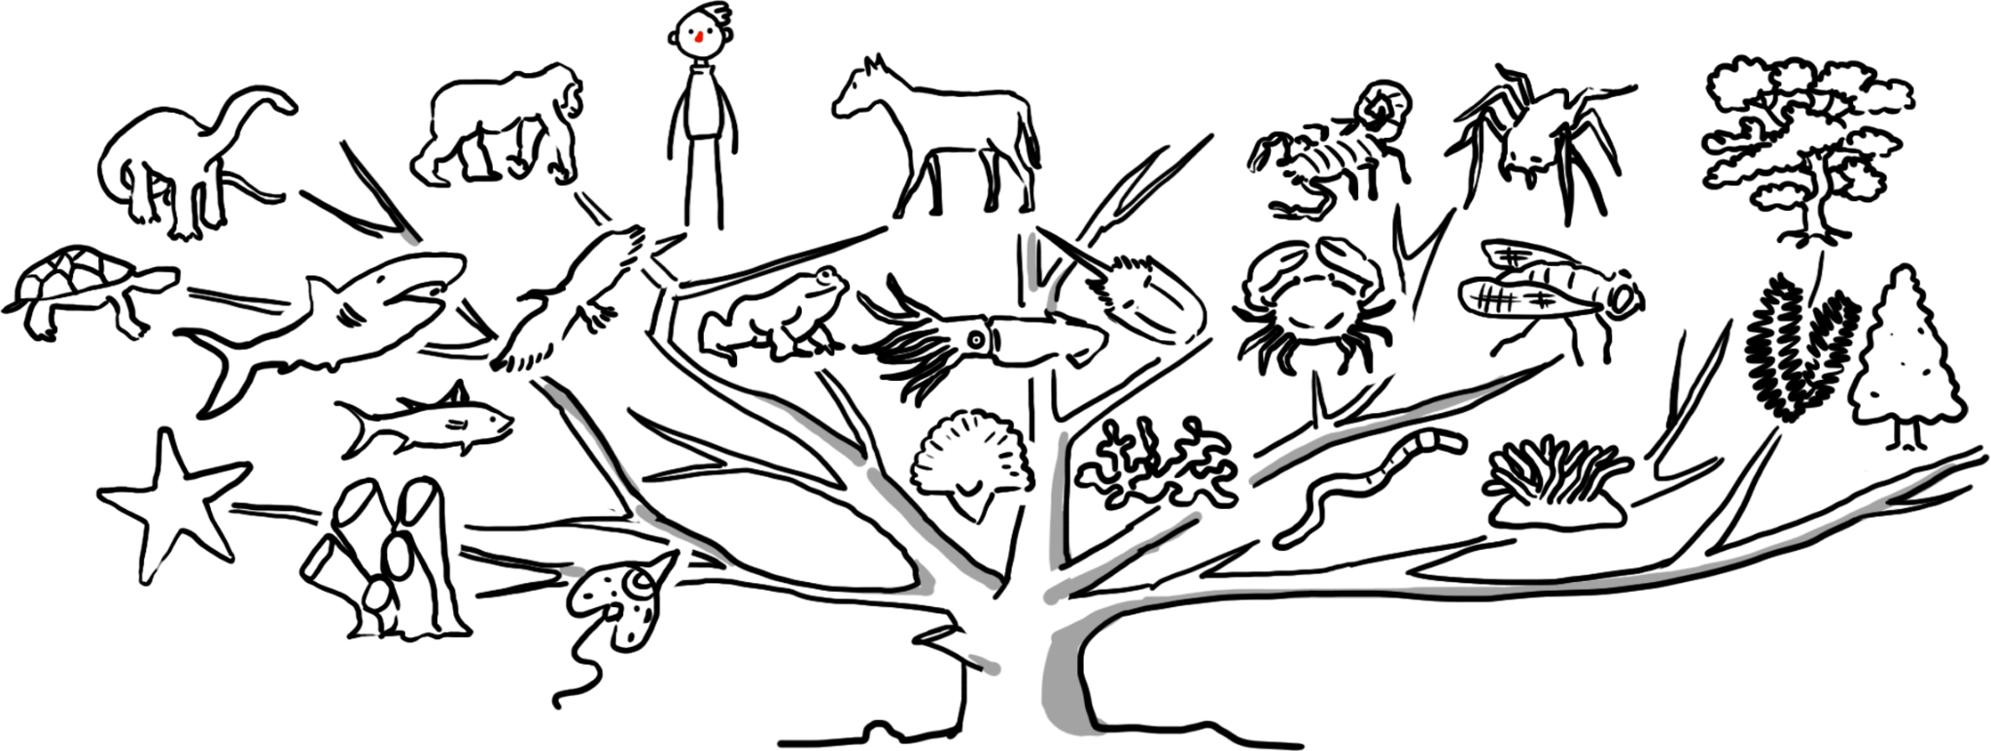
Evolution

Slide 10
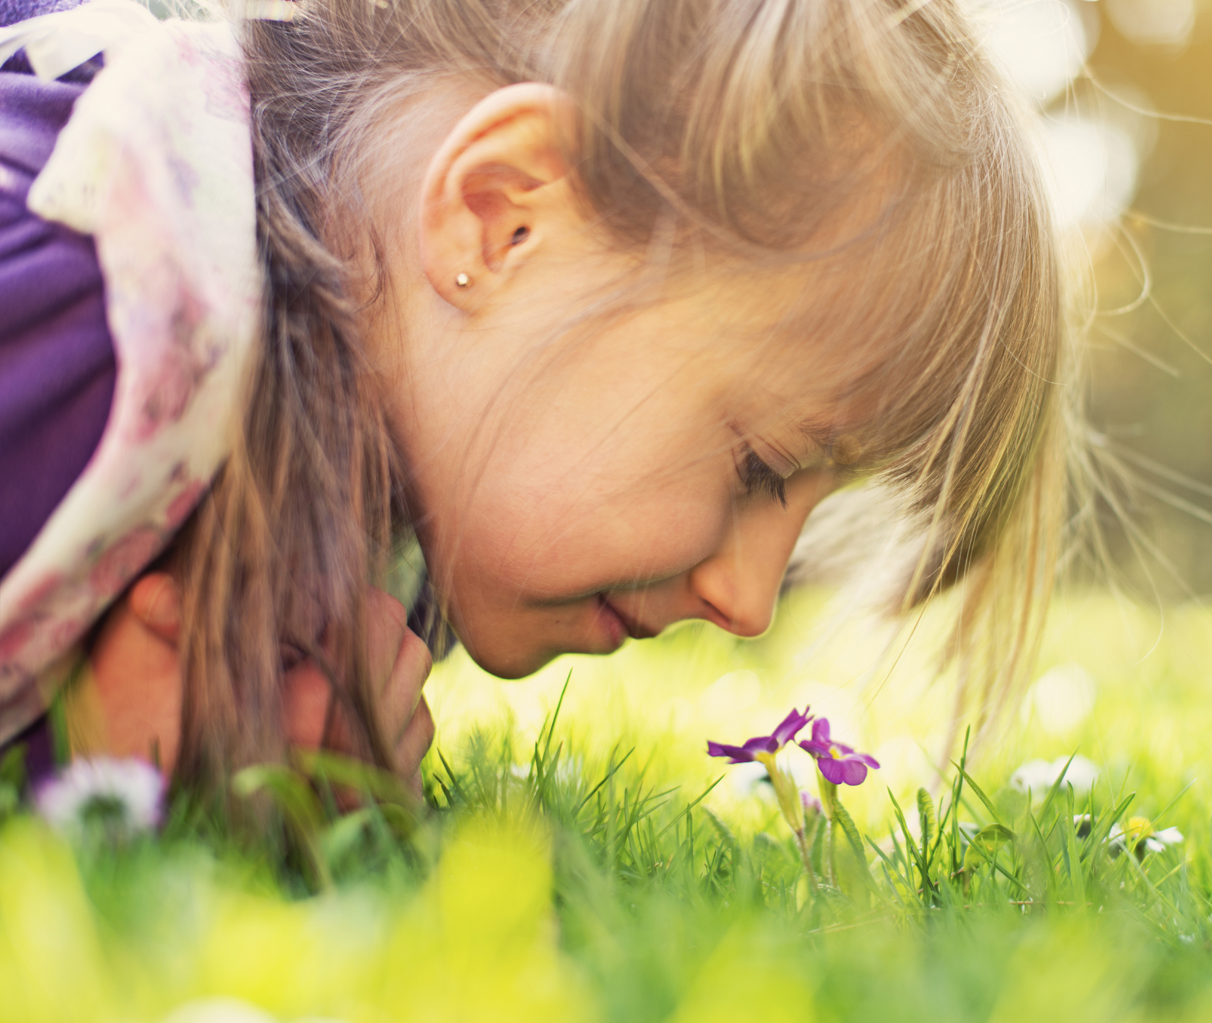
Human beings
We are made from the same materials as everything else in the universe

Slide 11
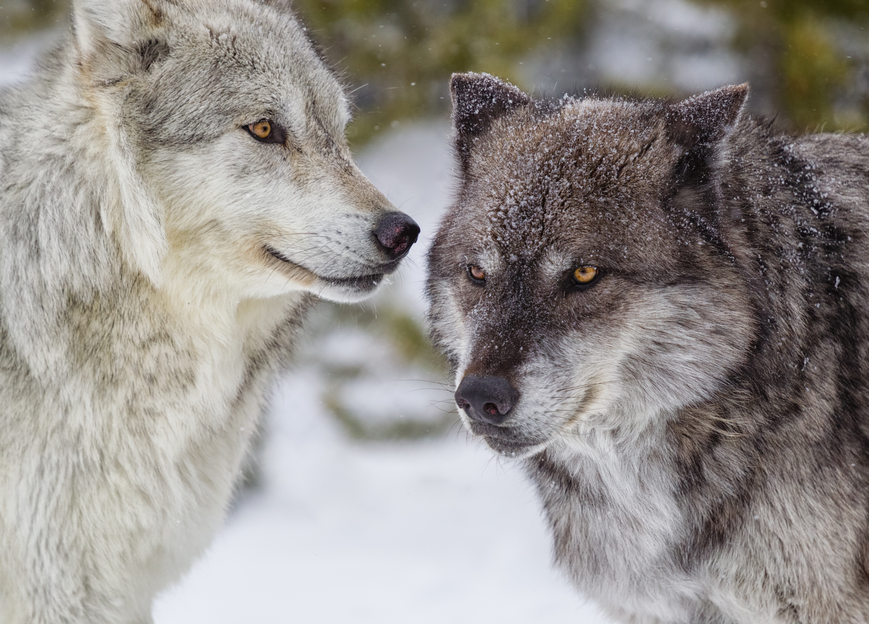
The two wolves

Slide 12
The two wolves
An old woman said to her grandson: ‘I have two wolves inside me. One wolf is bad – greedy, angry, jealous, cruel, untrustworthy, arrogant, and cowardly. The other wolf is good – loving, brave, honest, kind, peaceful, modest, and happy. These two wolves are fighting inside me every day. But these two wolves are not just inside me. They are also in you. They are fighting inside everybody.’
After a moment, the boy asked: ‘Which wolf will win?’
The old woman smiled and said: ‘The one that you feed.’

Slide 13
Human being: good and bad
What is good and bad about human beings?
What good and bad things have human beings achieved?

Slide 14
Human beings
Create an image of a human being that…
Illustrates both sides of our nature (good and bad)
Highlights the features a humanist might think we should celebrate and promote

Slide 15
A humanist understanding of human beings
Science can tell us the story of where we came from
Human beings are animals with good and bad features
Human beings can help to make the world a better place

