Slide 1
Human beings

Slide 2
A humanist approach to life: a summary
Humanists believe science provides the best way to understand the world and we should look for natural explanations for events (humanists don’t believe in a god)
Humanist believe we should be free to shape the one life we have and that we can make our own lives meaningful by seeking happiness in the here and now, and supporting others to do the same
Humanists believe we should use empathy and have a responsibility to consider the impact of our actions on the welfare of other people and animals

Slide 3

A humanist understanding of human beings
Science can give us natural explanations for our origins
Human beings evolved positive and negative qualities
Human beings can help to make the world a better place

Slide 4
Humanism

Slide 5
Humanism

Slide 6
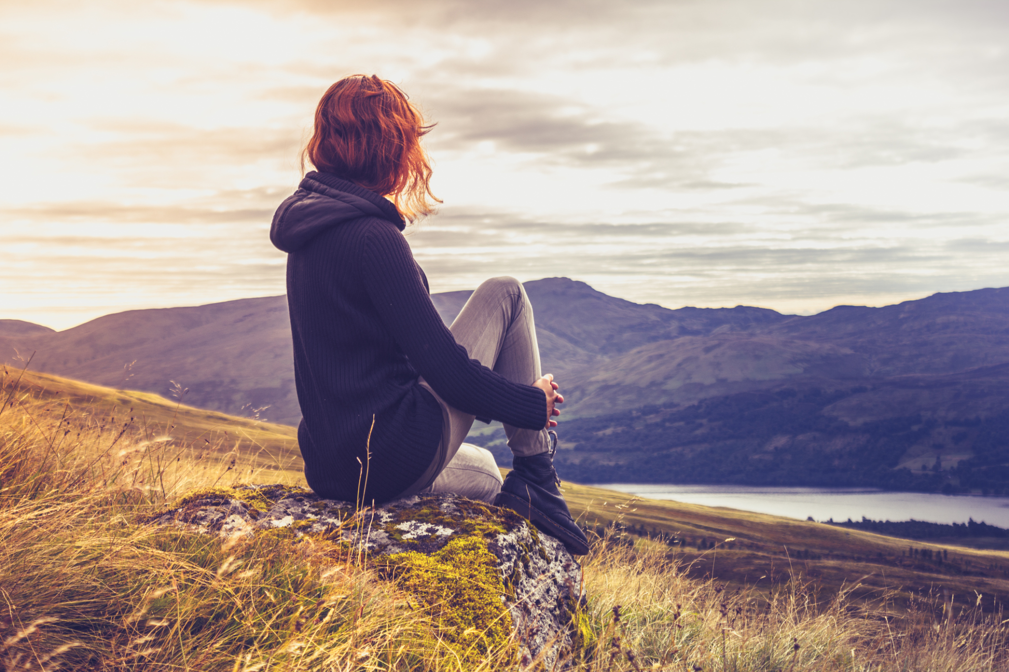
Big questions
Human origins:
Where do we come from?
Human nature:
What are we?
Human potential:
Where are we going?

Slide 7

Humanists believe the world is a natural place
We should look for natural explanations

Slide 8
Atheist
= someone who does not believe in god

Slide 9
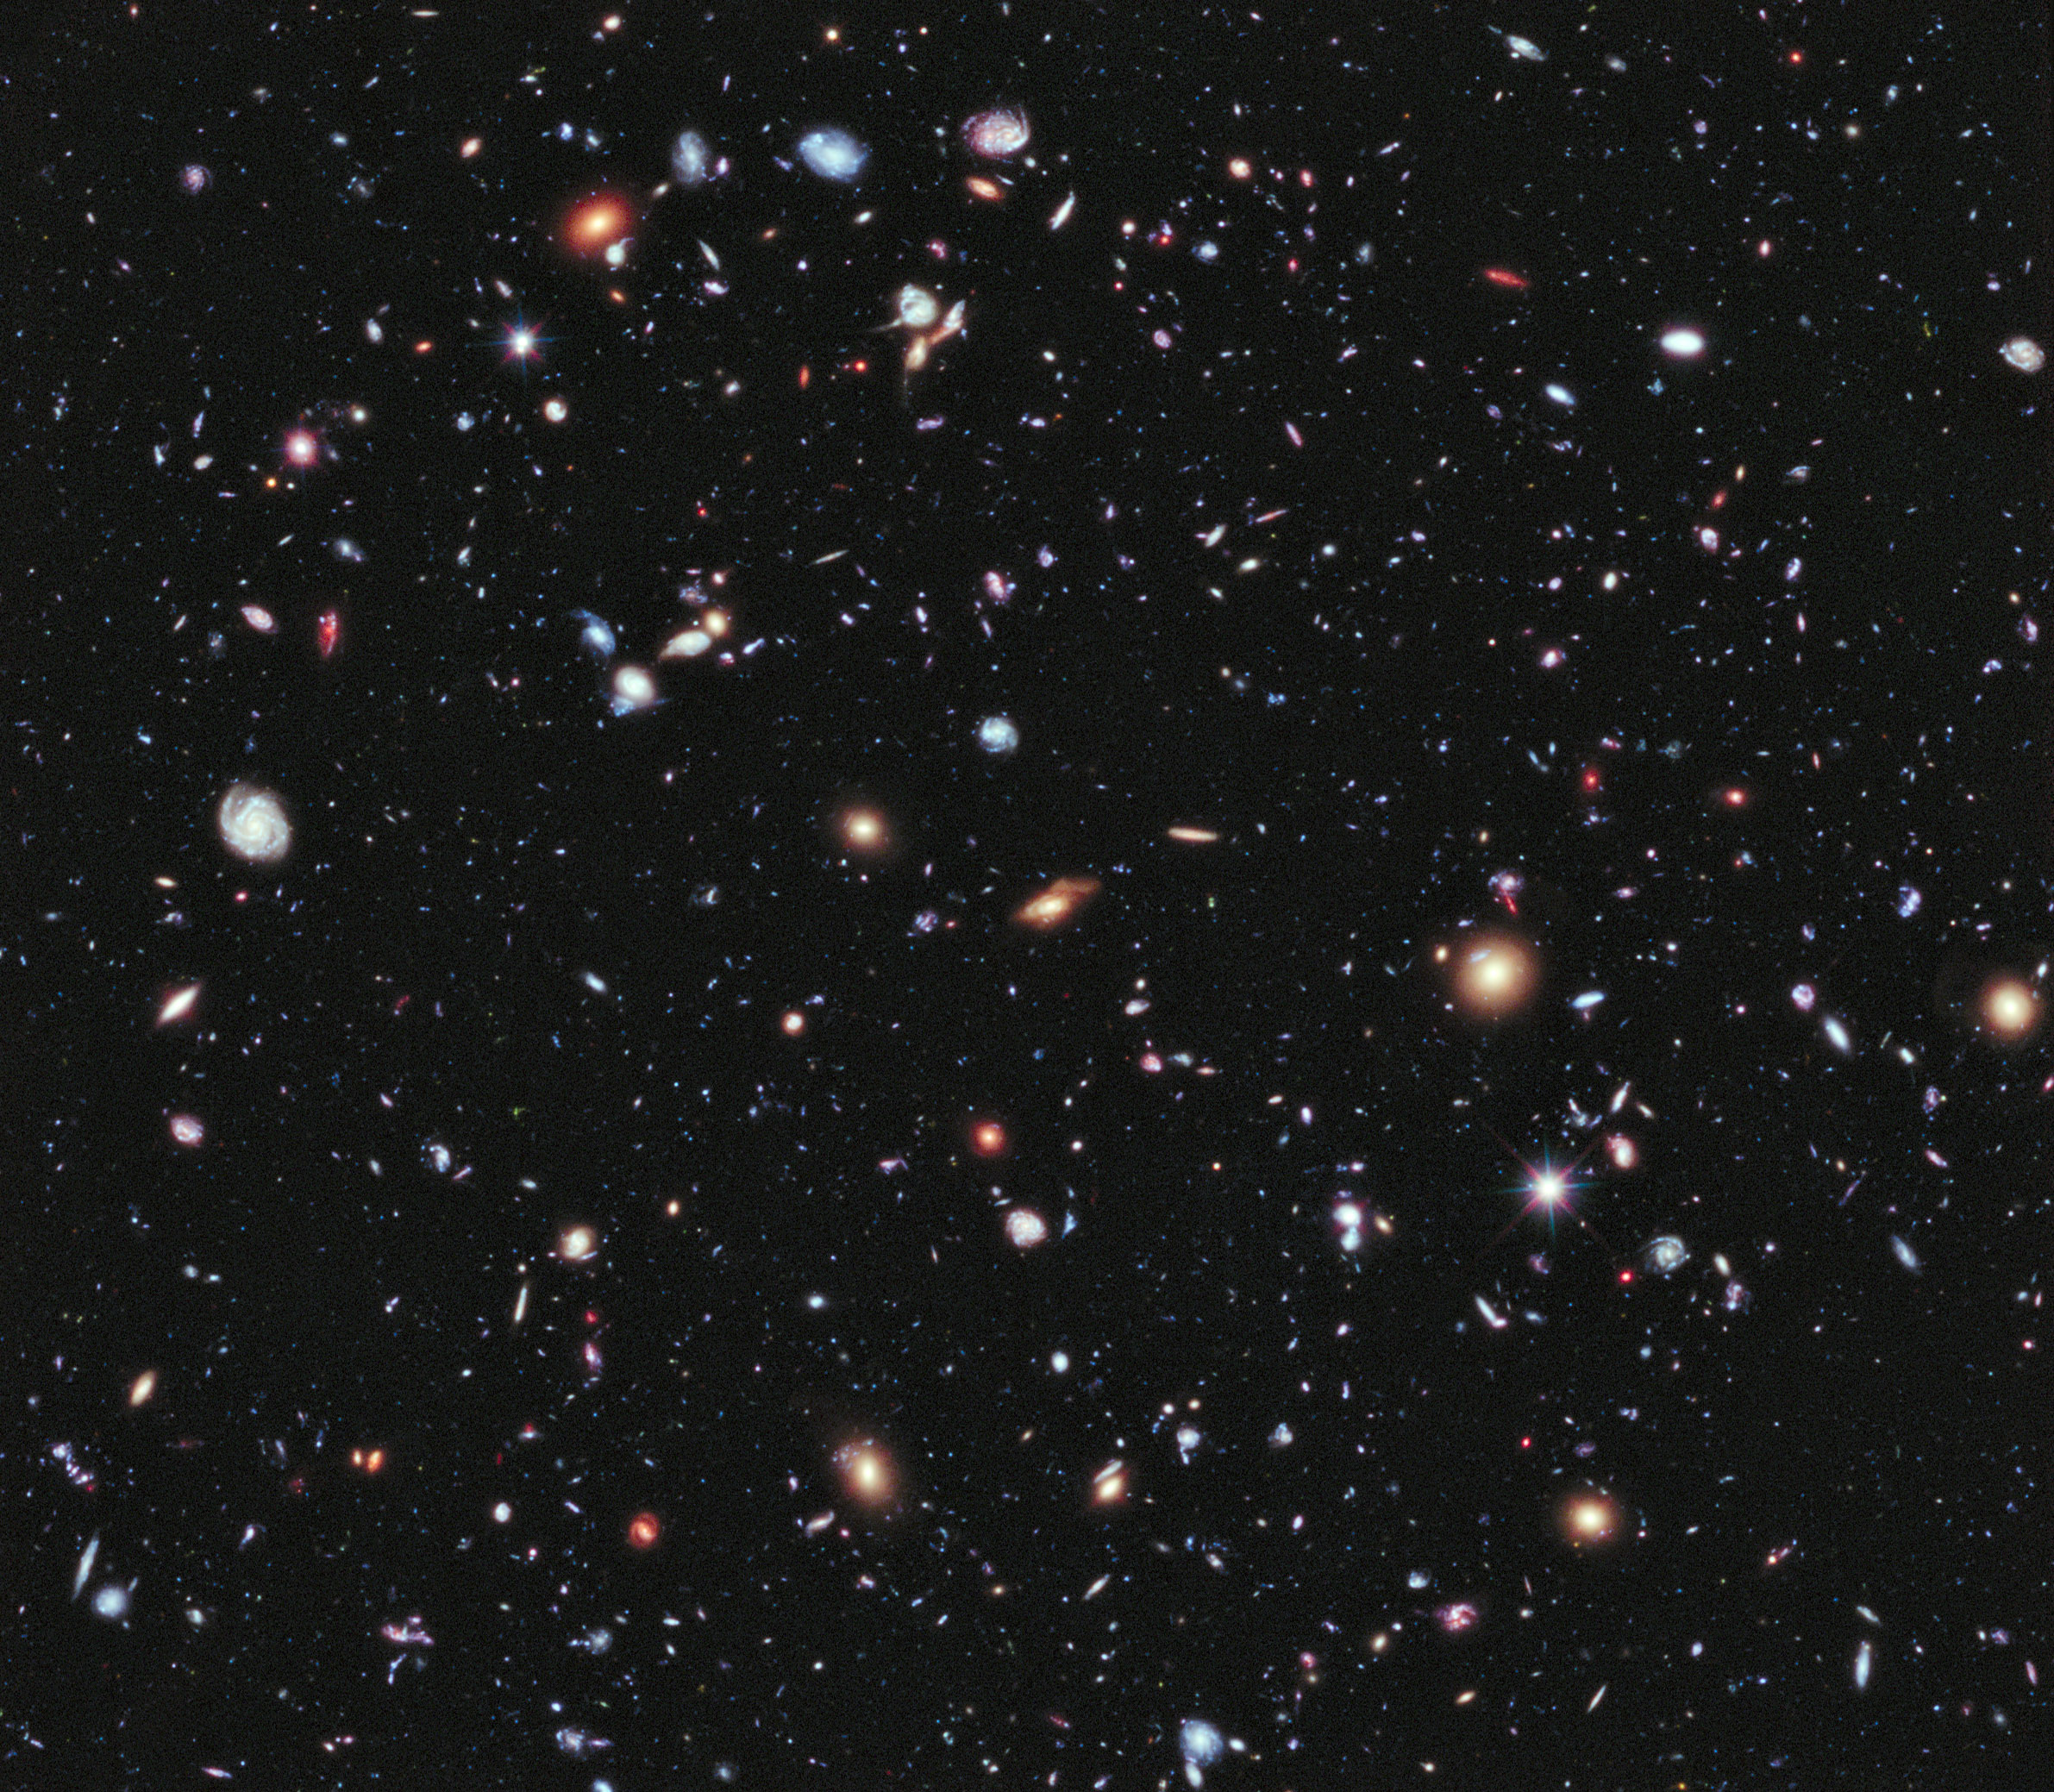
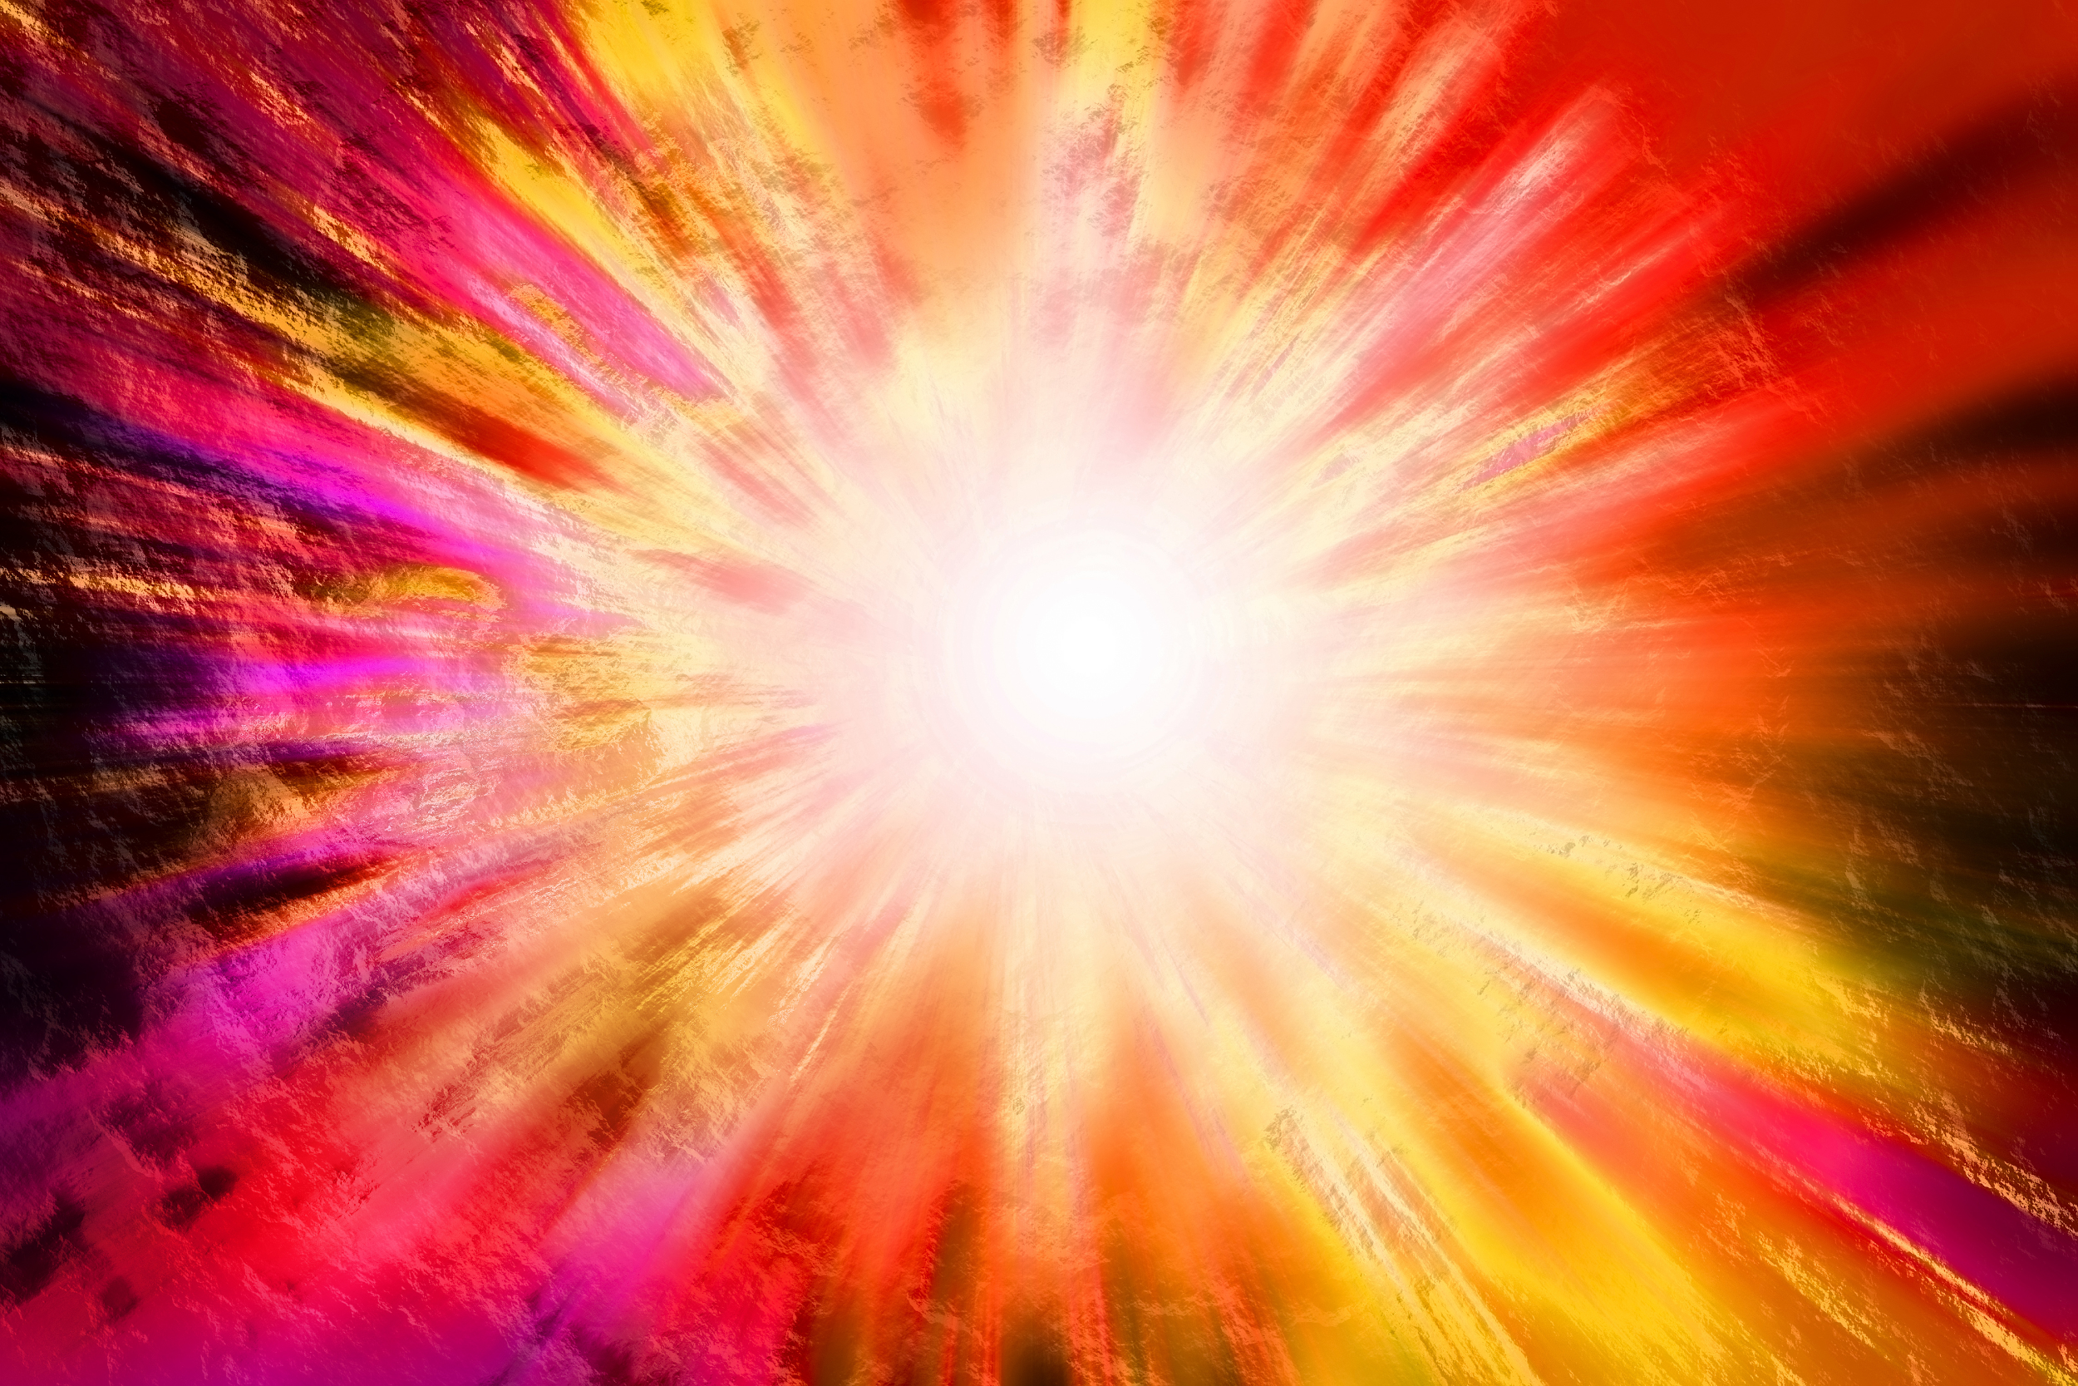
The Big Bang

Slide 10
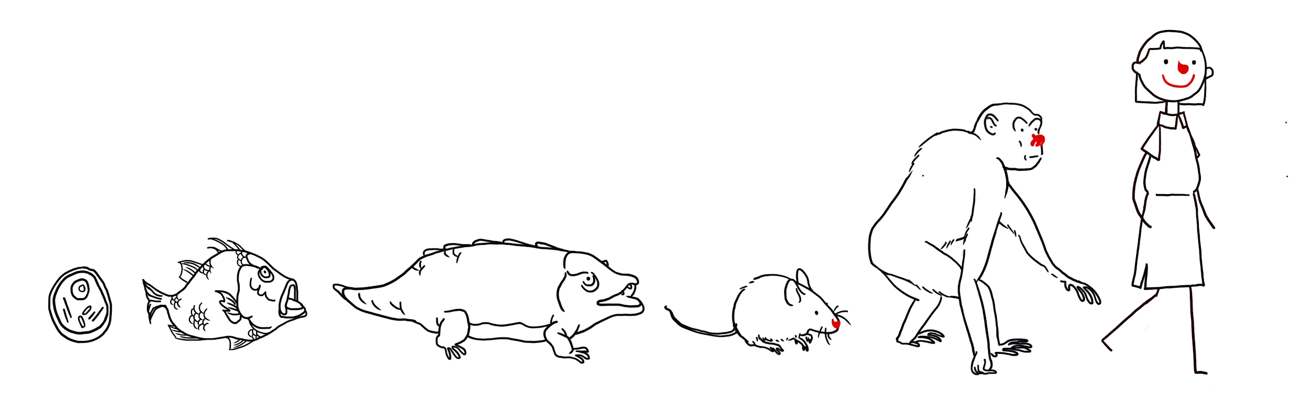
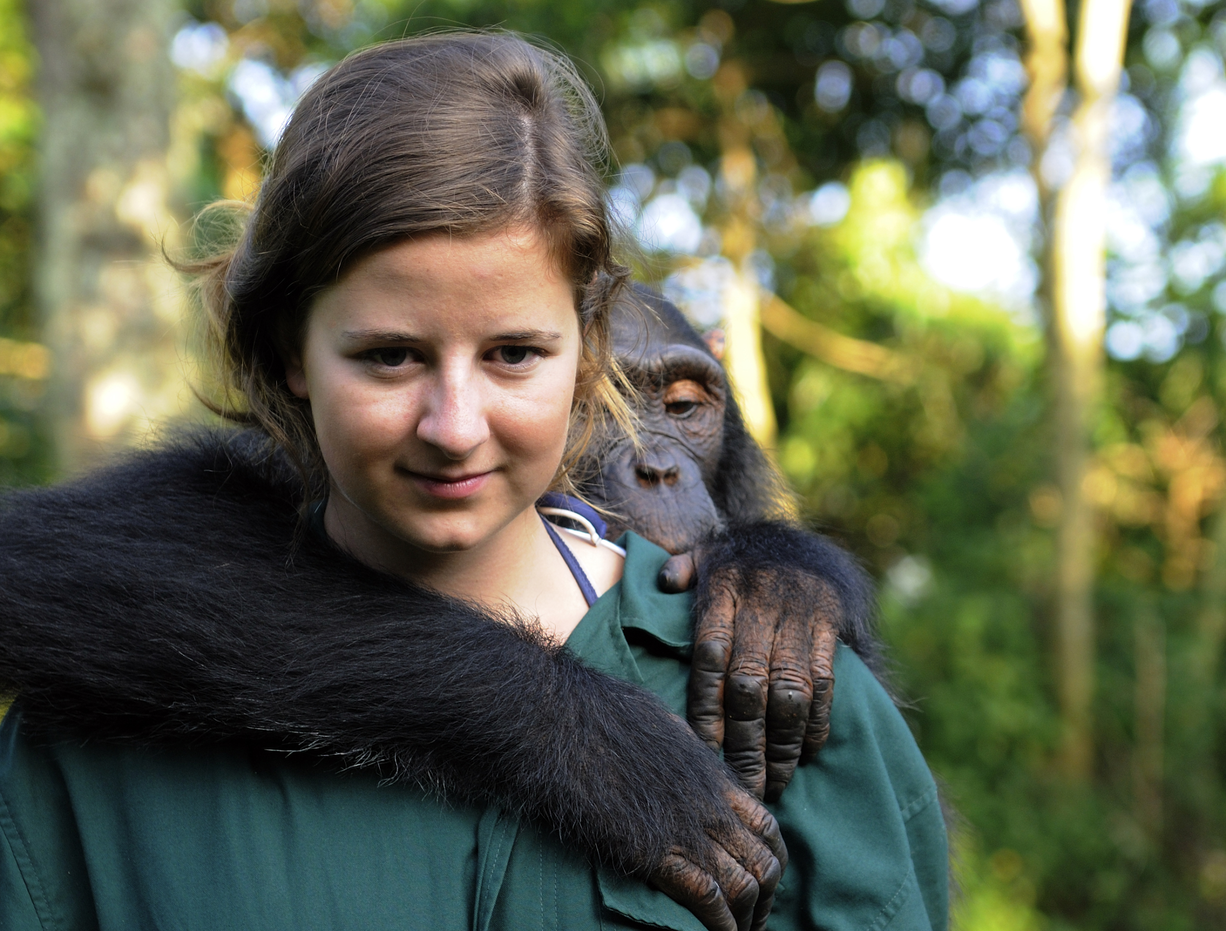
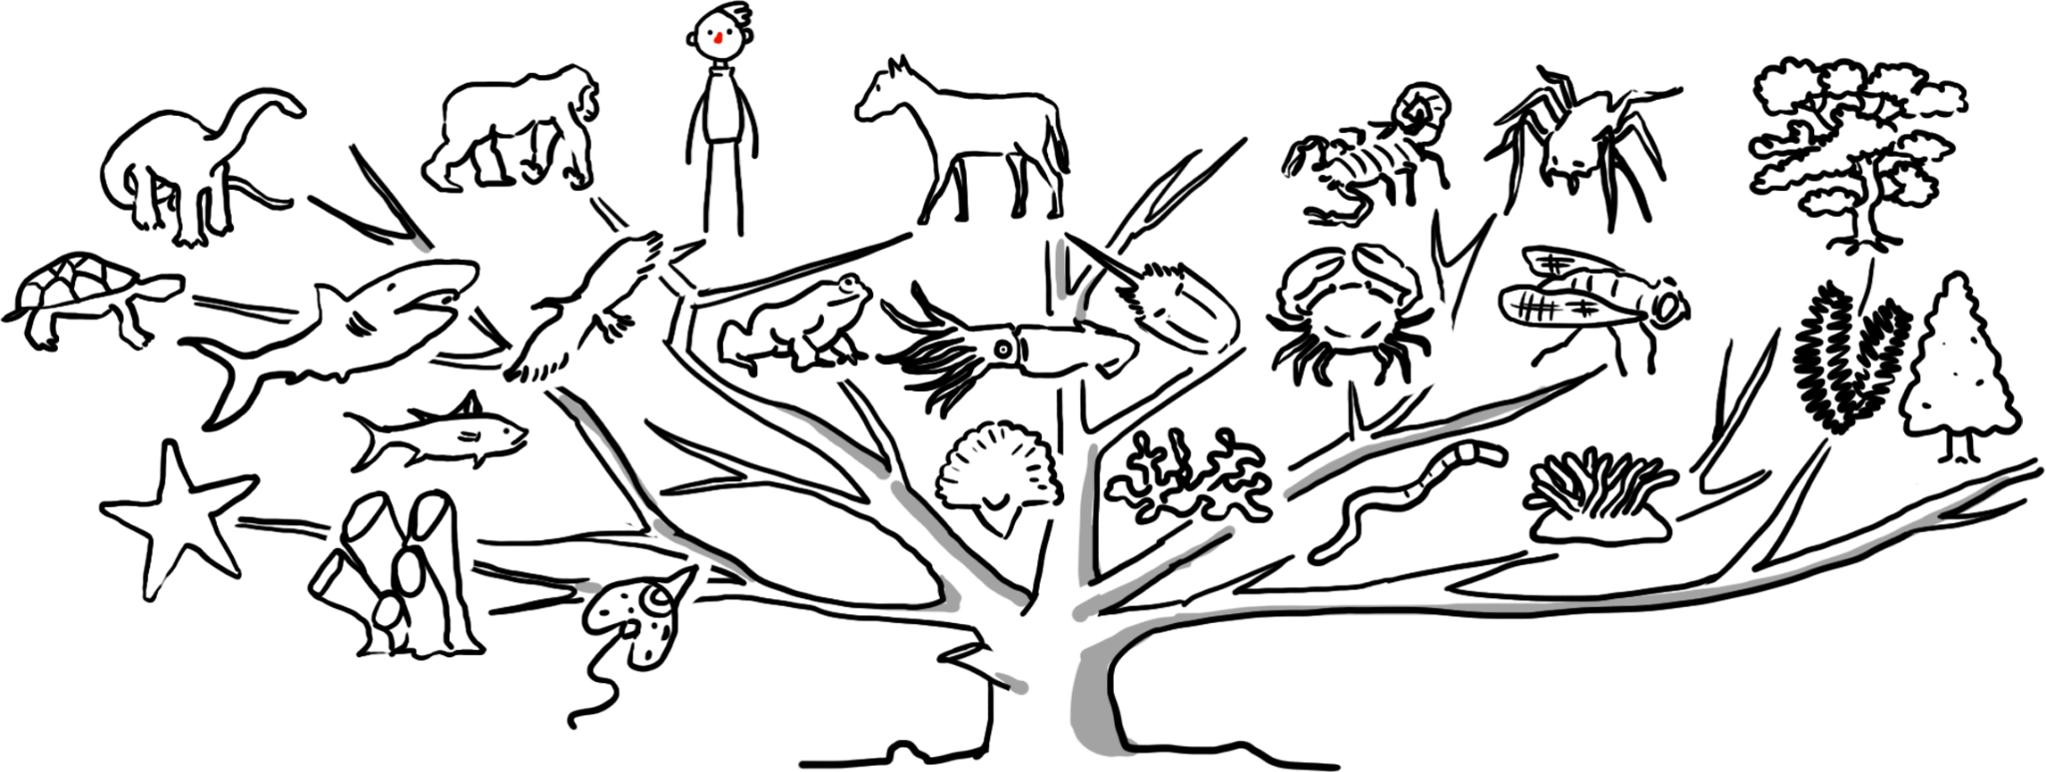
Evolution

Slide 11
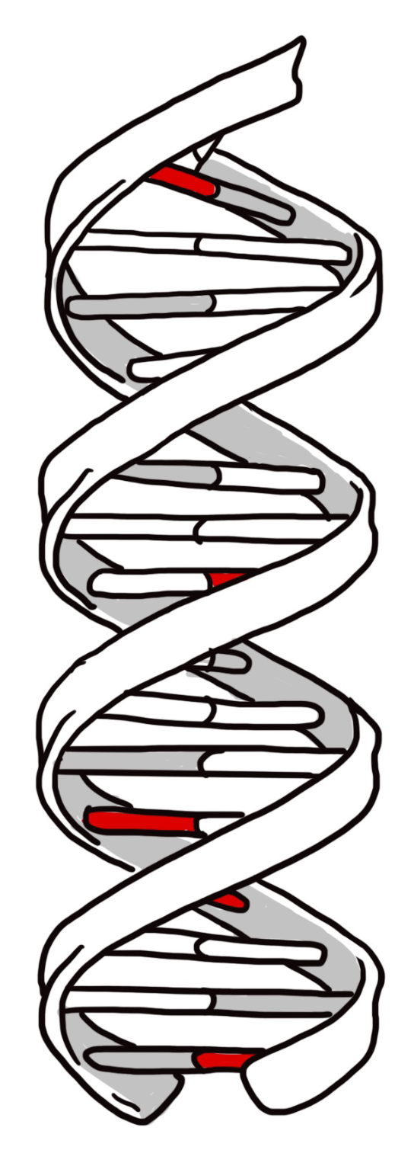
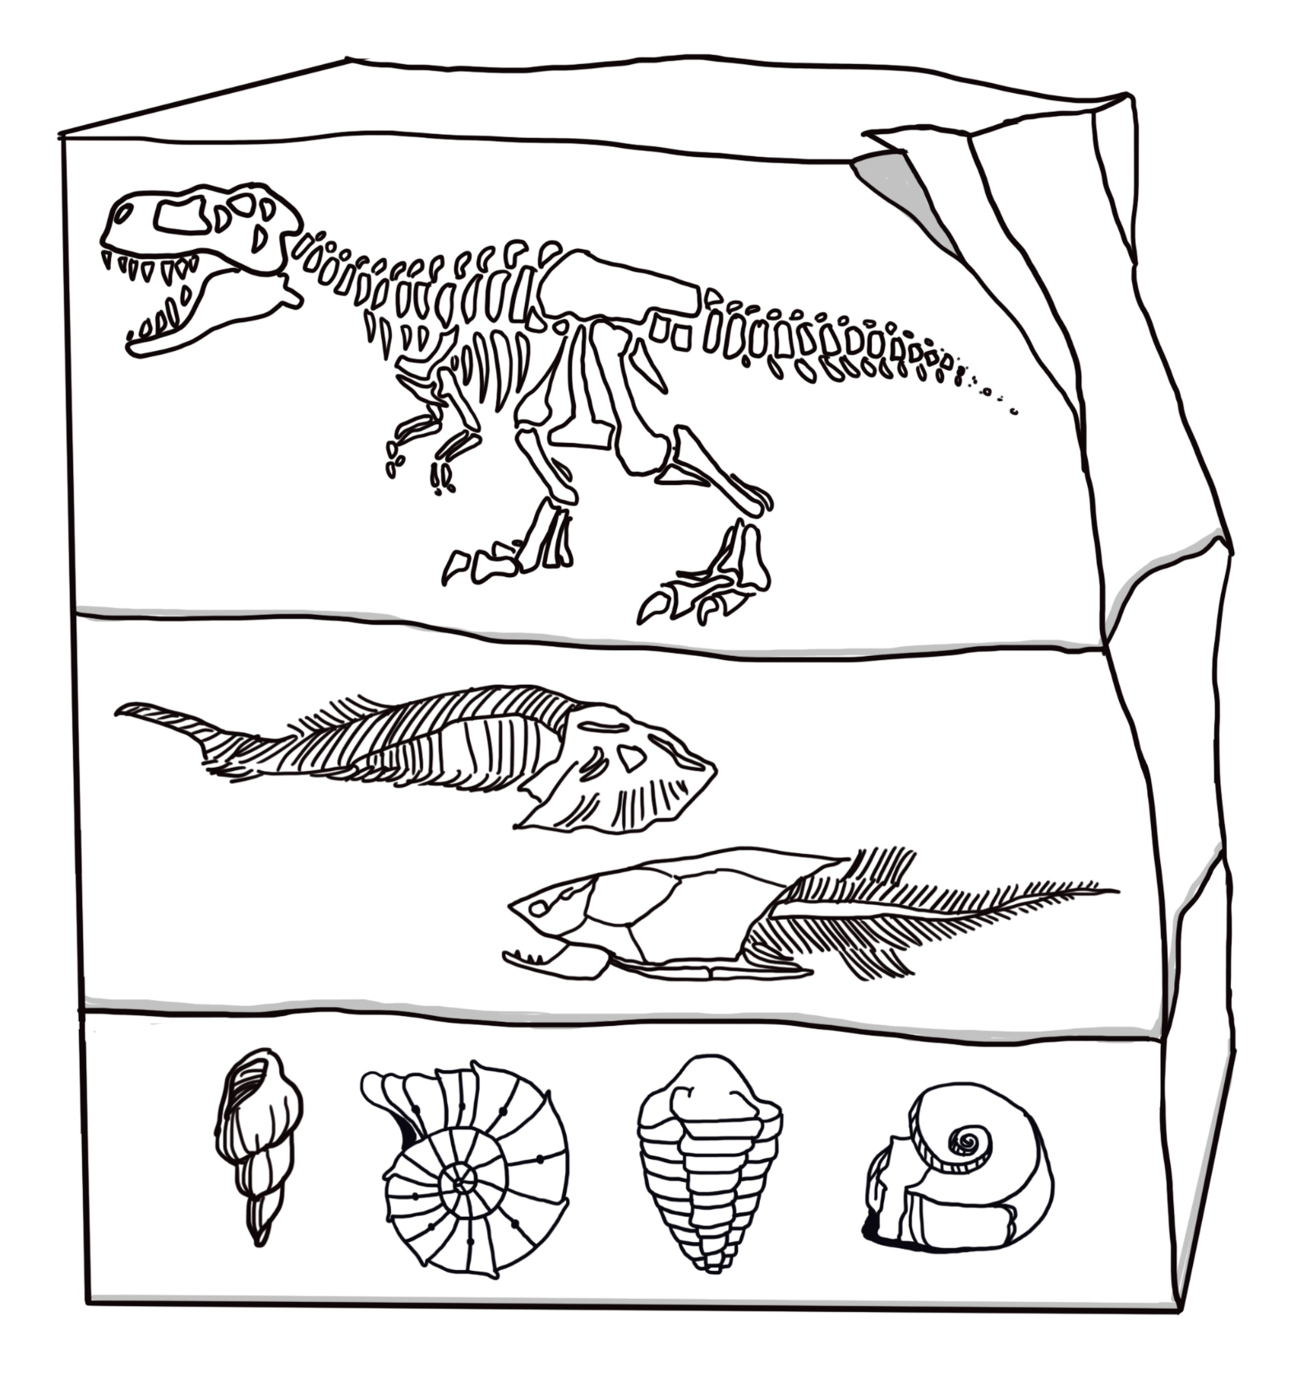
Evidence for evolution

Slide 12
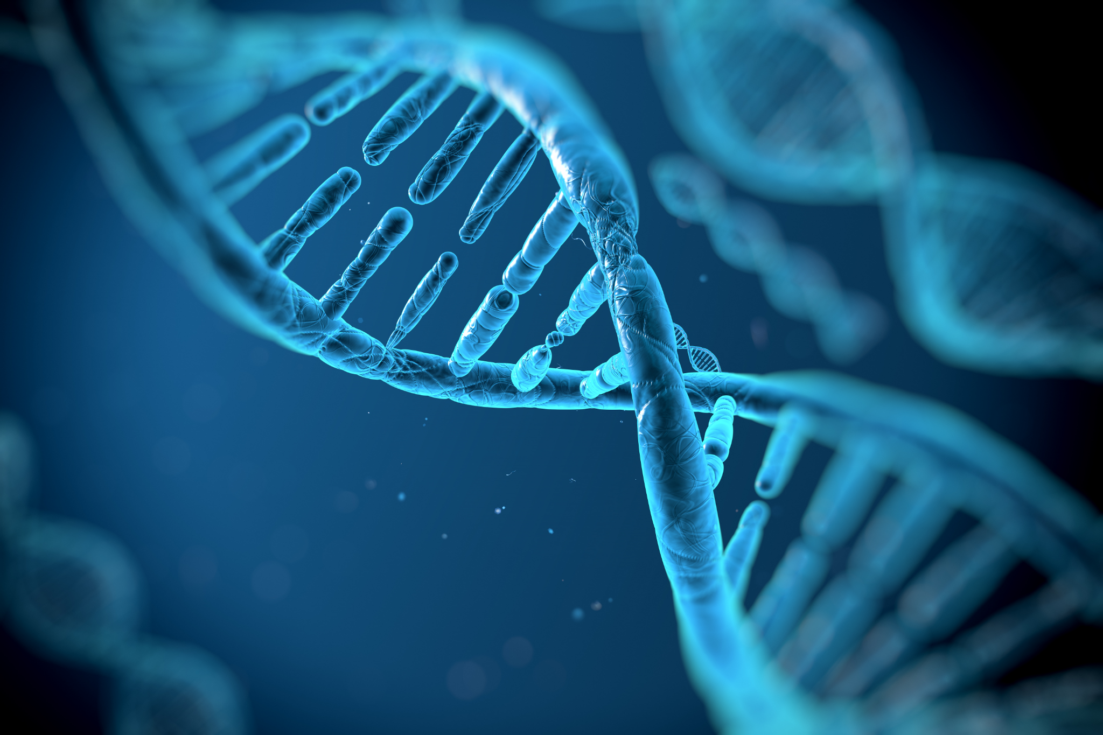

Slide 13
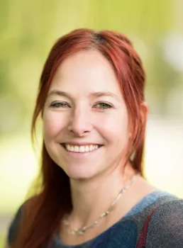
Evolution
‘We’re not the pinnacle of evolution. Instead, we are connected with all other species; part of the huge, copiously branching tree of life. As conscious beings, we must surely endeavour to look after each other – and the planet.’
Alice Roberts, President of Humanists UK

Slide 14
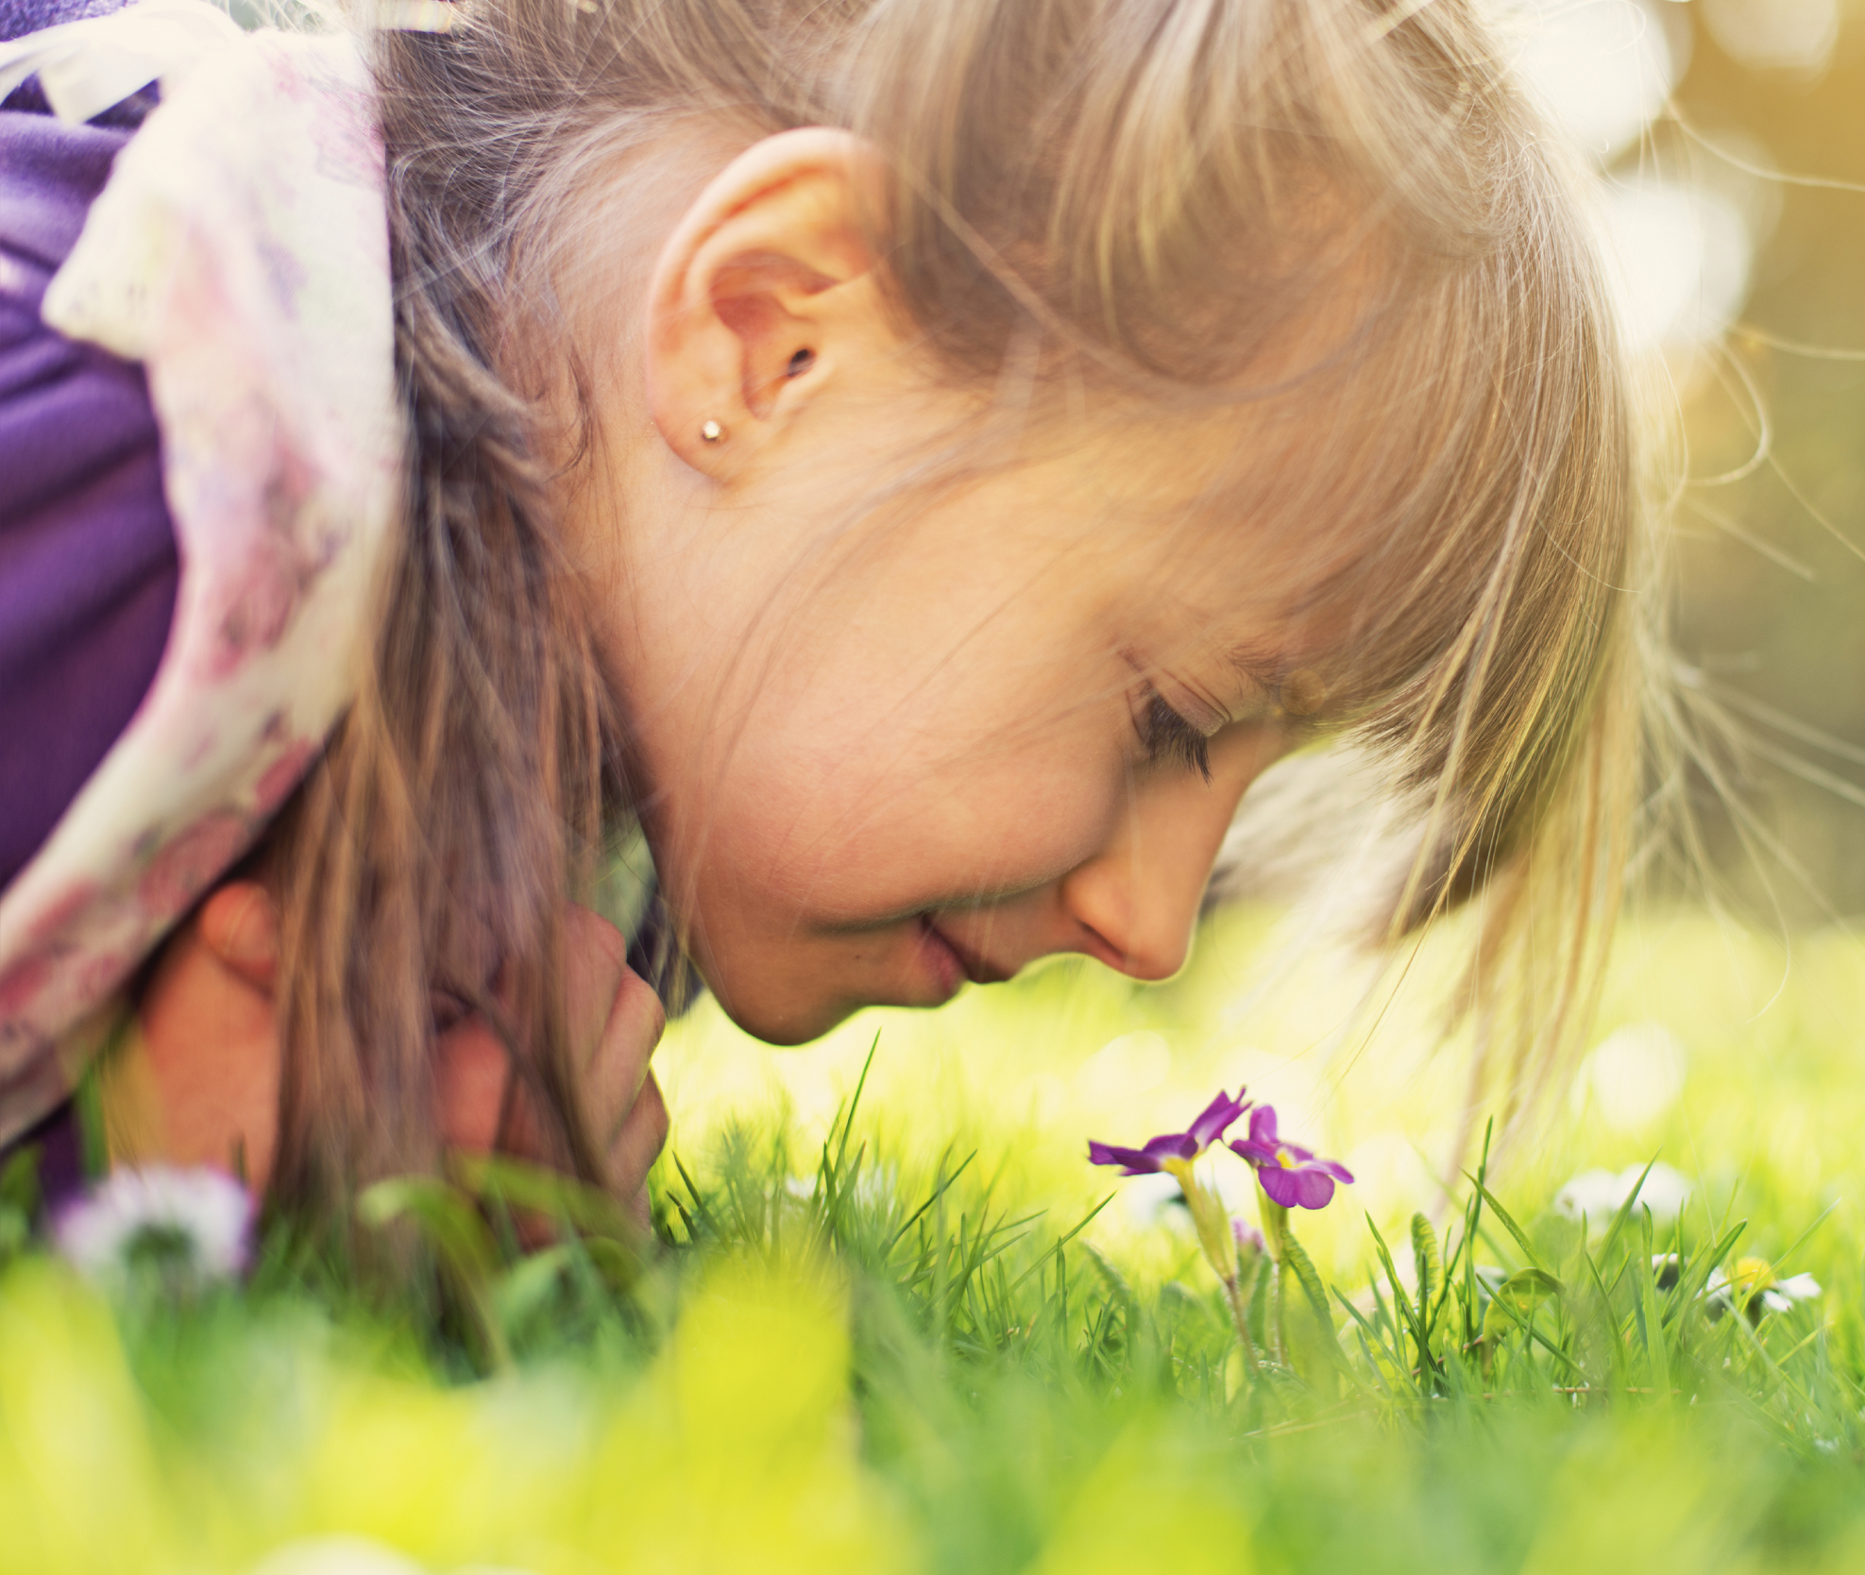
Human beings
We are made from the same materials as everything else in the universe

Slide 15
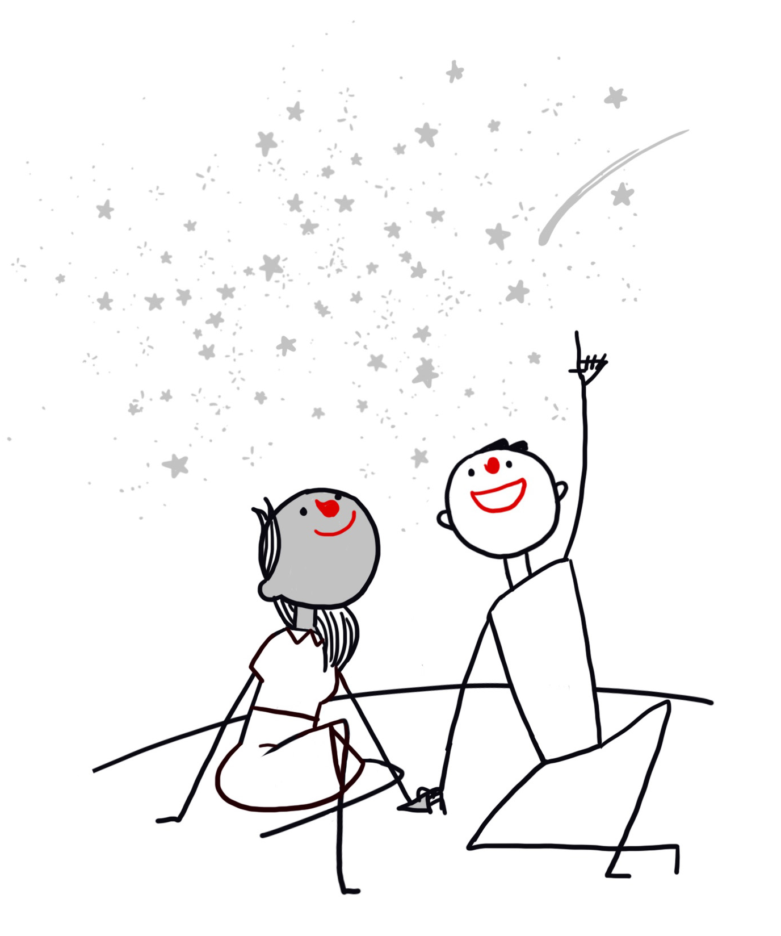
Humanists find wonder in the scientific story
‘Learning about the nature of space and time or the structure of atoms fills me with awe and wonder. It makes me want to learn more.’
Jim al-Khalili, scientist and Vice-president of Humanists UK
‘Our entire bodies and brains are made of a few dollars’ worth of common elements.... Assemble them all in the right proportion... and the result is our feeling, thinking, striving, imagining, creative selves. Such ordinary elements; such extraordinary results!’
James Hemming, President of Humanists UK (1977-1980)
‘The calcium in our teeth, the iron in our blood, the carbon in our apple pies were made in the interiors of collapsing stars. We are made of starstuff.’
Carl Sagan, astronomer

Slide 16
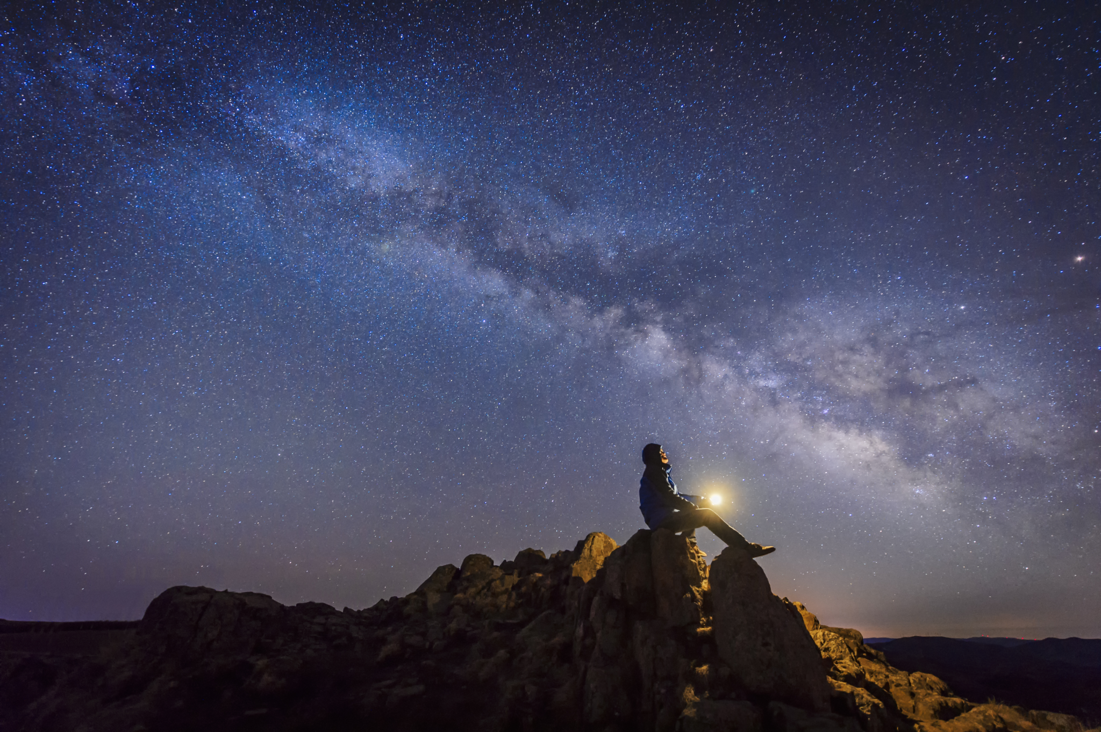

Slide 17
Human being: good and bad
What is positive and negative about human beings?
What positive and negative things have human beings achieved?

Slide 18

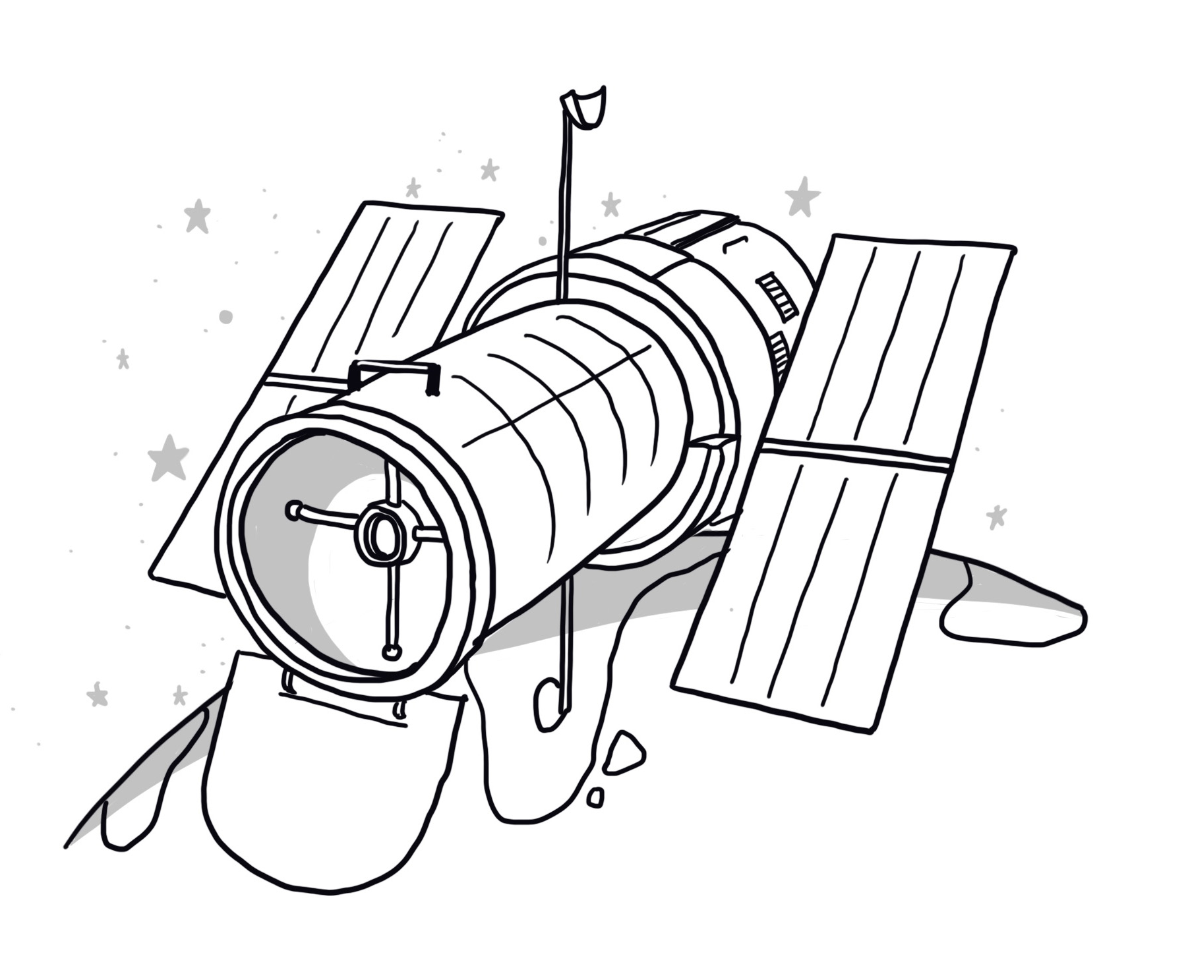
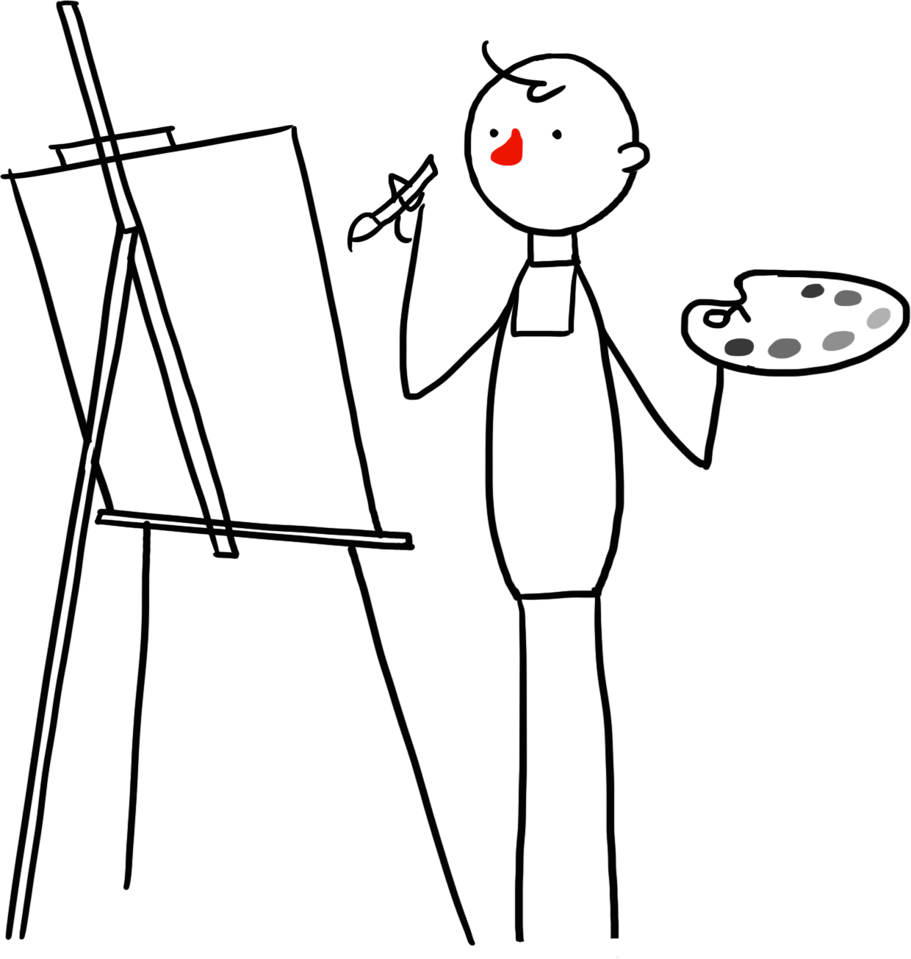

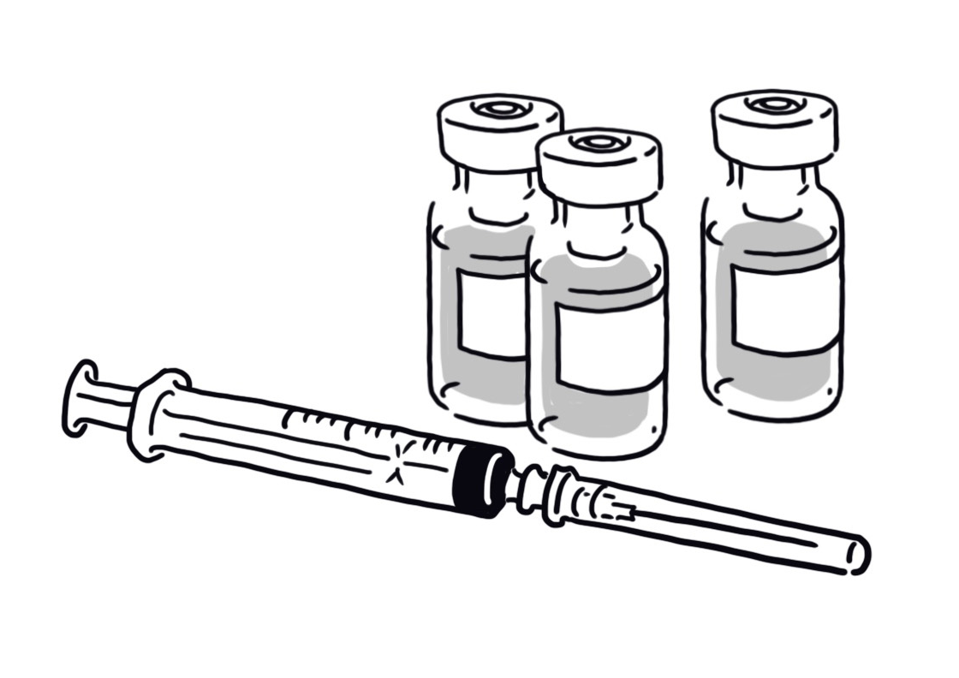
The humanist understanding of human beings
We have both positive and negative capacities
All these capacities are natural
We have a responsibility to think about how we can make the best use of our capacities
We should make the most of our potential to try to make the world a better place

Slide 19
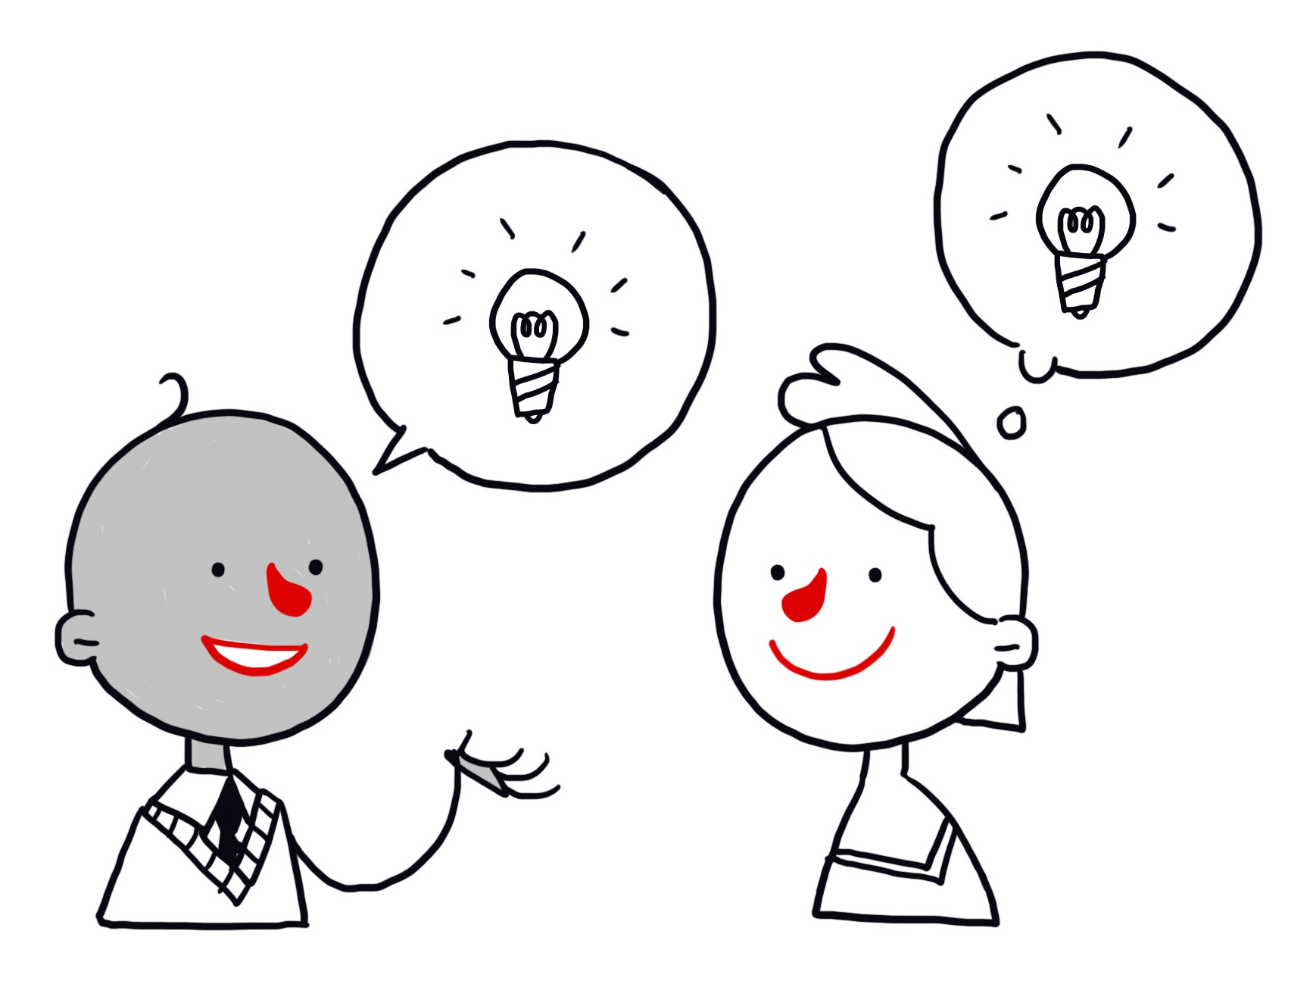
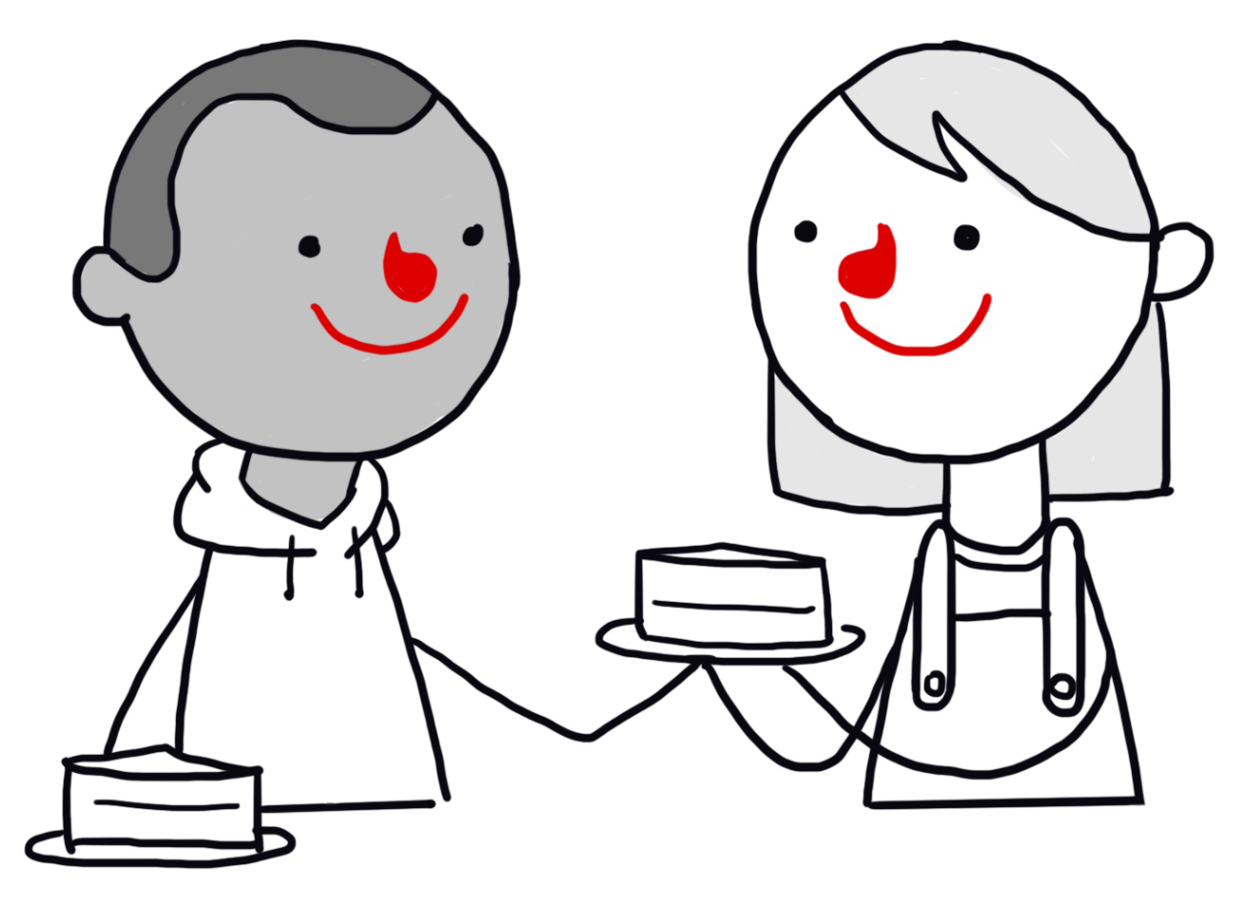
Our positive capacities
We can ask and answer questions about the world.
We can be creative and we can imagine how things could be different.
We are capable of empathy, kindness, friendship, and love.
We can use language to communicate with each other, and can share our ideas, knowledge, and experiences.
We can plan for the future and reflect on our choices.
We can be happy.
Humanist believe all these have evolved naturally

Slide 20
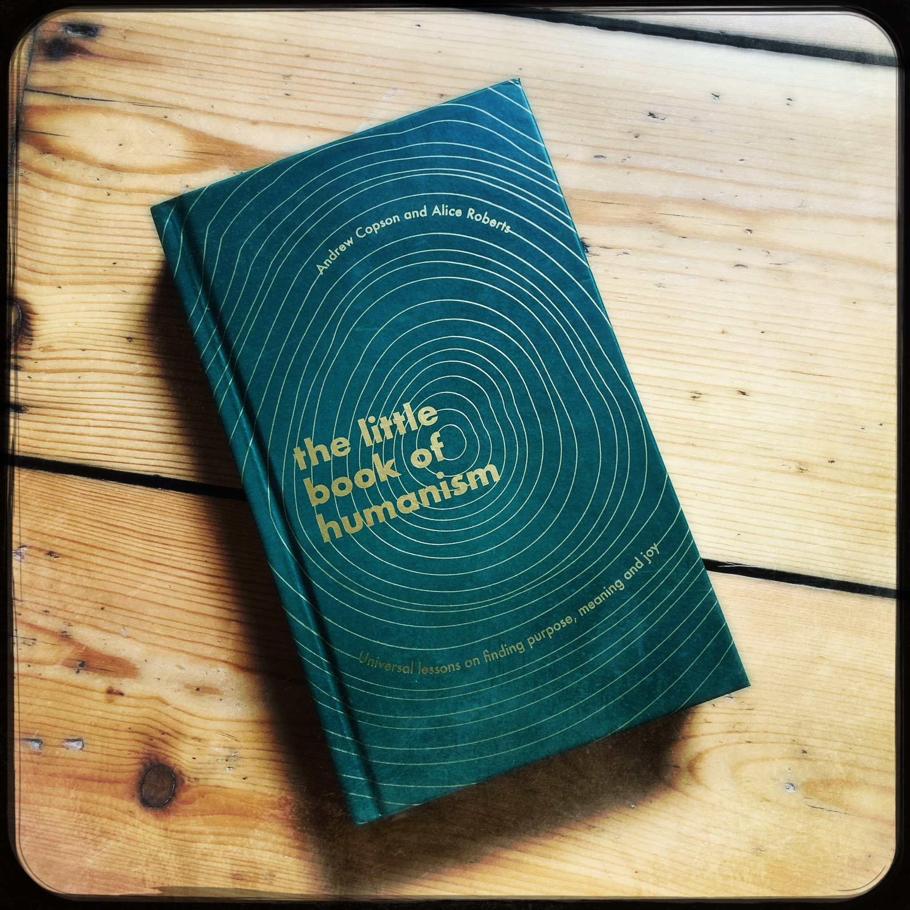
Human potential
‘You are related to every other animal on the planet, but you are different from other animals. You don’t just move through your life with events happening to you. You experience those events. You can look back at them, think about them, and in your mind you give them meaning. You can look forward and think about your future. You can make plans. And you can choose to live this one life well.’
from the Little Book of Humanism

Slide 21
Human beings
Create an image of a human being that…
Illustrates both sides of our nature (good and bad)
Highlights the features a humanist might think we should celebrate and promote

Slide 22
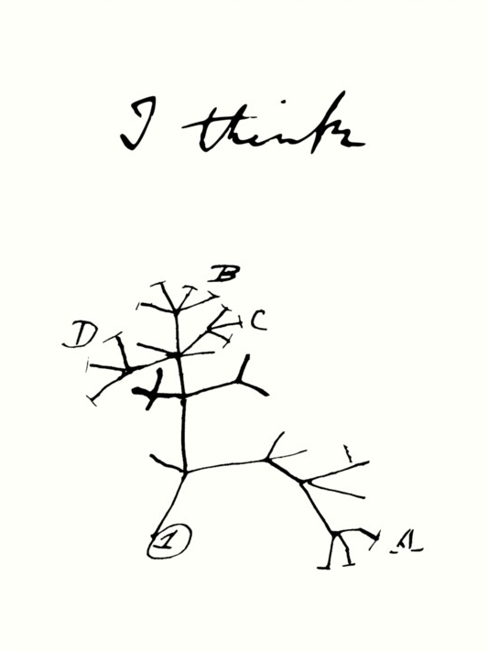
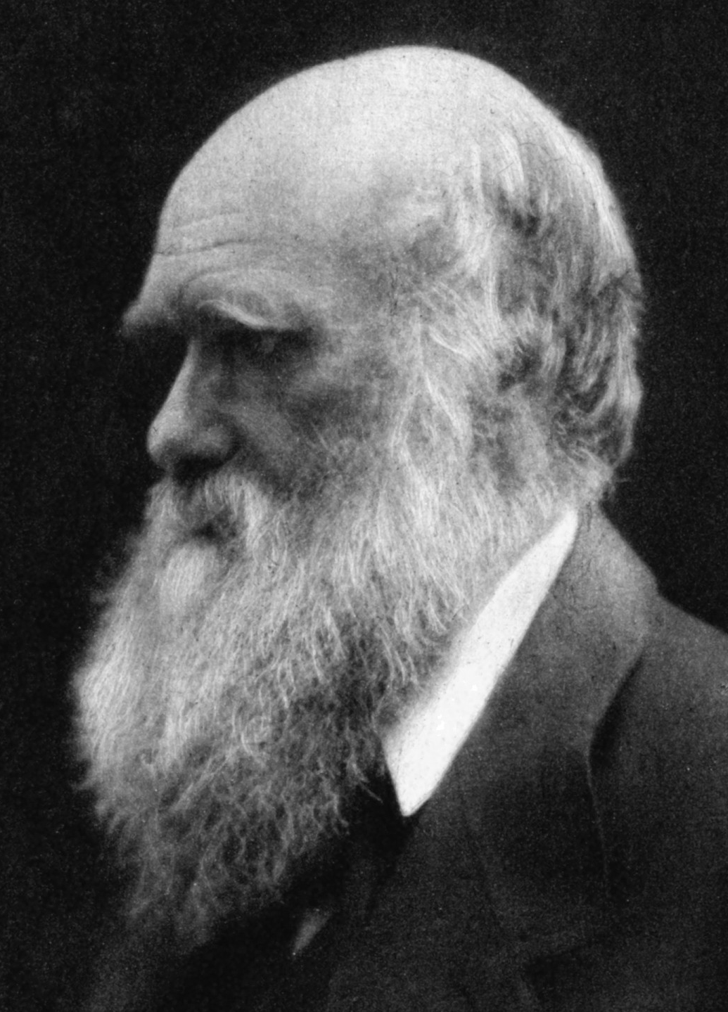
Charles Darwin

Slide 23
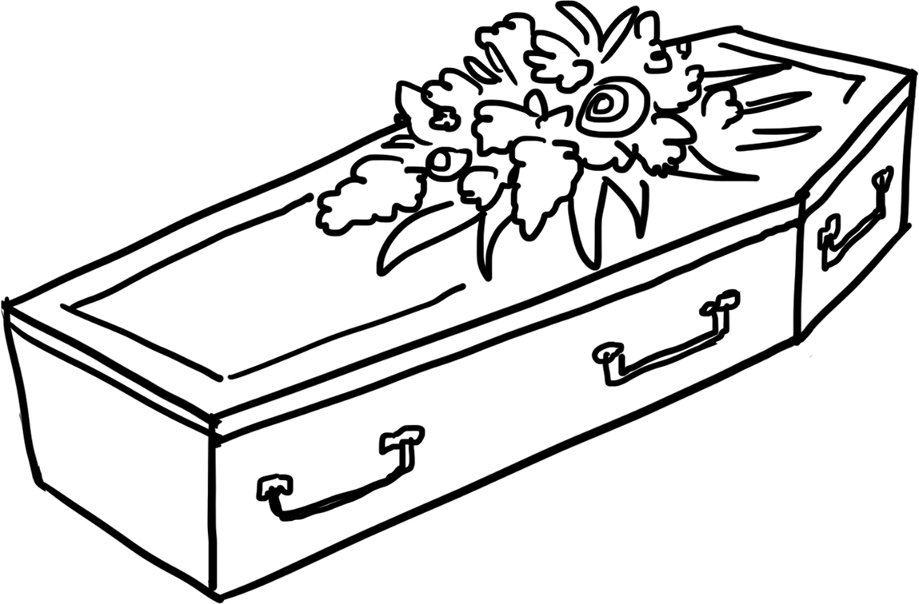
Mortality
Humanists believe this is the one life we have.
They see no good or persuasive reason or evidence to believe we live on after our physical death.

Slide 24
Human beings: humanist responses
How might a humanist respond to these statements?
Human beings can do so many amazing things that we must have been created with a special purpose.
Science hasn’t answered all our questions about where we come from, so we need to turn to religion to explain our origins.
Human beings are nothing but trouble. We have only made things worse and will continue to do so in the future.

Slide 25
A humanist understanding of human beings
Science can give us natural explanations for our origins
Human beings evolved positive and negative qualities
Human beings can help to make the world a better place

Slide 26
Additional quotes

Slide 27
A humanist understanding of human beings
‘We, as humans, have the power to make good choices, to lead a good life, to create a better society – and look after our planet, too. Humanists think that hope for a better future lies with the choices we make, and that our own human capacities for reason, love and empathy and moral sense can make us better people.’
Alice Roberts, President of Humanists UK

Slide 28
A humanist understanding of human beings
‘We do have special abilities that mean we have the power not only to understand but to transform the world around us. We can manipulate our environment in ways and to a degree that no other animal can or has been able to do. We have the capacity to make tools and machines that help us to obtain food, to travel vast distances, and to survive harsh environments. We have developed the ability to combat disease and to produce amazing architecture as well as great art and music. We are capable of all these things – but also of searing acts of destruction that place us and millions of other species at risk. Our conscious appreciation of who we are and where we’ve come from brings with it a huge responsibility. We are not just like every other animal: we are both incredibly powerful and aware of our impact.’
Alice Roberts, President of Humanists UK

Slide 29
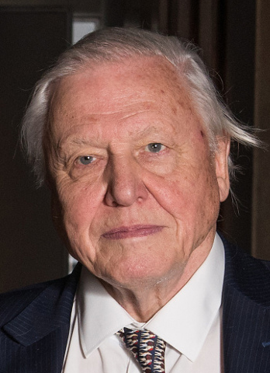
A humanist understanding of human beings
‘Although denying that we have a special position in the natural world might seem becomingly modest in the eye of eternity, it might also be used as an excuse for evading our responsibilities. The fact is that no species has ever had such wholesale control over everything on earth, living or dead, as we now have. That lays upon us, whether we like it or not, an awesome responsibility. In our hands now lies not only our own future, but that of all other living creatures with whom we share the earth.’
David Attenborough, natural historian and broadcaster

Slide 30
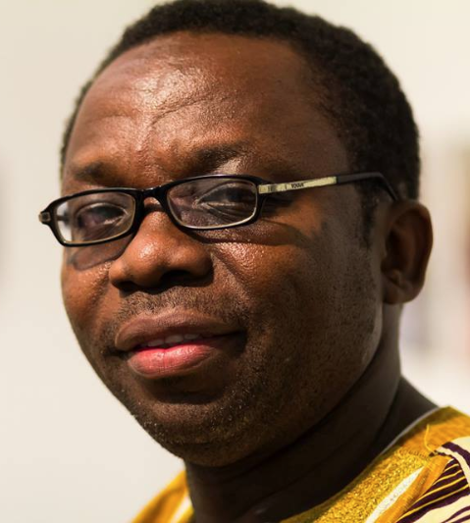
A humanist understanding of human beings
‘Our destinies are in our hands, not predetermined. And it's left for us to shape our lives and destinies to reflect our best hopes and aspirations. I believe that human beings have the power to turn situations of poverty into those of wealth and prosperity. We have the capacity to alleviate suffering, extend life, prevent diseases, cure debilitating ailments, reduce infant mortality, and preserve our planet… Human beings are creative beings. We have the power to generate new ideas, new solutions, and new cures. It is in our nature to create anew, to be inventive and innovative.’
Leo Igwe, founder of Nigerian Humanists

Slide 31
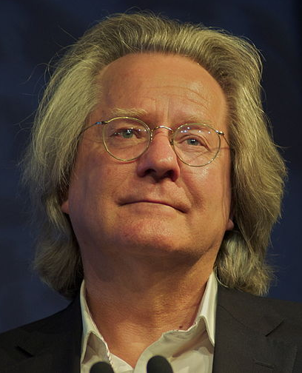
A humanist understanding of human beings
‘[Humanism] is an attitude towards the task of thinking about how to live a life worth living… do this thinking on the basis of the best, most sympathetic, most generous and realistic understanding of human nature and the human condition that we can muster.’
AC Grayling, Handbook of Humanism

Slide 32
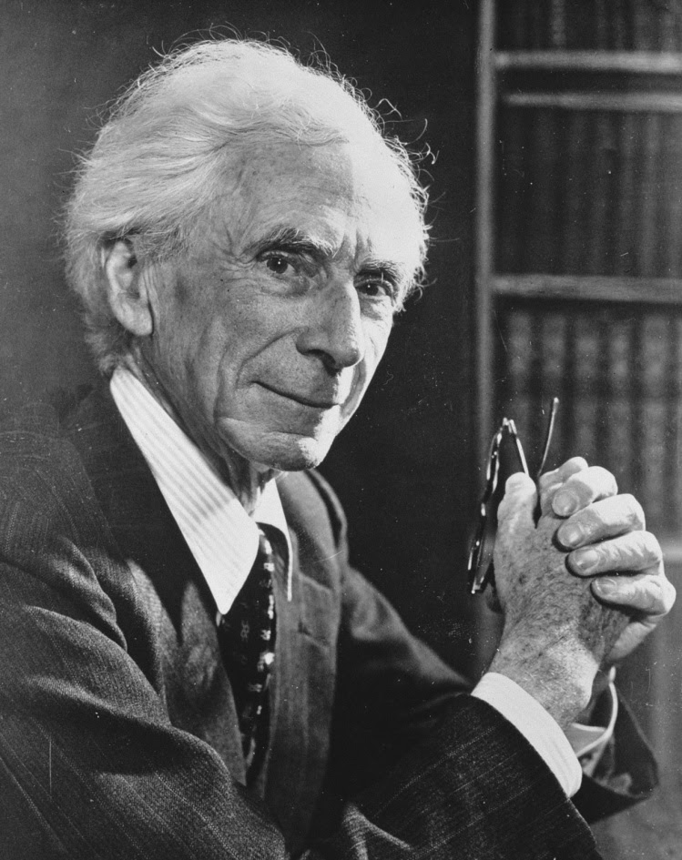
Reflecting on our position
‘We want to stand upon our own feet and look fair and square at the world – its good facts, its bad facts, its beauties, and its ugliness; see the world as it is, and not be afraid of it.’
Bertrand Russell, humanist philosopher

