Slide 1
WHAT IS HUMANISM?
Human nature, human potential

Slide 2
Humanism

Slide 3
Humanism

Slide 4
THE HAPPY HUMAN

Slide 5
HUMANISM
Optimism
Reason
Empathy
Agency
Natural

Slide 6
HUMANISM
Action
Thinking
Kindness
Freedom
Natural

Slide 7
HUMANISM
Working for a better world
Thinking clearly
Being kind
Making choices
Recognising our natural origins

Slide 8
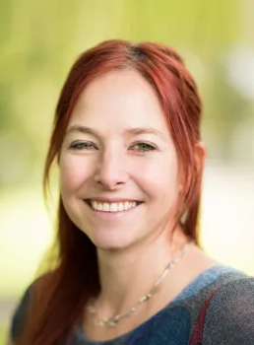
Natural
‘We are part of this natural universe and this natural world. We are part of the story of life on this planet. We can feel a real sense of belonging and connectedness in this story, and also a humility in the face of all the contingencies and chances that led to the survival of our species.’
Alice Roberts, anatomist
and Vice-president of Humanists UK

Slide 9
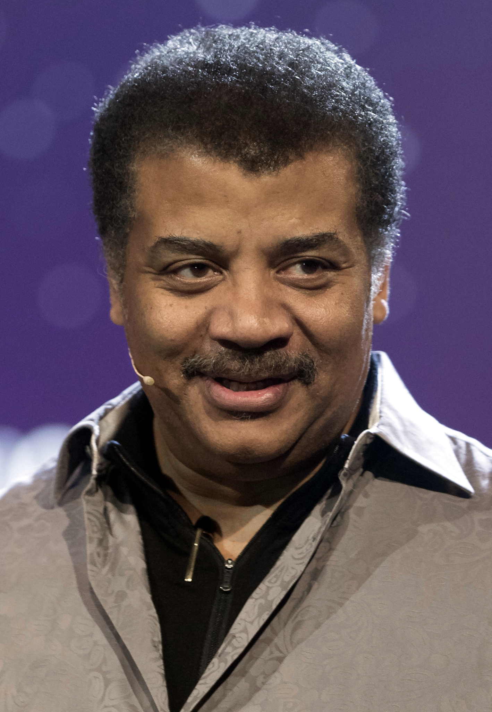
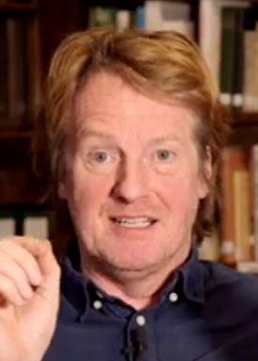
Reason
‘The scientific method… can be summarised in one sentence: Do whatever it takes to avoid fooling yourself into thinking something is true that is not.’
Neil Degrasse Tyson, astrophysicist
‘Beliefs can be reasonably held if they are supported by evidence…’
Stephen Law, philosopher

Slide 10
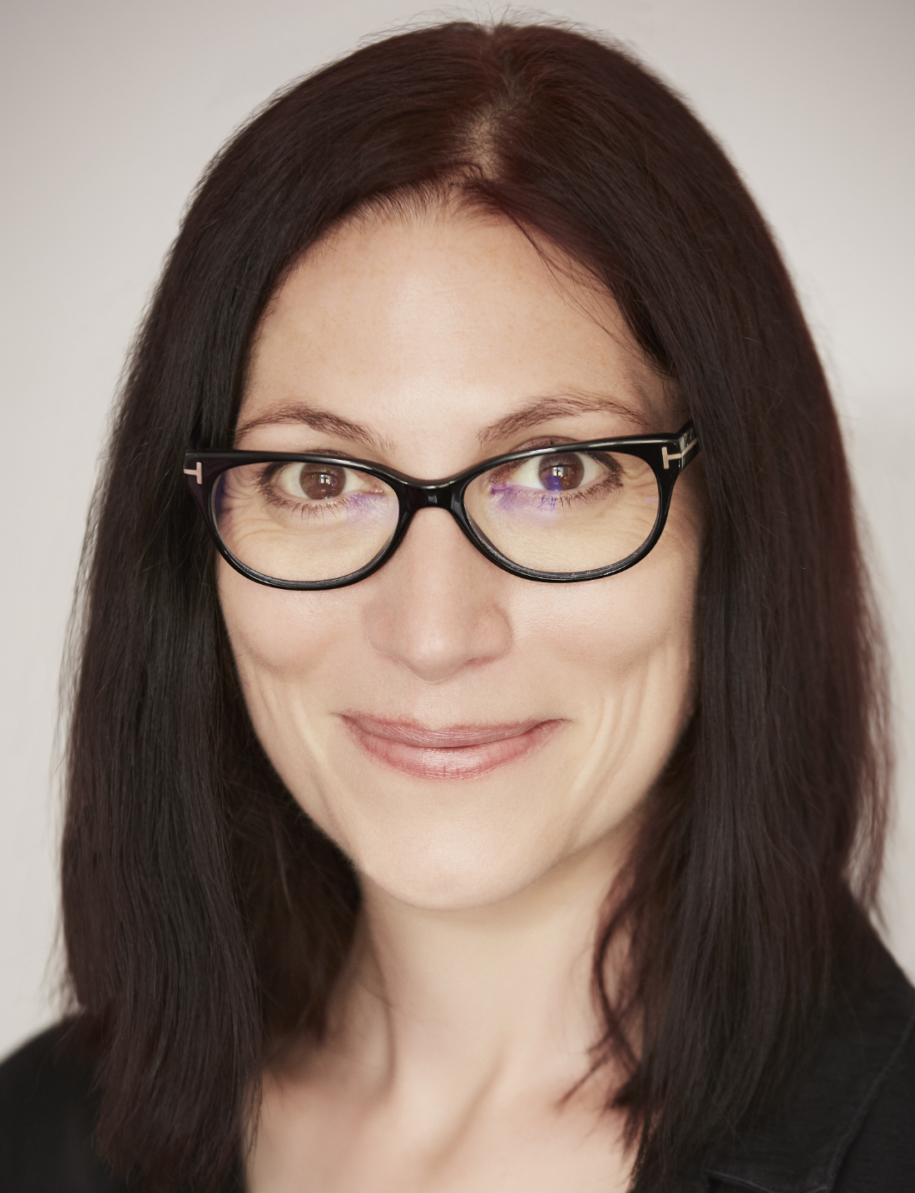
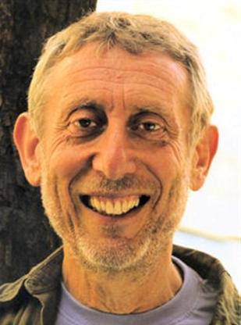
Empathy
‘Imagining yourself on the receiving end of your own behaviour is a good way to decide whether you’re doing what you think is right or wrong.’
Natalie Haynes, author and patron of Humanists UK
‘Empathy, compassion, and reason are essential elements in the development of human society, and these form the bases of humanist morality.’
Michael Rosen, co-author of What is humanism?

Slide 11
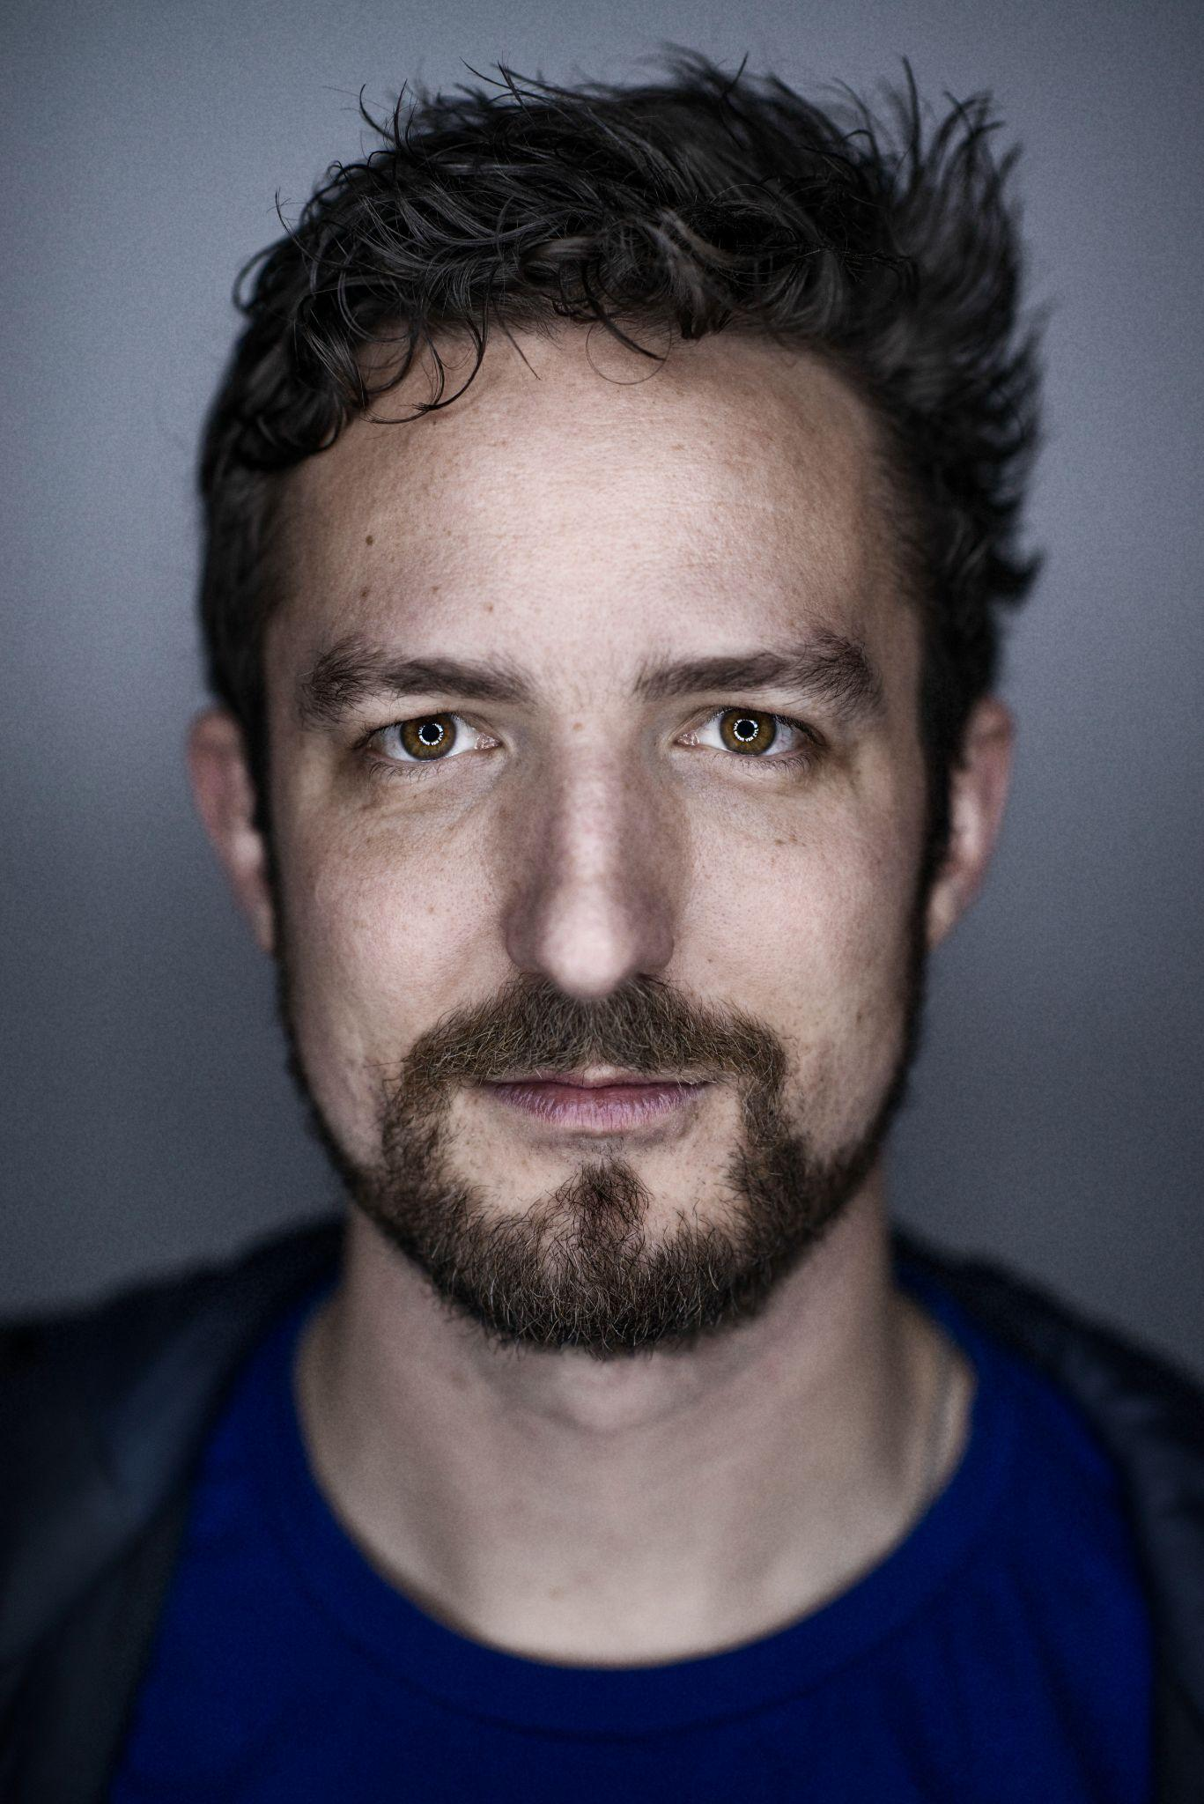
Agency
'If there’s no ultimate meaning of life, that doesn’t mean our existence needs to be meaningless; we can determine for ourselves what is meaningful.’
Lola Tinubu, Association of Black Humanists
‘As a humanist, I think there’s no inherent meaning to the universe… But that’s not the end of that statement or that conversation. We can create meaning and order and structure and beauty and art… It’s a declaration of autonomy. If we want to have beauty and structure and meaning in our lives then we have to provide it.’
Frank Turner, musician

Slide 12
Optimism and action
‘One of my humanist values, which has inspired me to work for human rights, is that when I leave the world, I want to leave it in a better shape. I don’t want the generations that would come after me to face the same kind of challenges that my generation has been facing.’
Gulalai Ismail, Pakistan, Ambassador for Humanists International
‘Humanism is a way of thinking and living that emphasizes the agency of human beings. Humanism stresses the fact that we, human beings, are capable of changing the world. That we have the power to make a difference in our lives, both individually and collectively, without recourse to some outside force.’
Leo Igwe, Nigeria, Founder of Humanist Association of Nigeria

Slide 13
Wonder at human nature
‘Our entire bodies and brains are made of a few dollars’ worth of common elements: oxygen, hydrogen, nitrogen, carbon, enough calcium to whitewash a chicken coop, sufficient iron to make a two‐inch nail, phosphorous to tip a good number of matches, enough sulphur to dust a flea‐plagued dog, together with modest amounts of potassium, chlorine, magnesium and sodium. Assemble them all in the right proportion, build the whole into an intricate interacting system, and the result is our feeling, thinking, striving, imagining, creative selves. Such ordinary elements; such extraordinary results!’
James Hemming (1909-2007), child psychologist
and president of Humanists UK 1977-1980

