Slide 1
Conway Hall in Action
Photos to accompany the Conway Hall virtual tour

Slide 2
Entrance

Slide 3
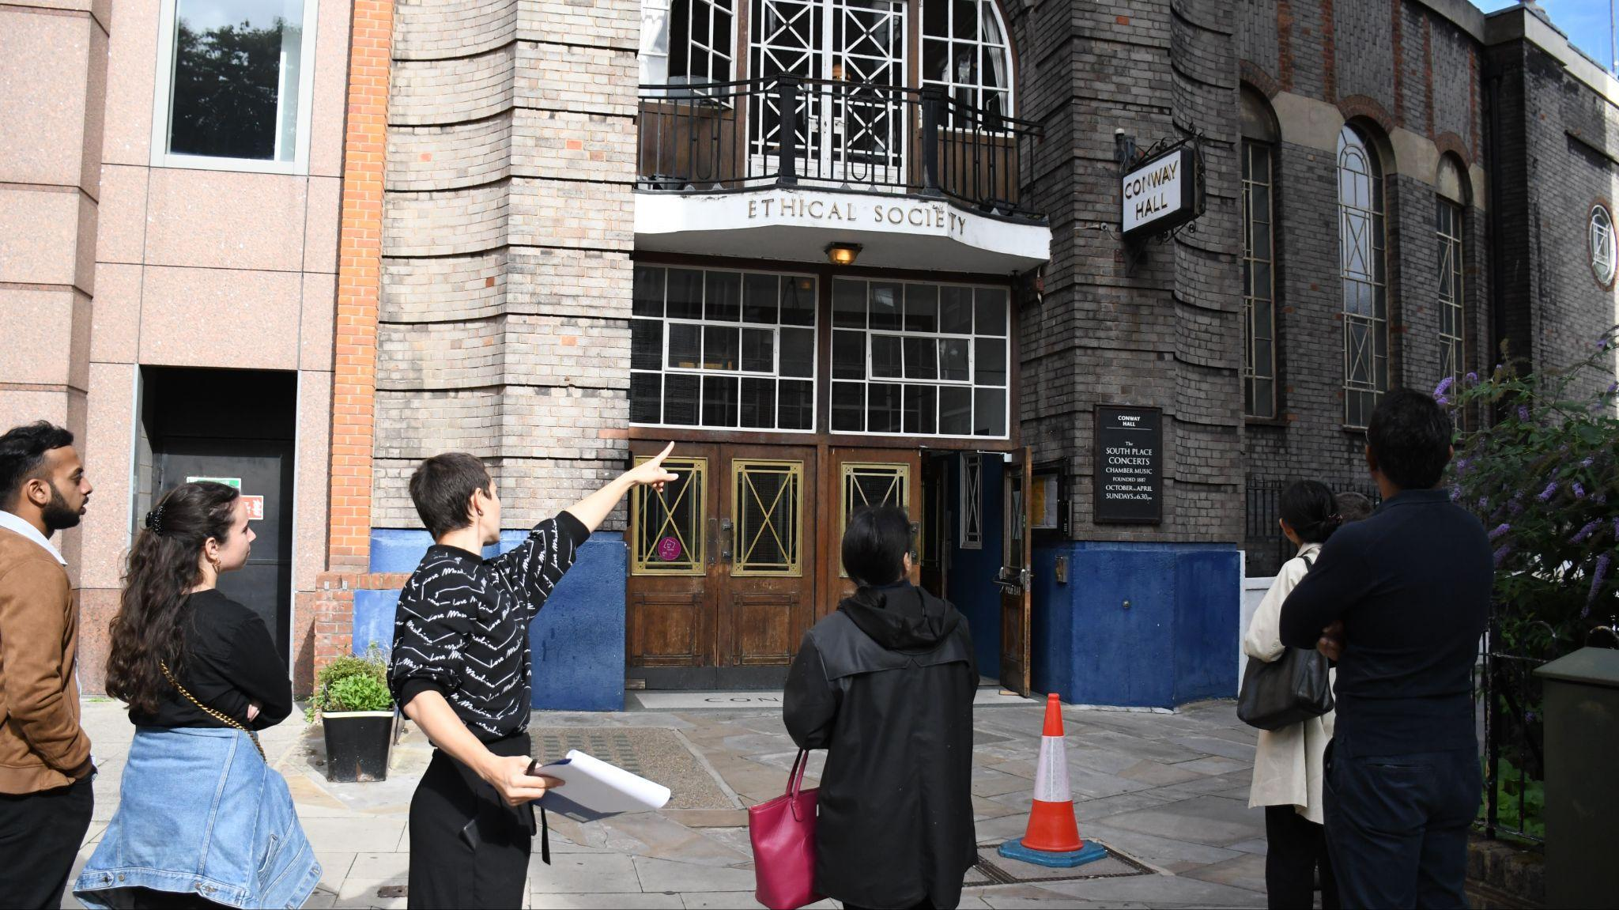
Notes:
Conway Hall’s Head of Programmes, Holly, giving a tour of Conway Hall as part of Open House Festival, September 2022. © Conway Hall

Slide 4
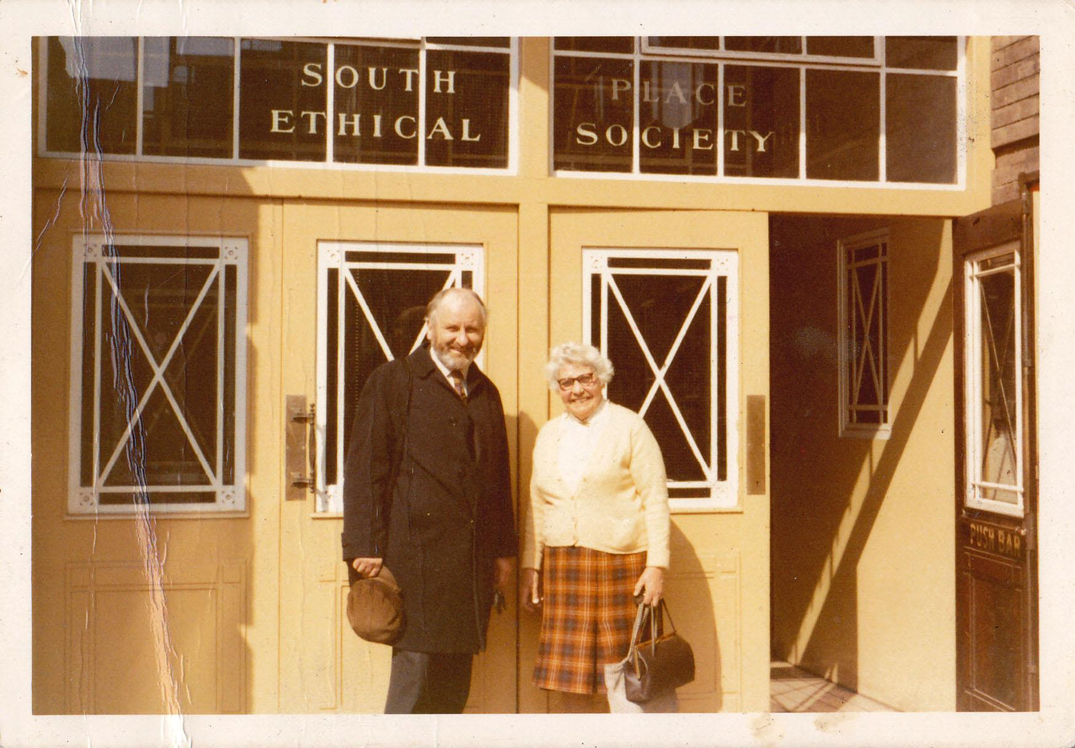
Notes:
Rose Bush and another member of the South Place Ethical Society in front of Conway Hall. Conway Hall/South Place Ethical Society

Slide 5
Main Hall

Slide 6
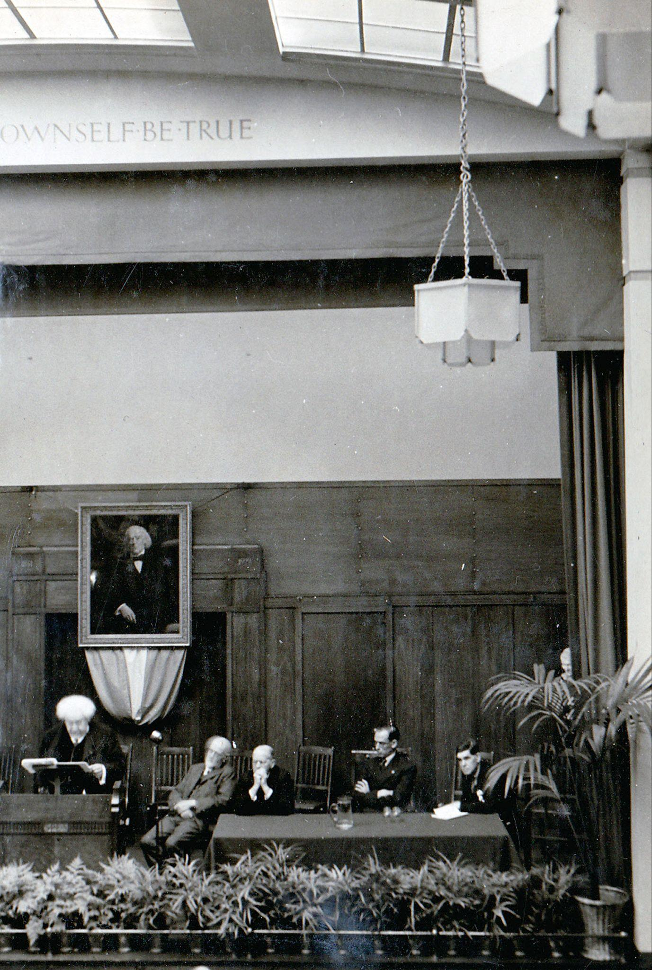
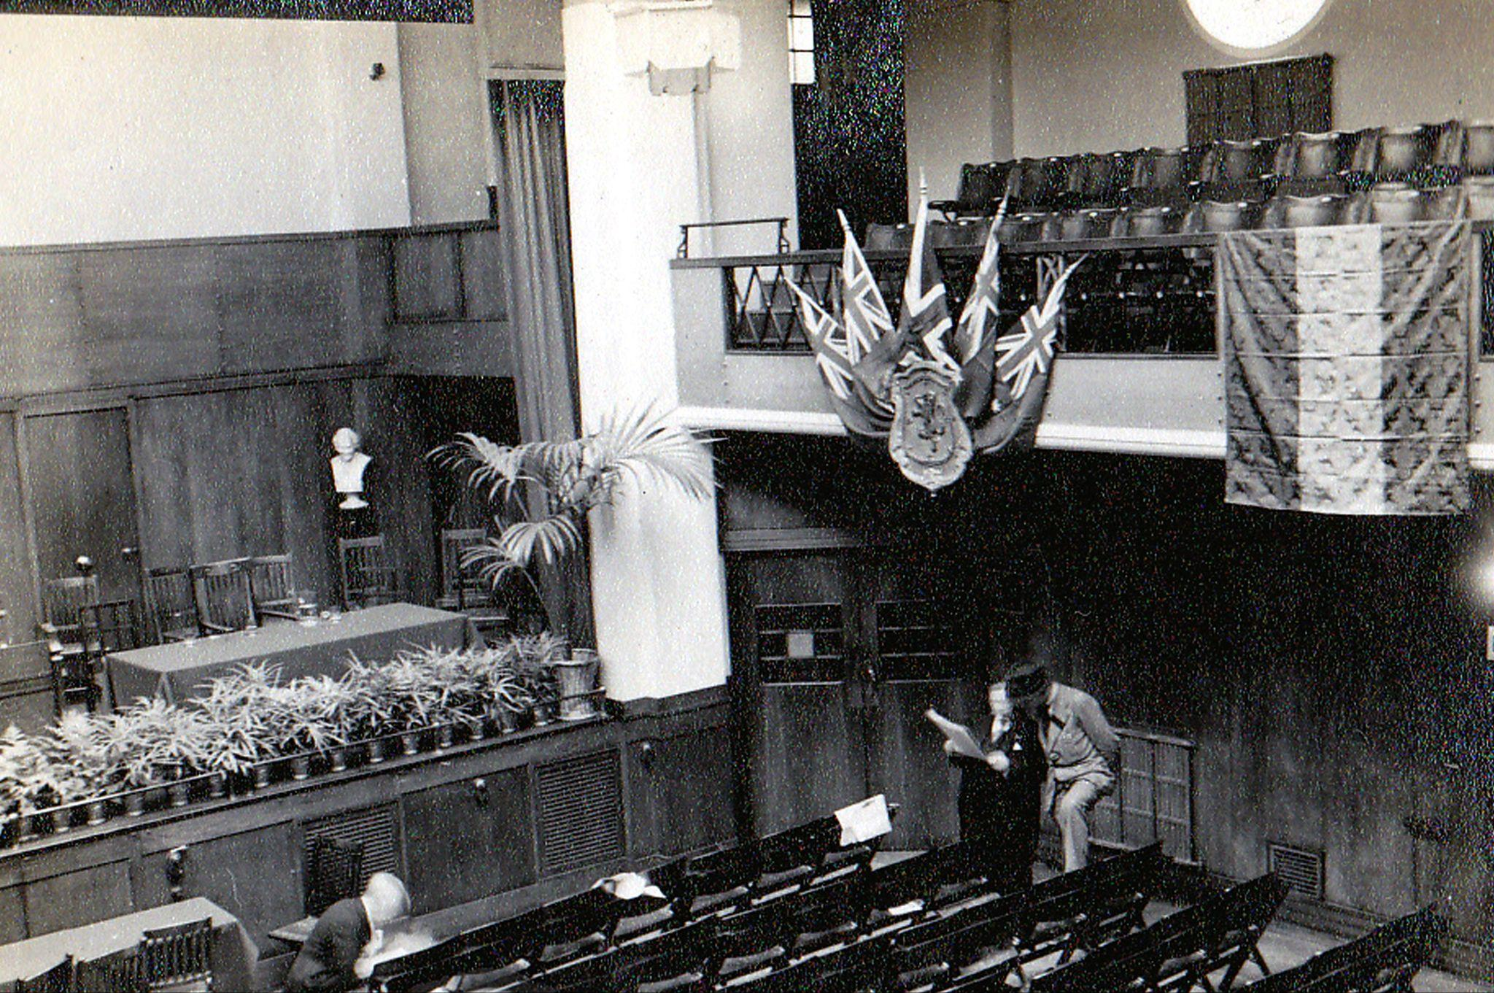
Notes:
Main Hall decorated for the congress of the World Union of Freethinkers, 1938. Conway Hall/South Place Ethical Society

Slide 7
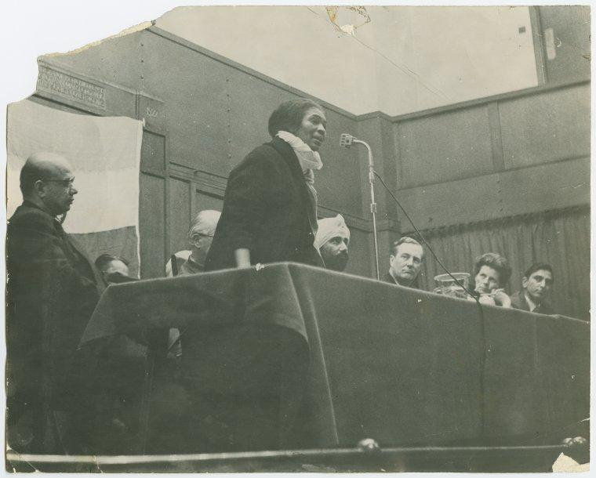
Notes:
Activist Claudia Jones speaking from the stage at Conway Hall, c. 1963

Slide 8
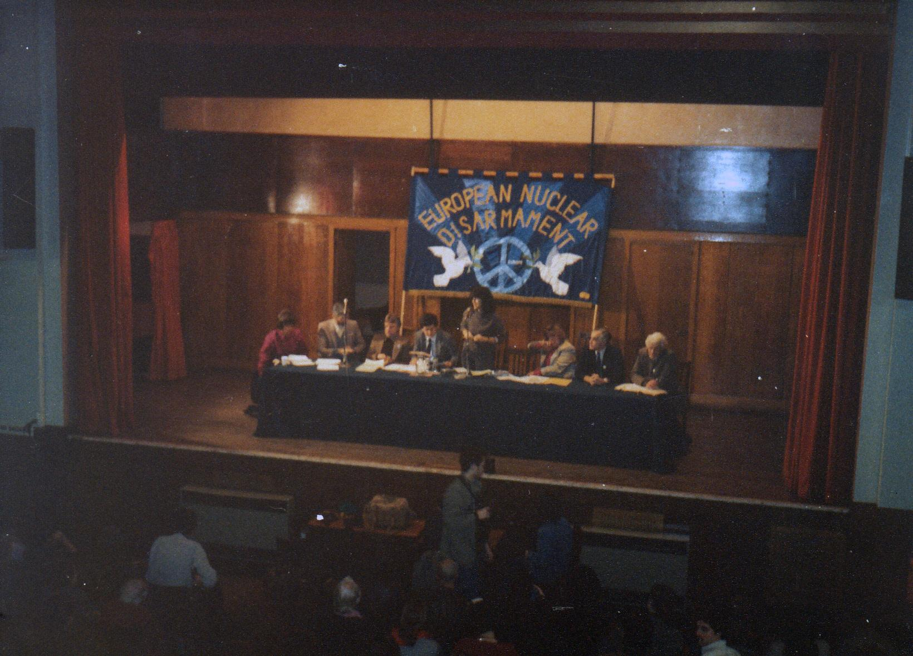
Notes:
Meeting of European Nuclear Disarmament (END) c. 1980s/1990s. Conway Hall/South Place Ethical Society

Slide 9
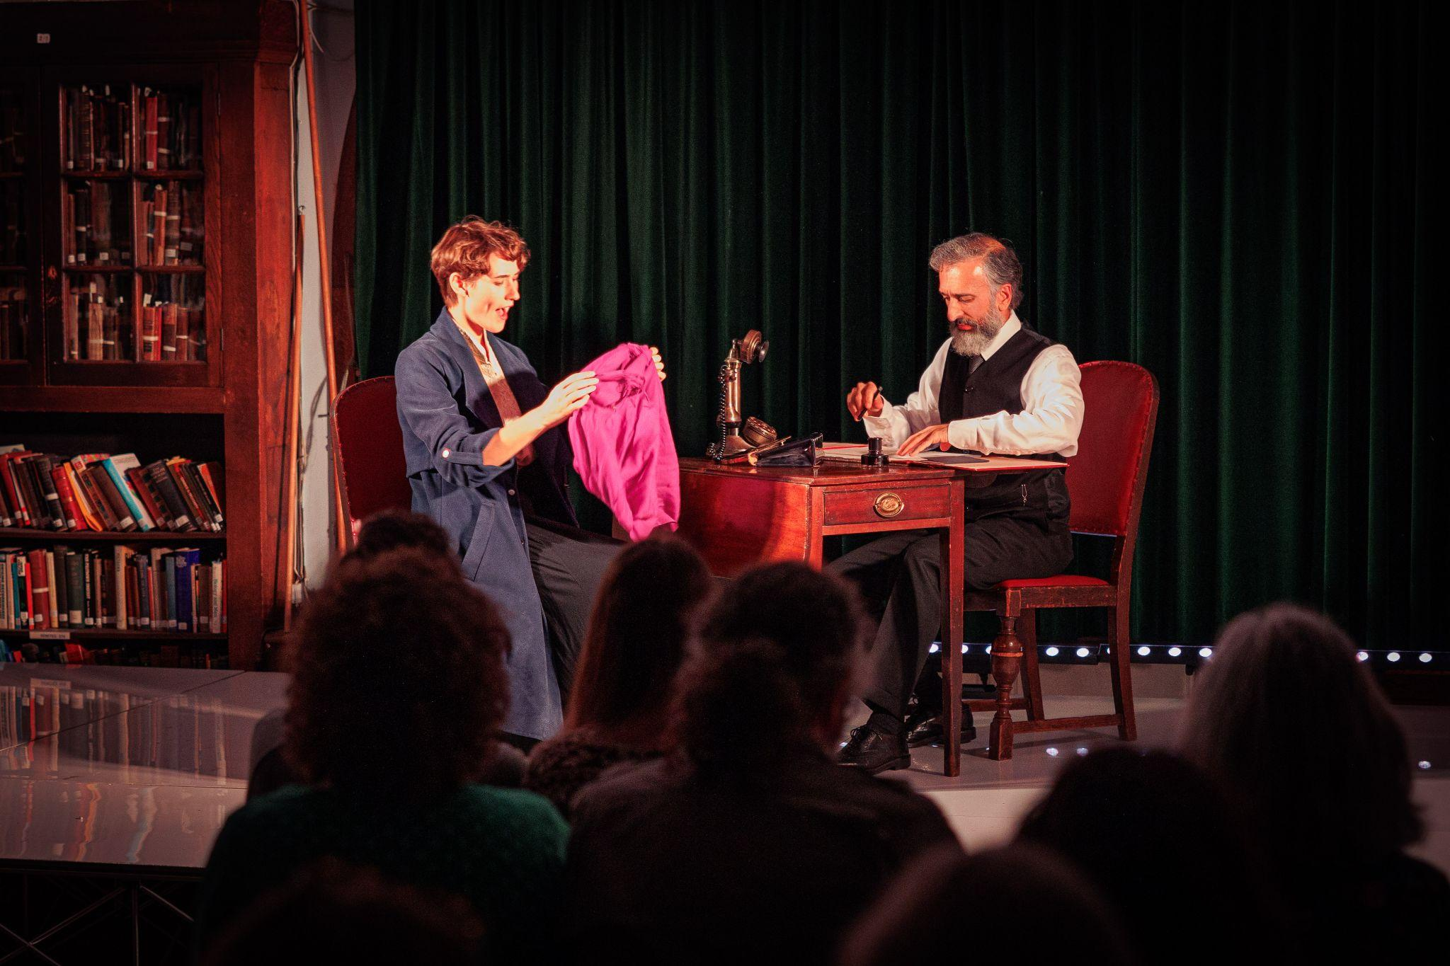
Notes:
Performance by Daytimers of their show Mehfil: An Evening of South Asian Poetry, October 2022. © Dan Evans

Slide 10
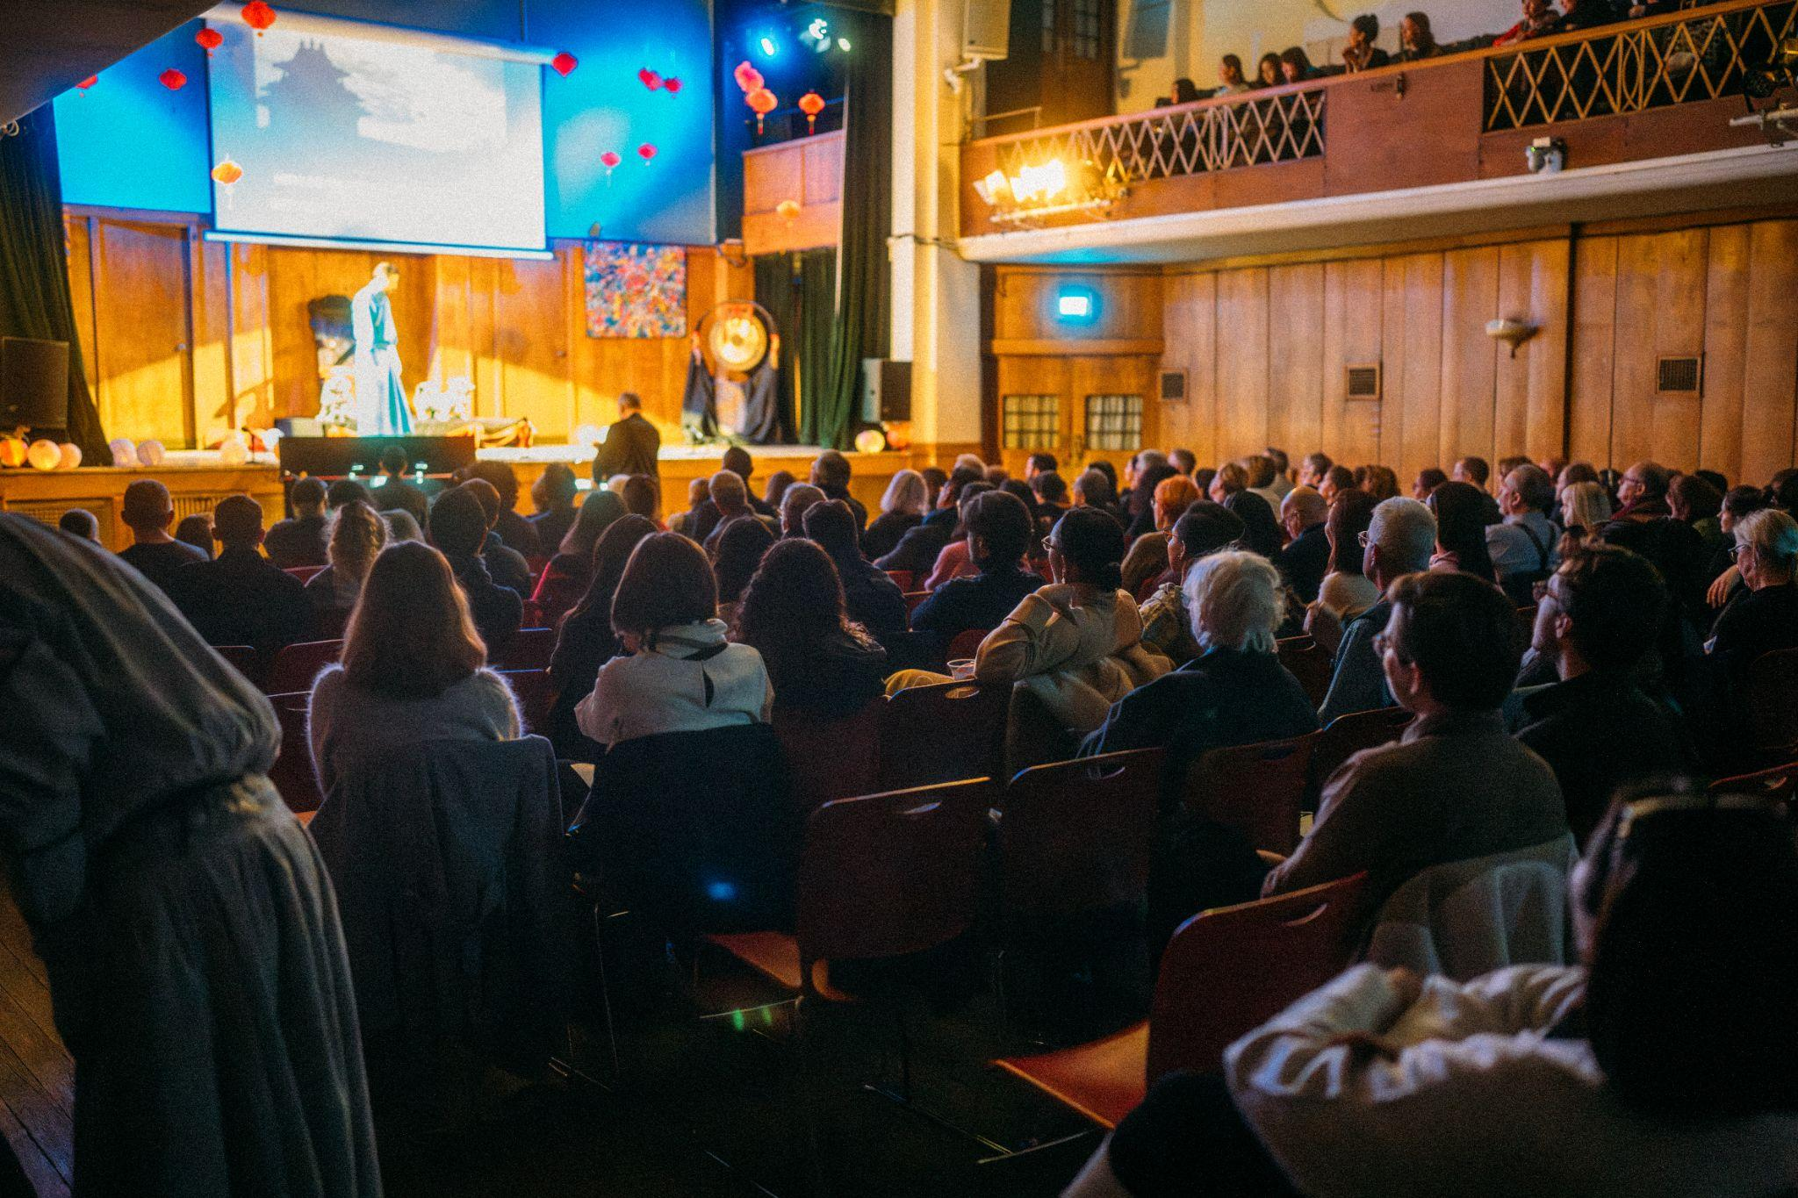
Notes:
Audience during the performance of the opera Turandot by the London Performing Academy of Music, December 2024 © Christopher Andreou

Slide 11
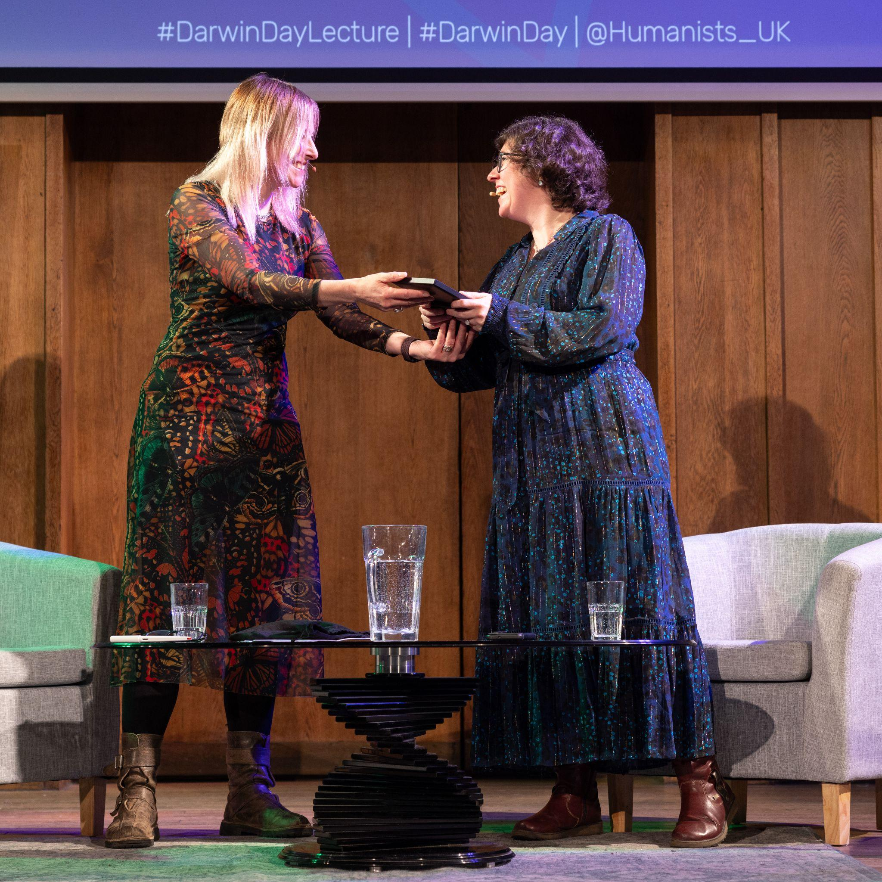
Notes:
Alice Roberts and Rebecca Wragg Sykes at the Darwin Day Lecture 2024 - Humanity’s Superpower: Lessons in community and empathy from 4 million to 40,000 years ago

Slide 12
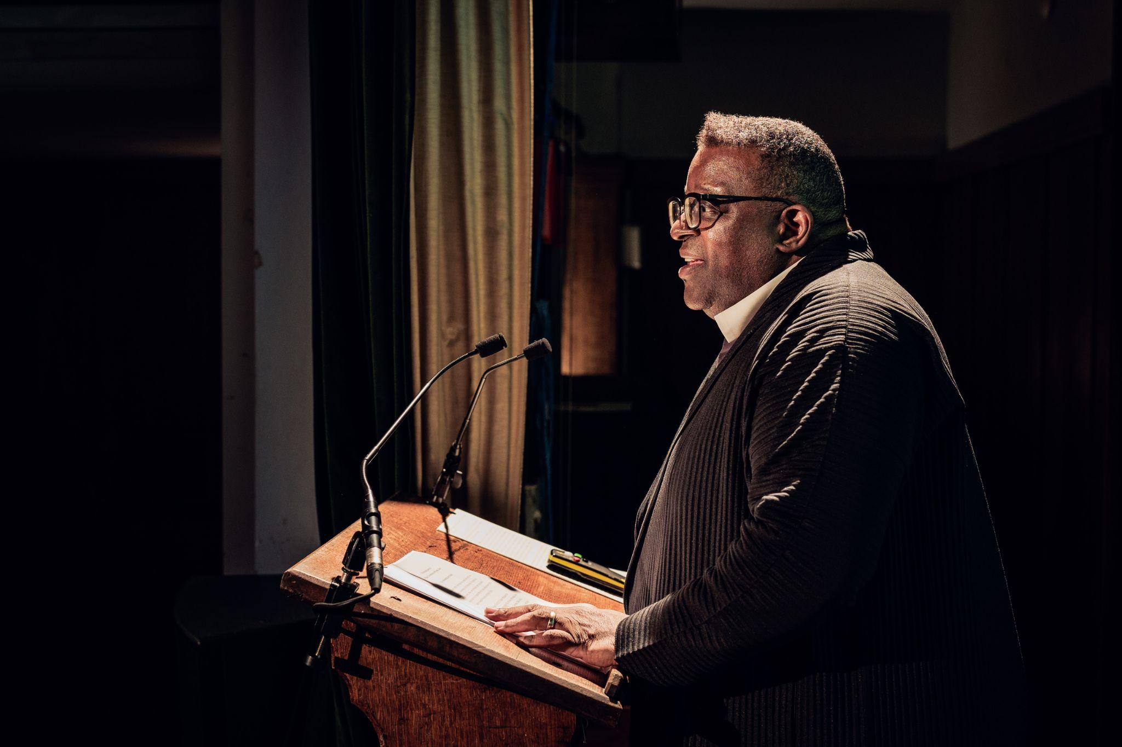
Notes:
Stuart Hall Foundation lecture © Dan Evans

Slide 13
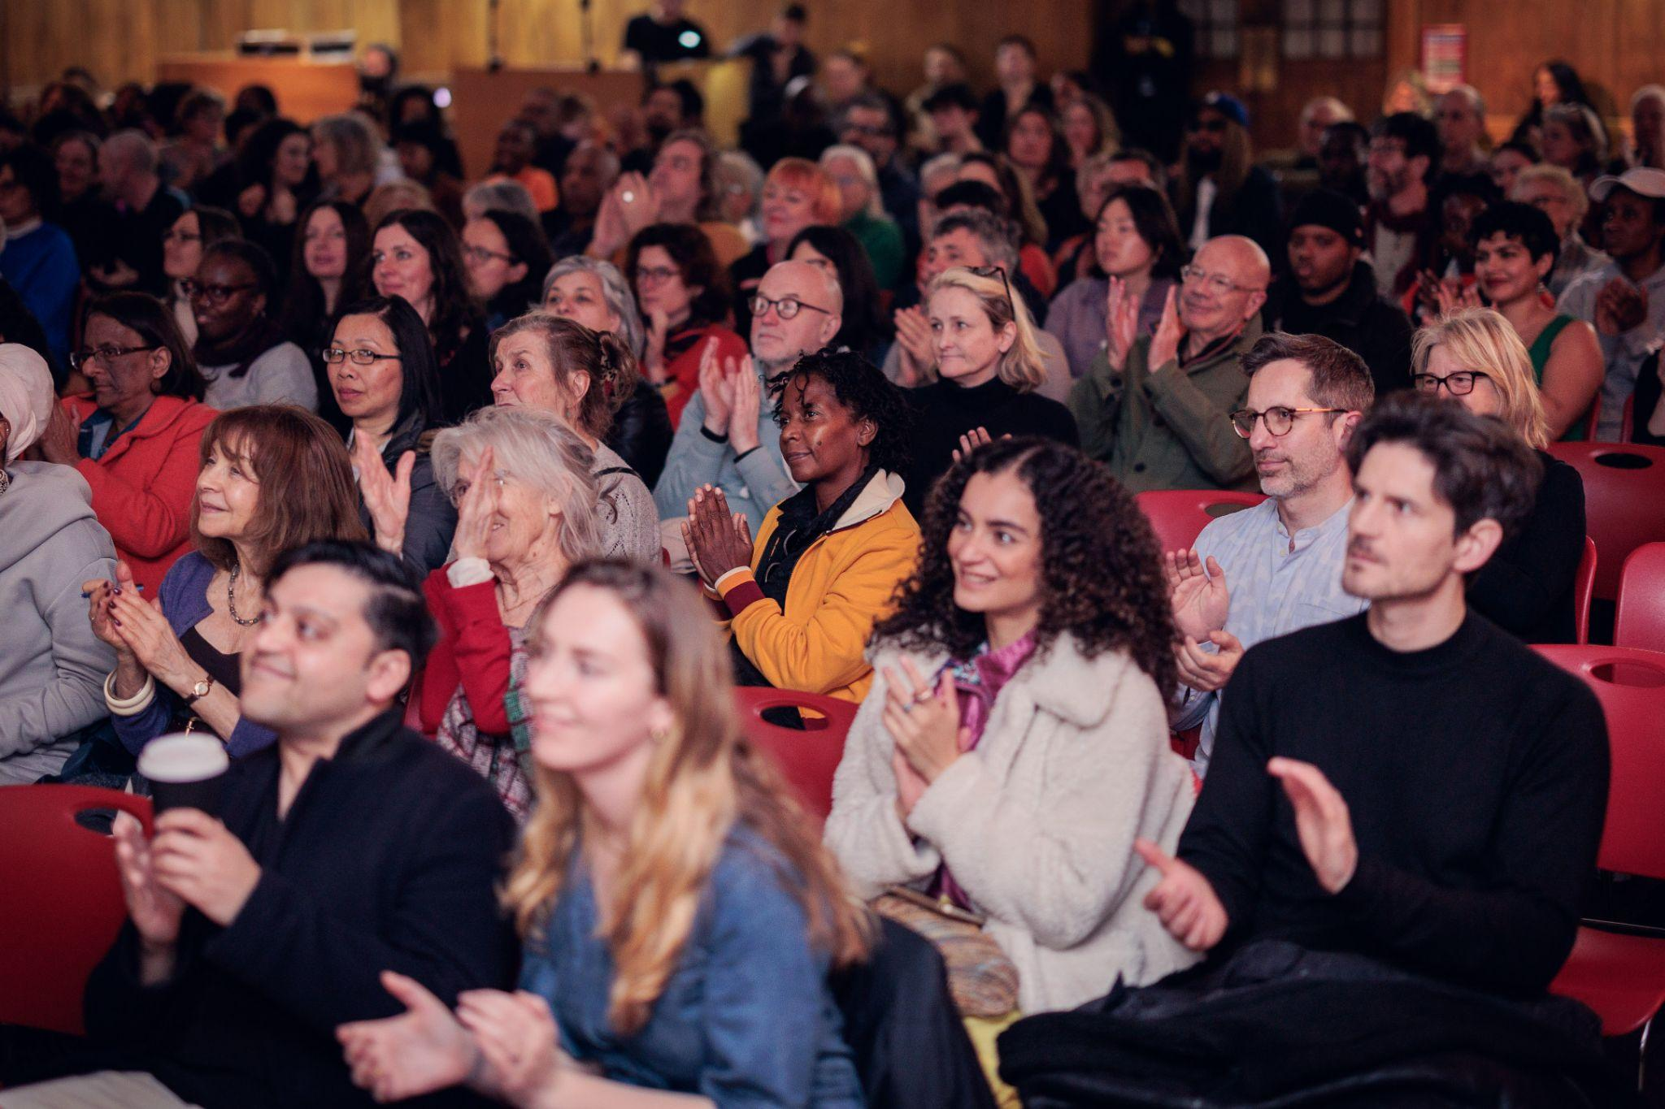
Notes:
Audience at the Stuart Hall Foundation lecture © Dan Evans

Slide 14
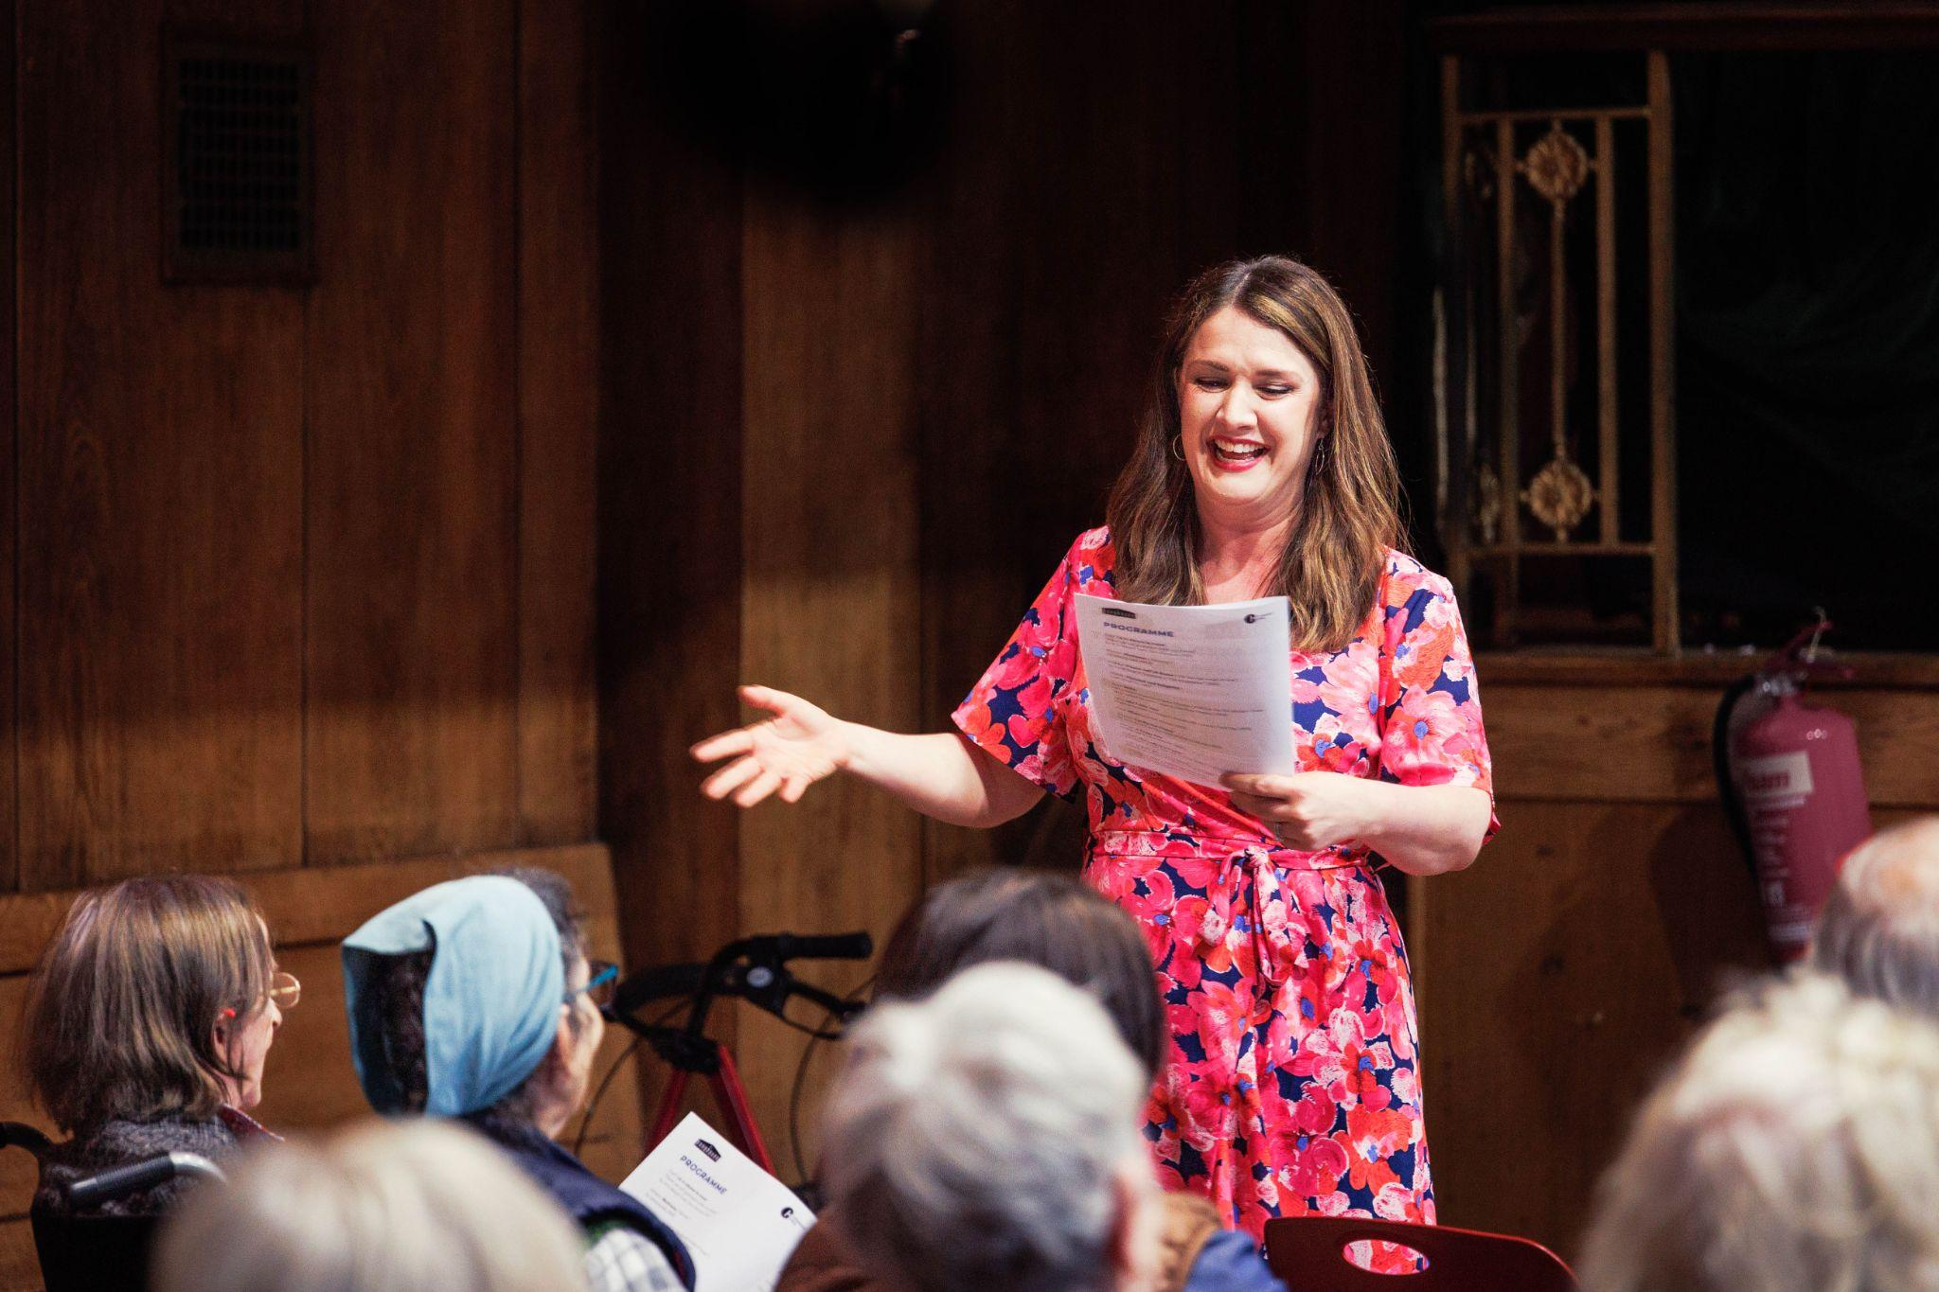
Notes:
Songhaven, a dementia-friendly concert series at Conway Hall © Dan Evans

Slide 15
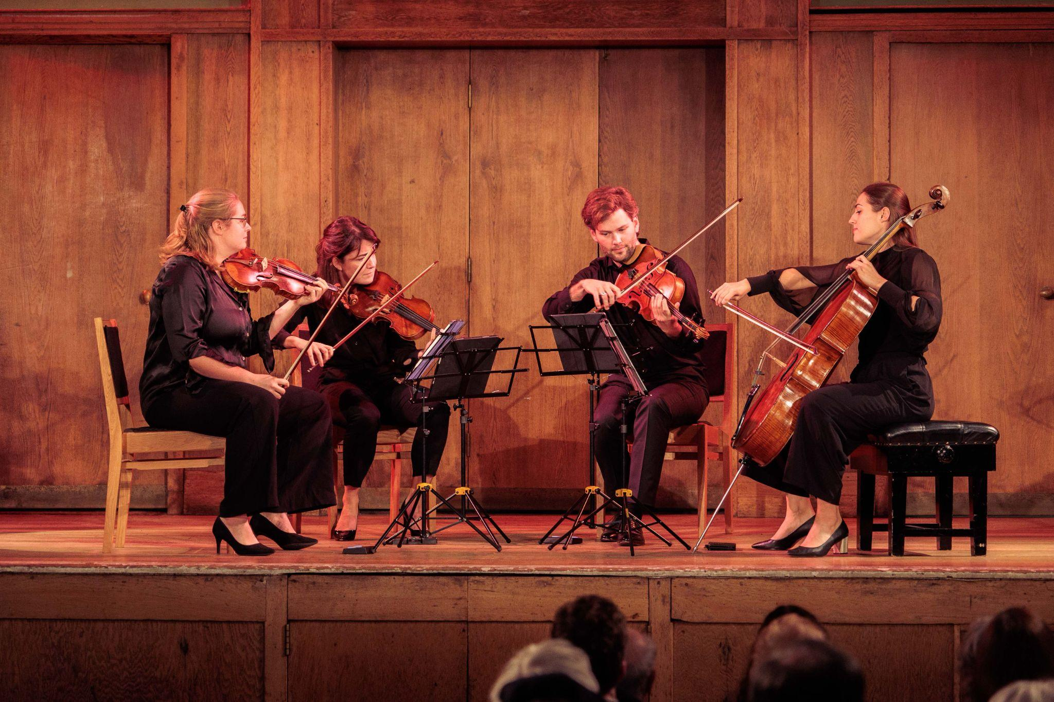
Notes:
A Sunday Concert: The Barbican Quartet © Dan Evans

Slide 16
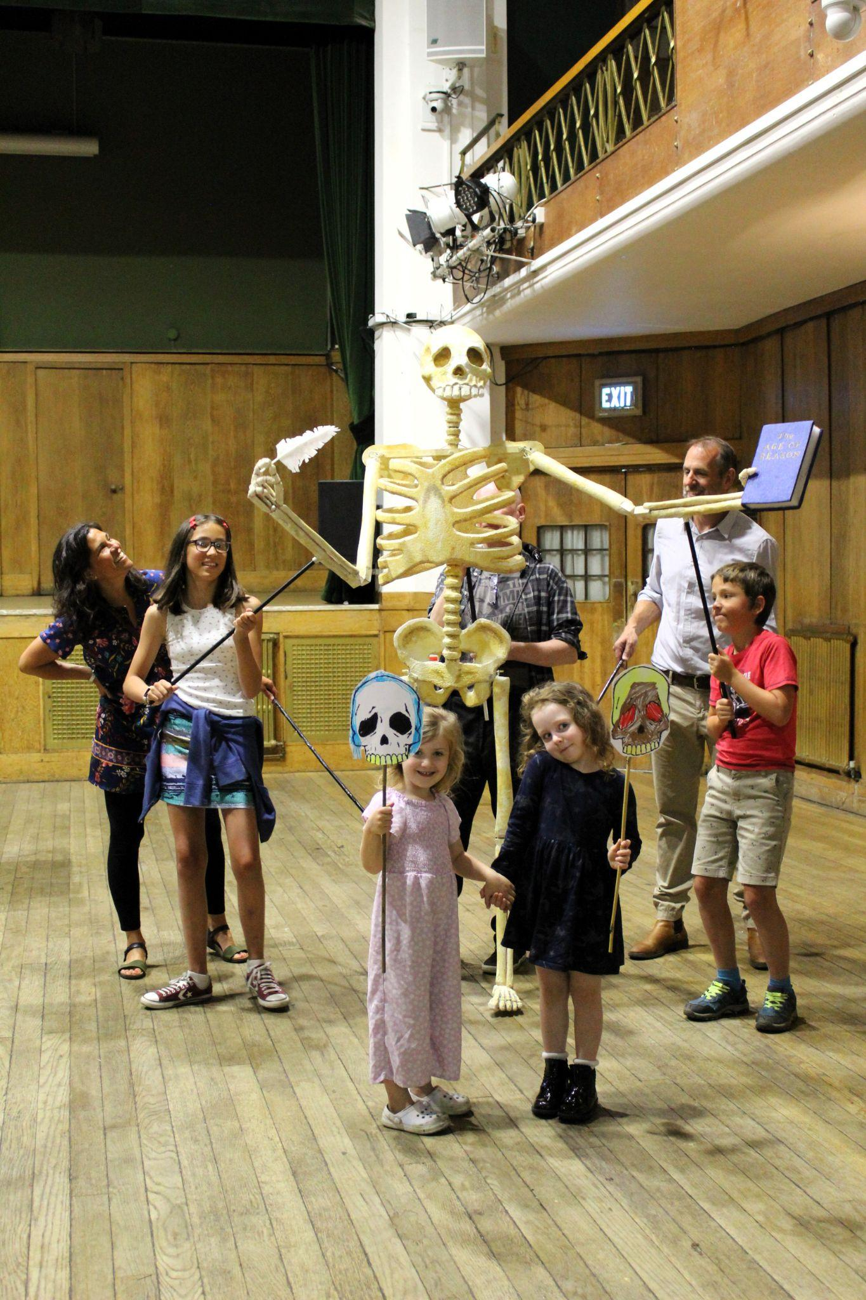
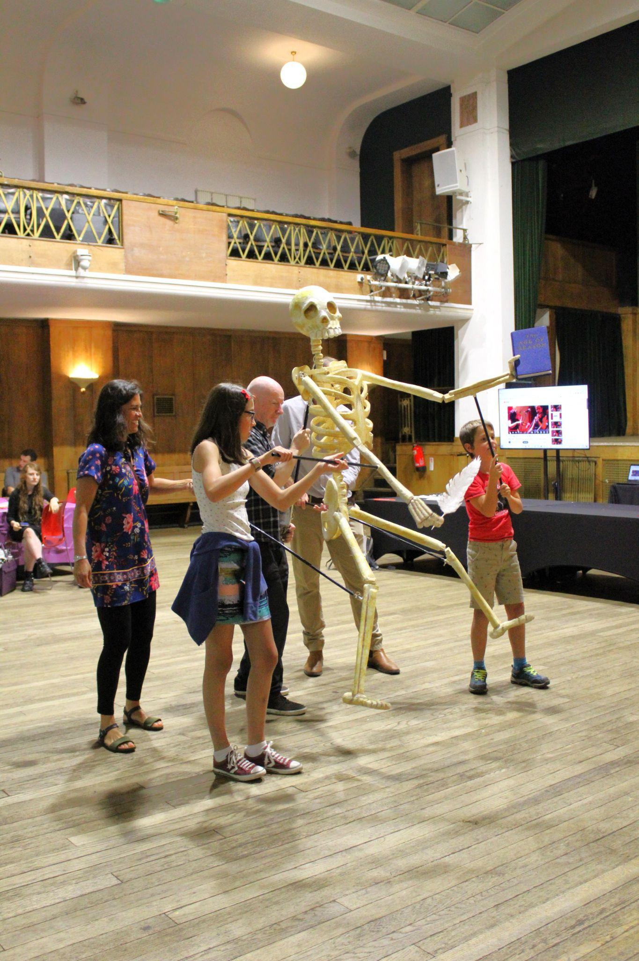
Notes:
Puppet building workshop based on the life of Thomas Paine, September 2024

Slide 17
Library

Slide 18
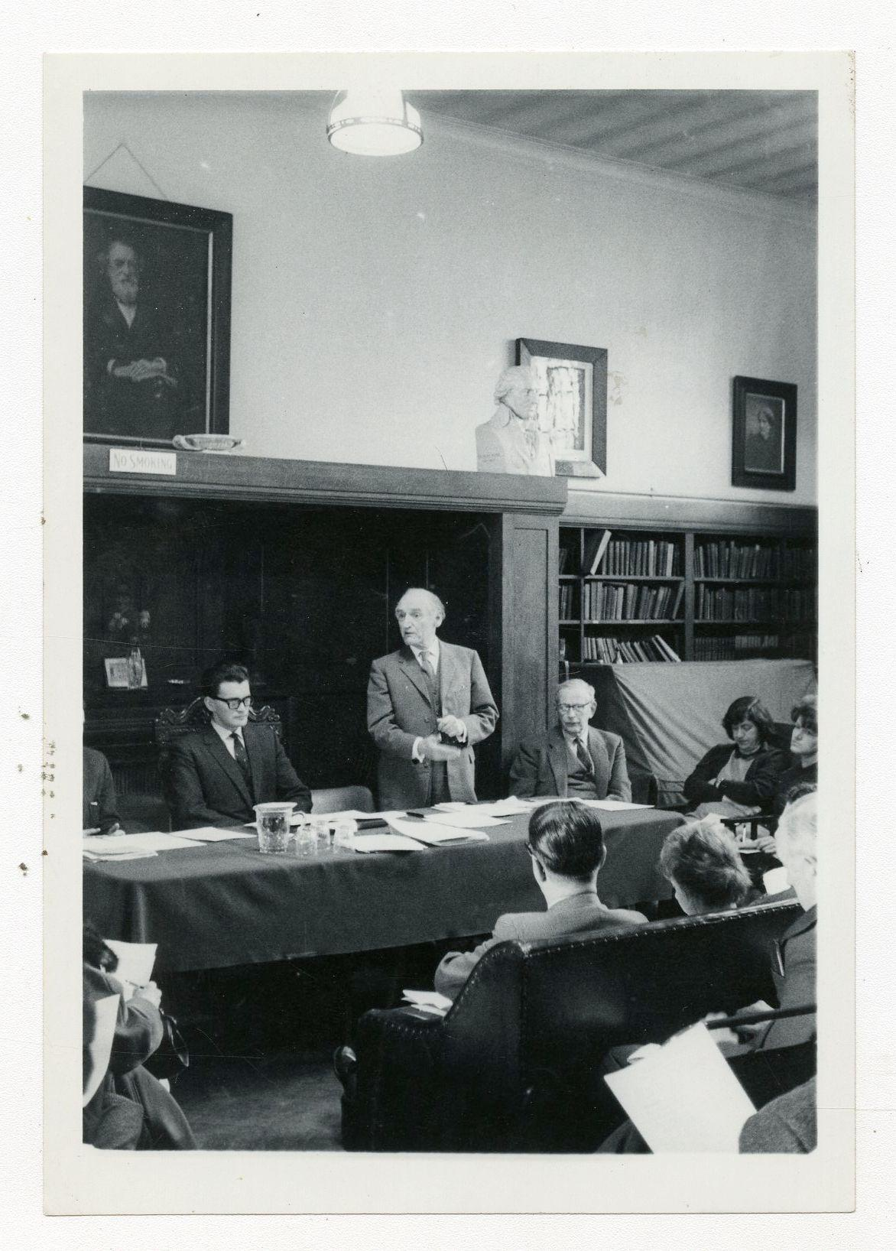
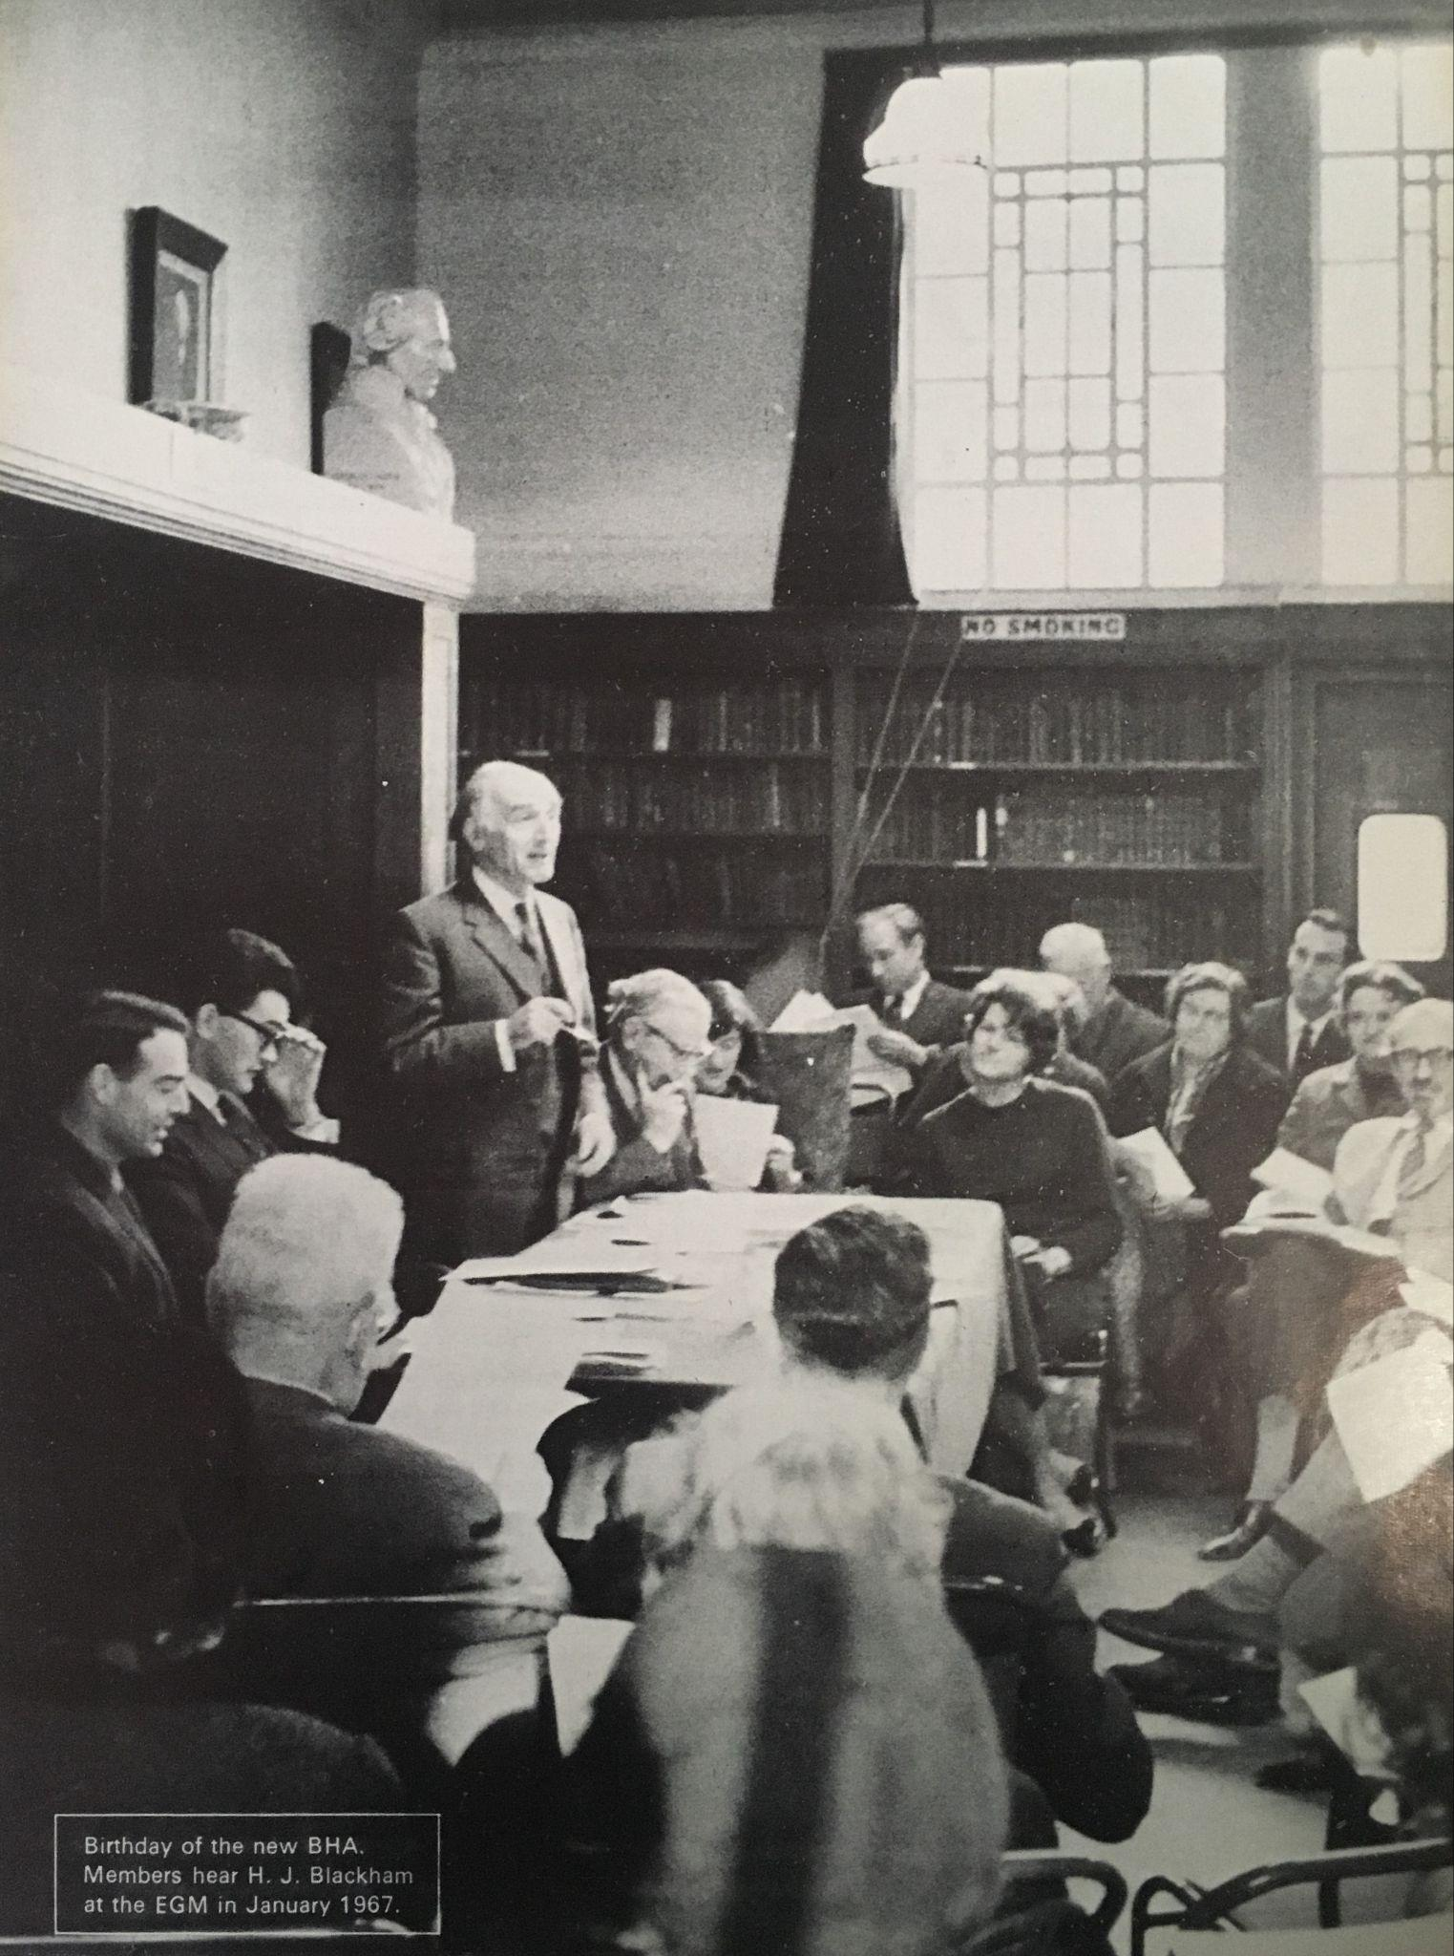
Notes:
Meeting of the British Humanist Association in the Library, January 1967

Slide 19
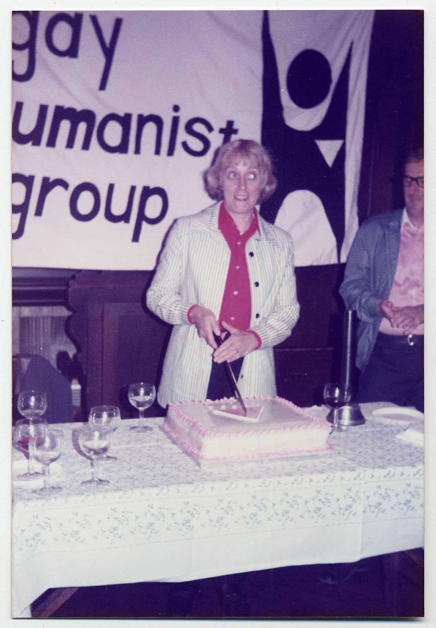
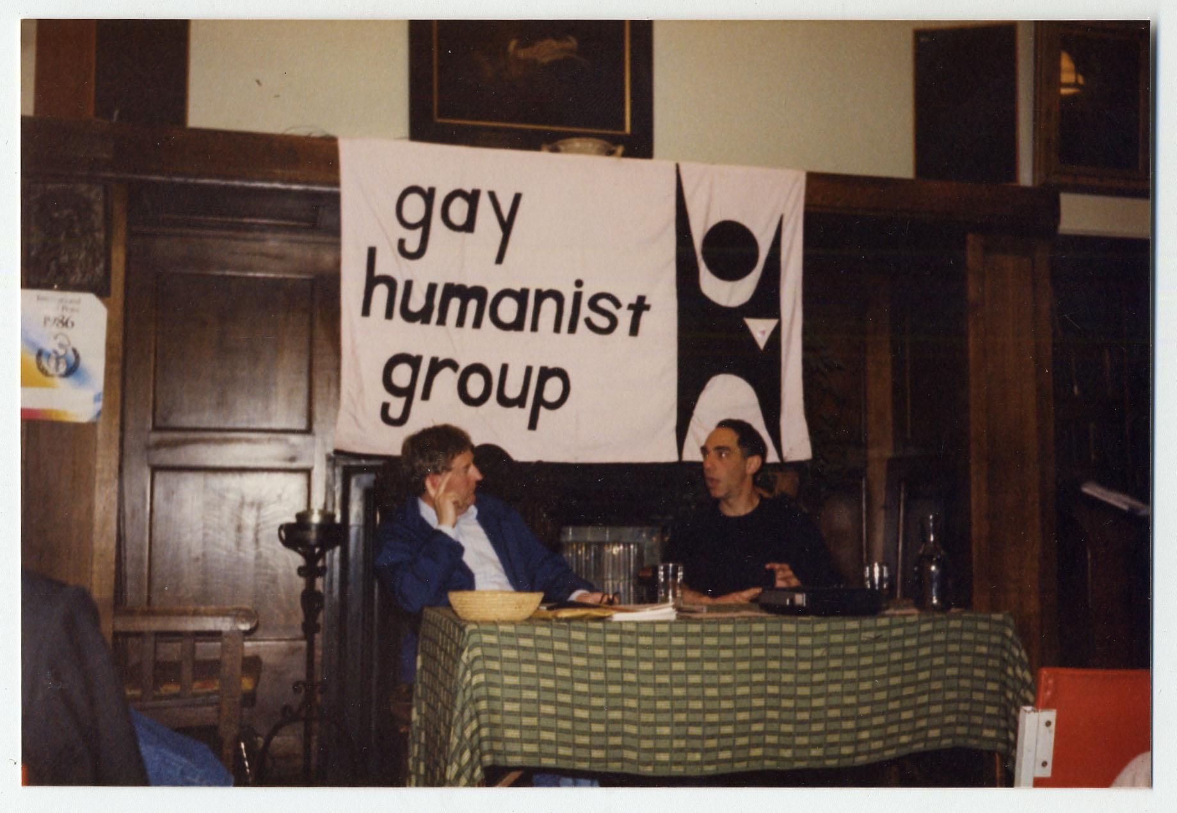
Notes:
Left: Writer and President of the Gay Humanist Group (now LGBT Humanists) Maureen Duffy cuts the cake at the group’s 5th anniversary celebration, 1984, in the Library
Right: Filmmaker Derek Jarman speaks at Gay Humanist Group meeting in Conway Hall Library, May 1986

Slide 20
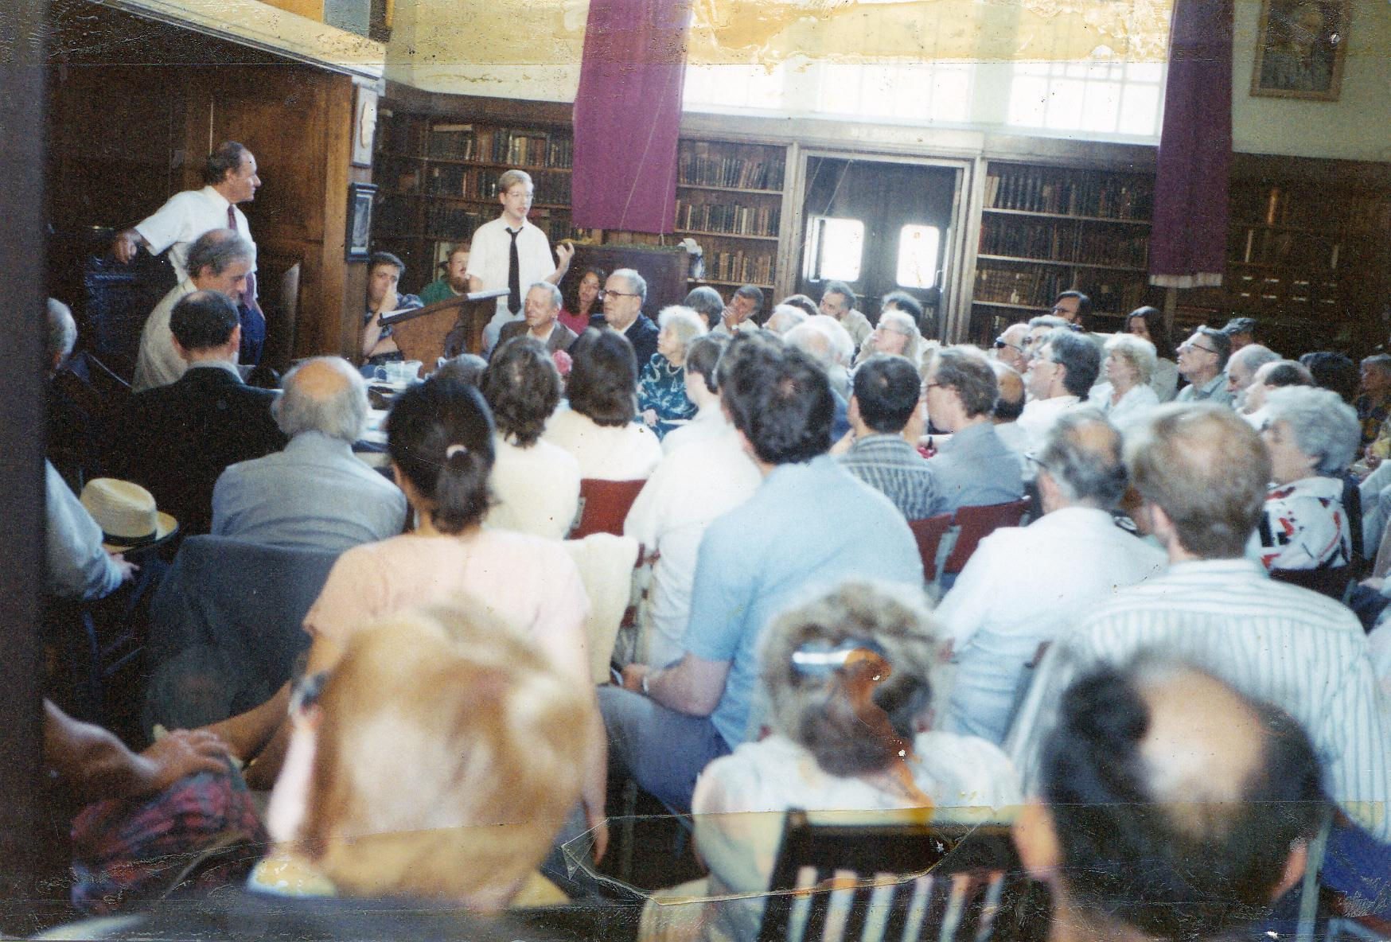
Notes:
A Sunday meeting of the Ethical Society in the Library. Conway Hall/South Place Ethical Society

Slide 21
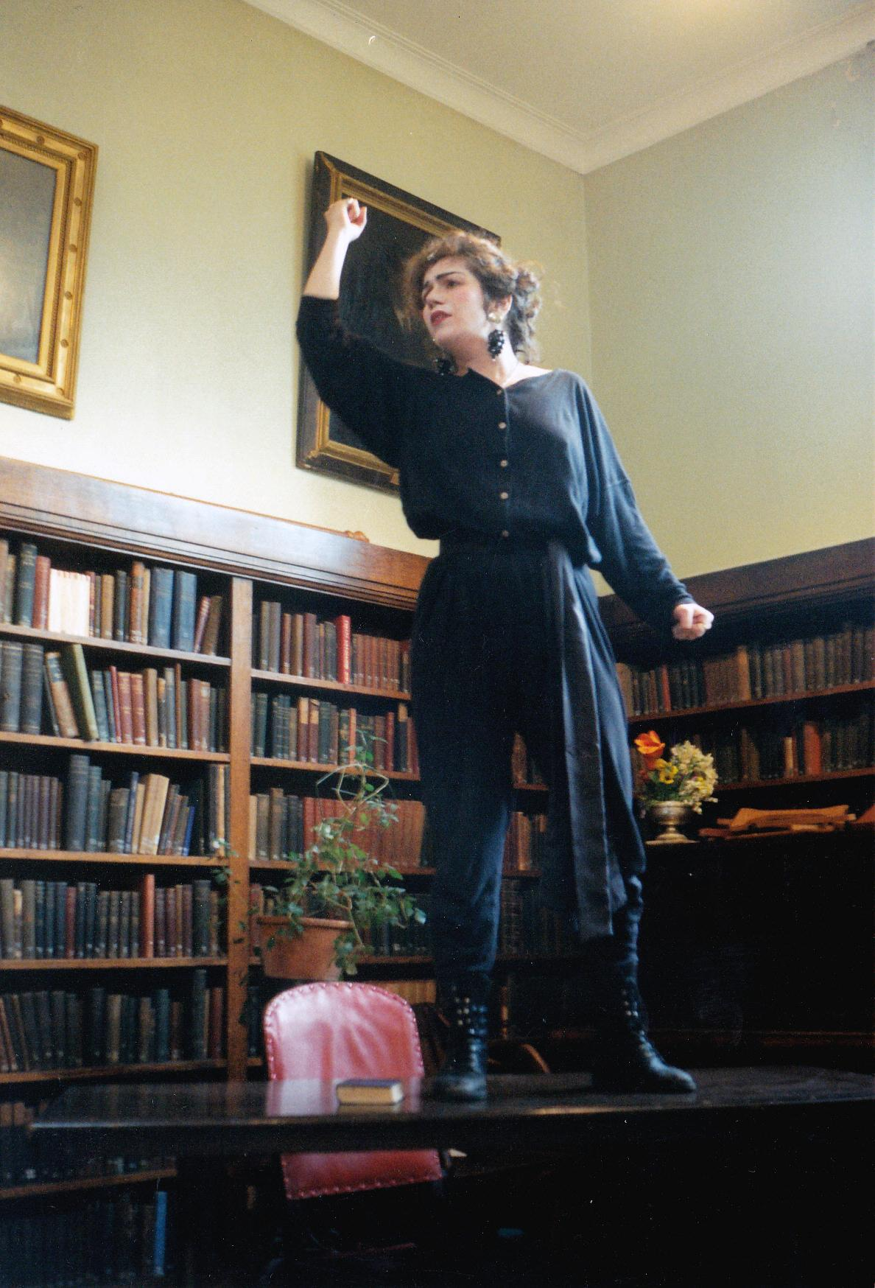
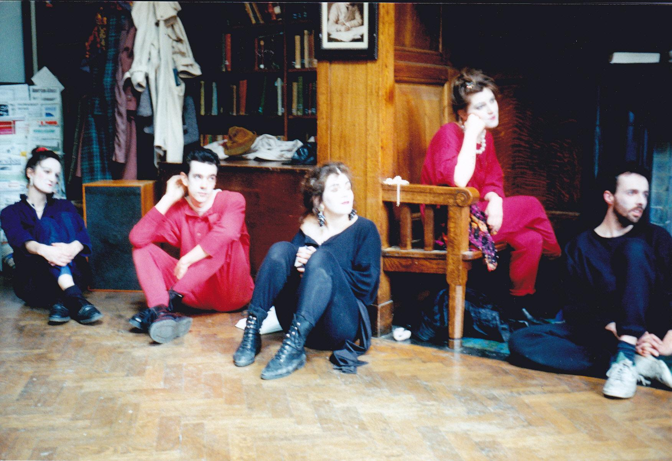
Notes:
Drama event in the Library. Conway Hall/South Place Ethical Society

Slide 22
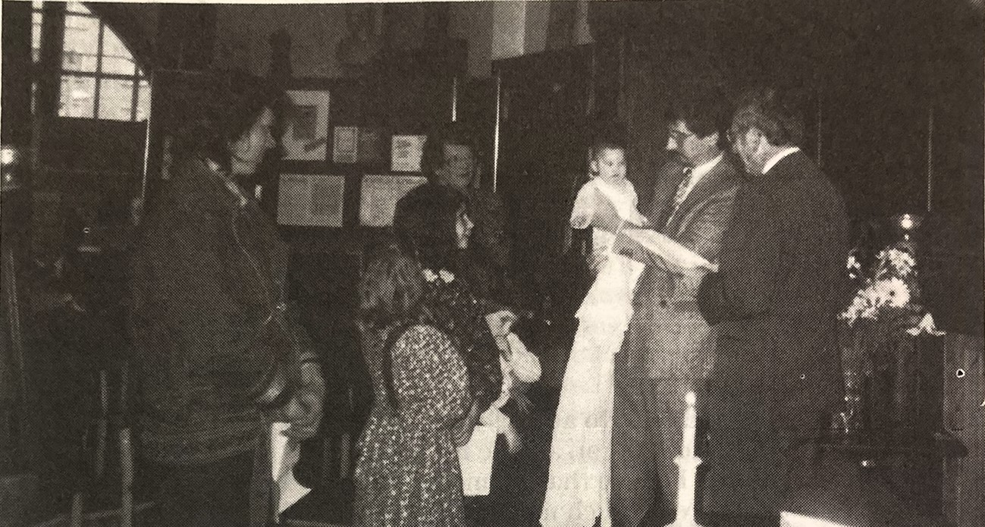
Notes:
Humanist naming ceremony in Conway Hall Library, October 1991 (printed in Humanist News, November 1991)

Slide 23
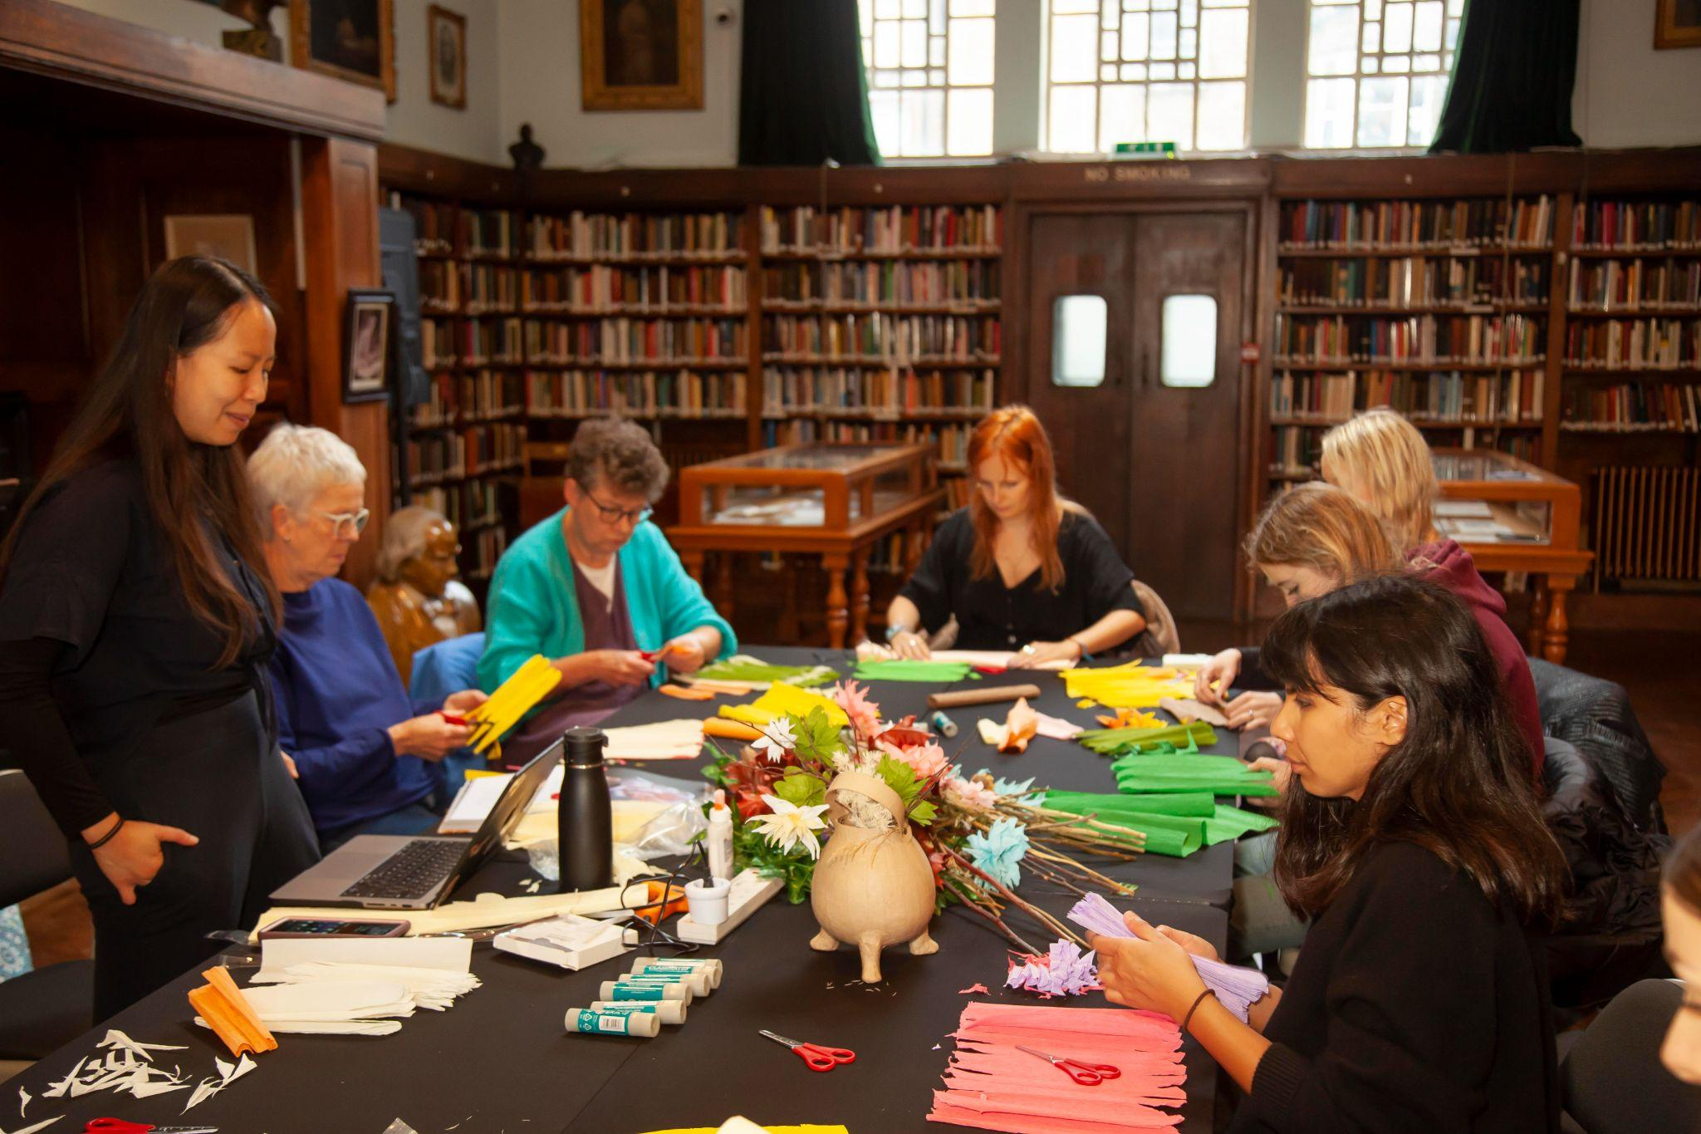
Notes:
Monster Flowers: Life Drawing & Paper Flower Making Workshop, part of the Bloomsbury Festival 2024 © Stuart Keegan

Slide 24
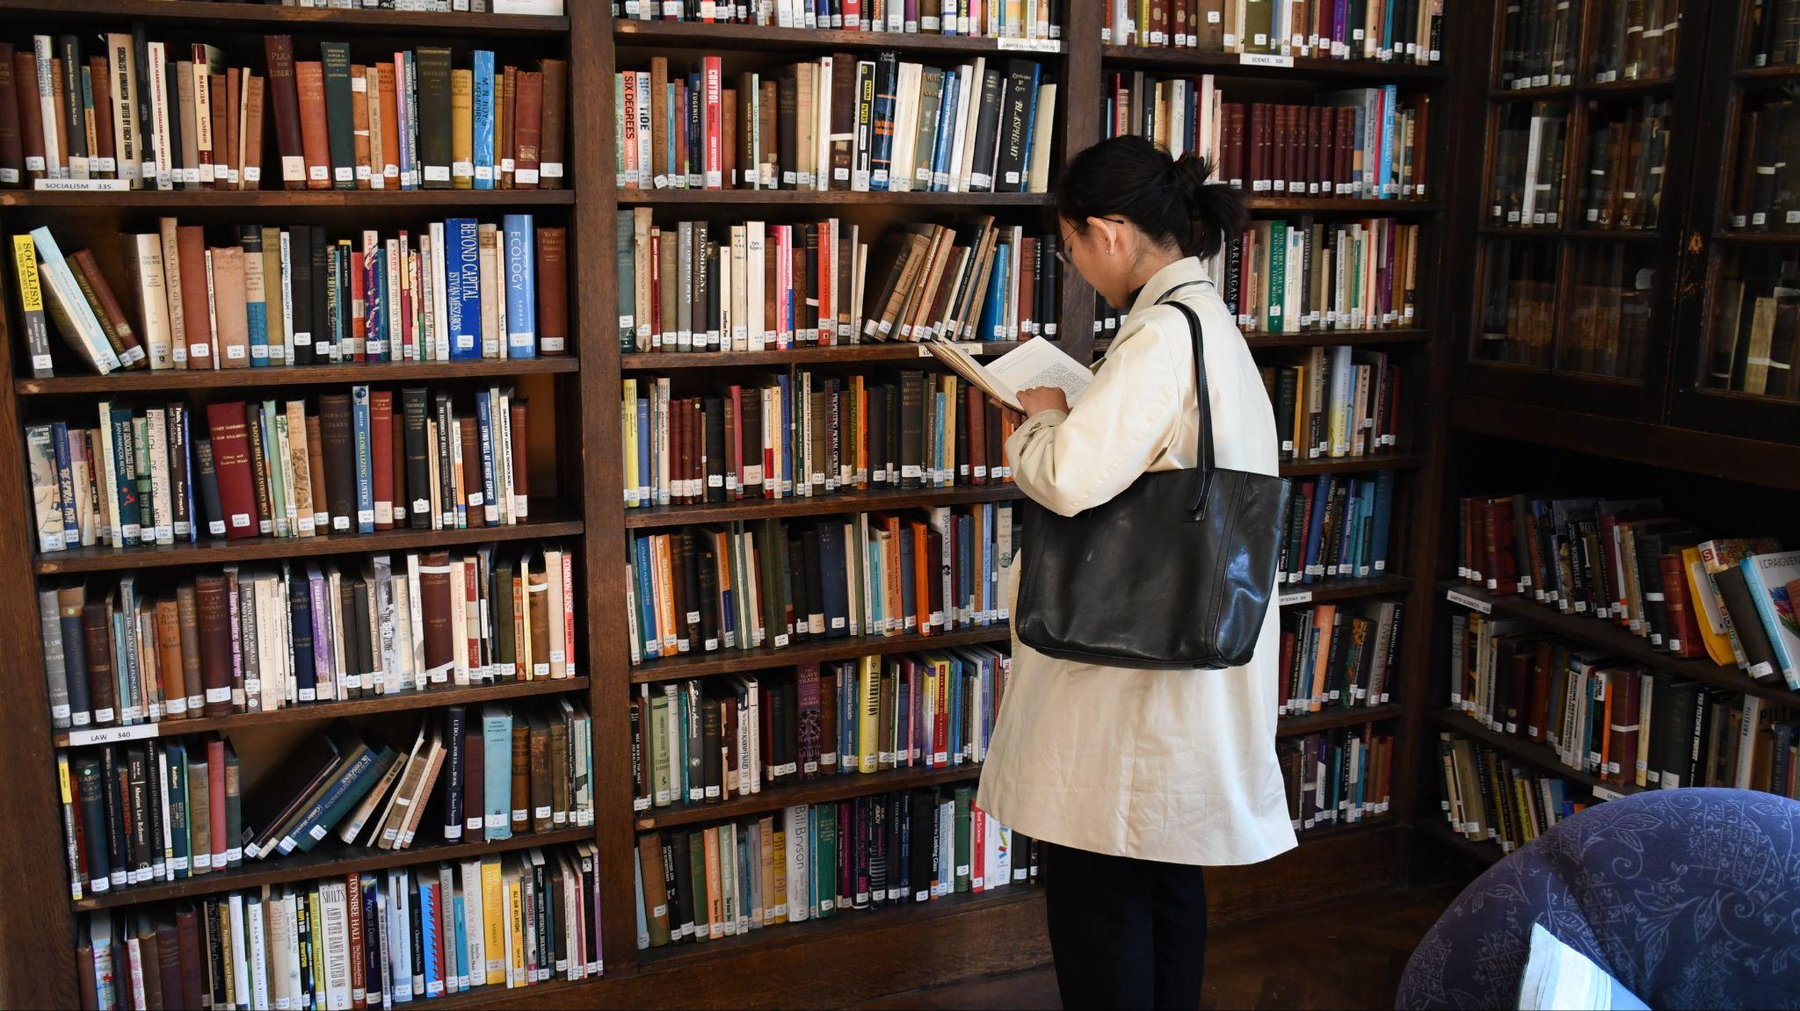
Notes:
A visitor to the Library during Open House Festival, September 2022. © Conway Hall

Slide 25
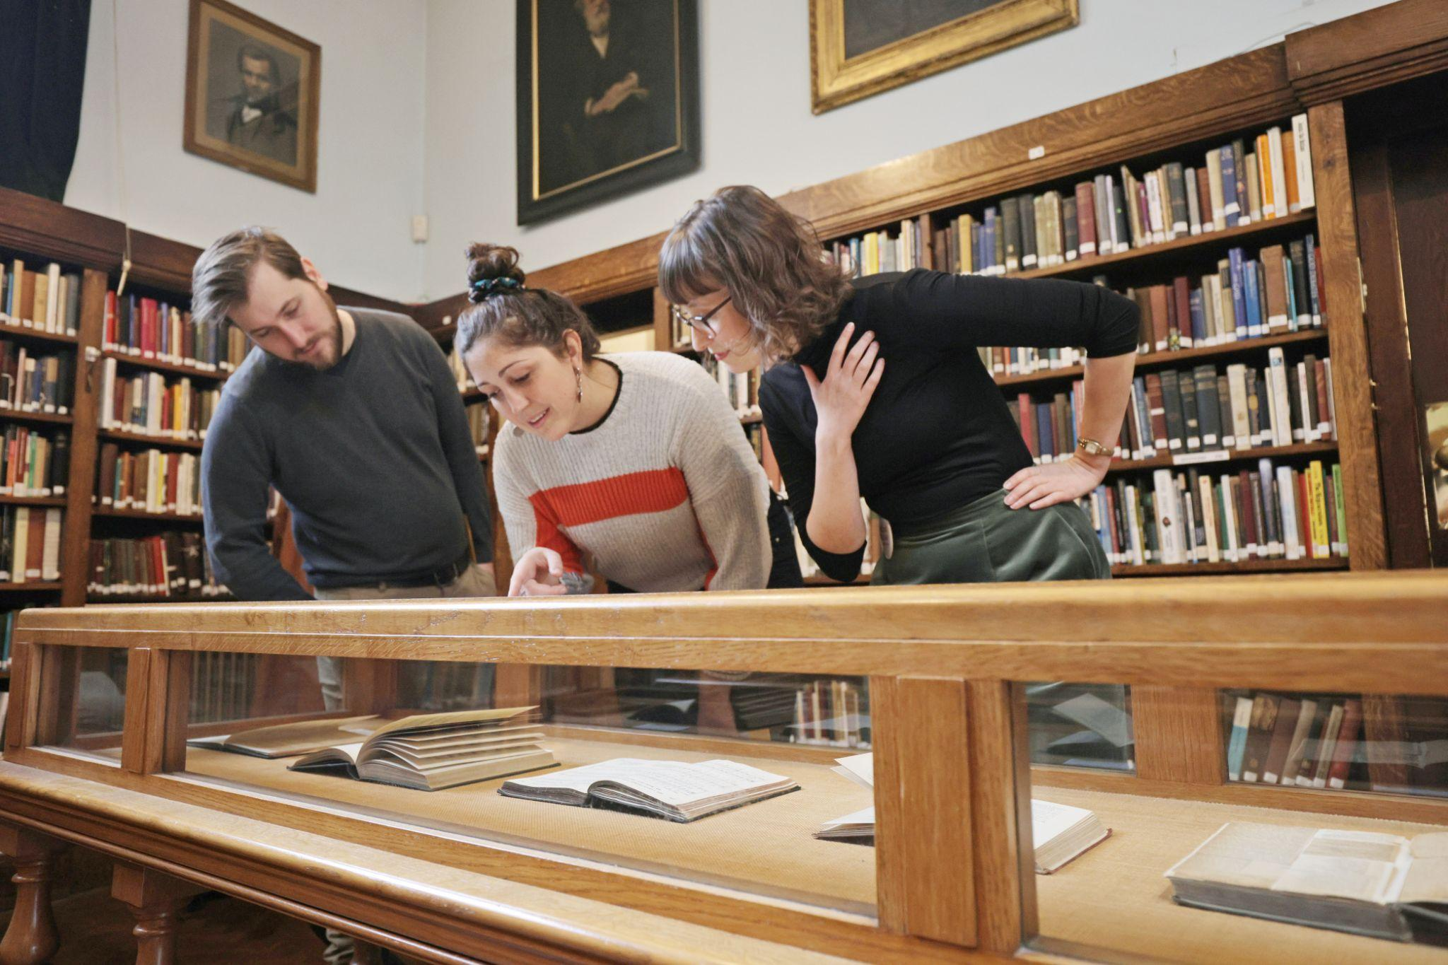
Notes:
Looking at the Library exhibition as part of a workshop on secular ceremonies, 2022 © Conway Hall

Slide 26
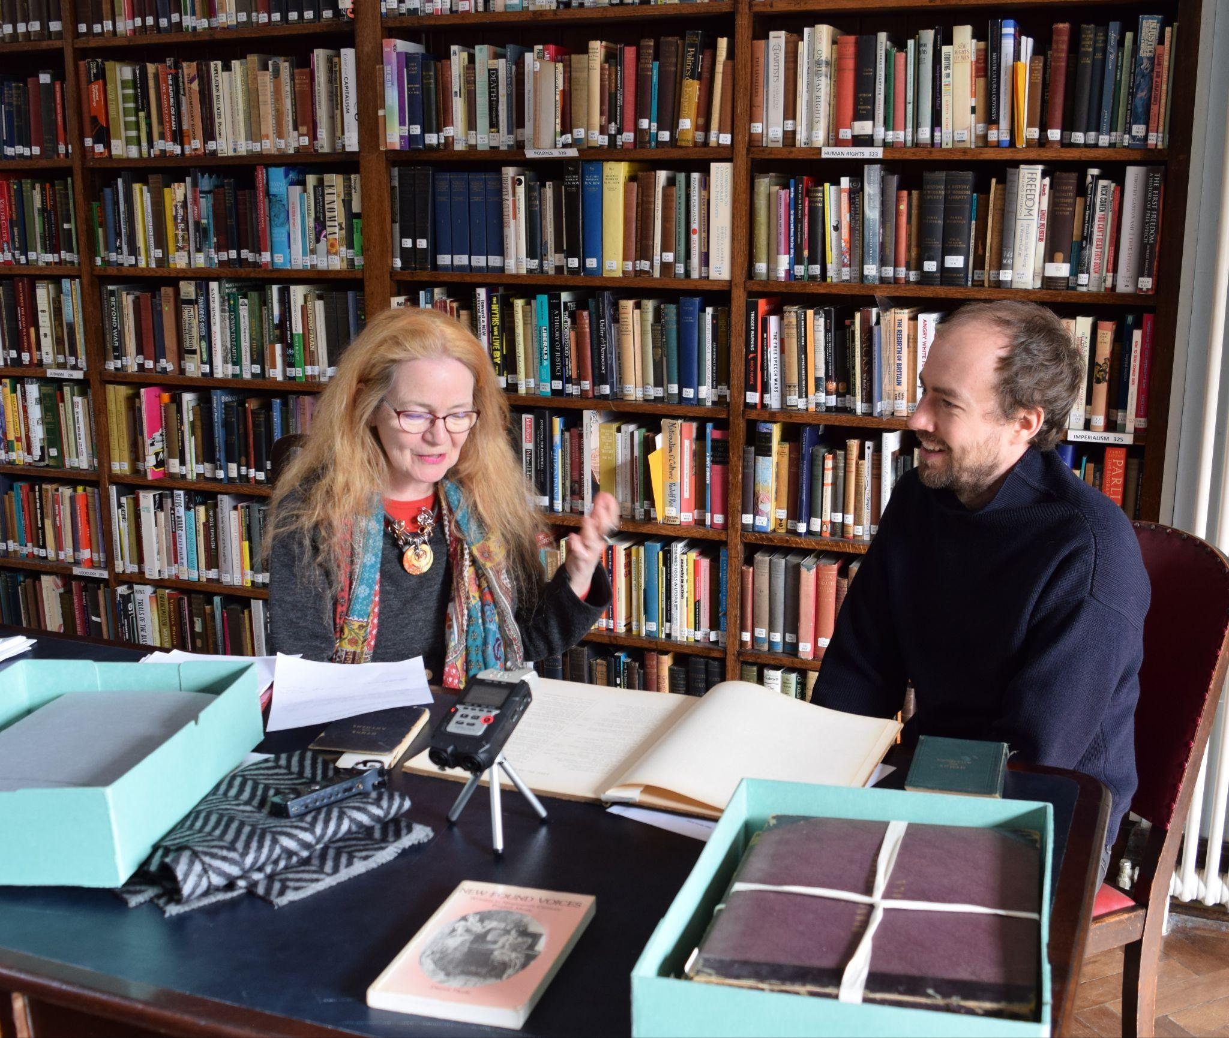
Notes:
Frances and Oskar from Electric Voice Theatre exploring the archive collections © Electric Voice Theatre

Slide 27
Brockway & Bertrand Russell Rooms

Slide 28
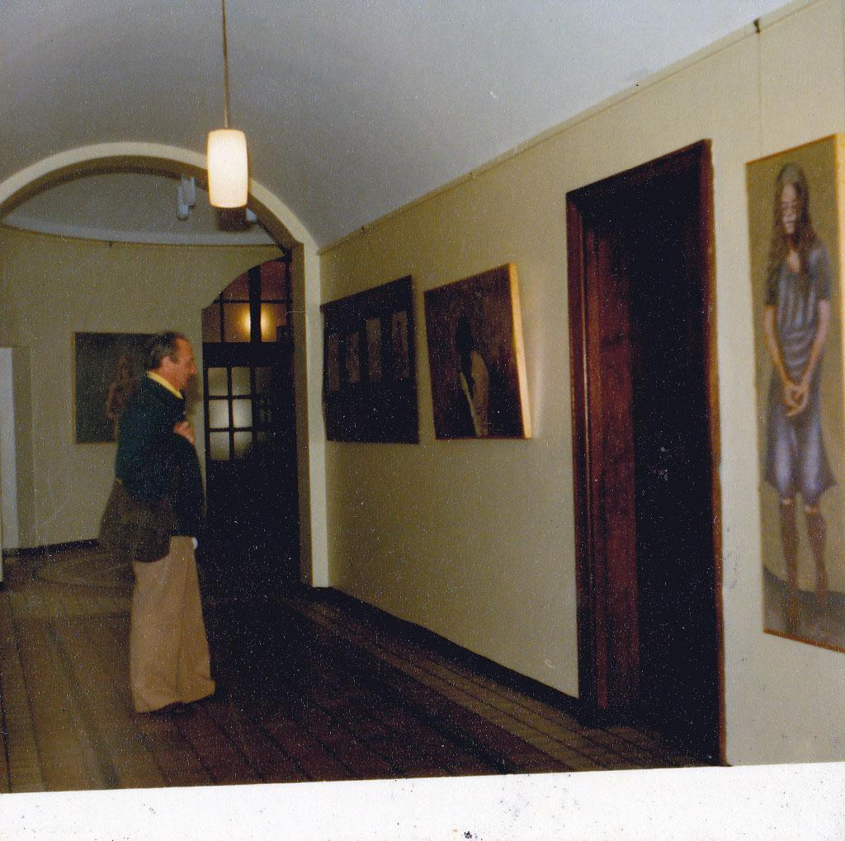
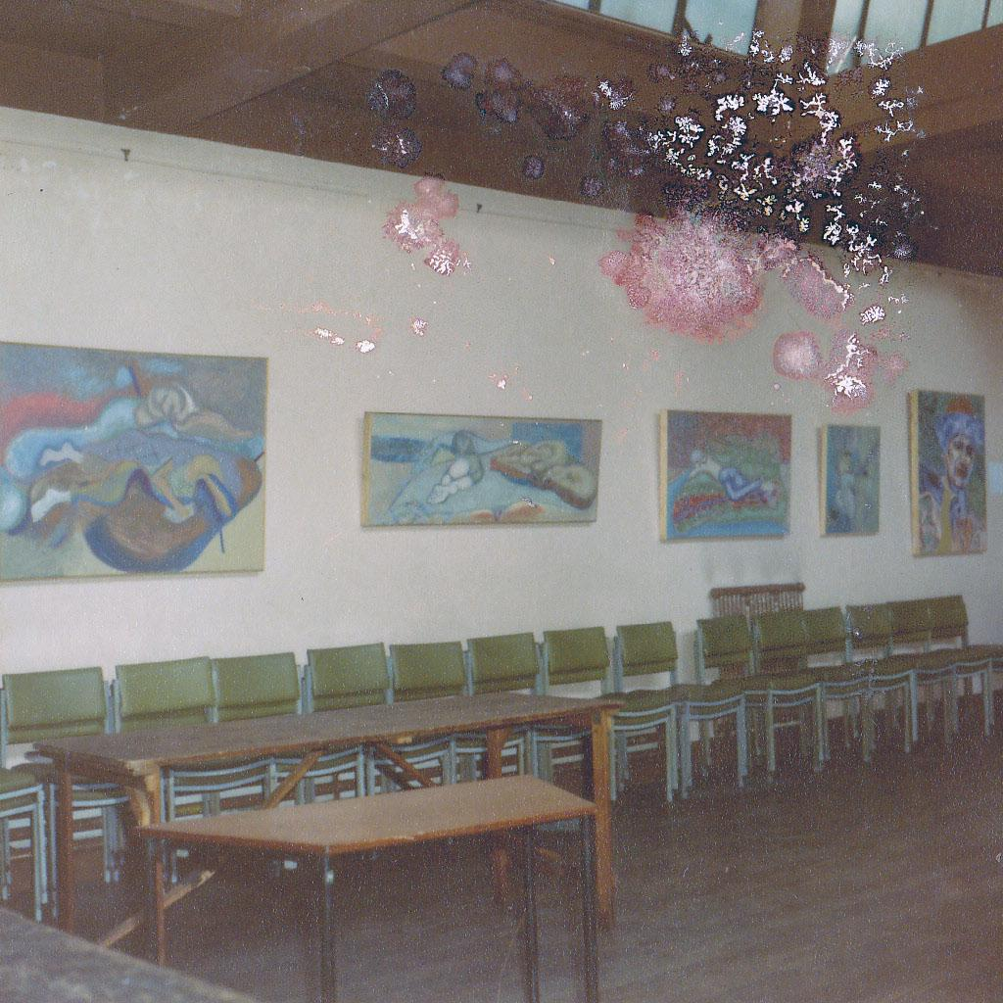
Notes:
Exhibition in the Brockway Room and corridor, 1980. Conway Hall/South Place Ethical Society

Slide 29
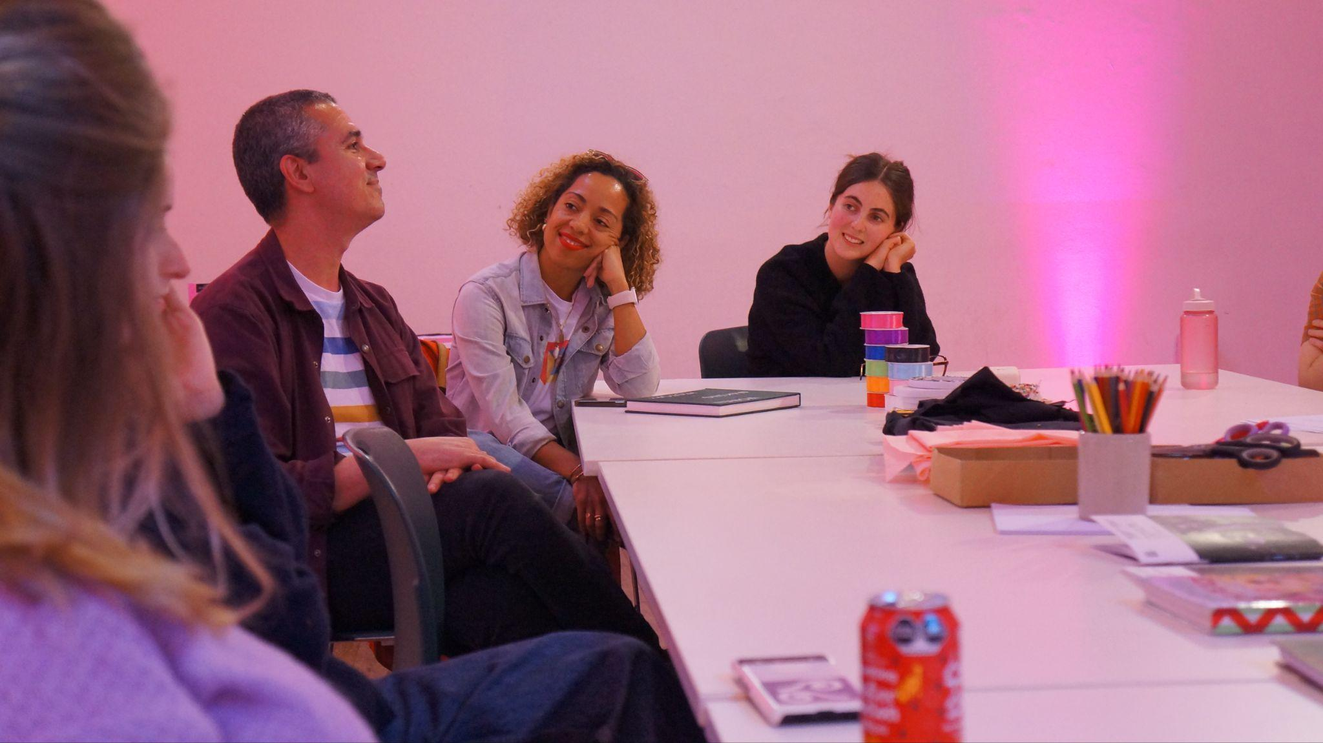
Notes:
Participants at a banner making workshop, April 2024

Slide 30
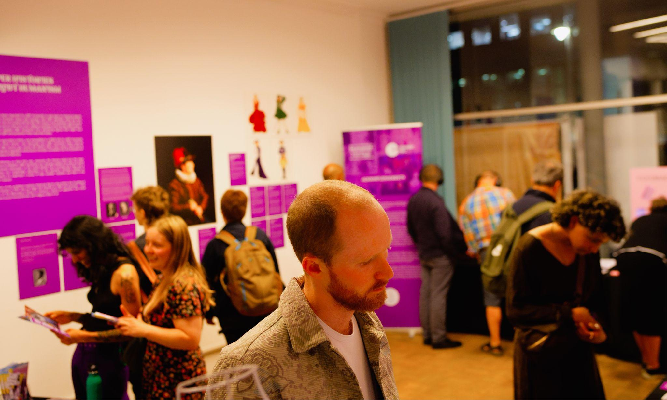
Notes:
Exhibition in the Bertrand Russell Room, July 2024. © Alavari Jeevathol

