Slide 1
What do humanists value?
Designing a humanist building

Slide 2
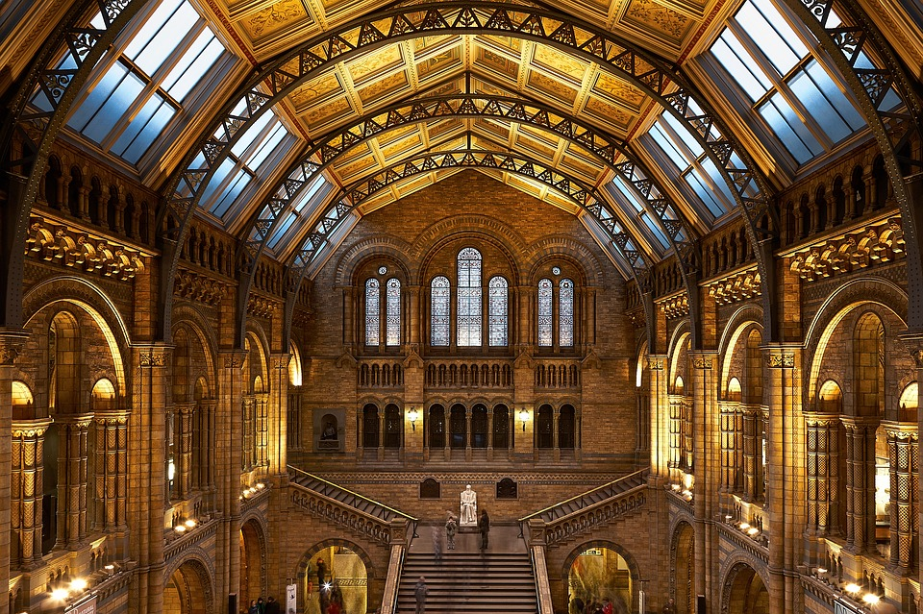
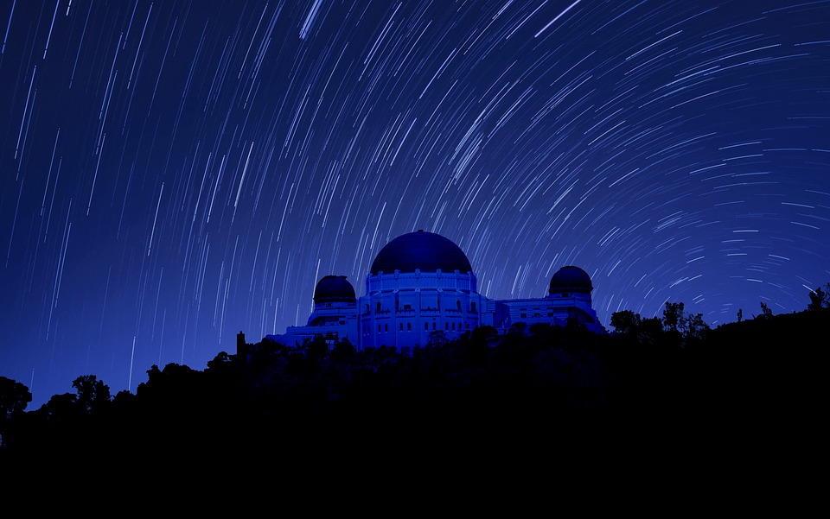
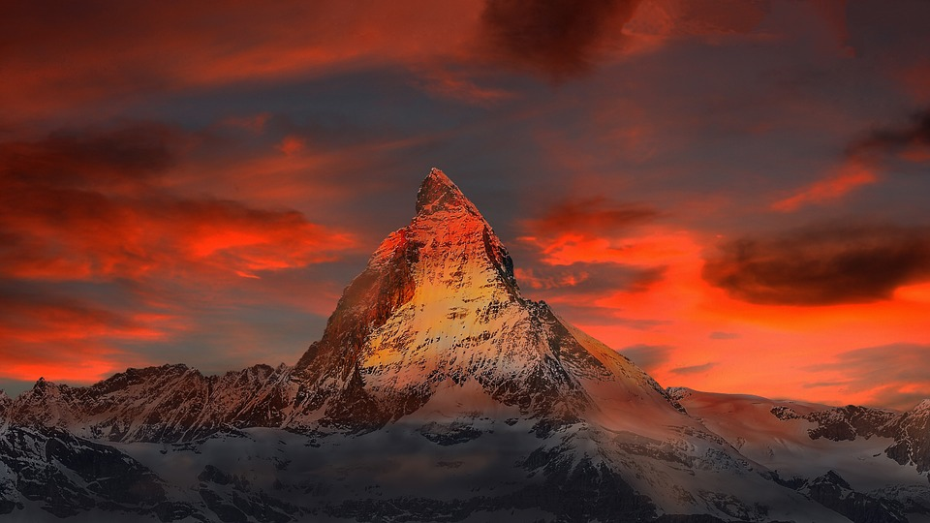
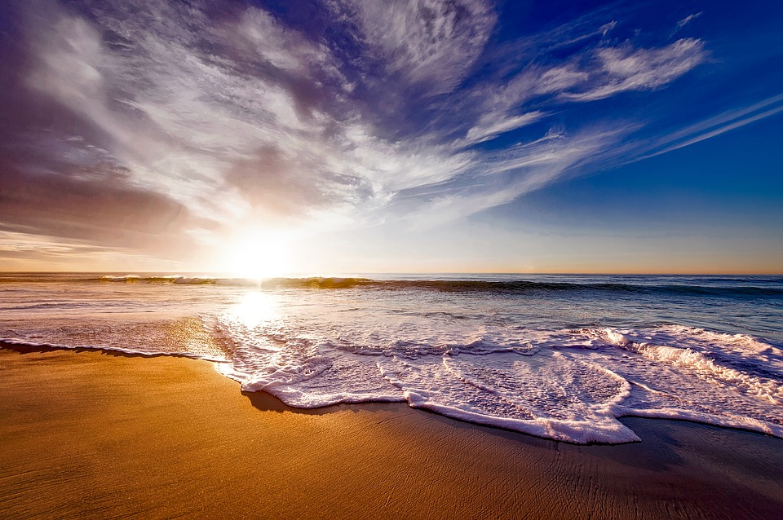
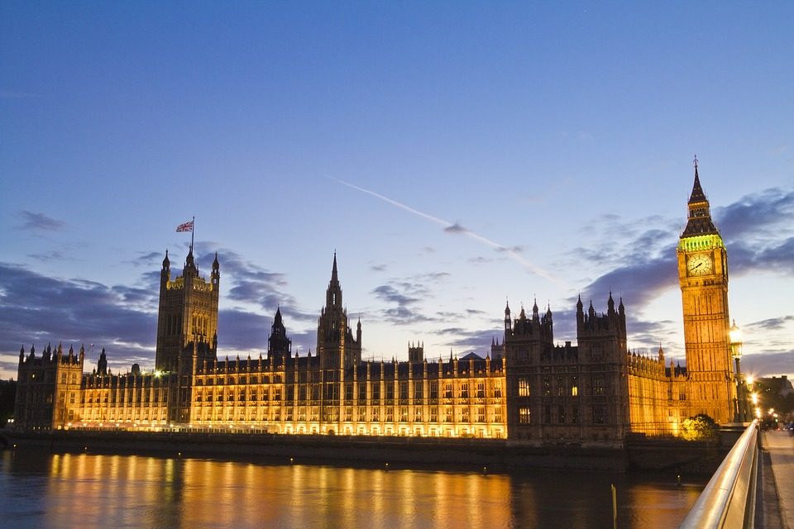
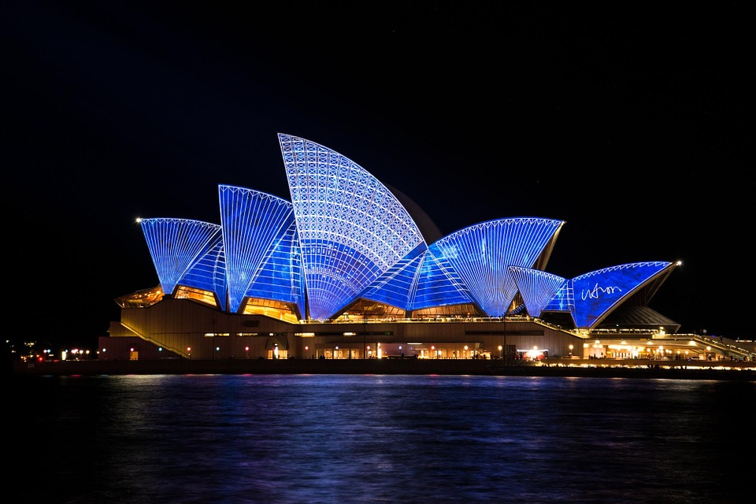

Slide 3
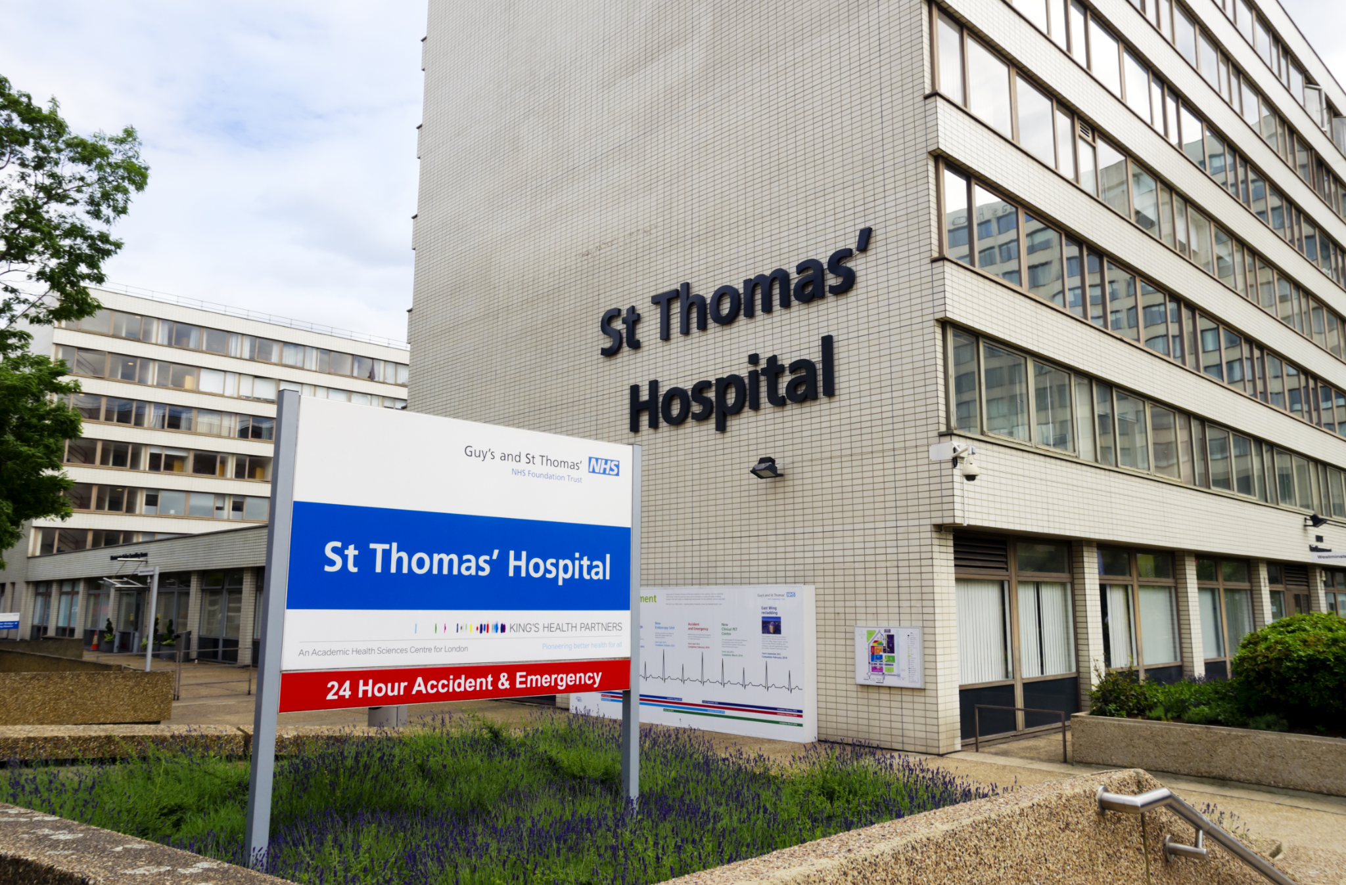
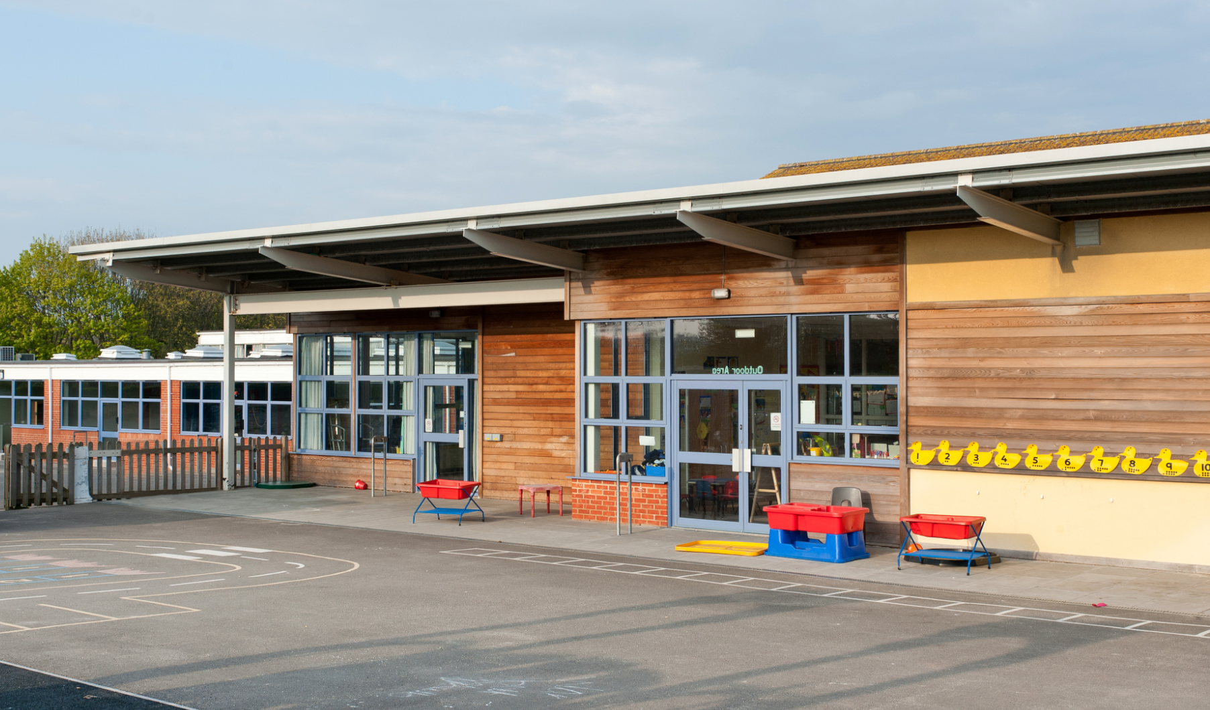
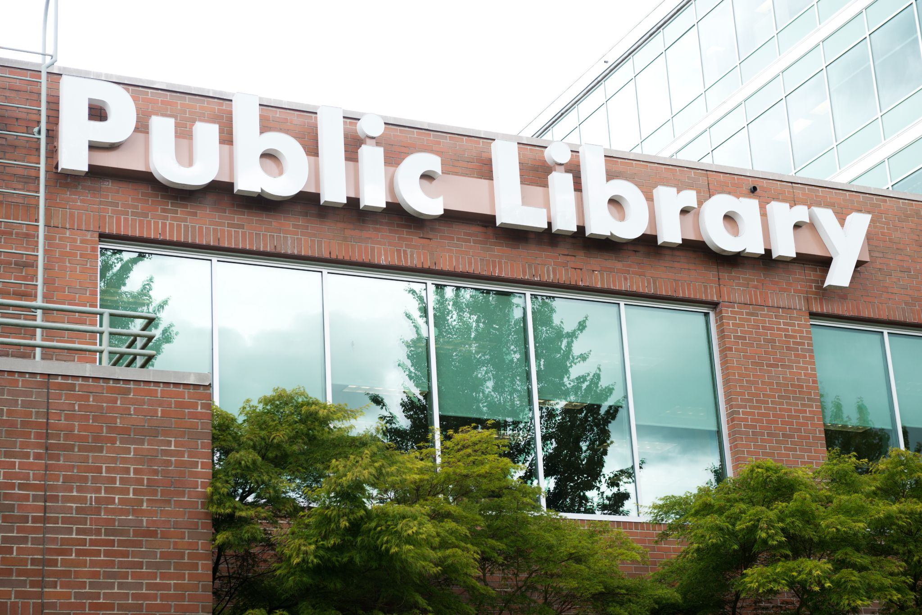
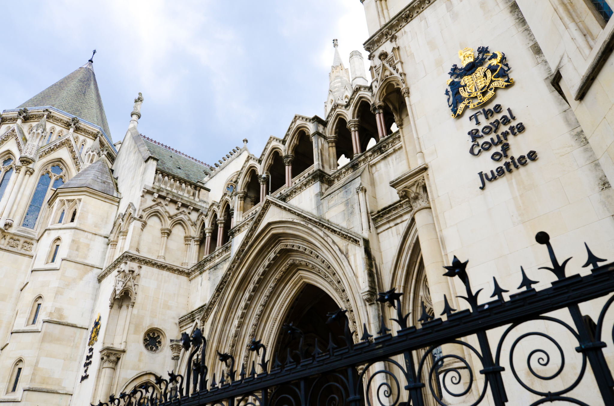
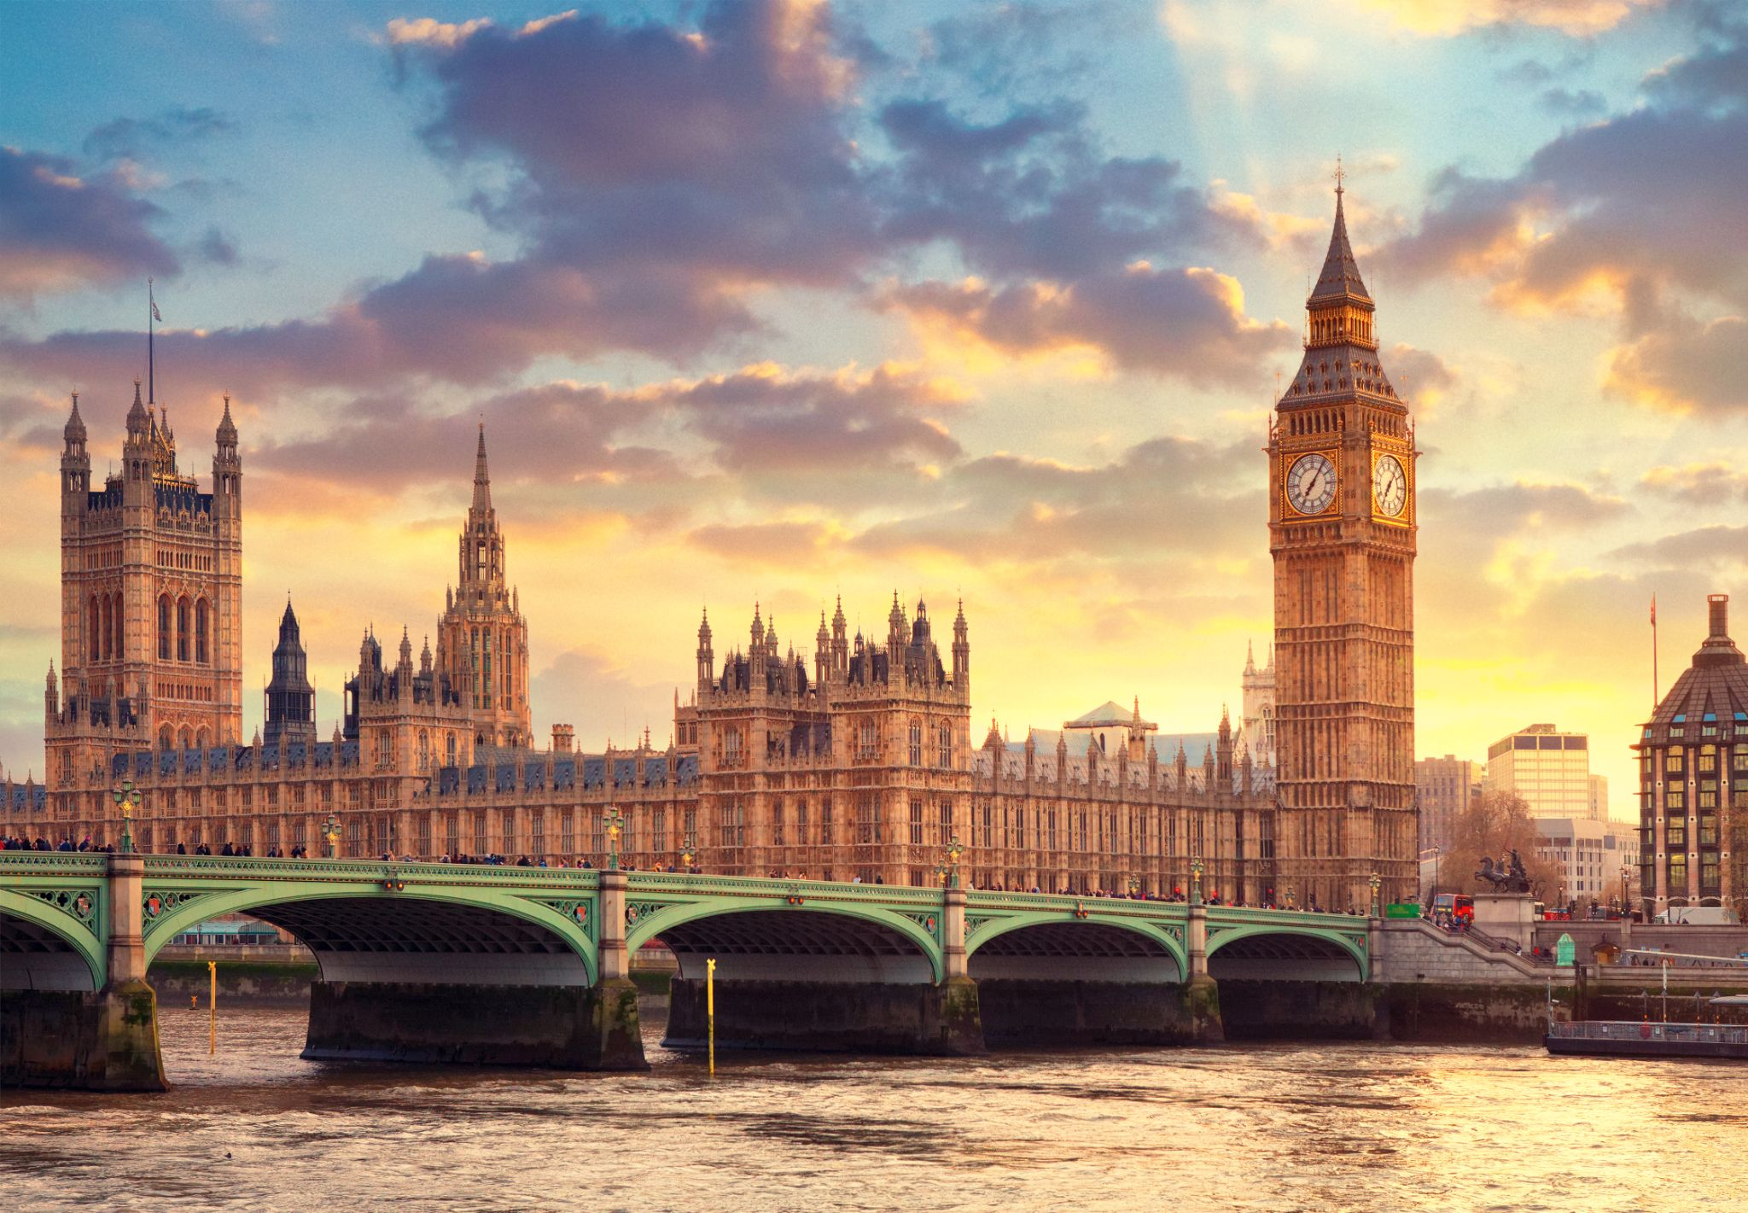
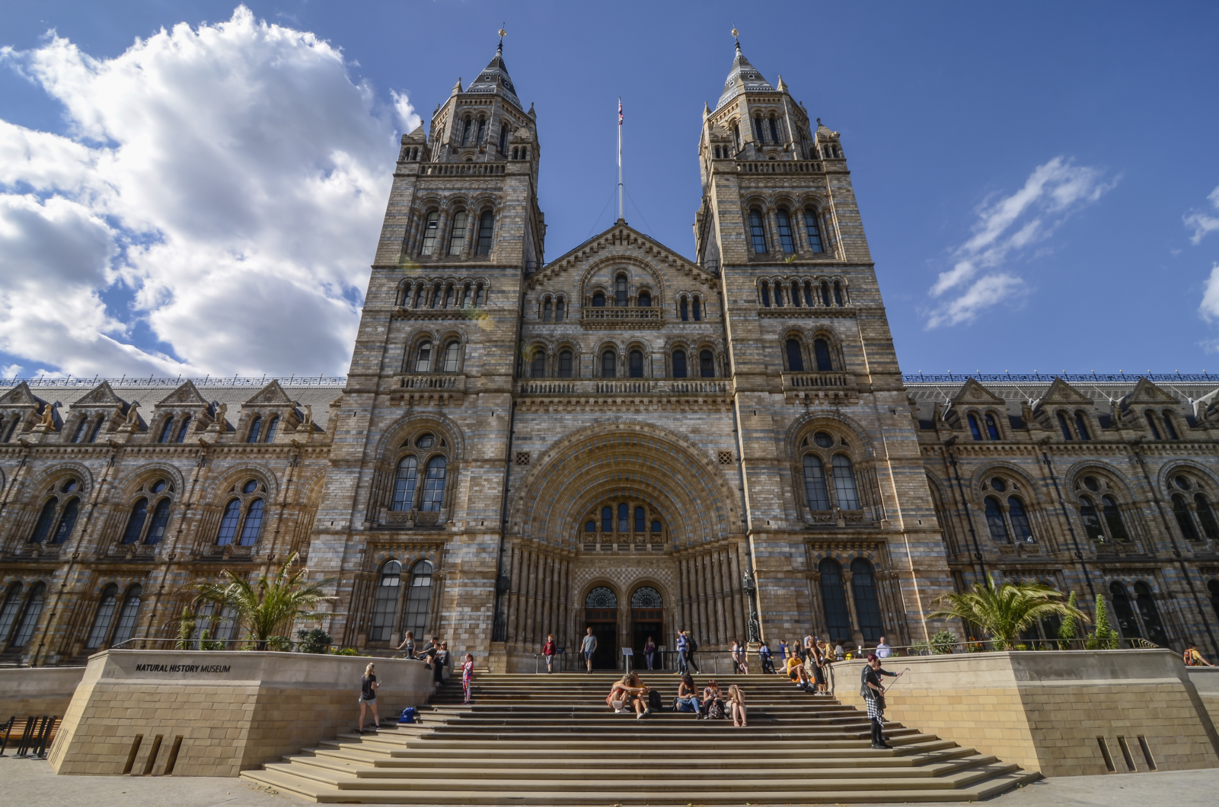
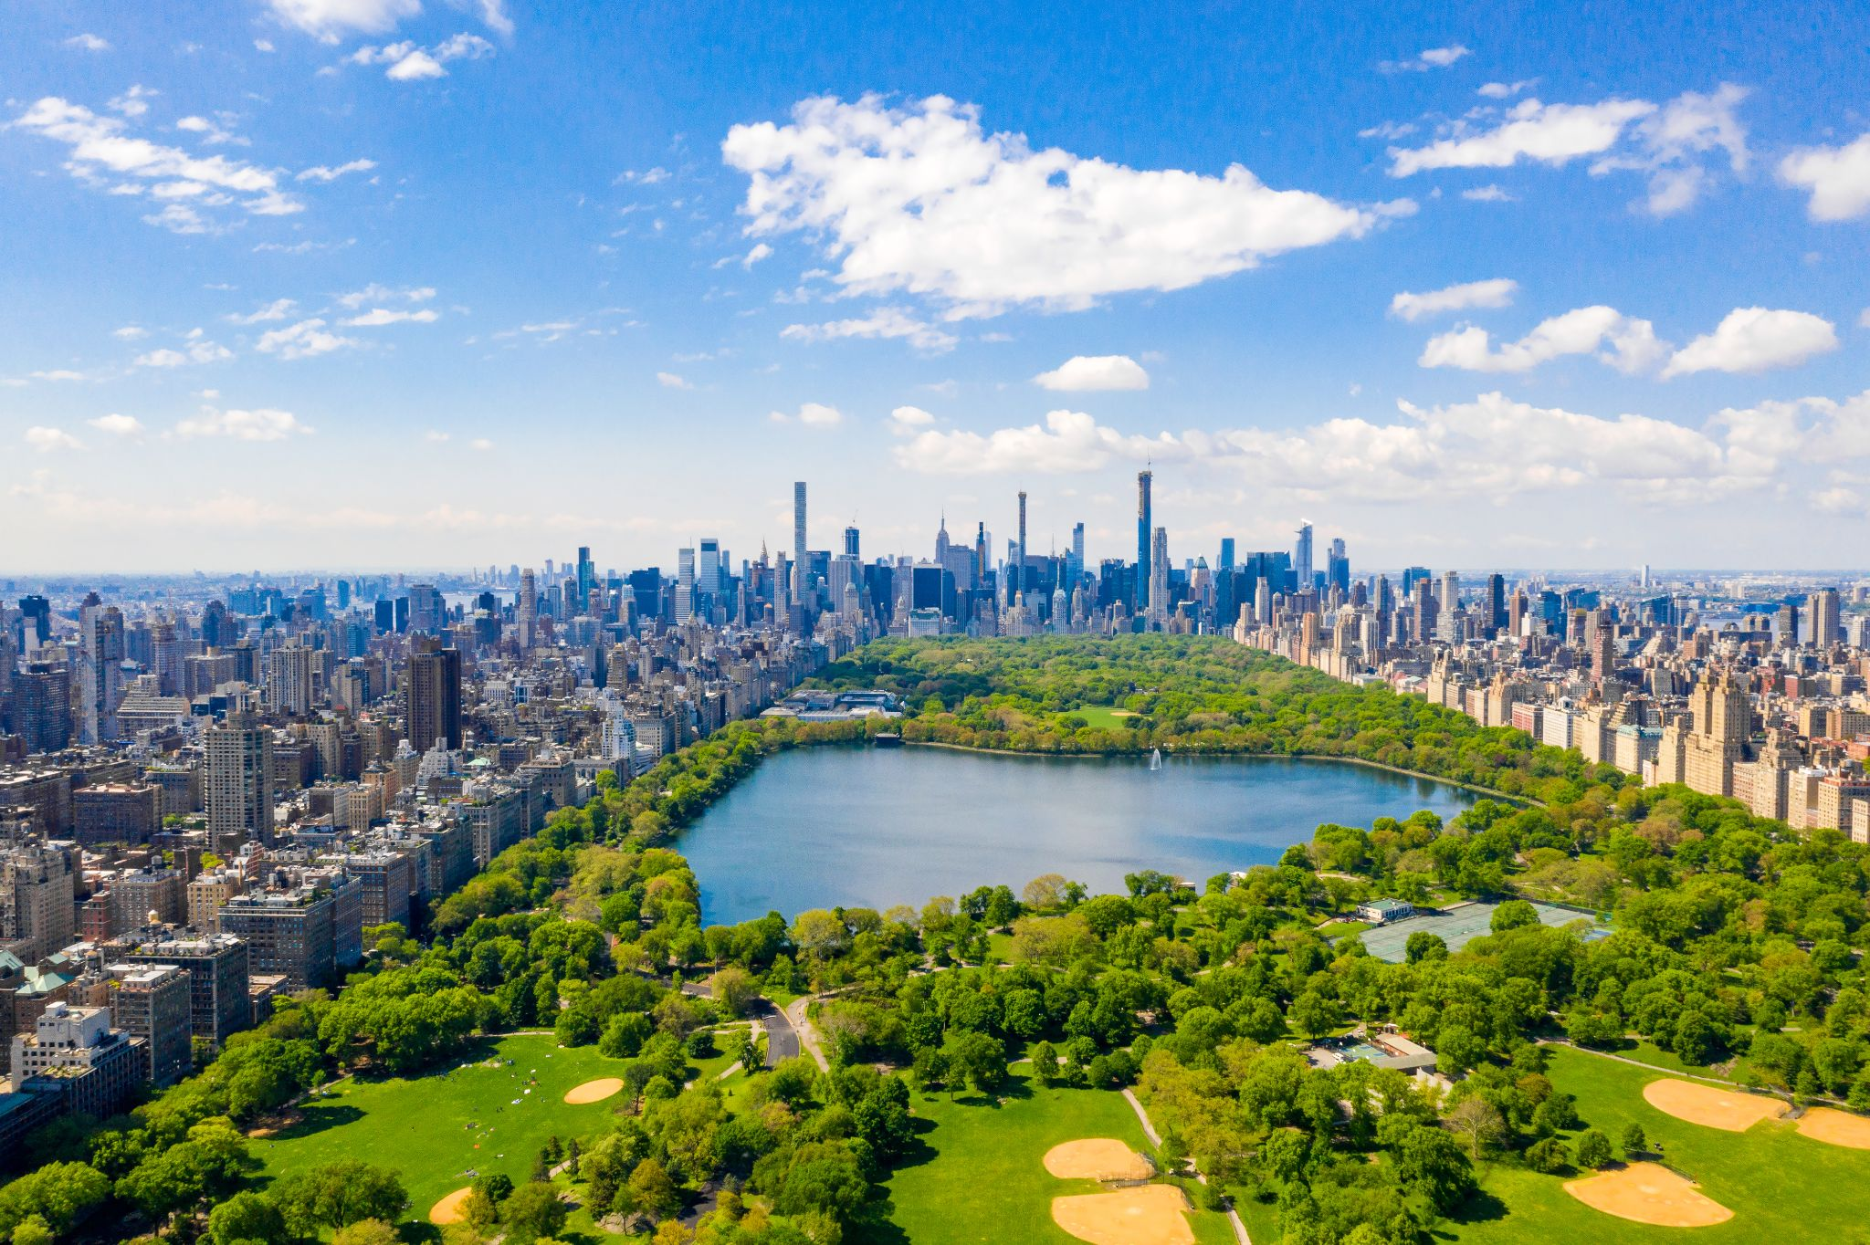
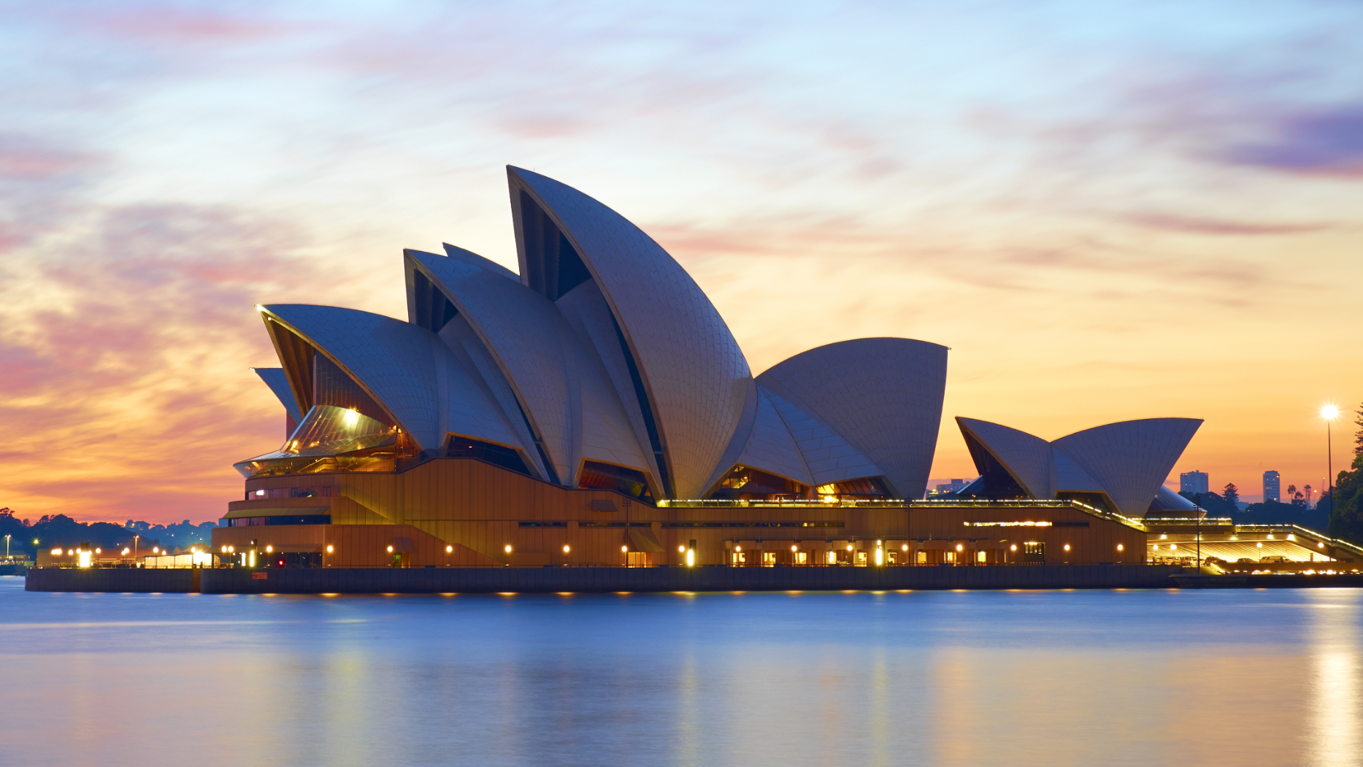
Special places

Slide 4
How could you represent these words in a building?
Words connected with things humanists value
One life | Happiness | Friendship
Community | Humanity | Progress
Empathy | Science | The arts
Creativity | Freedom | Optimism
Curiosity | Evidence | Reason
Uncertainty | Democracy | Human rights
Social justice | Equality | The natural world
Human talents and capabilities | Human achievements | Making our lives meaningful

Slide 5
What might a humanist building look like?
How might it represent things that humanists value?
What might it have in common with, and how might it differ, from religious buildings such as a church, mosque, synagogue, or temple?
Some questions to think about:
Should a humanist building hug the Earth or reach for the stars?
Should a humanist building focus more on humanity or the natural world?
Should a humanist building reflect individual freedom or our connections with other humans?
Should a humanist building fit with the surroundings or stand in contrast to them? Does it depend on what the surroundings are (e.g. urban or natural)?

Slide 6
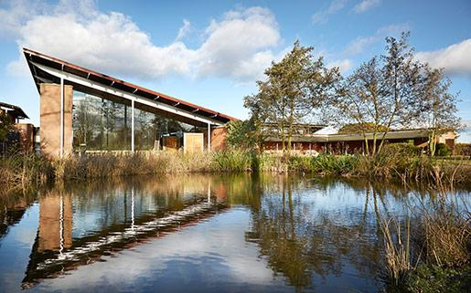
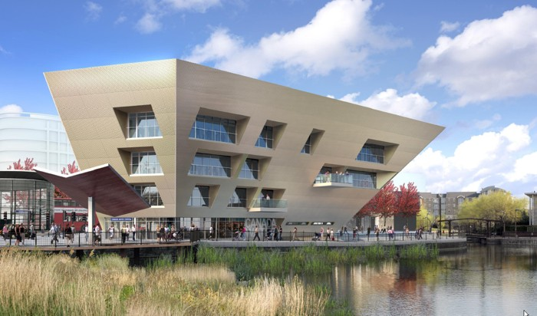
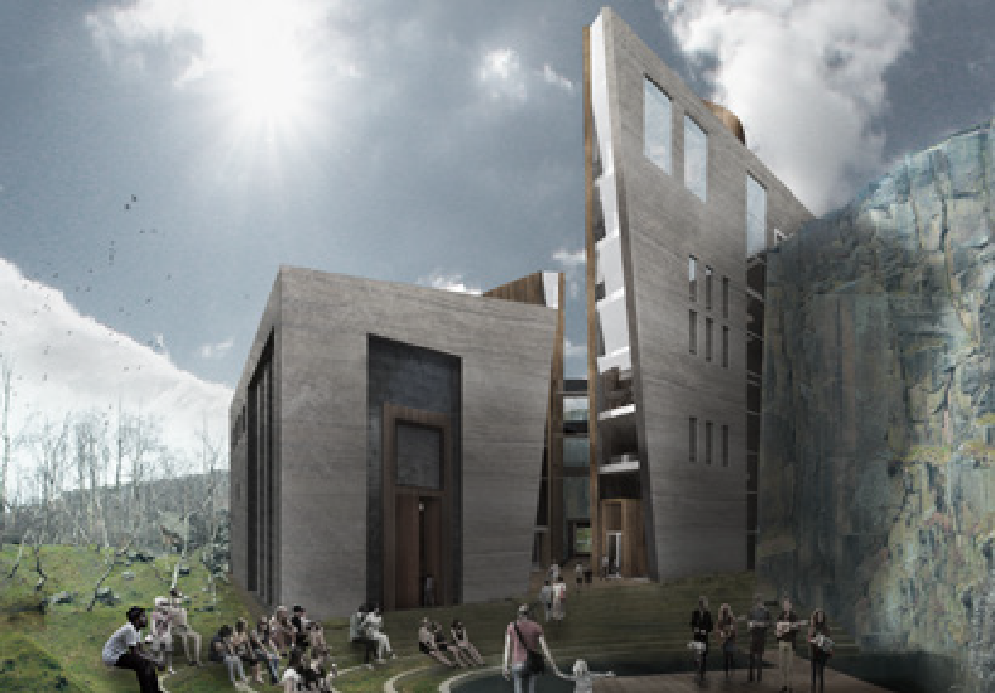
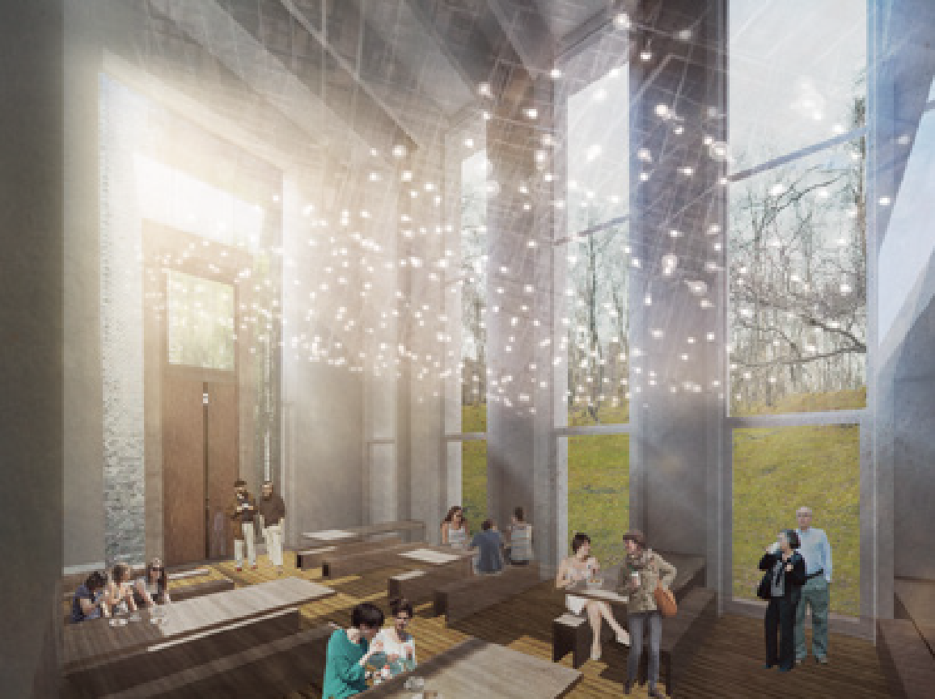
Humanist buildings?
Telford Crematorium
The glass wall in the main assembly room allows mourners to gaze out at the surrounding natural landscape, to take comfort from it, and to feel at one with it.
Canada Water Library
Rooted in the ground but opening up to ambitious possibilities?
Designs for a humanist retreat
Hannah Flory, Chris Gaunt, and John Cox, University of Liverpool

Slide 7
Design a humanist building
Design and draw a blueprint of a humanist building.
It must feature at least five features that represent things humanists value
Consider...
Location: Where would it be?
Exterior: What would the outside look like? What is the relationship between the inside and the outside? Should the exterior say something about the purpose of the building? How should the building be accessed?
Interior: How would the rooms be organised inside and how might they be decorated?
Other features: What else would there be inside and outside the building? Would there be any words, images, or symbols?
Activities: What would the building be used for?

