Slide 1
What is humanism?

Slide 2
A humanist approach to life: a summary
Humanists believe the world is a natural place – we should ask questions and look for evidence to help us to understand it (humanists don’t believe in a god)
Humanists believe we should be free to find what makes us happy
Humanists believe we should be kind to other people, animals, and the planet

Slide 3
Humanism
Humanism is a non-religious worldview or a non-religious approach to life.
It supports non-religious people to answer questions about the world around us and about how we should live.

Slide 4
Humanism
Humanism is not a religion
Humanists do not believe in a god
They do not have a holy book
They do not have places of worship like churches or mosques

Slide 5
Humanism
Millions of people in the UK and around the world share humanist beliefs.

Slide 6
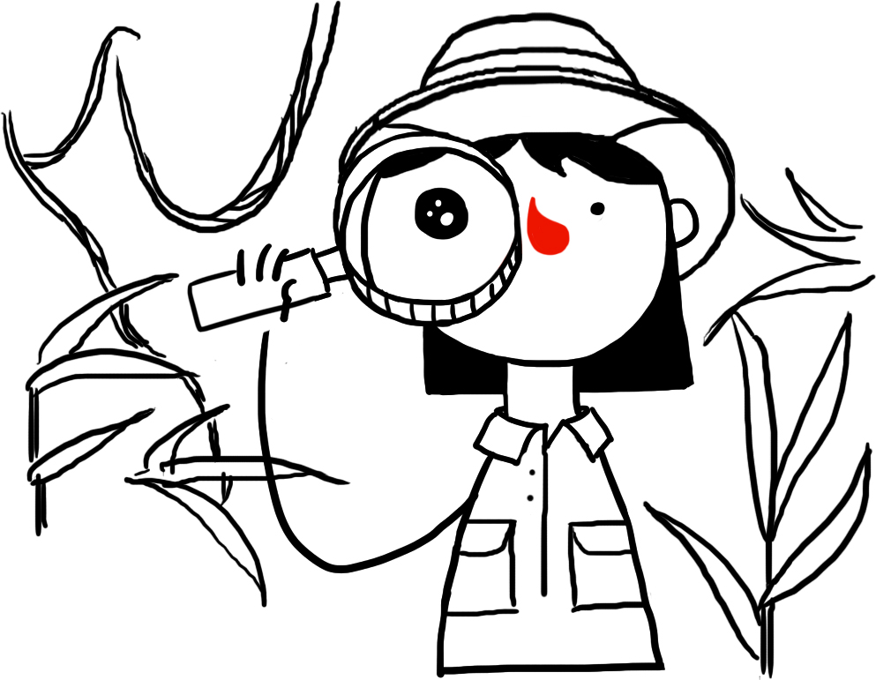
Humanism
Three things that humanists believe
The world is a natural place – we should ask questions and look for evidence to help us to understand it
We should all be free to find what makes us happy.
We should be kind to other people, animals, and the planet.

Slide 7
The Happy Human
Celebrating being human
Celebrating what human beings can do
Celebrating that we can be happy

Slide 8
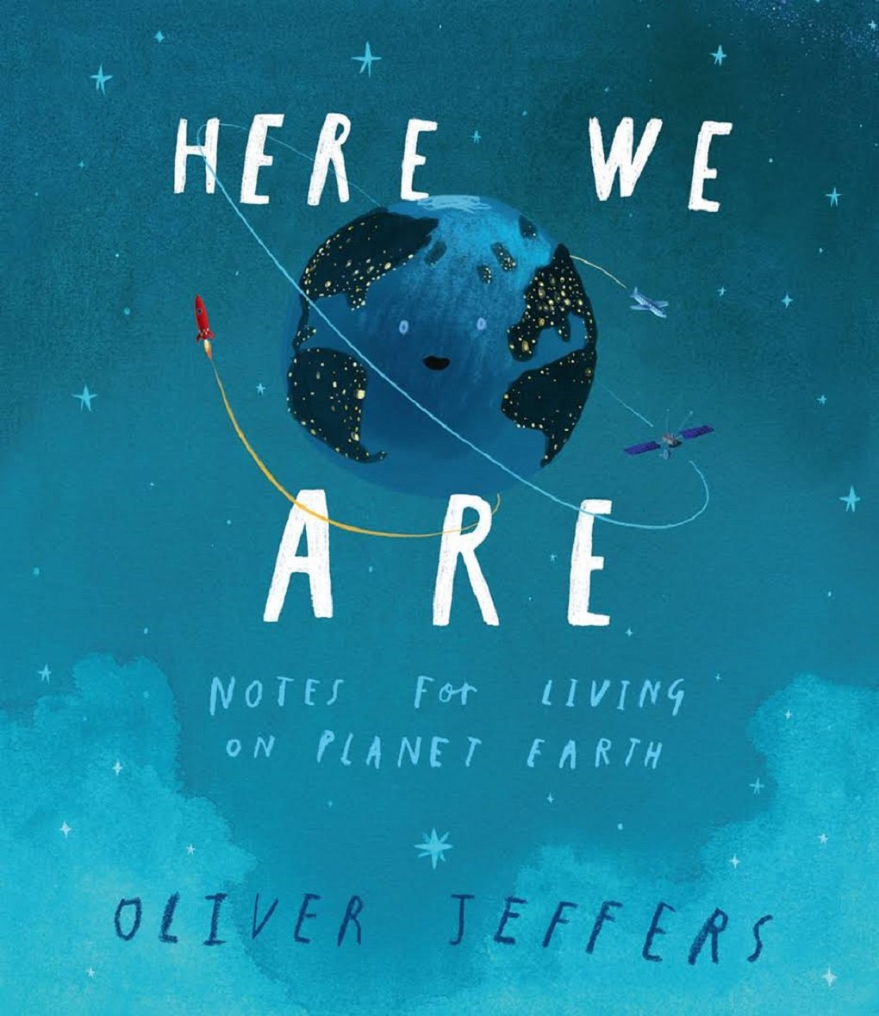
Here We Are
Notes for living on planet Earth
by Oliver Jeffers

Slide 9
Decorate a Happy Human

Slide 10
Humanism
Three things that humanists believe
The world is a natural place – we should ask questions and look for evidence to help us to understand it.
We should all be free to find what makes us happy.
We should be kind to other people, animals, and the planet.

