Slide 1
Humanist ethics

Slide 2
A humanist approach to life: a summary
Humanists believe the world is a natural place – we should ask questions and look for evidence to help us to understand it (humanists don’t believe in a god)
Humanists believe we should be free to find what makes us happy
Humanists believe we should be kind to other people, animals, and the planet

Slide 3
A humanist approach to being good
We should try to be kind to other people, animals, and the planet
We should think carefully about how other people might feel
We should treat other people the way we would like to be treated

Slide 4
Why might a humanist believe we should we be good?
Our actions have an impact on other people

Slide 5
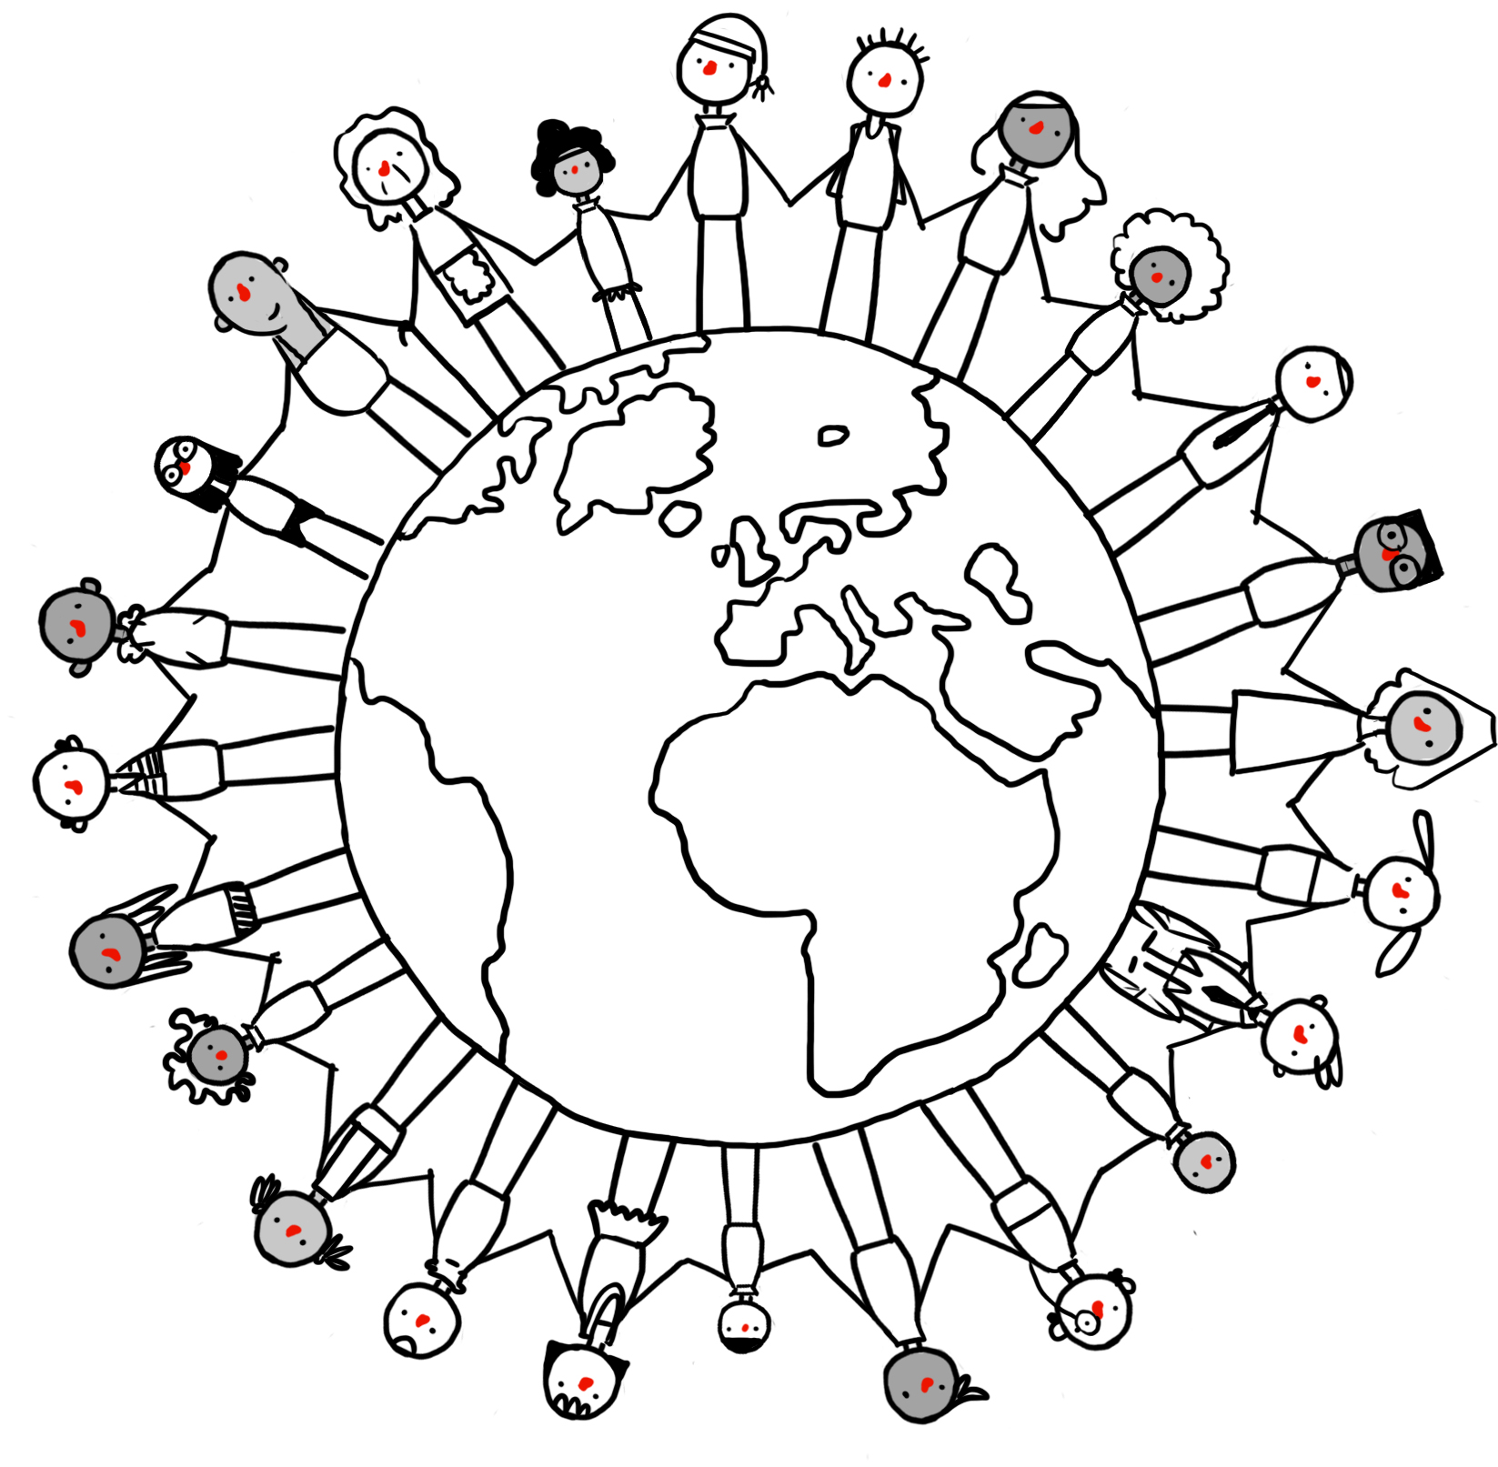
Why might a humanist believe we should we be good?
Shared feelings and needs
We all want to be happy
We all want to be treated with kindness and respect
None of us wants to suffer or be harmed

Slide 6
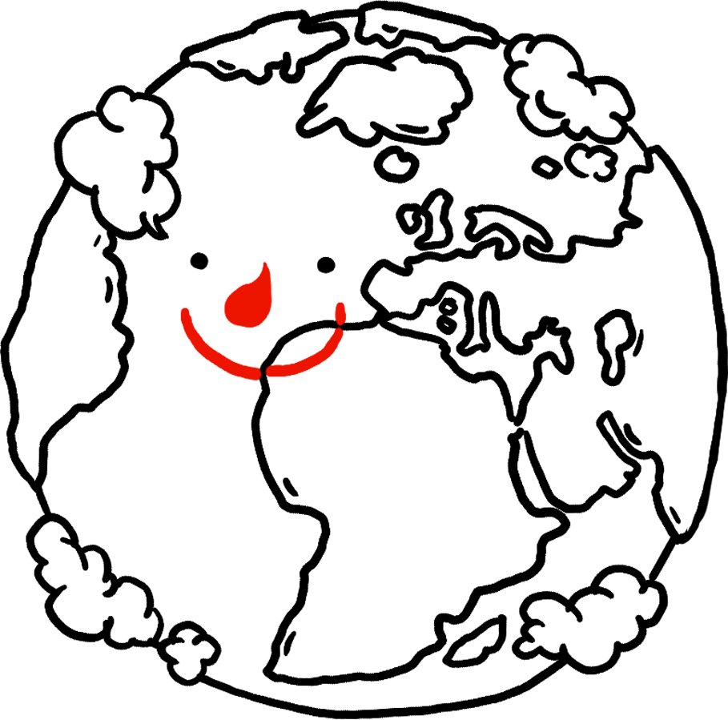
Why might a humanist believe we should we be good?
Humanists believe we need to take care of each other, other animals, and the planet.
Being good to each other makes the world a better place to live.

Slide 7
Why might a humanist believe we should we be good?
How would this make you feel?
How would it make someone else feel if it was done to them?
Someone helps you to do something you find difficult
Someone lies to you
Someone bullies you
Someone shares their sweets with you
Someone ignores you
Someone gives you a smaller piece of cake than everyone else
Someone lets you choose to do what you would like to do

Slide 8
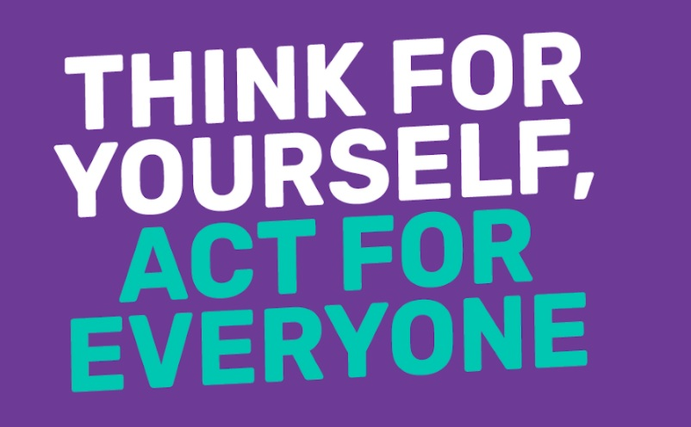

Slide 9
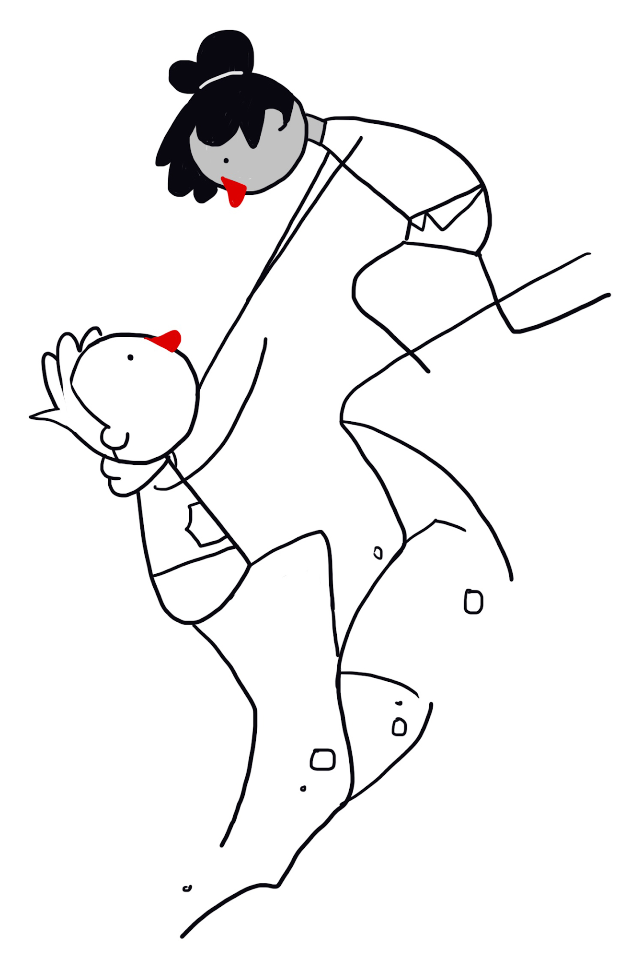
How might a humanist decide what to do?
Think for yourself
Consequences
Empathy
Golden rule

Slide 10
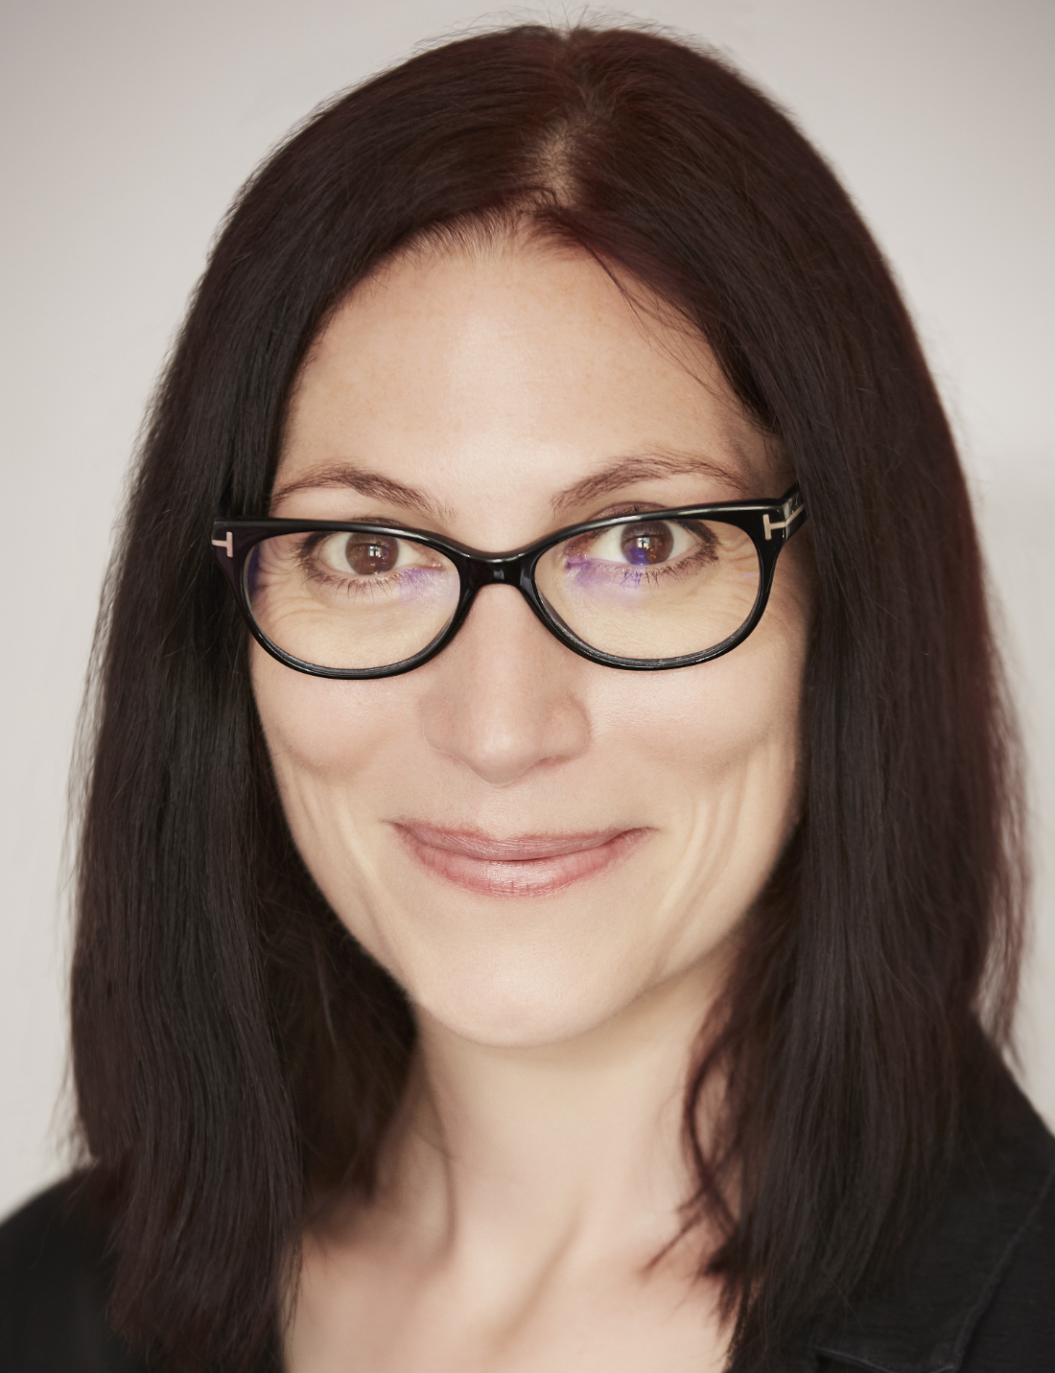
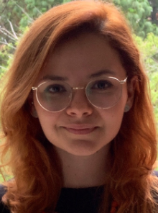
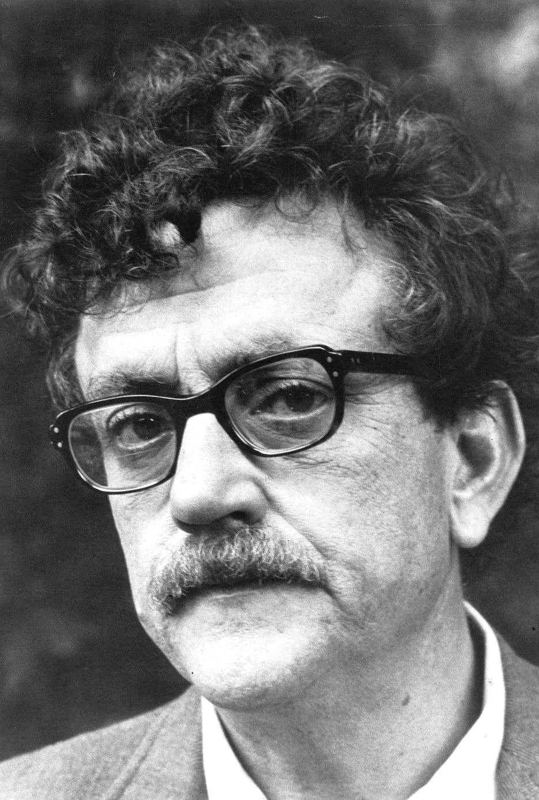
Deciding what to do
'Imagining yourself on the receiving end of your own behaviour is a good way to decide whether you're doing what you think is right or wrong.'
Natalie Haynes, author
‘If you want to be a good person, you will be because you decided to; not because someone else tells you to.’
Ana Raquel Aquino, Humanists Guatemala
‘There’s only one rule that I know of… you’ve got to be kind.’
Kurt Vonnegut, author

Slide 11
Being good can make us happy
‘The way to be happy is to make others so.’
Robert Ingersoll, American humanist
‘I have learned that there is no such thing as helping someone and not getting anything in return, because helping someone makes you feel good inside.’
Shappi Khorsandi, comedian
‘Every good deed is like a pebble in a pond, sending ripples out in all directions… Kindness is catching.’
Rutger Bregman, historian

Slide 12
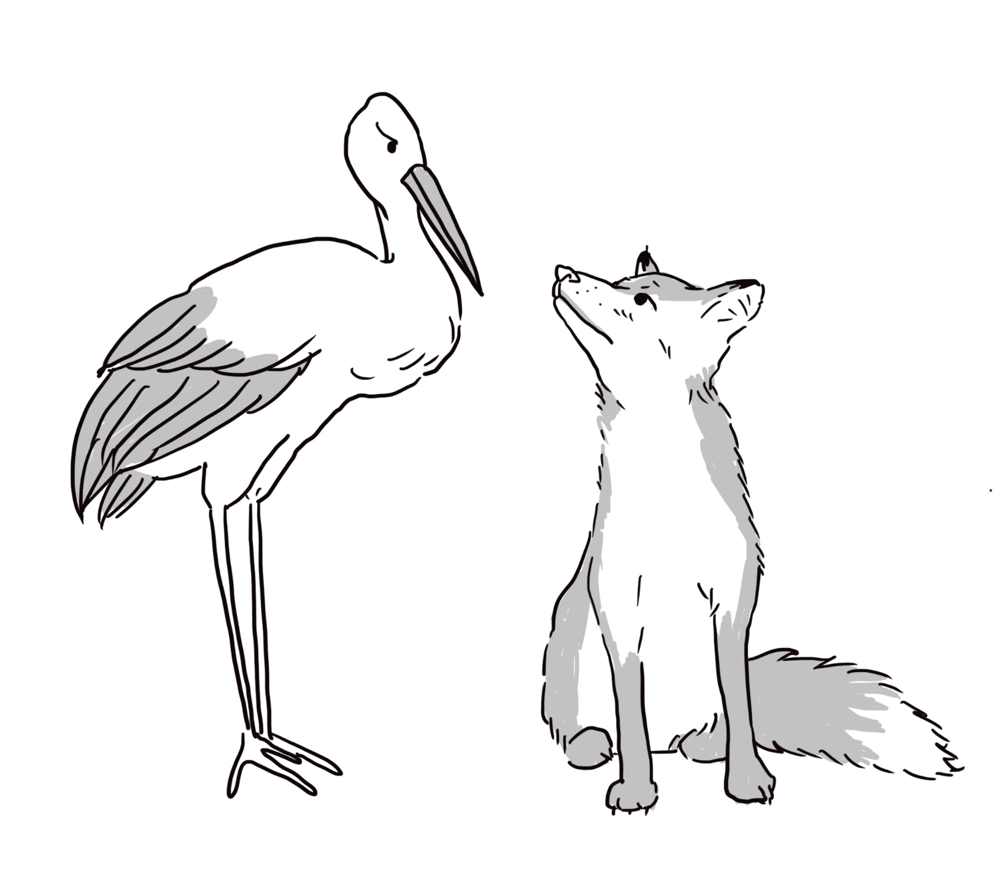
The fox and the stork

Slide 13
The Golden Rule
‘Treat other people as you'd want to be treated in their situation.’
‘Do not treat others in a way you would not like to be treated yourself.’

Slide 14
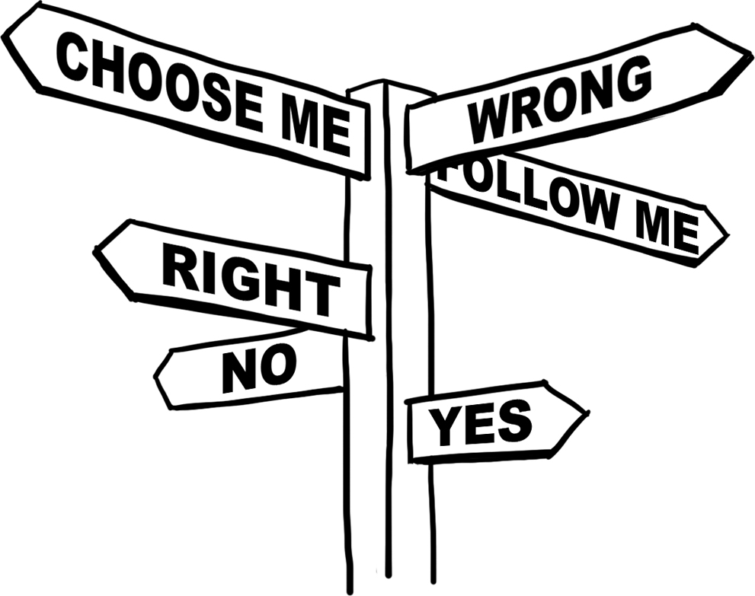
Moral dilemmas
Who might you have empathy with?
How might you use the Golden Rule?
What would be the consequences of the different options?
What would the world be like if everyone acted the same way?

Slide 15
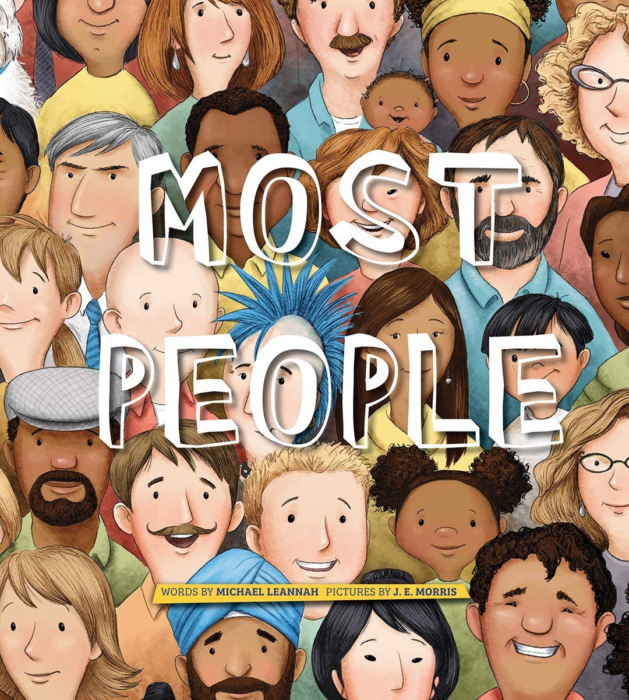
Most people

Slide 16
Being good
‘Often it’s easy to be good: to hold the door open for someone carrying heavy bags, to give honest directions to someone who’s lost, or to bake a cake for a friend who’s feeling down. Most of the time we have a pretty good idea of what is the right thing to do. And we just do it.’
Sandi Toksvig, broadcaster and patron of Humanists UK

Slide 17
A humanist approach to being good
We should try to be kind to other people, animals, and the planet
We should think carefully about how other people might feel
We should treat other people the way we would like to be treated

