Slide 1
What is humanism?
KS1/2 Assembly
Notes:
An assembly for World Humanist Day (21 June) or a general introduction to humanism.

Slide 2
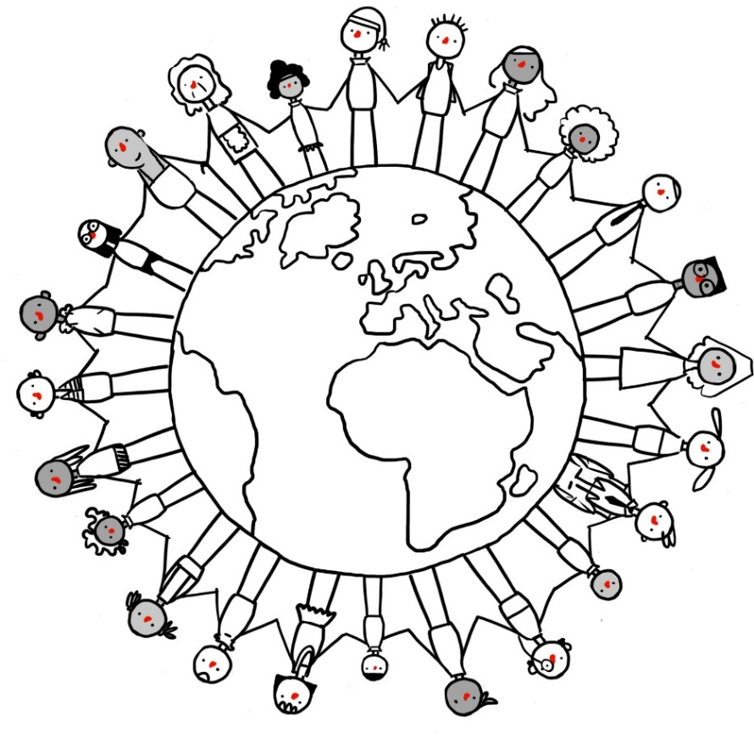
World Humanist Day
21 June
Notes:
Explain that today (or on the 21 June) it is World Humanist Day, a day celebrated by humanists around the world. In this assembly you are going to learn a little more about humanists and what they believe.

Slide 3
What is humanism?
Notes:
Explain Humanism is not a religion but a non-religious approach to life followed by many people in the UK and around the world.

Slide 4
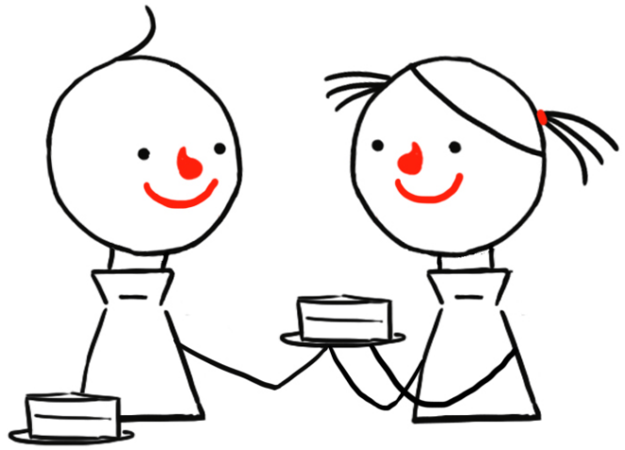
Three things that are important to humanists…
Being kind
Finding happiness
Asking questions
Notes:
Show the three pictures only.
Ask students if they can guess what three things are important to humanists, based on these pictures.
Show Ask questions, Be kind, Find happiness
Explain that these are three things that are very important to humanists.

Slide 5
Asking questions
Notes:
Explain First we’ll look at the reason humanists believe it is important to ask questions

Slide 6
Asking questions
?
Questions can help to change the world for the better
How can I cure this disease?
How can I make sure there is enough food to eat?
How can I make the world a fairer place?
Notes:
Explain that humanists think it is very important for us to ask questions.
Some questions have changed the world for the better
Show How can I cure this disease? How can I make sure there is enough food for people to eat? How can I make the world a fairer place? These questions have led to new inventions, improvements in human health and wellbeing, and a better understanding of the world.
Ask the students if they can think of any good questions.
Explain that humanists believe we should ask questions, but we should also think carefully about the answers we are given. We should ask ‘is that really the best answer?’

Slide 7
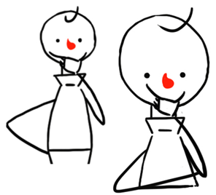
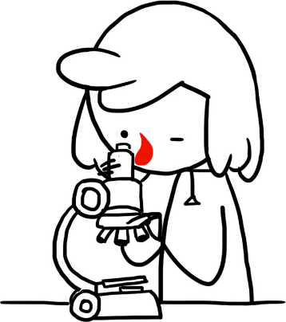
How do humanists decide what to believe?
Evidence
The world is a natural place
Science
Notes:
Explain that when we are trying to work out what is true, humanists believe we should look for evidence. If people give us an answer to a question, we should ask for evidence.
Explain Humanists believe that the world is a natural place. They don’t believe in anything supernatural (e.g. ghosts, magic, alternative medicines). They don’t believe in a god or gods. They don’t see any evidence for them.
Explain that humanists believe science gives us the best way of understanding the world. Science is a way of asking questions about the world and then testing if our answers are right.

Slide 8
Being kind
Notes:
Explain Now let’s look at why humanists believe it is important to be kind.

Slide 9
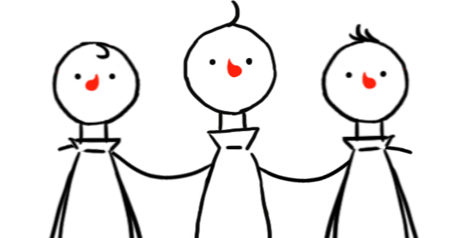
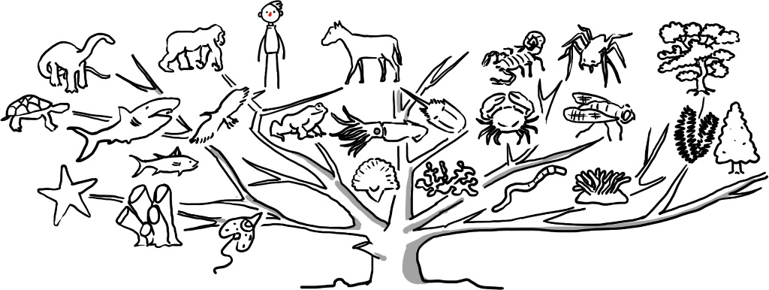
Being kind
We need to take care of each other
Notes:
Ask the students what they think ‘Be kind’ means.
Explain that humanists think we need to take care of each other. We need to be kind to the people around us, but we also need to think about people on the other side of the world.
Explain that humanists think we should also be kind non-human animals, as they are part of the tree of life just like we are. Humanists also believe we should look after the environment because doing so is kind to future generations.

Slide 10
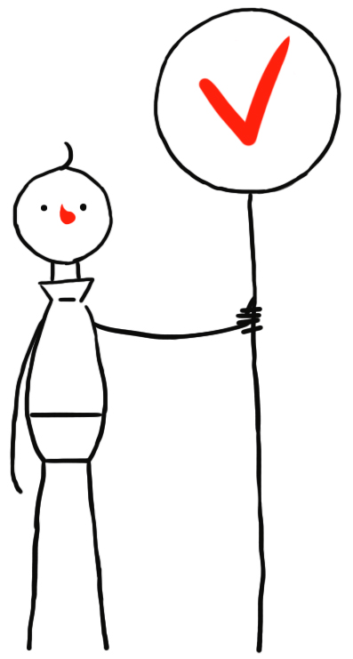
How do we know what is the right thing to do?
Think about:
What our actions will do to other people
How other people will feel
Notes:
Explain that humanists believe that being good is more than just following rules or avoiding punishment. It involves thinking about the consequences of our actions (what our actions will do to other people and animals) and thinking about how other people feel.
Ask the students how they feel when someone is unkind, ungrateful, unfair, or cruel to them. Ask them to freeze frame their faces to show how they would feel. Then ask them to show how they think someone else would feel if someone was unkind, ungrateful, unfair, or cruel to them. Did their faces change? What does that tell us?
Explain that we have empathy. We can imagine what it might be like to be someone else and so can think about how we would like to be treated in their situation.

Slide 11
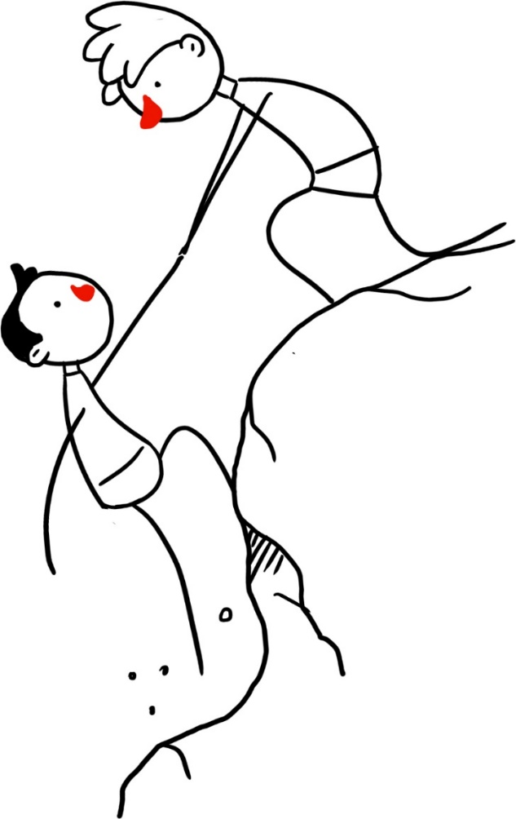
The golden rule
Treat others as you would like to be treated
Don’t treat others in a way you wouldn’t like to be treated
Notes:
Show the golden rule: Treat others as you would like to be treated yourself. Do not treat others in a way you would not like to be treated yourself.
Explain this advice appears all around the world.
Present the students with the following scenario: ‘You are in a sweet shop with some friends. The owner of the shop is not looking. One of your friends tells you to steal some sweets. What should you do? Why?’
Explain that humanists believe that although laws against stealing and the threat of punishment can help persuade us not to steal, the main reasons not to do it are because of the harm it causes to other people. We would not like other people to steal from us.

Slide 12
Finding happiness
Notes:
Explain And, lastly, we’re going to look at why humanists think it’s important to find happiness.

Slide 13
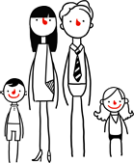
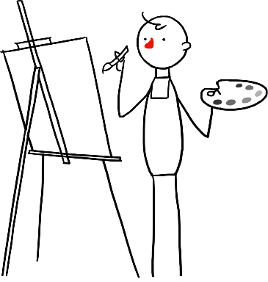
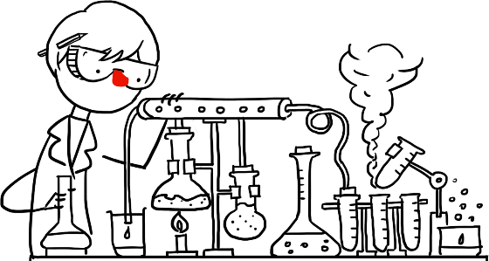
The Happy Human
Notes:
Ask the students what does this image look like? What does it make you think of?
Ask the students when they might stand like the happy human with their arms in the air (e.g. celebrating scoring a goal, finding the answer to a difficult problem, shouting 'Hurray!', stretching up to feel awake and energetic).
Explain that humanists believe we only have one life and so we need to make the most of it.
Ask the students what makes them happy. Hopefully you will get a variety of answers. Give some examples of things that make you and other people you know happy (e.g. being creative, the natural world, relationships with other people, learning new things).
Explain that humanists believe that it is important that we are each able to find our own way to be happy and that this might be different for everybody. There is no single answer to the question, ‘How can I be happy?’ We are all have different interests and talents.
Humanists believe living a happy life doesn’t mean being happy all the time, but it means being happy with our lives overall. Sometimes we have to do things we don’t enjoy to make our lives better (e.g. learning a difficult skill or tidying our bedrooms).

Slide 14
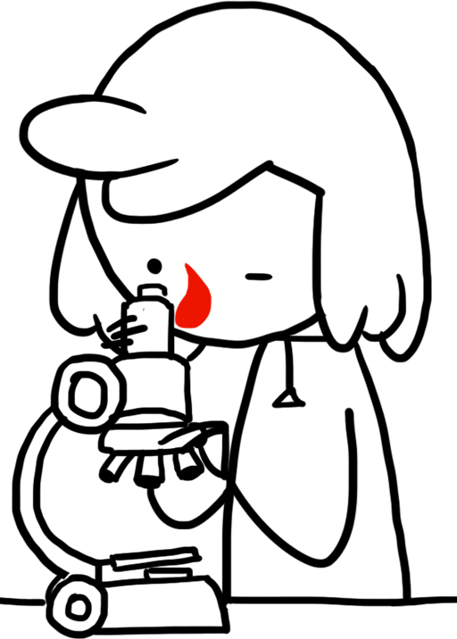
Freedom
Is there anything we should not be free to do?
Notes:
Explain that freedom is very important to humanists. They believe that we should all be free to think for ourselves and to decide how we want to live our lives. We need to try different things and find what makes us happy. And we need to be tolerant of other people’s choices: we need to let other people do whatever makes them happy. It is important to humanists that people should be free to decide not to be a humanist if they don’t think it’s right for them.
Ask the students if there is anything that we should not be free to do.
Explain that humanists believe we should be free to believe and do what we want as long as our actions do not cause harm to others or prevent them from finding what makes them happy.
Explain that not everyone is happy. Many people around the world do not have the freedom or opportunity to find happiness. Humanists believe that should motivate us to do our best to create a world in which everyone has the opportunity to find happiness in the here and now.

Slide 15
What three things are important to humanists?
Being kind
Finding happiness
Asking questions
Notes:
Ask the students what are the three things humanists think are important.
Recap that humanists think it is very important to ask questions, be kind, and find happiness.
Explain that humanists believe that asking questions (being curious) and being kind can help us to be happy.

Slide 16
Thank you

